Slide 1
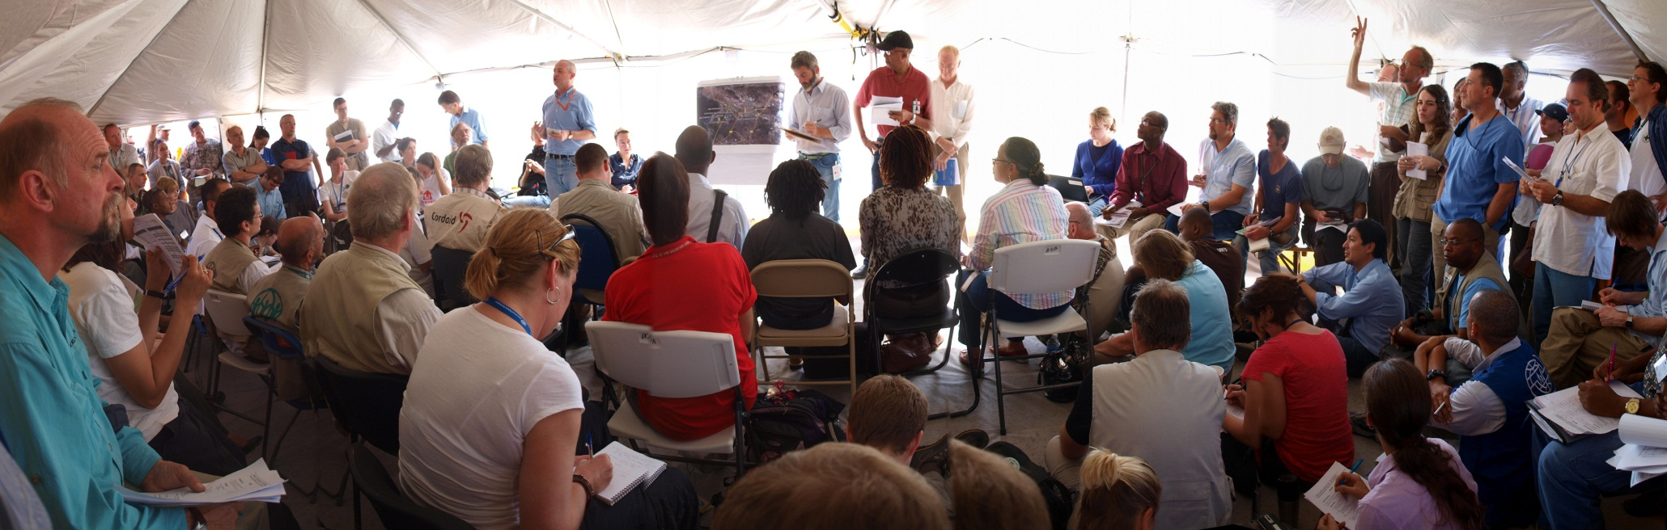
The Cluster Approach

Slide 2
The initial problem
Is anyone already doing X?
What organisations are already here?
Who needs assistance?
Where can I get information?
Where do people need assistance?
Who is doing Y in X-town?
Who is in charge?
Why is the government (not) doing X?
How can I get funds?

Slide 3
Origin of the Cluster approach
The Humanitarian Response Review:
Commissioned in 2004 by the Emergency Relief Coordinator to assess the capacities and effectiveness of the global humanitarian system.
Led to the initiation of a Humanitarian Reform Process as of 2005 to address several areas of weakness.

Slide 4
Purpose of the Cluster approach
Ensuring more predictable leadership and clearly defined responsibilities by identifying cluster leads that are accountable for the coordination of the activities of their respective sector, including functioning as a provider of last resort, where necessary.
Ensuring timely and effective responses, including through the maintenance of global capacity, rosters of trained experts and stockpiles.
Strengthening partnerships between UN agencies, IOM, NGOs, the International Red Cross Red Crescent Movement and other humanitarian actors, while also ensuring more coherent linkages with national authority counterparts.
Improved strategic field-level coordination and prioritization, leading to fewer gaps and duplication.
Notes:
Please note: The IFRC is as “Cluster Convener” is not accountable o the UN and not a provider of last resort, because of the independence of the Red Cross Red Crescent Movement. We will talk about this more, later in the presentation.

Slide 5
Transformative Agenda
The response to the Haiti earthquake and Pakistan floods in 2010 exposed weaknesses and inefficiencies. The “Transformative Agenda” aims to address these shortcomings.
“We recognize that we need to focus not on the process of implementing change, but on the impact of change.” (IASC)
More info: IASC Principals Transformative Agenda
Notes:
Not all issues that were raised by the Humanitarian Reform Review have been solved. This why the “Transformative Agenda” was written. It emphasizes some points that were not adequately reflected in the original document and gives strategic and operational guidance for some of the issues that haven’t been addressed adequately yet.

Slide 6


Slide 7
The three pillars of the Transformative Agenda
Better leadership of the international humanitarian response to support countries’ own relief efforts
Improved coordination structures, needs assessments, planning and monitoring
Improved accountability to all stakeholders, with special emphasis on the people affected by disasters.
A detailed presentation on the Transformative Agenda can be found on ShelterCluster.org
Notes:
Leadership:
- Roster of Emergency Coordinators for Level 3 Emergencies
- Empowered Leadership
- Inter-Agency Rapid Response Mechanism
- Leadership Training
Coordination:
- Strategic Use of Clusters
- Simplified Cluster Management
- Minimum Commitments for Participation in Clusters
- Strengthening NGO Representation in the Humanitarian Country Team
Accountability:
- Common Humanitarian Programme Cycle to Achieve Collective Results
- Assessment, Strategic Statement, Resource Allocation, Implementation, Monitoring, Reporting and Evaluation
- Common Performance and Reporting Framework
- Accountability to Affected People

Slide 8
IASC, the Clusters and the UN
The Inter-Agency Standing Committee (IASC) is a coordination mechanism that brings UN and non-UN actors together
The Cluster approach is an IASC initiative
-> the Cluster approach is NOT a UN-only coordination mechanism!
The majority of global cluster leads are UN agencies

Slide 9
11 Clusters
Area of Activity | Global Cluster Lead
Camp Coordination/Camp Management (CCCM) | UNHCR (conflict) IOM (natural disasters)
Education | UNICEF/Save the Children
Shelter | UNHCR (IDPs in conflict) IFRC (natural disasters)
Emergency Telecommunications | WFP/OCHA/UNICEF
Food Security (frm. Agriculture) | FAO and WFP
Health | WHO
Logistics | WFP
Nutrition | UNICEF
Protection | UNHCR (conflict) UNHCR/OHCHR/UNICEF (IDPs from disasters and civilians other than IDPs affected by conflict)
Water, Sanitation and Hygiene | UNICEF
Early Recovery (Cluster Working Group)* | UNDP
Notes:
Early Recovery is relevant to all sectors. This why, at the global level, Early Recovery is set up as a Cluster Working group to which all Clusters are encouraged to contribute. Equally, at country level, Early Recovery is frequently not set-up as a Cluster, but considered to be a cross-cutting activity for all Clusters.

Slide 10
Clusters and Cluster Leads
Not all Clusters are activated in each emergency
Clusters can be combined (for example Health and Nutrition)
Global Cluster leads and Country Cluster leads don‘t have to be identical.
New thinking: train national NGOs in coordination so they can lead Clusters
Global Cluster leads are accountable to the Emergency Response Coordinator (ERC).
Exception: IFRC, because Red Cross Red Crescent is independent from the UN system

Slide 11
Cross-cutting issues
List of cross-cutting issues for the Cluster Approach
Early Recovery | HIV and AIDS
Age | Human Rights
Housing, Land and Property Rights | Gender
Disability | Mental Health
Environment | Landmines
Livestock
Sometimes referred to as cross-cutting issue
Information Management

Slide 12
Coordination
≠
Implementation
Cluster coordinators should not directly implement programmes but support Cluster partners in providing assistance in a coordinated way.

Slide 13
The “provider of last resort”
Sector leads act as “providers of last resort”, meaning that they have committed themselves to filling gaps in their sector if nobody else steps up. Exception: IFRC is not a provider of last resort.
The concept of the “provider of last resort” is meant to improve predictability since it is clear who will have to step up, if everything else fails.

Slide 14
Definition: provider of last resort
“Where necessary, and depending on access, security and availability of funding, the cluster lead, as provider of last resort, must be ready to ensure the provision of services required to fulfil critical gaps identified by the cluster and reflected in the Humanitarian Coordinator‐led Humanitarian Country Team Strategic Response Plan.”
Source: IASC Transformative Agenda, Chapeau and Compendium of Actions 19 January 2012

Slide 15
Limitations to the concept of “provider of last resort”
“… the commitment of cluster leads to do their utmost to ensure an adequate and appropriate response.”
“…it is necessarily circumscribed by some basic preconditions that affect any framework for humanitarian action, namely unimpeded access, security, and availability of funding.”
Source: IASC Guidance Note on Using the Cluster Approach to Strengthen Humanitarian Response (November 2006)
Notes:
They don’t necessarily have to do it themselves, they just have to do “their utmost” to ensure that it is done.
If there is no money, or if security situation is prohibitive, the provider of last resort does not have provide services. However, in these situations, he does have to do his best to advocate for funds and/or access.

Slide 16
Cluster activation
Based on an initial assessment of the needs and after discussion with the host government, the Resident or Humanitarian Coordinator (RC/HC) agrees with the Humanitarian Country Team which Clusters should be activated.
The RC/HC designates national cluster leads in consultation with global cluster lead agencies.
The RC/HC recommends the Cluster activation to the Emergency Response Coordinator (ERC) of; ERC gives global cluster leads 24 hours to approve proposal
Where available, national/regional coordination mechanisms should be supported. In these cases, the Cluster approach needs to be adapted.

Slide 17
Cluster de-activation
Individual Clusters are de-activated when
National and/or development partners are able to take over from a Cluster
Humanitarian needs in a particular sector have sharply decreased or ceased
Notes:
Official wording:
“The de-activation of clusters is a decision to stand-down one or several clusters because (a) either the cluster has transferred responsibility for delivery and possibly capacities, tools, systems and resources to national and/or development partners, or (b) humanitarian needs in a particular sector have sharply decreased or ceased (e.g. when affected people have returned, reintegrated or relocated).”

Slide 18
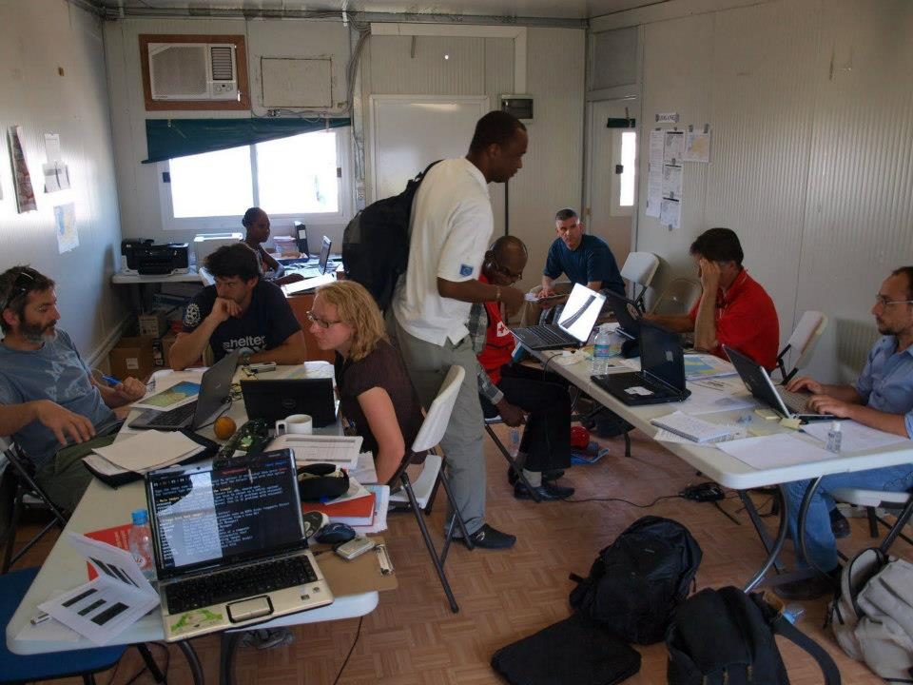
Coordination
Services

Slide 19
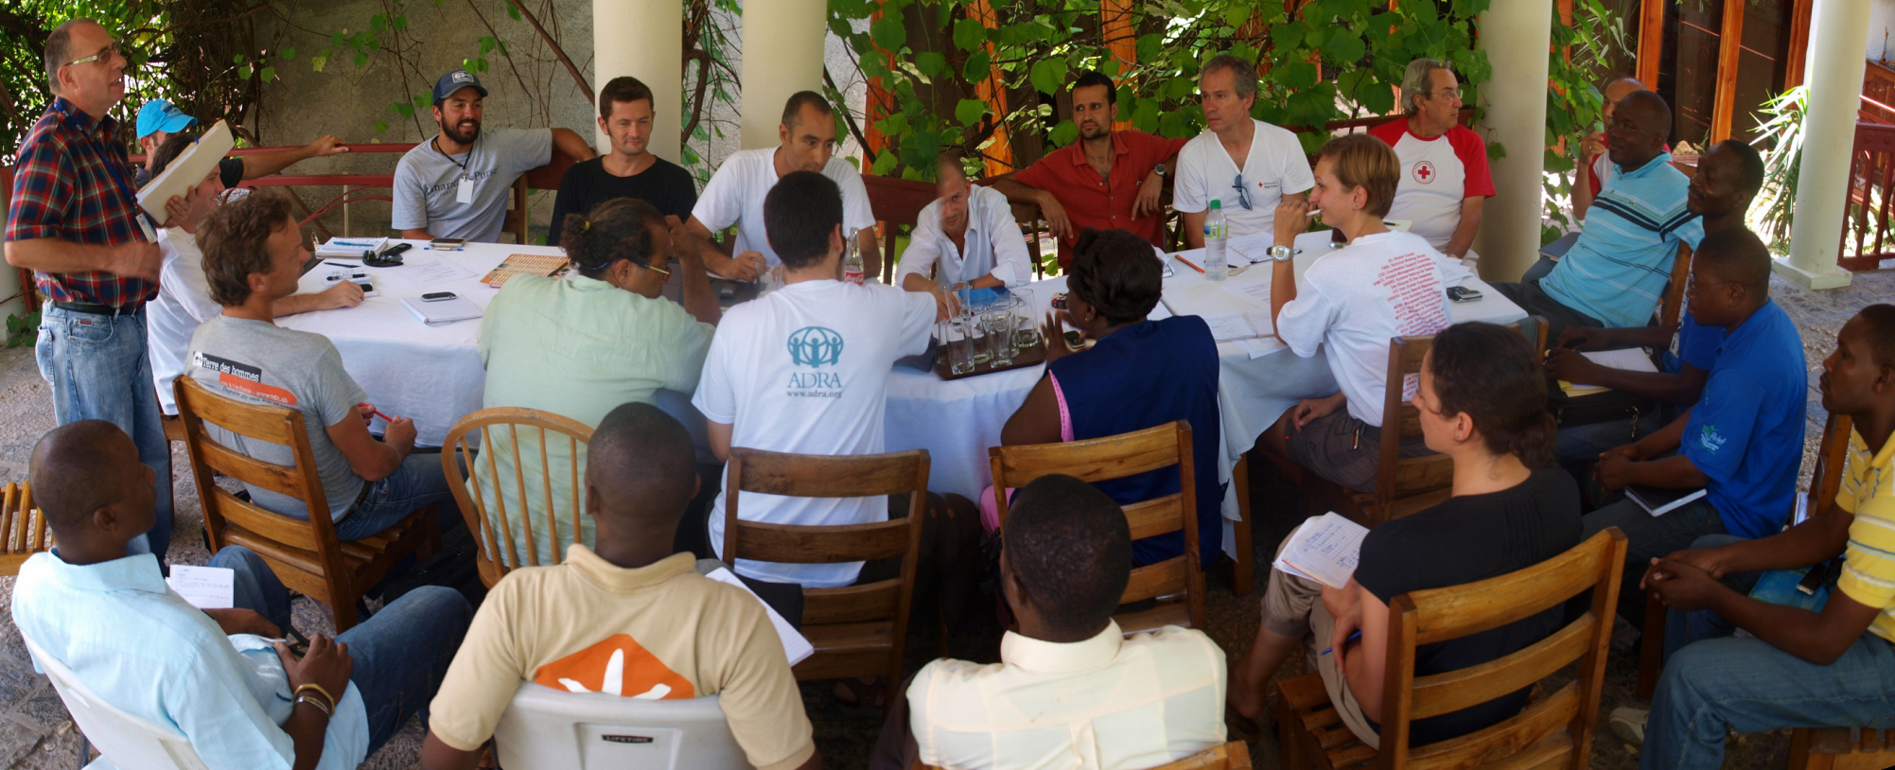
The Cluster is the forum where all actors can discuss and agree on issues related to their sector.
It takes the commitment of all Cluster partners to implement these decisions.
Notes:
The Cluster Team is there to support the work of everyone and to facilitate agreement on important topics. However, the team depends on the Cluster partners to implement decisions that have been agreed on.

Slide 20
Coordination
≠
Tasking
Notes:
Some Cluster Leads confuse “coordination” with “telling people what to do”. This is particularly a risk, when the Cluster Coordinator is “double-hatting” and where many Cluster partners are also implementing partners of the Cluster lead agency. However, that is not how the system was designed and it is one of the reasons why some agencies separate the Cluster coordination function completely from all other functions of the organization. In the case of the IFRC for example, the Cluster Coordinator does normally not report to the in-country head of operations but directly to Geneva. Coordinators are supposed to be impartial facilitators.

Slide 21
Six core functions at field level
1. Supporting service delivery
Provide a platform to ensure that service delivery is driven by the agreed strategic priorities
Develop mechanisms to eliminate duplication of service delivery
2. Informing strategic decision-making of the HC/HCT for the humanitarian response
Needs assessment and response gap analysis (across sectors and within the sector)
Analysis to identify and address (emerging) gaps, obstacles, duplication, and cross-cutting issues including age, gender, environment and HIV/AIDs
Prioritisation, grounded in response analysis
3. Planning and strategy development
Develop sectoral plans, objectives and indicators that directly support realisation of the HC/HCT strategic priorities
Apply and adhere to existing standards and guidelines
Clarify funding requirements, prioritisation and cluster contributions for the HC’s overall humanitarian funding considerations (e.g. Flash Appeal, CAP, CERF, Emergency Response Fund/Common Humanitarian Fund)

Slide 22
Six core functions at field level
4. Advocacy
Identify advocacy concerns to contribute to HC and HCT messaging and action
Undertake advocacy activities on behalf of cluster participants and the affected population
5. Monitoring and reporting the implementation of the cluster strategy and results; recommending corrective action where necessary
6. Contingency planning/preparedness/capacity building in situations where there is a high risk of recurring or significant new disaster and where sufficient capacity exists within the cluster.
→ Accountable to the HC/RC (except IFRC)
Source: IASC Reference Module for Cluster Coordination at the Country Level; Oct 2012

Slide 23
Special role of the IFRC as Shelter Cluster “convener”
Not accountable to the HC/ERC because of independence and neutrality of the Red Cross Red Crescent Movement
Not a “provider of last resort”
IFRC does not receive funds from the CERF
Notes:
The IFRC signed a Memorandum of Understanding with OCHA in 2006 outlining its special role as a “Cluster Covenver”. The MoU can be downloaded at ShelterCluster.org https://www.sheltercluster.org/References/SC%20Coordination%20Toolkit%20library/7.1.5%20IFRC%20-%20UNOCHA%20MoU.doc

Slide 24
Coordination
≠
Funding
But:
The Cluster team will assist Cluster members in writing proposals to access pool funds, such as the CAP and UN Flash Appeal.
Members of the Strategic Advisory Group (SAG) vet proposals for pool funds to ensure a consistent shelter response strategy.

Slide 25
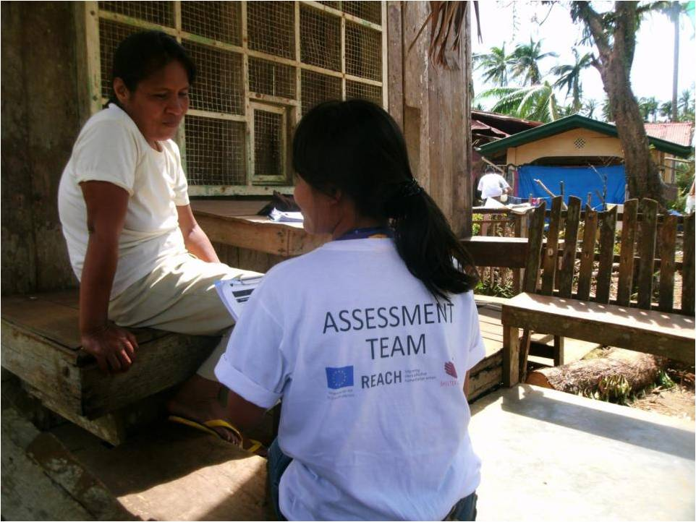
Cluster products
Notes:
What follows are examples of the most important Cluster products. Depending on the emergency, Country Cluster Teams, supported remotely by the Global Cluster Teams, may produce additional products.

Slide 26
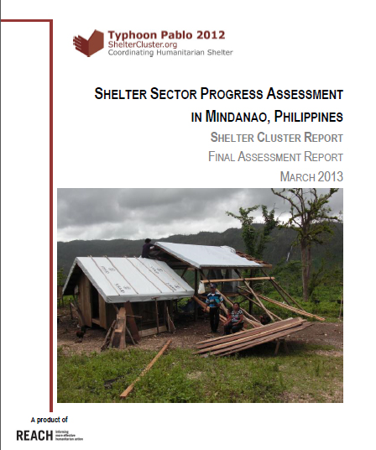
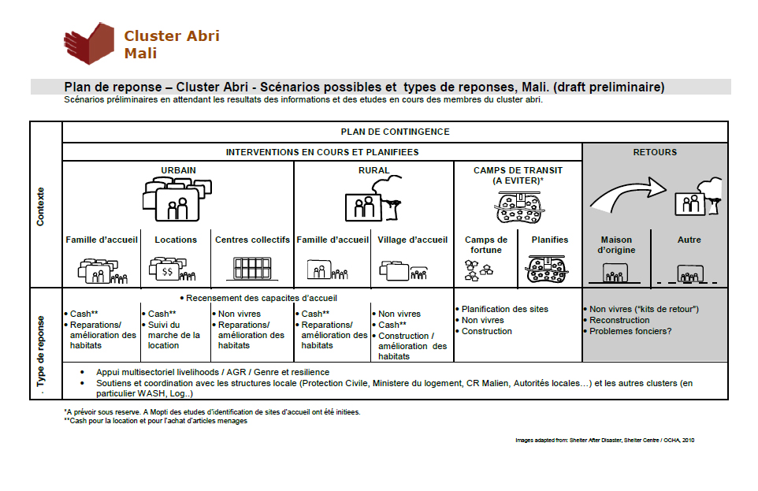
Needs assessments and strategic framework

Slide 27
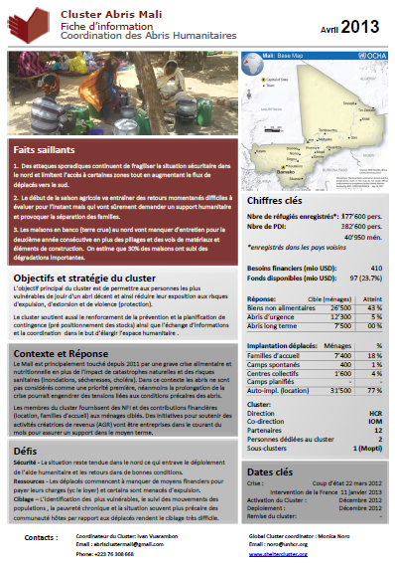
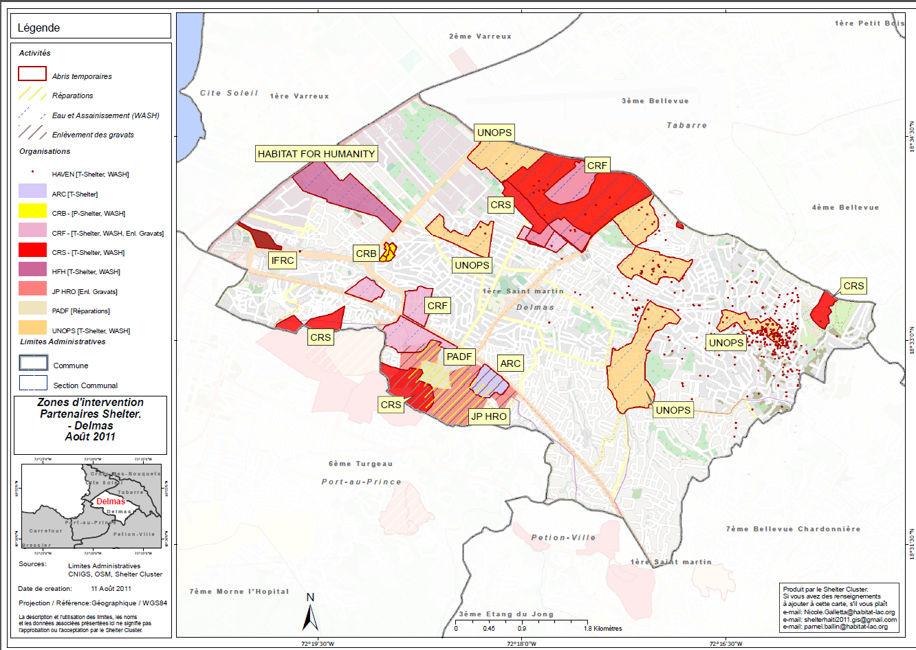
3W and Factsheets

Slide 28
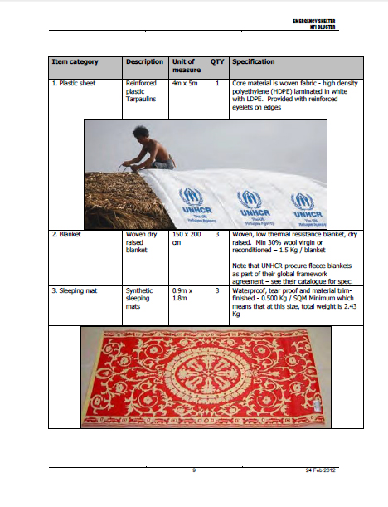
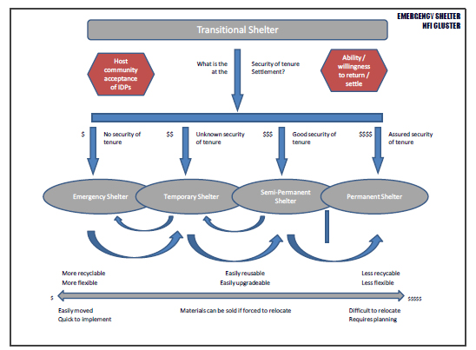
Accountability through agreed, transparent processes and clear technical guidelines

Slide 29
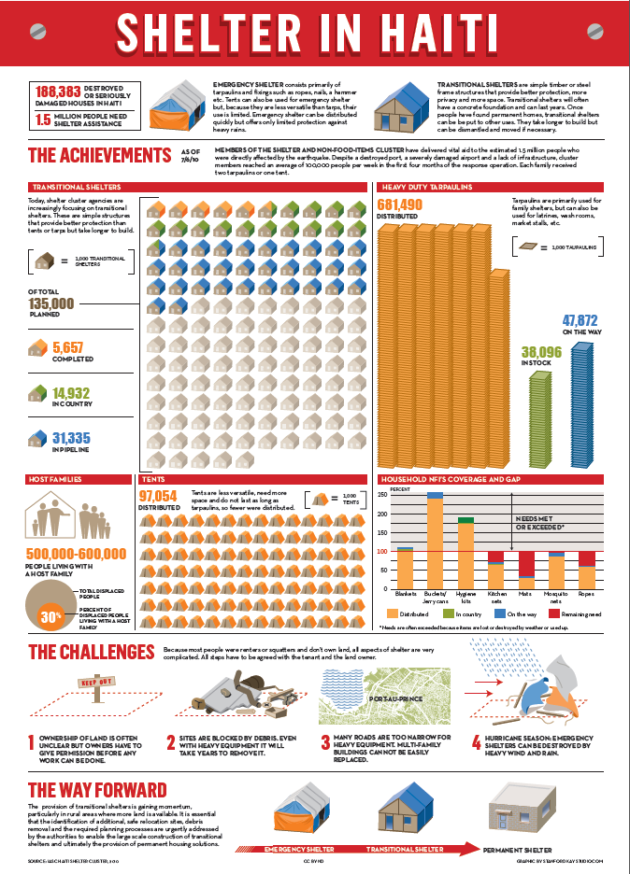
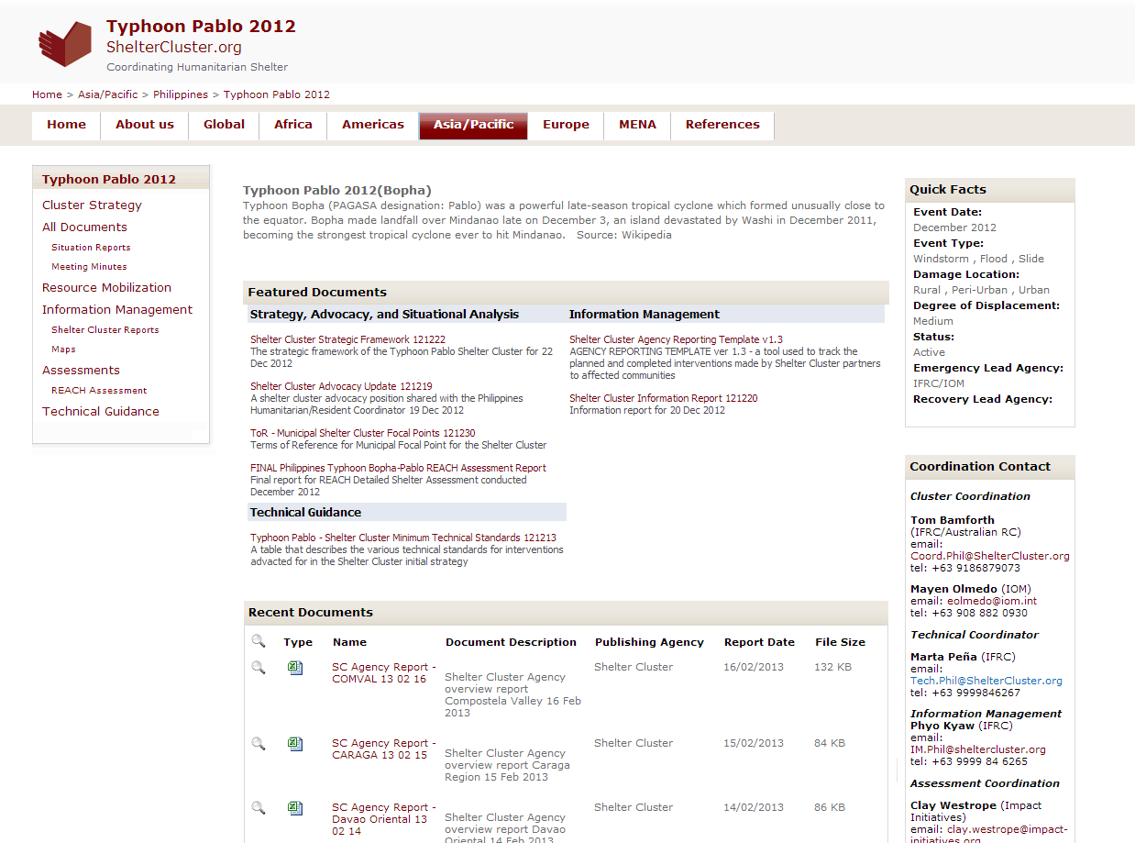
Communication and advocacy, minutes, best practice and lessons learned
www.ShelterCluster.org

Slide 30
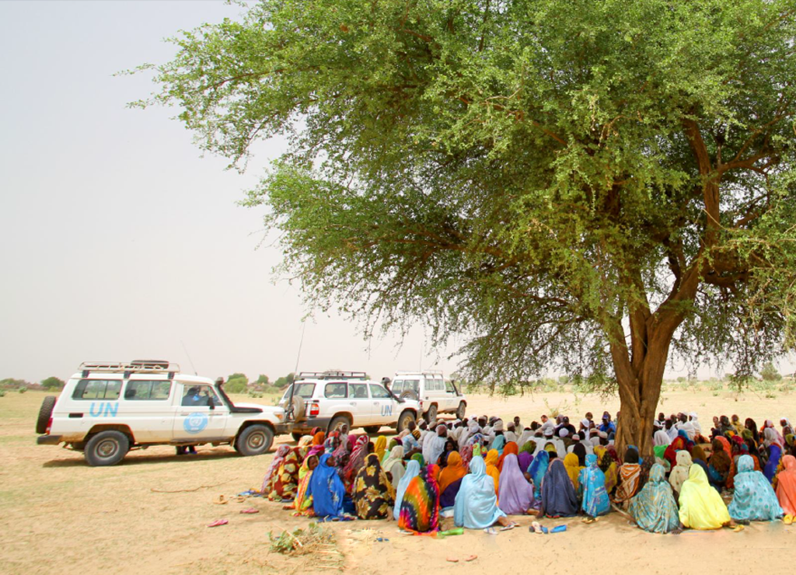
Cluster structures in the field
Photo: OCHA/P Peron

Slide 31
Who are the Cluster partners?
UN agencies
Host government
International NGOs
Red Cross Red Crescent Movement
Local NGOs / Civil Society Organizations
Representatives of the Affected Population
Donors
Academia

Slide 32
What you can do for the Cluster
You are the Cluster! The Cluster is only as good as the participation of its members.
As a Cluster member you should
Participate in assessments
Provide information about your activities
Take actively part in the setting of strategies
Provide analysis
Accept limited coordination responsibilities
Contribute resources (funds, personnel, coordination)

Slide 33
Ideal Country Cluster structure
SAG
TWIGs
Main Cluster Meeting
TWIGs
SAG = Strategic Advisory Group; TWIG = Technical Working Group

Slide 34
Country Cluster Structure
Main Shelter Cluster meeting: Everyone
Strategic Advisory Group (SAG): Max 15 key operational partners. Develops the overall strategy and provides strategic oversight. Vets proposal for Flash appeal etc.
Technical Working Groups (TWiGs): Specific, short-term. For example: Drainage, Temporary shelter design, etc.
Notes:
SAGs also exist on the global level. Instead of TWiGs, the global level has working groups (WGs)

Slide 35

The Cluster cannot live up to its full potential if the coordinator is all alone.

Slide 36




Shelter Cluster Core Coordination Team
Remote support
Technical coordinator
Coordinator
Information manager

Slide 37













Potential Shelter Cluster Coordination Team (large disaster)
Remote support
Land rights
Environment
Mapping/GIS
Contingency planning
Dept./Hub coordinators
Tech
Coord
IM
Debris
Media
Logistics
Gov. liaison
Urban settlement
Community liaison

Slide 38

Challenges
Photo: OCHA/D DeLoroenzo

Slide 39
Challenges for the Cluster Approach
Lead agency staff often don’t understand role of Cluster coordination (tasking vs. coordinating)
Frequently no dedicated staff for Cluster coordination and not enough resources to add value
Still very UN centric and NGOs sometimes feel that they are not equal partners
Not enough involvement of local NGO/CSOs
Not enough involvement of affected people
Some new actors don’t know about the Cluster system such as some faith based groups, very new or very small NGOs.
Can be resource intensive for organizations (too many meetings) if the Cluster is not well managed.
Notes:
The Shelter Cluster tries to

Slide 40
Thank you!
More info:
www.ShelterCluster.org
Follow us on Twitter:
@ShelterCluster

