Slide 1
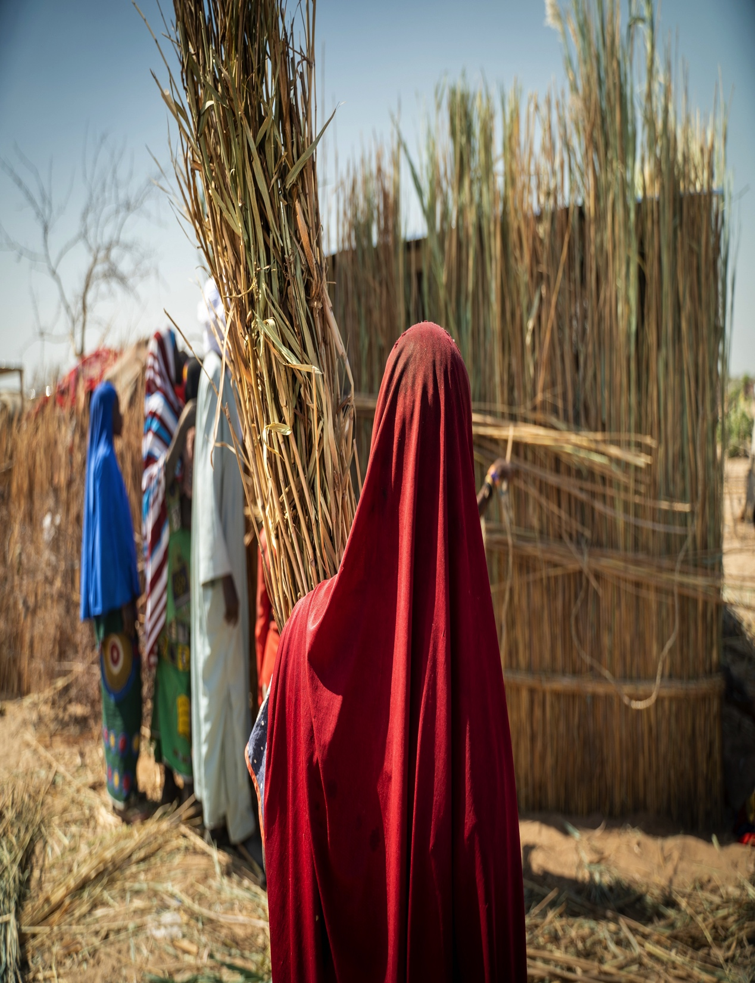
UNDRR & GSC COLLABORATION
Strengthening DRR integration in Shelter and Settlements
June 2024 – March 2025

Slide 2
OVERVIEW
The Issue
Shelter Cluster partners are responding to the same disasters again and again in the same locations
We are not using responses to reduce the likelihood of the same disaster in the future
This wastes money, requires unnecessary demand for environmental resources (direct and indirect) and lead to unnecessary harm to disaster survivors.
Our Approach
Strengthen DRR as part of humanitarian shelter and settlement response
Support via consultancies for technical support and flood mitigation funding
Guidance on integrating DRR into shelter & settlement assistance.
Madagascar, Yemen, Afghanistan
Close collaboration with GSC Green Team (USAID and SDC funded).

Slide 3
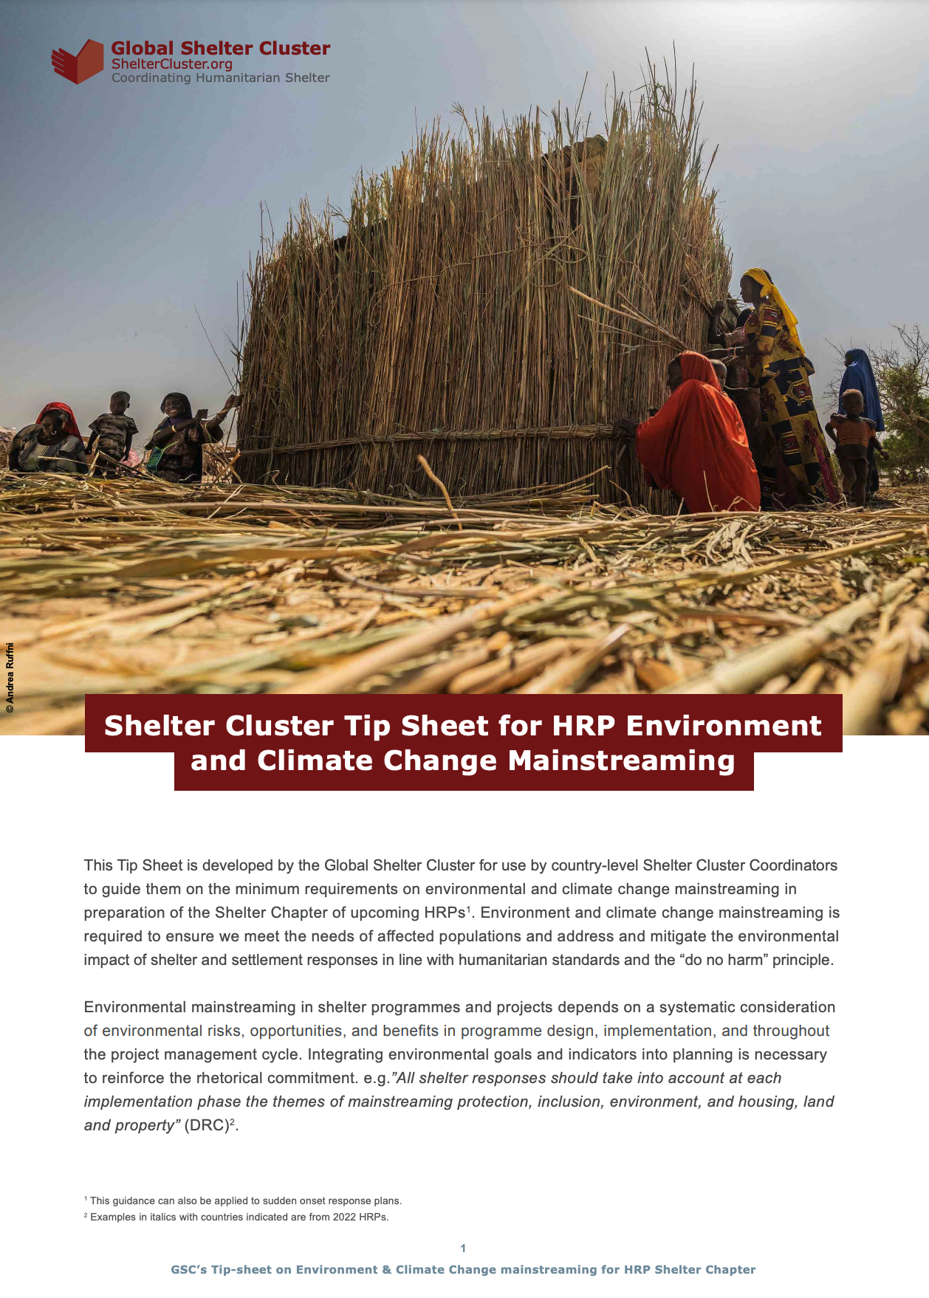
GLOBAL
Guidance package to support country clusters in the 2025 HPC planning process & broader shelter cluster strategic planning:
  Entry points to mainstream DRR in Humanitarian Shelter Projects
  HNO and HRP environment tip sheets updated to include DRR
  FAQ on risk-informed humanitarian action for cluster partners
  Webinar
Online training module: Mainstreaming DRR in humanitarian shelter and EHI activities through the development and implementation of country shelter cluster strategies
Guidance for shelter cluster on funding sources and instruments available to humanitarian actors, for integrating DRR and environment into operational responses

Slide 4
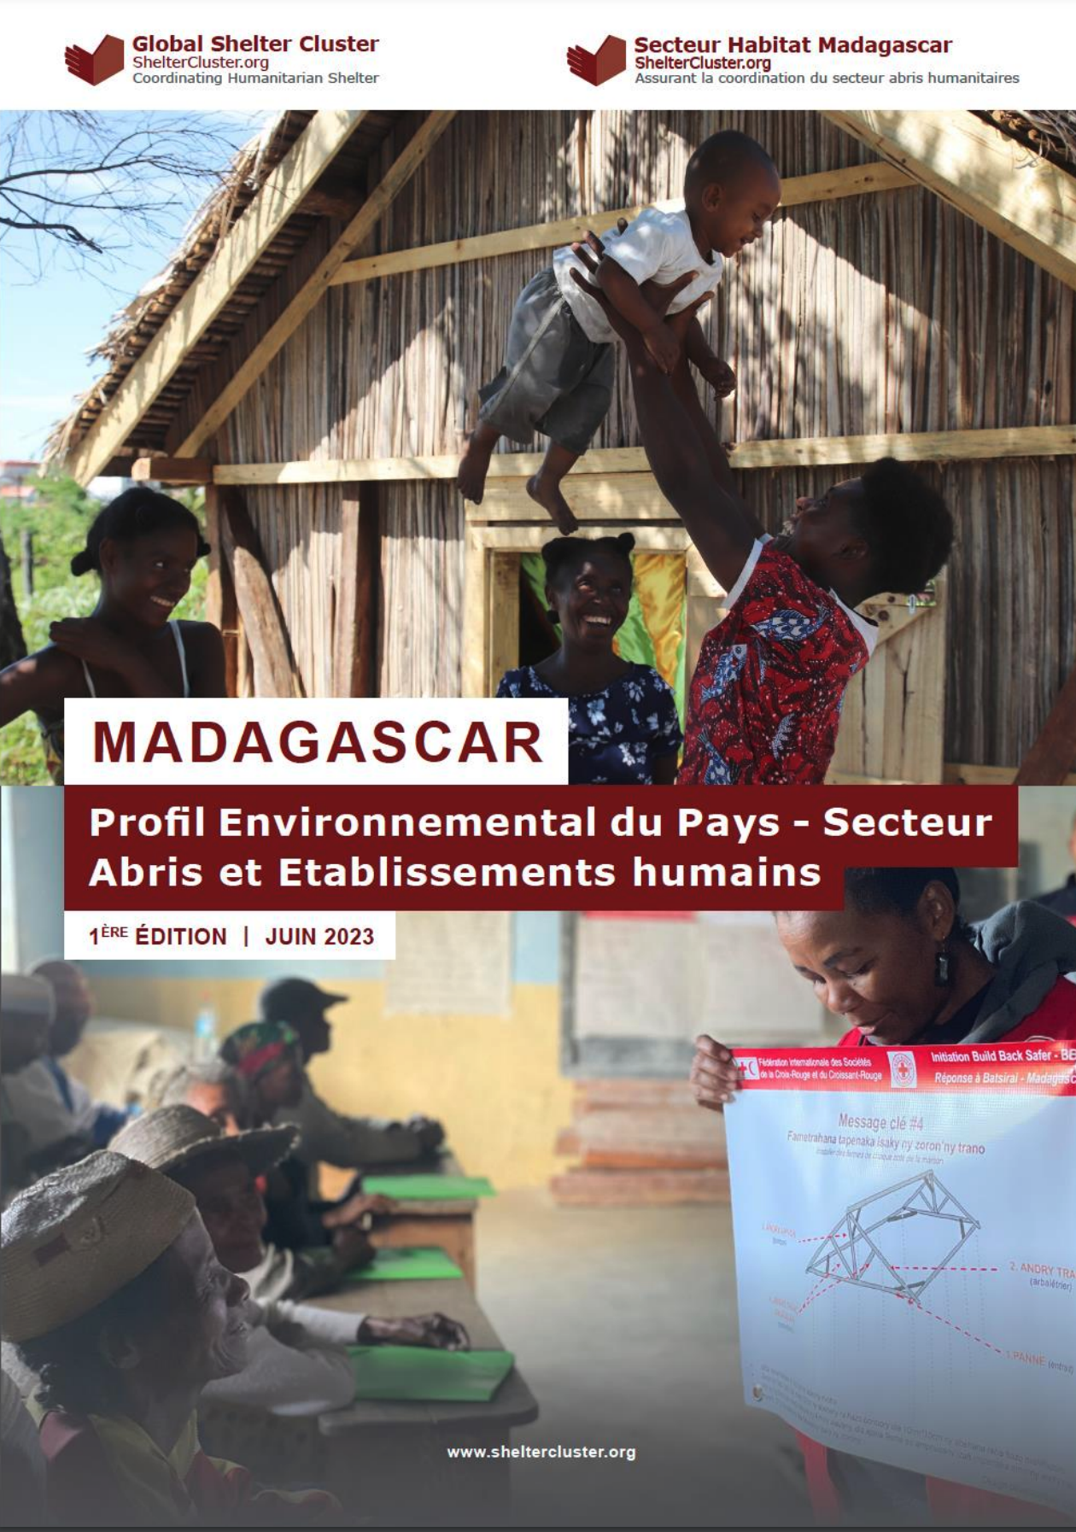
MADAGASCAR
Scoping to identify cluster DRR needs
No. 1 cluster priority: Development of a cluster DRR strategy
TWIG TOR developed
Local consultant being hired (via UNDRR)
Synergies with USAID funded WWF eco-DRR/NBS work and national simulation exercise with UNDRR
Linked to the development of cluster strategy and national contingency planning
Development of case studies and lessons learnt
Builds on BHA-funded Environmental Country Profile

Slide 5
YEMEN
Support Yemen Shelter Cluster's existing flood mitigation work via technical support for capacity building and advocacy, and UNDRR funding for mitigation activities
Evaluation of proposals for DRR activities at selected shelter sites & technical support to strengthen projects, including NBS
Planning & implementation of community-oriented training on flood risk management (based on existing guidance, inc. UNHCR resources and USAID-funded Flood Green Guide)
Development of advocacy and communications materials on the role of DRR in humanitarian shelter response in Yemen to support resource mobilisation
Builds on Environmental Country Profile

Slide 6
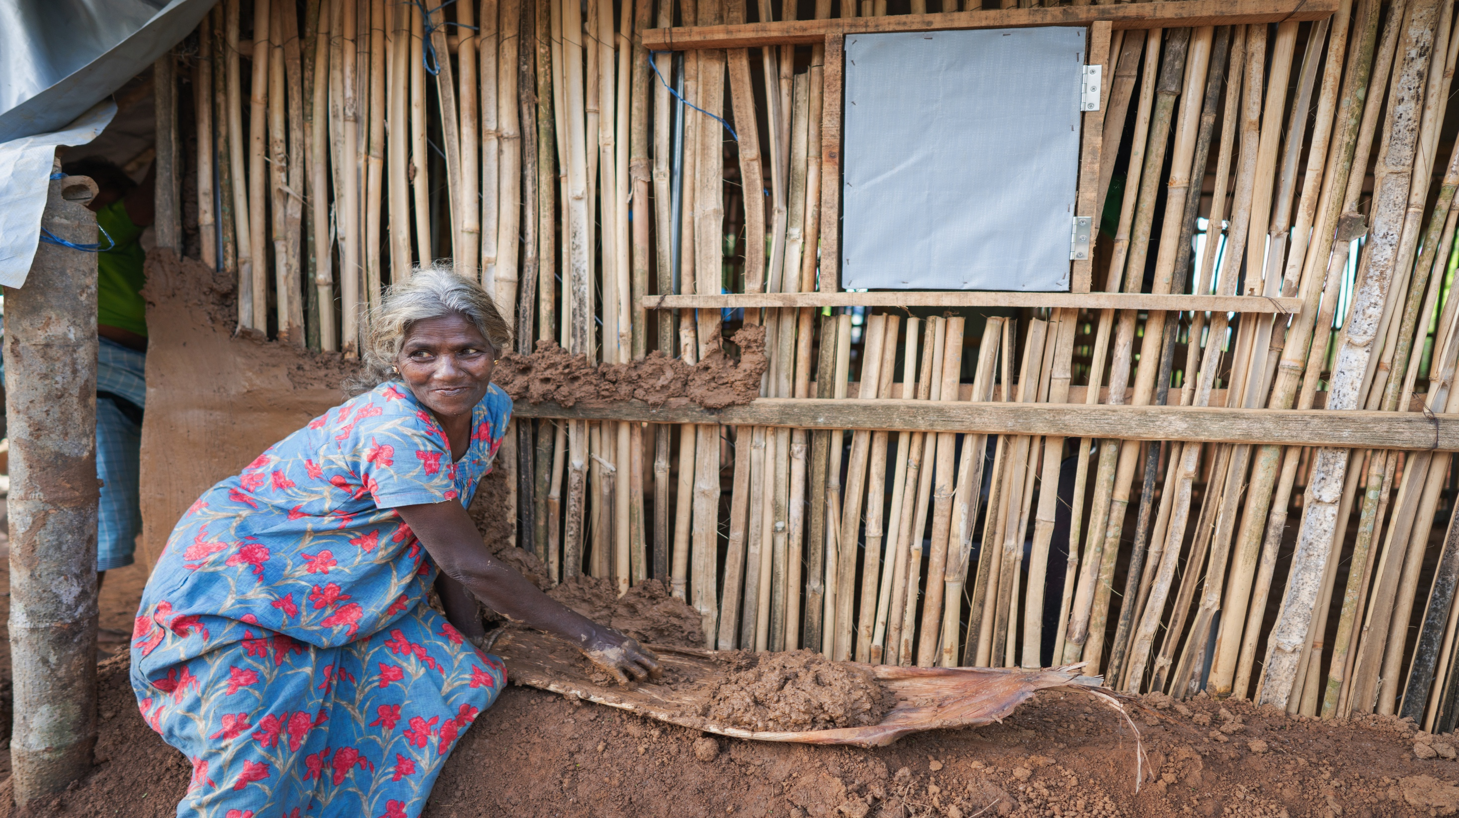
THANK YOU

