Slide 1






USWG Webinar September 17th 2024
AGENDA
Welcome! The session will start at 9:00am EDT
Open the chat and say hello to everyone. Use the chat for questions to the facilitators at any time throughout the webinar.
Test your speakers/headphones and microphone.
Participants will stay muted during the session.
Open the participant panel. Check your name is listed. You can rename yourself by selecting the 'More' button when you go over your name in the list.
Please turn on your camera if you are able. It's much nicer to see you all!
Notes:
This is the holding slide as participants arrive before 15.00. Mentimeter link for word cloud will be shared in the chat for those arriving early and will be shared again later.

Slide 2

THE URBAN SETTLEMENTS WORKING GROUP
Notes:
The facilitator greets the participants, and introduce themselves.
ANDREA
If you are experiencing any problems using Zoom please send a message in chat to Andrea Lopez from InterAction (person nominated to facilitate behind scenes) who will help you with any issues possible.
Please note that this session is interactive at various stages, but we will give everyone instructions when we start the interactive bits, about how to access those activities
With limited time to cover all the material in this workshop we would like to invite you to use the chat to post your concerns and questions about the Settlements Approach throughout the event. We will be collecting these as we go along and for the Q&A session at the end of the hour.

Slide 3
Exploring Approaches to Working in Urban Environments

Slide 4
TODAY’S SPEAKERS
Osama Slo, Acting Coordinator
Early Recovery and Livelihoods Working Group for Northeast Syria
Marcelle Rubis, Program Manager of Urban DRR
Catholic Relief Services, Philippines
Samar Farhat, Urban Recovery & Advocacy Advisor
Habitat for Humanity
Maya Abou Dib, Program Manager
Catholic Relief Services
Lebanon
Javier Cidon, Field Operations Officer Disaster Risk Reduction
Habitat for Humanity, Jamaica
Wafa Al-Daily, Executive Director
EHAAR International, Yemen
Notes:
Lou

Slide 5
Transforming households and local organization capacities

Slide 6





Locating DRR Interventions
in Urban Settlements
Catholic Relief Services Philippines
THRI
E
Towards a Resilient and Vibrant Urban Ecosystem

Slide 7
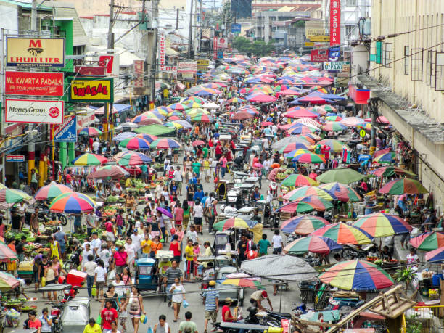

Shelter and Settlements Situation in Urban Communities
Rapid urban migration and population growth in urban communities
THRI
E
Towards a Resilient and Vibrant Urban Ecosystem

Slide 8
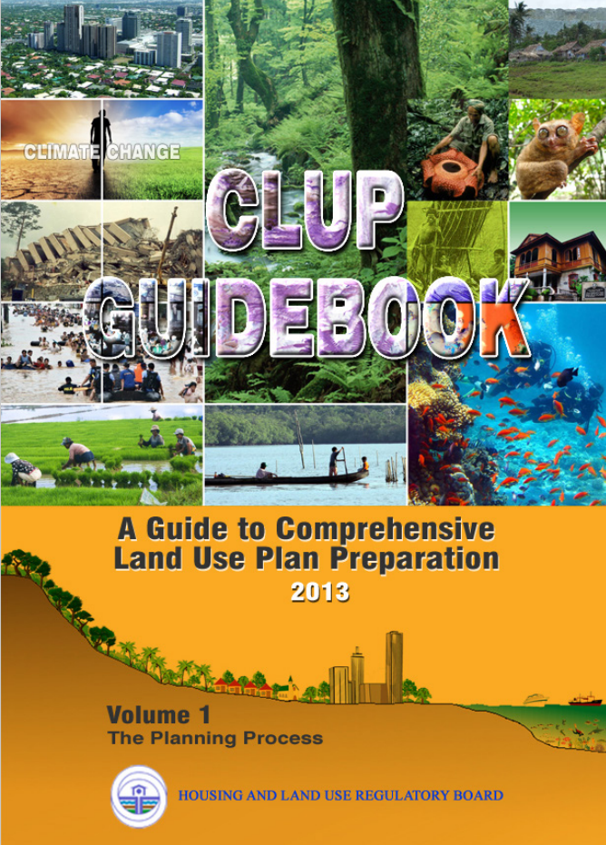
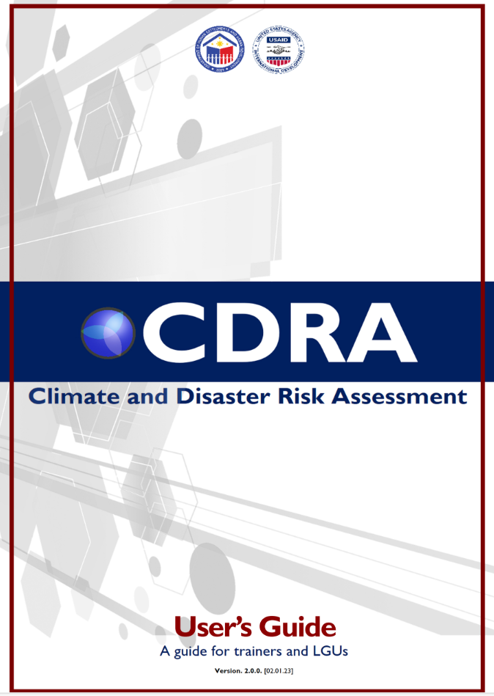
Shelter and Settlements in Urban Communities: Governing Policies
Land Use Planning
Framework of mainstreaming Climate and Disaster Risk Assessment (CDRA) in Comprehensive Land Use Plan (CLUP)
THRI
E
Towards a Resilient and Vibrant Urban Ecosystem

Slide 9
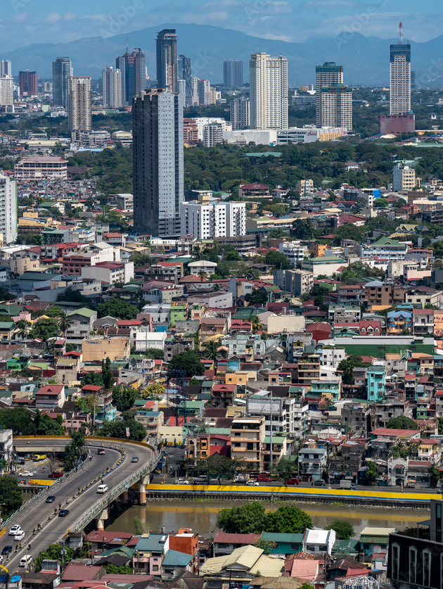
Shelter and Settlements in Urban Communities: Systemic Barriers
1. Informal Settlements and squatting
2. Inconsistent Policy implementation
3. Infrastructure and Service delivery gap
Place photos here
THRI
E
Towards a Resilient and Vibrant Urban Ecosystem

Slide 10
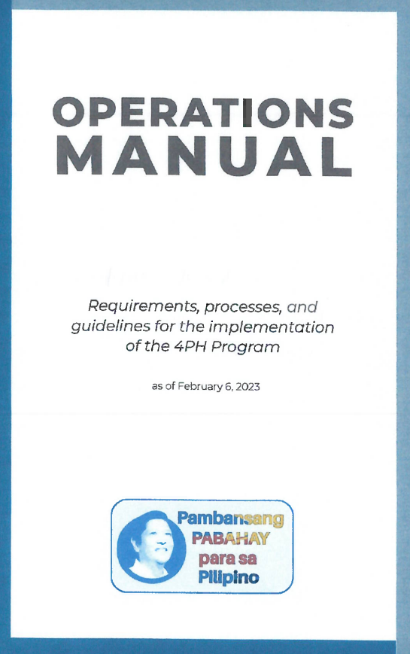
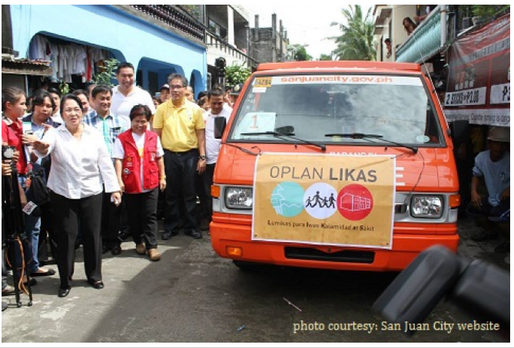
Shelter and Settlements in Urban Communities: Government-led Initiatives
1. Oplan LIKAS (Lumikas Para Iwas Kalamidad At Sakit)
2. Pambansang Pabahay Para sa Pilipino Housing (4PH Program)
THRI
E
Towards a Resilient and Vibrant Urban Ecosystem

Slide 11

Shelter and Settlements in Urban Communities: Government-led Responses
3. Balik Probinsya, Bagong Pag-asa Program
THRI
E
Towards a Resilient and Vibrant Urban Ecosystem

Slide 12
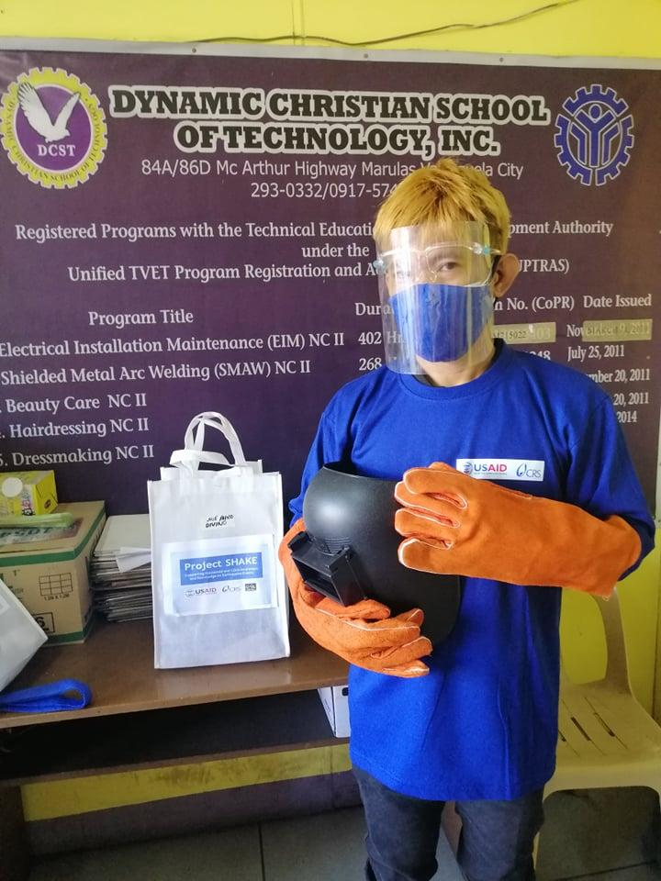
Shelter and Settlements in Urban Communities:
CRS’ Best Practices
Supporting Household and LGU Awareness and Knowledge for Earthquake Preparedness (SHAKE)
THRI
E
Towards a Resilient and Vibrant Urban Ecosystem

Slide 13
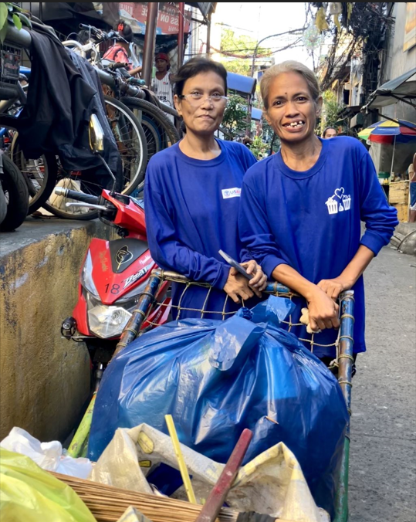
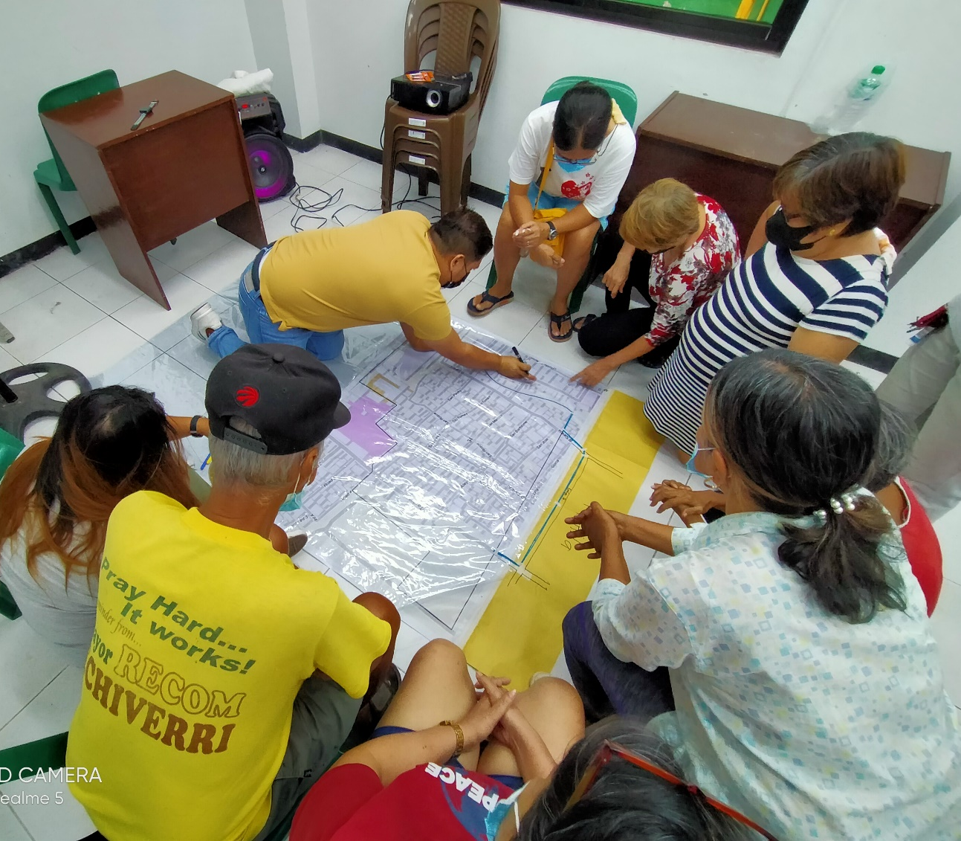
Shelter and Settlements in Urban Communities:
CRS’ Best Practices
Preparing for Enhanced Protection in Disasters (PrEPD)
Clean Manila, Blue Bay (CMMB)
THRI
E
Towards a Resilient and Vibrant Urban Ecosystem

Slide 14
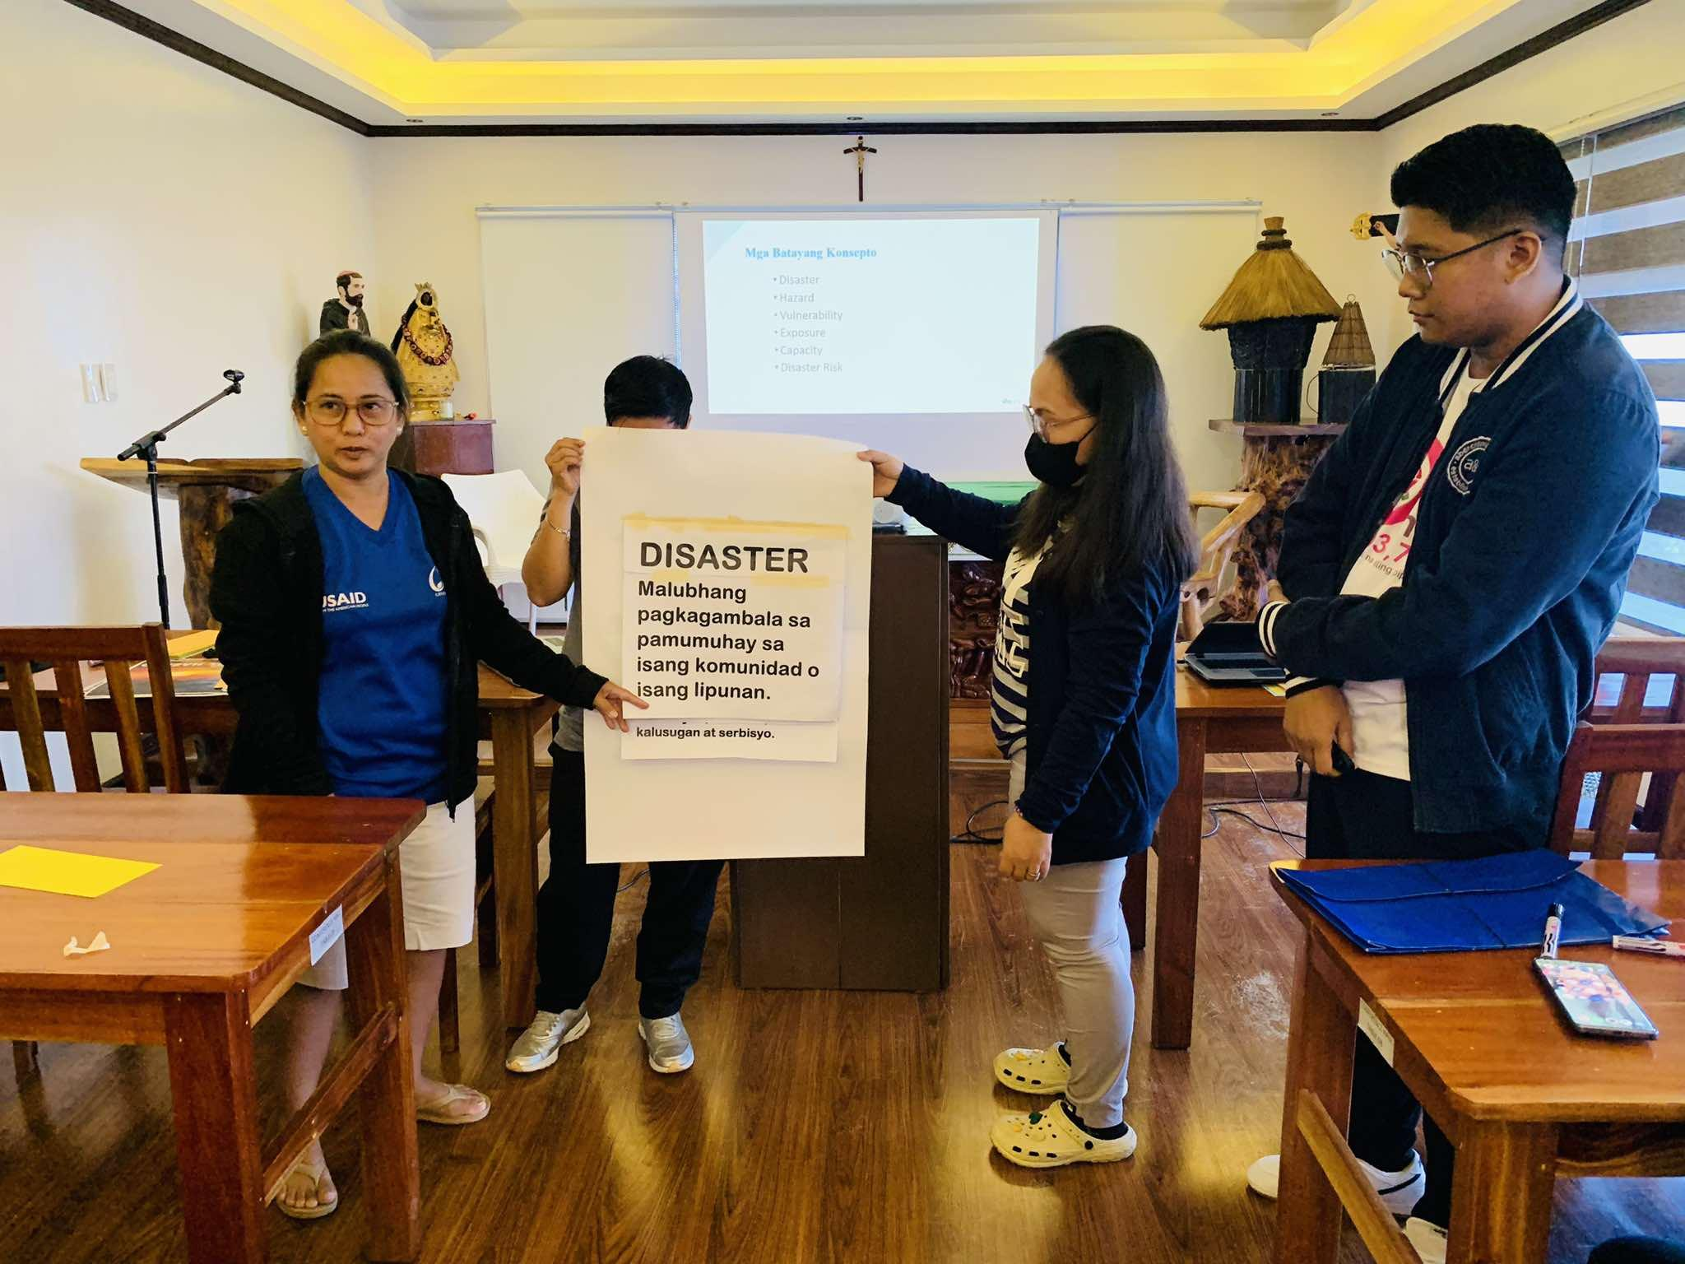
Shelter and Settlements in Urban Communities:
CRS’ Best Practices
Transforming Households and Local Organization Capacities for a Resilient and Vibrant Urban Ecosystem (THRIVE)
THRI
E
Towards a Resilient and Vibrant Urban Ecosystem

Slide 15
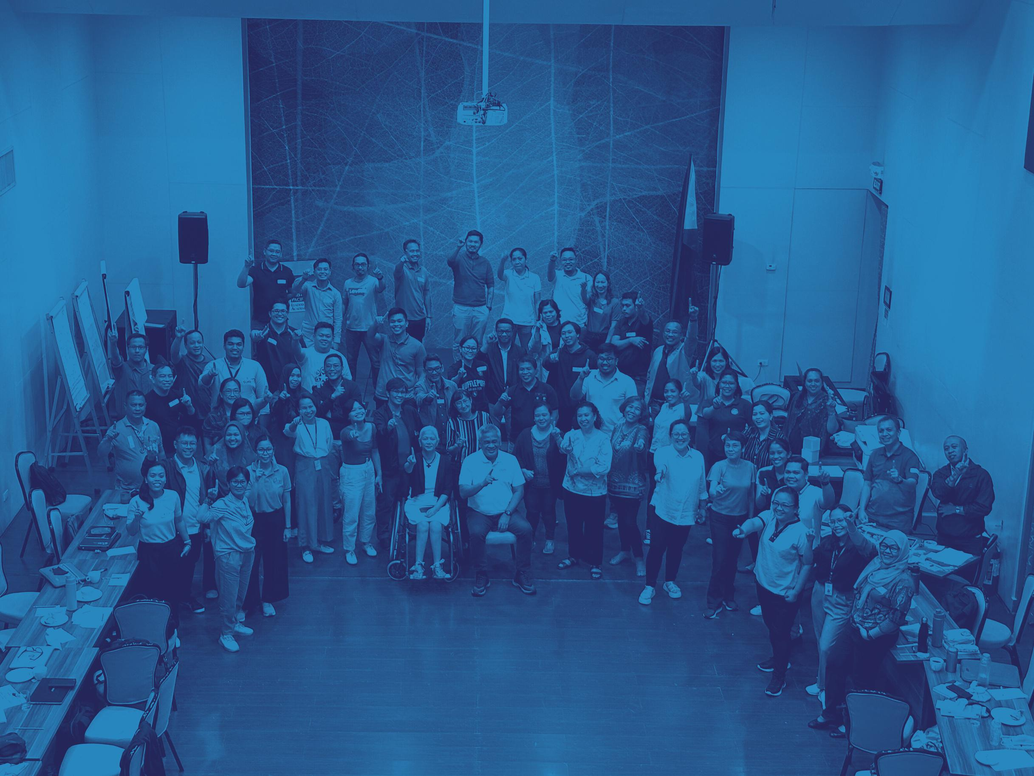
Thank you!
THRI
E
Towards a Resilient and Vibrant Urban Ecosystem

Slide 16
Shelter and urban recovery

Slide 17
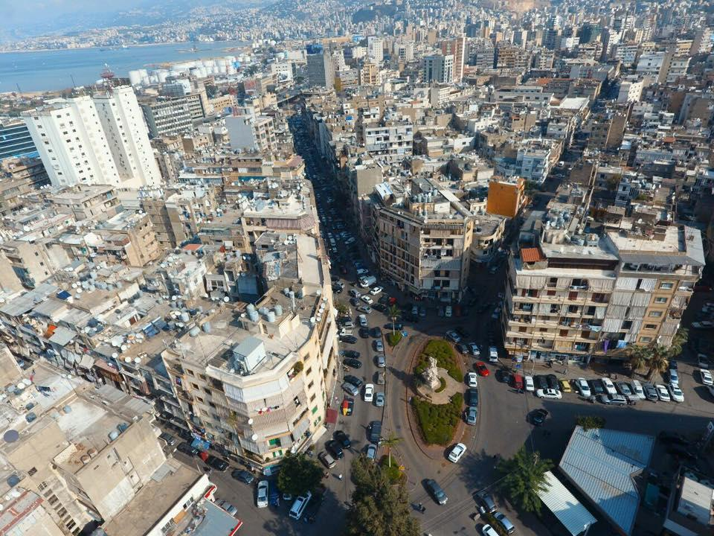


Shelter and Urban interventions
Lebanon
Urban Settlement Working Group (USWG) Webinar
17 September 2024
Presented by:
Maya Abou Dib – Catholic Relief Services
Samar Farhat – Habitat for Humanity
Notes:
Lebanon has been facing multiple crises over the years, Lebanon’s context is marked by weak governance, rapid urbanization and pressure on limited resources.
More recently, in 2019, Lebanon faced an economic crisis and Beirut Blast in 2020 which had great impact on the country.
It is now estimated that more than half the country's population is below the poverty line, making it difficult to access to basic services
These crises impacted the shelter conditions as people live in substandard living conditions, are unable to repair their homes.
Municipal institutions, burdened by financial constraints, struggle to maintain essential infrastructure and services, impacting waste management, water, and electricity supply.
This photo is of Bourj Hammourd neighborhood in Beirut, one of the most vulnerable

Slide 18
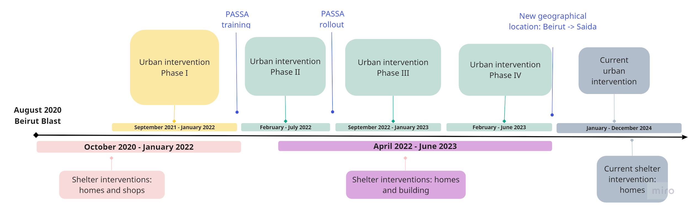
Timeline
Building Homes, Communities, and Hope
Notes:
From October 2020 till June 2023, we worked on shelter and urban interventions in Bourj Hammoud area.
Following the blast, CRS in partnership with HfH began responding to the emergency through local organizations who had previously been partners in the Preparing to Excel in Emergency Response (PEER) Project which focused on strengthening faith-based organizations’ institutional and technical capacity to respond to emergencies.
PASSA training then rollout with phase III

Slide 19



Holistic approach
Homes & Families
Shelter repairs
Neighborhood & Communities
Community-based interventions
Sector & Society
Local NGOs
Shelter Sector
Market systems
Building Homes, Communities, and Hope
Notes:
One of the successes in our response was adopting a holistic approach through doing interventions at the household, building and neighborhood levels for the same communities while coordinating closely with the municipality, shelter sector and other actors. CRS/HfH also lead the Area-Based Approach Technical Committee. And throughout the intervention, provided capacity building local partners.
This approach helped us maximize impact since we provided support at the household and neighborhood level in the same area and to the same community.

Slide 20
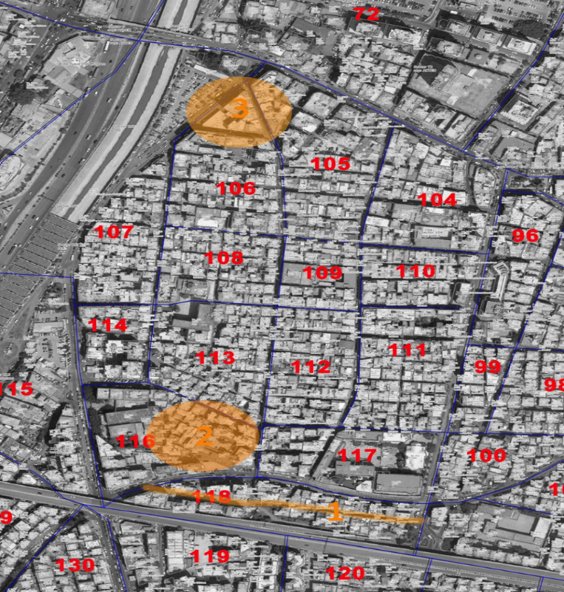
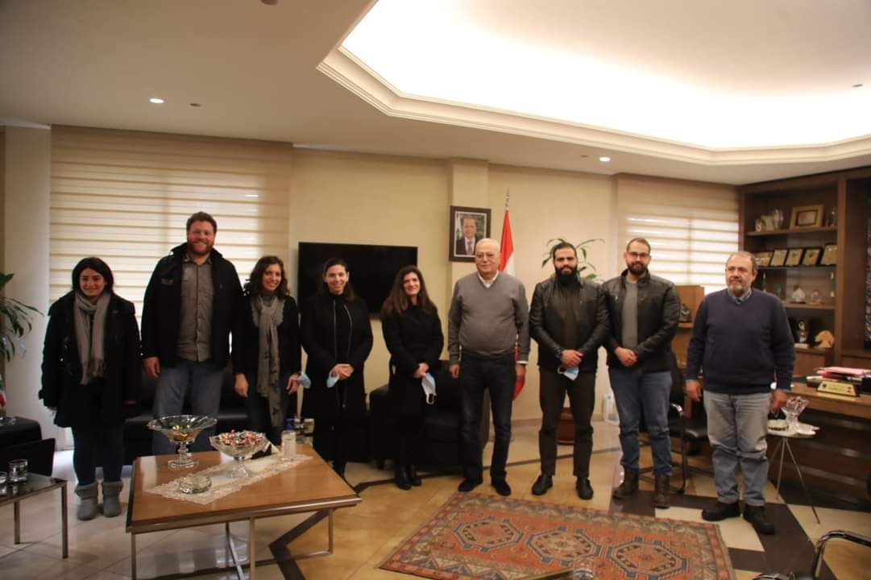
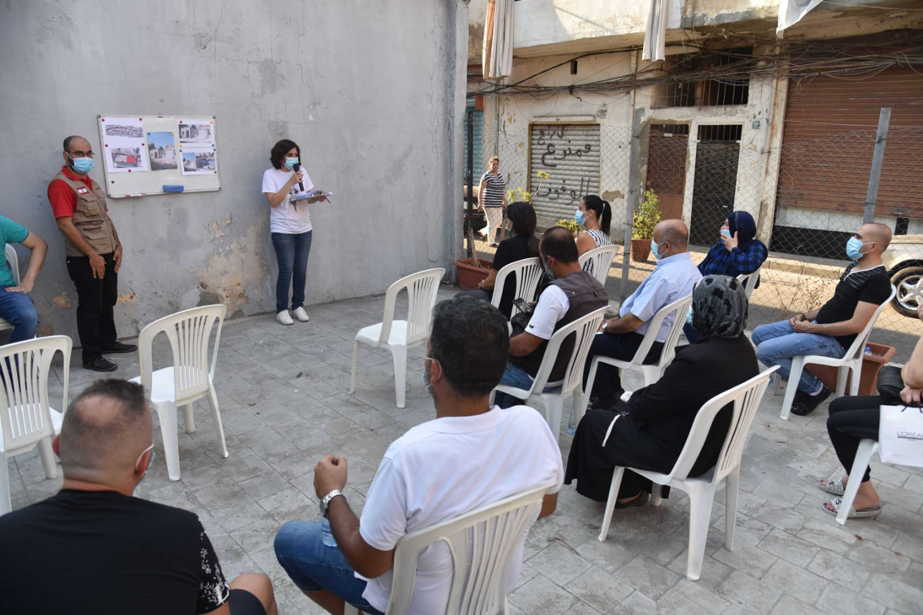
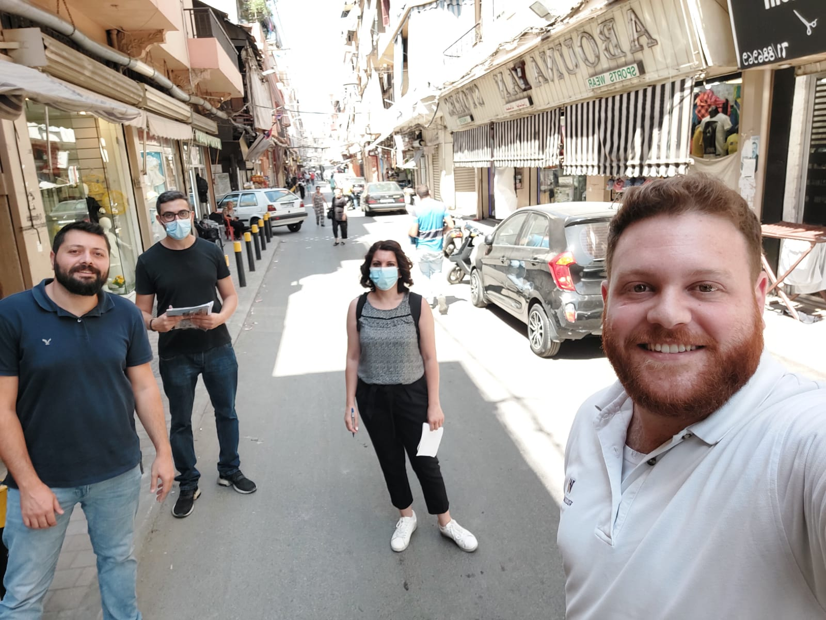
Urban Intervention – Phase I & II QIPs in Maraash
Identification of Quick Impact Projects (QIPs) through:
- Coordination with local authorities
- KII with various stakeholders
- FGD with the local community
- Transect walks (daytime and nighttime)
4 main Components of QIP:
- Cable Management
- Street Lighting
- Rehabilitation of Building Facades
- Rehabilitation of an open space
Zone 116
Zone 118
Building Homes, Communities, and Hope

Slide 21
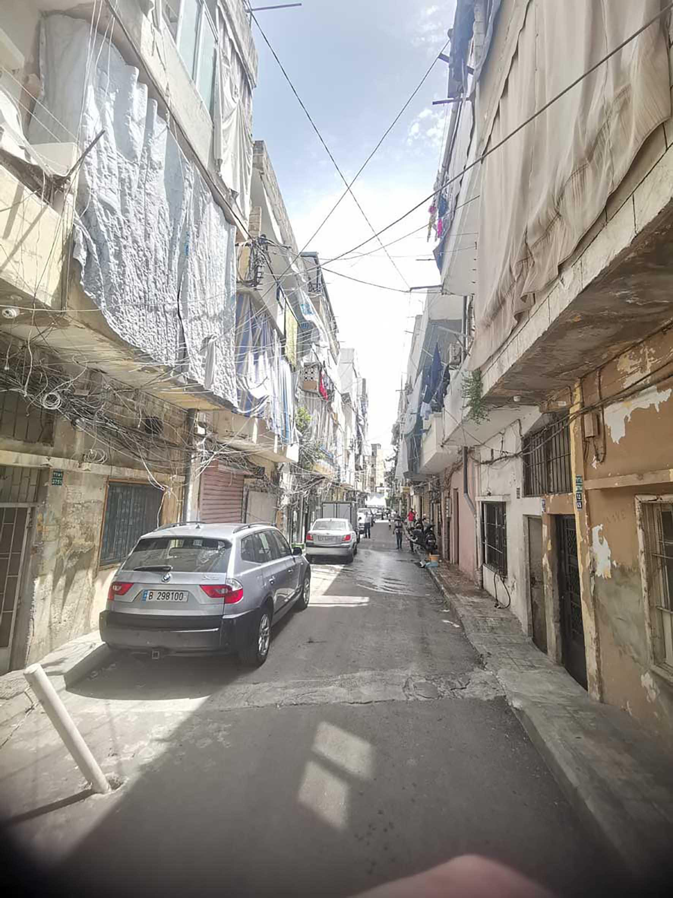
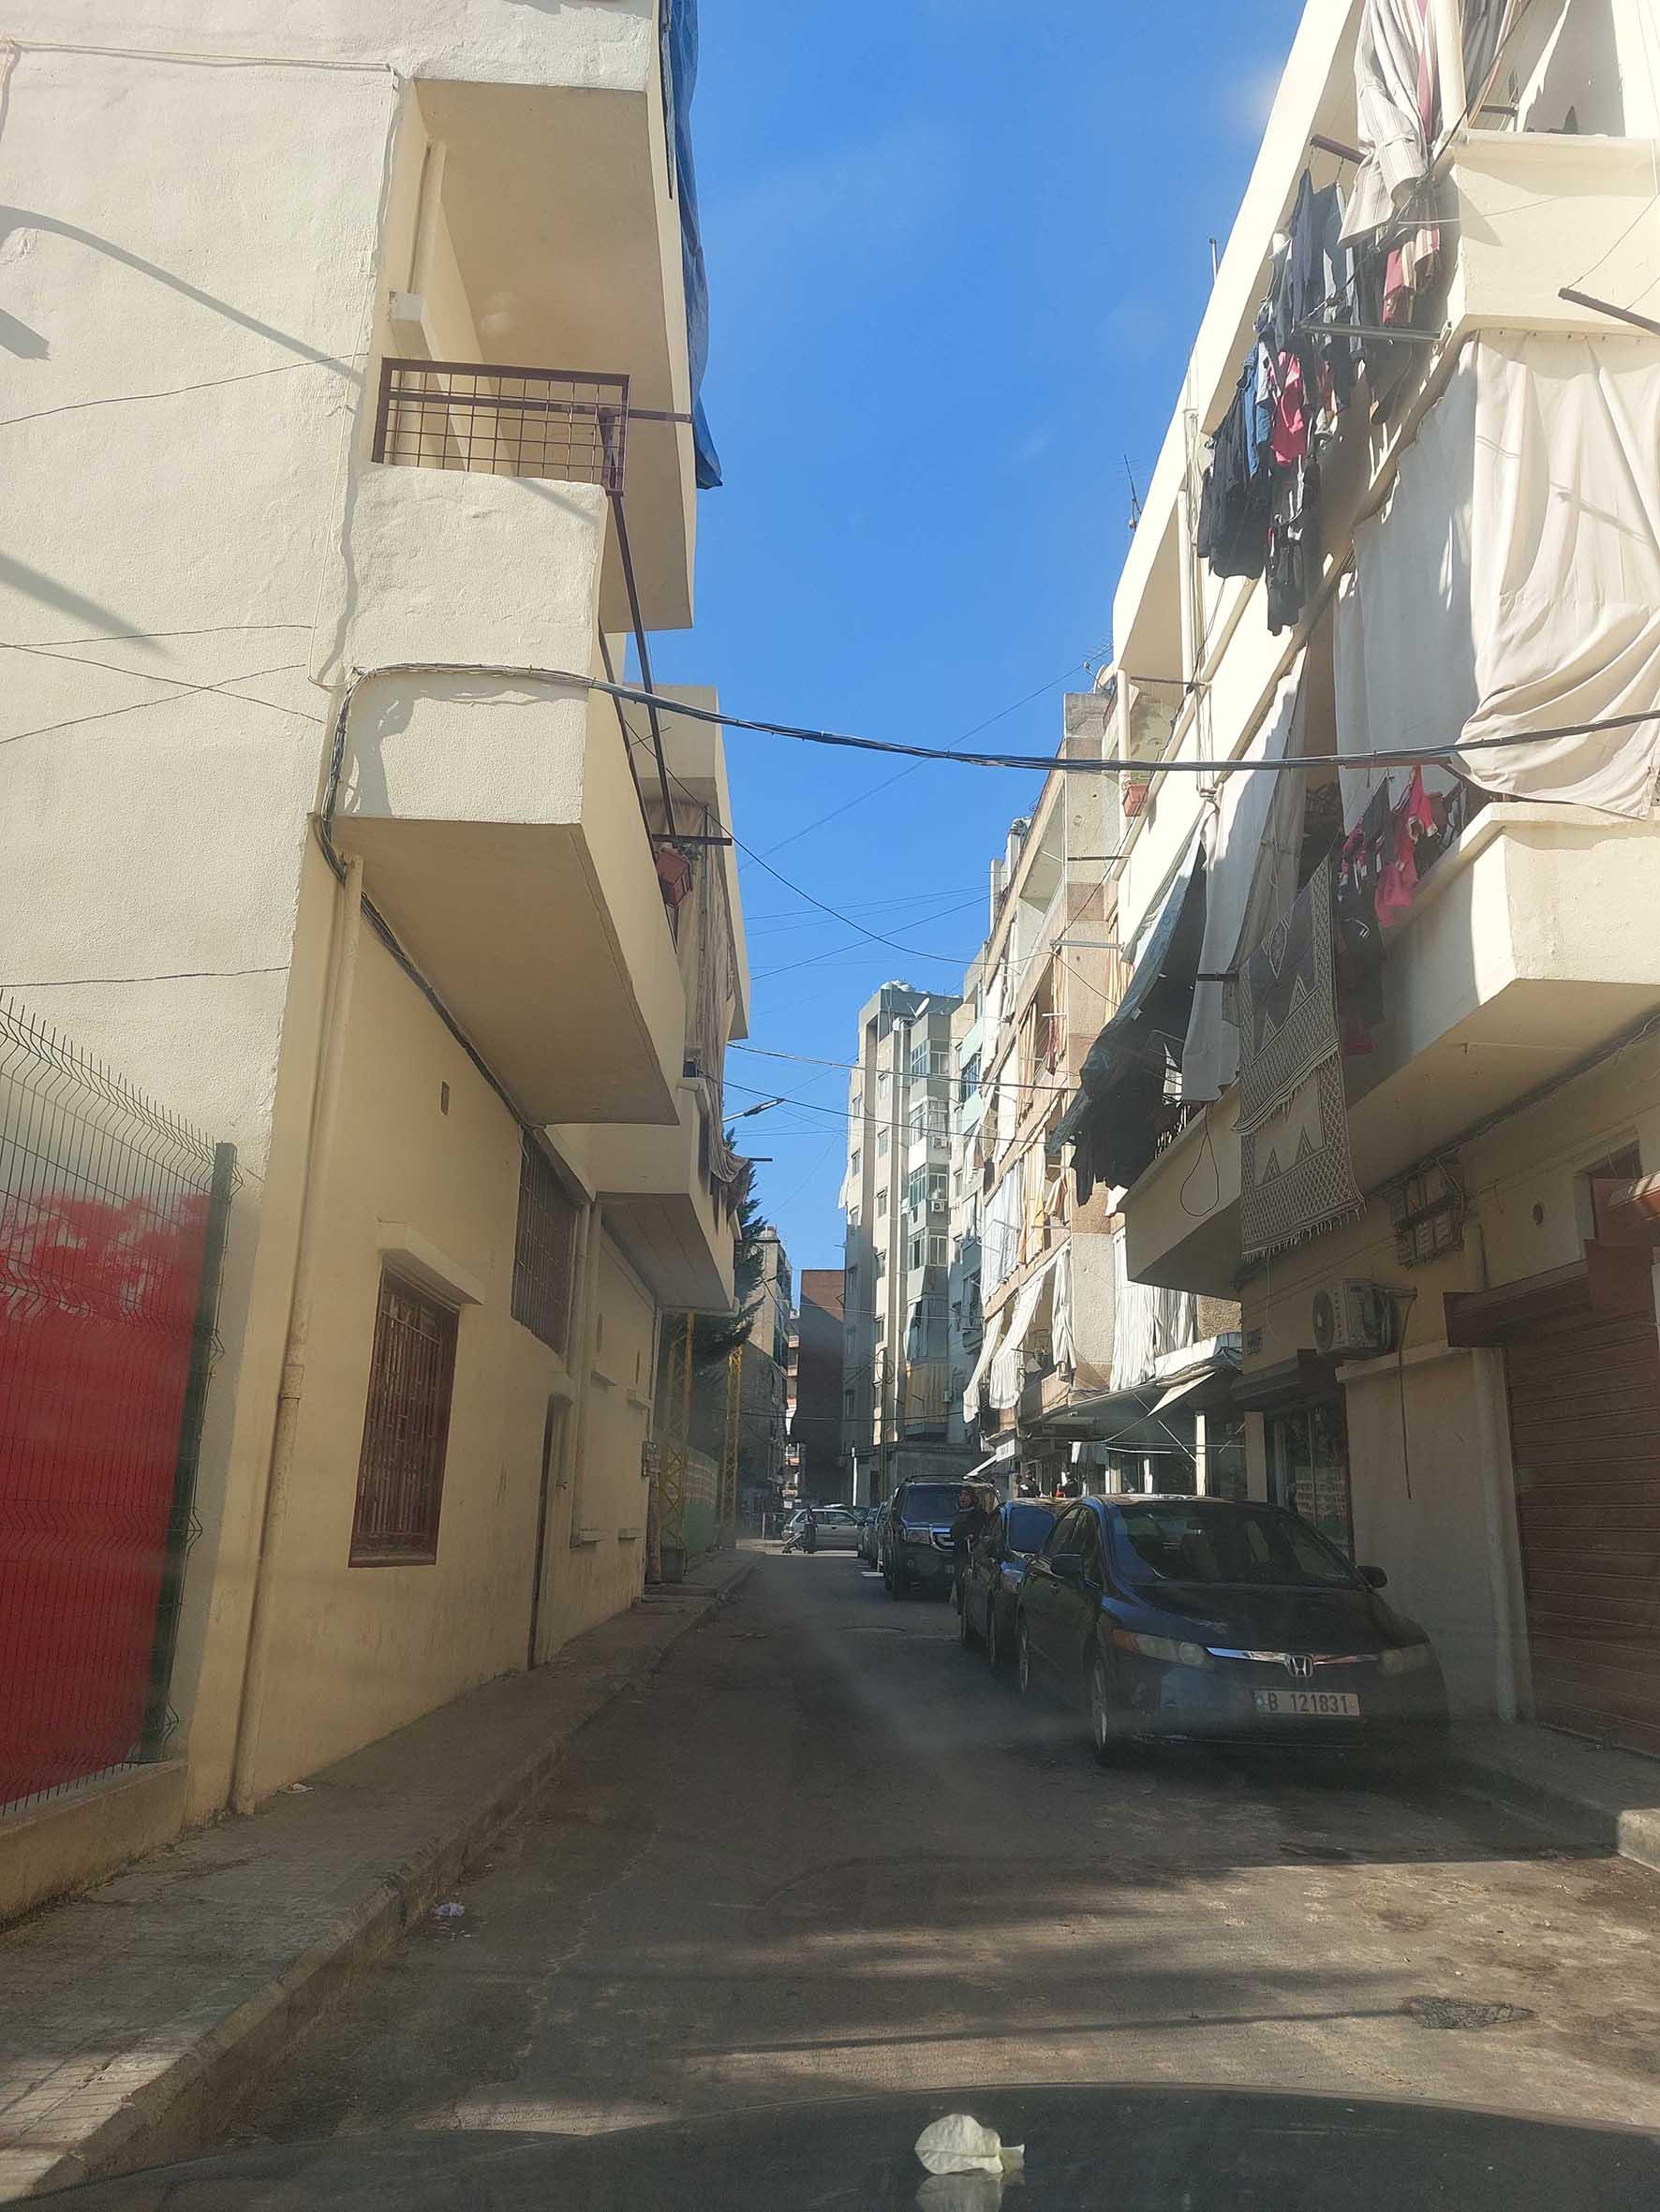
QIP in Maraash – Cable Management
Before After
Building Homes, Communities, and Hope

Slide 22
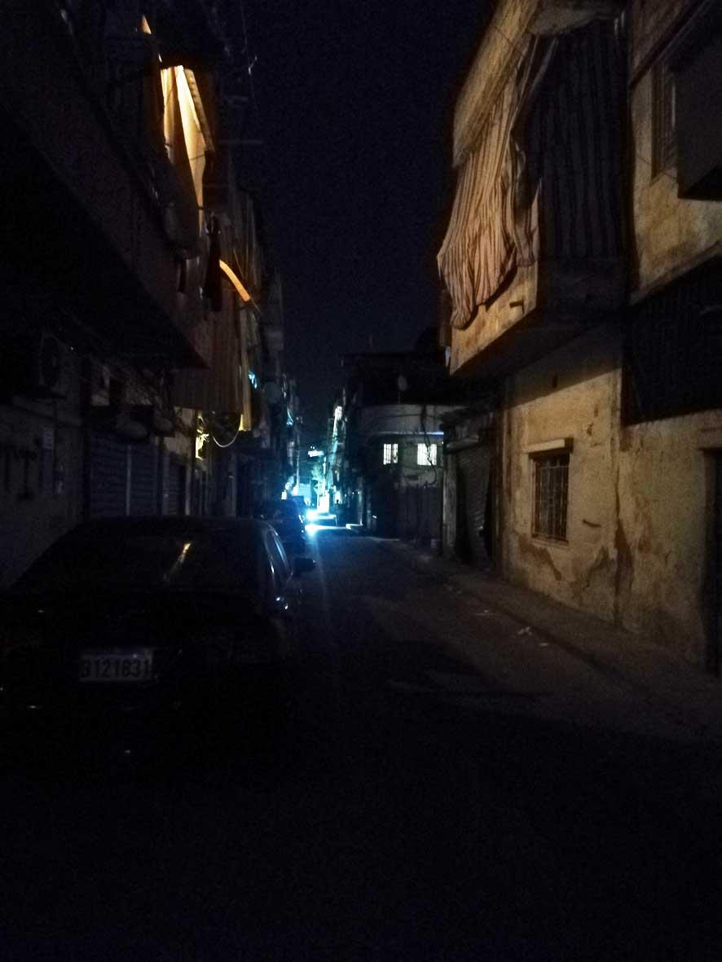
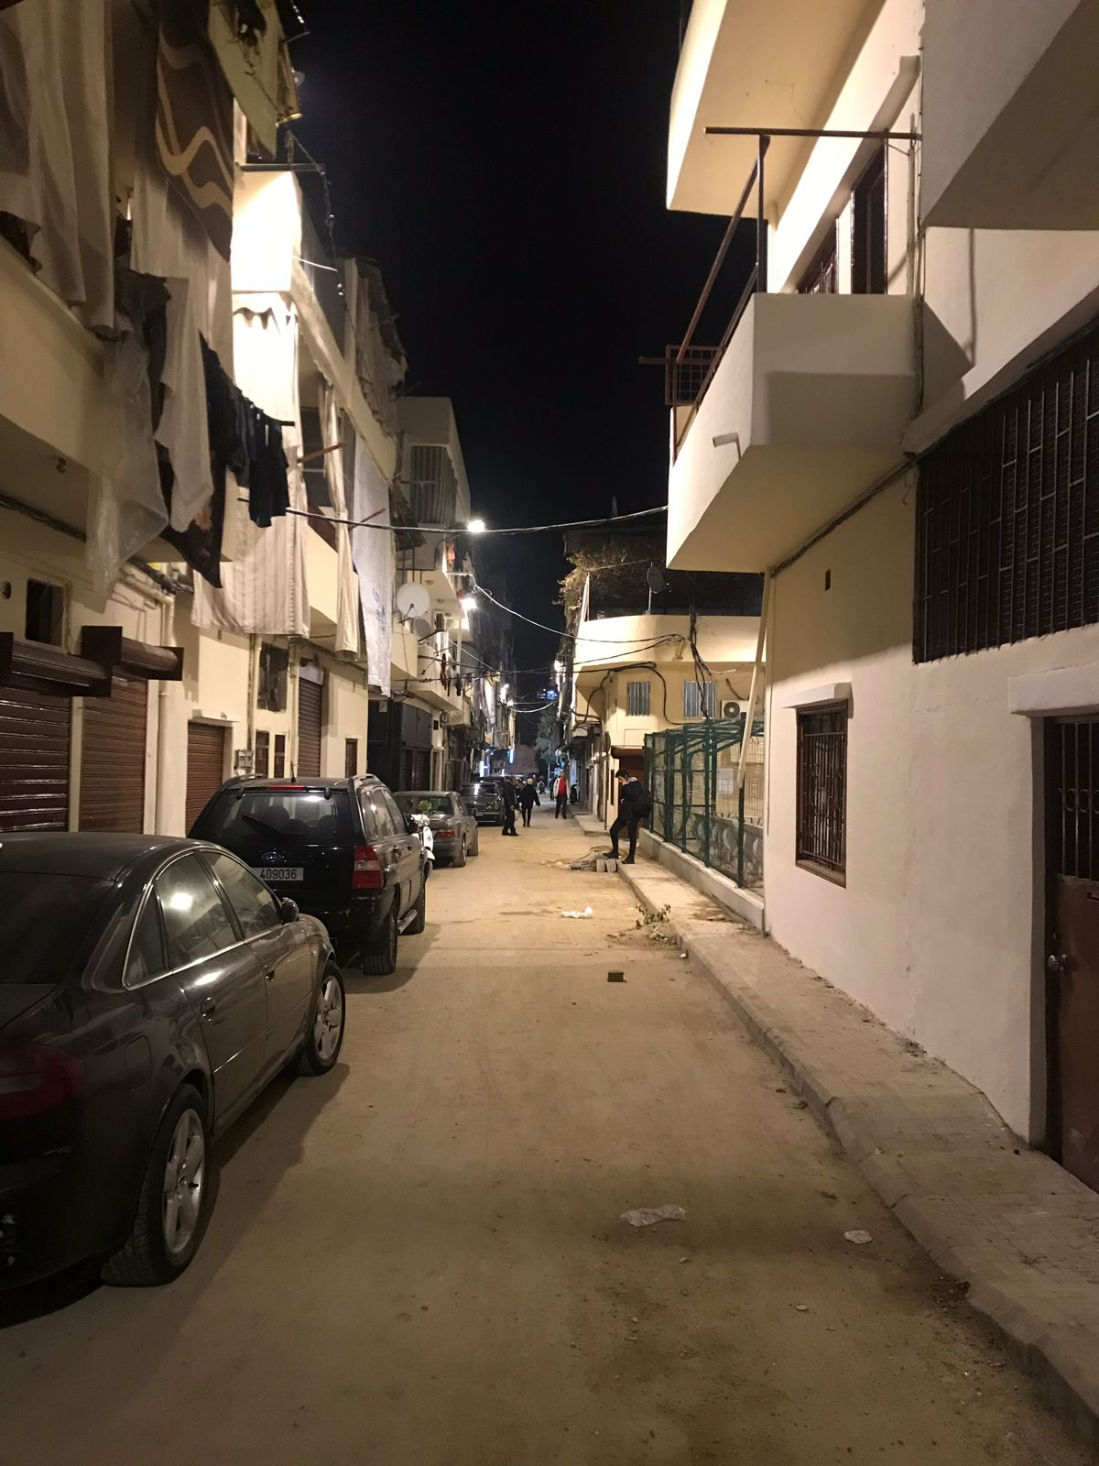
QIP in Maraash – Street Lighting
Before After
Building Homes, Communities, and Hope

Slide 23
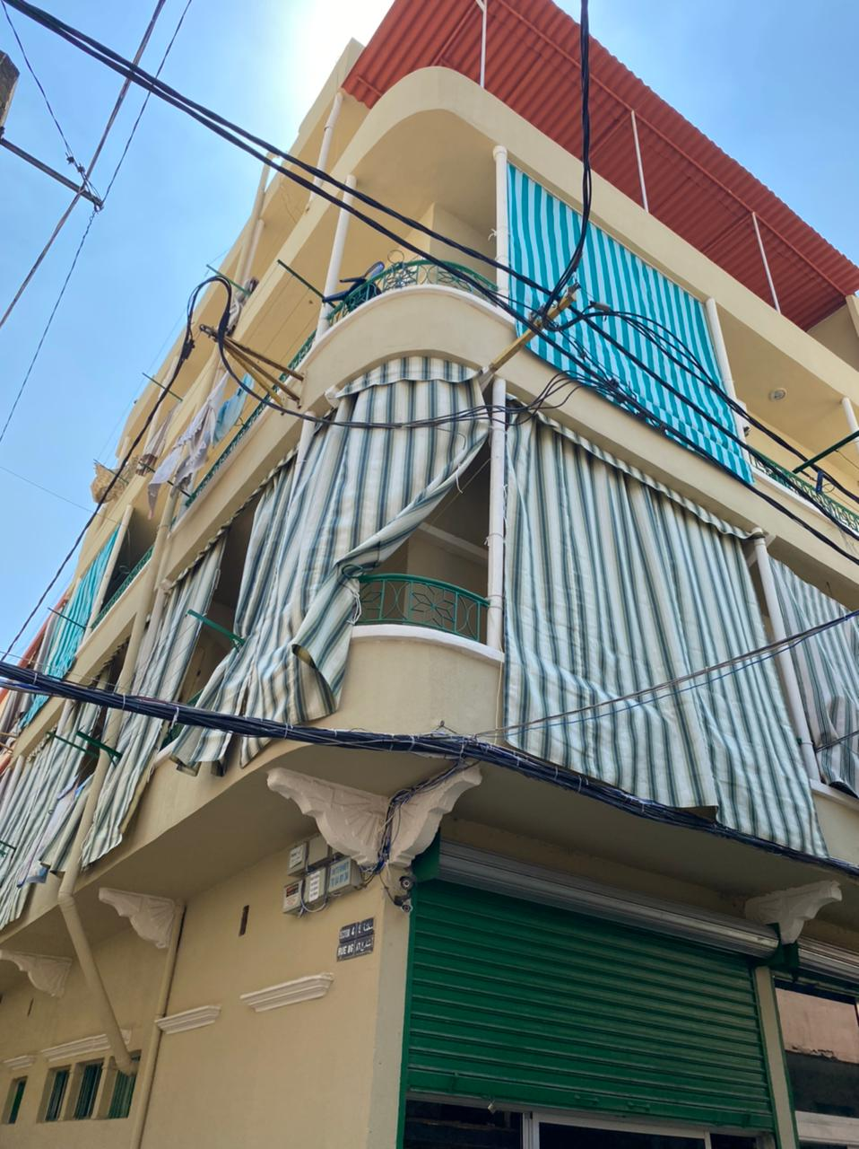
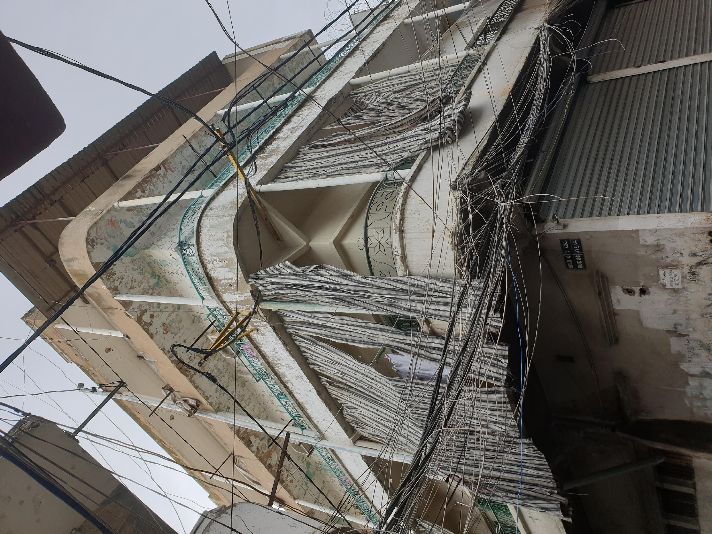
QIP in Maraash – Rehabilitation of Building Facades
Before After
Building Homes, Communities, and Hope

Slide 24
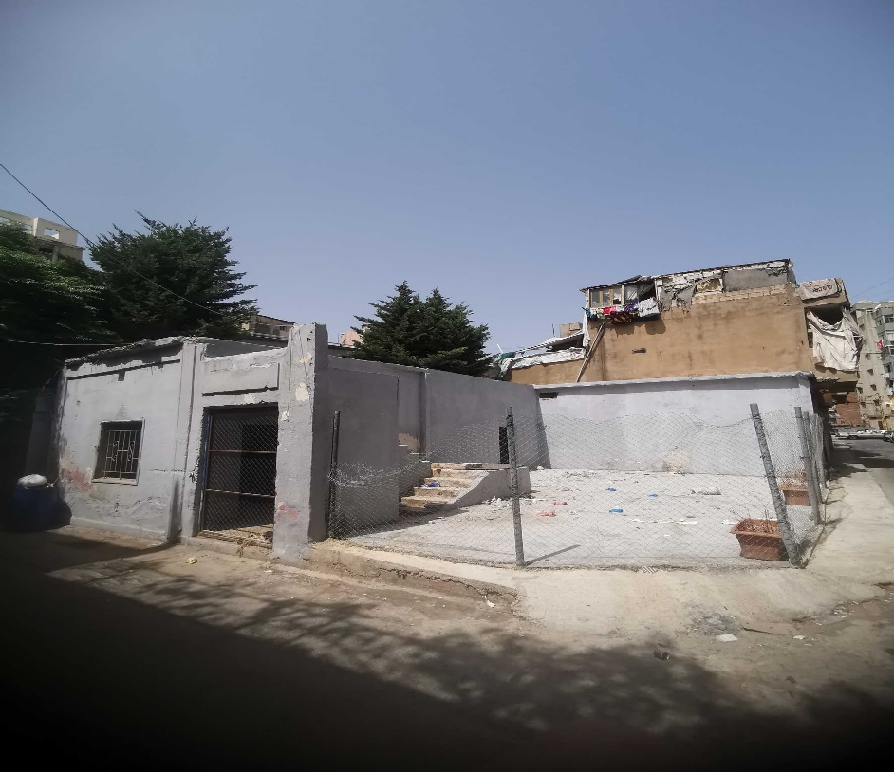
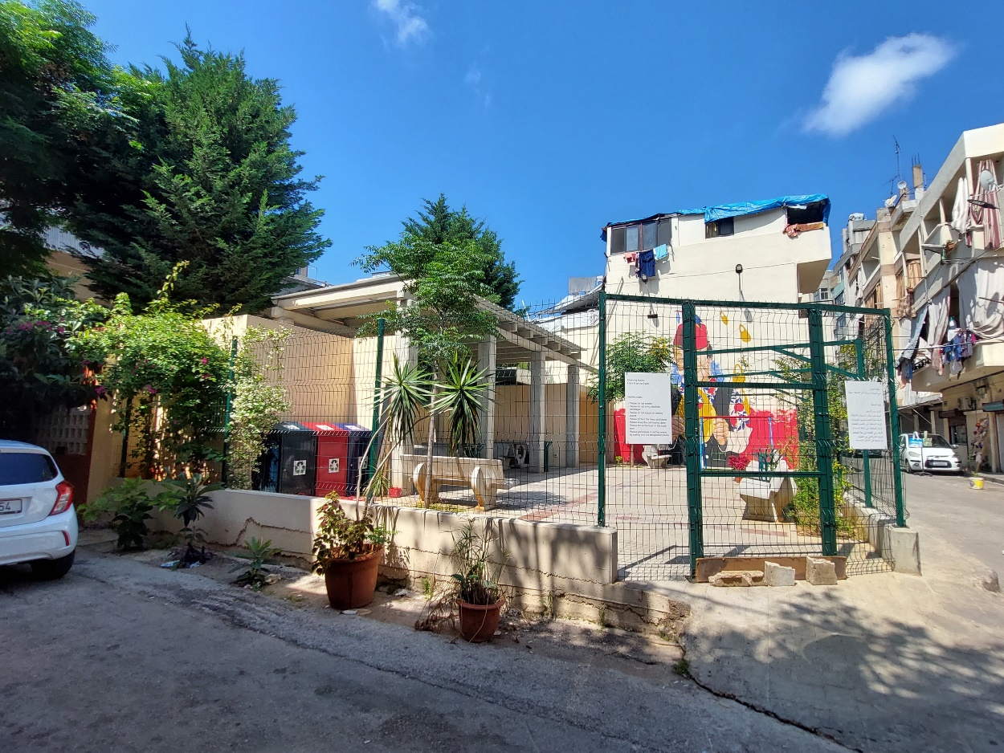
QIP in Maraash – Rehabilitation of an Open Space
“Children lack space to play and to deal with the trauma caused by the `blast. It is great to have a clean and fenced area for the children to meet and play safely.”
Huwayda, Resident in Maraash.
“This project uplifted the neighborhood and brought life to it. It’s wonderful to have a safe space for children to play, and for the elderly to rest and enjoy the sunshine.”
Samira, Shop owner in Maraash.
“I live in an apartment at the ground level, with no balconies. Some days, I don’t even see the sun in my place. It is good to have a place just to sit in and enjoy sunrays”.
Marie, Resident in Maraash.
Building Homes, Communities, and Hope

Slide 25
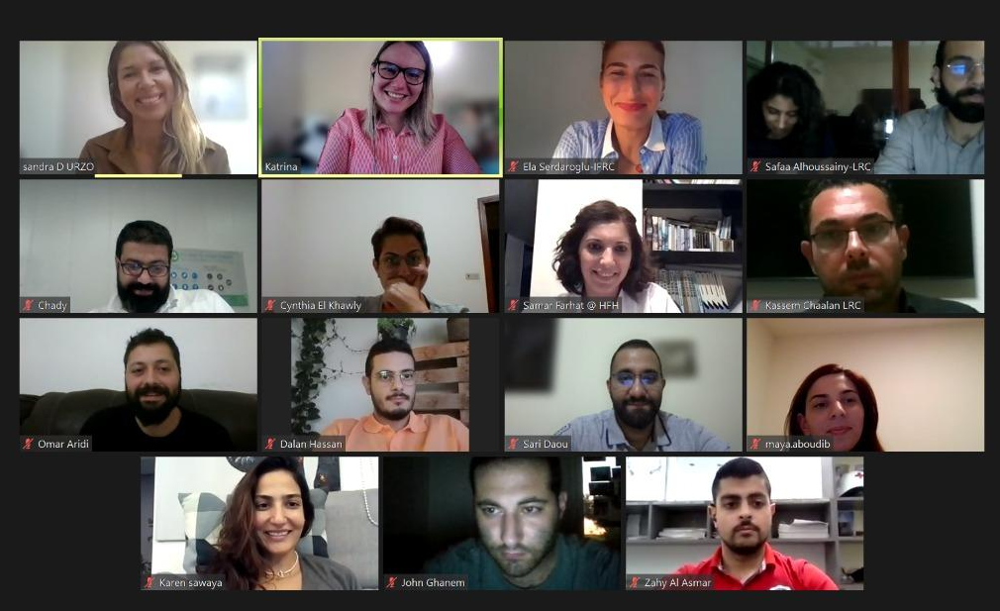
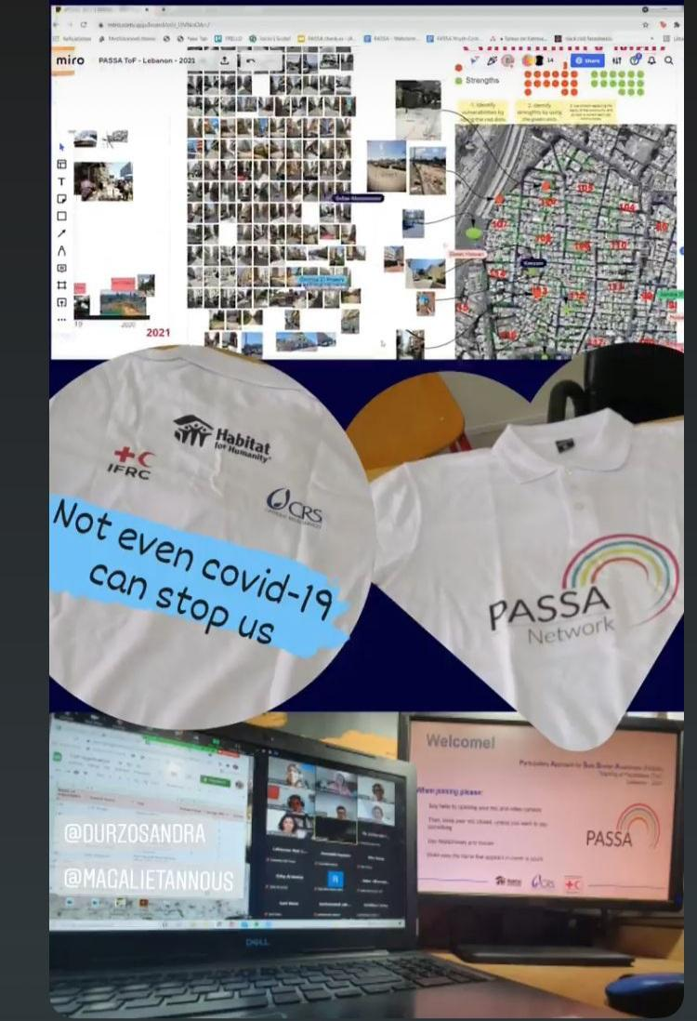
Urban Intervention – Participatory Approach for Safe Shelter & Settlements Awareness (PASSA)
PASSA is a participatory tool aimed at raising the understanding of safer shelter practices within a community.
Main Objectives of PASSA
- Develop local capacities to reduce the risks associated with shelter and neighborhoods.
- Raise awareness of the everyday vulnerable to the everyday risks related to the built environment.
- Enable communities to identify risks and solutions through Community Action Plans.
Building Homes, Communities, and Hope

Slide 26
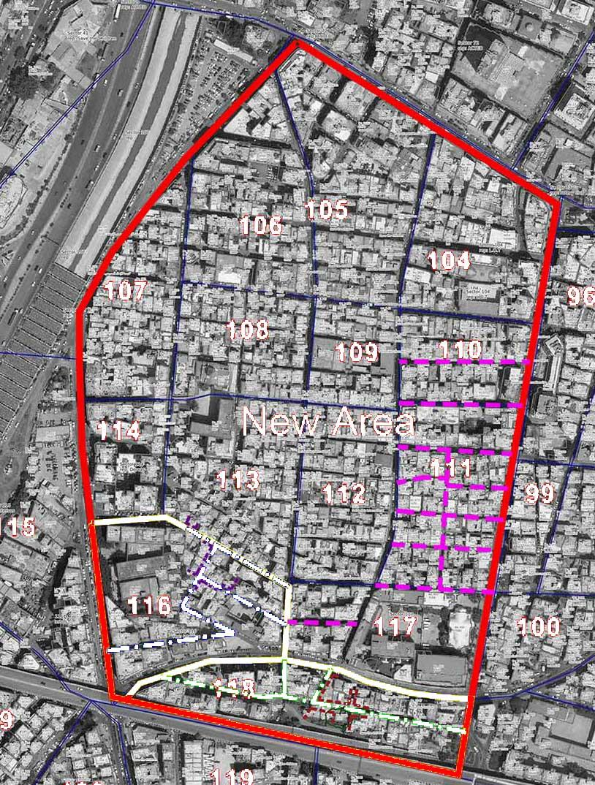
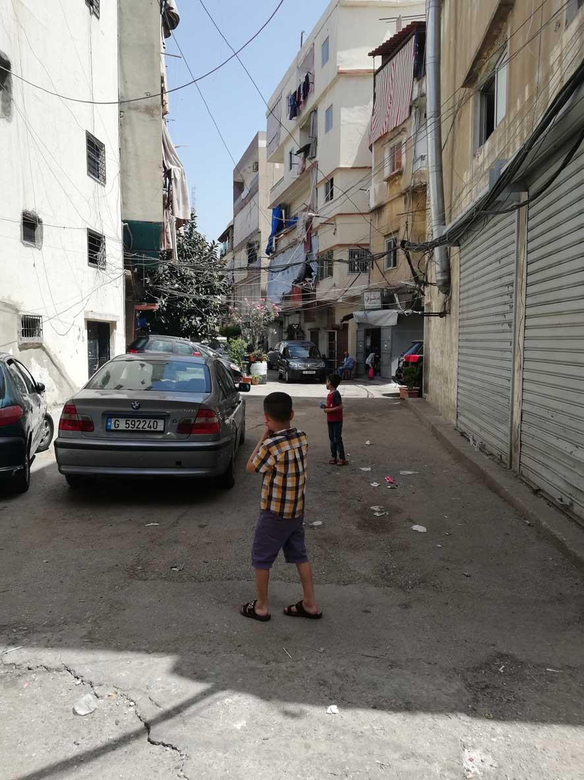
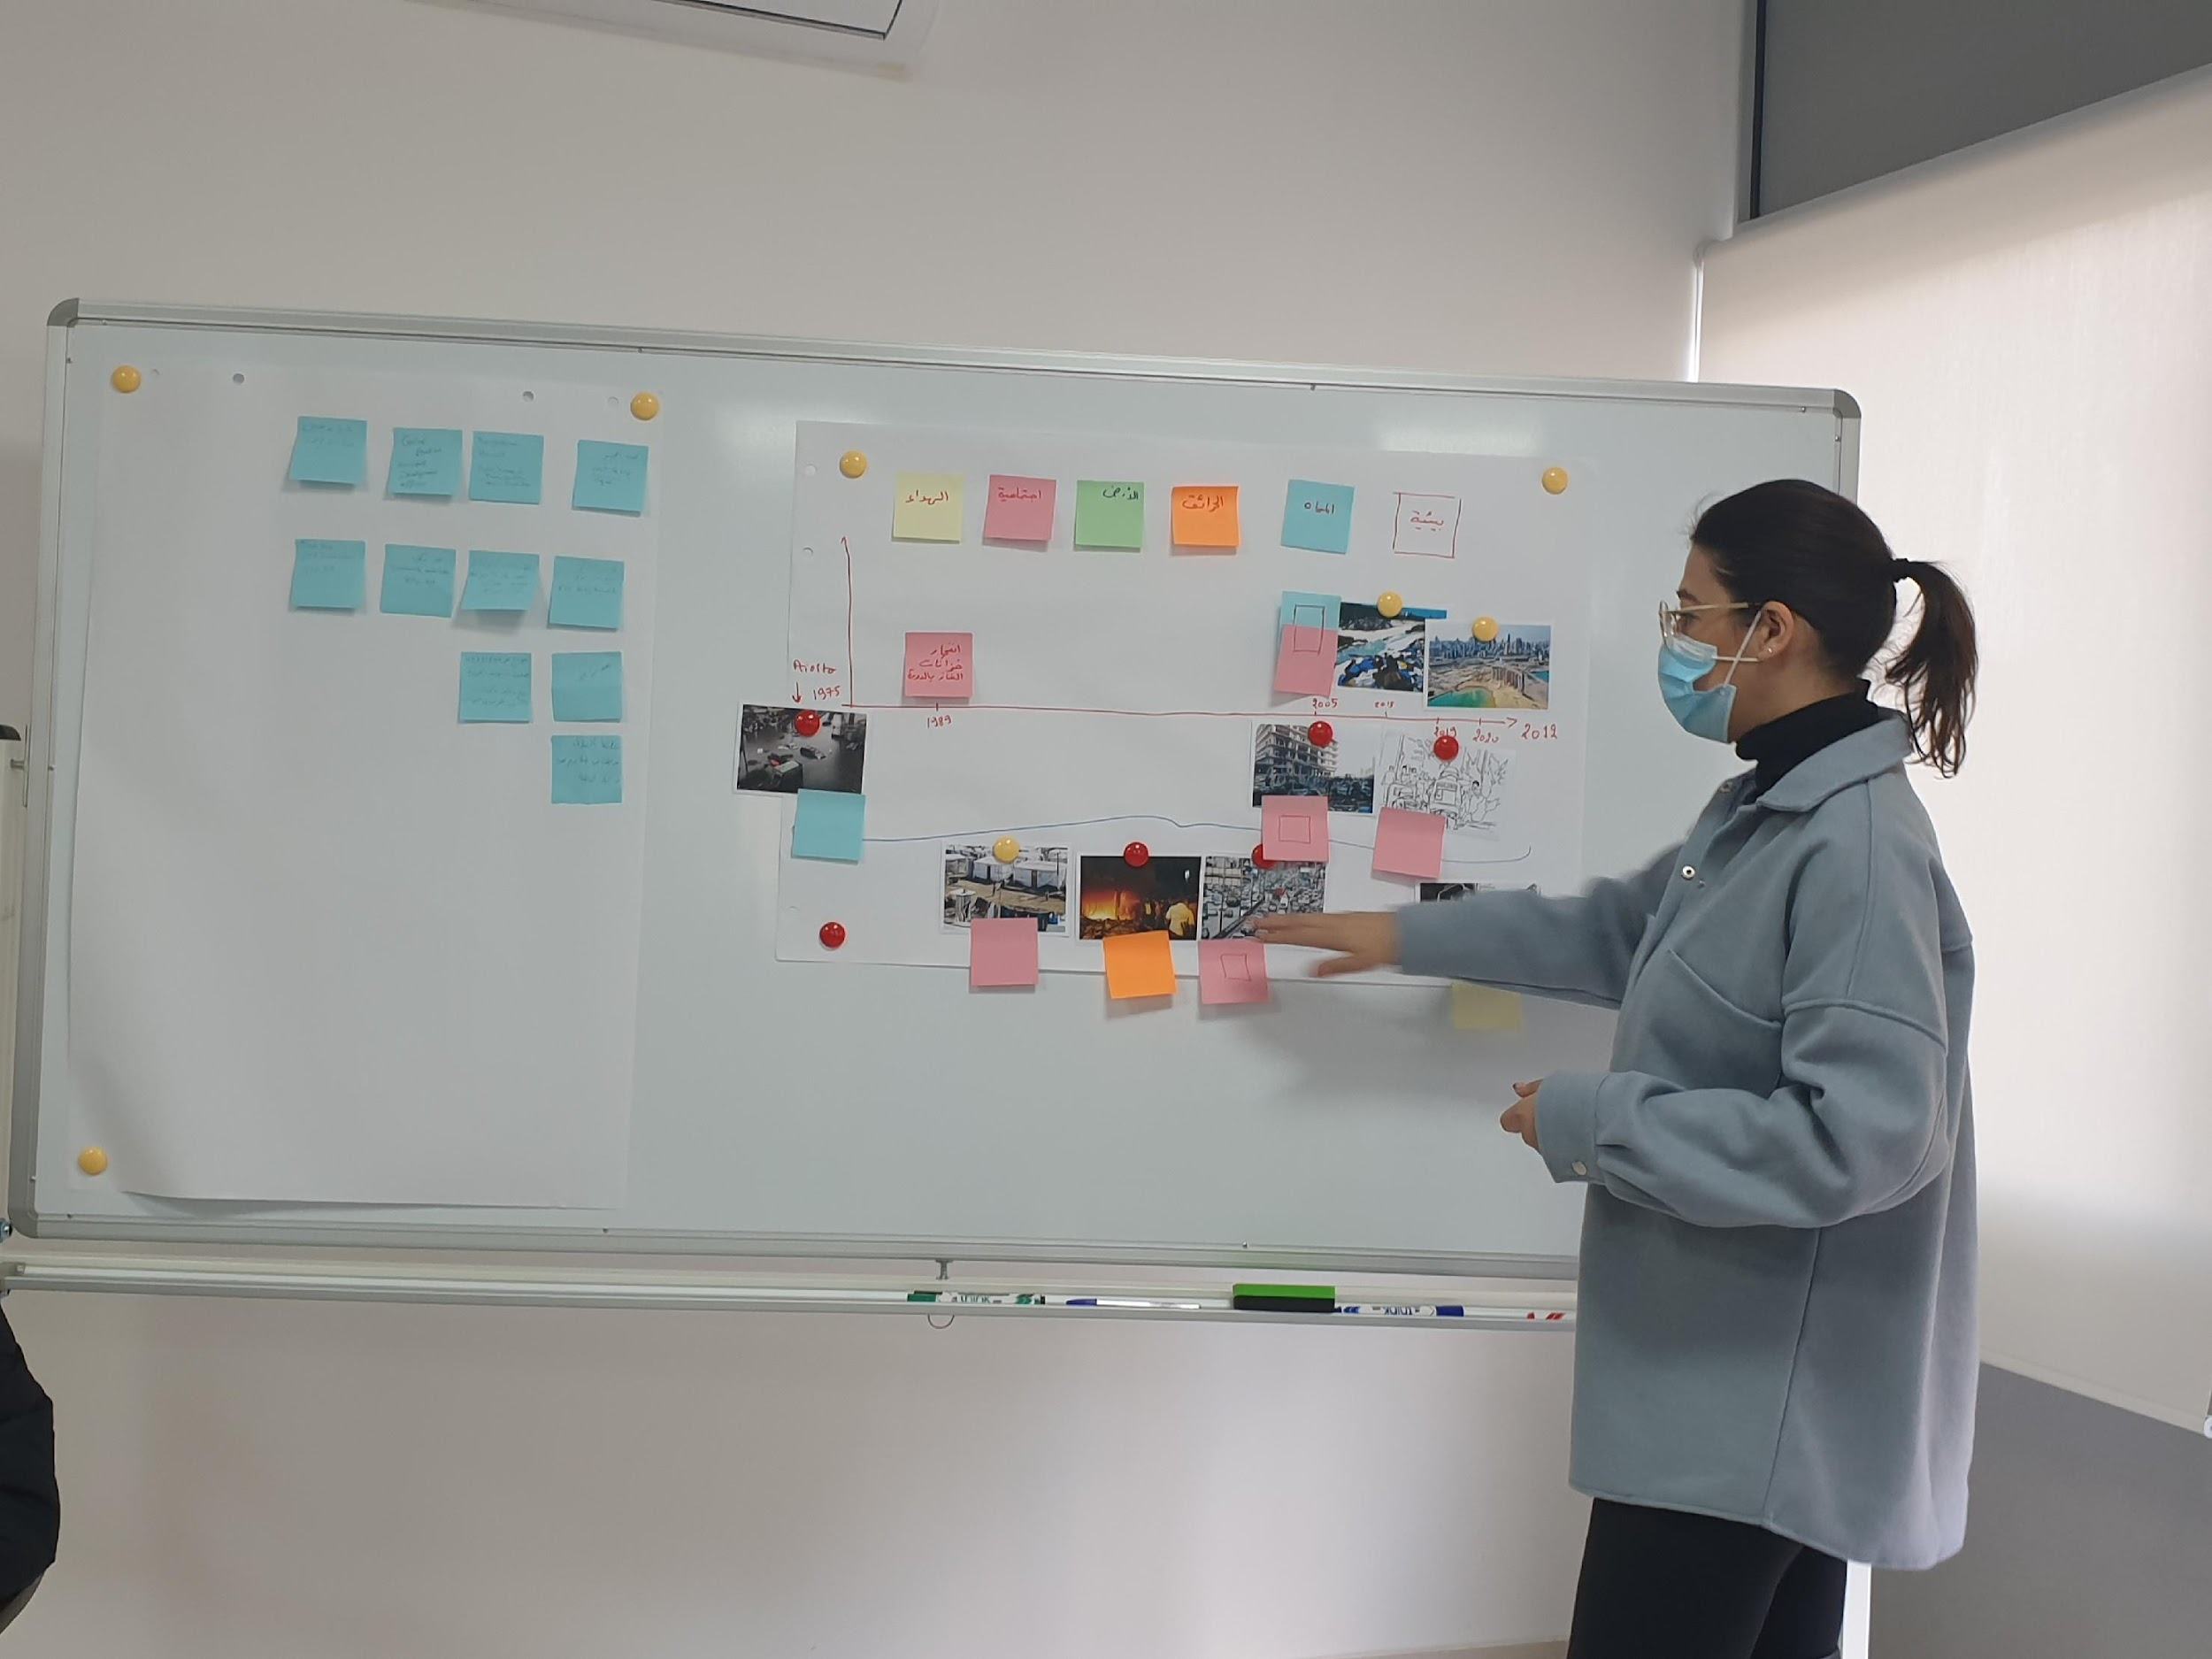
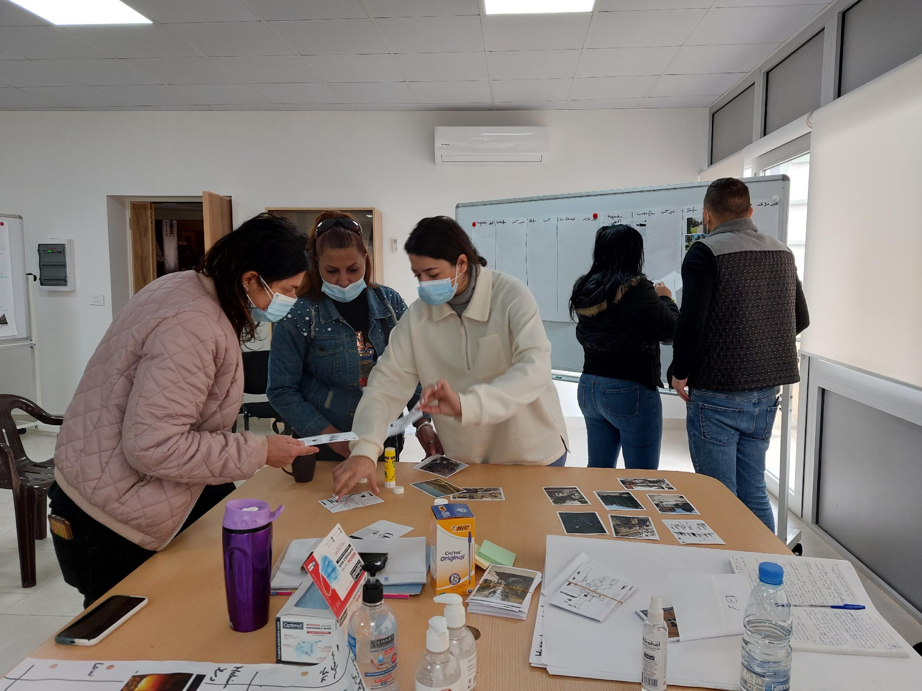
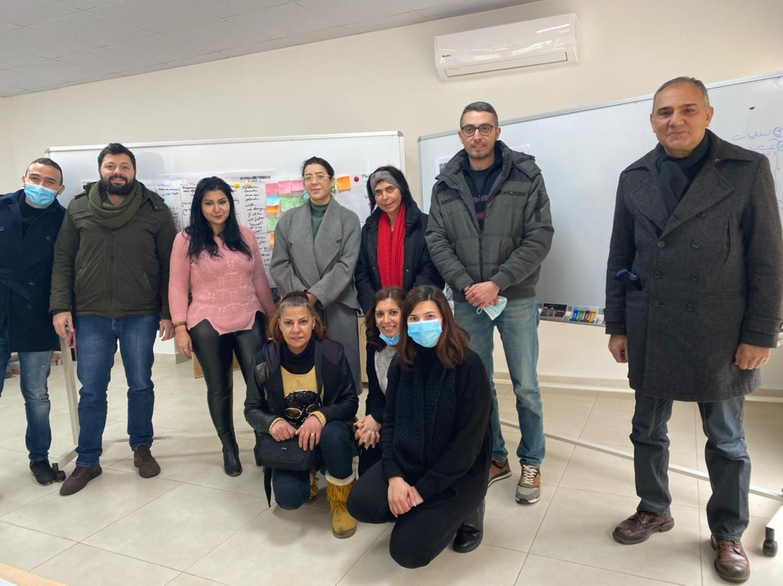
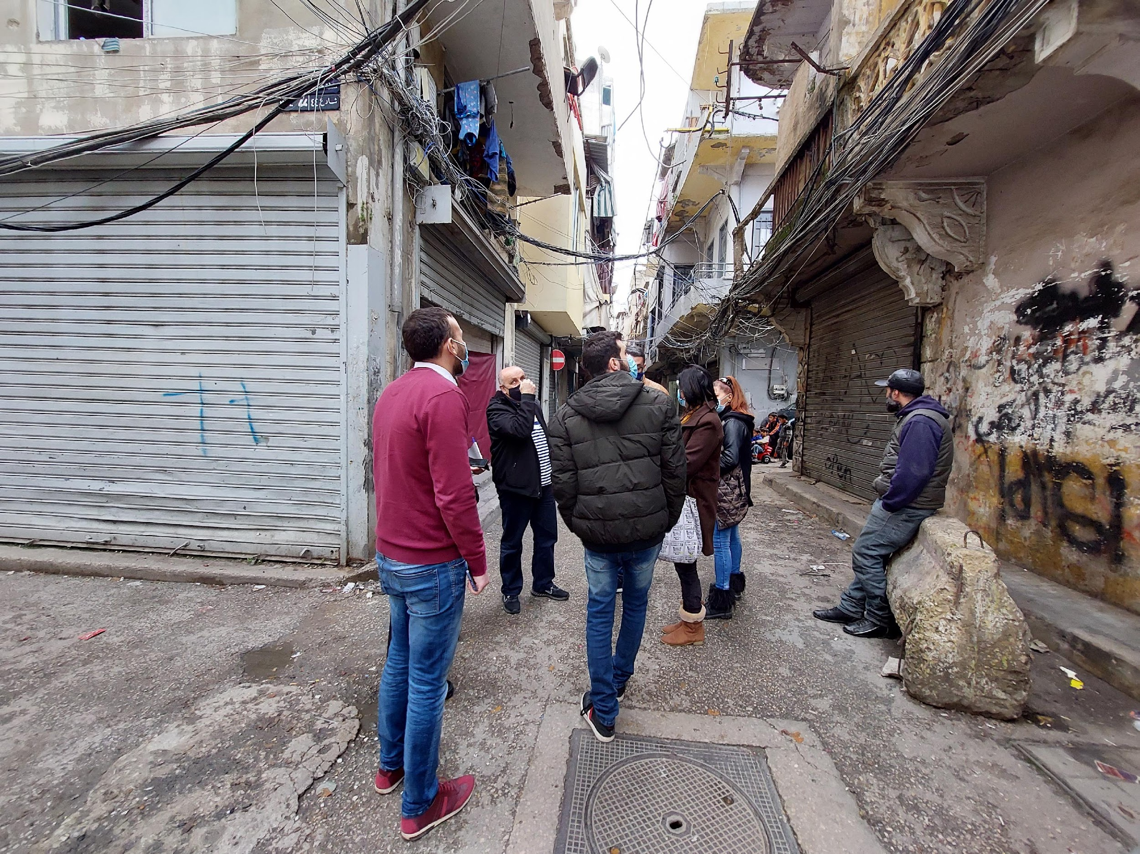
Urban Intervention – Phase III - PASSA in Maraash
Priorities Identified by the PASSA Group
- Entanglement of electric cables and lack of street lighting
- Structural conditions of buildings
- Solid waste management
Successes
High-level coordination with local authorities
Challenges
A limited number of participants
Some participants not fully engaged
PASSA Roll-out
in Maraash Neighborhood
Building Homes, Communities, and Hope

Slide 27
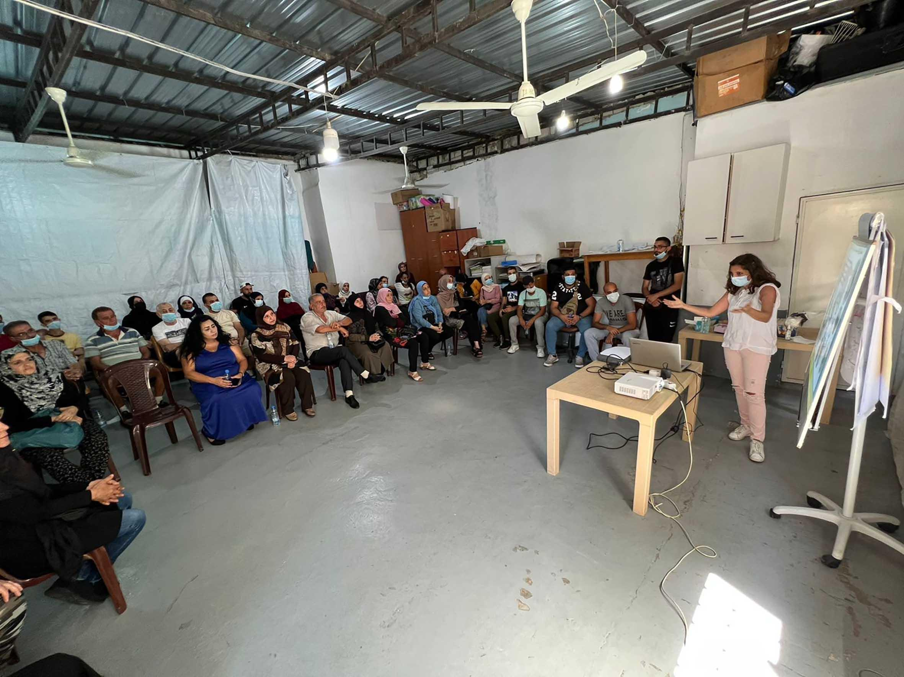
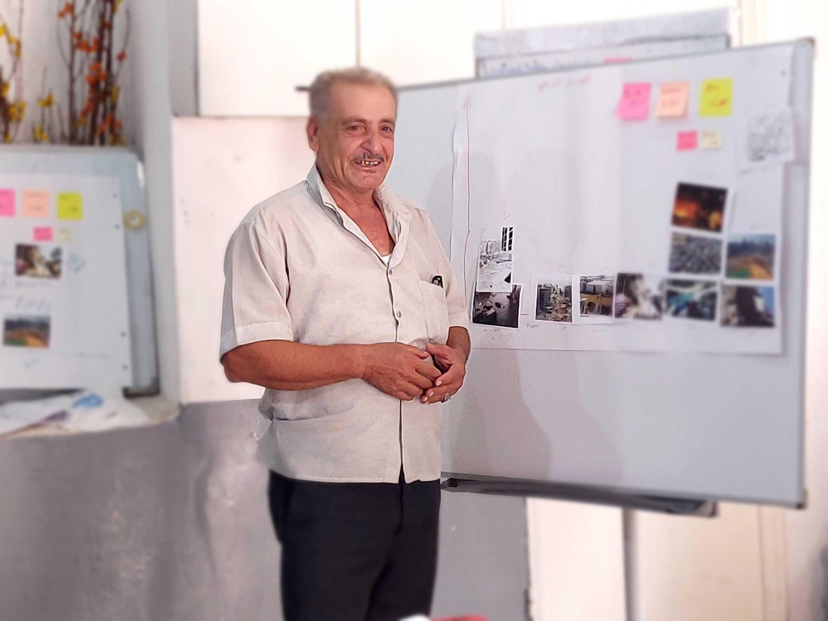
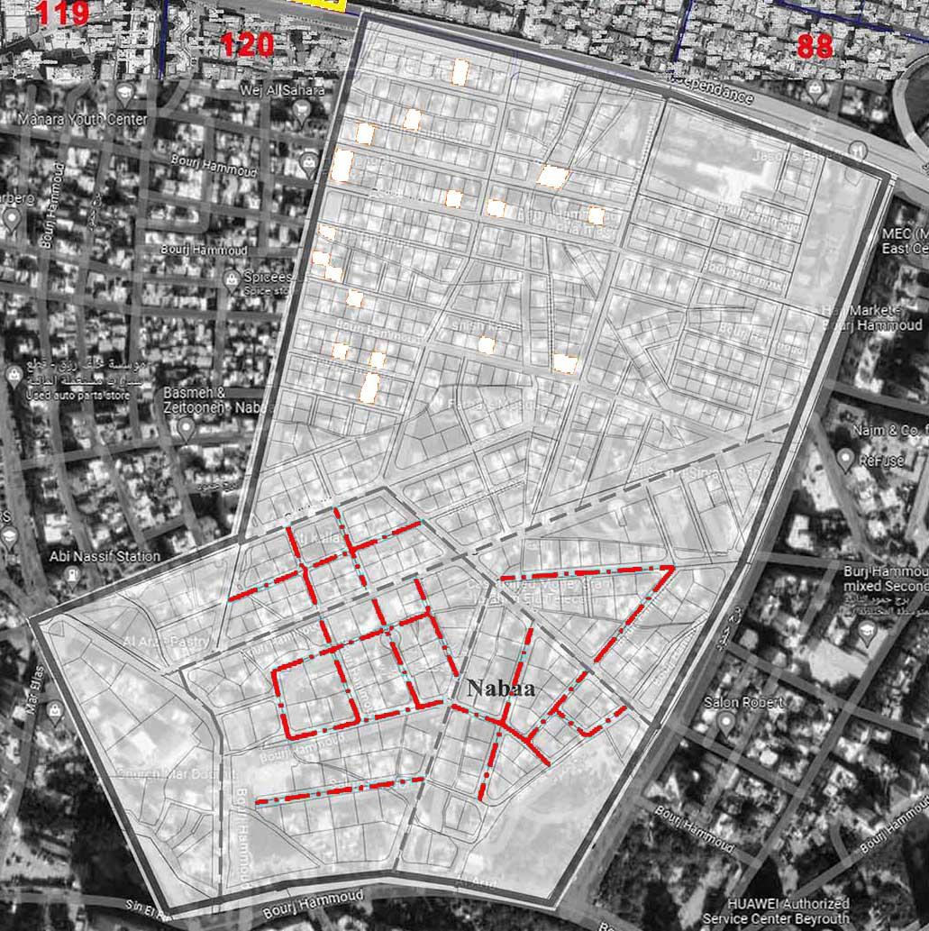
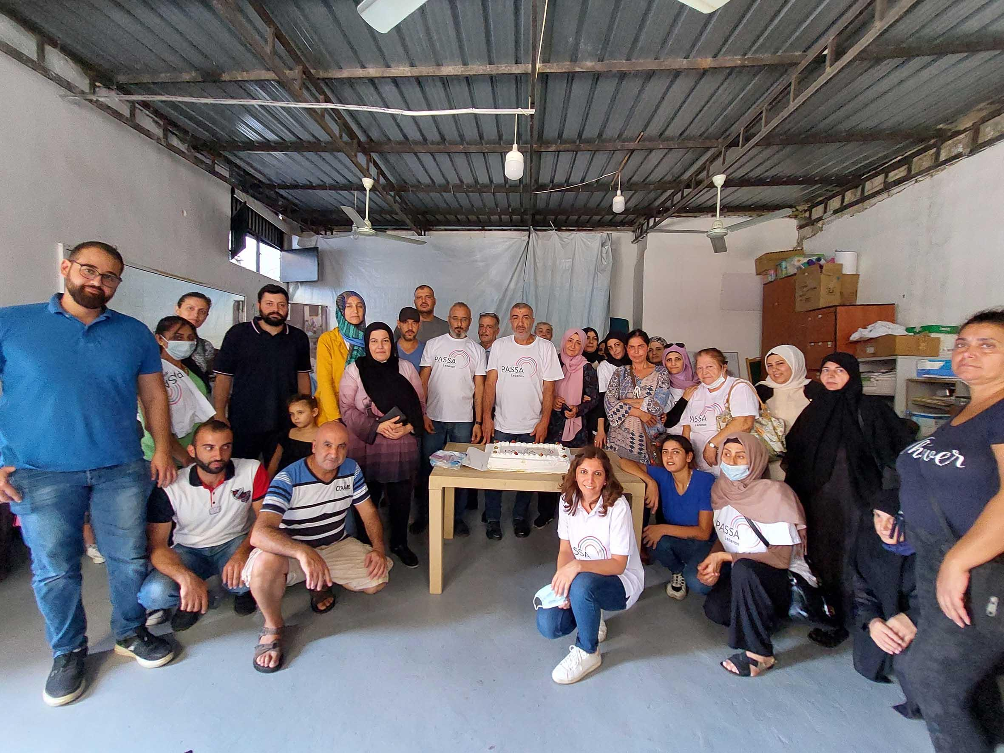
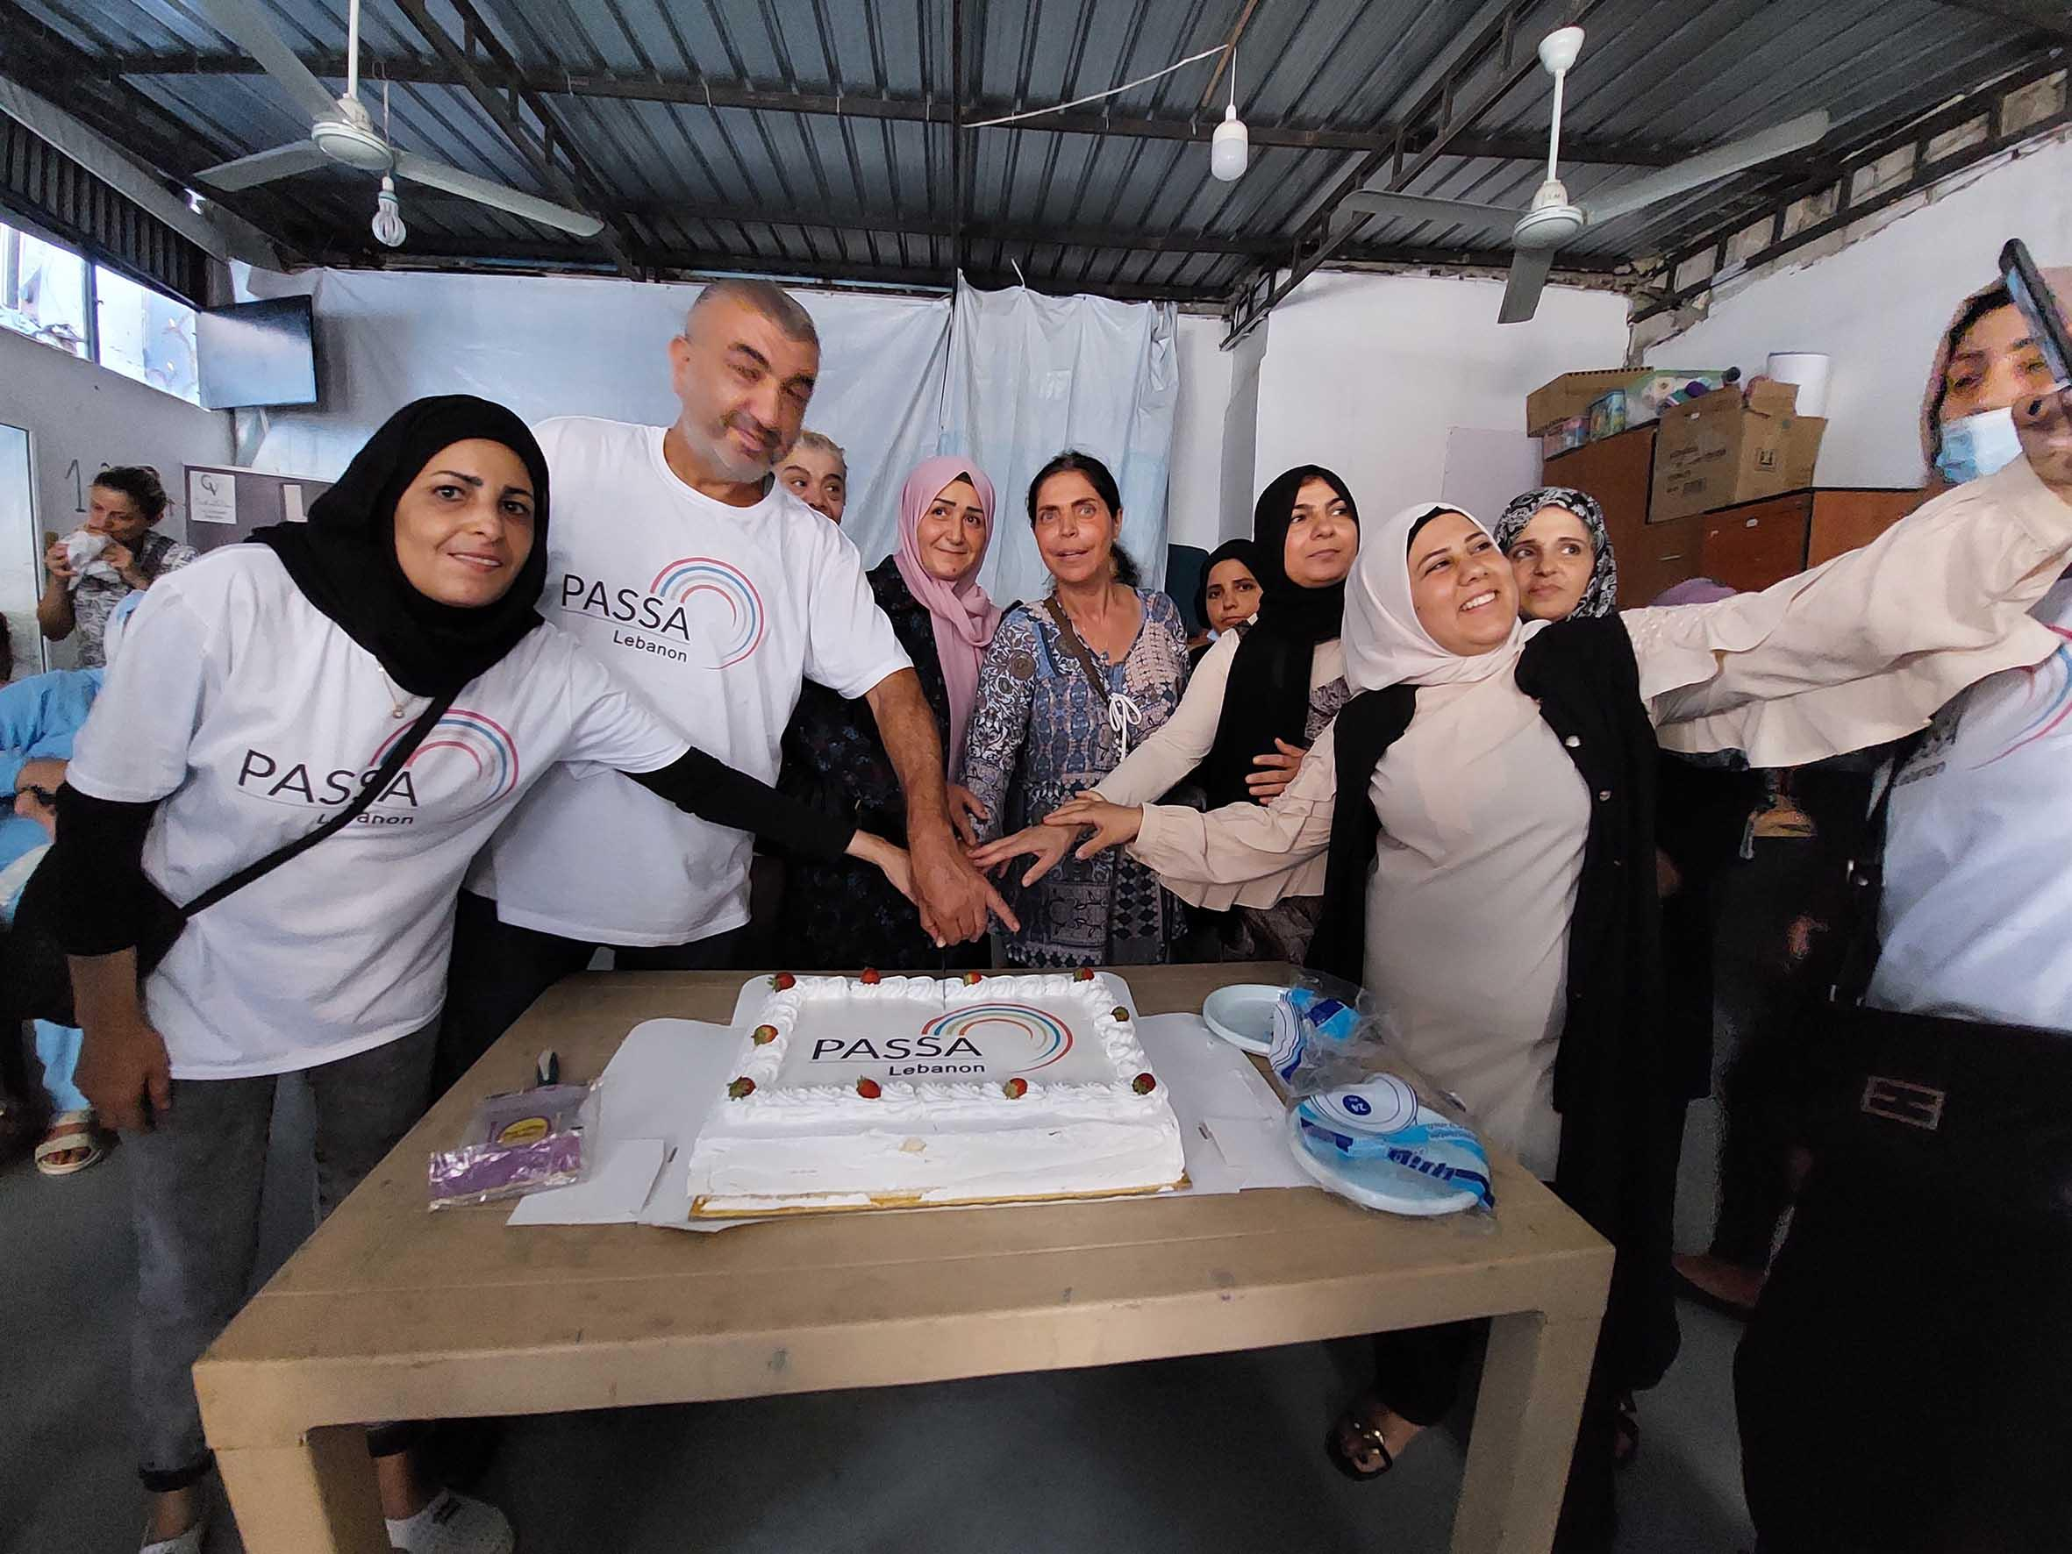
Urban Intervention – Phase IV - PASSA in Nabaa
Priorities Identified by the PASSA Group
- Entanglement of electric cables
- Maintenance of sewage network (water channels, ditches…)
- Solid waste management
Successes
- Increased level of participation from the local community
- Community appreciation of the awareness raised and people’s voices being heard
- Interest from other organizations to intervene
“ I now cross the street, more aware and noticing various details, problems, and risks within our neighborhood, and I think about what can be done to improve it”. A female resident, and member of the PASSA Group in Nabaa.
Building Homes, Communities, and Hope

Slide 28


THANK YOU
Samar Farhat - sfarhat@habitat.org
Maya Abou Dib - maya.aboudib@crs.org

Slide 29
Building resilience for emerging disasters

Slide 30
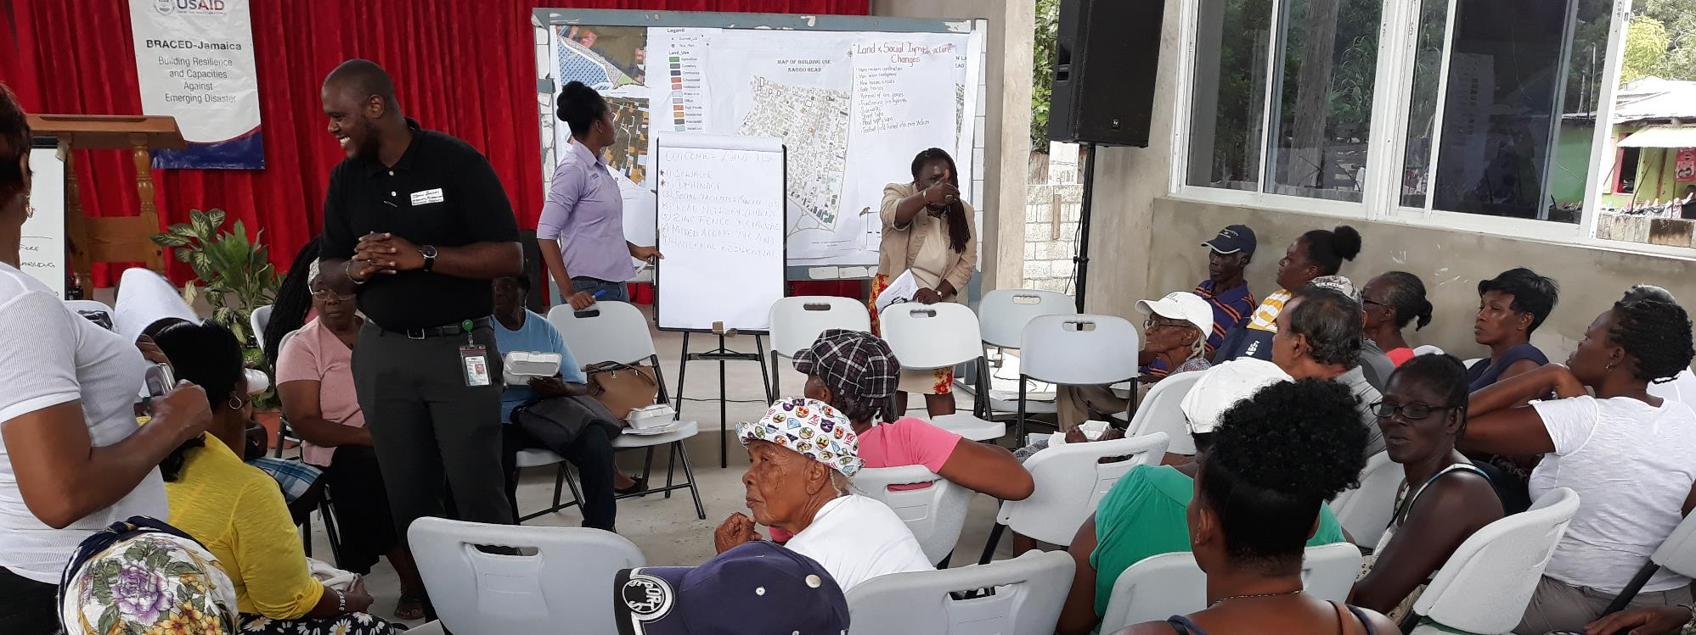
Urban DRR Program in Jamaica 2015-2019
Habitat for Humanity International
USWG webinar September 2024
Notes:
Could you please prepare a presentation of up to 10 minutes (10 slides), focusing on the challenges, lessons, and best practices of working in urban environments? Please prioritize graphics over text and share it with us by the 12th of September.

Slide 31
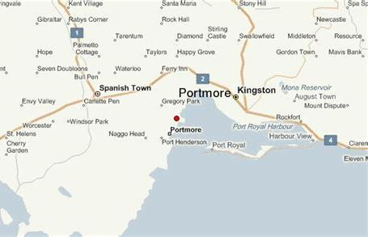
Program description
Context, outputs

Slide 32
Context – Portmore, Jamaica
Uncontrolled urban expansion > informal settlements with low-quality housing, inadequate access to water and sanitation, weak community structures.
Flooding
Storm surges
Hurricanes
Earthquakes
HAZARDS
VULNERABILITY
Low socio-economic levels (education, unemployment) > exclusion, poverty, violence.
RISK
EXPOSURE
2nd largest city, coastal. Most densely populated areas are located on low-lying reclaimed lands.

Slide 33
Program Outputs
Community mapping and assessment
Increased housing physical resilience
Introduction of basic services
Promotion of shelter-livelihoods linkages
Emergency preparedness training
Neighborhood redevelopment technical assistance
Support for land regularization and secure tenure
Notes:
Program phase 1: The outputs and activities of the initial proposal were:
Community Mapping through different participatory and digital methodologies to analyze vulnerabilities and capacities to disasters, and identify existing and missing urban basic services.
Promote housing physical resilience: training of residents in construction trades and subsequent recruitment, retrofitting of demonstration housing, creation of a resilient housing manual adapted to the context, raising awareness of safe housing, promotion of self-retrofitting.
Improve access to WASH basic services. Raise WASH awareness, improve access to safe water, build demonstrative disaster resilient sanitation solutions, and set up a garbage collection system.
Bolster community preparedness for emergencies through increased awareness , courses, and the development of community response plans.
Implement micro-projects that enhance community resilience, to be decided by the communities.
Program phase 2:The intervention uncovered a critical need to address secure land tenure as a key factor exacerbating disaster vulnerability – as insecure tenure discourages homeowners from investing in their properties. Recognizing the promising potential of this intervention, the donor extended their support with an additional funding tranche, centered on embedding secure tenure into target communities together with settlement physical planning (a comprehensive community redevelopment plans).
Program phase 3: Acknowledging the impact of this transformative initiative, the donor offered a third tranche aimed at expanding the scope and impact by establishing an efficient "fast-track" methodology to accelerate national land tenure regulation initiatives.
Small thing: I often hear the term “Community Mapping” – Would you like to use this instead?
Design and implement?
Increased awareness?

Slide 34
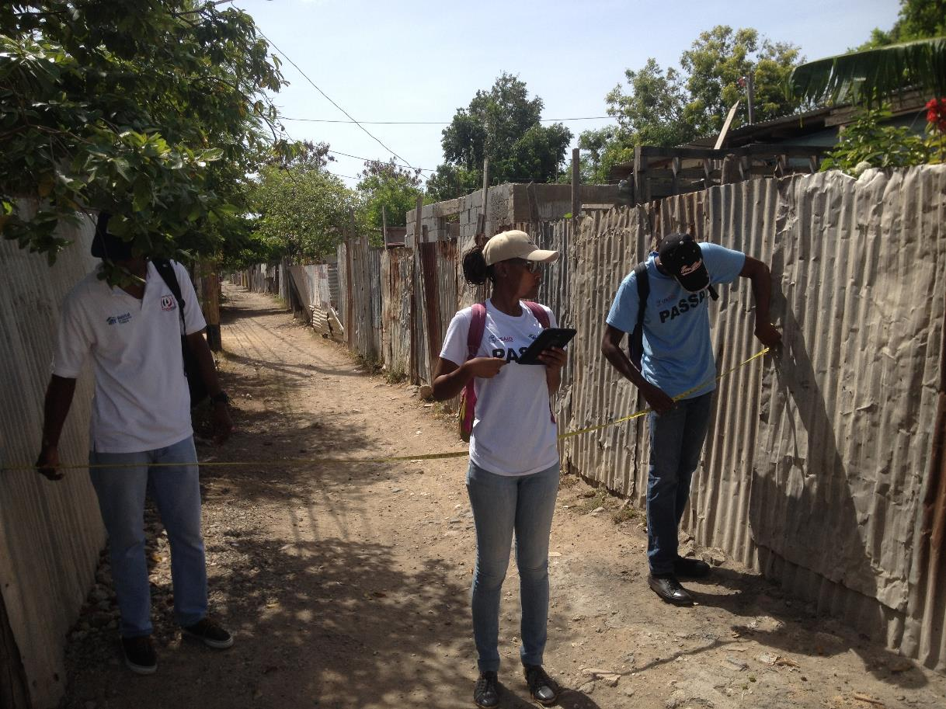

Slide 35
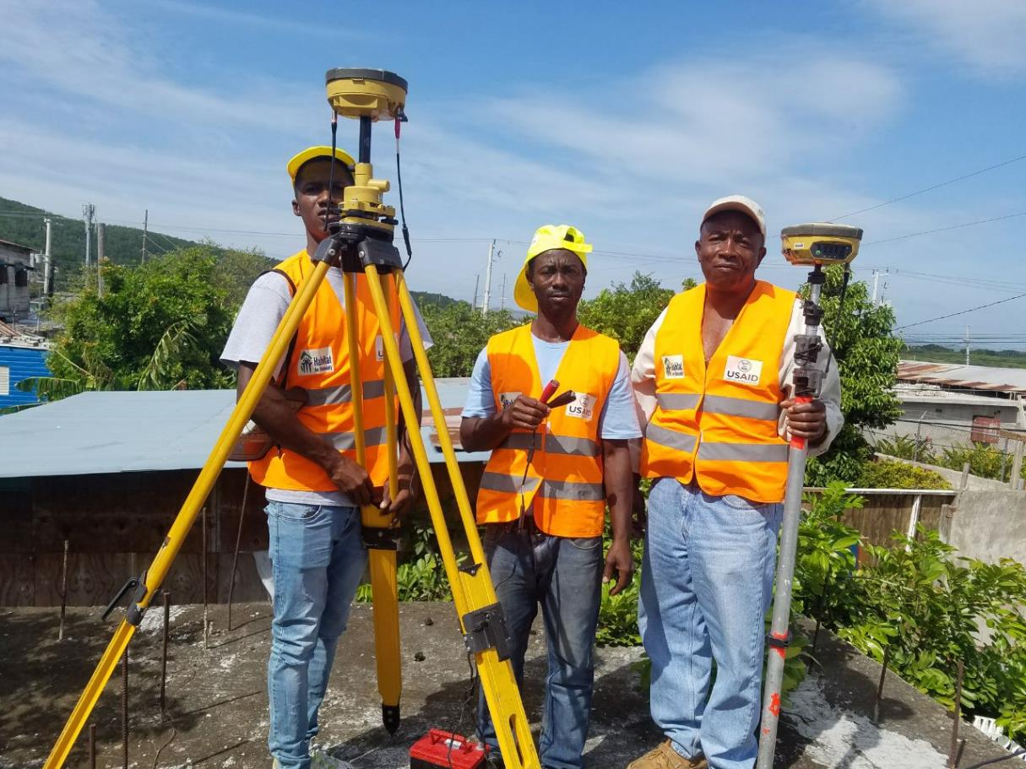

Slide 36
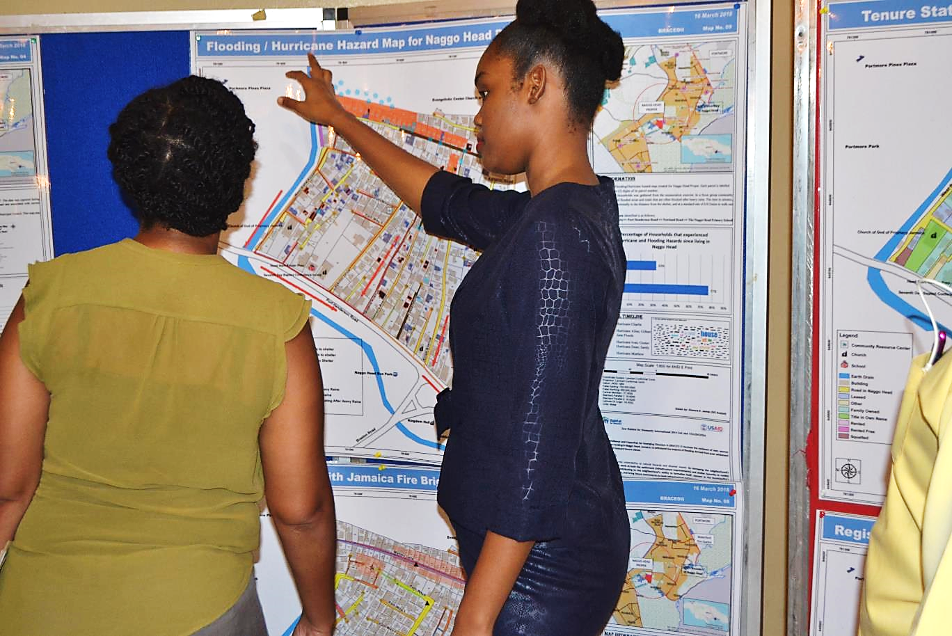

Slide 37
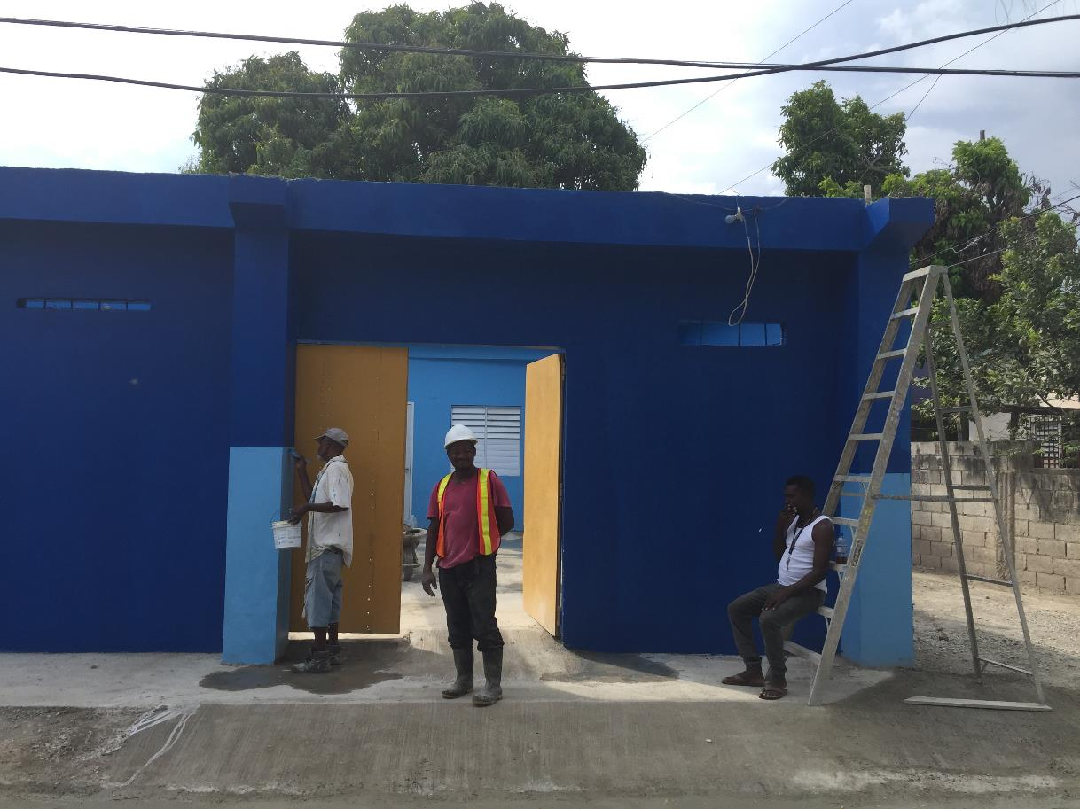

Slide 38
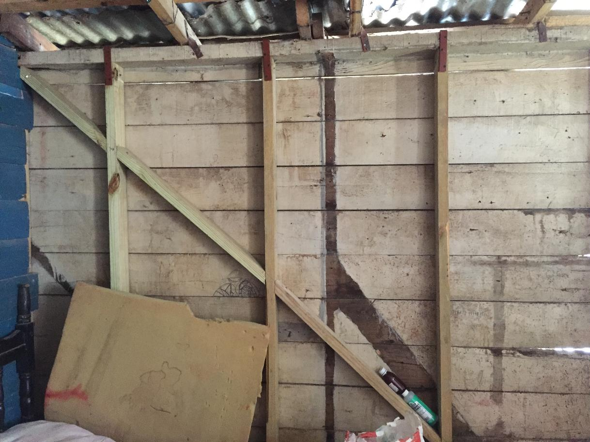

Slide 39
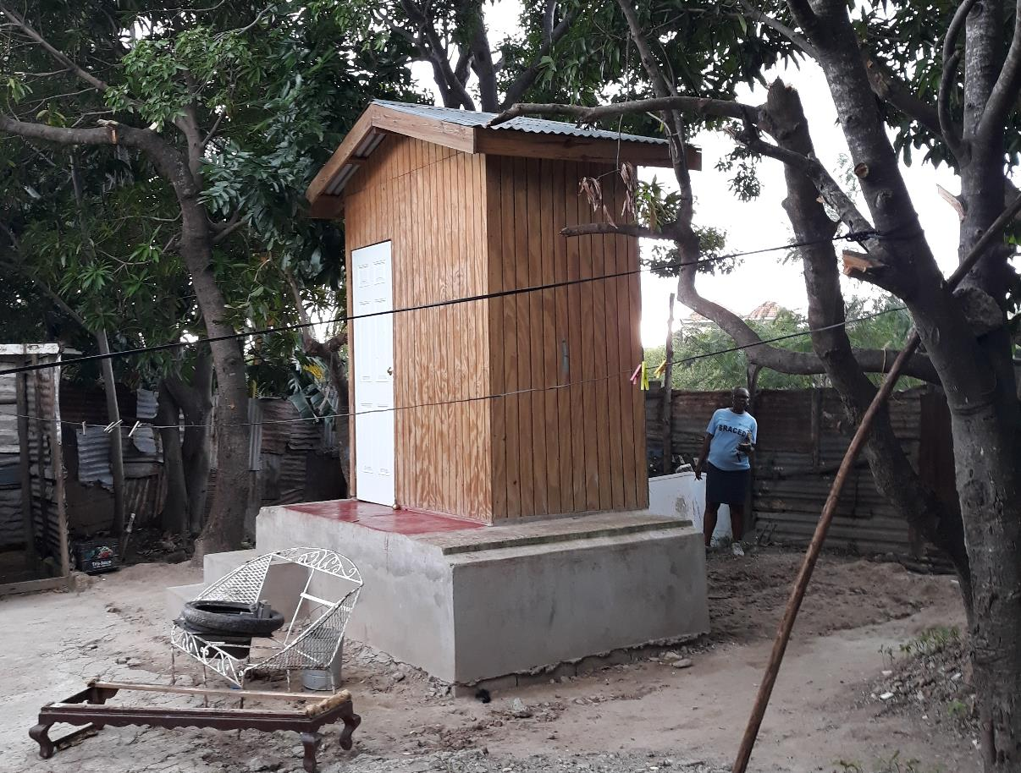

Slide 40
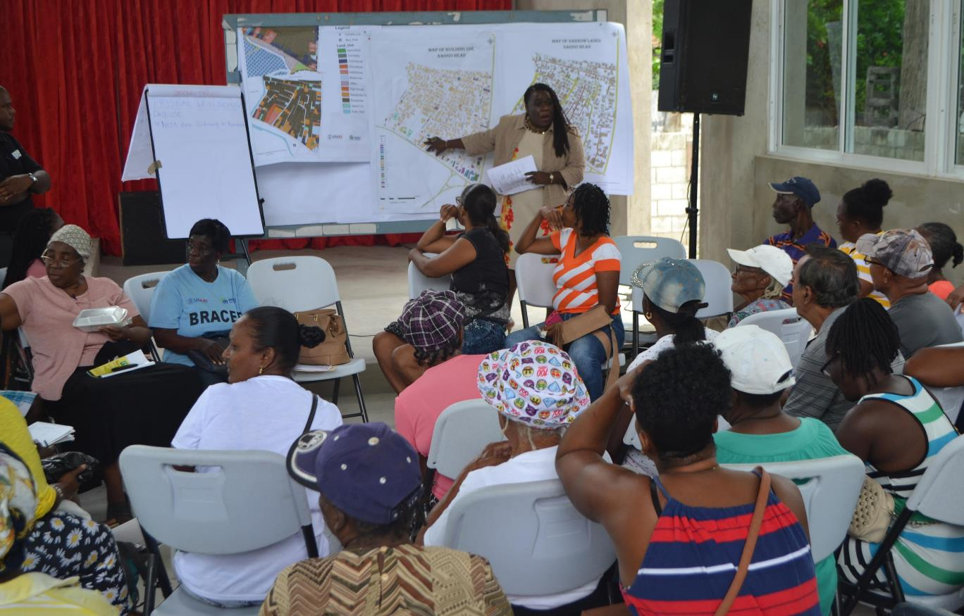

Slide 41
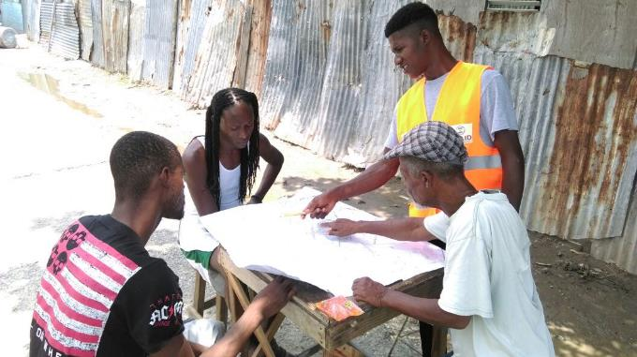
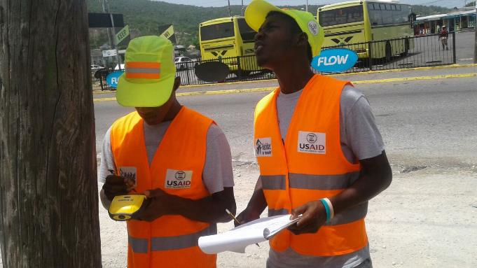
Challenges, Lessons, Best Practices

Slide 42
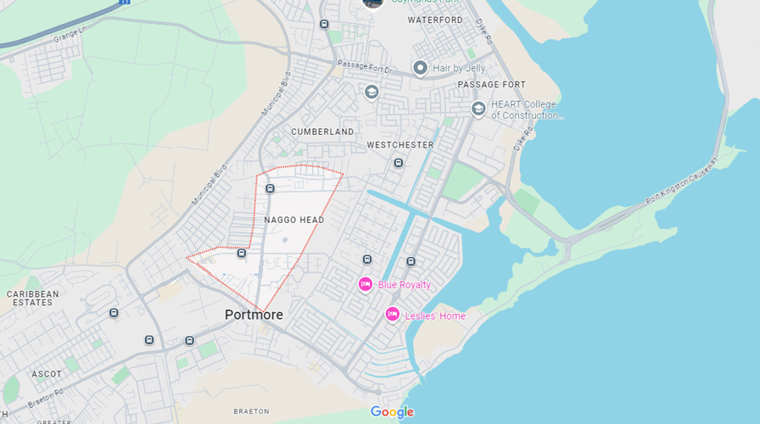
Challenges (urban-specific)
Entering new communities
Informal settlements
Violence
Local staffing
Bureaucracy
Land space
Notes:
Informal settlements (legal recognition, access to basic services, land tenure issues, etc.)
Entering new communities (fed up with past unfulfilled promises). Partnership with credible institutions is a must.
Violence (a deep-rooted and complex problem in Jamaica, exacerbated by extreme poverty, inequality, lack of opportunity, presence of drug gangs, lack of basic services, family disintegration, limited state presence).
Despite urban context, we struggled to find local staff with necessary expertise.
Infrastructure construction requires much more bureaucracy.
Political involvement as a source of divided community and potential for added violence.
Land space to make adjustments to informal communities is really difficult to achieve.

Slide 43
Lessons learned (urban-specific)
Neighborhood development can work in Jamaican urban informal settlements context
Visible demonstration models that can be replicated
Land regularization and secure land tenure as foundation towards community and household resilience
Source: Project final evaluation
Notes:
Neighborhood development (community building and community planning) can work in Jamaican informal settlements.
- Recognize the specific characteristics of each community;
- Have clear benefits that the community can galvanize around, such as visible sanitation solutions or land regularization and obtaining land titles;
- Build and strengthen institutional structures in the communities through building relations with many stakeholders, both in and outside the communities;
- Empower residents through training (with certification) in a number of areas which may provide livelihood/income. Some residents that benefited from activities started seeing opportunities in urban gardening or other small businesses.
Visible demonstration models.
- Through a package of training and sensitization activities to achieve disaster risk reduction impact at the family and individual levels, community members were empowered to address their situation as well as take charge of community action.
- BRACED successfully employed several of the community builders to conduct the construction activities.
- This provided housing retrofitting demonstration models, visible sanitation improvement (garbage receptacles and elevated VIDP toilets).
Understanding regularization and secure land tenure as the foundation towards building housing and settlements resilience in urban contexts.

Slide 44
Best, promising practices (urban-specific)
Considering Land Regularization and Security of Tenure as key towards neighborhood redevelopment and resilience
Engaging multiple stakeholders.
Sound community participation.
Use of Technology
Advocacy towards national land policies transformation
Systematization of the experience
Notes:
Considering Land Regularization and Security of Tenure as key towards neighborhood resilience
Participatory approach. Full bottom-up community engagement. Establishment and strengthening of community groups towards community organizational efforts.
Engaging multiple stakeholders. Local government, political representatives and national agencies; Academy; some national NGOs, and private businesses.
Technology. Use of tablets, GIS and drones to map neighborhoods, run by national specialists and community members.

Slide 45

https://www.youtube.com/watch?v=iMwRMVRHFVY

Slide 46
Thank you!
Feedback/Questions? Please contact us:
Mario Flores
Director, Field Operations
Disaster Risk Reduction and Response
mflores@habitat.org
Javier Cidón
Officer, Field Operations
Disaster Risk Reduction and Response
jcidon@habitat.org

Slide 47
Integrating accessibility and disability inclusion into urban interventions

Slide 48


Mainstreaming Universal Accessibility in the World Bank's Operations a pilot support to projects in Senegal and Yemen
Feb. 2023-April 2024
Wafa Al-Daily, Ph.D.
Urban Planner and International Development Expert
Executive Director, EHAAR International

Slide 49

Key Stages of the Study
Introduction and awareness raising on universal accessibility in the built environment in Yemen. Operationalizing Universal Accessibility in urban projects in Yemen Dissemination and feedback: sharing lessons learned with a wider audience
Notes:
Universal Accessibility in Urban Infrastructure and Rehabilitation Projects in Yemen
Mainstreaming Universal Accessibility in Urban Operations: a pilot to support projects in Yemen and Senegal is a World Bank project under the QII Partnership.
The project raises awareness on Universal Accessibility in the built environment among urban stakeholders and provides guidelines to project owners, urban professionals, policy-makers in Yemen and Senegal.
Project context in Yemen: Yemen Integrated Urban Services Emergency Project (YIUSEP-II)

Slide 50
Implementation
Introduction and awareness raising: Universal Accessibility and urban infrastructure/built environment projects
Operationalizing Universal Accessibility in urban infrastructure/built environment projects
Dissemination and feedback: sharing lessons learned with a wide audience
Semi-structured interviews
Observation
Photo documentation
Seminar
Technical review – YIUSEP II subprojects
Pilot Project: Al-Wahdah youth sports club (Co-design process: meetings & workshops)
Dissemination workshop
Internal Workshops (WB)
Assessment Report
Awareness-raising video
Technical recommendations
Practical Guide
Publications
Training Material
Restitution video
Notes:
Activities:
Review of best practices, case studies and standards on Universal Accessibility in the regions and worldwide
Stakeholder engagement, semi-structured interviews with stakehodlers and persons with disabilities
Site visits and documentation
Production of awareness-raising videos with persons with disabilities
Seminars with stakeholders (1 day for each country)

Slide 51

Engagement based on:
Semi-structured interviews with key and secondary stakeholders
Online seminar and workshops
Focus group discussions
Photographic and video documentation
Site visits
Technical design review (11 YIUSEP 2 subprojects)
Al-Wahdah Youth Sports Club Co-design

Slide 52




Slide 53




Assessment Report
Source: Humanity Inclusion
Notes:
Assessment Report
Methodology
Concepts and definitions
Universal accessibility and the built environment: lessons learned from other countries
Disability situation in Yemen
Regulatory and legal framework for accessibility in Yemen
Barriers and opportunities for implementing accessibility in the built environment
Bibliography and References
Toolkit

Slide 54
Outcomes
Challenges
1. The lived experience of persons with disabilities in the built environment
2. Common technical, legal, societal and financial challenges
Opportunities
1. Making the case for mainstreaming Universal Accessibility in Yemen
2. Entry points for mainstreaming Universal Accessibility in urban infrastructure projects under YIUSEP-II
Notes:
Challenges
1. The lived experience of persons with disabilities in the built environment
Inadequate infrastructure
Limited access to public transportation
Absence of accessible restrooms and sanitation facilities
Inaccessible public buildings
Barriers to leisure, education and employment
War-related damage
2. Common technical, legal, societal and financial challenges
Technical and practical knowledge, skills and information
Lack of resources
Gender limitations
Opportunities
1. Making the case for mainstreaming Universal Accessibility in Yemen
Priority setting and awareness raising
Cost-benefit analysis
Peacebuilding and inclusion
2. Entry points for mainstreaming Universal Accessibility in urban infrastructure projects under YIUSEP-II
Capacity-building and training
awareness raising and campaigning
Provision of technical and legal support
Promotion of participation and dialogue
Learning from international best practices.

Slide 55

YIUSEP II pilot project for UA enhancement: Al-Wahdah youth sports club
Objectives of the Co-design Process
Identify a pilot infrastructure rehabilitation project
Develop user-centric design solutions
Enhance the skills and expertise
Provide localized technical and methodological guidance on UA
Site map showing the location of the project site and circulation
Notes:
Objectives of the Co-design Process
Identify a pilot infrastructure rehabilitation project to showcase the feasibility and added value of UA enhancement that can serve as a replicable model for Yemen (and in similar (post-)conflict and reconstruction settings).
Develop user-centric design solutions, including the feedback from persons with disabilities, while aligning the design with global standards.
Enhance the skills and expertise of local authorities, implementing agencies, and professionals in UA and inclusive urban planning.
Provide localized technical and methodological guidance on UA enhancement in urban infrastructure projects.
Methodology
Identification and site visits, technical review: The Al-Wahdah sports facility was flagged as suitable pilot project. Field visits to the Al-Wahdah sports facility were organized with UNOPS. The initial Al-Wahdah sports facility were shared and reviewed to identify Universal Accessibility gaps. A comprehensive took place to cover the gaps.
Co-design events: Ten co-design and co-learning workshops and in-person meetings with the technical teams (UNOPS), key stakeholders and persons with disabilities focusing on enhancing the Universal Accessibility features of the Al-Wahdah youth sports club in Sana’a.
Preparation of UA guidance and training: Based on the technical review and engagement, localized Universal Accessibility guidelines were elaborated based on the RECU approach.
Updated Designs: The project designs were updated incorporating reasonable and feasible Universal Accessibility Enhancement.

Slide 56


Co-design Outcomes
Challenges
Limited funding
Project timeline and continuity
Lack of coordination
Awareness
Lack of skilled urban planners, engineers and architects
Absence of capacity building
Promoting accessibility
Iterative design for excellence
Model for future facilities
Notes:
Co-design Outcomes
Promoting accessibility: The co-design process led to a deeper understanding of the needs of persons with disabilities, resulting in comprehensive integration of Universal Accessibility (UA) elements. This includes features such as accessible toilets, ramps, parking, signages, and tactile, promoting inclusivity for all.
Iterative design for excellence: Through collaborative reviews and refinements, the final design achieved a seamless blend of the sports club's core requirements with inclusive Accessibility standards.
Model for future facilities: The project outcome sets a benchmark for UA integration in sports facilities within Yemen and beyond. It demonstrates the power of co-design in creating spaces that empower and serve all users.

Slide 57

Guidelines
Target Audience:
Policymakers
Urban planning and design professionals
Project owners
Project developers (project management, design, construction)
Organizations of disabled people and their partners
Technical and financial partners
Academia and universities
Challenges
Resources
Technical and practical knowledge skills and information
Gender-based exclusion
Regulation and enforcement
Awareness, priority setting and participation of persons with disabilities
Notes:
Content of the Technical Guideline:
Introduction (purpose and importance)
Definitions and concepts (disability and PwDs; guiding concepts)
Disability and disability inclusion in Yemen
Practical guidance for mainstreaming universal accessibility in urban infrastructure projects (Reach, Enter, Circulate, and Use; in addition to cross-cutting issues)
Appendix (efforts and challenges to protect the rights of PwDs in Yemen) + references

Slide 58

Key Takeaways
Quick-win solutions
Timing is key
Great interest from designers, civil engineers, architects and other relevant professionals
Enhance cross-sector dialogue
Notes:
Key Takeaways
Quick-win solutions with demonstration effects is effective for ensuring stakeholder buy-in and ownership, such as cost-efficient UA enhancements in the building design (handrails, ramps, signage) and surrounding areas (accessible pathways and parking lots).
Timing is key: introduce the Universal Accessibility approach as early as possible in the project cycle to allow for effective participation of persons with disabilities in the needs assessment and project design and implementation phases, and to integrate Universal Accessibility principles in the technical designs and budget across subprojects.
Designers, civil engineers, architects and other relevant professionals are interested in and engaged on Universal Accessibility and appreciate dedicated training, peer-learning and continued technical assistance during the project design phase.
Enhance cross-sector dialogue and provide a space for persons with disabilities and their organizations to participate in all stages of the project, to ensure that UA and disability inclusion are mainstreamed in regulatory and legal frameworks, policy and project documents.

Slide 59

THANK YOU
Dr. Wafa Al-Daily
Wafa.hameed@ehaarinternational.org
www.ehaarinternational.org
Reports available online:
Yemen Practical Guidelines:
https://documents.worldbank.org/en/publication/documents-reports/documentdetail/099050124115516810/p1749911e845bd0b6191ae15f1b19bfb4ff
Yemen Engagement Brief:
https://documents.worldbank.org/en/publication/documents-reports/documentdetail/099050124115629267/p17499116dbabd0511bb49105834c1fe9a9

Slide 60
Discussion
Notes:
Hilmi

Slide 61
Conclusion
Notes:
Hilmi

