Slide 1
UPDATES ON RELOCATION PROJECTS FOR ‘SENDONG’ SURVIVORS
AS OF APRIL 26, 2012

Slide 2
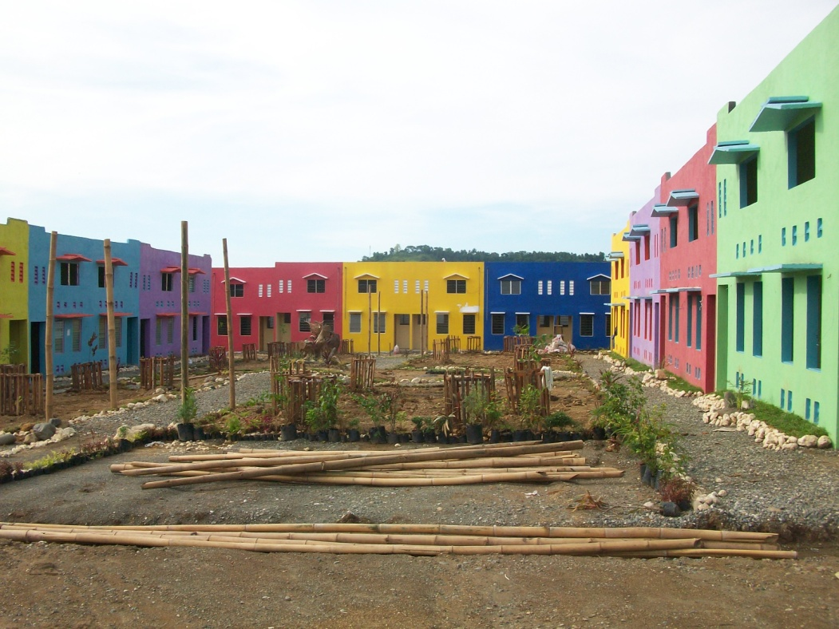
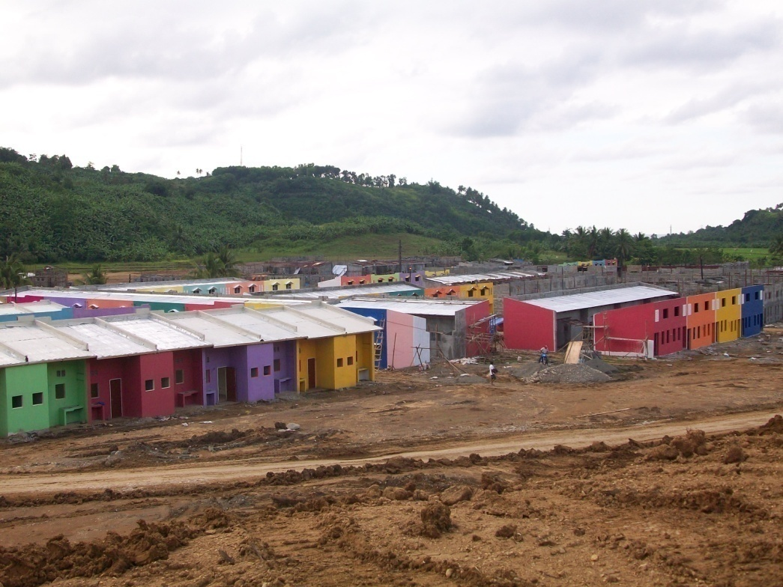
BAYANIHAN SA ILIGAN VILLAGE
STA. ELENA, ILIGAN CITY
1,712 rowhouses
ONGOING ACTIVITIES:
1. backfilling and main road
opening
2. ongoing 437 units construction
(134 completed w/o septic, doors and
windows)
3. Lay-out for IOM temporary shelter
(200 units)
4. Development/Building Permit on
process
IMMEDIATE CONCERNS:
Payment of the land
Site Development Fund
Land Erosion
Water supply

Slide 3
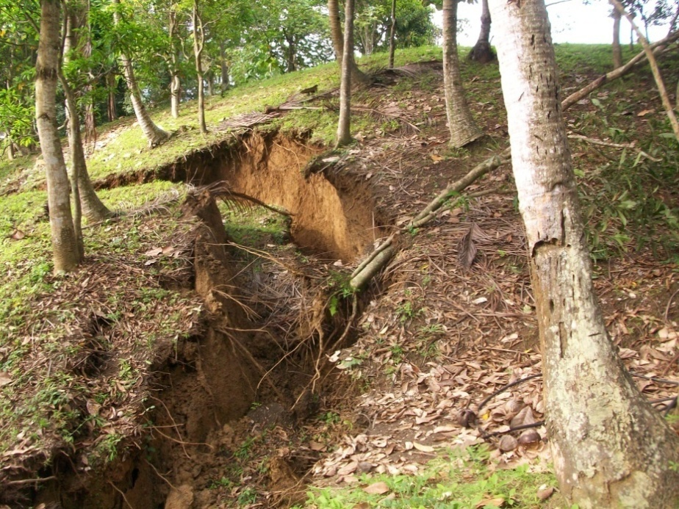
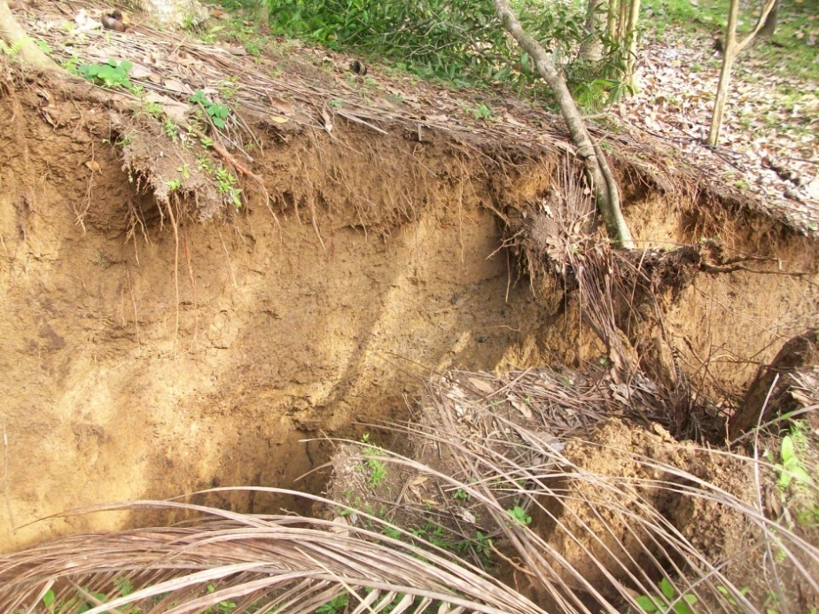
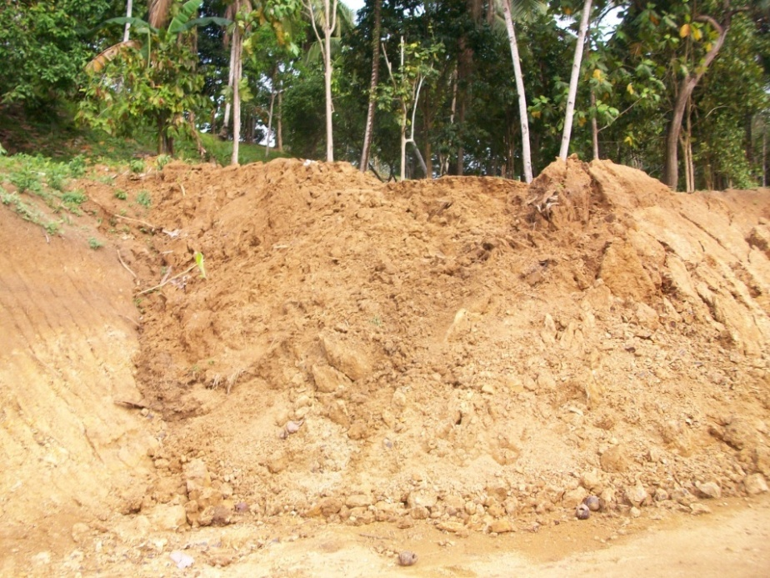
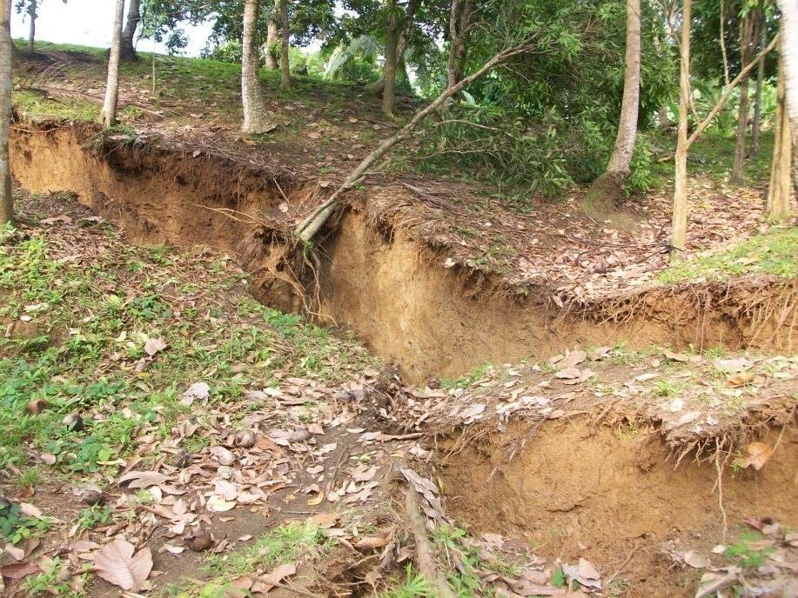
LAND EROSION AT STA. ELENA

Slide 4
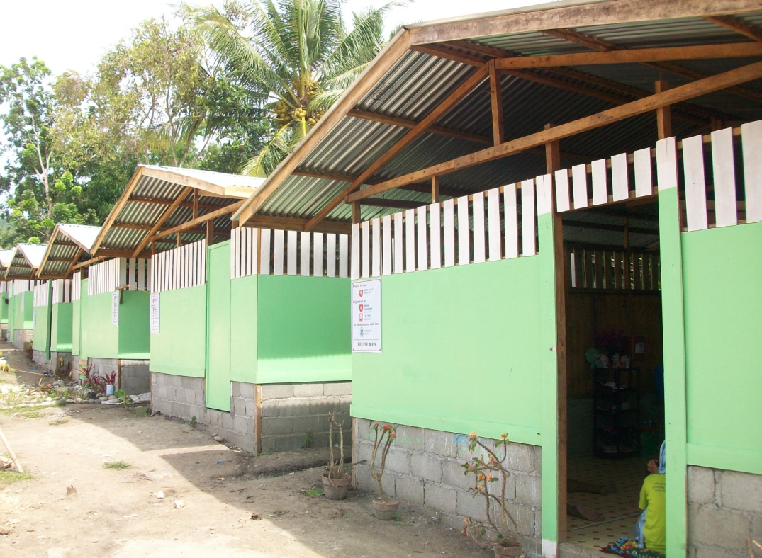
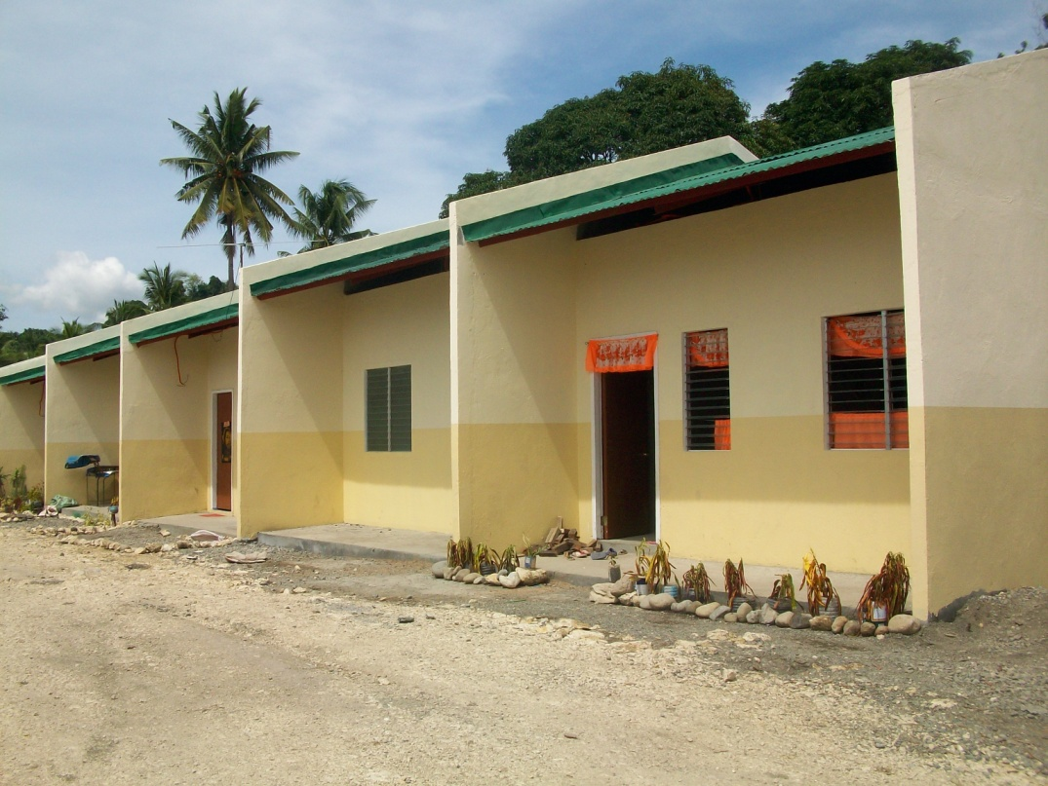
DEUS CARITAS EST VILLAGE
LUINAB, ILIGAN CITY
236 single detached / rowhouse
ONGOING ACTIVITIES:
1. 120 ongoing house construction
2. 116 completed (108 occupied)
3. Development/building permit on
process
IMMEDIATE CONCERNS:
Site Development Fund
Drainage outfall problem
Water supply

Slide 5
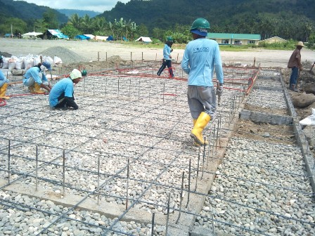
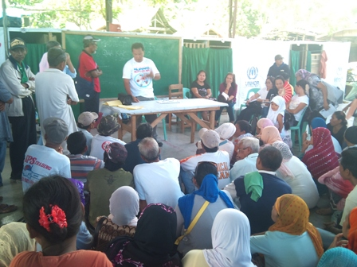
KAPUSO VILLAGE
Mandulog, Iligan City
200 rowhouses
ONGOING ACTIVITIES:
1. 20 ongoing house construction
2. 10 classroom building ongoing
construction
3. Organization of HOA
4. Development/building permit on process
5. IOM Bunk houses construction
IMMEDIATE CONCERNS:
Site Development Fund
River control protection
Electrification and water supply

Slide 6
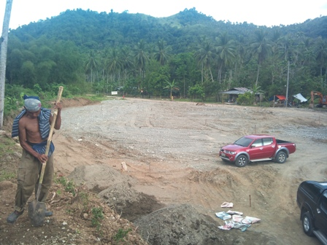
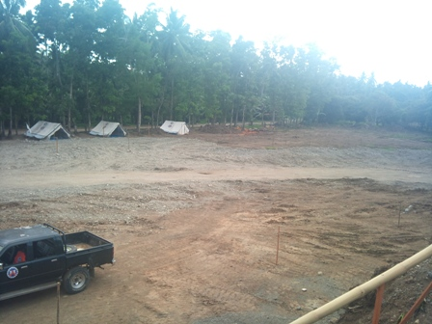
RED CROSS VILLAGE
Digkilaan, Iligan City
292 Single detached
ONGOING ACTIVITIES:
1. Backfilling
2. Land survey
3. Preparation for May 8 ground
breaking ceremony
IMMEDIATE CONCERNS:
Site Development Fund
River control protection
Electrification and water supply

Slide 7
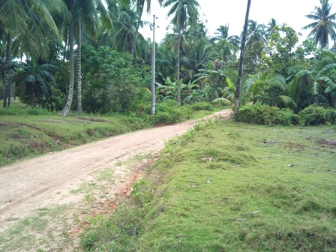
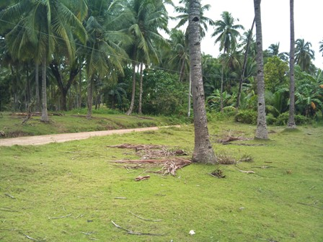
ILIGAN ECO VILLAGE
Dalipuga, Iligan City
1500 Single detached
ONGOING ACTIVITIES:
Land survey
Acquisition on process
IMMEDIATE CONCERNS:
Site Development Fund
Electrification and water supply

Slide 8
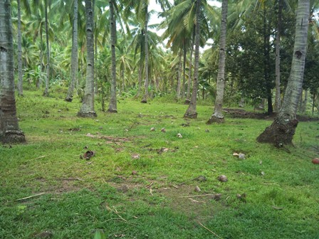
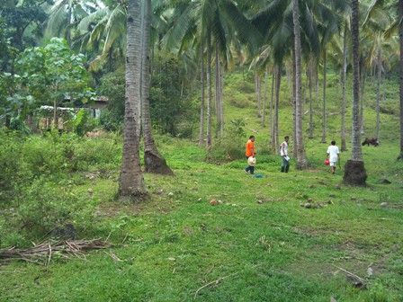
UPPER HINAPLANON HEIGHTS
Upper Hinaplanon, Iligan City
1,700 rowhouses
ONGOING ACTIVITIES:
Land survey
2. Acquisition on process
IMMEDIATE CONCERNS:
Site Development Fund
Electrification and water supply

Slide 9
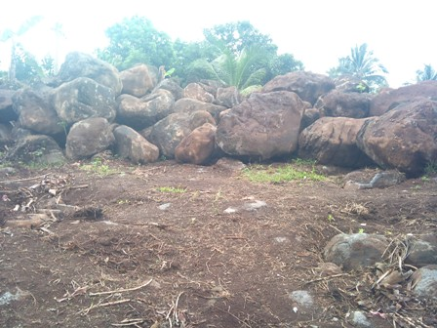
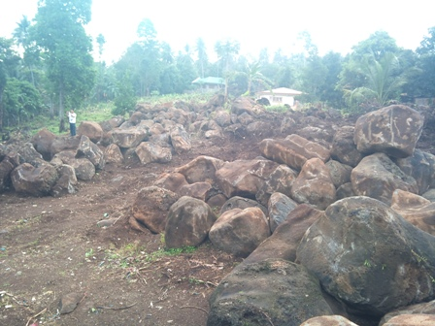
ST. MICHAEL HEIGHTS
Buru-un, Iligan City
293 Single detach
ONGOING ACTIVITIES:
Ongoing site clearing
2. Site dev. Plan ongoing
IMMEDIATE CONCERN:
Barangay objection in
hauling boulders
2. Permit in hauling

Slide 10
SUMMARY:
Total No. of Relocation Projects - 7
Total No. of house and lot generated - 5,933

Slide 11
DAGHANG
SALAMAT!

