Slide 1
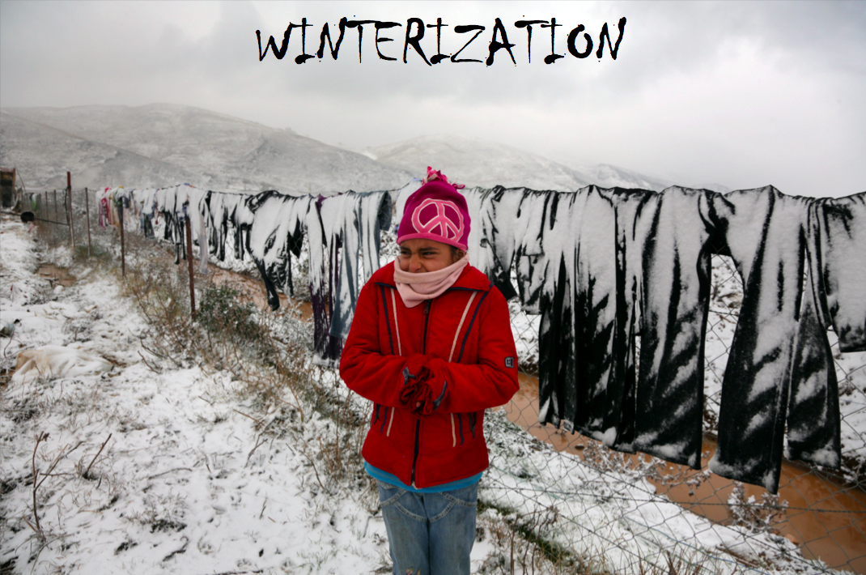

Slide 2
Planning Scenario
Planning figure: 1.8 million people displaced across Iraq since January 2014.
Assessments in KR-I have identified 480,000 persons in need of urgent shelter and winterization assistance.
  Ongoing settlement assessment in Dohuk will determine settlement and shelter categories and volume outside the camps and schools.
  The government has announced that 5-6 additional camps will be constructed within the next 35-40 days in Dohuk, hosting 120,000 IDPs from outside the schools.
Assessments in South/Central have identified 120,000 persons in need of urgent shelter and winterization assistance.
Timeline for implementation end November 2014

Slide 3
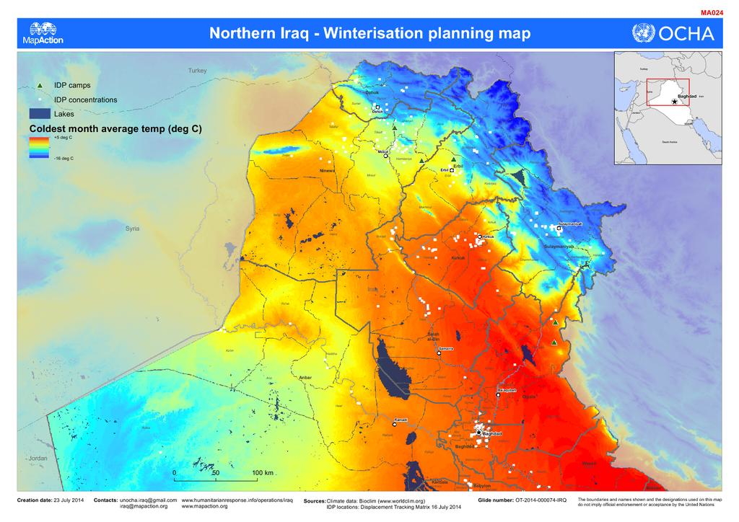
Winterization Area

Slide 4
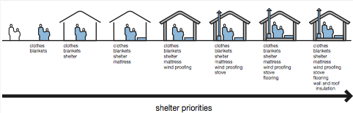
NFI/Shelter priorities/phases

Slide 5
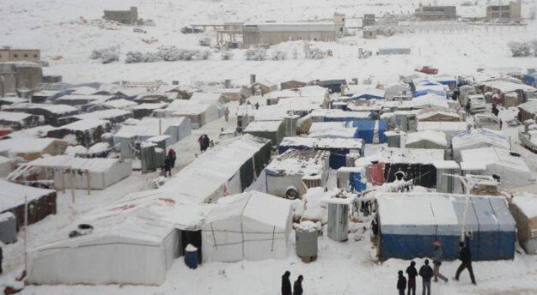
What does the winter look like?

Slide 6
Types of Winterization Kits
NFI, keeping the immediate space around bodies warm to maintain core body temperature
  Warm clothing
  Blankets, quilts to provide personal insulation
  Other NFI for individuals with special needs
Sheltering individuals from the elements
  Sealing off and weatherproofing
  Insulation
  Stoves/heaters including fuel for the winter

Slide 7
Suggested basic & supplementary NFI winterization kits
Basic winterisation kit (basic)
  1 Carpet
  6 High-thermal blanket / Quilt
  1 Plastic sheet
  6 Mattress
Supplementary winterisation kit (personal)
  6 Clothes/shoes (for adults and children)
  - High-thermal blanket / Quilt (depending on needs)
  1 Jerry can for water
Other NFI for individuals with special needs
  1 Hygiene kit
  1 Baby kit

Slide 8
Suggested shelter winterization kits
  Sealing off & weather-proofing
    1 Inner liner for family tent with 1 partition
    Weather proofing and partition for substandard shelter (to be defined by TTC)
  Insulation
    8 Polystyrene boards for floor and 5 Thermal mats for tents
    Insulation of substandard shelter (to be defined by TTC)
  Heating
    1 Heater (type depending of shelter solution)
    1 Jerry can for fuel
    Fuel for the winter through in-kind or cash assistance (depending on temperature and shelter type)

Slide 9
Kits dependency
Basic
kit
Supplementary
kit
Winterization
kit
Standard
Clothes
Thermal blankets
NFI
Tent or
Sub std. shelter
Sealing-off and weatherproofing
Heating and insolation
Shelter

Slide 10
Shelter/NFI Cluster
Winterization Strategy Outline
  This winterization strategy will provide technical guidelines for upgrading non-winterized shelter and using NFI and shelter kits to reach agreed minimal winterization standards.
  This strategy will be the output of interagency discussions including field, sub-national and national staff from the shelter clusters members and will include: ?
  This strategy will complements rather than replaces existing NFI and shelter strategies which aim to provide help to IDPs and the affected population to get through the winter in upgraded winterized tents or existing substandard buildings.

Slide 11
Proposed ToR for
Winterization WG/TTC
Contents:
Overview
    Definitions
    Justification
    Timeline
Approach
    Modality & Selection Criteria
    Inter agency coordination (e.g. gender and cross cutting issues)
    Kit types and contents
    Methodology
    Marked assessment and linkages to other intervention (e.g. rehabilitation)
    Technical Support (tip-sheets, training, samples etc.)
    Procurement / warehousing / storage
First WG/TTC meeting: Wednesday 8 October, at 14:00

