Slide 1
Winterization
There are four categories of displaced people that have the highest risk in relation to winter, and who are in the need of winterization assistance, including
Families and individuals residing in tents, including in refugee camps or in makeshift accommodation in informal settlements;
Individuals and families who are living in sub-standard accommodation, such as collective centers, informal settlements or unfinished buildings;
Individuals living in geographic areas subject to severe winter conditions such as high altitude or traditionally low or freezing temperatures;
Families who, despite having habitable accommodation, are socio-economically vulnerable and unable to cover the costs of heating fuel or utility bills related to heating.

Slide 2
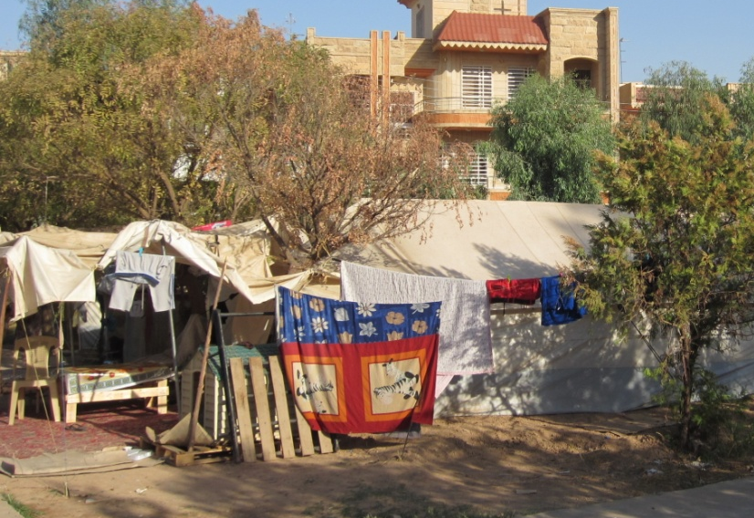
Current shelter options
Informal settlements/ tents on public land

Slide 3
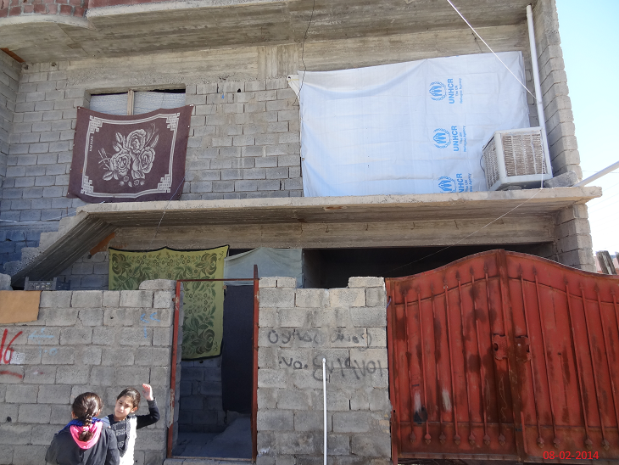
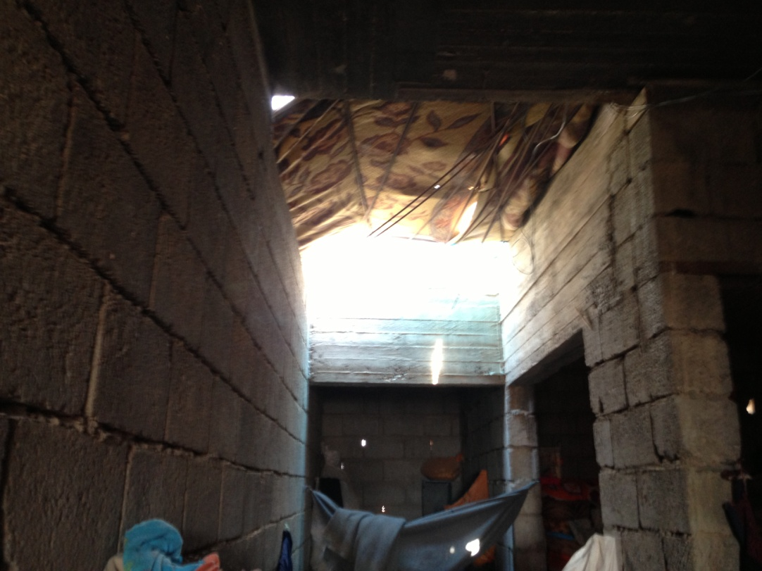
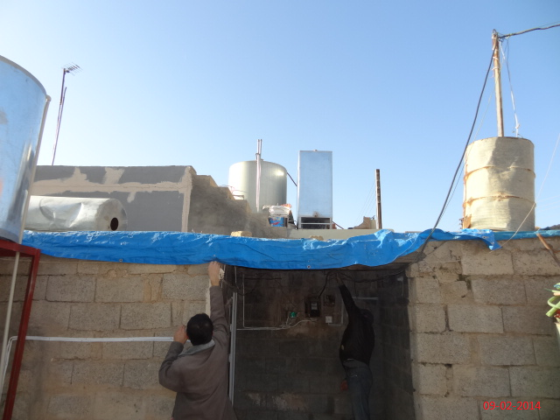
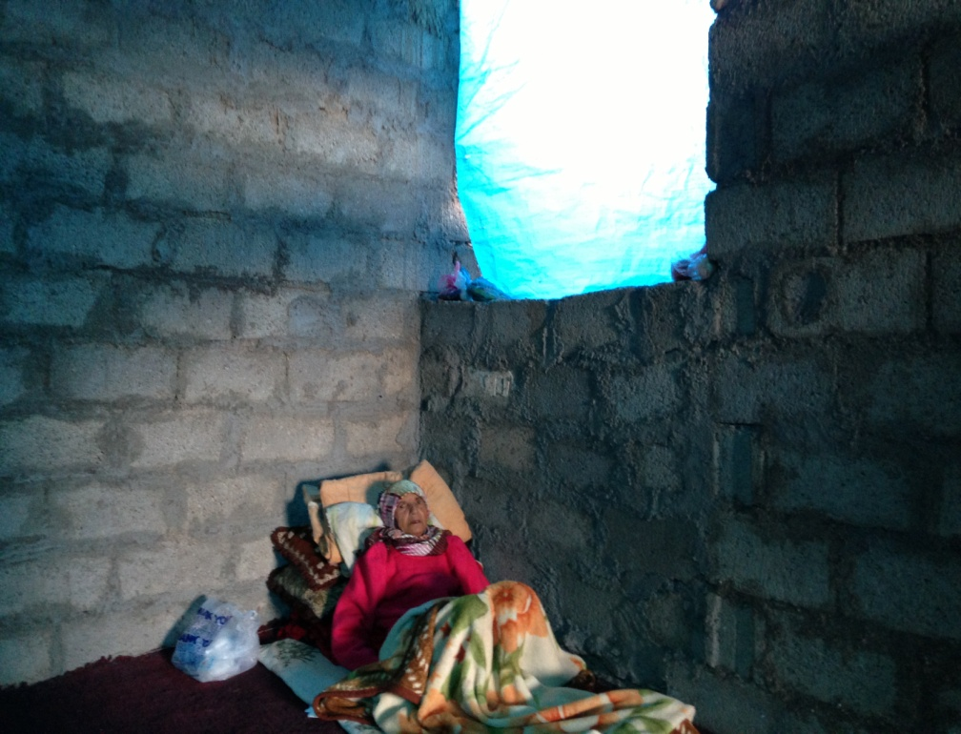
People living in substandard conditions in urban areas

Slide 4
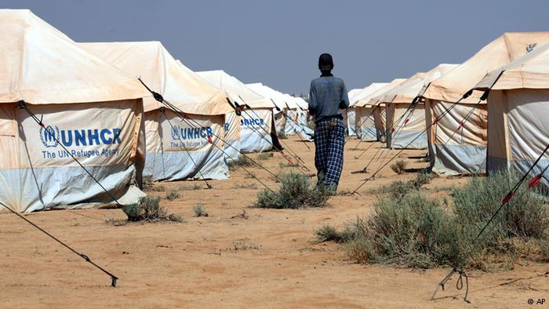
Tents in Camp Settlements

Slide 5
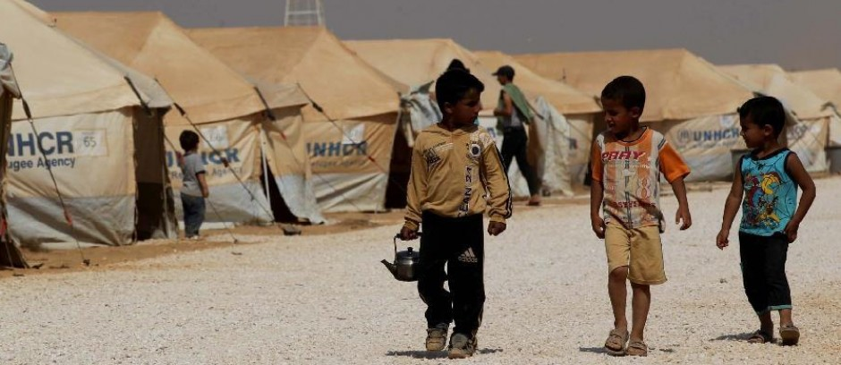
People living in camps

Slide 6
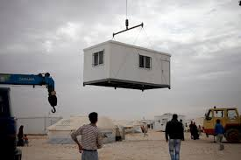
Caravans

Slide 7
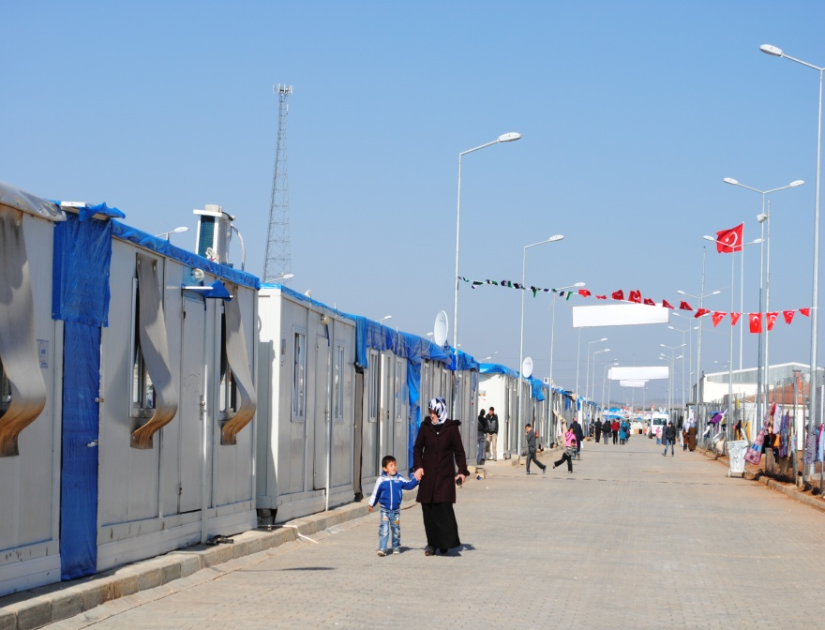
Caravans in camps
Provision of pre-fab container dwellings:
improved living conditions, better protection from the elements of the weather, more privacy, dignity and protection.
safety: This is a priority strategy for addressing the needs and concerns of women and girls, who consider their tent homes unsafe as tents cannot be locked

Slide 8
Guidelines for Winterization
warm clothes, bedding & blankets.
Shelter that provides protection from the elements, by:
Notes:
Heating, although important, is a lower shelter priority than warm clothes, good quality blankets, quilts and mattresses, and a waterproof and draft proof shelter.

Slide 9
1. Provide waterproofing for roof & drainage
Distribution of plastic sheeting, rope and basic flooring insulation as key tools for upgrade.
Drainage must be dug around the shelter.
blanket or plastic sheet covering unused door.
note drainage ditches
and site drainage around tent

Slide 10
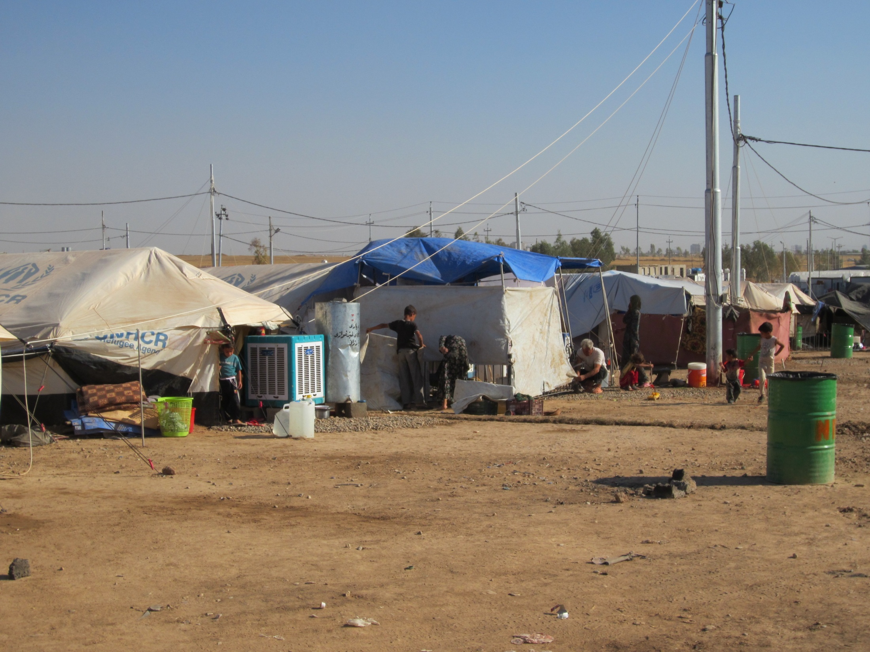
No drainage

Slide 11
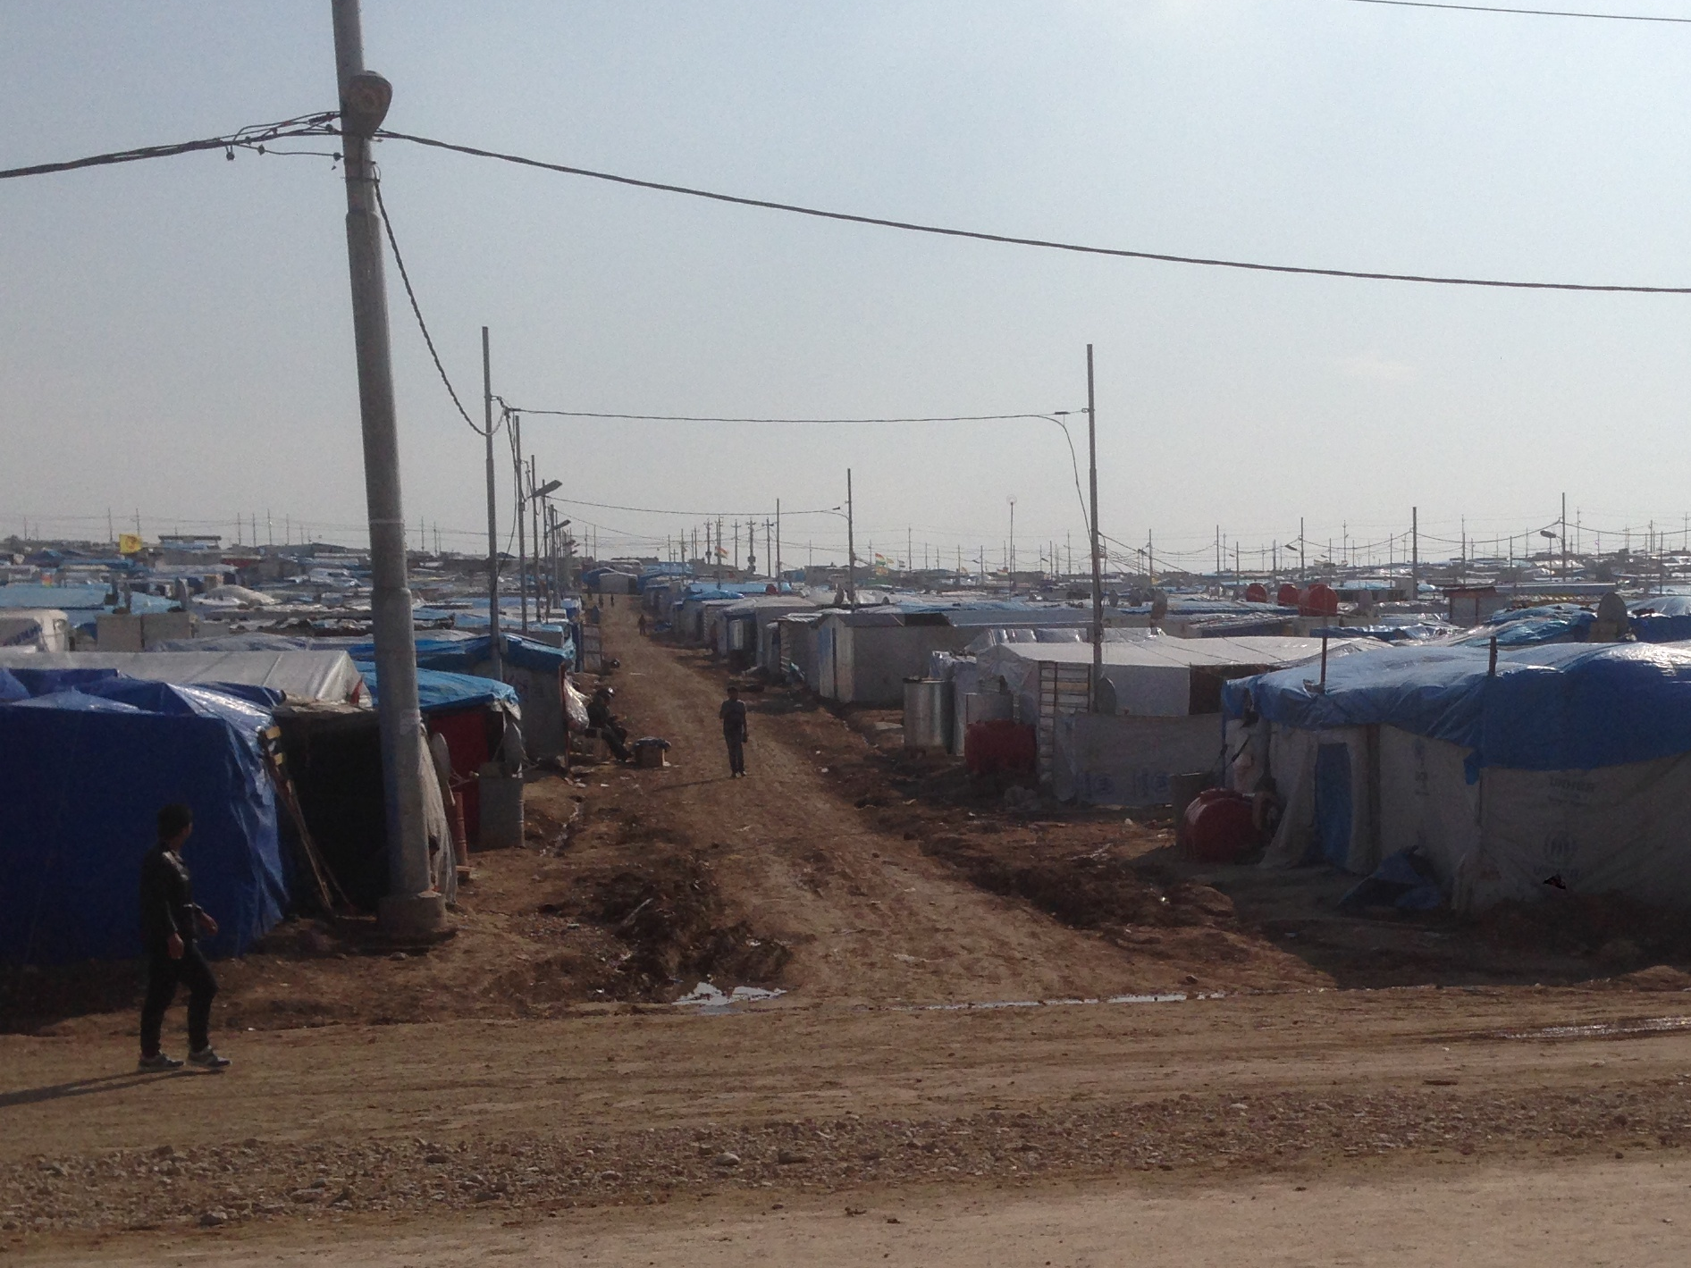

Slide 12
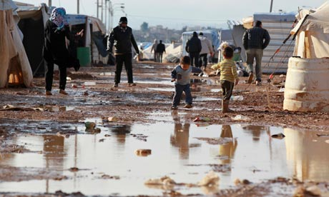

Slide 13
2. Reduce the effect of draughts and rain tools are needed to help prevent tents from flooding tents should be orientated with their doors away from the prevailing wind (prevailing winds N-NW)
tent as originally erected
tent with plastic sheet
waterproofing fly
tent with raised floor
(wood or earth/stone)
tent with low
earth/stone walls

Slide 14
Increase Internal Comfort methods of increasing headroom for comfort by excavating floor or constructing tent on raised walls, or lowering headroom to increase warmth.
tent as originally
erected
tent with excavated
floor
tent raised on
blocks
tent with lowered roof
to increase warmth

Slide 15
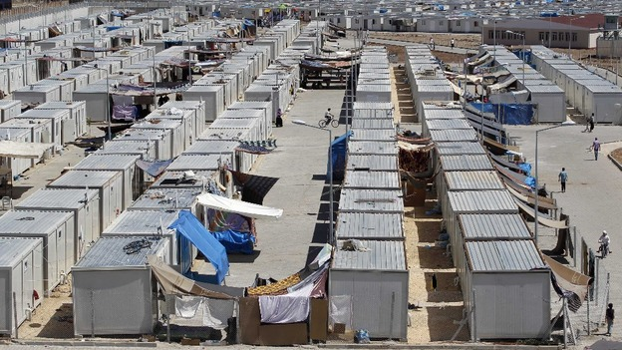
Syrian refugee camp in Turkey
  3. Improved pathways (gravelling & proper drainage)

Slide 16
Implementation approach
Encourage participatory approach / self help
Prioritization of the most vulnerable groups.
Extend assistance to people outside of camps.
Ensure people are allowed to upgrade their shelters on site in coordination with camp management.
Ensure that people have access to tools to dig adequate drainage / provide sand bags.
Hold public awareness campaigns at the point of distribution of all shelter equipment to explain health and safety issues: risks of cooking and heating and fire inside tents, etc.

Slide 17
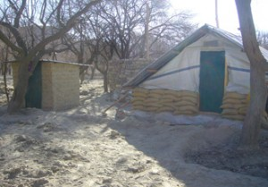
These shelters have been constructed using local materials incorporating disaster risk management (DRM) elements using sand bags and plastic sheets

Slide 18
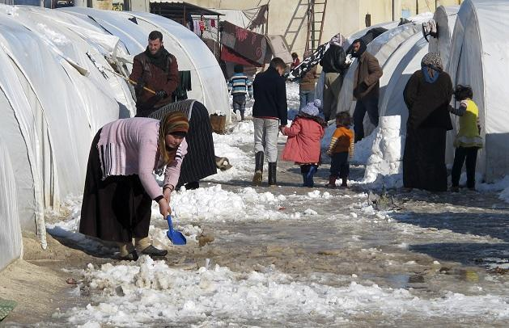

Slide 19
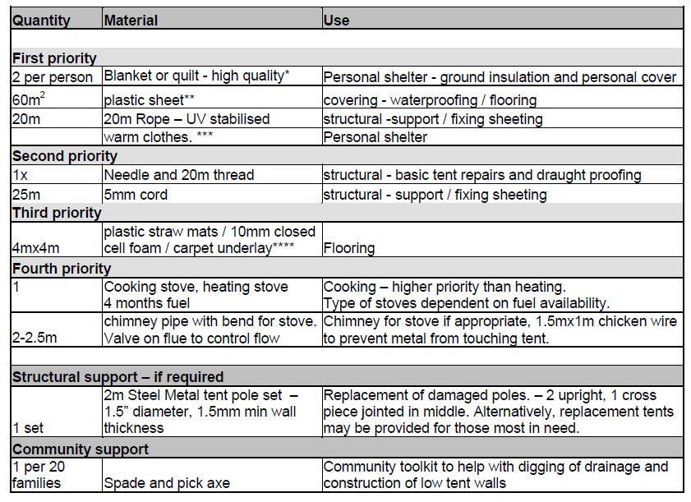
Tent winterization upgrade kit

Slide 20
Thank you

