Slide 1
“ToT on Earthquake Resistant Construction Technology”
e"sDkLo k"j{ tof/L
Earthquake Preparedness

Slide 2
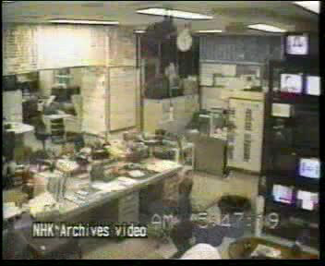
e"sDk=======

Slide 3
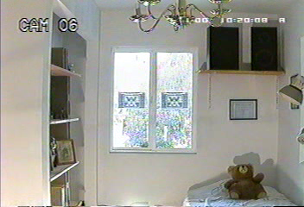
e"sDk=======

Slide 4
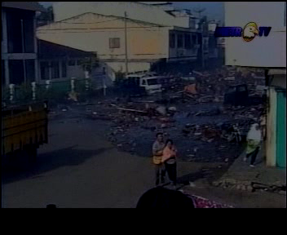
;"gfdL

Slide 5
o:tf] cj:yfdf tkfO stf hfg'x'G5 <
d';nwf/] kfgL k/]sf] a]nf .
Hff]8n] x'/Latf; rn]sf] a]nf .
lxpF k/]sf] a]nf .
tkfOsf] 6f]ndf h+unL af3 cfPsf] a]nf .
cl;gf k/]sf] a]nf .
e"sDk cfPsf] a]nf .

Slide 6
e"O{+rfnf] ===
e"O{+rfnf] PSsf;L cfpg ;Sg] Pp6f 7"nf] k|fs[lts k|sf]k xf] . e"O{+rfnf] h'g;'s} a]nf klg hfg ;Sb5 / tkfO{ Tolt a]nf sFxL klg x'g ;Sg'x'G5 .
vfgf vfO/x]sf] a]nf
l6=eL x]l//x]sf] a]nf
lgbfO/x]sf] a]nf
clkm;df sfd ul//x]sf] a]nf
l;g]df xndf l;g]df x]l//x]sf] a]nf
v]tdf sfd ul//x]sf] a]nf
ljBfnodf kl9/x]sf] a]nf
uf8Ldf u'l8/x]sf] a]nf
clxNo}
o:tf] a]nfdf tkfO{ s] ug'{x'G5 <
e"O{rfnf]sf] Ifltaf6 aRg tkfOn] s] ug'{ k5{ <

Slide 7
e"O{rfnf]sf] ;dodf k|foM dflg;x? s] u5{g\ <
>LdtL, 5f]/f5f]/LnfO{ ;Demg]
xQkQ efUg]
gftfuf]tfnfO{ ;Demg]
5/l5d]ssf] af/]df ;f]emvf]h ug]{
Notes:
There are several key points to be emphasized in this module on institutionalization. The first is that there is no perfect, universal organizational model for disaster management and mitigation. There is a range of organizational structures and techniques for creating necessary linkages among organizations and programs. Each model or structure has its own potential and its own limits.
It is clear that, in the absence of an ideal model to fit every situation, each governmental entity must find its own pragmatic approach that works for it. What is critically important is that agencies at every level, from local through national, take disaster management and mitigation explicitly into consideration. These functions cannot be dealt with only at one level of government and ignored at the other levels of government.
Notes:
_______________________________________________________________________________________________________________________________________________________________________________________________________________________________________________________________________________________________________________________________________________________________________________________________________________________________________________________________________________________________________________________________________________________________________________________

Slide 8
e"O{+rfnf] / o;af6 x'g] Ifltaf6 aRg] pkfox? klxn] g} yfxf kfO/fv]df / ;f] cg';f/ k"j{tof/L u/]df ;Defljt hLpwgsf] Ifltaf6 aRg ;lsG5 eGg] tkfO{+nfO{ yfxf 5 <
o;f] x'g ;s]df IfltnfO{ w]/} xb;Dd 36fpg ;lsG5 .
Notes:
COURSE OVERVIEW

Slide 9
e"sDkLo k"j{ tof/L M
e"sDk cfpg' cl3 ug'{kg]{ sfo{x?

Slide 10
;Defljt e"O{rfnf]sf] Ifltaf6 aRg cfh} b]lv tkfO{n] ug'{ kg]{ y'k|} sfo{x? 5g\ M
cfˆgf] 3/, clkm; tyf cGo :yfgdf ;'/lIft / c;'/lIft :yfgx? kQf nufO/fVg]
e"Orfnf] kl5 Psfk;df ;lhn} e]6\g ;Dks{ of]hgf agfO/fVg]
3/df ePsf aRrf, a'9fa"9L, czQm, la/fdL tyf ue{jtL dlxnfx?sf] nflu klg ljrf/ k'¥ofO /fVg]
tkfO{sf aRrfx?sf] ljBfno;Fu klg ljrf/ ljdz{ ug]{ . ;dGjo ug]{
e"O{rfnf] kl5sf] cfkt\sfnLg ;dosf] nflu cTofjZos j:t'x?sf] hf]xf] u/L/fVg]
5/ l5d]sdf ;/ ;Nnfx ul//fVg] tyf cfkg\sflng of]hgf agfO/fVg]
;do ;dodf k"jf{Eof; ug]{
cfkm"n] hfg]sf s/f ;a}nfO{ l;sfpg]

Slide 11
e"O{rfnf]sf] ;dodf ;'/lIft :yfgx? M klxNo} yfxf kfO/fVgf];\ .
tkfO{x?sf] 3/leq jf 3/aflx/ ;'/lIft Pj+ c;'/lIft b'j} vfn] :yfgx? /x]sf x'G5g\ . ltgLx?sf] klxn]g} klxrfg ul//fv] e"O{rfnf]sf] ;dodf ;'/lIft /xg ;lhnf] x'G5 .
3/ leqsf s]xL ;'/lIft :yfgx? M–
alnof 6]a'n / cGo kmlg{r/x?sf] d'lGt/
3/sf leqL uf/f]x?sf] 5]p, 9f]sfsf] rf}sf]; d'lGt/, b'a} lt/ uf/f] ePsf sl/8f]/x?, leqL lkn/x?sf 5]p
3/ leqsf s]xL c;'/lIft :yfgx? M–
zLzfsf ‰ofnx? / kmf]6f] k|m]dx?sf] 5]p
leQfdf gc8ofO{Psf ux|f} b/fh Pj+ ¥ofsx?sf] 5]p
3/ aflx/sf ;'/lIft :yfgx?
v'Nnf v]t jf rf}/x?
km/flsnf] af6fx? –cUnf sdhf]/ 3/x? 7"nf ?vx?, 6]lnkmf]g tyf lah'nLsf vDafx?, cfsfz] k'nx? eGbf 6f9f

Slide 12
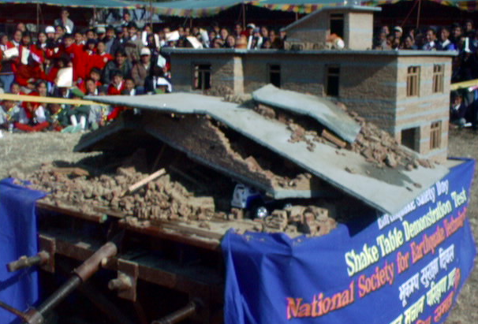
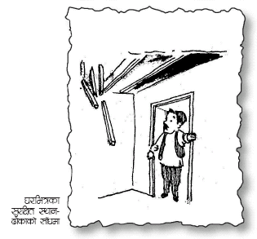
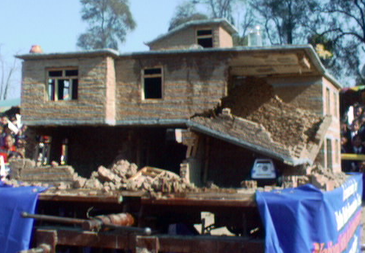
3/leqsf ;'/lIft :yfgx?
3/leqsf ;a} :yfgx? plQs} ;'/lIft jf c;'/lIft x'Fb}gg\ .

Slide 13
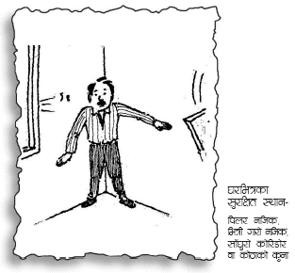
3/leqsf ;'/lIft :yfgx?
W3
W3
Relatively safe places
W5
W3
Relatively unsafe places
W6
W3
V1
D1
W1
D2
W2
Ground Floor Plan
Office II
National Society for Earthquake Technology Nepal
Example Building

Slide 14
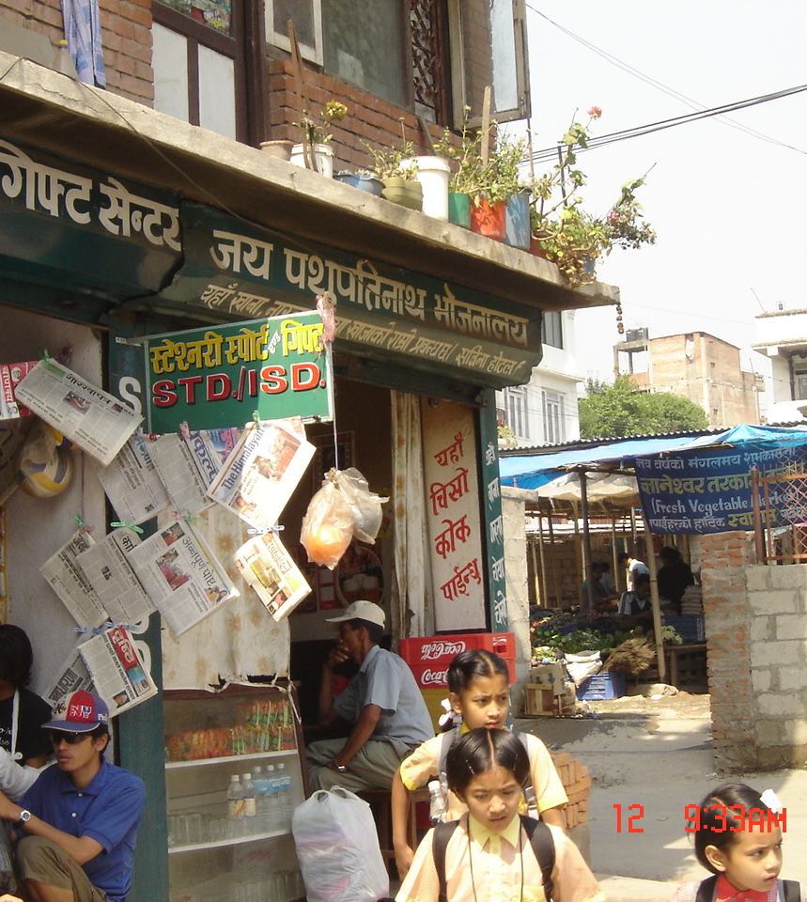
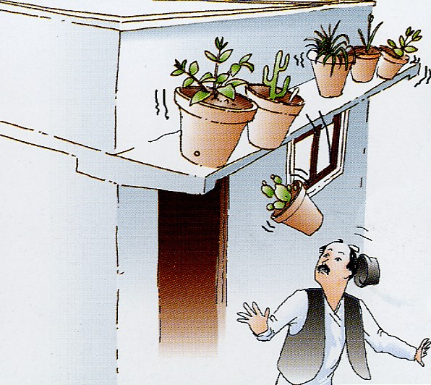
e"sDkLo k"j{tof/L

Slide 15
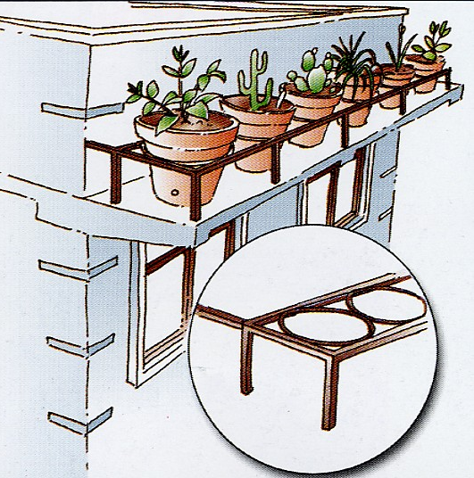
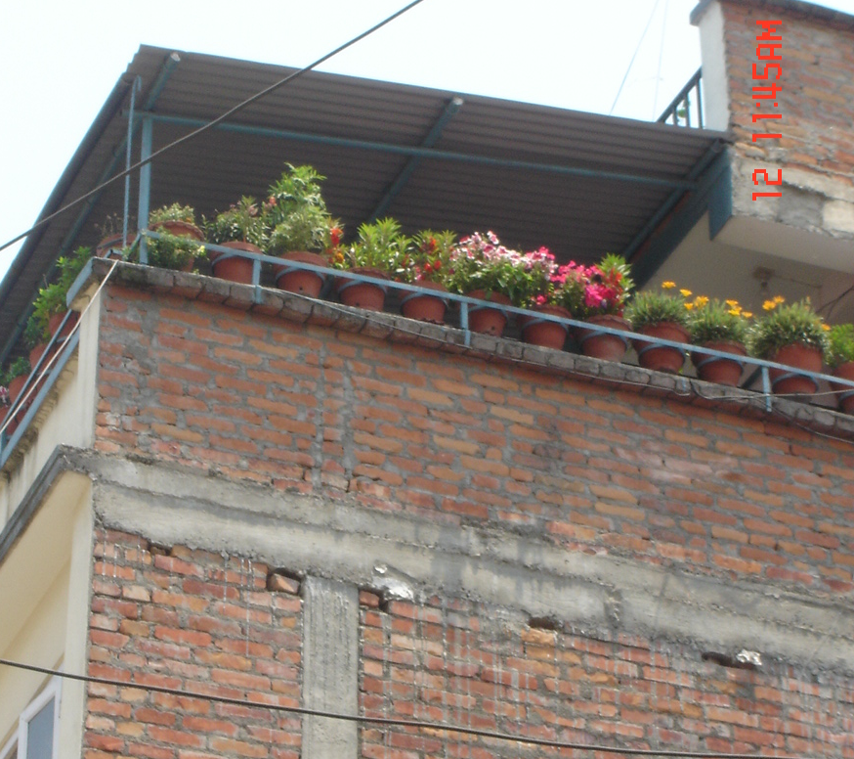
e"sDkLo k"j{tof/L

Slide 16
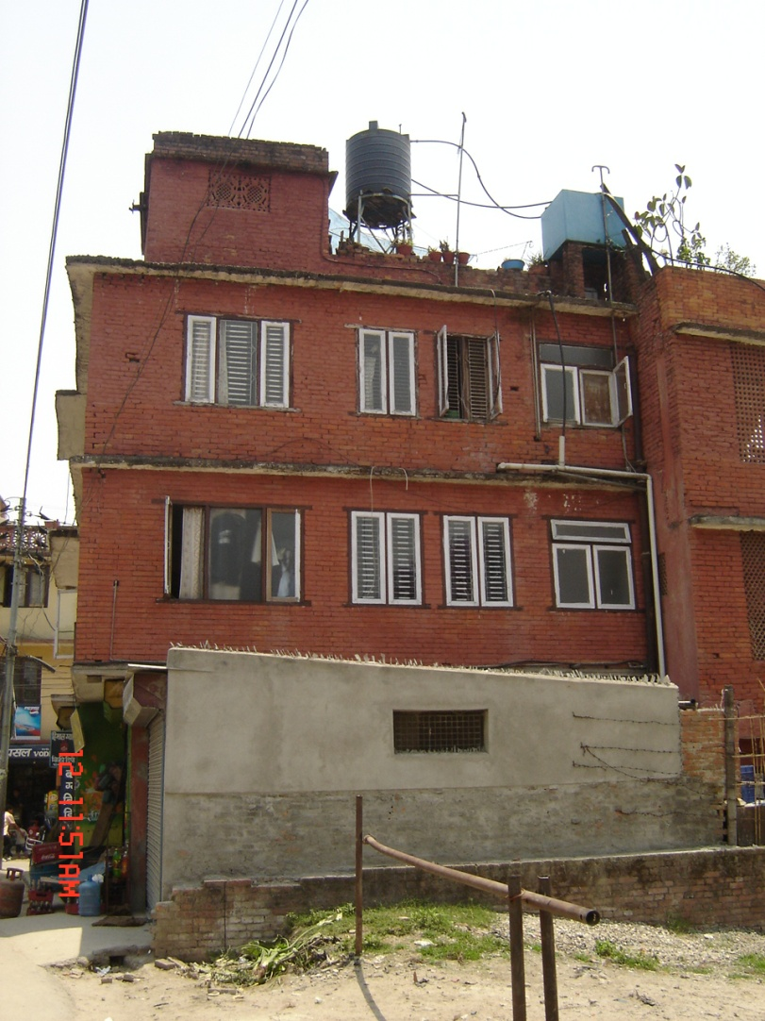
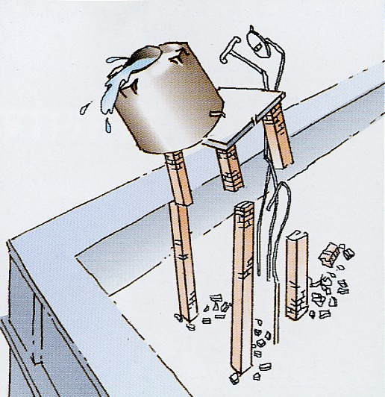
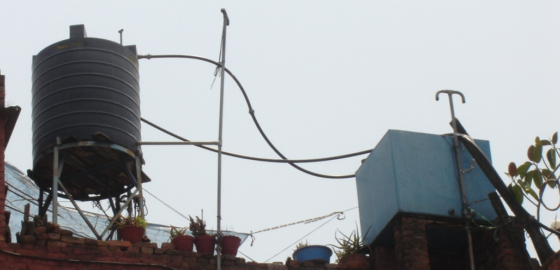
e"sDkLo k"j{tof/L
© mn 2005
JICA Study Team

Slide 17
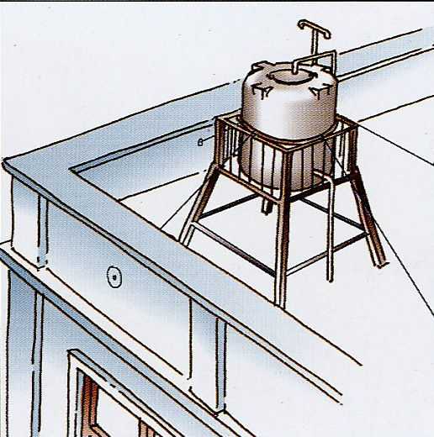
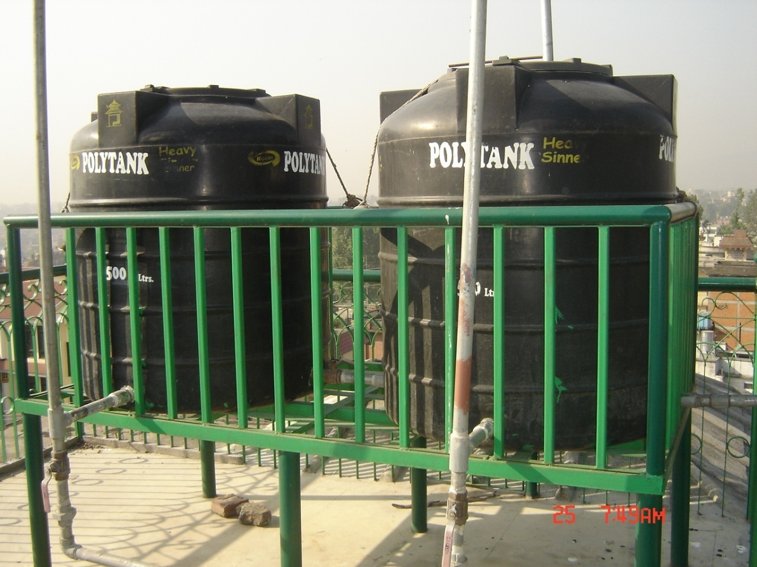
e"sDkLo k"j{tof/L
JICA Study Team

Slide 18
e"O{rfnf] kl5sf nflu ;Dks{ of]hgf
e"O{rfnf] k5fl8 tkfO{ Pj+ tkfO{sf] kl/jf/sf ;b:ox? hxfF ;'s} ePklg s;/L e]6\g] egL klxn] g} ;/ ;Nnfx u/L of]hgf agfO{ /fVg';\ .
tkfO{sf] 6f]n l5d]s tyf 6f]n eGbf aflx/ klg sDtLdf b'O{ j6f e]6\g] :yfgx? klxn] g} klxrfg u/L /fVg';\ .
tkfO{sf] zx/ jf b]z eGbf aflx/ klg ;Dk{ssf] nflu pko'Qm :yfgx? lglZrt u/L /fVgf]; .
e"Orfnf] kl5 e]6\g] :yfg jf ;Dks{ :yfgsf] af/]df lj:t[t 7]ufgf, 6]lnkmf]g g+= OToflb ;a} hfgsf/L kl/jf/sf ;a} ;b:ox? ;u ;fyd} /xg] aGbf]a:t ldnfpg'xf];\ .
o:tf] vfnsf] ;Dks{ of]hgfsf] af/]df 3/ kl/jf/df ;do–;dodf ;Nnfx ug]{ ug'xf]; / slxn] sfxL k"jf{Eof; klg ug'{xf]; .
p4f/ tyf /fxt ;+DalGw sfd ug]{ ;+w ;:yfx?sf] 6]lnkmf]g gDa/ kl/jf/sf ;a} ;b:ox?n] ;fy} /fVg] abf]a:t ug'{xf]; .

Slide 19
kl/jf/df ljz]if x]/rfx cfjZos kg]{ JolQmx?
aRrf, a'9f a'9L, czQm, ckf+u, lj/fdL tyf ue{jtL dlxnfnfO{ e"O{rfnf] / To; k5fl8sf] ;dodf klg ljz]if x]/rfxsf] h?t kb{5 .
cfˆgf] 3/df o:tf] JolQmx? sxf 5g\ yfxf kfO{/fVg'xf];\ .
ltgLx?nfO{ geO gx'g] cf}iflw af cGo cfjZos a:t'x? s] s] 5g\ yfxf kfO{/fVg'xf];\ / ltgLx?sf] ljz]if hf]xf] u/L /fVg'xf];\ .

Slide 20
;'/lIft /fVg'xf];\
kl/jf/ dxTjk"0f{ sfuhftx? nfnk"hf{, r]s a's, gful/stf, kf;kf]{6 aLdf sfuhft, k/Lro kq, k|df0f kqx?
;a} dxTjk"0f{ sfuhftsf Ps–Ps k|ltx? cfˆgf] sfof{no jf cGo ;'/lIft :yfg tyf cfktsfnLg ;fdfu|Lx?sf] emf]nfdf klg /flv/fVgf];\ .
cfˆgf] 3/sf] gSzf klg cGo sfuhftx? ;+u /fVgf]; tyf p4f/ sfo{ ;+u ;DalGwt ;+:yf 5g\ eg] Toxf klg lbO{/fVgf];\ . o;n] e"Orfnf] kl5sf] vf]hL tyf p4f/ sfo{df d2t k'¥ofg]5 .

Slide 21
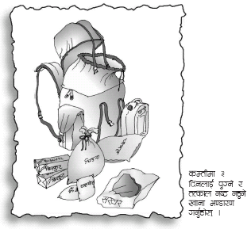
cfkt\sfnLg ;fdfu|Lsf] emf]nf
e"O{rfnf] kl5 klg geO{ gx'g] cfwf/e"t j:t'x? /flvPsf] emf]nf jf afs; tof/ kf/L ;'/lIft / ;lhn} e]6\g ;lsg] :yfgdf /fVg'xf];\ .
cTofjZos a:t'x?
lkpg] kfgL tyf vfg]s'/f
;/;kmfOsf ;/;kmfOsf ;fdfgx?
k|fylds pkrf/ ;fdfu|L
ljz]if JolQmx?sf nflu cfjZos cf}iflwx?
sDtLdf Pshf]/ km]g]{ sk8f
dxTjk"0f{ sfuhftx?
;fdfGo cf}hf/x?
xft] /]l8of], 6r{nfO{6 tyf ;nfO{, nfO{6/

Slide 22
kfgL
e"O{rfnf] kl5 kfgLsf] cefj x'g;Sb5 .
To;}n] sDtLdf tLg lbgsf] nflu k'Ug] kfgLsf] aGbf]a:t ug{ ;Sg' x'G5 < o;f] ePdf cfjZos kfgLaf6 al~rt x'g' kb}{g .
tkfO{sf] cfFug jf s/];faf/Ldf kf]lnlyg 6\of+sL /fVg ;Sg' xG5 .
t/ o:tf] 6\of+sL sf] kfgL ;do ;dodf k|of]u ub}{ km]/L /fVg' kb{5 .
kfgL lgd{nLs/0f ug]{ cf}iflwx?,Water guard klg ;fy} /fVg'xf];\ .
lgd{n rSsL jf cGo cf}iflwx? ;fydf /fVg'xf];\ .

Slide 23
vfg]s'/f
7"nf] e"O{rfnf] kl5 vfg]s'/fsf] klg cefj x'g ;Sb5 . To;}n] a]n}df To;sf] af/]df aGbf]a:t ul//fvf}+ .
rfF8f] glau|g] tof/L vfg]s'/f pko"Qm x'G5g\ . h:t} M–lrp/f, bfndf]7, rfprfp, nfvd/L, kfp8/ b'w, g'g, lrgL OToflb
;fd'bflos ;+w ;+:yfx?df cfkt\sfnLg ;dodf vfgf ksfpgsf] nflu cfkt\sfnLg r'Nnf] -:6f]e_sf] klg aGbf]a:t ul//fVg' pQd x'G5 .
/flvPsf] vfg]s'/fx? ;do ;dodf km]g'{ kb{5 .

Slide 24
;/;kmfO{sf ;fdfg tyf ;fdfGo cf}hf/x?
;fj'g, 6'yk]i6, a?z, sfO{of] ?dfn, 6\jfOn]6 k]k/, ls6gfzs cf}iflw, /j/sf] kGhf
;fgf] du tyf hls{g
;fdfGo xft] cf}hf/x?–k]rs;, dftf]{n, wg, ;gf;f], rSs', s/f}tL, lks, ;fa]n, Hofs
afSnf] kGhf, d'v 9fSg] df:s
Jof6«L af6 rNg] xft] /]l8of], 6r{ nfO{6, hu]8f Jof6«L
l;6\7L

Slide 25
e"O{rfnf] kl5sf] nflu alQ
e"O{rfnf]sf] ;dodf lah'nL alQsf] k|zf/0f lau|g, eTsg uO{ aGb x'g ;Sb5 .
To;}n] j}slNks aQLsf] Joj:yf clxNo} ul//fVg'kb{5 .
Jof6«Laf6 rNg] 6r{nfO{6, s]xL hu]8f Jof6«Lx? tyf lrdx?
-6r{nfO{6 cf]5\ofg ghLs /fVg'xf];\ ._
nfnl6g, 6'sL jf d}gaQL, ;nfO{ nfO6/
h]g]/]6/

Slide 26
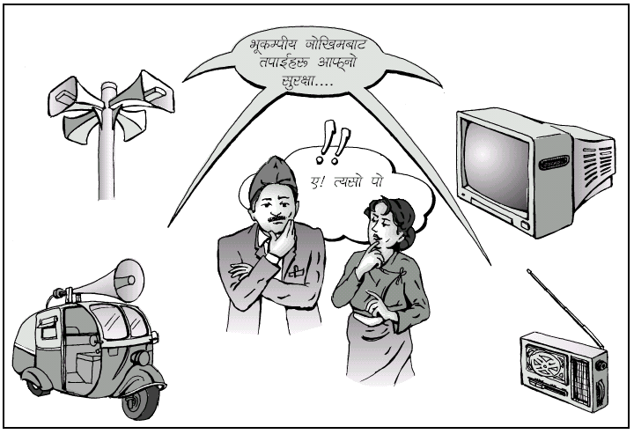
;~rf/ ;Dks{
6]lnkmf]gx? lju|]sf x'g ;Sb5g\ / ;s];Dd 6]lnkmf]gsf] k|of]u gug'{ /fd|f] x'G5 .
o:tf] cj:yfdf df]afOn kmf]g k|efjsf/L x'g ;Sb5g\ t/ ltgLx? klg ;'rf? ?kn] ;~rfng gx'g ;Sb5g\ .
To;}n] e"O{rfnf]sf] ;dodf cfjZos ;"rgf tyf ;dfrf/x?sf] nflu /]l8of] e/kbf]{ dfWod x'g ;Sb5g\ . xft] /]l8of] ;fy} /fVg'xf];\ .

Slide 27
e"O{rfnf]af6 cfunfuL x'g ;Sb5 .
ljh'nLsf tf/ jf :jLrx?df ;6 x'gfn], Uof; lns x'gfn] jf r'Nxf]af6 cfunfuL x'g ;Sb5 .
ljh'nLsf] d]g :jLr tyf Uof;sf] /]u'n]6/ aGb ug]{ t/Lsf 3/sf ;a} 7"nf dfG5x?n] l;ls/fVg'xf];\ .
cfuf] lgefpg] l;ln08/ 5 eg] Tof] k|of]u ug]{ t/Lsf hflg/fVg'xf];\ .
;fj{hlgs tyf w]/} dfG5] e]nf x'g] :yfgx?df clUg lgoGqs l;ln08/x? pko'Qm :yfgdf /flv/fVg'xf];\ .
;lhn} cfunfuL x'g ;Sg] kbfy{x? h:t} M dl6t]n, k]6«f]n, /S;L OToflb ;'/lIft / ;lhn} cfuf]n] gl6Kg] :yfgdf /fVg'xf];\ .

Slide 28
k|fylds pkrf/
k|fylds pkrf/ ;DalGw tflnd jf 1fg lnO /fv]df e"O{+rfnf]sf] ;dodf cToGt pkof]uL x'g ;Sb5 .
k|fylds pkrf/ afs; tyf pkrf/ lgb]{lzsf -h:t}M 8fS6/ gePdf_ ;fy} jf ;lhn} e]l6g] ;'/lIft :yfgdf /fVg'xf];\ .
cTofjZos cf}iflwx? kof{Kt dfqfdf /flv/fVg'xf];\ .
3/ tyf clkm;sf ;a} JolQmx?nfO{ cfwf/e"t hfgsf/Lx? lbO/fVgf];\ .
6fpsf]df nfUg] rf]6 d[To'sf] d'Vo sf/0f xf] eGg] hfgsf/L cfkm' tyf ;a}nfO{ lbO/fVgf];\ .

Slide 29
ejgsf] e"sDkLo ;'/Iff
s] tkfO{ a:g'ePsf] 3/ e"sDkLo lx;fan] ;'/lIft 5 < cyjf goFf 3/ agfpb} x'g'x'G5 eg] e"sDkLo lx;fan] ;'/lIft agfpg] ljrf/ ug'{ePsf] 5 <
5}g eg] o;df Wofg lbg'xf];\ .
3/leqsf j:t'x? klg e"sDksf] ;dodf v;]/ jf 9n]/ Iflt k'¥ofpg ;S5g .
ltgLx?nfO{ ;'/lIft / alnof] lsl;dn] /fVg'xf];\ .

Slide 30
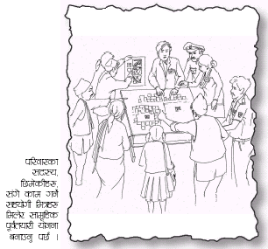
Psfk;df s'/fsfgL ug'{xf];\ .
e"O{rfnf]af6 ;'/lIft /xg] pkfosf] af/]df 3/ kl/jf/df ;do–;dodf s'/fsfgL ug'{xf];\, cfjZostf cg';f/ of]hgf agfpg'xf];\ / ;do–;dodf cEof; ug'{xf];\ .
cfˆgf] 3/ l5d]sdf klg o;af/]df s'/fsfgL ug'{xf];\, cfkm'n] hfg]sf s'/fx? c?nfO{ klg l;sfpg'xf];\ .
cfˆgf] 6f]nsf] e"sDkLo ;'/Iffsf nflu ;d'bfodf 5nkmn u/L of]hgf agfpg'xf];\ / sfof{Gjog ug'{xf];\ .

Slide 31
e"sDkLo k"j{ tof/L M
e"sDk cfpFFb} ubf{ ckgfpg' kg]{ ;fjwfgL

Slide 32
3/leq x'g'x'G5 eg]
gcflQg'xf];\, w}o{k"j{s /xg'xf];\ / c?nfO{ klg 9f8; lbg'xf];\ .
s]xL kfOnf lx+8L klxn] g} klxrfg ul/Psf 3/leqsf jf sf]7fleqsf ;'/lIft :yfgdf uO{ a:g'xf];\ .
kl/jf/sf cGo ;b:ox?nfO{ klg ;'/lIft :yfgdf hfg d4t ug'{xf];\ .
zLzf ePsf ‰ofn tyf cUnf b/fhx? Pj+ cGo c;'/lIft :yfgx?af6 6f9f a:g'xf];\ .
6fpsf]nfO{ 5f]Kg'xf];\, lgx'/]/ zfGt eO{ a:g'xf];\ .

Slide 33
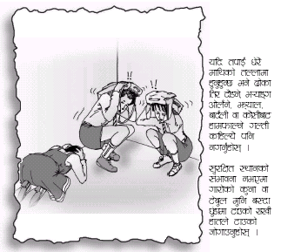
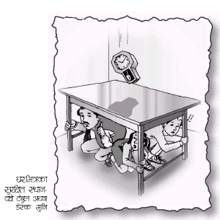
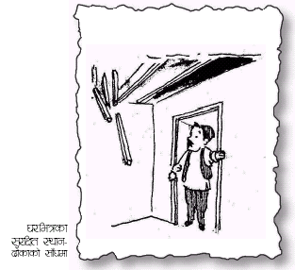

Slide 34
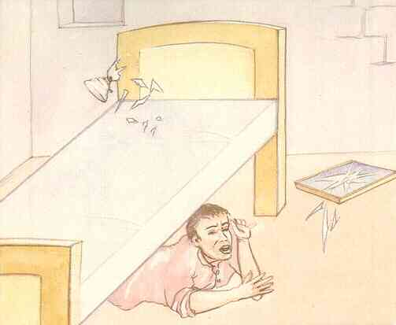
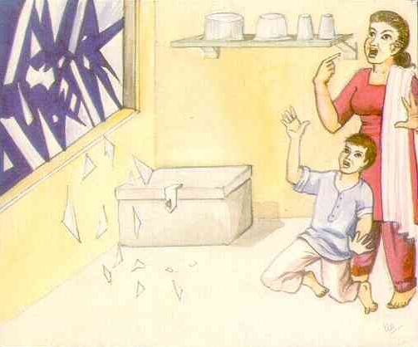
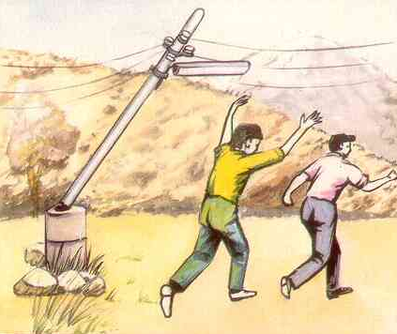
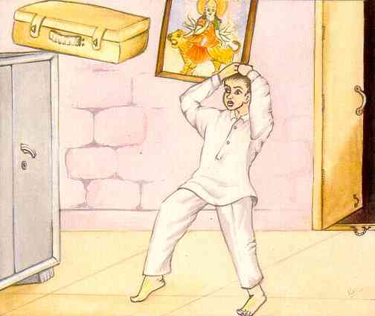
3/leq x'g'x'G5 eg]

Slide 35
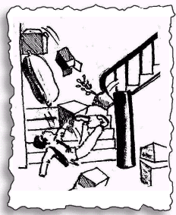
3/leq
e"O{rfnf]kl5 9f]sfx? lqk6 x'g ;S5g\ / kl5 9f]sf vf]Ng gldNg] x'g ;S5g\ .
To;}n] e"O{rfnf]sf] ;dod} sDtLdf Pp6f 9f]sf v'nf ug]{ k|oTg ug'{xf;\ .
e¥ofªaf6 tn jf dfly ghfg'xf];\ . e¥ofª c;'/lIft :yfg xf] .
;fdfgx? vl;/x]sf x'g ;Sb5g\, To;}n] otf ptf gug'{xf];\ .
‰ofnaf6 slxNo} klg aflx/ gxfDkmfNg'xf];\ .

Slide 36
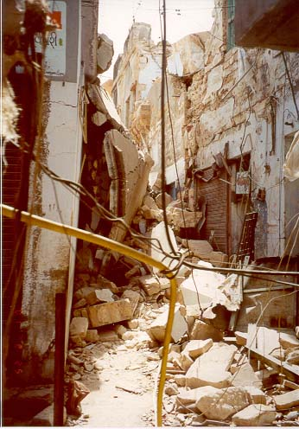
3/ aflx/ x'g'x'G5 eg]
ghLssf] ;'/lIft :yfgdf hfg'xf];\ .
o:tf] ;'/lIft :yfg cUnf 3/x?, ljh'nLsf tf/x? tyf vDafx? tyf cfsfz] k'nx? eGbf 6f9f v'Nnf rf}/ Pj+ km/flsnf ;8sx? x'g ;Sb5g\ .
leqL zx/df x'g'x'G5 eg] 3/x?sf 9f]sf d'lGt/sf efu ;'/lIft x'g ;Sb5g\ t/ 3/ leq gk:g'xf];\ .
;fF3'/f uNnLx?df glx+8\g'xf];\ .

Slide 37
;jf/L ;fwg rnfO/xg' ePsf] 5 eg]
km/flsnf] / v'Nnf ;8sdf x'g'x'G5 eg] t'?Gt} ;jf/L ;fwg /f]Sg'xf];\ .
Jo:t / ;Ff3'/f] ;8sdf x'g'x'G5 eg] ;jf/L ;fwgsf] ult 36fpg'xf];\ , lj:tf/} v'Nnf ;8s tkm{ nfUg'xf]; / /f]Sg'xf];\ .
cfsfz] k'n, cUnf ?v, ljh'nLsf] vDaf jf tf/ xf]l8{ª af]8{ jf ;fOgaf]8{ d'lg ;jf/L g/f]Sg'xf];\ .
e"O{rfnf] g/f]lsP ;Dd ;jf/L ;fwg leq} a:g'xf];\ . s]an 9f]sf dfq clnstf vf]Ng'xf];\ .
e"O{rfnf] ;lsO;s]kl5 ;jf/L rnfpg' eGbf cl3 ;jf/L tyf af6f]sf] /fd|f] ;Fu hfFr ug'{xf];\ clg dfq ;jf/L rnfpg'xf];\ .

Slide 38
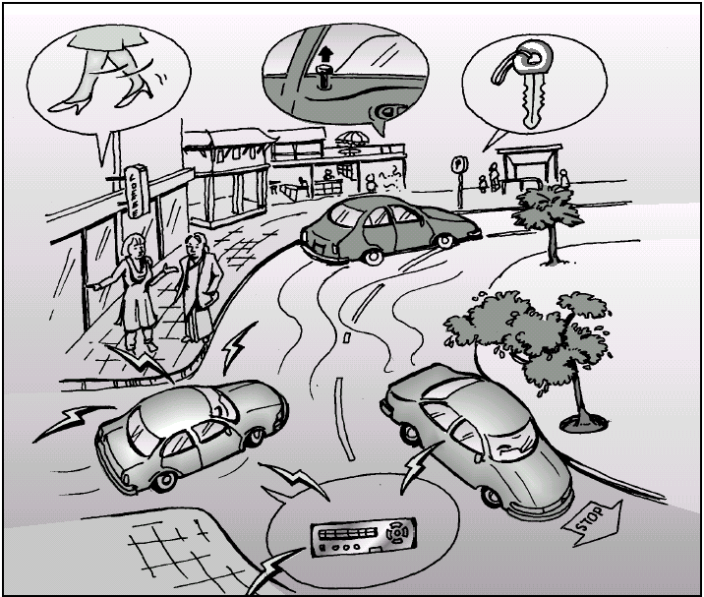

Slide 39
e"sDkLo k"j{ tof/L M
e"sDk uO;s]kl5 ug{' kg]{ sfo{x?

Slide 40
3/ elTsO{ y'lgg'eof] jf k'l/g'eof] eg]
zfGt /xg'xf];\, lj:tf/} Zff; km]g'{xf];\ / cfkm' lhljt /xg]df cfzfafbL x'g'xf];\ . ljutdf y'k|} lbg kl5 klg 3fOt]x?sf] p4f/ ul/Psf w]/} pbfx/0fx? 5g\ .
w]/} cflQ+bf t'?Gt klg d[To' x'g ;Sb5 .
;xotfsf] nlu glrRofpg'xf];\ .
p4f/stf{x?sf] ;+s]tsf] k|tLIff ug'{xf];\ / ;+s]t cfPkl5 dfq cfjfh lbg'xf];=\ .
o:tf] cj:yfdf l;6\7Ln] tkfOnfO{ 7"nf] d4t k'¥ofpg ;Sb5 .
To;}n] klxn]g} l;/fgL d'gL l;6\7L /flv/fVg'xf];\ .

Slide 41
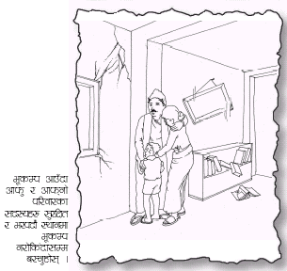
e"sDkkl5
3/ leq x'g'x'G5 eg] kl/jf/sf ;a} ;b:onfO{ hDdf u/L klxn]g} klxrfg ul/Psf 3/ aflx/sf] ;'/lIft :yfgdf hfg'xf];\ .
e"O{rfnf] kms{g ;Sb5 To;}n] t'?Gt 3/ leq ghfg'xf];\, 3/ g/fd|/L Ifltu|:t ePsf] 5 eg] s'g} xfntdf klg k'gM leq ghfg' xf];\ .
tTsfn} kmf]gsf] k|of]u gug'{xf];\, kmf]gsf] cfjZostf tkfO{nfO{ eGbf a9tf vf]h tyf p4f/ stf{x?nfO{ kb{5 .

Slide 42
;s];Dd tTsfn}
cfunfuL x'g;Sg] j:t' tyf :yfgx? aGb ug'{xf];\ . h:t} M UofF; r'Nxf], lx6/, ljh'nLsf] :jLr Otoflb
UofF; lns ePdf UofF;sf] eNe aGb u/L aflx/ lg:sg'xf];\ .
cfunfuL z'? eO{ Psk6ssf] k|oTgdf To;nfO{ lgefpg g;s]df t'?Gt} aflx/ lg:sg'xf];\ .
vfg]kfgLsf d'Vo eNex? aGb ug'{xf];\ . kfgL v]/ hfg ;Sb5, v]/ hfg glbg'xf];\ .
s's'/, la/fnf], afv|f, ufO{ j:t' h:tf kfNt' hgfj/x?nfO{ km'sfO{lbg'xf];\ . ltgLx? klg cflQPsf x'G5g\ .
s's'/ tyf cGo hgfj/x?af6 xf]l;of/ x'g'xf];\, ltgLx?n] cflQP/ 6f]Sg ;Sb5g\ .

Slide 43
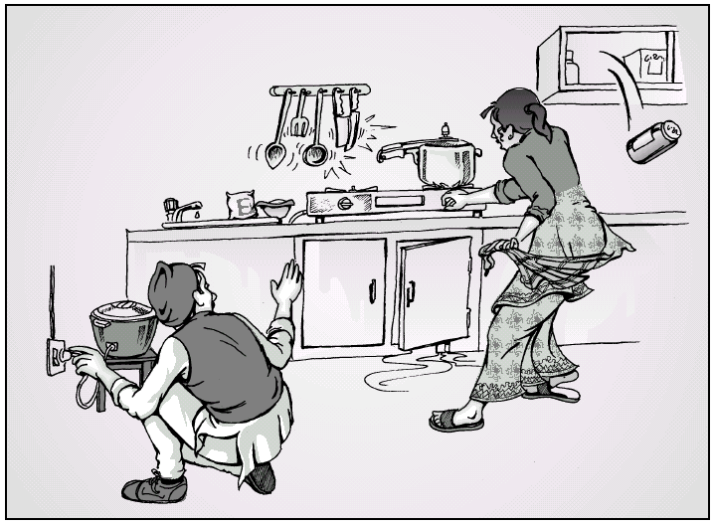

Slide 44
tkfO{n] ;Sg] cj:yf ePdfq
3fOt] tyf RoflkPsf, k'l/Psf JolQmx?nfO{ d4t ug'{xf];\ .
tflnd lng' ePsf] 5 eg] dfq 3fO{t]x?nfO{ k|fylds pkrf/ ug'{xf];\ .
3fOt]x?sf] vf]hL tyf p4f/ sfo{ ub}{ x'g'x'G5 eg] cfˆgf] ;'/Iffdf klg Wofg lbg'xf];\ . tkfO{ hLljt} /xg' ePdf c? w]/} 3fOt]x?nfO{ d4t k'¥ofpg ;Sg' x'G5 .
-d]lS;sf]df *)) JolQmx?nfO{ arfpFbf !)) hgf p4f/ stf{x?sf] Hofg uof]_
l;ls:t 3fOt]nfO{ c:ktfn nfg' cl3 k|fylds pkrf/ lbg] afx]s w]/} grnfpg'xf];\ . ltgLx? cem} vt/fdf eP dfq ltgLx?nfO{ ToxFf af6 cGoq} n}hfg'xf];\ .

Slide 45
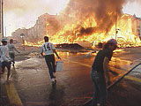
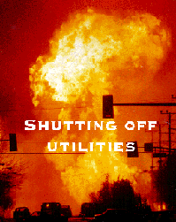
l:yltnfO{ lgoGq0fdf lng d4t ug'{xf];\
cfunfuL ePsf] v08df clUg lgoGqsnfO{ va/ ug'{xf];\ / cfkm'n] klg cfuf] lgefpg d4t ug'{xf];\ .
ljh'nLsf] d]g :jLr aGb ug'{xf];\ . e"O{df v;]sf, nq]sf ljh'nLsf tf/x?nfO{ g5'g'xf];\ . c?nfO{ klg 5'g glbg'xf];\ .
vt/f hGo kbfy{x? kf]lvPsf 5g eg] ;kmf ul/lbg'xf];\ .
v:g nfUg nfu]sf j:t'x?af6 6f9} /xg'xf];\ .

Slide 46
ljrf/ k'¥ofpg'xf];\
s]6fs]6LnfO{ PSn} g5f]8\g'xf];\ . ltgLx?;+u s'/fsfgL ug'{xf];\, v]Ng'xf];\ tfls ltgLx? w]/} gcflQpg\ .
v'NNff eFf8f] jf v'Nnf kf]v/Lsf] kfgL gvfg'xf];\ .
UoFf;, /]u'n]6/ cfunfuL gx'g] 9'Ss geP;Dd gvf]Ng'xf];\ .
k'/} 9'Ss geP;Dd ;nfO{, nfO{6/ afNg] jf ljh'nLsf :jLrx? cg ug]{ gug'{xf];\ .
gf+Ëf] v'6\6f glx+8\g'xf];\ .
uf8L grnfpg'xf];\ . a? ;fOsnsf] k|of]u ug'{xf];\ jf k}bn lx8\g'xf];\ .

Slide 47
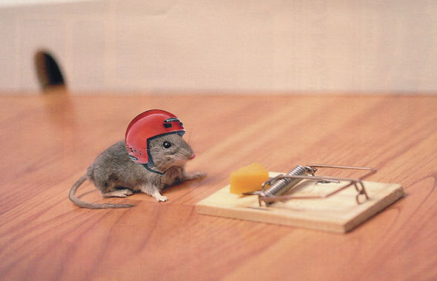
slxNo} gug'{xf];\
cfkm" klg cflQg] / c?nfO{ klg cTofpg]
grflxg] xNnf km}nfpg] . e"O{rfnf] kl5 km]/L e"O{rfnf] cfpb}5 eGg] xNnf Jofks ?kdf rNg ;Sb5 . To;sf] kl5 gnfUg'xf];\ t/ e"O{rfnf] km]/L kms{g ;S5 eGg] s'/fdf rflx+ ;r]t x'g'xf];\ .
vf]hL p4f/ tyf /fxt sfo{ k|lt grflxbf] l6sf l6Kk0fL gug'{xf]; . e"O{rfnf]sf] ;dodf ;a}hgf xtf/df cfkm"n] ;s];Dd sfd ul//x]sf x'G5g\ . To;}n] o:tf] cj:yfdf grflx+bf] l6sf l6Kk0fL u/]/ sfd ug]{ x?nfO{+ cK7\of/f] gkfg'{xf];\ .

Slide 48
wGojfb Û
Notes:
Here are some of the issues for discussion with the participants if they are interested and raise the questions.

