Slide 1
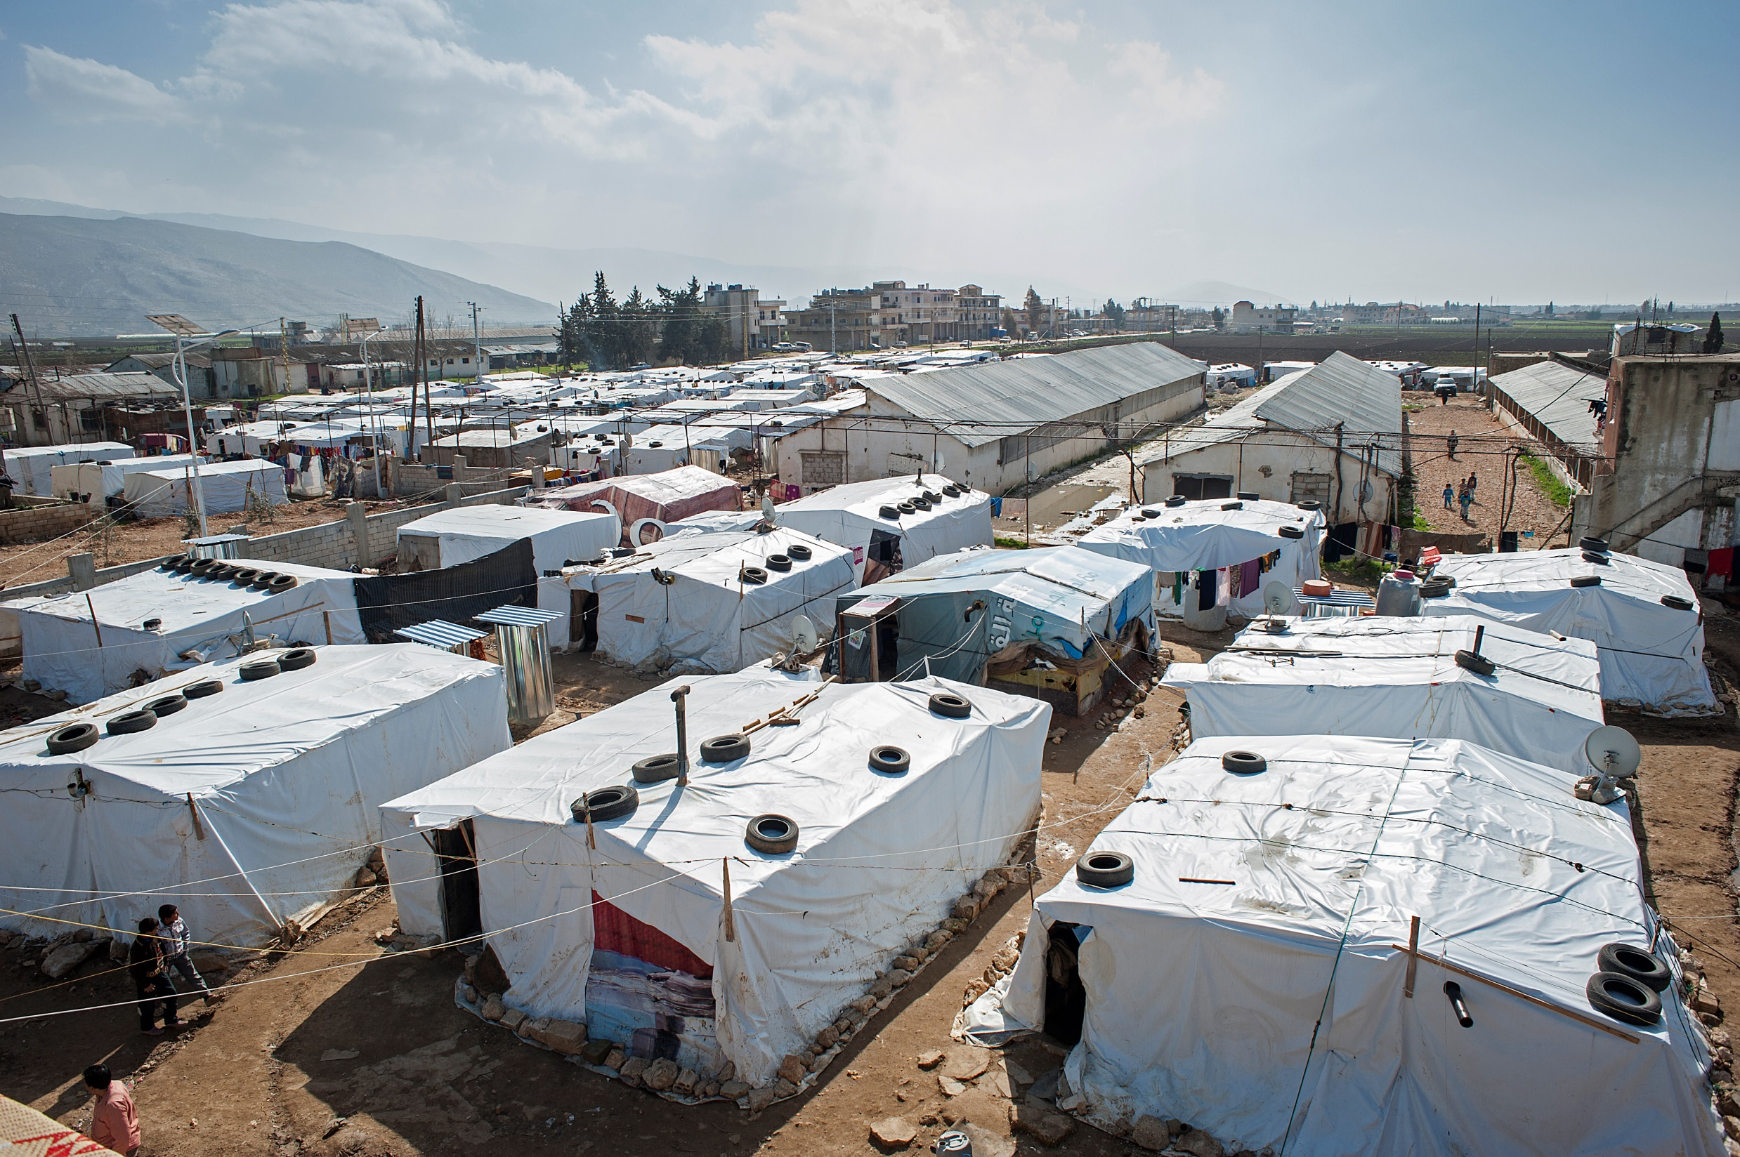


Mapping Informal Settlements (IAMP)

Slide 2

Definition of an Informal Settlement
An Informal Settlement is
  An unofficial group of temporary residential structures
  Structure: plastic-sheeting and timber structures built for human habitation, with limited or no masonry
  Size: Any number of tents, including single tents.
  Area: Contiguous site of any size, or non-contiguous tents within 300 m2
  Management: none or informal community-led management (Shawish or focal point)
  Demographics: Not restricted to refugees or any particular ethnicity or nationality
Inter Agency Mapping Platform

Slide 3
Benefits of the Project
NGOs can plan work in additional settlements, closing gaps, as basic information and location is provided
Regular detection of new settlements, inactivation of missing settlements
Same coding system allows for easier coordination on the national and local level as well as a common approach to reporting
One coherent and unified approach to mapping which creates a reliable baseline of data to build upon
Inter Agency Mapping Platform

Slide 4

Purpose of IAMP
Identify and collect basic Information on a regular Basis
Common Language and data set
Identify, track and locate vulnerable communities
Serve as a common baseline for activities
Notes:
To identify and collect basic information about each Informal Settlement on a regular basis (monthly in Bekaa; Bi-monthly in the rest of Lebanon)
To provide common language and dataset for informal settlements
To identify remote, vulnerable communities, and track size and locations of these communities
Serve as a common baseline for activity planning, gap identification, assessments, monitoring, and coordination

Slide 5
History of the IAMP
2013
2014
2015
2016
2017
May
Partners used to collect data as part of their work
January
Mapping Project highlighted as best Practice
January
One sweep every 3 months
June
MEDAIR started with the pilot project
Jan - Dec
One sweep per month
August
Started Mapping after cleanup
January
IAMP project started in all of Lebanon
Jan - Dec
Monthly and Bimonthly sweeps
Jan – Dec Bimonthly sweeps
Notes:
Different actors used to collect data independently as part of their work
same settlement under different names, areas were ignored due to miscommunication between NGOs, etc…)
Gap in consistent, high quality, and comprehensive informal settlement data
Medair’s independent mapping was highlighted as a best practice, the methodology was formalized, and mapping partners were designated throughout the country

Slide 6
IAMP Roles and Responsibilities
IAMP Coordinating Agency (Medair)
Humanitarian Coordinating Agency (UNHCR)
Mapping Partners (Medair, REACH, Soliarites International, CISP, PU-AMI Beirut/Mt. Lebanon, and PU-AMI South
Inter Agency Mapping Platform

Slide 7
Field Level Impacts
The Public Viewer account on Collector has enabled field teams to locate settlements and plan more efficient distributions
Database of key contacts for the refugee communities and focal points to base interventions upon
The PCode system allows for the combining of multiple data sets together for gap analysis comparisons
Community self-identification during emergencies and in everyday interactions with the humanitarian community
Inter Agency Mapping Platform

Slide 8
Coding System: PCodes
5 3 2 1 1 – 01 – 001
Governorate (ie: Bekaa)
Incremental Number inside each Cadaster
Shelter Type
District (ie: Baalbek)
Cadastral
(ie: Ras Baalbek Es-Sahel)
01: Informal Settlement
The new PCode will be defined as “12345_01_001”
-The first 5 digits indicate the CAS-Code. The number is unique for every cadastral in Lebanon.
-The second 2 digits indicate the type of the settlement
-The last 3 digits indicate the sequential number of the Informal Settlement (within every cadastral).
Inter Agency Mapping Platform

Slide 9
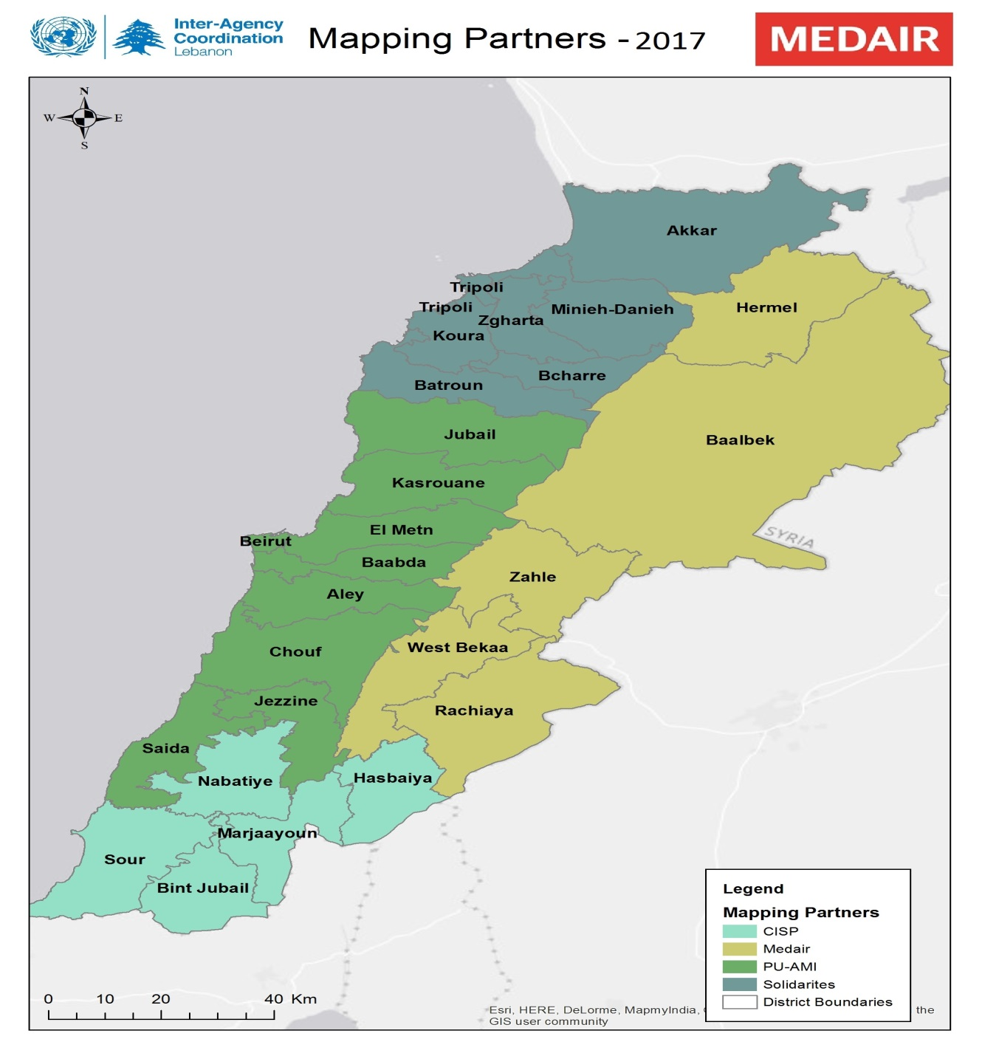
Mapping Partners for 2017
Mapping Partners are:
Solidarités International
PU-AMI, Beirut/Mt. Lebanon
PU-AMI, Jezzine/Saida
CISP
Medair
Inter Agency Mapping Platform
Notes:
Data is collected nationally
Data is collected by different mapping partners across different operational areas but the same methodology, training, and core datasets are collected across the country

Slide 10



IAMP Update
Nationally 23.26% of Registered Syrian Population lives in Informal Settlements*
  65.77% in the Bekaa
  26.36% in the North
  5.08% in the South
  2.79% in Beirut/Mt. Lebanon
236,662Individuals
41,613 Tents
4,373 Settlements
*Based off number of registered Syrian population as of 30 Sep 2016 and IAMP 34
Changes between IAMP24 and IAMP34
13.61%
Increase in Number of Settlements.
19.71%
19.1%
Increase in Number of Tents..
Increase in Number of Individuals..
Inter Agency Mapping Platform

Slide 11
IAMP Coordinating Agency
Responsibilities
Communication
Training Mapping Partners
Cleaning and verifying the data received nationally
Collating data and issuing to UNHCR once a month
Sole responsibility to create PCodes for each Informal Settlement
Facilitating access to and managing the online web maps
Lead collation of best practices and lessons learned for the improvement of methodology
Regular feedback to mapping partners on data collected
Periodic review of dataset after IAMP release to communicate issues – to Mapping Partners and FPs
Regular communication/advocacy with national level working groups on updated status of the IAMP
Ad-hoc updates on IAMP data collection nationally for IAMP Key Contacts
Forwarding as appropriate issues faced in the field, referrals, and other matters related to the IAMP
Notes:
Agency responsible for methodological oversight, ensuring data quality through centralized data management, and coordination of Mapping Partners.
Responsibilities:
Training Mapping Partners
Cleaning and verifying the data received nationally
Collating data and issuing to UNHCR once a month
Sole responsibility to create PCodes for each Informal Settlement
Facilitating access to and managing the online web maps
Lead collation of best practices and lessons learned for the improvement of methodology in collaboration with UNHCR for approval at the interagency level
Regular feedback to mapping partners on data collected
Periodic review of dataset after IAMP release to communicate issues – to Mapping Partners and FPs
Regular communication/advocacy with national level working groups on updated status of the IAMP
Ad-hoc updates on IAMP data collection nationally for IAMP Key Contacts
Forwarding as appropriate issues faced in the field, referrals, and other matters related to the IAMP

Slide 12
Humanitarian Coordinating Agency
Responsibilities
Communication
Promotion of the IAMP as a core data set and tool for coordination in informal settlements
Hosting and retaining ownership of the data
Releasing the IAMP dataset on a monthly basis
Designating an IAMP focal point at each UNHCR field- or sub-office for purposes of monitoring implementation of IAMP methodology and promotion of the IAMP at the local level
Collate all existing information on Informal Settlements as part of the initial set-up process for mapping in a new area
Facilitating access to politically difficult areas and helping address problems in the field
Dissemination of the IAMP dataset to all relevant parties
Dissemination of the restricted access IAMP data as needed
Regular communication with the IAMP Coordinating Agency on overall progress, bottlenecks, changes to the methodology and other issues
Ensuring connection between various sector WGs and the IAMP at national and local level
Notes:
UNHCR, in this role, is responsible for coordination and promotion of the IAMP as the official Informal Settlement dataset for humanitarian coordination purposes.
Responsibilities
Promotion of the IAMP as a core data set and tool for coordination in informal settlements
Hosting and retaining ownership of the data
Releasing the IAMP dataset on a monthly basis
Designating an IAMP focal point at each UNHCR field- or sub-office for purposes of monitoring implementation of IAMP methodology and promotion of the IAMP at the local level
Collate all existing information on Informal Settlements as part of the initial set-up process for mapping in a new area
Facilitating access to politically difficult areas and helping address problems in the field
Dissemination of the IAMP dataset to all relevant parties
Dissemination of the restricted access IAMP data as needed
Regular communication with the IAMP Coordinating Agency on overall progress, bottlenecks, changes to the methodology and other issues
Ensuring connection between various sector WGs and the IAMP at national and local level

Slide 13
Mapping Partner
Responsibilities
Communication
Collecting data according to the methodology
Reporting challenges to the IAMP Coordinating Agency
Ensuring Pcode Business Cards are available in every settlement
Attending trainings as organized by IAMP Coordinating Agency
Active participation in any meetings related to further development of the project
Advocating for the identification and use of IAMP PCodes in their area of operation
Daily (or as data is collected) communication with the IAMP Coordinating Agency – data collection sheets, issues, sweep progress
Promotion of IAMP in local WGs and mapping implementation in their area of coverage
Communication of best practices, bottlenecks, issues in the field and proposed changes
Communicating with partners regarding any sites missing pcodes
Notes:
Mapping Partners are directly responsible for the implementation of data collection for IAMP on the field level.
Responsibilities
Collecting data according to the methodology
Reporting challenges to the IAMP Coordinating Agency
Ensuring Pcode Business Cards are available in every settlement
Attending trainings as organized by IAMP Coordinating Agency
Active participation in any meetings related to further development of the project
Advocating for the identification and use of IAMP PCodes in their area of operation
Daily (or as data is collected) communication with the IAMP Coordinating Agency – data collection sheets, issues, sweep progress
Promotion of IAMP in local WGs and mapping implementation in their area of coverage
Communication of best practices, bottlenecks, issues in the field and proposed changes
Communicating with partners regarding any sites missing pcodes

Slide 14
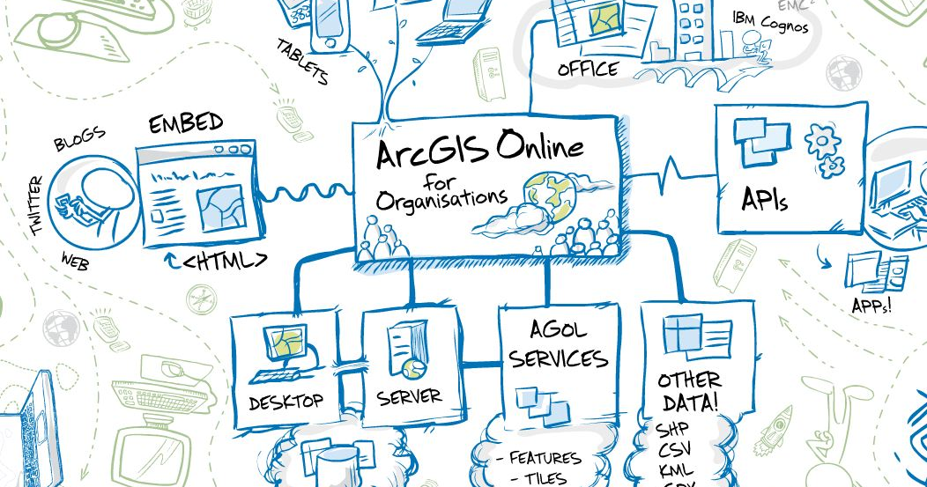
ArcGIS Online
©Medair/Kate Holt
Inter Agency Mapping Platform
Notes:
Using ArcGIS Online to verify data
Online IAMP Viewer (can be filtered by area)
Dots on Map
Red- Needs to be updated
Blue- Has been updated

Slide 15
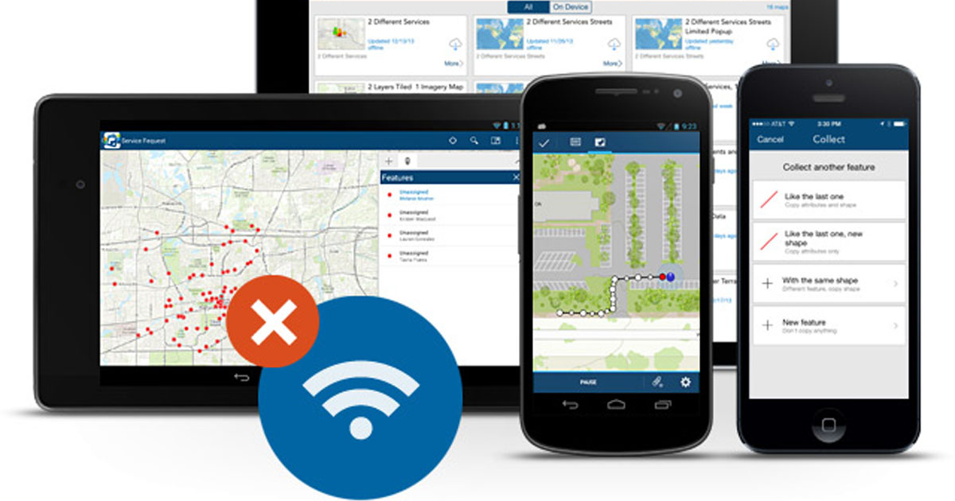
Collector (Public Viewer Account)
©Medair/Kate Holt

Slide 16
Important
When mapping teams are conducting mapping, they should be doing this independently from other projects
  This is to ensure active and impartial identification of new settlements, regardless of the agency’s coverage of those settlements
Inter Agency Mapping Platform

Slide 17
Field Operation Procedures
Arrive to the site
Identify the focal point /Shawish, and introduce the staff and the project.
  Identify the Shawish or Community Focal Point
  Introduce the staff and project: explaining why the staff is there and also ask permission to conduct the assessment
Inter Agency Mapping Platform

Slide 18
Pcode Visibility
Creating or Checking PCode Visibility
  In second visit the PCode Card / Shawish business Card should be given to the Shawish that contains the Pcode, the FP and the FP’s Phone number among other data.
  On every visit, check that the PCode Card is available and correct, if not issue a new one.
Inter Agency Mapping Platform

Slide 19
Counting Tents or Closed/Empty Tents
All tents regardless of its occupancy status
  If a tent is empty but liveable, count it as a tent
  Mention the number of empty tents in the notes as empty tents can influence the ratio of individuals to tents and can make the results appear strange
  Do not count tents if they are a Mosque, kitchen, shop or anything else that in not intended to be a dwelling
If tents are empty (and door closed up)
  Ask a nearby neighbour regarding the tent
  If no one is available to ask about the closed tent, leave the site to sweep on another day.
  If no one is available on the second attempt to sweep the site, write down the number of empty tents and any directly observable information and make a note “after a second sweep attempt, no one was found on the site.” In this case the size would still be considered Active/Less than 4 not Inactive.
Inter Agency Mapping Platform

Slide 20
Areas with Restricted Access
Alternative Mapping Procedure in the South
  Due to restrains in using all mobile devices, CISP is using Google earth to assign longitude and latitude
Restricted access due to security constraints
  Alternative means of collecting data in areas with limited access
    Issues of ensuring data quality
    Mapping partner versus temporary and limited secondment
    Long-term affect on resource advocacy
Inter Agency Mapping Platform

Slide 21
Data Validation Procedure
Flow chart of processes.
Inter Agency Mapping Platform

Slide 22
Referral Procedure (Implementing Partners)
1
2
3
Collect Information while in the field
Download the referral form
Email it to the correct people
Cadaster
Coordinates
Nbr of tents
FP name and phone
Nearest Pcoded site
Distinguishing features near by
Find it on the UNHCR IM DropBox under Mapping and PCodes
Local Implementing Partner
IAMP Coordinating Agency
Relevant shelter and WASH Sector FP
Notes:
Collect the following information District
Cadastral
GPS- Latitude and Longitude Number of Tents
Contact name and number for Shawish
Near another settlement that is PCoded? Yes, what PCode?
Any distinguishing features to help relocate the site: near a fuel station, near a road junction, etc.
Fill out the PCode referral form (on the UNHCR IM Databox) and email to both the local mapping partner, the IAMP coordinating agency (Medair, gis2-zah@medair.org and gispm-zah@medair.org), and your relevant shelter and WASH sector focal points.

Slide 23
Referral Procedure (Mapping Partner)
Receive Referral Form
Field Verification
Send the PCode
Keep a Record
Notes:
Field verification of all referrals within their area of coverage
Communicate with referral agency if information concerning the site is unclear
Field verifications should be done within 1 sweep, and ideally within 1 month. A high priority should be given to verifying referrals, but this should not greatly disturb normal mapping activities.
Keeping a record of all referrals

Slide 24
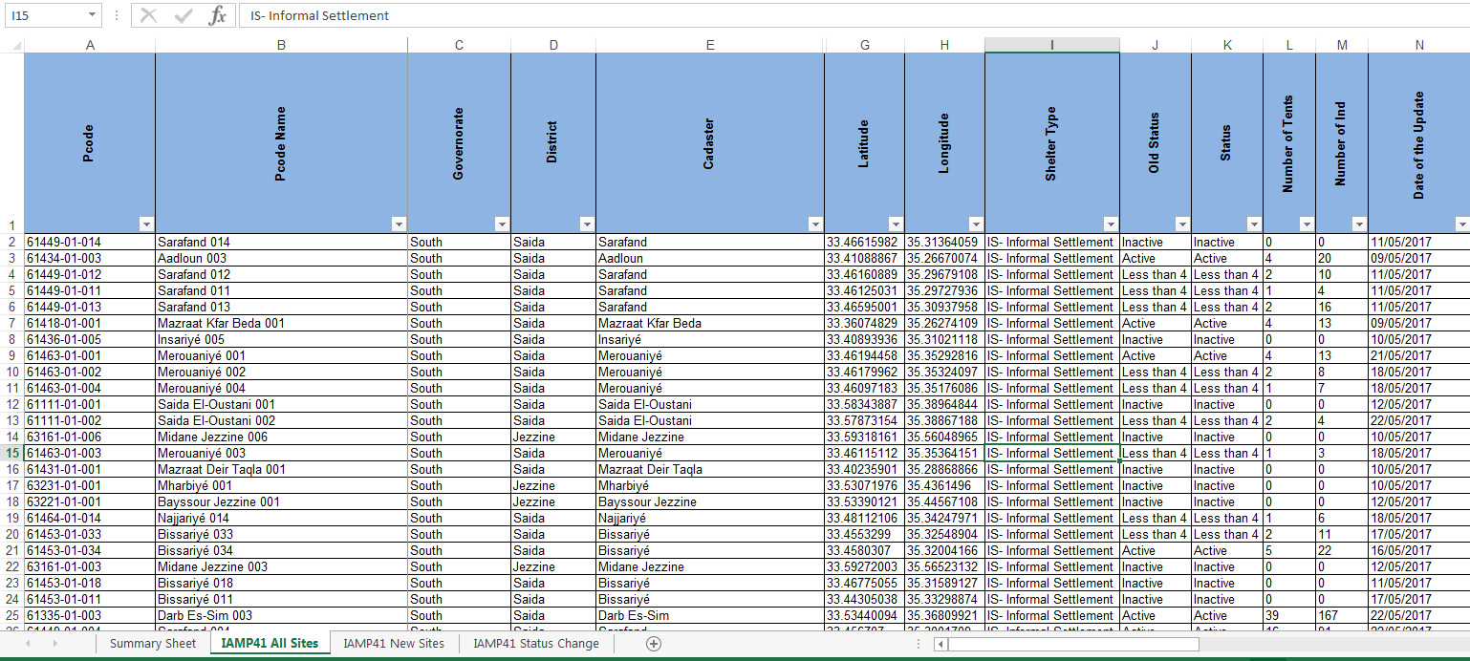
IAMP Sample

Slide 25
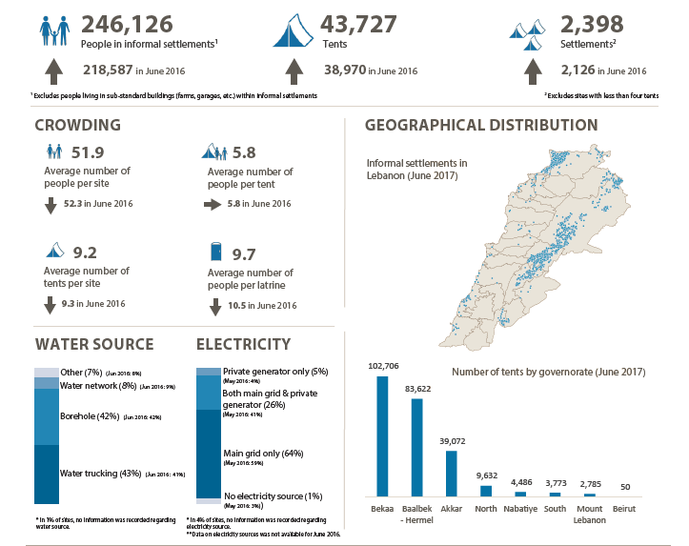

Slide 26
Any Questions?
Inter Agency Mapping Platform

Slide 27
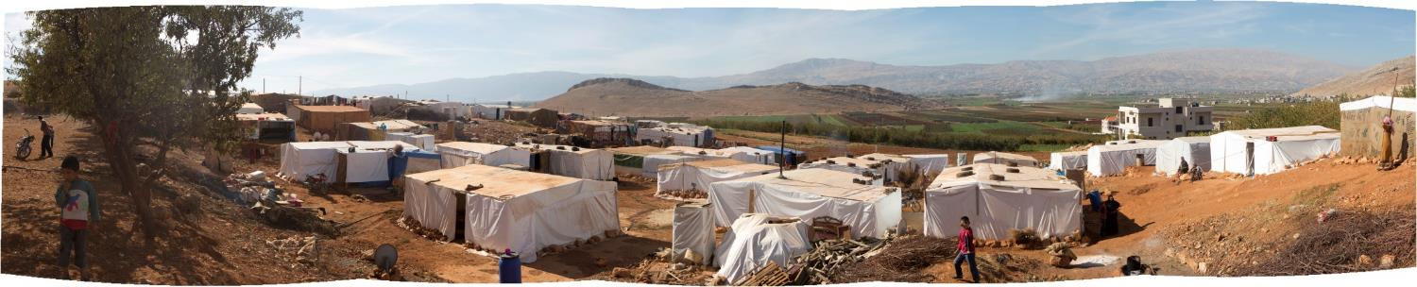
Thank You
Inter Agency Mapping Platform

