Slide 1
Shelter Cluster Coordination Workshop
Sharing of experiences and idea’s
Alexander van Leersum
2 Oct 2017

Slide 2
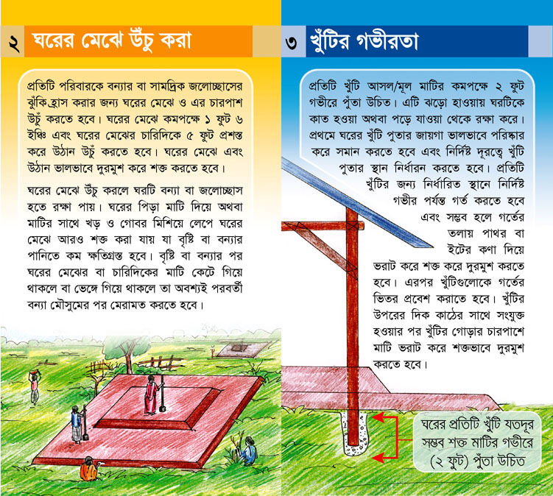
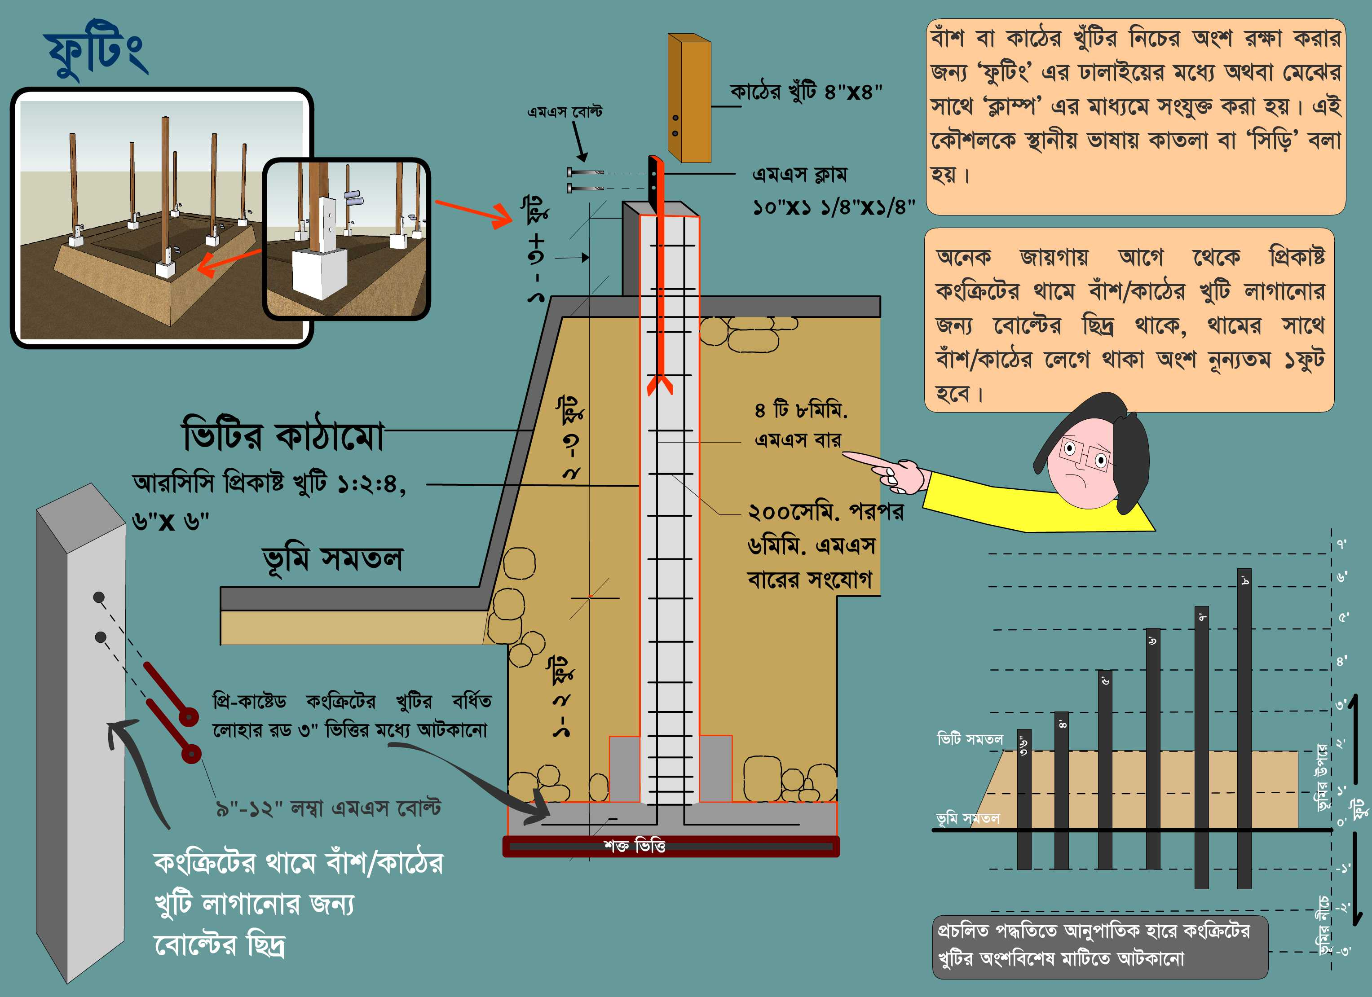
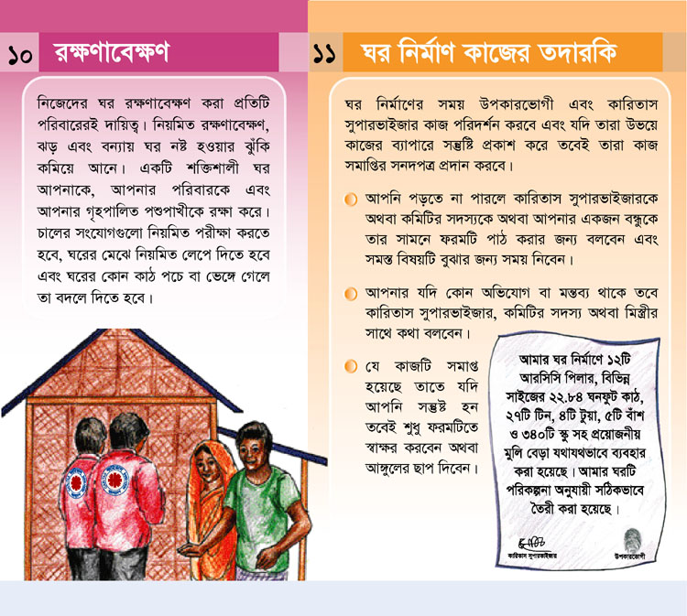
Technical support: Bangladesh July 2017
IEC development
Version x,y,z
2007
2014
2017

Slide 3
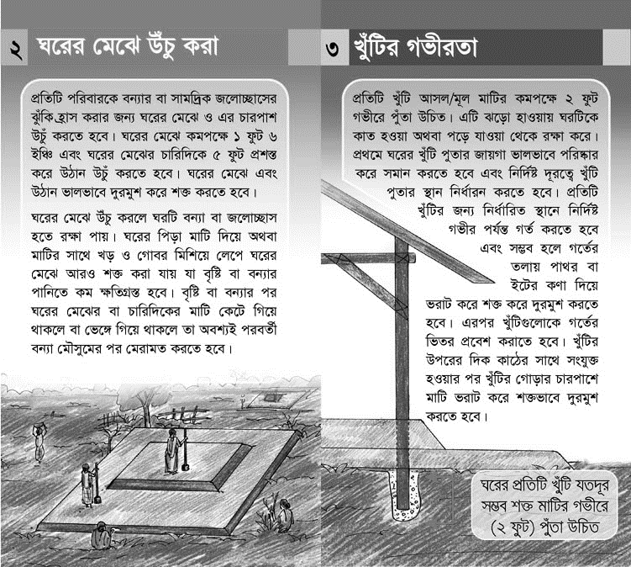
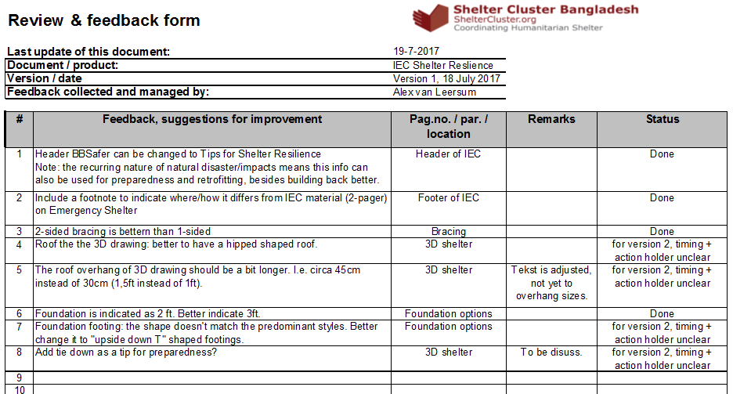
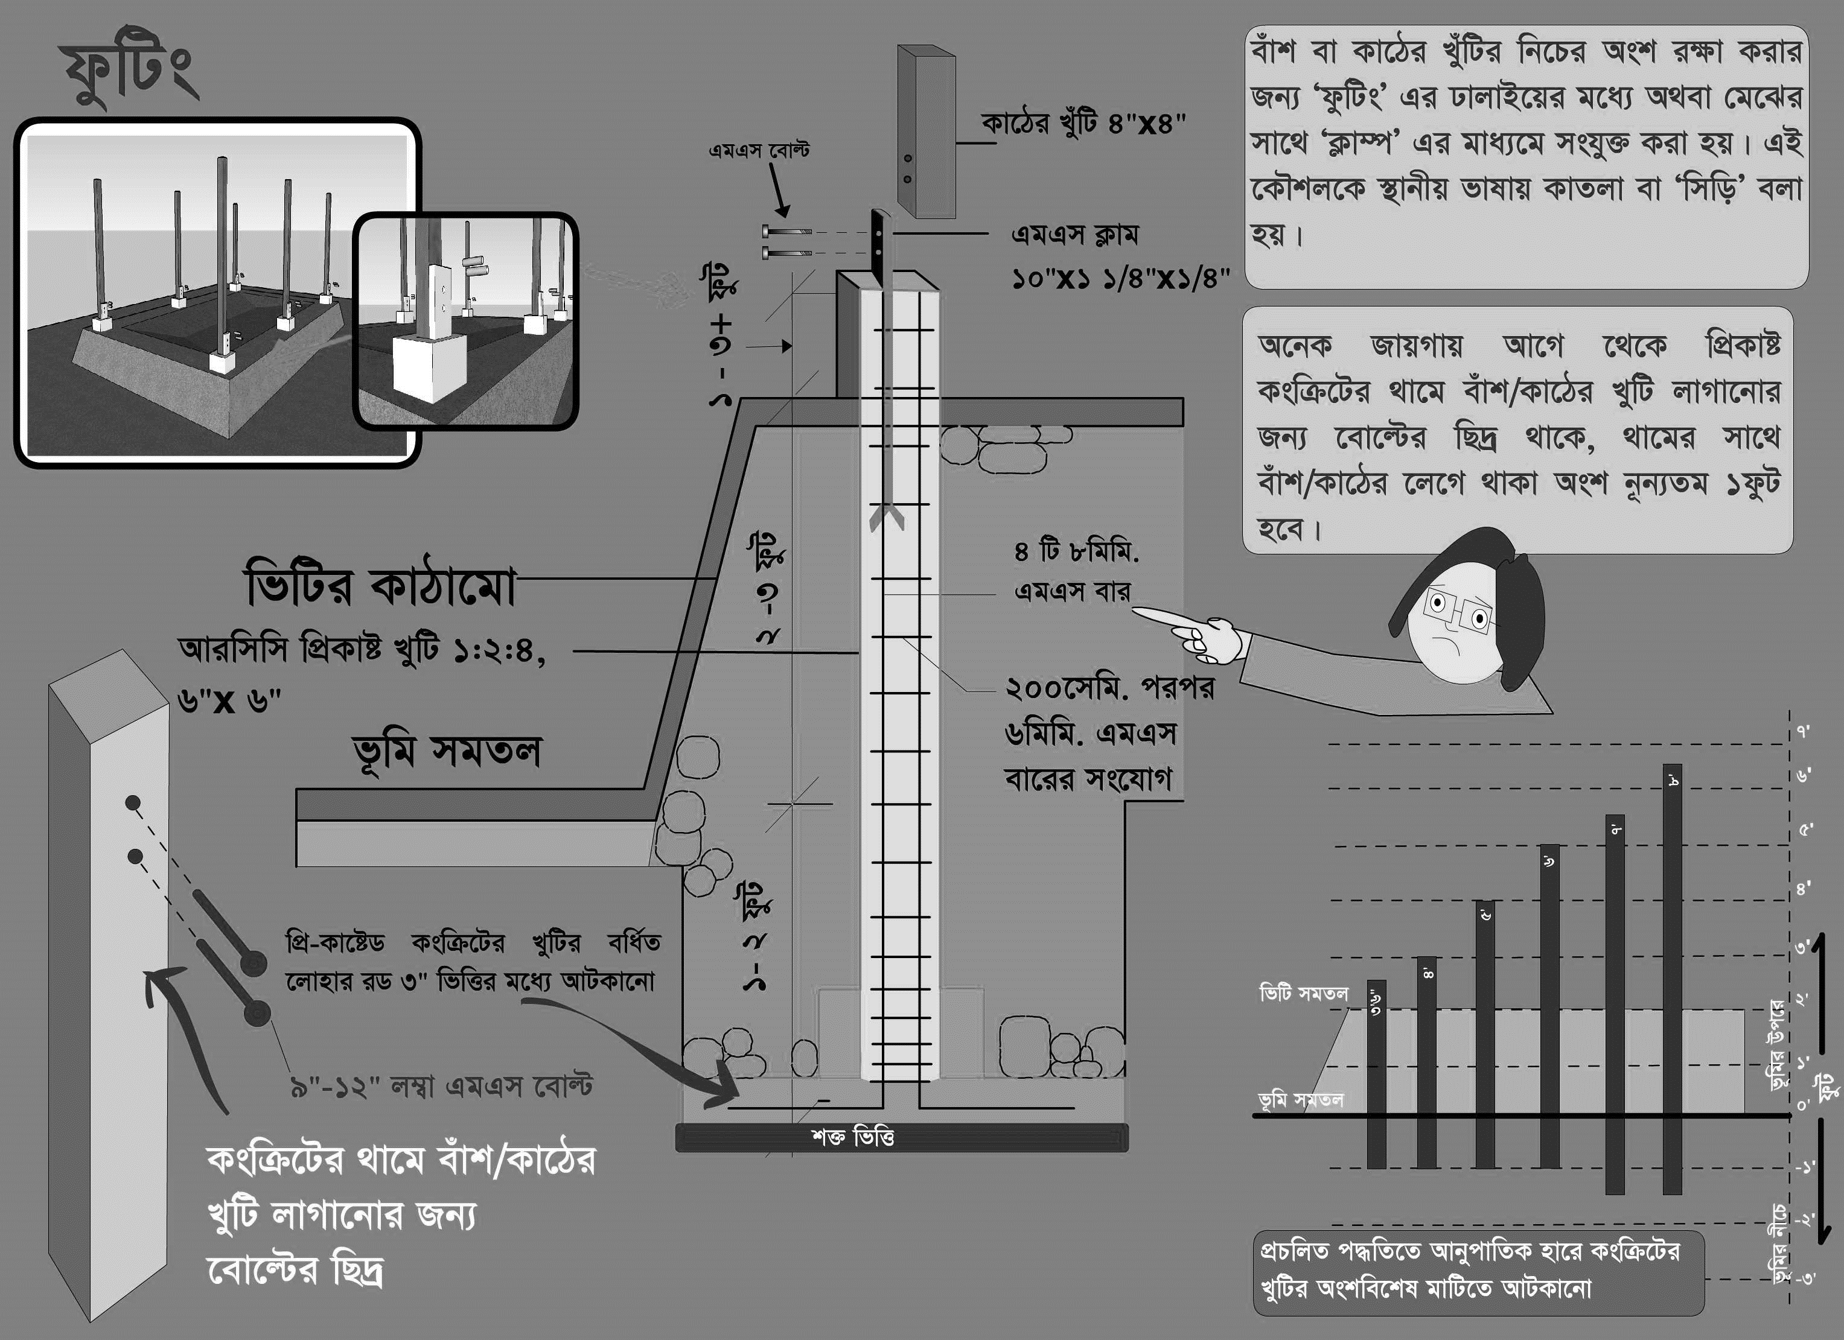
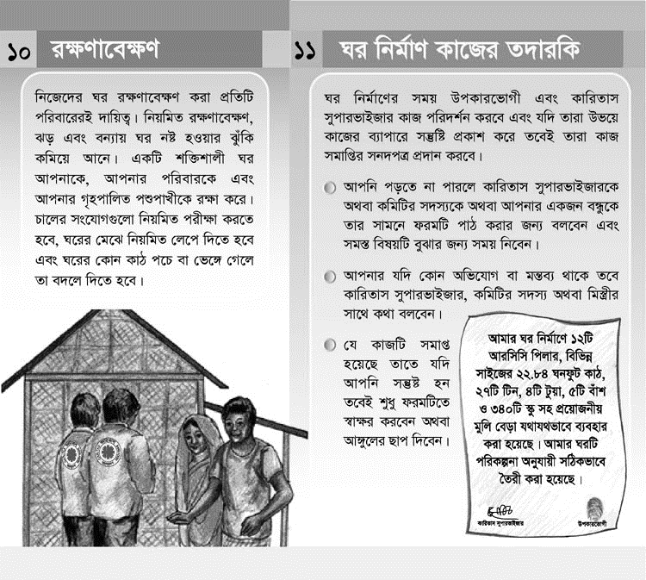
Technical support: Bangladesh July 2017
IEC development
Version x,y,z
2007
2014
2017

Slide 4
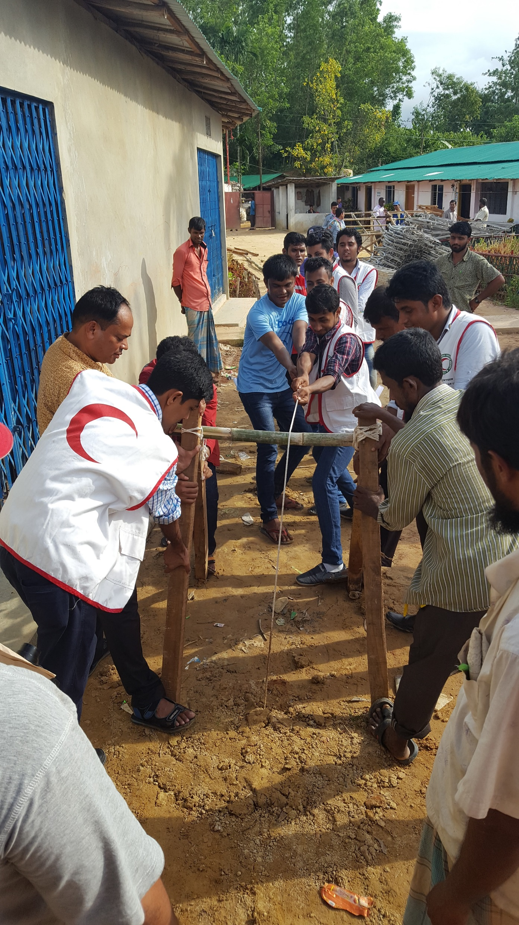
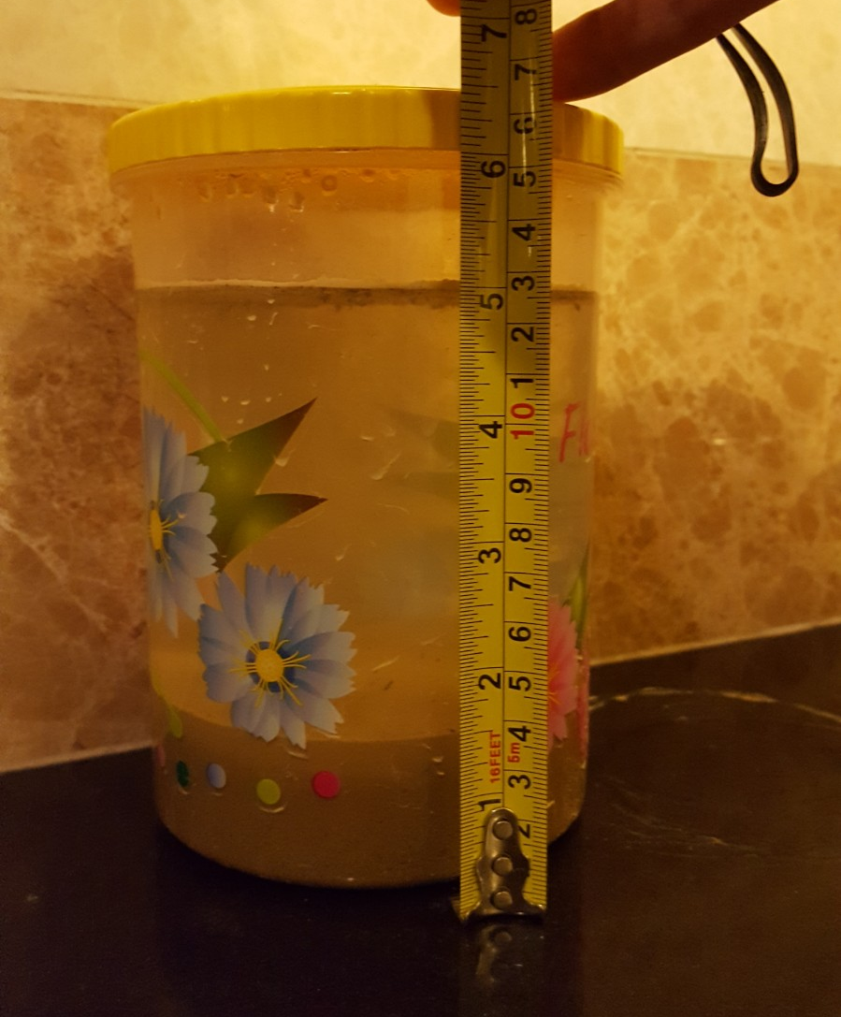
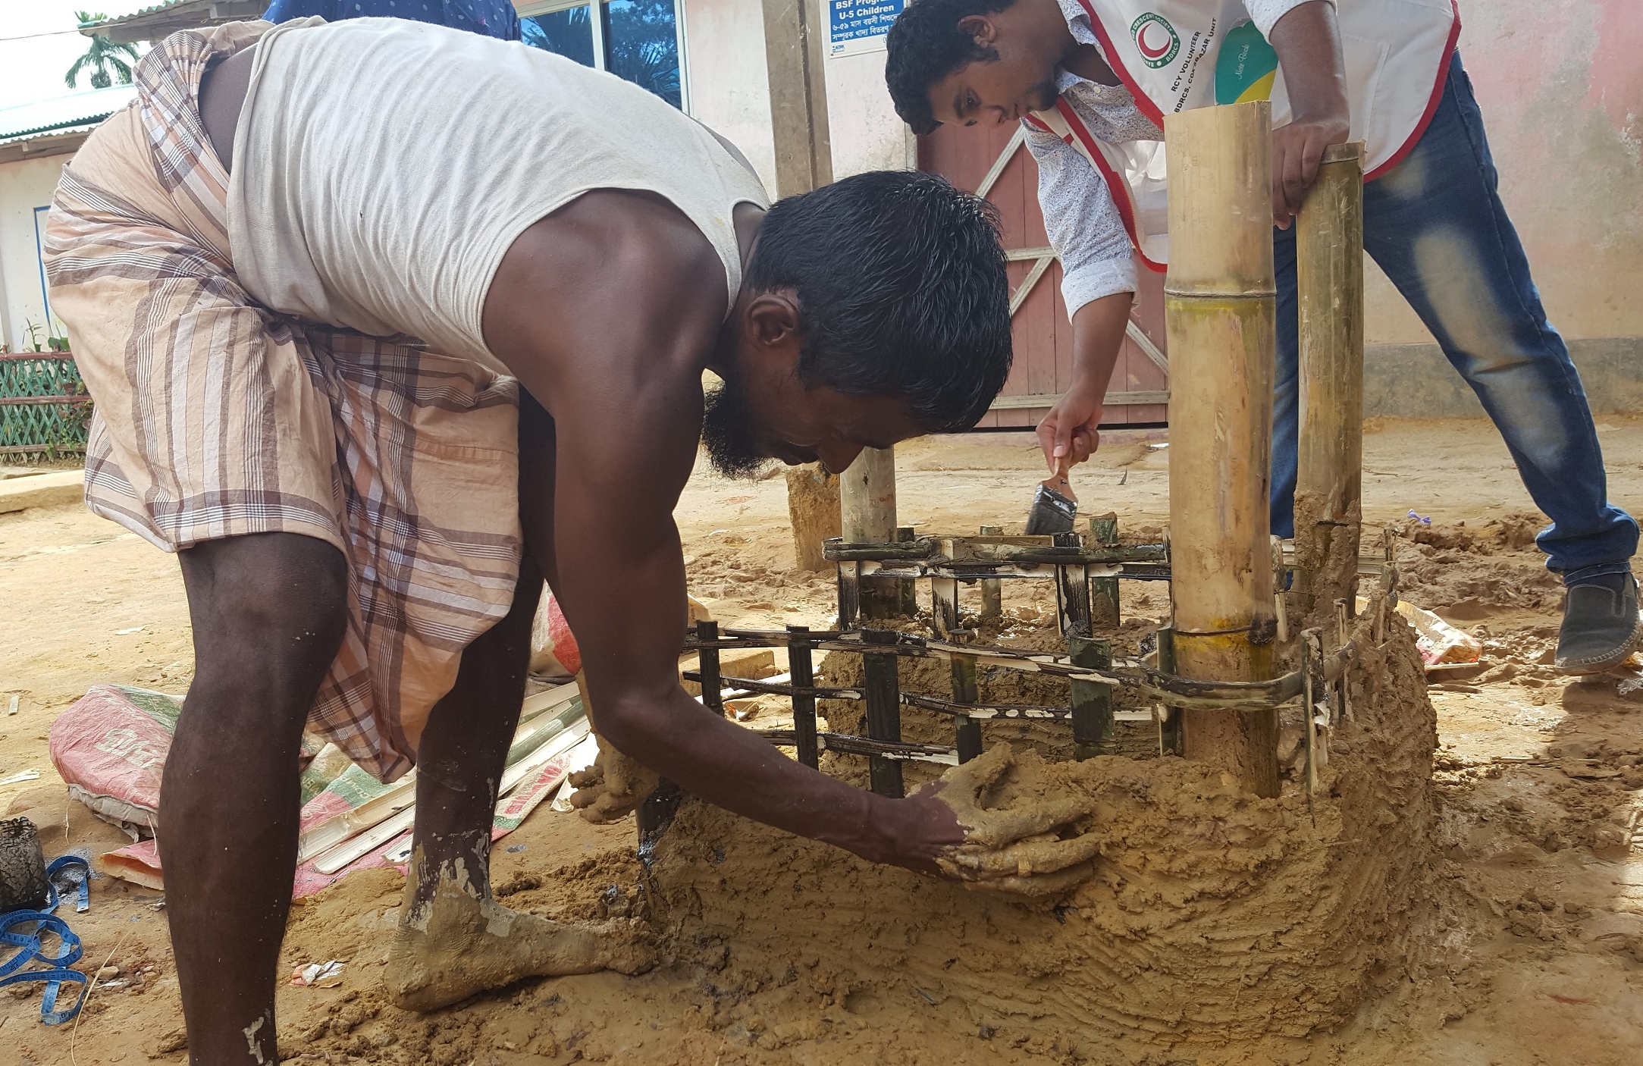
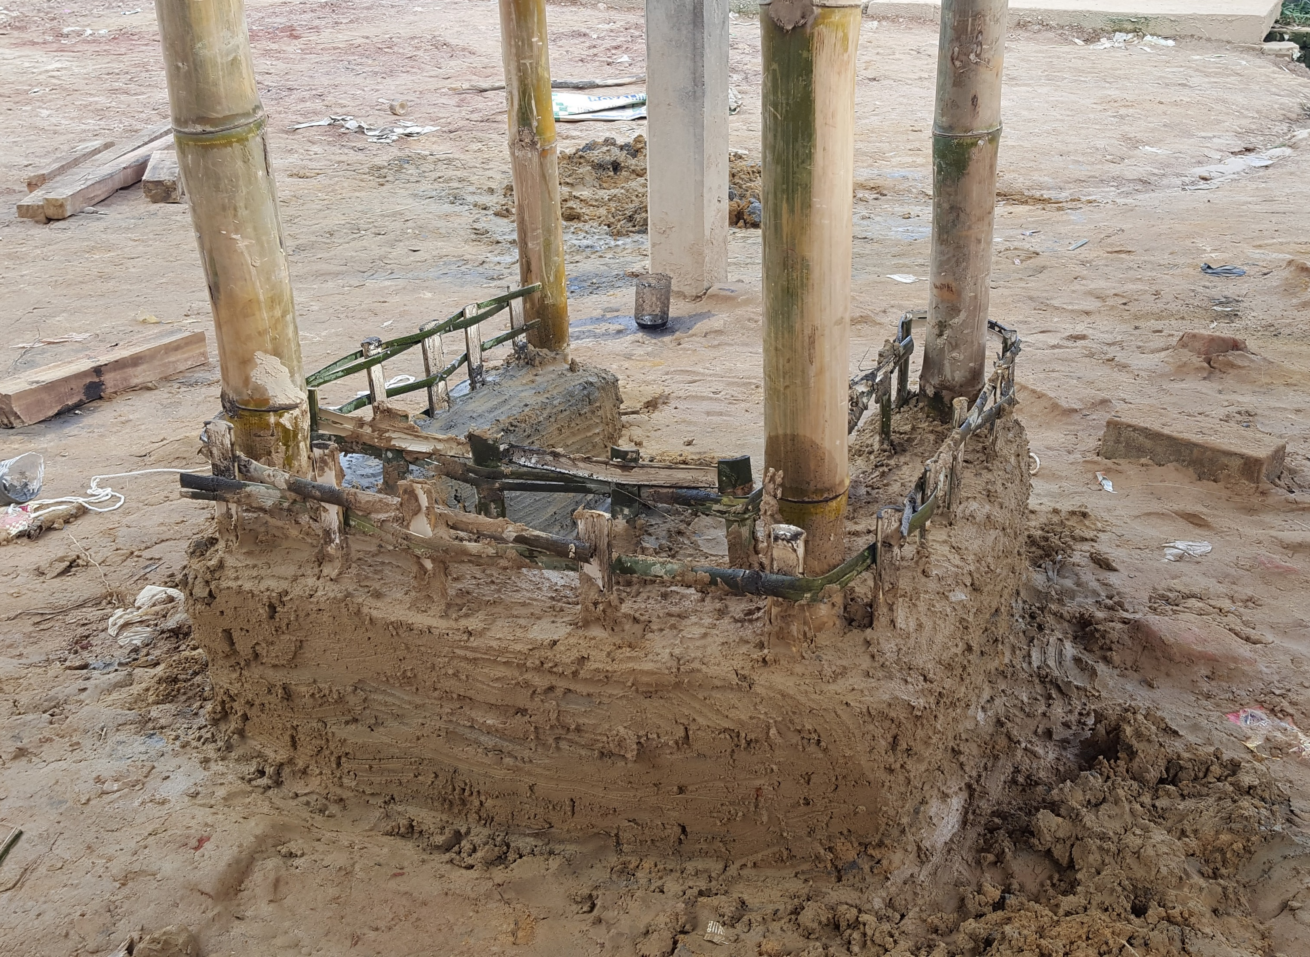
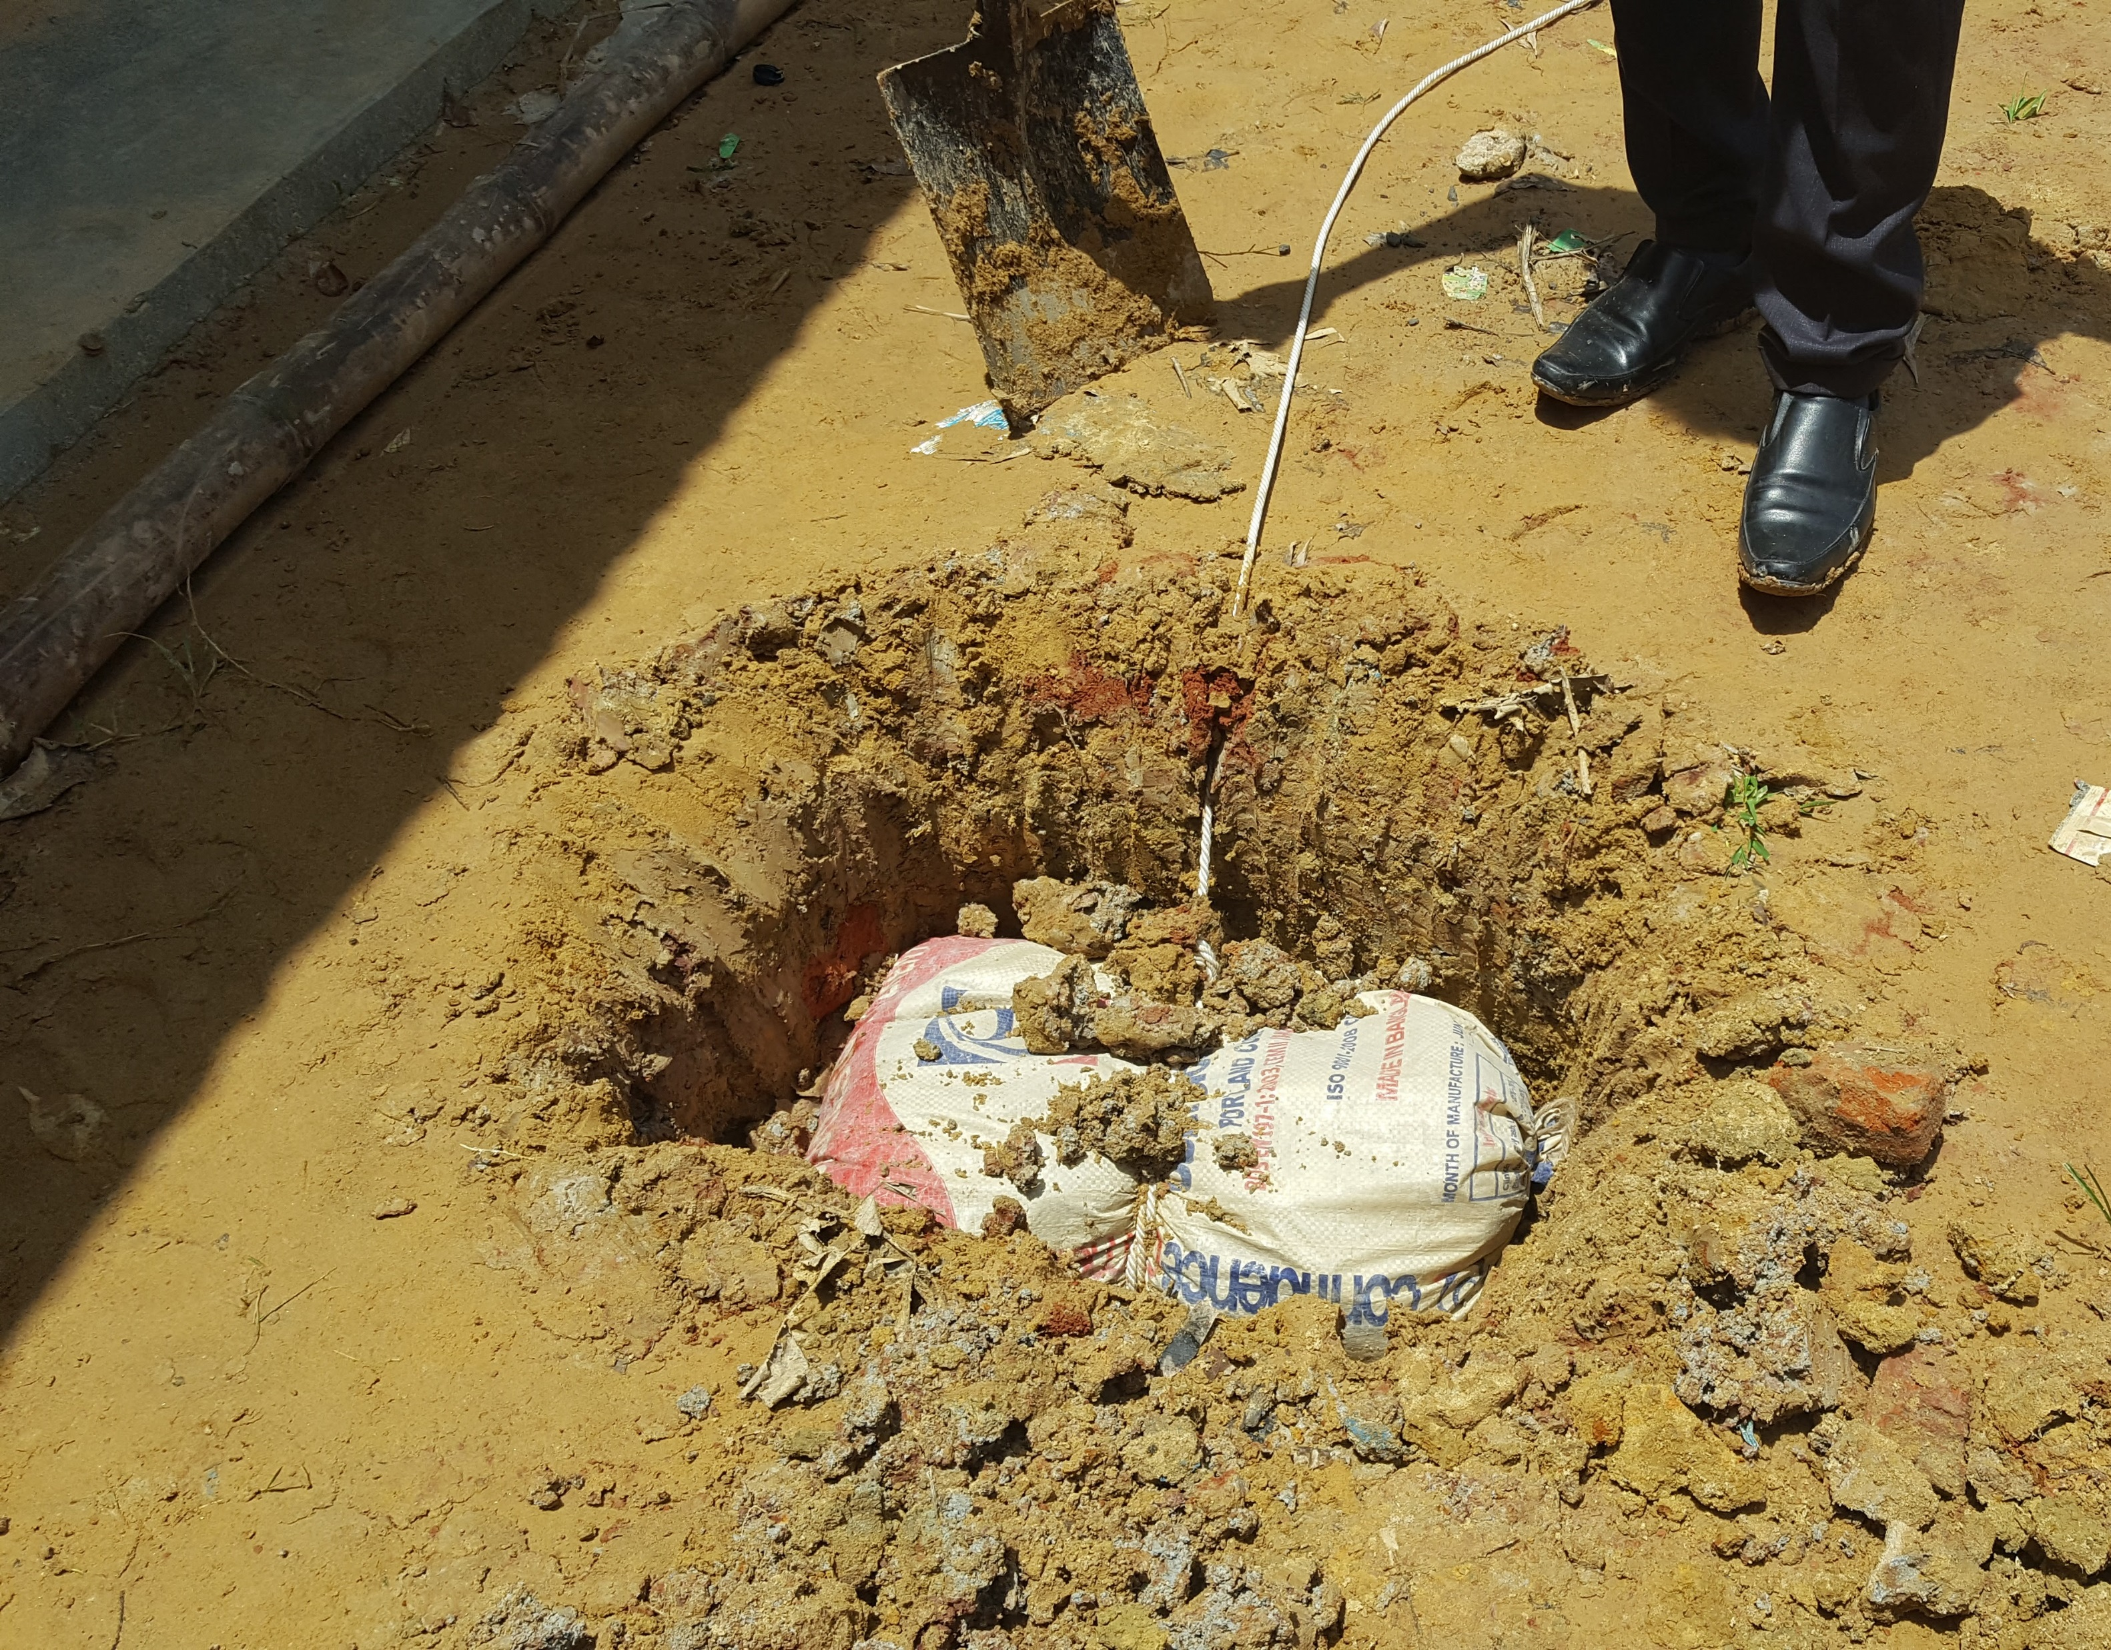
Technical support: Bangladesh July 2017
IEC development
Shelter Resilience training
  Anchor pulling exercise
  Sand-cement stabilisation
  Q: any relevant experience with fiber strengthening?

Slide 5


Technical support: further options
Monitoring framework (for cash-based shelter projects)
  Objective: short-cycle Plan-Do-Check-Act
Approximate engineering + special sector treatment
  Fill gap of non-engineered vs engineered structures
  Fill gap in standards/norms and codes:
  Overcome ‘fear of liability’
Baseline management
  Supports evidence based programming
  Feeds into discussion of output v.s. outcome
  Options for impact measurement (mid- and long term)
Tents
Shelters
Housing
Notes:
Approximate engineering:
E.g. comprehensive set of engineering rue of thumbs;
- simple (excel) tools with parameters such as shelter size, key design features, soil type, anchoring type, ty downs, etc.
Work towards: special sector treatment / liability wafer for engineering community for humanitarian shelter.
Objective = overcome ‘inactivity’ because of liability fear of engineering companies.

