Slide 1
Accountability Working Group
Update

Slide 2
Cluster Evaluations
Pakistan Evaluation (August 2014)
Development of a draft Cluster Evaluation Strategy and Tools

Slide 3
Cluster Assessments
Philippines Dec 2013-Jan 2013, April 2014, August 2014
Mali April 2014
Central African Republic April 2014

Slide 4
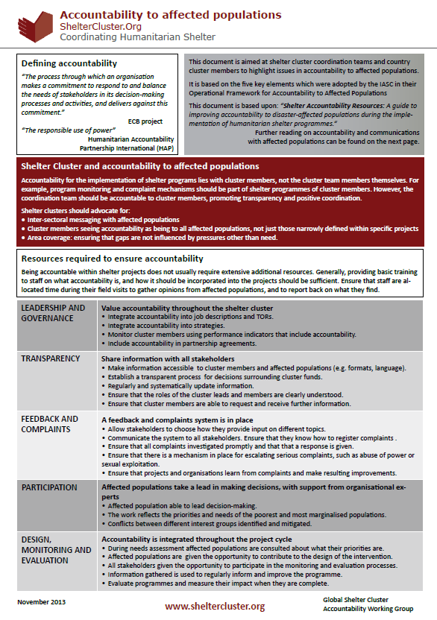
Accountability to affected populations
Two-pager on Accountability to Affected Populations

Slide 5
Shelter Information Portal
Creation of a pilot Shelter Information Portal (online database) will accompany the Shelter Cluster Assessment in Myanmar, October 2014
Collection of IM tools from you!

