Slide 1
Urban Settlements WG
Welcome to the first steering group meeting
Steering Group member Introductions
Summary progress of USWG to date
Area/Settlement Based Guidance:
Why? (objective)
Who for? (audience)
What? (content)
How? (process)
Questions, comments, input
What now? (next steps)
02 May 2019
USWG
Urban
Settlements
Working Group

Slide 2
Steering Group Members
CLUSTERS
Global Shelter Cluster Angel Pascual
CCCM Giovanni Federici
Global Food Security Cluster Marina Angeloni
WASH Cluster Ross Tomlinson
Protection Cluster Sofia Khetib-Grundy / Musa Al-Asad
DONORS
OFDA / USAID Charles Setchell
ECHO Denis Heidebroek
INTERNATIONAL ORGANISATIONS
OCHA Annarita Marcantonio / Juliet Lang
UNDP Rekha Das / Amita Gill
World Bank Karima Ben Bih
UN-Habitat Esteban Leon
NETWORKS / ALLIANCES
Global Alliance for Urban Crises Filiep Decorte
ALNAP Leah Campbell
USWG
Urban
Settlements
Working Group

Slide 3
Background to the WG
TRENDS
Numerous discussions, events and papers written about the need to move away from siloed sector-focused assistance.
Agencies, donors, IASC and academics have advocated for area-based / settlements approaches
Several events, such as conferences by InterAction, UKSF, GAUC, GSC and CCCM have explored a way forward
However,
Approaches have not been applied systematically.
A handful of agencies have implemented small-scale, discrete projects outside of the mainstream humanitarian response.
USWG
Urban
Settlements
Working Group

Slide 4
Background to the WG
PROGRESS
The USWG commenced in May 2017
An inclusive and transparent platform and collective approach to operationalization
Engaged relevant clusters, NGOs, donors and UN agencies
Meetings to discuss issues, lessons and outreach strategy
Terminology paper and Compendium of case studies
Executive summary and lessons form case studies
OFDA funding for field consultations, guidance and dissemination
6 Clusters and 60+ Organizations
Platform to share lessons
Over 30 case studies
USWG
Urban
Settlements
Working Group

Slide 5
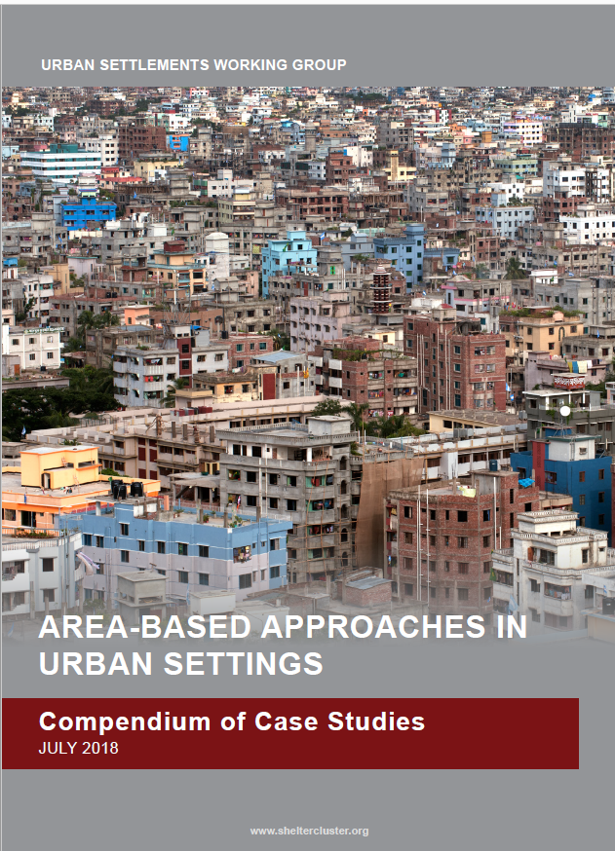
USWG Case Study Compendium: Analysis & Executive Summary
Consultants:
Victoria Maynard & Elizabeth Parker
USWG
Urban
Settlements
Working Group

Slide 6
USWG Case Study Compendium: Analysis & Executive Summary
Definition
Area-based approaches provide multi-sectoral support which considers the whole population living in a specific geographic area with high levels of need
USAID (2011) DFID & NRC (2014), Parker & Maynard (2015), IRC (2015), IDMC (2015), Sanderson & Sitko (2017), ReDSS (2018).
July
September
March
USWG
Urban
Settlements
Working Group
Notes:
Reasons for adopting area-based approaches
If well designed and implemented area-based approaches can:
create a ‘platform’: diversity of actors/ different capacities/ collective response
complement existing (governance) systems
reduce tensions and inequalities; improve social cohesion
effectively focus resources: multi-sector and multi-stakeholder approach

Slide 7
USWG Case Study Compendium: Different scales and stages of area-based approach
July
September
USWG
Urban
Settlements
Working Group

Slide 8
Area based / settlement guidelines
Objective
To support humanitarian and development agencies understand and apply settlement based approaches in humanitarian response & recovery
Primary Audience
Humanitarian & development agencies (International Organisations, NGOs)
Program managers & technical staff
Process;
Creation of Steering Group
Draft Initial contents for discussion
Three Regional Consultations
Three National Consultations
Chapter writing by technical experts
Consolidation & review
USWG
Urban
Settlements
Working Group

Slide 9
Complementing other processes & products
Global Food Security Cluster
Urban
Livelihoods Working Group
PCI / RedR
Neighborhood Approach Guidance
IASC Urban Reference Group & Rslts Grp 1
Urban Coordination Guidance note
ALNAP
Numerous research products
CCCM
Urban Displacement and Out of Camps (UDOC)
CCCM
Mobile Approach case studies
Global Alliance for Urban Crises
Framework for Engagement between Local Authorities & Humanitarian Actors
Livelihoods; gFSC; urban
Neighbourhood level, operational focus; agency-led
Inter-cluster; urban; coordination
Context analysis; urban; coord; multisctr
CCCM; urban; governance
CCCM; evidence base
urban; engagement with Local Authorities
USWG
Area / settlement based guidelines
USWG
Urban
Settlements
Working Group

Slide 10
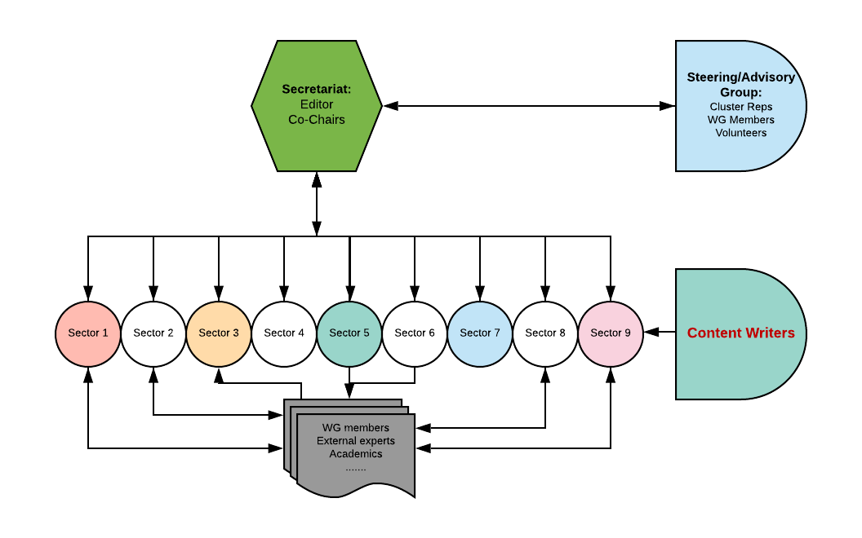

USWG: Settlement Approach Guidance: 2019 - 2020
Overall strategy
Initial content framing
Consultation process - how to engage
March

Slide 11
Steering Group (SG):
The SG will advice the Co-Chairs and the Principal Editor on the content and overall thematic format. Primary responsibility will be to:
Provide advice in developing the overall frame of the guidance, the contents sheet and structure within each chapter;
Provide periodic advice and peer review; and
Act as a champion for this work within your own circles of influence
The Guidance is intended to address operational issues and useable as possible, while at the same time, representative of the diversity of actors and sectors.
Provide strategic advice to the USWG co-conveners (CRS, Impact and InterAction) and the Principal Editor as well as content writer of each chapter.
Collaborate, advise and peer review during writing and finalization of guidance.
Liaise with appropriate technical experts during the process.
Commit up to 2-3 hours/month for advice and review of the Guidance Notes. The overall development period is expected to be around a year. Starting March 2019 – Sept 2019
Contribute significant experience in policy, practice and coordination of humanitarian and development assistance in diverse contexts.
Act as an independent expert, championing this approach and suggesting additional opportunities.
Represent concerns within their own sector and/or organization, as well as outside entities.
USWG
Urban
Settlements
Working Group

Slide 12
USWG Area based / Settlement Approach Guidance: DRAFT 0 CONTENT sheet (initial ideas for inputs)
1. Introduction; (6 pages) | Suitable expertise / sector lead
Objective of the guidelines / Target Audience; ie Humanitarians
Why an Area based / settlement approach?
About this guideline: Definition, Characteristics, Principles, Strength and opportunities for Adopting area-based approach,
Links to development and exit strategy, community centred approach.
Deciding when and where ABA is appropriate - Pros, cons, type and phase of crisis, Location, Rural and Urban - Enabling contexts, Immediate need vs long- term outcomes, - Preparedness, response, recovery, development
Complementary alternative approaches
Learning from practice (link to compendium)
USWG
Urban
Settlements
Working Group

Slide 13
USWG Area based / Settlement Approach Guidance: DRAFT 0 CONTENT sheet (initial ideas for inputs)
2. Guidance on the four defining characteristics | Suitable expertise / sector lead
Define a specific geographic area with high needs (4 pages) Why this issue? Key actions; Guidance notes;
Work Multi- sectoral (4 pages) Why this issue? Key actions; Guidance notes;
Work with Multiple stakeholders (4 pages) Why this issue? Key actions; Guidance notes;
Consider the whole population (4 pages) Why this issue? Key actions; Guidance notes;
USWG
Urban
Settlements
Working Group

Slide 14
USWG Area based / Settlement Approach Guidance: DRAFT 0 CONTENT sheet (initial ideas for inputs)
3. Operationalising Area based / settlement approach | Suitable expertise / sector lead
Applying the approach at different scales; (6 pages) City/Town ; District/borough ; Ward/Neighbourhood key/common principles amongst all scales.
Collaboration & Partnerships (4 pages) Stakeholder mapping of local and international actors Establishing/promoting approach in preparedness/peace-time Predictable partnerships / ways of working between local/national and international actors
Area Based Coordination & monitoring mechanisms (4 pages) Eg: City level working group ; Tri-sector task force ; One agency
Area based Assessments (4 pages) Profiling & context analysis Area Based Assessments Multi-sectoral needs assessments DTM. Etc
Area based Planning & prioritisation (4 pages) Joint planning / prioritisation processes
Implementation of area-based initiatives Differing models
USWG
Urban
Settlements
Working Group

Slide 15
USWG Area based / Settlement Approach Guidance: CONTENT sheet (initial ideas for your inputs)
Operationalising Area based / settlement approach | Suitable expertise / sector lead
Appropriate Funding models (4 pages) Humanitarian / stabilisation / development funding
Outcomes and impact (4 pages)
Efficiency and effectiveness (4 pages) Core competencies / Urban Competency Framework
USWG
Urban
Settlements
Working Group

Slide 16
Questions , Comments & discussion
Contents:
Appropriate structure?
What is missing?
Key existing resources to be referenced?
Highlight interest in specific sectors to:
Act as peer reviewers/support and/or
Propose to co-write chapter and/or
Suggest a colleague/others to write
Inputs gathered over coming 10 days for overall contents structure
Looking ahead:
3 x regional consultations AND 3 x country level studies / consultations: Suggestions on location & timing?
USWG
Urban
Settlements
Working Group

