Slide 1
27 June 2019
Urban Settlements Working Group
USWG
Urban
Settlements
Working Group

Slide 2
AGENDA
Topic | Speaker
1. Development of USWG area / settlement approach guidance: Informal WG member updates on the area / settlement approach Opportunities, missed opportunities, challenges?
2. Development of USWG area / settlement approach guidance: Brief Update Contents outline Initial call-out for chapter authors and co-authors | USWG co-chairs
3. Case Study presentation: Barrio Mio: Urban DRR project applying the neighbourhood approach, undertaken by PCI in Guatemala City | Leah Campbell, Senior Research Officer, ALNAP
4. Shelter Projects & Upcoming MENA S&S forum | Alberto Piccioli, Shelter & Settlements Officer, IOM
5. AOB/ wrap up

Slide 3
Development of USWG area / settlement approach guidance
Brief Update
Contents outline
Initial call-out for chapter authors and co-authors
USWG
Urban
Settlements
Working Group

Slide 4
Steering Group Members
CLUSTERS
Global Shelter Cluster Angel Pascual
CCCM Giovanni Federici
Global Food Security Cluster Marina Angeloni
WASH Cluster Ross Tomlinson
Protection Cluster Sofia Khetib-Grundy / Musa Al-Asad
DONORS
OFDA / USAID Charles Setchell
ECHO Denis Heidebroek
INTERNATIONAL ORGANISATIONS
OCHA Annarita Marcantonio / Juliet Lang
UNDP Rekha Das / Amita Gill
World Bank Karima Ben Bih
UN-Habitat Esteban Leon
NETWORKS / ALLIANCES
Global Alliance for Urban Crises Filiep Decorte
ALNAP Leah Campbell
USWG
Urban
Settlements
Working Group
Notes:
The SG will advice the Co-Chairs and the Principal Editor on the content and overall thematic format. Primary responsibility will be to:
Provide advice in developing the overall frame of the guidance, the contents sheet and structure within each chapter;
Provide periodic advice and peer review; and
Act as a champion for this work within your own circles of influence
The Guidance is intended to address operational issues and useable as possible, while at the same time, representative of the diversity of actors and sectors.
Provide strategic advice to the USWG co-conveners (CRS, Impact and InterAction) and the Principal Editor as well as content writer of each chapter.
Collaborate, advise and peer review during writing and finalization of guidance.
Liaise with appropriate technical experts during the process.
Commit up to 2-3 hours/month for advice and review of the Guidance Notes. The overall development period is expected to be around a year. Starting March 2019 – Sept 2019
Contribute significant experience in policy, practice and coordination of humanitarian and development assistance in diverse contexts.
Act as an independent expert, championing this approach and suggesting additional opportunities.
Represent concerns within their own sector and/or organization, as well as outside entities.

Slide 5
Complementing other processes & products
Global Food Security Cluster
Urban
Livelihoods Working Group
PCI / RedR
Neighborhood Approach Guidance
IASC Urban Reference Group & Rslts Grp 1
Urban Coordination Guidance note
ALNAP
Numerous research products
CCCM
Urban Displacement and Out of Camps (UDOC)
CCCM
Mobile Approach case studies
Global Alliance for Urban Crises
Framework for Engagement between Local Authorities & Humanitarian Actors
Livelihoods; gFSC; urban
Neighbourhood level, operational focus; agency-led
Inter-cluster; urban; coordination
Context analysis; urban; coord; multisctr
CCCM; urban; governance
CCCM; evidence base
urban; engagement with Local Authorities
USWG
Area / settlement based guidelines
USWG
Urban
Settlements
Working Group

Slide 6
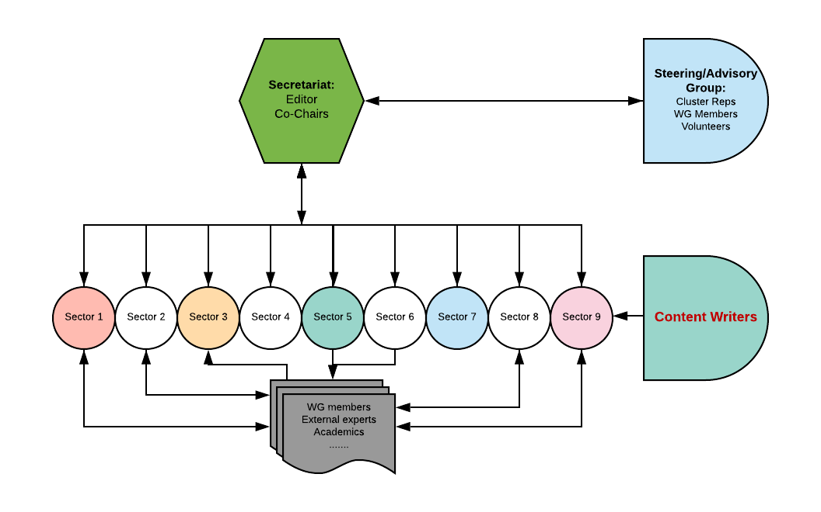

USWG: Settlement Approach Guidance: 2019 - 2020
Overall strategy
Initial content framing
Consultation process - how to engage
March

Slide 7
Area based / settlement guidelines
Objective
To support humanitarian and development agencies understand and apply settlement based approaches in humanitarian response & recovery
Primary Audience
Humanitarian & development agencies (International Organisations, NGOs)
Program managers & technical staff
>>CONTENTS & SIGN UP SHEET<<
USWG
Urban
Settlements
Working Group

Slide 8
WG members inputs
Contents:
Key existing resources to be referenced?
Highlight interest in specific sectors to:
Propose to co-write chapter and/or
Suggest a colleague/others to write
Looking ahead: time scale
Creation of Steering Group/ contents sheet approved
Three Regional Consultations: 1. Amman (July); 2. Asia TBC. 3. Africa TBC
Three National Consultations call for any WG member to host a session in their circles? Chapter writing by technical experts
Consolidation & review
USWG
Urban
Settlements
Working Group

Slide 9
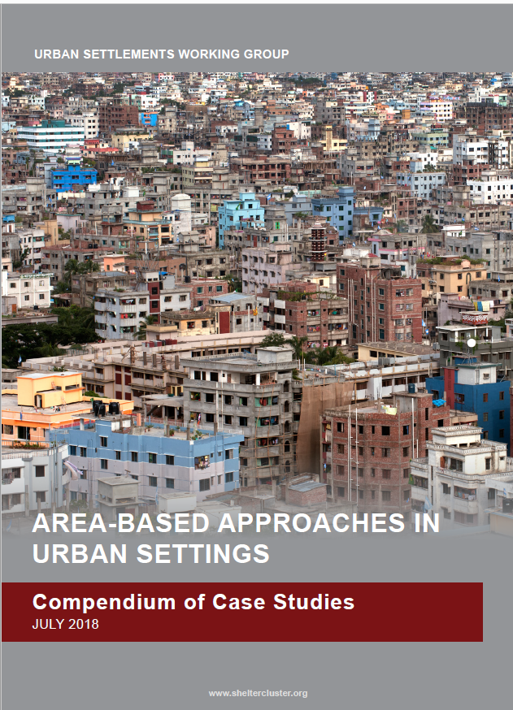
USWG Case Study Compendium: Analysis & Executive Summary
Consultants:
Victoria Maynard & Elizabeth Parker
USWG
Urban
Settlements
Working Group

Slide 10
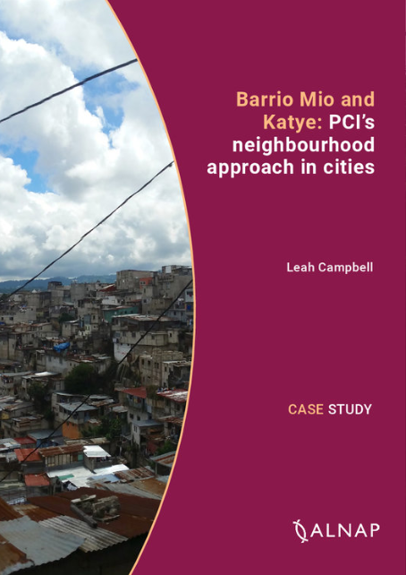
Barrio Mio: Urban DRR project applying the neighbourhood approach, undertaken by PCI in Guatemala City
Leah Campbell, ALNAP
USWG
Urban
Settlements
Working Group

Slide 11
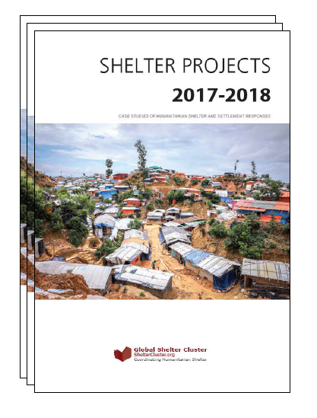
Shelter Projects & Upcoming MENA S&S forum
Alberto Picciolo, IOM
USWG
Urban
Settlements
Working Group

Slide 12
AOB?
Other points to discuss?
Additional links to your own work
Future case studies?
USWG
Urban
Settlements
Working Group

