Slide 1
17 September 2019
Urban Settlements Working Group
USWG
Urban
Settlements
Working Group

Slide 2
AGENDA
Topic | Speaker
1. Development of Area / settlement approach guidance: Brief Update Status of call-out for chapter authors & Next Steps. | USWG co-chairs
2. USWG regional/country consultations: PAST: Lombok, Indonesia & Jordan, Amman UPCOMING: Geneva (Shelter Week), Bangkok & The Philippines | USWG co-chairs
3. Member Updates: Child friendly settlement research and framework Forced Migration Review – Cities & Towns upcoming issue Academic / Practitioner Collaboration | Andrew Powell USWG co-chairs InterAction: Kathryn Sidlowski
USWG
Urban
Settlements
Working Group

Slide 3
Development of area / settlement approach guidance
Brief Update:
Status of call-out for chapter authors
Next Steps
USWG
Urban
Settlements
Working Group

Slide 4
Area / Settlement Approach Guidance
Topic | Chapter (co) authors | Peer Reviewers
1. INTRODUCTION
1. Objective / Audience / What is an Area Based Approach? | USWG co-chairs |  | ECHO, CCCM, UNDP
2. Why an Area Based Approach? | USWG co-chairs |  | UNDP, ECHO
3. Aligning with the system; links to development and exit strategies | Tom Bamforth / IFRC |  | UNDP, ECHO, OCHA
4. When & where Area Based Approaches are appropriate? | USWG co-chairs |  | ECHO, OCHA
5. Complementary approaches & learning from practice | USWG co-chairs
2. COMPONENTS OF THE AREA BASED APPROACH
1. Define a specific geographic area with high needs | Jim Kennedy IMPACT |  | ACTED, AECOM, gFSC (TBC)
2. Work Multi-sectoral | Eva Suarez / Gareth Lewis CCCM +1 other pending acceptance |  | ECHO, OCHA, gFSC (TBC)
3. Work with Multiple stakeholders | Giovanna Federici Eva Suarez / Gareth Lewis |  | UNDP, CCCM
4. Consider the whole population | Giovanna Federici +1 other pending acceptance |  | CCCM

Slide 5
Area / Settlement Approach Guidance
Chapter | Chapter (co) authors | Peer Reviewers
3. OPERATIONALISING THE AREA BASED APPROACH
1. Needs assessment and Analysis | IMPACT JIPS & UN-Habitat Reg Office (TBC) |  | CCCM, OCHA, gFSC (TBC)
2. Strategic planning | CRS UN-Habitat & UCLG (TBC) |  | UNDP, OCHA
3. Resource mobilisation | To confirm |  | ECHO, OFDA, Jim Kennedy
4. Implementation and monitoring | Jim Kennedy +1 other pending acceptance |  | UNDP, OCHA
5. Collaboration and partnerships | InterAction, IMPACT Marina Angeloni |  | OCHA
6. Area based coordination & Information Management | Fiona Kelling / Laura Heykoop CCCM |  | CCCM, UNDP, gFSC, OCHA, Jim Kennedy
USWG
Urban
Settlements
Working Group

Slide 6
NEXT STEPS: Area / Settlement Approach Guidance
Missed the boat? Still interested in contributing as a chapter author or peer reviewer? Get in touch with us.
Re-group chapter authors in coming week:
  Proposed Geneva meeting during Shelter Week
Timeframe:
  Draft 1: Qtr4 2019;
  Peer Review: Qtr1 2020
  Draft 2/Final draft: Qtr1&2 2020
Questions / comments?
USWG
Urban
Settlements
Working Group

Slide 7
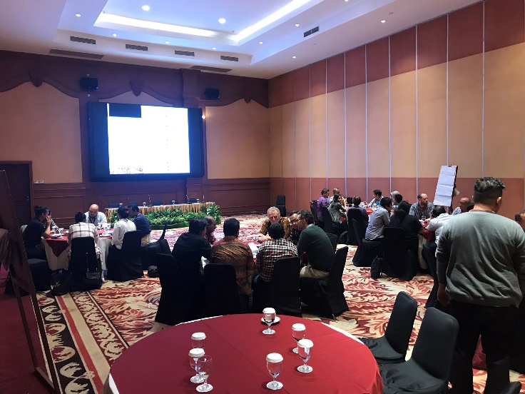
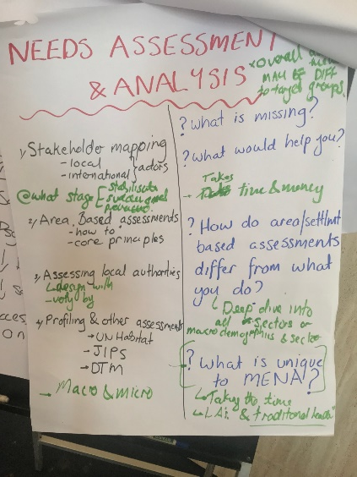
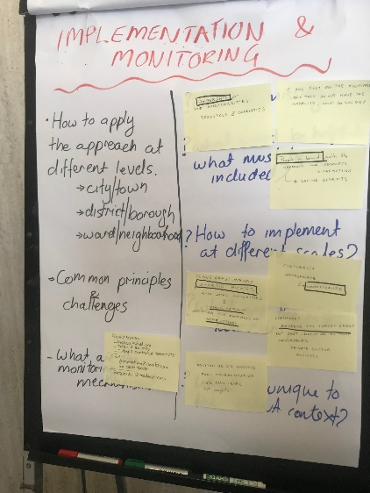
Recent USWG regional / country consultations
Lombok, Indonesia
Amman, Jordan
USWG
Urban
Settlements
Working Group

Slide 8
Upcoming USWG regional/country consultations
October Shelter Events - Geneva | IFRC office, Chemin des Crets17, Geneva.
7 - 8 October: Coordination Workshop – for country-level shelter coordination team members and agency representatives who deploy them. Objective: to review the coordination tools and methodologies and share practices.
9 - 10 October: GSC Meeting – for representatives of GSC partners and country-level shelter cluster coordination team members. Objective: to review progress made and plan for next year. Theme: Capacity of the Shelter Sector. | Please register here
11 October: Shelter practitioners meeting – for shelter practitioners to share practices in shelter programming, supported by Shelter Centre. Participation and presentations in-person in Geneva as well as worldwide through live videoconferencing. Theme: TBC. | Now open for proposals for general sector presentations: please send title, summary and proposed duration to meeting@sheltercentre.org as soon as possible.
USWG
Urban
Settlements
Working Group
Notes:
The SG will advice the Co-Chairs and the Principal Editor on the content and overall thematic format. Primary responsibility will be to:
Provide advice in developing the overall frame of the guidance, the contents sheet and structure within each chapter;
Provide periodic advice and peer review; and
Act as a champion for this work within your own circles of influence
The Guidance is intended to address operational issues and useable as possible, while at the same time, representative of the diversity of actors and sectors.
Provide strategic advice to the USWG co-conveners (CRS, Impact and InterAction) and the Principal Editor as well as content writer of each chapter.
Collaborate, advise and peer review during writing and finalization of guidance.
Liaise with appropriate technical experts during the process.
Commit up to 2-3 hours/month for advice and review of the Guidance Notes. The overall development period is expected to be around a year. Starting March 2019 – Sept 2019
Contribute significant experience in policy, practice and coordination of humanitarian and development assistance in diverse contexts.
Act as an independent expert, championing this approach and suggesting additional opportunities.
Represent concerns within their own sector and/or organization, as well as outside entities.

Slide 9
Upcoming USWG regional/country consultations
9 - 10 October: GSC Meeting Theme: Capacity of the Shelter Sector. | Interested / volunteers
Urban Settlement/Area Based Guidance session Consultation on the guidelines? Deep dive into a broad topic? Consultation hosted by the writers? Writers call?
2. Ideas? Session Two – an open discussion / debate on the settlement / area based approach. Any recent experiences we could share and debate? Biera?
USWG
Urban
Settlements
Working Group
Notes:
The SG will advice the Co-Chairs and the Principal Editor on the content and overall thematic format. Primary responsibility will be to:
Provide advice in developing the overall frame of the guidance, the contents sheet and structure within each chapter;
Provide periodic advice and peer review; and
Act as a champion for this work within your own circles of influence
The Guidance is intended to address operational issues and useable as possible, while at the same time, representative of the diversity of actors and sectors.
Provide strategic advice to the USWG co-conveners (CRS, Impact and InterAction) and the Principal Editor as well as content writer of each chapter.
Collaborate, advise and peer review during writing and finalization of guidance.
Liaise with appropriate technical experts during the process.
Commit up to 2-3 hours/month for advice and review of the Guidance Notes. The overall development period is expected to be around a year. Starting March 2019 – Sept 2019
Contribute significant experience in policy, practice and coordination of humanitarian and development assistance in diverse contexts.
Act as an independent expert, championing this approach and suggesting additional opportunities.
Represent concerns within their own sector and/or organization, as well as outside entities.

Slide 10
Upcoming USWG regional/country consultations
Bangkok: Wednesday 20 November (Full Day)
Looking for multi-sectoral wide participation: Shelter & Settlements; Water, Sanitation & Hygiene; Protection; Livelihoods & Income Generation; Humanitarian Coordination, the donor, civil society & U.N communities
Regional colleagues interested to attend?
Philippines: 25 – 29 November (TBC)
Looking for multi-sectoral wide participation in both Metro Manila & Tacloban
Bilateral discussions & ½ day workshop
Regional colleagues interested to attend?
USWG
Urban
Settlements
Working Group
Notes:
The SG will advice the Co-Chairs and the Principal Editor on the content and overall thematic format. Primary responsibility will be to:
Provide advice in developing the overall frame of the guidance, the contents sheet and structure within each chapter;
Provide periodic advice and peer review; and
Act as a champion for this work within your own circles of influence
The Guidance is intended to address operational issues and useable as possible, while at the same time, representative of the diversity of actors and sectors.
Provide strategic advice to the USWG co-conveners (CRS, Impact and InterAction) and the Principal Editor as well as content writer of each chapter.
Collaborate, advise and peer review during writing and finalization of guidance.
Liaise with appropriate technical experts during the process.
Commit up to 2-3 hours/month for advice and review of the Guidance Notes. The overall development period is expected to be around a year. Starting March 2019 – Sept 2019
Contribute significant experience in policy, practice and coordination of humanitarian and development assistance in diverse contexts.
Act as an independent expert, championing this approach and suggesting additional opportunities.
Represent concerns within their own sector and/or organization, as well as outside entities.

Slide 11
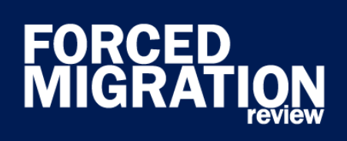
Upcoming Cities & Towns Issue
Analyzing needs and challenges
What are the universal challenges involved with displacement to urban contexts? What variables come into play in different contexts and locations?
Frameworks, approaches and initiatives
How effective and inclusive are ‘area-based’ (or ‘place-based’) approaches?
Multi-stakeholder collaboration and engagement
How can humanitarian and development actors effectively support local authorities in ways that work for both displaced and host communities? How do the various actors navigate competition and power disparities?
Resilience and sustainability
What role do refugees, IDPs, stateless people and host populations play in helping to build cohesive, sustainable communities?
Submissions close November 4th
USWG
Urban
Settlements
Working Group

Slide 12
Member Updates
Child friendly settlement research and framework
Andrew Powell
Academic-practitioner collaboration
Kathryn Sidlowski
AOB / updates?
USWG members
USWG
Urban
Settlements
Working Group

