Slide 1

Community and business resilience
SHELTER WORKING GROUP

Slide 2

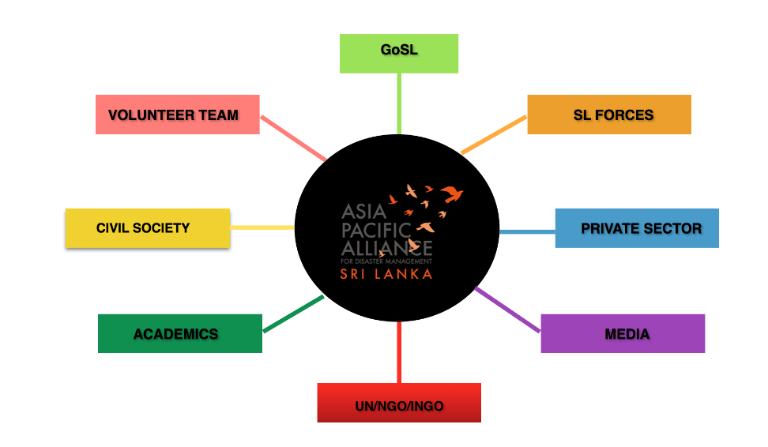
Effect of disasters on sri lanka
Notes:
The A-PAD network in Sri Lanka which is been further extended at the international level through the Asia Pacific Parliamentarian Forum for Disaster Management and the Connecting Business Initiative following WHS.

Slide 3
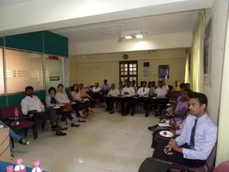
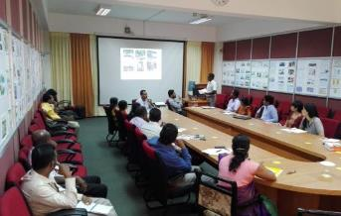
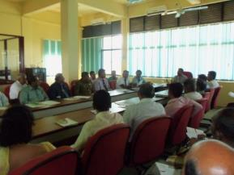
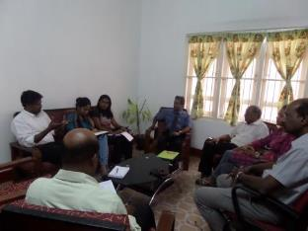
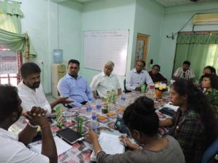
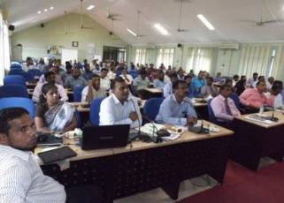
A-PAD NETWORK – DISTRICT PLATFORM MEETINGS
2014 08 22 Hambantota Platform Official Launch
2015 12 14 Network Meeting Hambantota
2016 07 08 Network Meeting Badulla
2015 02 24 Jaffna Platform initiative - Meeting with CCI Jaffna
2015 03 16 Eastern Platform initiative - Meeting with CCITD Trincomalee
2016 05 19 Batticaloa Platform Meeting

Slide 4
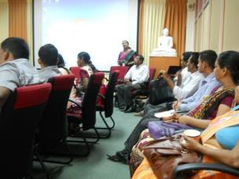
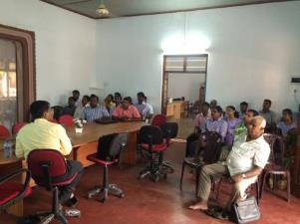
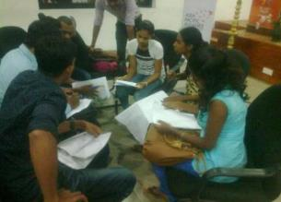
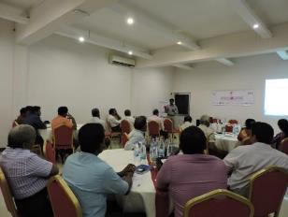
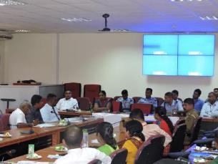
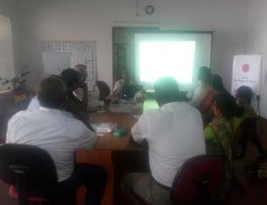
A-PAD NETWORK – DISTRICT - CAPACITY BUILDING
2015 01 30 Awareness on Disaster Psychosocial Response - Hambantota
2015 06 16 Awareness on on Disaster Recovery Activities - Jaffna
2015 11 24 Awareness on Entrepreneurship for young business communities - Hambantota
2016 02 03 Awareness on Disaster Psychosocial Response - Jaffna
2016 01 13 Awareness on RWH - Jaffna
2016 01 25 Awareness on Sendai Framework - Hambantota

Slide 5
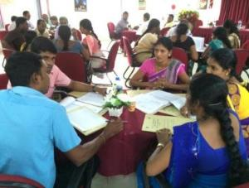
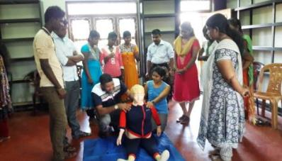
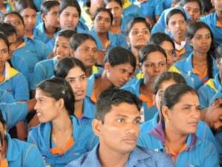
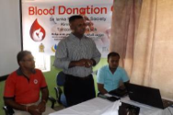
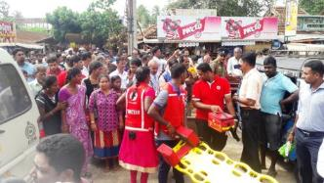
A-PAD NETWORK – DISTRICT - CAPACITY BUILDING
Basic Life saving support and First Aid – Over 200 individuals from 5 districts including Colombo
DRR Planning and Preparing Comprehensive Disaster Risk Assessment –Over 500 Local Govt Officials from 5 Divisions in Jaffna
Disaster Preparedness – MAS Vidyal – 920 employees
Blood Donation Camp - 54 Volunteers given awareness
Hospital Preparedness Planning Simulation –Over 200 individuals from 2 divisions in Jaffna district

Slide 6
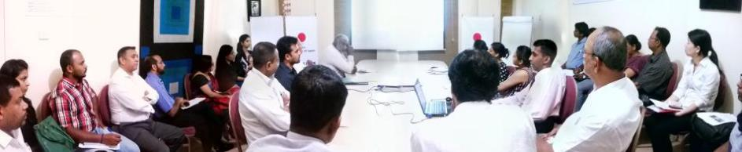
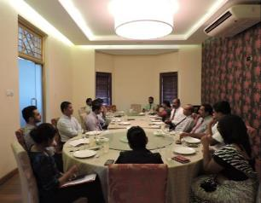
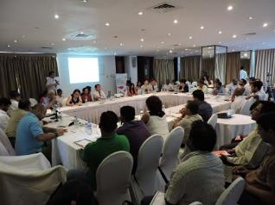
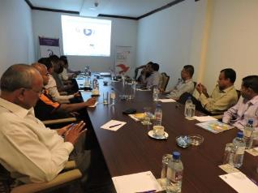
A-PAD NETWORK – COLOMBO PLATFORM MEETINGS
2014 11 04 Platform Meeting - Colombo
2015 09 03 Policy Meeting
2016 06 28 APAD Platform Meeting
2016 08 16 Sector Meeting

Slide 7
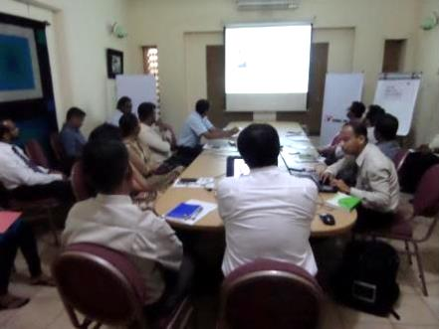
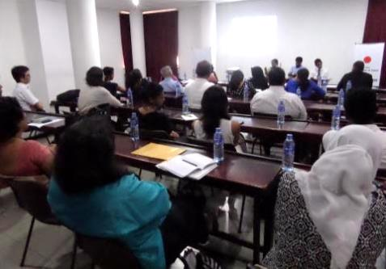
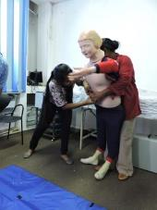
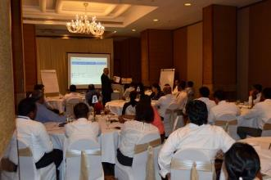

A-PAD NETWORK – COLOMBO – capacity building
2014 09 30 Awareness on Sphere - Colombo
2015 01 30 Awareness on Disaster Psychosocial Response - Colombo
2016 01 20 First Aid training - Colombo
2016 03 24 BCM Workshop - Colombo

Slide 8
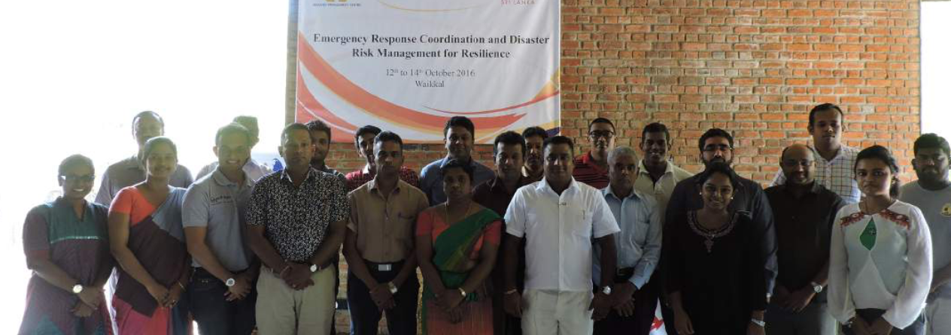
Disaster risk reduction capacity building
25 Participants representing Uva, Southern, North Western, Western

Slide 9
Disaster risk reduction 240 awareness programmes
Global Standard for Disaster Response - Introduction to Sphere Standards
Early Warning and Response Mechanism in Sri Lanka
Introduction to Psychosocial Response in Disaster Relief
Disaster Resilient Entrepreneurs
Emergency response and disaster prevention guidelines
Business Continuity and dDsaster Recovery Planning
Community Awareness in Disaster Risk Reduction Planning
Creating Disaster Resilient Communities
Disaster Resilient Homes
Management of Water Resources to Mitigate Effects of Drought and Flood at Village Level
Application of Minimum Standards In Disaster Planning And Response
Disaster Psychological Response
Rainwater Harvesting System
Solid Waste Management
Drip Irrigation
Organic Farming
Disaster Preparedness and Mitigation – “Household and Workplace”
Sustainable Rain Water Harvesting as Corporate Initiative
Response to Nepal Earthquake
National Consultation on Reducing Vulnerability and Managing Risk
Safe Structures and Risk Clearance
Private Sector Coordination in Emergency Response Preparedness
National Consultancy for Sendai Framework
Workshop on Basic Life Support & First Aid
SendaiSpring – Breaking down framework for local action
Emergency Response Coordination and Disaster Risk Management

Slide 10
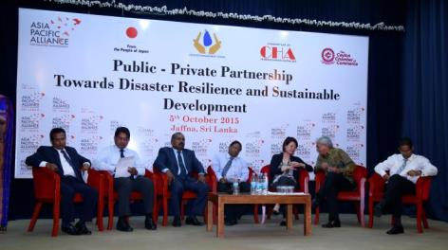
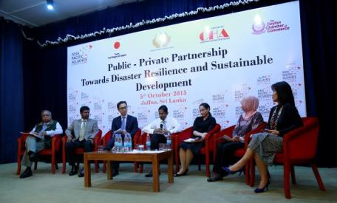
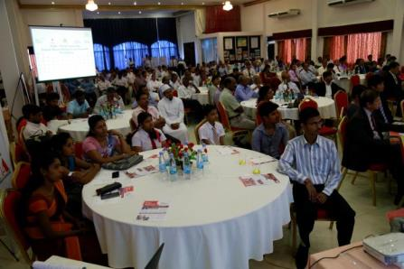
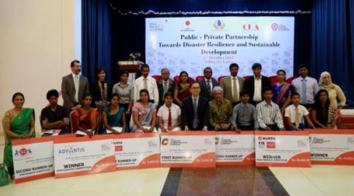
International Symposium 2015 - Jaffna Public - Private Partnership Towards Disaster Resilience and Sustainable Development

Slide 11
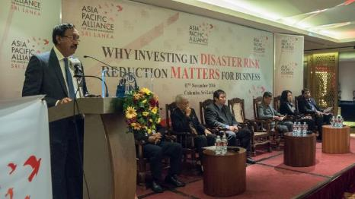
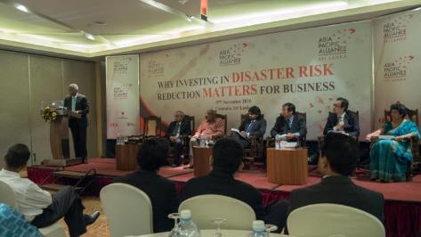
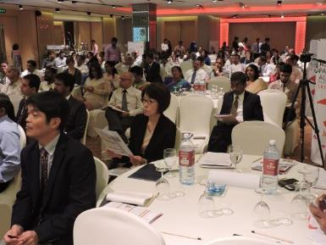
International Symposium 2016 – Colombo Why Investing in Disaster Risk Reduction Matters for Business

Slide 12

A-PAD RESPONSES [2014-2017]
Drought Relief [August & September 2014]
Meeriyabedda Landslide Relief Assistance [Oct – Dec 2014]
Flood Relief [Dec 2014 – Feb 2015]
Drinking Water Provision in Jaffna [Feb – Mar 2015]
Earthquake – Nepal [April - May 2015]
Floods and Landslides [May 2016]
Drought responses [October - present]
Meethotamulla Garbage Landslide Disaster [April 2017]
Floods and Landslides [May 2017]

Slide 13
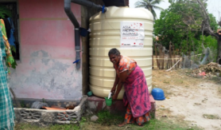
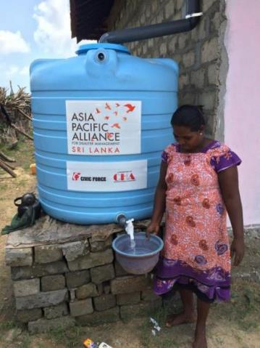
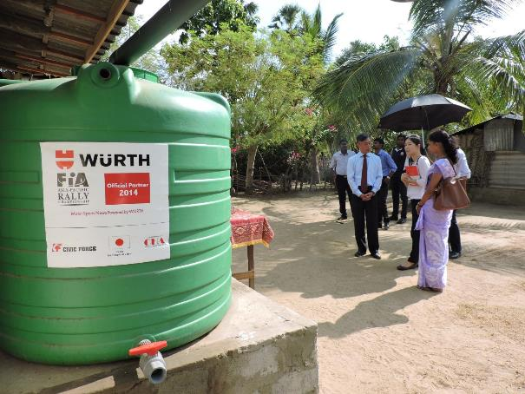
Disaster risk reduction - mitigation
Rainwater Harvesting – 76 families Benefited
Notes:
Also helped during the drought initiative.

Slide 14
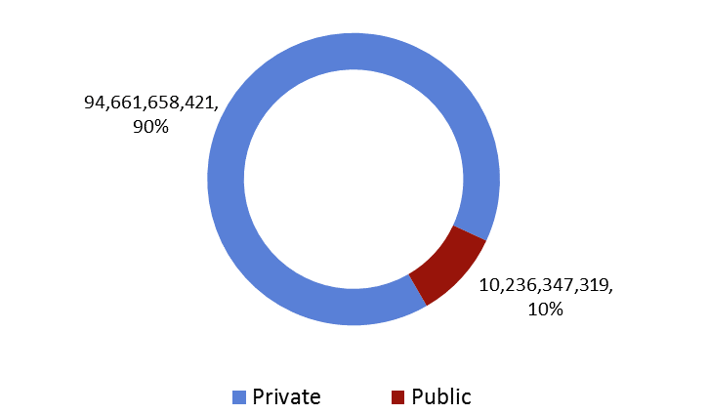
Overall effect – public vs. private sector
Source: PDNA 2016
Notes:
A-PAD looks into the development of the private sector. For these reasons, the need to inform, prepare and plan is necessary.

Slide 15
Disaster risk reduction curriculum
Stay Informed
To Build A Sustainable Disaster Resilient Community
Be prepared
Stay Safe

Slide 16
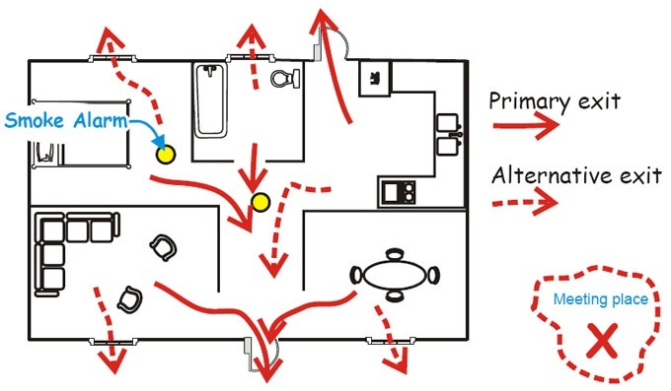
Drr awareness training programme

Slide 17


Drr awareness training programme
Duration – 45 Mins
Course Content – Location based
Trained Persons – 30,000

Slide 18
Drr awareness training programme

Slide 19
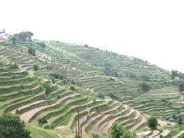
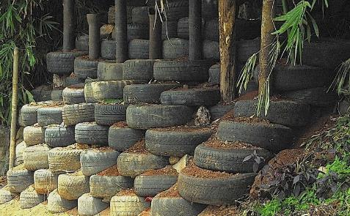
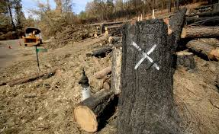
Drr awareness training programme landslides
Cultivate as per the slope
Adopt best practice according to the environment
Stop de forestation

Slide 20
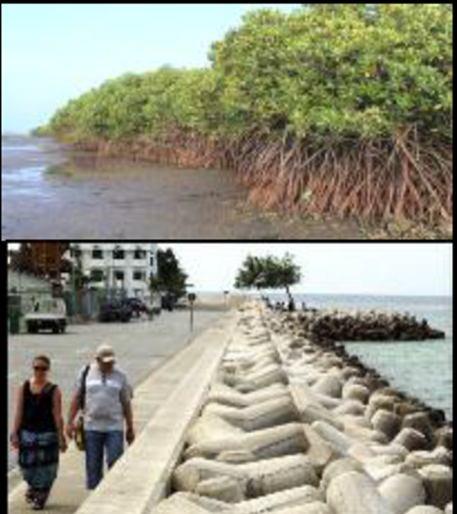
Drr awareness training programme sea level rise
Protect the mangrove
Build sea protected dams

Slide 21
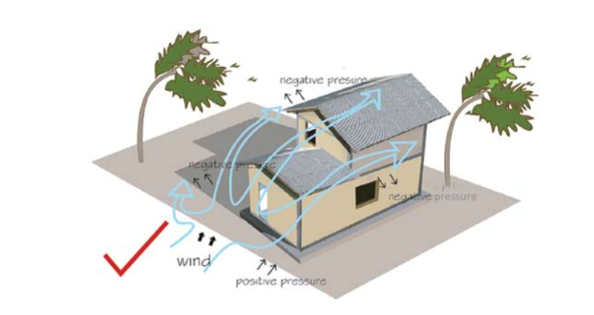
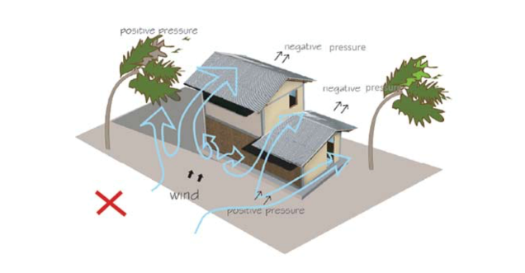
Drr curriculum – building orientation & placement cyclones and high winds
Notes:
Shorter side of building should be facing the wind direction

Slide 22
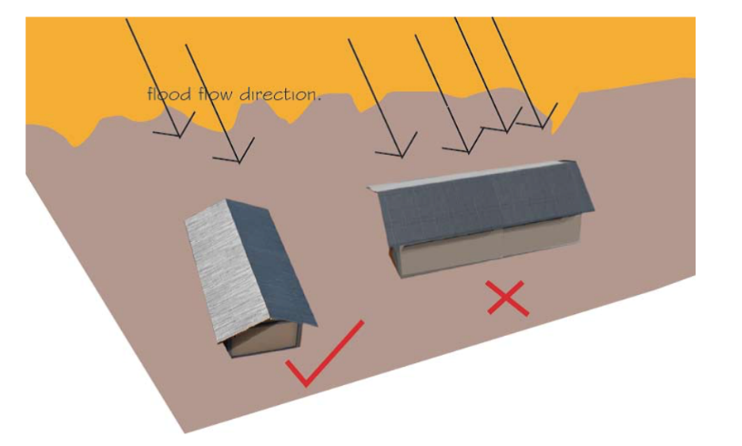
Drr curriculum – building orientation & placement coastal floods
Notes:
shorter side of building placed perpendicular to the flood flow direction

Slide 23
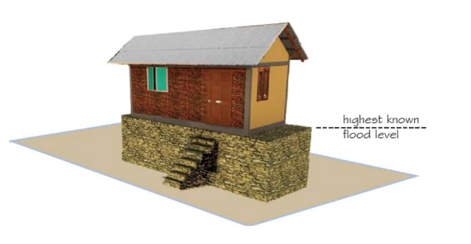
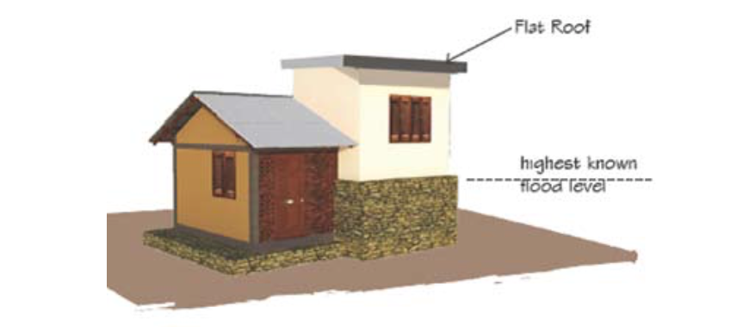
Drr curriculum – building orientation & placement inland floods
Notes:
Plinth height to be determined depending on the highest known flood level. If not possible to raise the plinth, raise one room

Slide 24
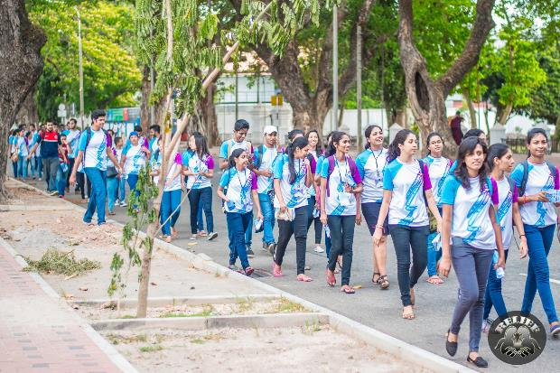

Disaster risk reduction - advocacy

Slide 25
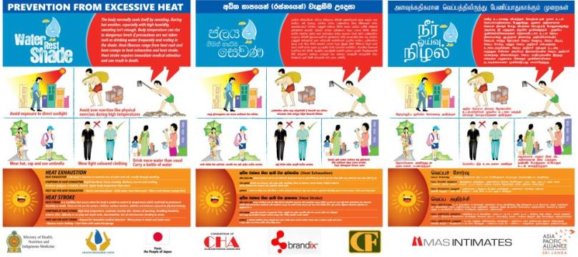
Disaster risk reduction - advocacy
1. Awareness Material – Sinhala, Tamil, English

Slide 26


Disaster risk reduction – advocacy and representation asia pacific parliamentarians forum for disaster management

Slide 27




Disaster risk reduction – advocacy and representation connecting business initiative

Slide 28

Disaster risk reduction advocacy – drowning prevention and water safety
Notes:
Plinth height to be determined depending on the highest known flood level. If not possible to raise the plinth, raise one room

