Slide 1
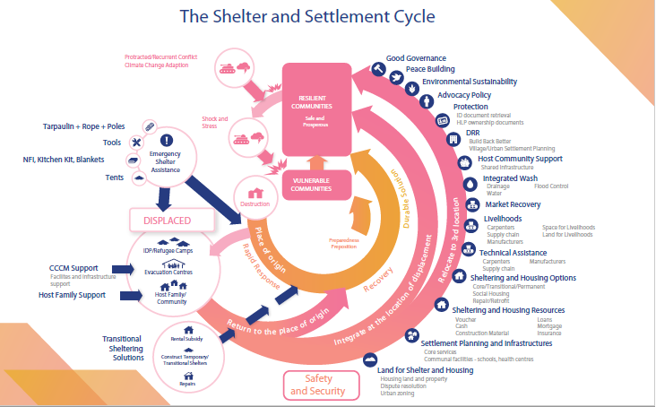

Slide 2
Local Based Programing
CRS’ experience in NE Nigeria
Donal Reilly, Director Technical Assistance HRD,

Slide 3
Message from UNSG WHS report
CORE RESPONSIBILITY FOUR
Change people’s lives – From delivering aid to ending need
Reinforce, do not replace, national and local systems…
Enable people to be the central drivers in building their resilience…
Deliver collective outcomes: transcend humanitarian-development divides
Commit to the following in order to move beyond traditional silos, work across mandates, sectors and institutional boundaries and with a greater diversity of partners toward ending need and reducing risk and vulnerability in support of national and local capacities and the achievement of the 2030 Agenda.

Slide 4
Background
Used private funds to see what we could learn and how we could influence a shift to area based programming.
Area Based Programming;
  Community centered
  Integrated programming
  Facilitates localization
  Area based coordination
Notes:
We took on board the SG’s message and decided to take a deeper look at how we could influence the conversation around area based programming

Slide 5
Integral Human Development Framework
Outcomes
Shocks,
Cycles & Trends
Strategies
Structures
&
Systems
(Institutions; value systems;
policies; power structures;
social, economic, religious
and political systems;
beliefs)
ASSETS
Spiritual & Human
Access
Physical
Social
Natural
Political
Influence
Financial
Feedback = Opportunities or Constraints
Notes:
How we currently view households in a humanitarian context is often at odds to how we view them in a development context. For example a typical livelihood framework that we would apply to a development context highlights the interaction between various household assets/capacities as well as external systems and structures in influencing household strategies and outcomes. We more readily recognize the complexity of decision making strategy in a development context than an humanitarian one. dev
Household Outcomes are influenced by strategies that are established based on a household’s analysis of it collective assets and capacities, and the influences and access of external structures and systems.

Slide 6
Integrated Emergency Response and Recovery
Key Elements:
Community/household needs centered approach. (bottom-up).
Committing to accompanying communities through the emergency response and recovery process.
Zonal/area operational approach.
Single point of coordination with communities with regards to assistance and services.
Single point of coordination with the local authorities.
Integrated technical provided to those leading at the area level.
Area level responsible for reporting up (multi sector) to next level.
Flexible – adapted to the given context.

Slide 7
On the ground in the NE
Official coordination systems were not functioning.
Local area coordination (LAC) groups managed by NGOs sprung up to respond to challenges in field-level coordination.
July 1, 2017, the UN and INGOs agreed to formalize LGA coordination in Borno, Yobe and Adamawa states.
The Humanitarian Country Team endorsed this formalization and agreed that INGOs will be the lead agencies for coordination at the LGA-level.
Cholera outbreak

Slide 8
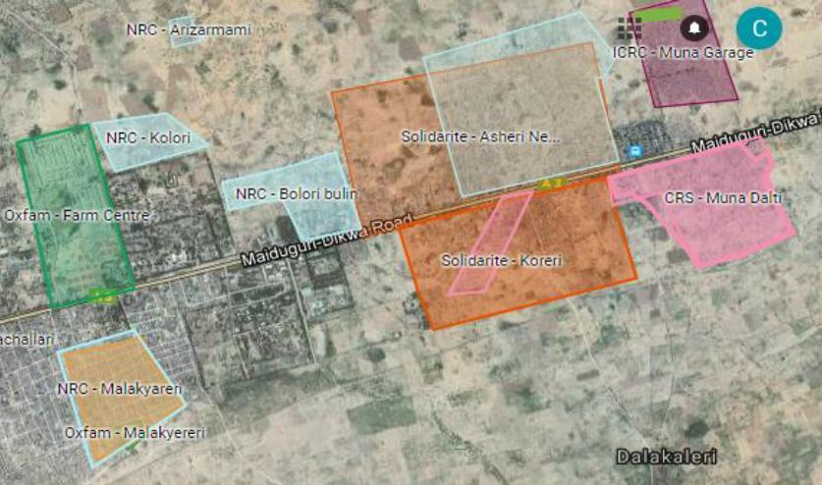

Slide 9
KEY ACHIEVEMENTS:
Successful coordination of the cholera response was achieved because;
INGOs working in Muna Corridor have been well-represented in on-going LAC meetings.
Muna Corridor mapping of actors, completed before the cholera cases as a part of LAC efforts, was pivotal in facilitating the initial coordination; and
LAC leadership engaged early, coordinating a local area response plan as soon as suspected cases were reported.
There was a clear sense of responsibility of LAC leadership to act.

Slide 10
CHALLENGES
Due to high staff turnover, organizational contact points needed to be updated at the outset of the emergency and this took time to address;
Many actors were not accustomed to thinking spatially or using maps.
There was no standard approach for hygiene promotion adopted by all WASH actors and not all agencies had trained hygiene promoters in cholera prevention and response messaging prior to this outbreak;
Some actors did not promptly follow-up on commitments they made or initially acknowledge they needed additional support.
LAC co-leads did not consult with the local government officials early in the process

Slide 11
LESSONS LEARNT
The LAC leads were able to quickly coordinate a response to the cholera outbreak due to the pre-existing LAC network.
LAC Terms of Reference (TOR) should be formalized, in conjunction with and buy-in from implementing organizations, the local and state government, sector coordinators, and OCHA;
Local and state government should be included as soon as possible in coordination efforts;
Having a Program Manager who could focus on the coordination and implementation of the response as the highest priority was essential
Having Information Management specialist staff present was crucial to the process, in order to maintain data bases, coverage maps and activity plans/reporting;
Using maps at meetings and collaborating with actors to improve maps may help habituate actors to leveraging these tools to improve coverage
Establish geographical boundaries of operation by easily identifiable natural or man-made features, such as streams or roads, may facilitate geographic coverage in urban areas.

Slide 12
Going Forward
Area Based Programming is possible if;
Donors fund integrated programming.
Donors fund Coordination and IM positions.
NGOs invest in IM.
NGOs have strong community engagement capability.
NGOs have multi-sector capability,
Or collaborate with others to provide sector specific services
Notes:
CRS’ case study was not a true

