Slide 1
Early Warning in Sri Lankan Landslides
National Building Research Organisation

Slide 2
Main triggering factor for Sri Lankan Landslides – Rainfall

Slide 3
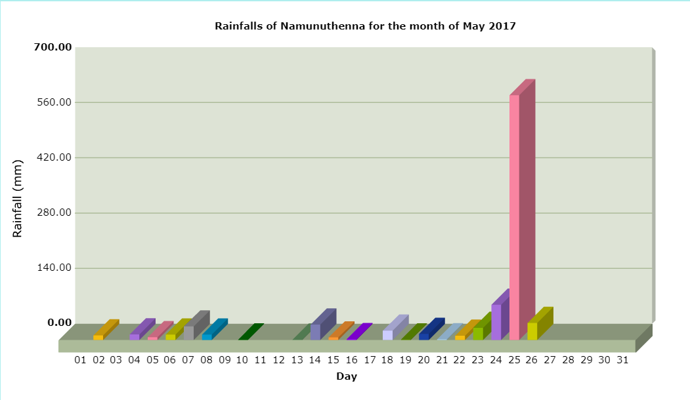
619 mm
Source: NBRO

Slide 4
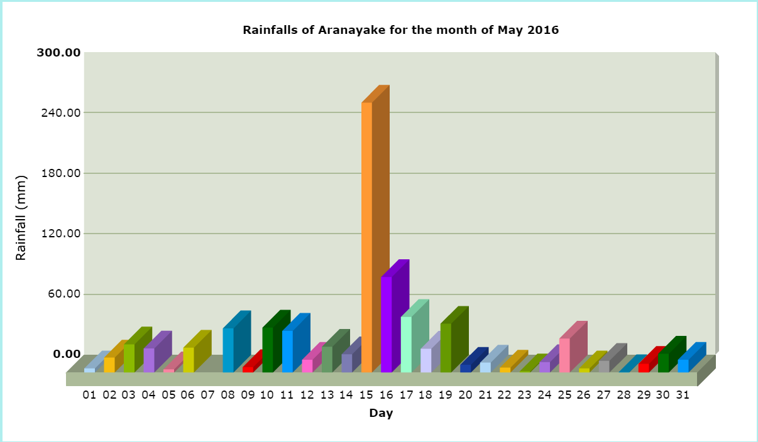
267 mm
94mm
Source: NBRO

Slide 5
Source: NBRO

Slide 6
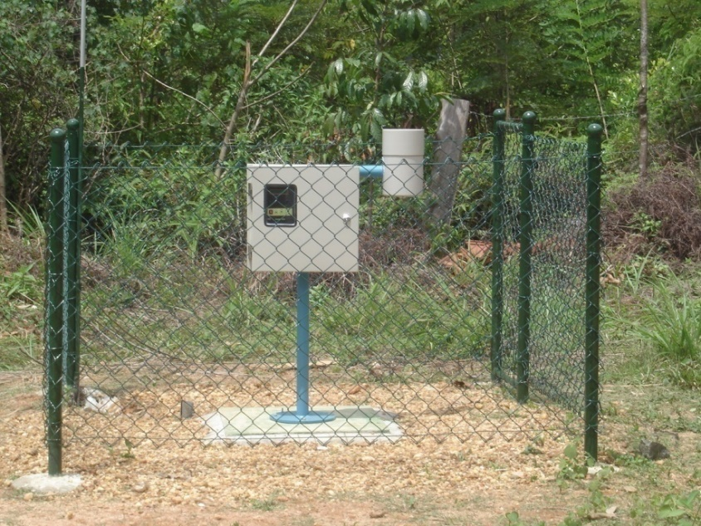
Automated rainfall monitoring system
Automated rainfall monitoring system consists of rain gauges with wireless interfaces and a central station.
Raingagues are installed in 12 districts including Matale, Kandy, Nuwara-Eliya, Kegalle, Ratnapura, Kalutara, Badulla & some vulnerable parts of Matara, Galle, Hambantota, Monaragala and Kurunegala.
The installed system of rain gauges accumulates and delivers the rainfall data of every 30 minutes to a single base, installed at NBRO Head office.
Real-time rainfall data from 105 automated rain-gauges are currently being collected and used to issue early warning to vulnerable communities when rainfall intensities reach to certain threshold values.
Notes:
The system consists of rain gauges with wireless interfaces and a central station. The rainfall information is transferred via SMS (Short Message Service) messages to the central station via a GSM cellular network. The information received in a database at the central station which can be accessed via the Internet, and the data analyzed.
With the financial support of government and UNDP, NBRO implemented the installation of automated raingauges.

Slide 7
Warning and Evacuation
Standard threshold limits of the Rainfall for landslides
Alert 75 mm/day
Colour Code: Yellow:
Be on alert on the possibility of landslides, rock falls, subsidence and cut slope failure if the rainfall exceeds 75mm and prevailing bad weather conditions continues within next 24 hours.
Colour Code: Amber:
If the rainfall exceeds 100mm and continues within next 24 hours, danger of landslides and cut slope failures exist.
Colour Code: Red:
If the rainfall exceeds 150mm and continues within next 24 hours or if the rainfall exceeds 75mm within an hour, evacuate to a safe place.
Warning 100mm/day
Evacuation, Off limit 75 mm/hour or 150mm/day

Slide 8
Early Warning Information Dissemination Flow for Landslide
Automated Rainfall Information
Department of Meteorology
NBRO Head Office
District Office
EOC, DMC
Media
Key Stakeholders
(District Secretary, Divisional Secretary, GN, Triforces etc.)
DMC District/DDMCU
Divisional Level/GN
Community Level
Notes:
District Disaster Management Coordination Unit (DDMCU)

Slide 9
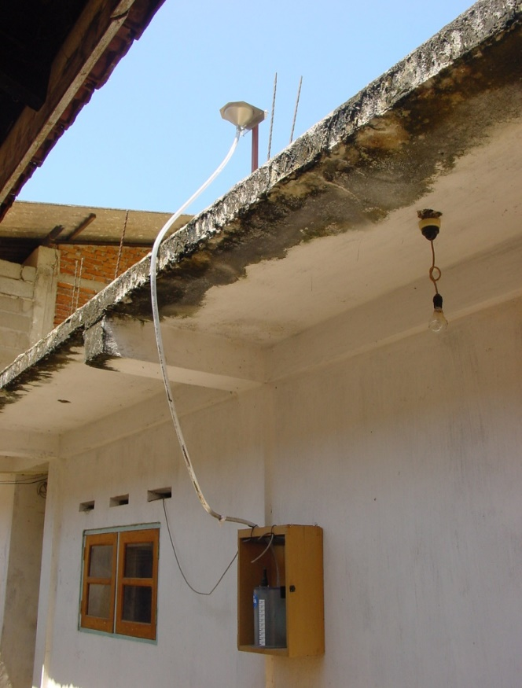
Community Based Early Warning
The regional early warnings issued by NBRO may not be reached to the actual communities on time or mostly neglected due to its generalized nature.
So, it has identified need of community based early warning systems at least for the identified potential landslide areas.
Therefore, NBRO has stepped into a community based awareness program.
It aims to educate and aware the communities, execute community based preparedness plans.
Site-specific automated landslide early warning systems (rain gauge, extensometer and moisture sensor coupled with siren and automatic communication system) are in placed.
Notes:
Surface deformation instruments

Slide 10
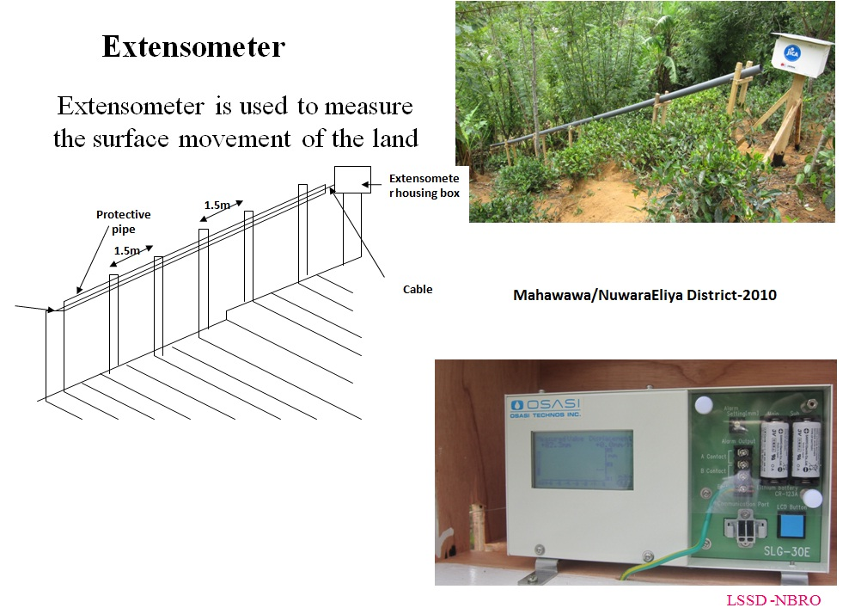

Slide 11
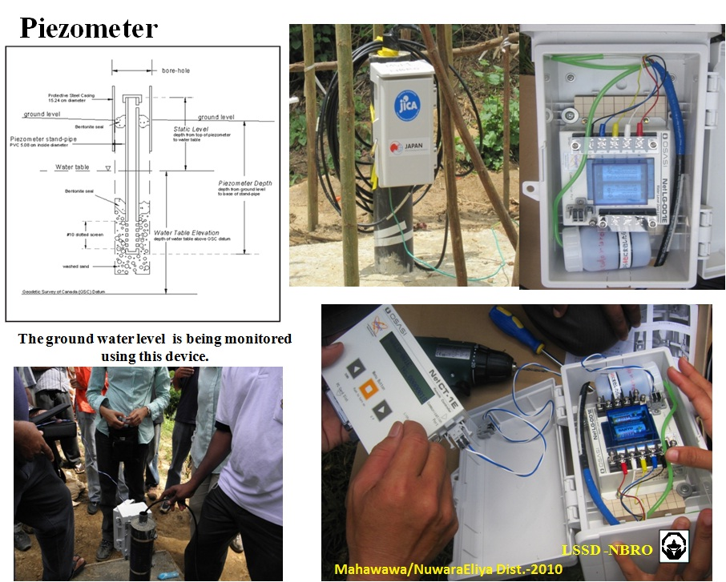

Slide 12
Number of houses planned for relocation
District | No. of houses to be relocated (Approximate)
Galle | 200
Matara | 350
Kaluthara | 1650
Rathnapura | 1400
Hambanthota | 200
Total | 3800
Source: GA offices and NBRO district offices

