Slide 1
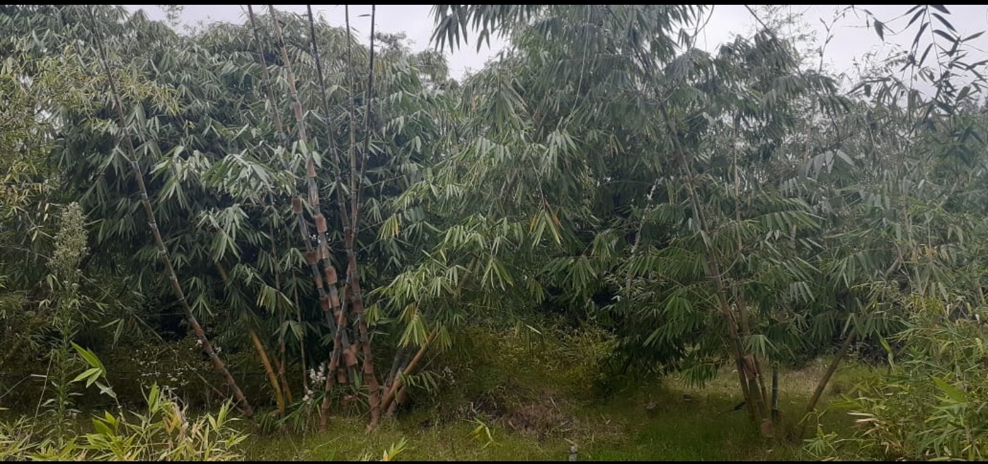
Horn of Africa Peace Network (HAPEN) Bamboo Piloting in Kismayo and Belet Hawa

Slide 2
About Bamboo
The term bamboo refers to a group of over 1250 species of grass varying from small to giant.
Bamboo - nicknamed the wonder plant - is the strongest and fastest growing woody plant on earth
Bamboo is an alternative to traditional timber as a renewable resource
The highly versatile giant grass can grow in almost any kind of climate and thrive in the poorest of soils.
Bamboo can be harvested as a perennial crop, without deforestation, three to five years after initial planting. It can be sustainably harvested for well over 40 years. Once it starts growing, bamboo remains rooted in the soil, producing new shoots each year. This helps secure the soil.
In Somalia, Bamboo has the potential to control desertification. It can be grown along the rivers banks. The area under growth is not recorded.

Slide 3
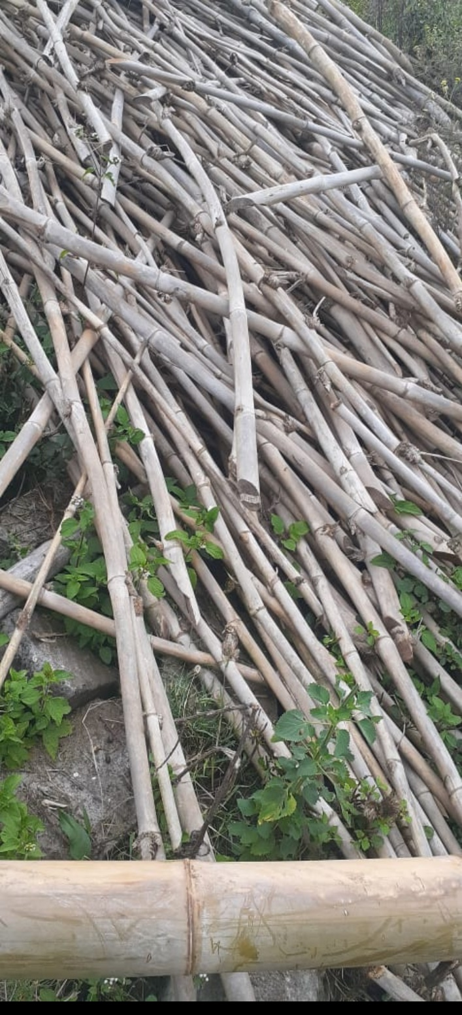
Priority Bamboo Species
International Network of Bamboo and Rattan (INBAR) and
UNEP (2003) recommended 38 priority bamboos of economic
importance.
Among the 38, the following species are available in Kenya and
have been found to do well in hot areas.
Dendrocalamus membranaceus cv. Grandis
Dendrocalamus maximuslamina
Dendrocalamus giganteus
Dendrocalamus stictus
Dendrocalamus asper
Dendrocalamus barbatus

Slide 4
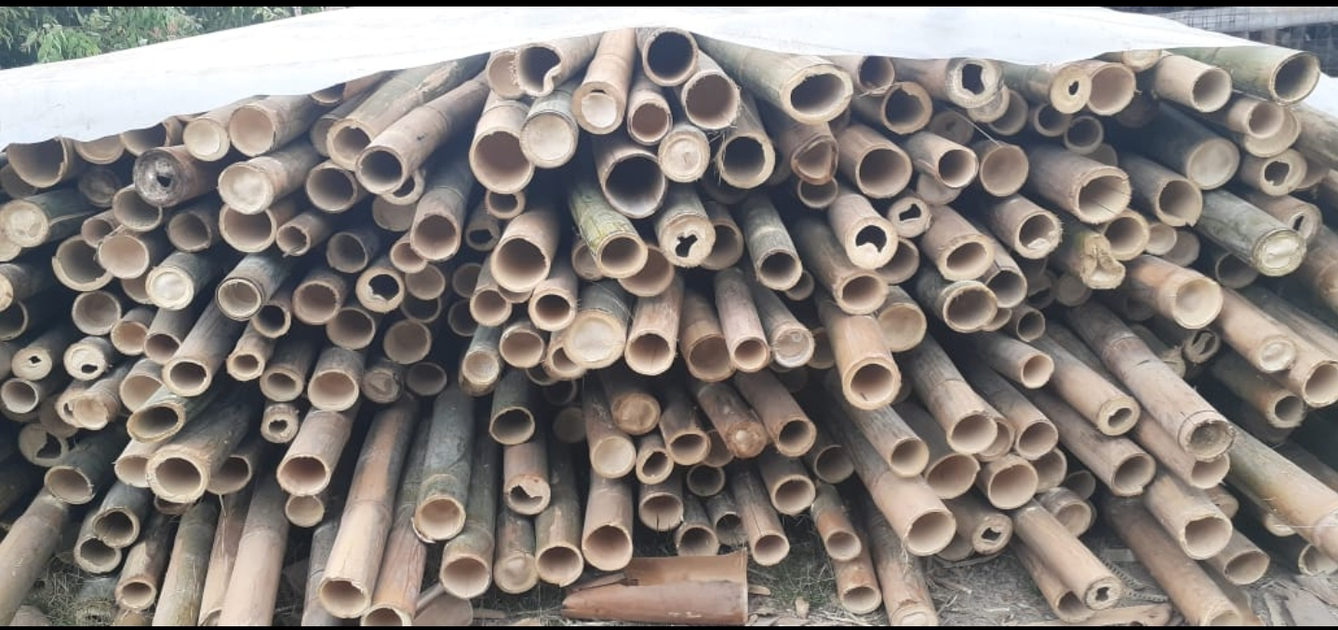
Proposed Piloting Sites
Kismayo
Yontoy
Gobwe
Belet Hawa
Malkariyey farm

Slide 5
Roll out plan
Have already sensitized farmers resulting in their readiness to plant bamboo on their farms
Start with about three varieties by the end of this month then narrow down to the best performing
Encourage more farmers to plant and grow the better performing variety
Mobilize resources to expand and popularize bamboo based on performance and benefits

