Slide 1
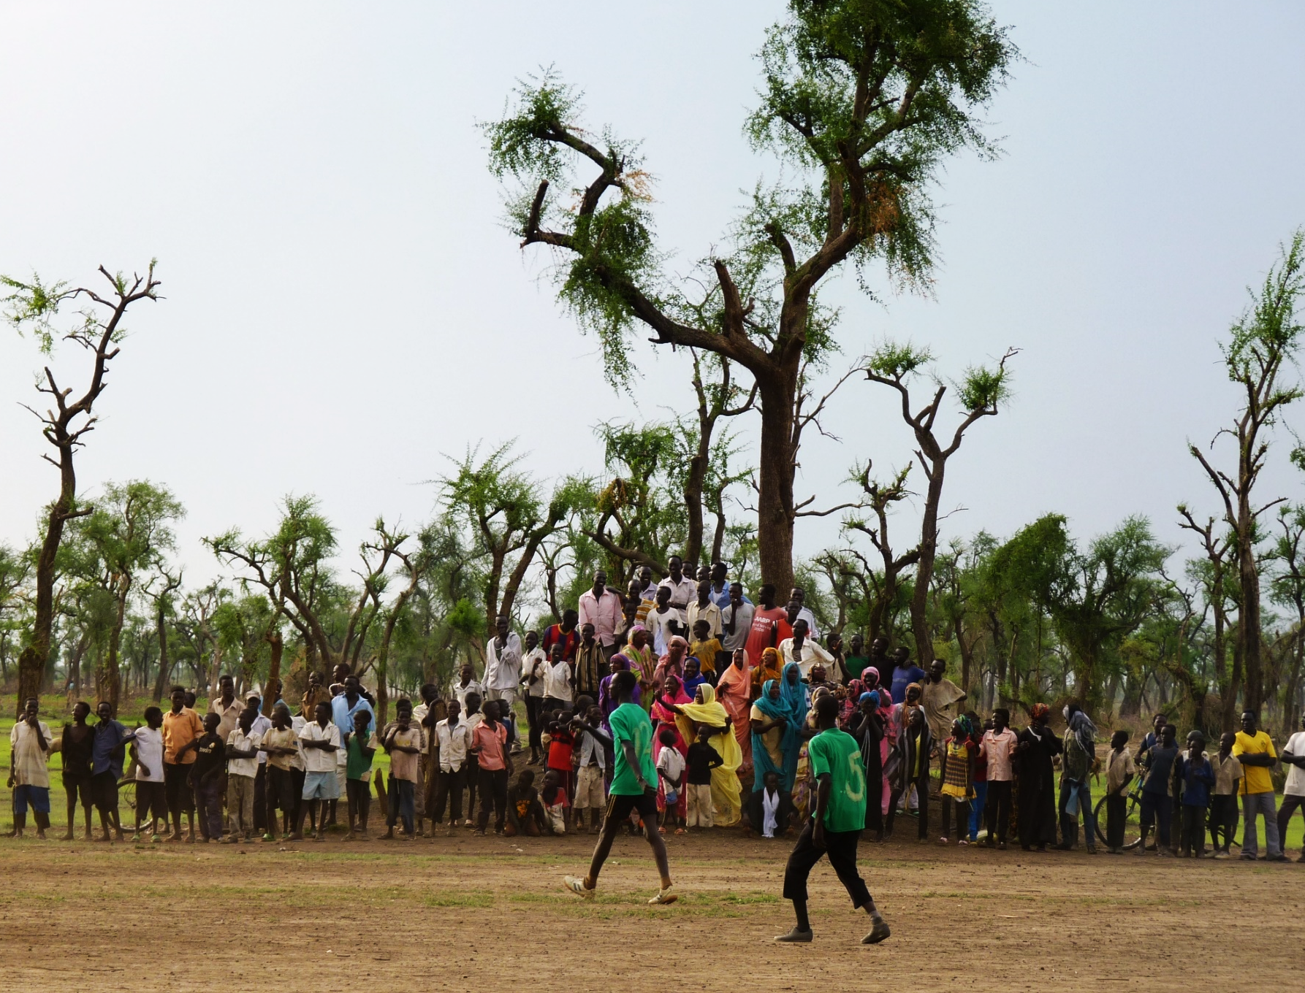
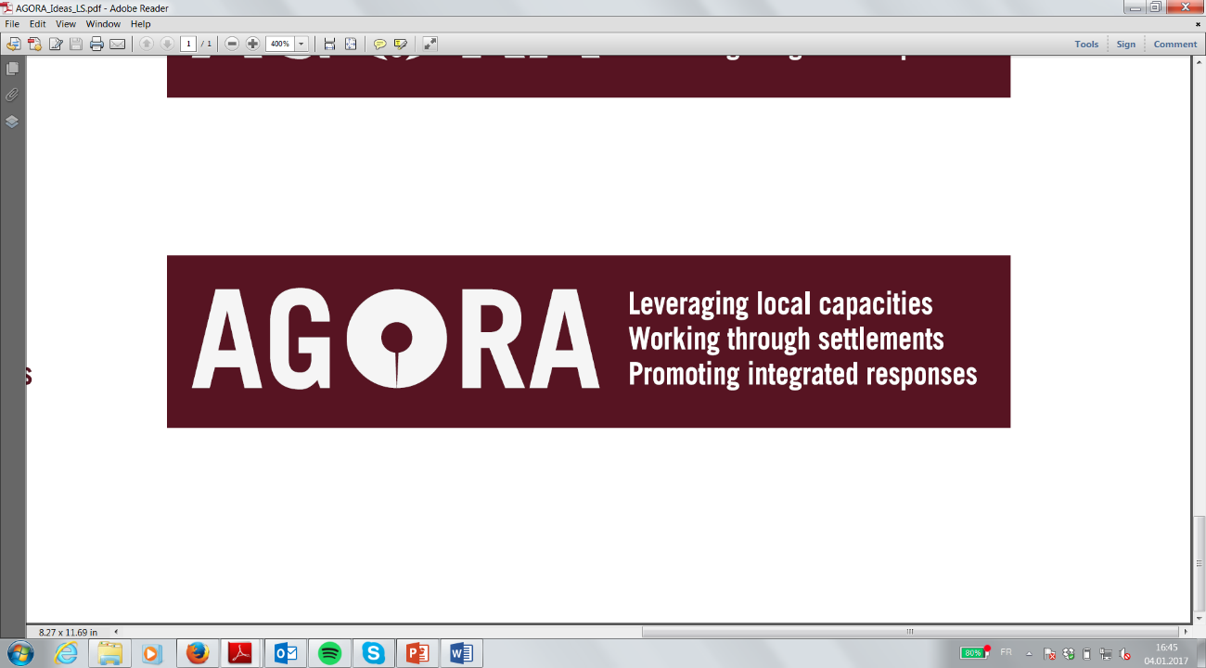
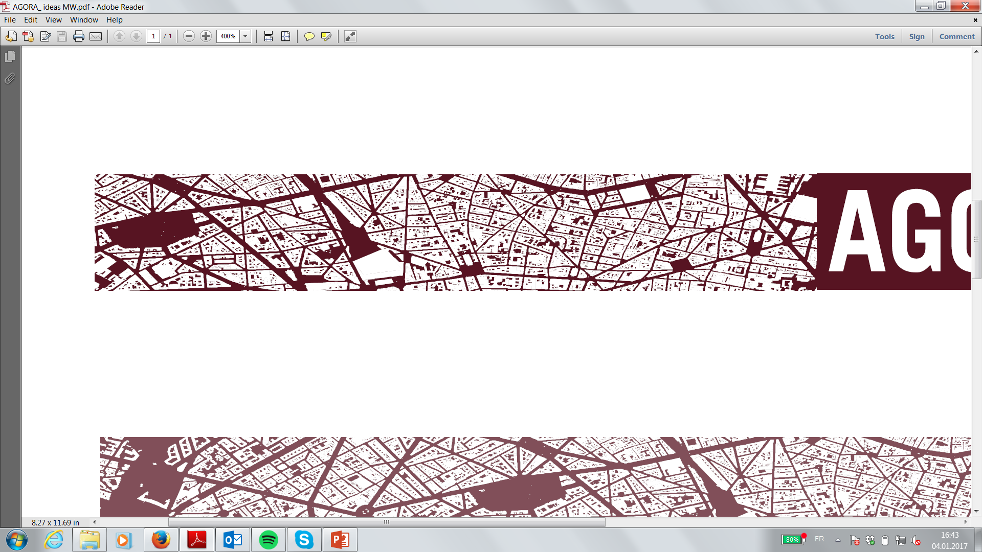
Settlement-based response coordination and planning
Bangui – Case Study Overview
Presentation to Shelter Cluster Settlement WG – 10.08.2017

Slide 2

Background on AGORA and Pilot
AGORA Overview
AGORA is a joint initiative of IMPACT and ACTED that aims to promote the recovery and stabilization of crisis affected communities through a localized approach which is structured around:
Synergies between local actors and exogenous aid stakeholders;
The use of settlements as the territorial unit for the planning, coordination and provision of aid and basic services.
Why Bangui?
Large crisis, with massive displacement, destruction of infrastructures, housing and disruption of basic services
With increased stability and safety, initial returns to Bangui (20 K in 2016), requiring a need to support local actors and re-start service delivery to absorb returning popultations
Pilot project to support a more integrated and efficient response to the returns in Bangui, through settlement based assessments and response plans

Slide 3
Bangui Case Study - Overview
Urban centre: Bangui, covering 4 neighbourhoods of Bangui (Fondo, Gbaya Ndombia I and II, Bloc Sara (Banga Sara I and II as well as Poto Poto Souma) and the Cité Boeing
Project timeframe: February – July 2017
Type of project: Settlement Based Assessment and planning, support to local authorities
Project partners: IMPACT, CUF/UCLG, ACTED (AGORA)
Coordination framework: HCT, in support of local authorities and OCHA, NGOs and other relevant humanitarian actors

Slide 4
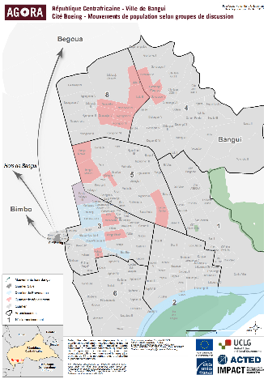

Bangui Case Study, Roll-out
Phase 1:
Phase 2:
Phase 3:
Phase 4:
Phase 5:
Set up of institutional framework and Urban Working Group
Settlement-based Assessments
Settlement-based response planning
Coordination and Implementation of response plans
Capacity building of Local Authorities in partnership with UCLG/CUF

Slide 5
Bangui Case Study – Key Achievements
Strong engagement of community representatives at neighbourhood level
High level of engagement from humanitarian actors, including INGOs, key UN Agencies (UNHCR, OCHA, UNDP, etc.), and Clusters
Settlement-based assessments and response plans enabled a shared prioritisation and planning across sectors / clusters and between international / local actors
Focus on promoting the engagement and building the capacity of local authorities, also using a municipality-to-municipality peer support scheme through CUF and UCLG
The settlement-based assessment findings and the subsequent response plan was used by donors for funding allocation and prioritisation.
The urban working group and the settlement-based response plan were a good practice to link humanitarian and development response.

Slide 6
Bangui Case Study – Challenges/Lessons
Key Challenges:
Linkage with existing coordination platforms
Local capacities and resources: Local actors were not very familiar with the humanitarian architecture/system and had limited and thinly spread resources to engage in coordination.
Geographical coverage: as this program is a pilot, the assessment was conducted in only 4 most affected neighbourhoods of Bangui.
Lessons Learned:
Engagement of local and international actors for joint prioritisation of response activities
Use of neighbourhoods as settlement-units for assessment and planning of response
Engagement of both humanitarian and development actors for joint planning of short and long term activities within the city of Bangui, linking humanitarian to development responses and plans
Peer to Peer support model for Municipality capacity building as an efficient way of increasing acceptance of support from local municipality stakeholders

