Slide 1

g]kfn ;/sf/
zx/L ljsf; dGqfno
zx/L ljsf; tyf ejg lgdf{0f ljefu
e"sDk k'glg{df0f tyf k'g:yfkgf cfof]hgf sfof{no
e"sDk k|lt/f]wfTds ejg lgdf{0f k|ljlw af/]
kfFr lbg] sflnu9 tflnd sfo{qmd
ejg dd{t tyf ;'b[9Ls/0f
efu # ;q !

Slide 2
ljifo ;"rL
s]sf] dd{t x'g ;Sb5 / s]sf] dd{t x'+b}g <
uf/] tyf k|m]d 9nfg ul/Psf] ejg dd{tsf] tl/sf
uf/] tyf k|m]d 9nfg ul/Psf] ejgsf] k|anLs/0f
Notes:
Objective:
This slide is intended to inform the participants what to expect in this presentation.
Activity:
Briefly elaborate what we are going to discuss in this presentation.
Slide details/ discussion:
Demolition and reconstruction of a damaged building is not a viable option. No one can afford it unless there is any other specific reason. Demolition and reconstruction is economically ruining (more than 100%) option.

Slide 3
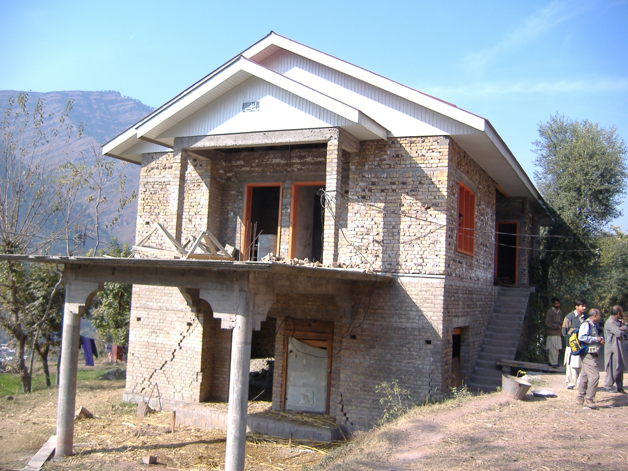
eTsfpg kg]{ ls gkg]{ <
Notes:
Objective:
To discuss that damage to house does not mean demolition and reconstruction.
Activities:
Let the participants identify damage in this building.
Ask the participants does this building requires demolition and reconstruction. If yes, why? If not, why not?
Slide Details / Discussion:
The slide presents a brick house that suffered wide cracks but not overturning of walls or demolition of any other building components.
These cracks can be easily repaired and building can be retrofitted.

Slide 4
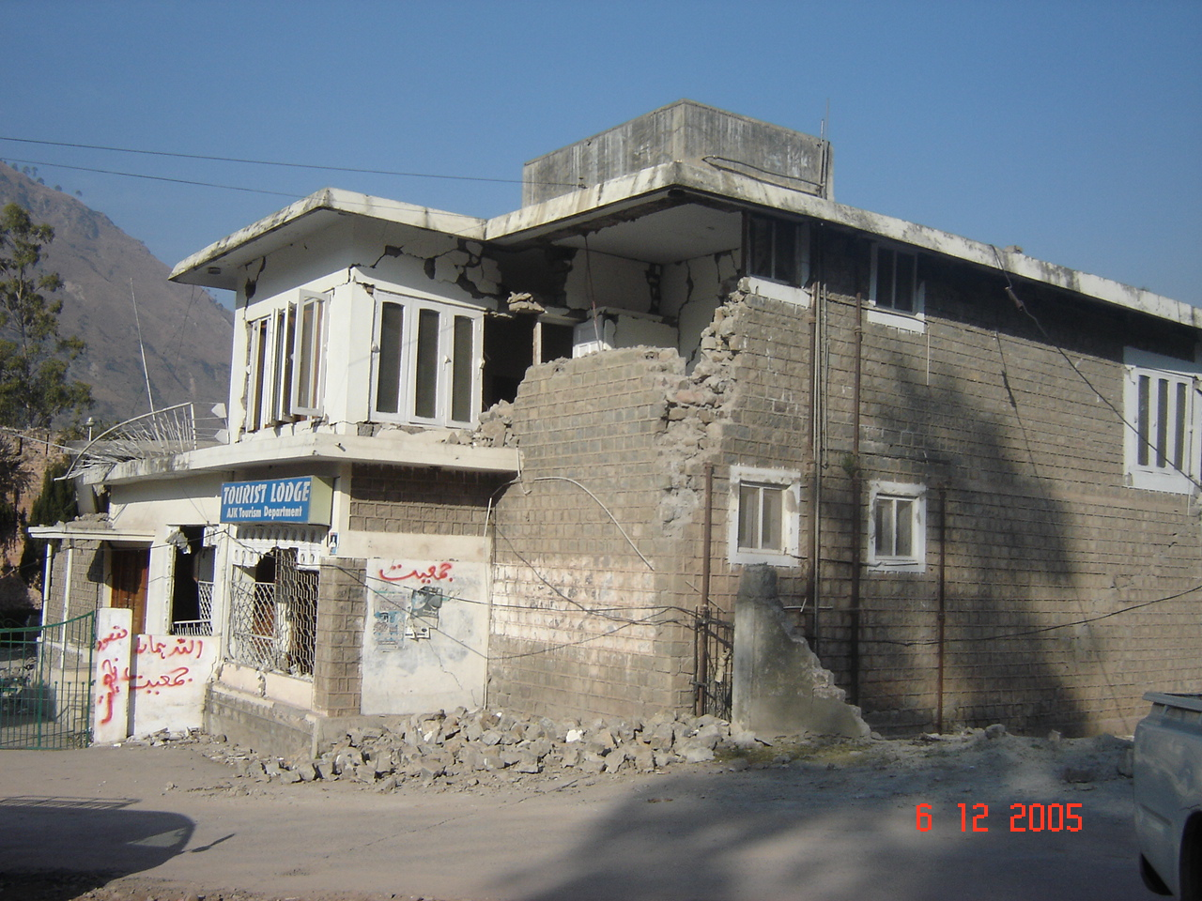
eTsfpg kg]{ ls gkg]{ <
Notes:
Objective:
To discuss that damage to house does not mean demolition and reconstruction.
Activities:
Let the participants identify damages in this building.
Ask people does this building requires demolition and reconstruction. If yes, why? If not, why not?
Slide details / Discussion:
The slide presents a stone house has suffered overturning of walls. However, the house or walls are not tilted.
The walls can be reconstructed, house repaired and retrofitted.

Slide 5
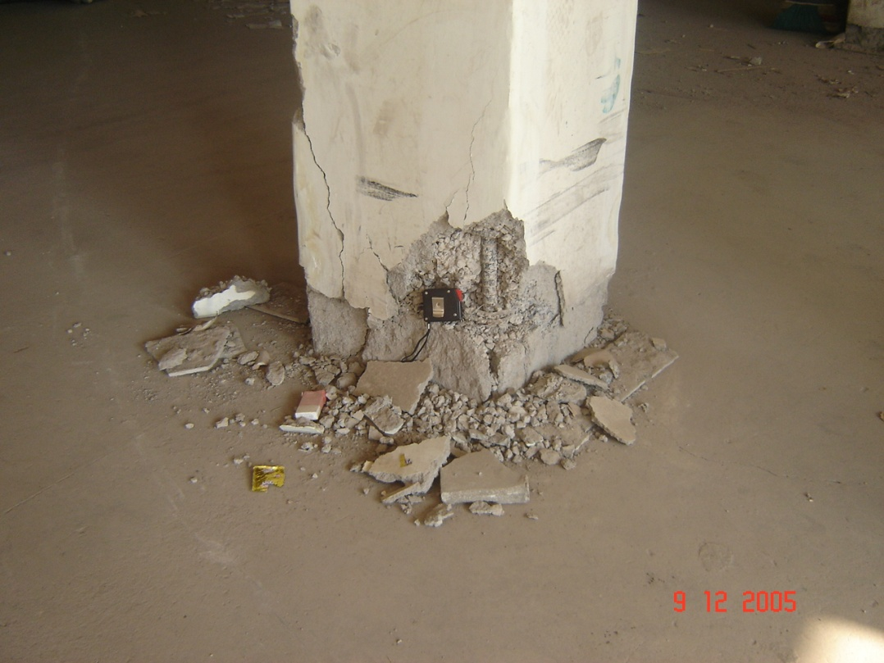
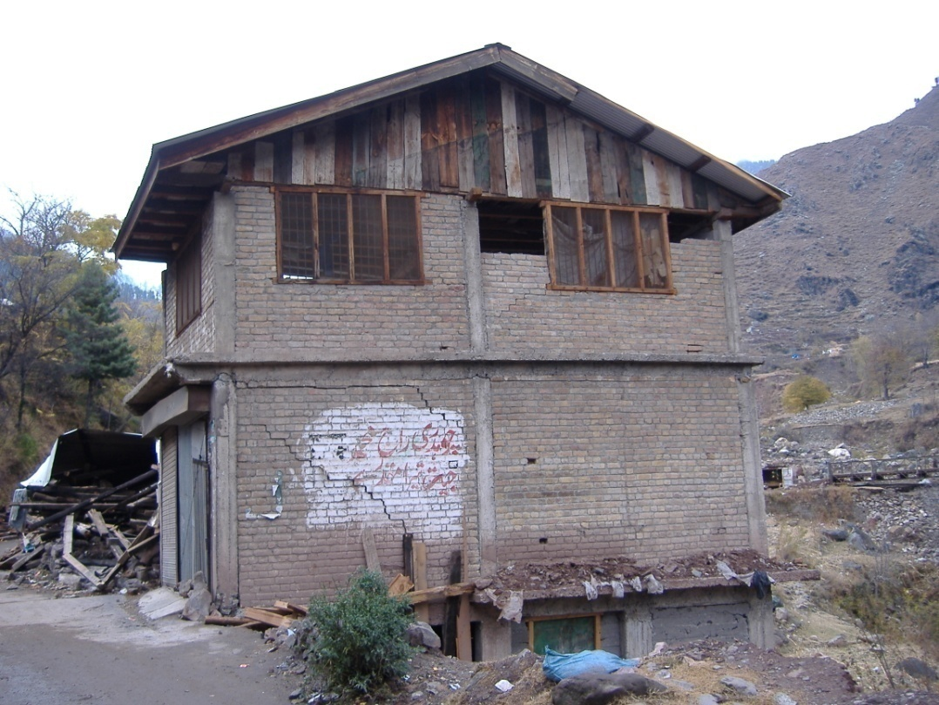
eTsfpg kg]{ ls gkg]{ <
Notes:
Objective:
To show that damage to house does not mean demolition and reconstruction.
Activities:
Let the participants identify damages in this building.
Ask people does this building requires demolition and reconstruction. If yes, why? If not, why not?
Slide Details / Discussion:
The first photograph presents spalling of cover at the bottom of a column. The damaged cover can be stripped off and reconstructed.
Second photograph presents cracks in the walls in the masonry infill RC frame. The walls suffered cracking. The house can be easily repaired.

Slide 6
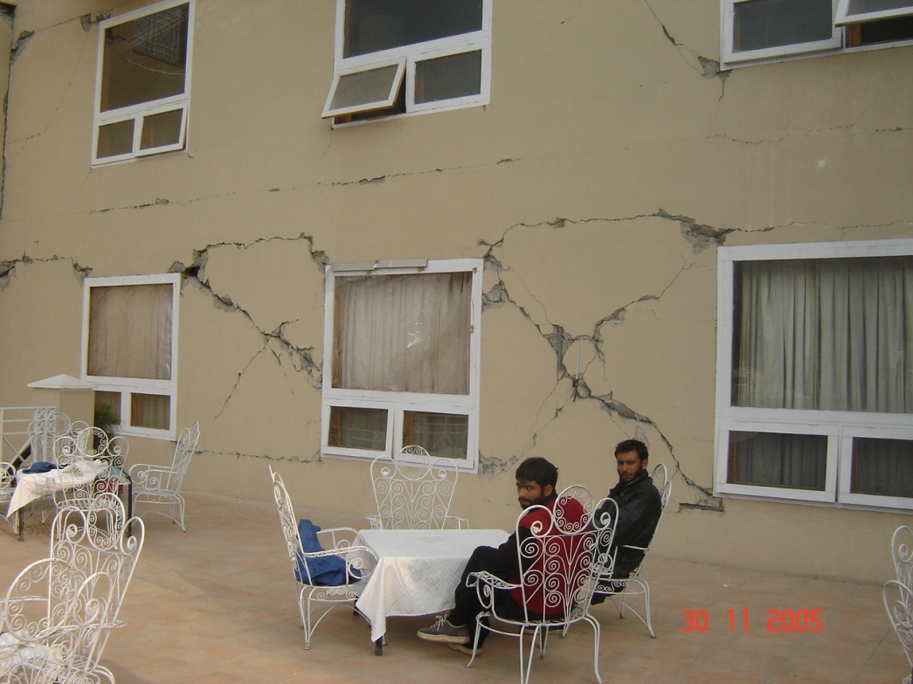
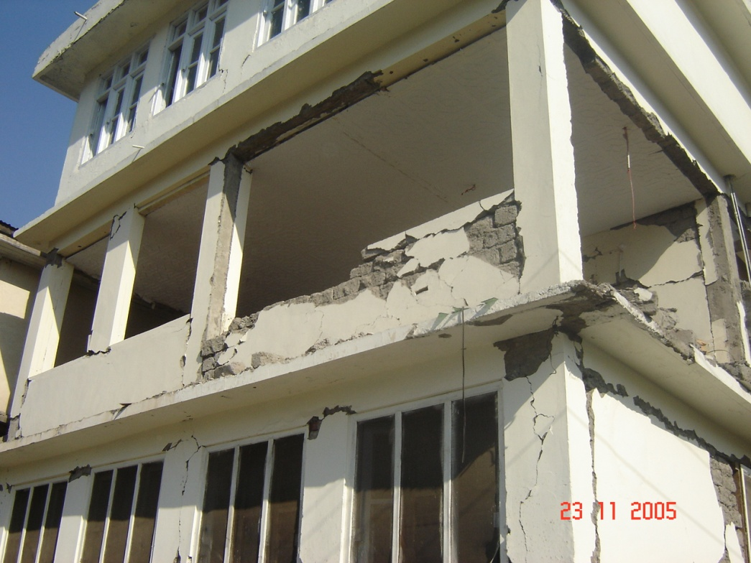
eTsfpg kg]{ ls gkg]{ <
Notes:
Objective:
To show that damage to house does not mean demolition and reconstruction.
Activities:
Let the participants identify damages in this building.
Ask people does this building require demolition and reconstruction. If yes, why? If not, why not?
Slide Details / Discussion:
The first photograph presents a RC frame building with severe cracks in infill masonry walls. These walls can be demolished or reconstructed or repaired.
In second photograph, walls topped because of lack of tie-up between frame wand walls. The walls can be reconstructed with tie-up, house repaired and retrofitted.

Slide 7
cf+lzs Iflt ePsf] jf k"/} Ifltu|:t gePsf] ejg eTsfpg cfjZos gkg{ ;S5 !! logsf] dd{t jf k|anLs/0f x'g;S5 !!
Notes:
Objective:
To summarize if building is only partly damaged, it is not necessary to demolish it.
Activity:
Summarize the slides presented so far
Slide Details / Discussion:

Slide 8
x:tIf]ksf ljsNkx?
dd{t
  b]lvg] u/L Iflt ePsf ejgsf cËx?nfO{ :ffljs adf]lhd PsLs[t ug]{
  em08} e"sDk k"j{sf] h:t} dha"lt k'gM k|fKt ug{ ;lsG5
k|anLs/0f
  ejgsf cËx?sf] k|lt/f]w Ifdtf j[l4 u/L ejgnfO{ dha"t kfg]{
Notes:
Objective:
To discuss the difference between repair and retrofit.
Activities:
Collect participants views in repair and retrofit.
Explain in brief. Just mending the cracks does not mean increase in strength. Improper repair may mean putting a bomb in the house.
Slide Details / Discussion:
This slide presents a distinction between repair and retrofitting. Many houses are being repaired with conviction that the building is being strengthened.

Slide 9
dd{t

Slide 10
uf/f]sf] u|fpl6+u
(rL/fsf] rf}8fO{ )=% b]lv % ld=ld= ;Dd)
Notes:
Objective:
To describe grouting of cracks.
Activities:
Ask participants, how these cracks can be mended.
Explain in brief.
Slide Details / Discussion:
If the width of cracks are less than 5 mm, these can be grouted. Remove the plaster and clean the cracks. Sealed the crack fully from one side with mortar or putty. Leave grout ports on the next sides. Now starting from bottom grout port, start injecting the grout until the grout start coming out from next upper grout port. Then inject from next upper port and continue in the similar way until all the cracks are filled with grout.

Slide 11
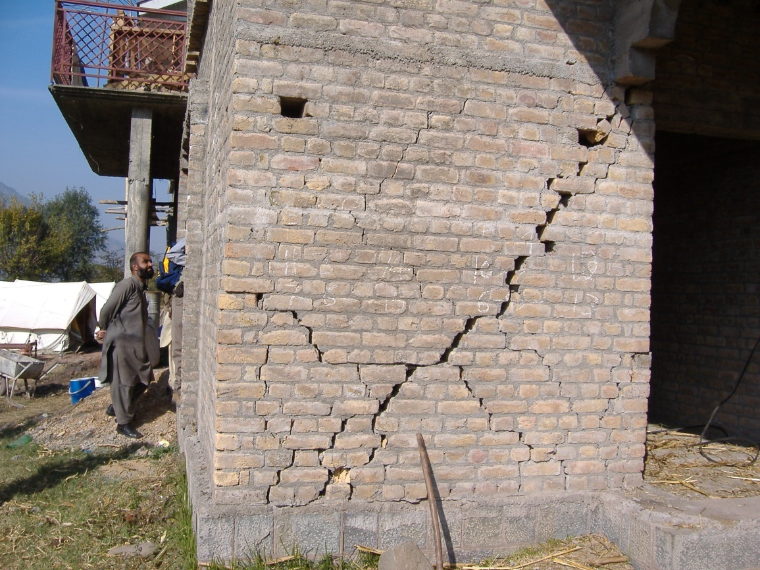
7"nf rL/fx?
(rL/fsf] rf}8fO % ld=ld= eGbf a9L)
Notes:
Objectives:
To show the repair of major cracks.
Activities:
Ask participants, how these cracks can be mended.
Explain in brief.
Slide Details / Discussion:
If there are major cracks, replace part of defected element constructing new one. It shall be done part by part. While removing in parts, provide temporary supports before removing it and also be careful about the stability of other parts too. Sometimes by providing the wire mesh and plastering it along the cracks may be sufficient.

Slide 12
9'Ëfsf] uf/f] k'gM lgdf{0f
Notes:
Objective:
To describe the repair of stone masonry
Activity:
Collect participants views on how to repair stone masonry.
Explain in brief.
Slide Details / Discussion:
Bulging or collapse of stone masonry can be repaired if the overall integrity of the building is not lost. First of all temporary supports are provided and overall stability is ensured before the commencement of the work. The damaged wall is replaced by new wall with through stones in appropriate locations.

Slide 13
5]plt/sf] vDaf dd{t
Notes:
Objective:
To discuss about repair of column.
Activities:
Explain about the figure and describe the process of repairing the column.
Slide Details / Discussion
This slide shows the process of column repair. Initially the overall integrity of the building is checked. If its columns are repairable, the support the floor well before starting the work. Remove damage part of concrete, removed the buckled bar and insert new bars with sufficient lapping to the existing bar. Provide stirrups @ 3 to 4 inch centre to centre.

Slide 14
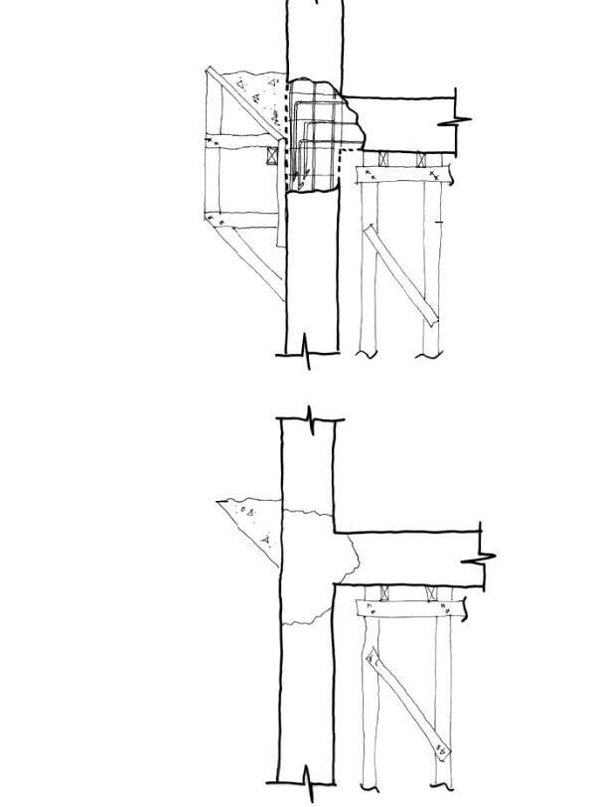
5]plt/sf] vDaf dd{t
aflx/L xf]k/
a9L ePsf] s+lqm6 x6fpg]
Notes:
Objective:
Continuation of repair of column
Activity:
Link with the previous slide and explain the remaining process of column repair.
Slide Details / Discussion:
This slide shows the remaining steps in the column repair. Prepare formwork properly and start concreting from side. External hopper helps to fill the concrete properly. Cut the excess concrete in the external hopper and remaining concrete will remain intact to form a continuous column.

Slide 15
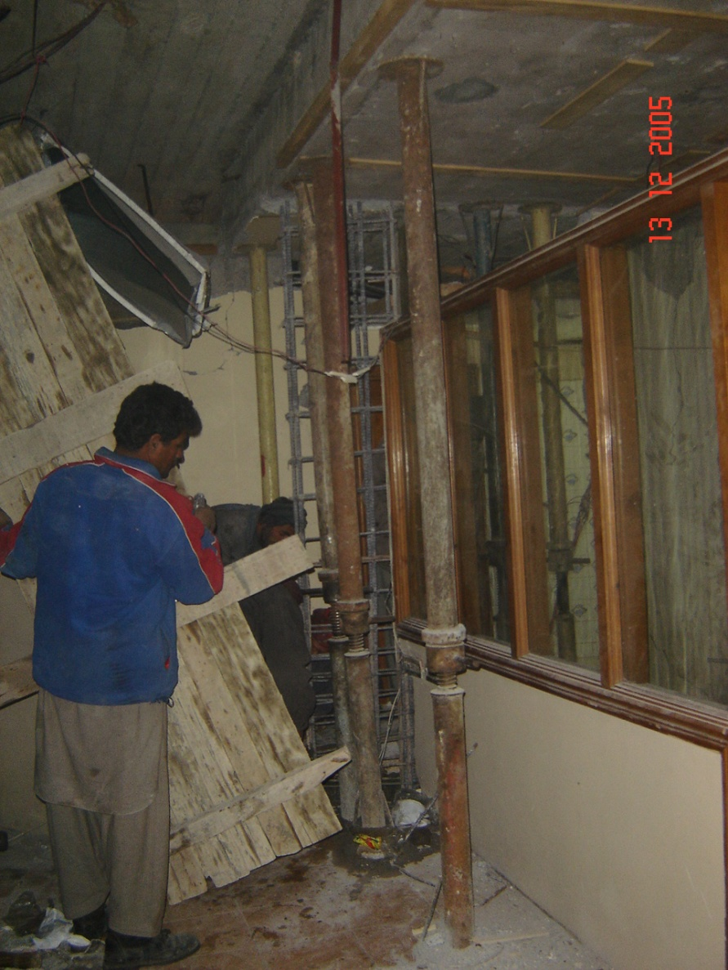
leqL vDaf dd{t
blng / vDafsf] cfwf/ ldnfpg]
lau|]sf] s+lqm6 x6fpg]
nDafOtkm{ 808L yKg]
glhs kg]{ u/L l/+ux? /fVg]
alnof] cg'kftsf] s+lqm6 xfNg]
csf]{ lbg kmdf{ vf]n]/ /fd|/L So"l/+u ug]{
Notes:
Objective:
To discuss repair of central column.
Activity
Explain about the process in detail
Slide Details:
In this slide, column is being repaired. The floor is supported and new reinforcement is inserted.

Slide 16
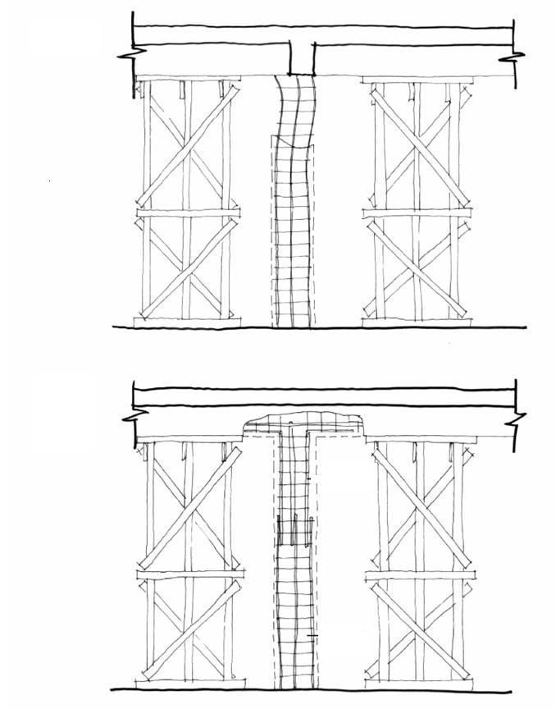
leqL vDaf dd{t
gof+ 808L
k'/fgf] 808L
Notes:
Schematic diagram of central column repair.

Slide 17
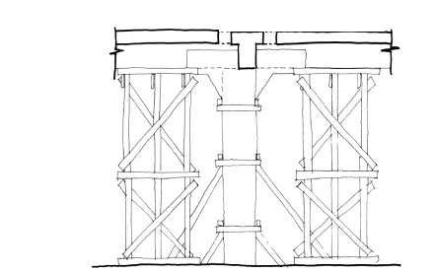
leqL vDaf dd{t
sDtLdf @)) ld=ld= Jof;sf] c:yfoL Kjfn
Notes:
Objective:
To discuss how to pour concrete in the interior column.
Activities:
Ask the participants how to pour concrete in the central column?
Explain the detail process.
Slide Details:
This slide shows the method of pouring the concrete in the interior column. A temporary hole of at least 8 inches diameter can be made on the slab. This makes easy to fill the concrete.

Slide 18
k|anLs/0f

Slide 19
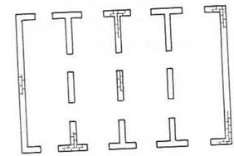
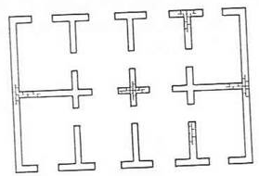
cfsf/df ;'wf/

Slide 20
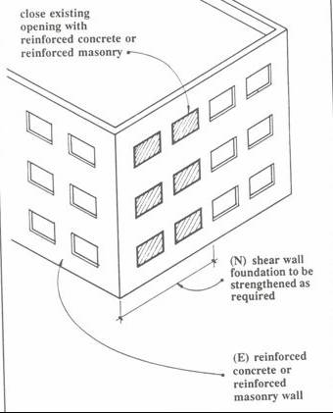
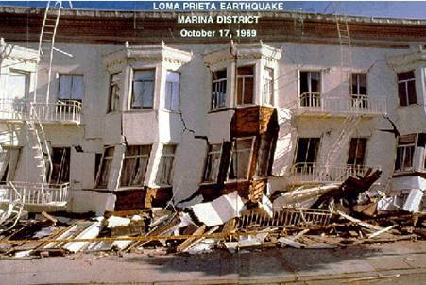
v'Nnf efu 36fpg]

Slide 21
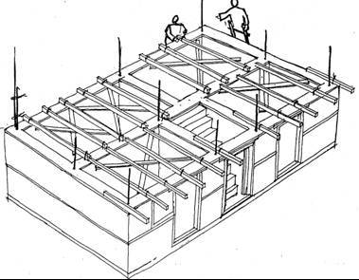
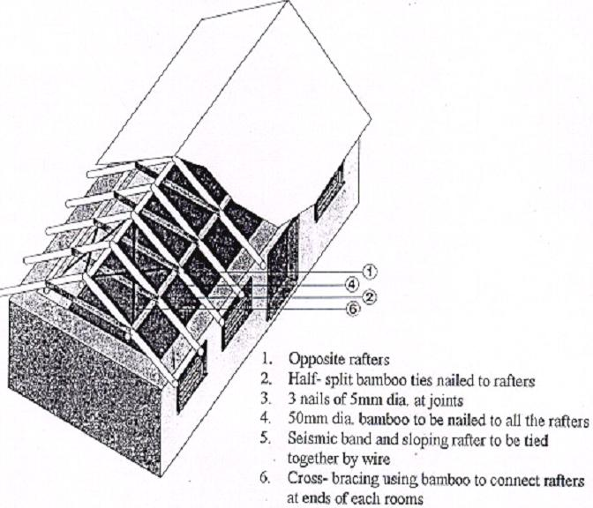
nlrnf] e'O{+nfO{ Ps l9Ssf agfpg]

Slide 22
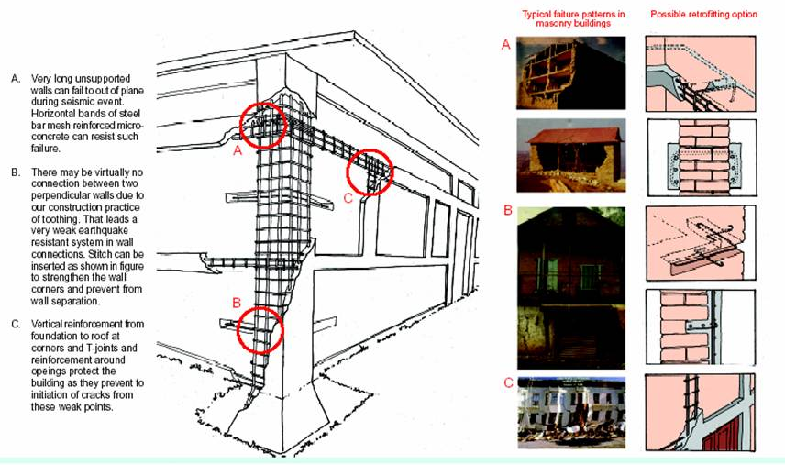
ejgdf k|anLs/0f ul/g] k|d'v :yfgx?

Slide 23
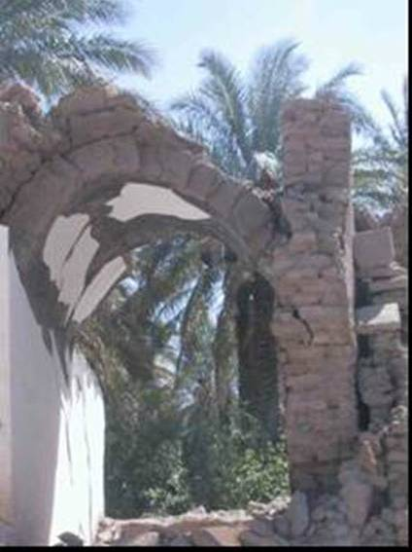
cfr{sf] ;'b[9Ls/0f

Slide 24
uf/f]jfnf ejgsf] k|anLs/0f

Slide 25
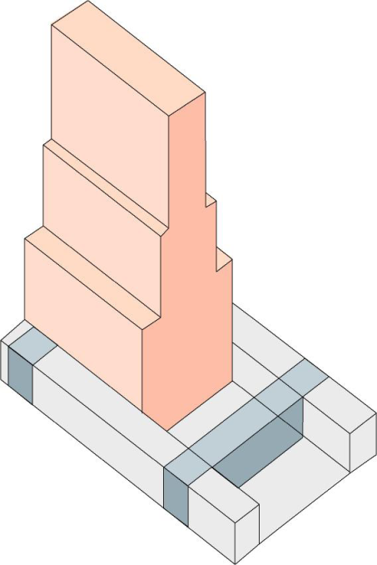
husf] k|anLs/0f
  of] hu dd{t ug]{ Ps ljlw xf]
  of] k|lqmof v08 v08df ug'{ kb{5 .
  husf] jl/kl/sf] df6f] x6fO{ v'Nnf ug'{kb{5 .
  cfjZostf cg';f/ hudflysf] efunfO{ c8\ofpg' kb{5 . To;kl5 gofF hu agfpg' kb{5 . cfjZostf cg';f/ husf] ulx/fO{ of rf}8fO{ a9fpg ;lsG5 .
  hu ;'wf/ ug{sf nflu k|fljlws 1fg cfjZos kb{5 . t;y{ k|fljlws;+u k/fdz{ u/]/ dfq of] sfo{ ug'{kb{5 .

Slide 26
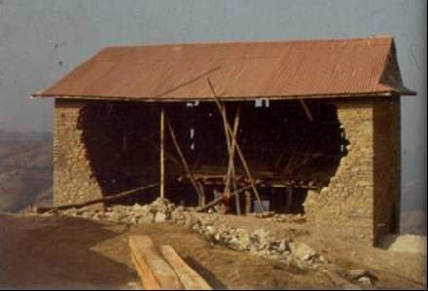
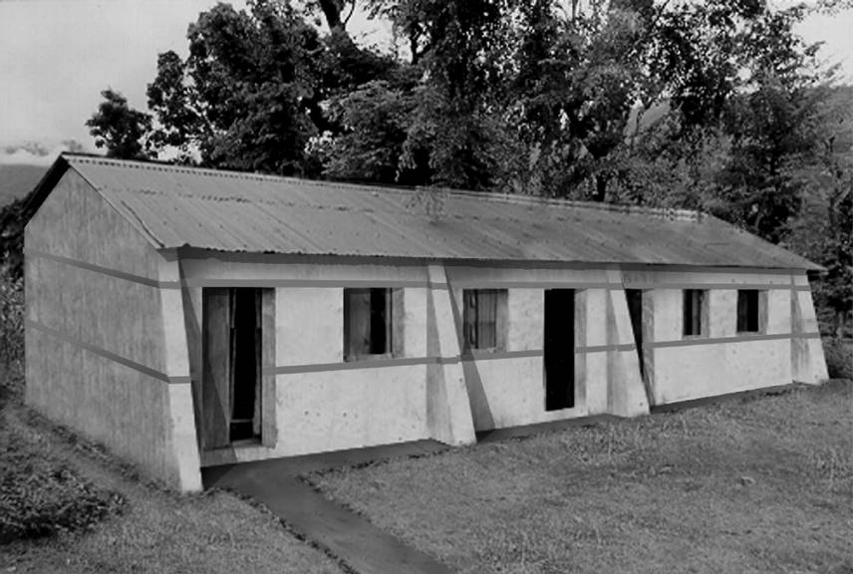
nfdf] uf/f]nfO{ cf8 uf/f]sf] e/

Slide 27
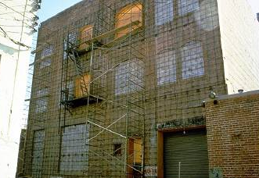
sdhf]/ uf/f]df s+lqm6sf] cfj]i6g

Slide 28
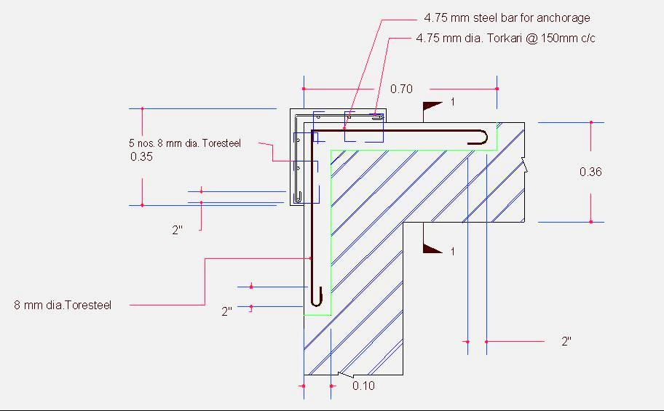
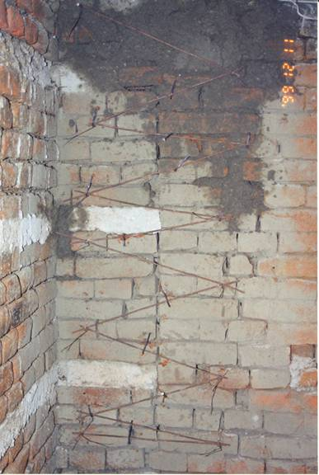
s'gf ;jnLs/0f ljlw
≥2.5T
!$Æ uf/f]sf] xsdf
≥2.5T
(Æ uf/f]sf] xsdf

Slide 29
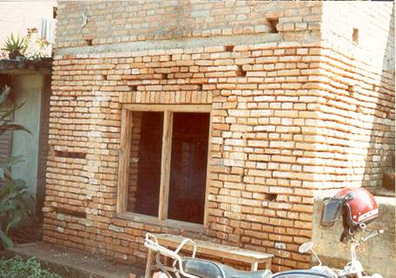
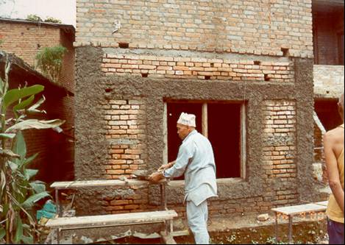
k6\6L /fVg] ljlw
808Ldfly dfOqmf] s+lqm6 ug]{
k6\6L /xg] :yfgsf] d;nf lgsfnL ;kmf ug]{

Slide 30
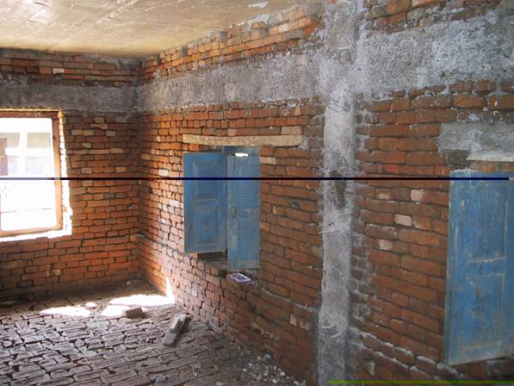
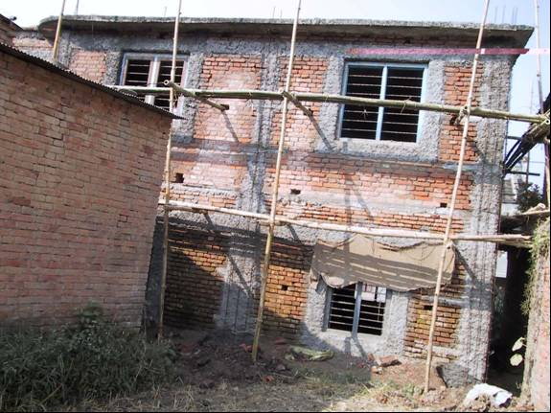
k6\6L /fVg] ljlw
NSET
ejgsf] leq / aflx/

Slide 31
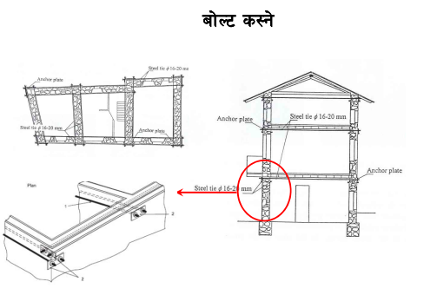

Slide 32
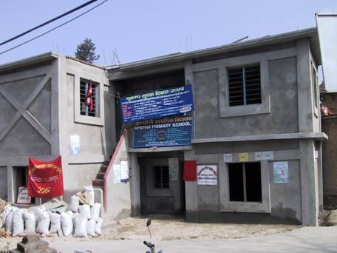
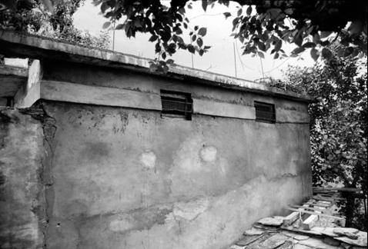
k|anLs/0f kl5

Slide 33
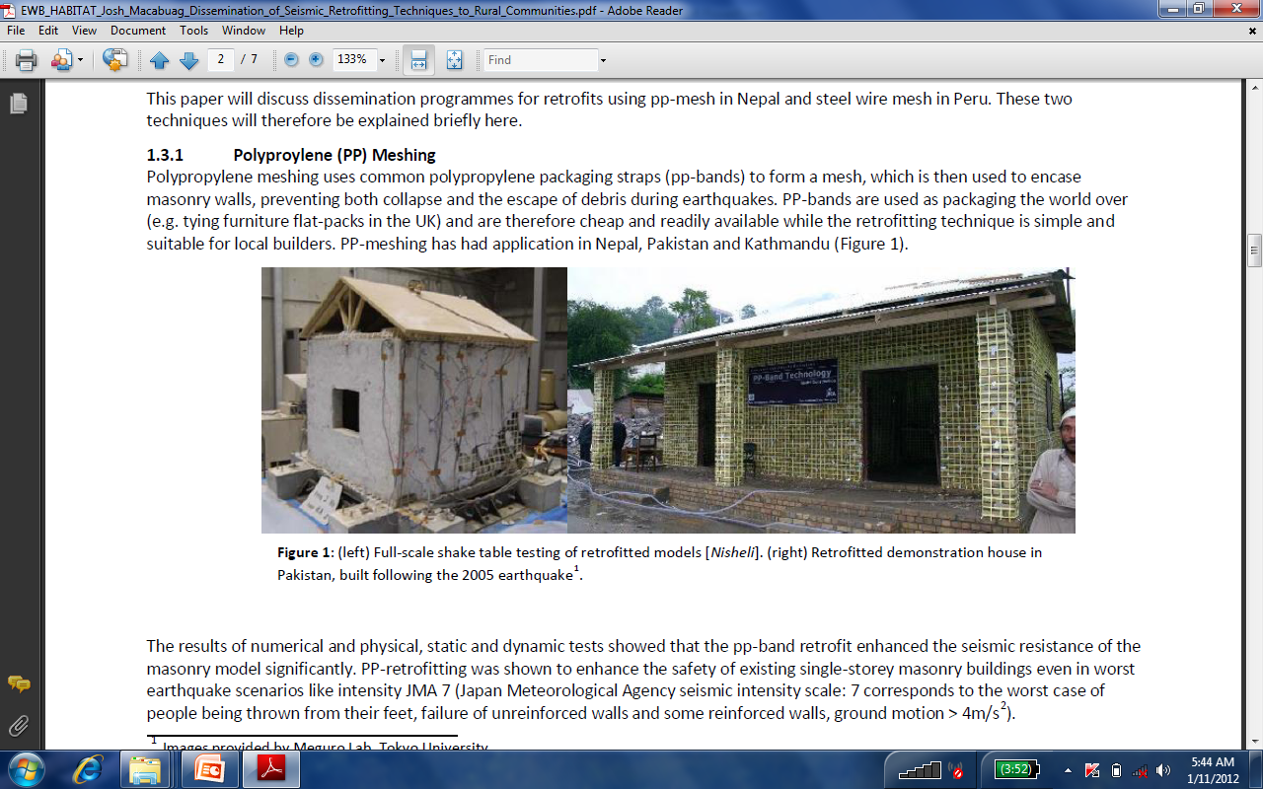
9'+ufdf6f]af6 ag]sf] ejg k|anLs/0f
ejgsf] ;+/rgfsf ;j} efunfO{ Ps l9Ssf kfg]{
  e"sDk y]]Ug] efux?nfO{ k/:k/df hf]8\g]
  cnu plePsf efux?nfO{ hf]8\g]
kf]lnk|k]lng -sfuhsf afs; Kofs ug{ k|of]u ul/g] kf6f_ k|of]u u/L ;anLs/0f ul/Psf] 3/

Slide 34
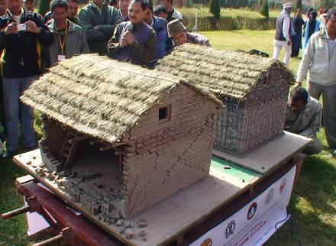
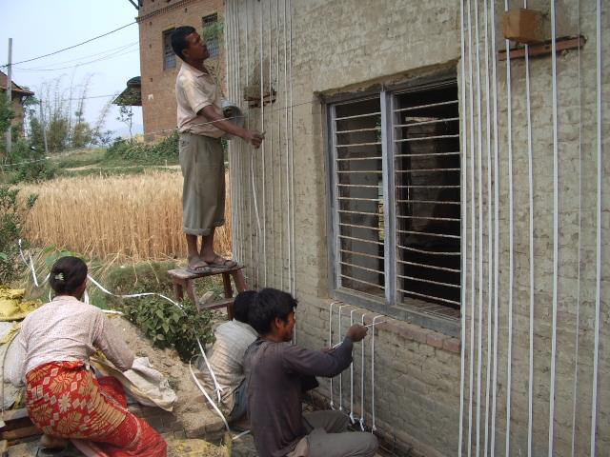
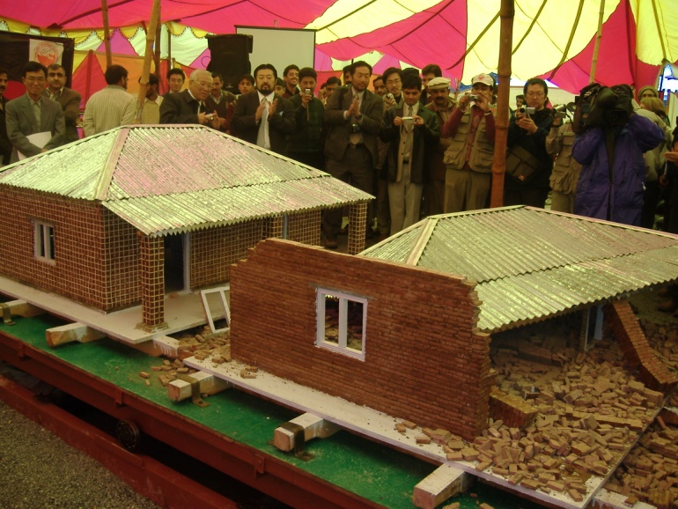
kf]lnk|k]lng -sfuhsf afs; Kofs ug{ k|of]u ul/g] kf6f_ k|of]u u/L k|anLs/0f ul/Psf] 3/, gd"gf 3/df k/LIf0f

Slide 35
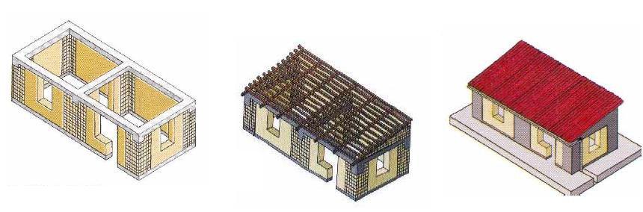
x/]s s'gf / hf]gL{df kmnfdsf] hfnL nufO{ k|anLs/0f

Slide 36
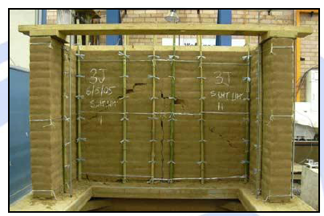
k|anLs/0fdf af+;sf] k|of]u

Slide 37
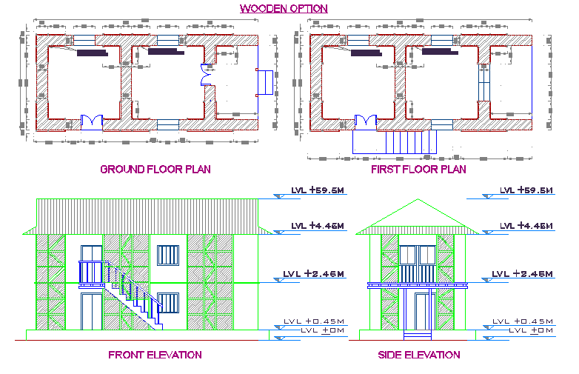
:yfgLo sf7sf] k|of]uaf6 k|anLs/0f

Slide 38
9nfg ejgsf] k|anLs/0f
;fdfu|L
  k/Dk/fut
    k|alnt s+lqm6
    l:6n
  kmfOa/ /]gkmf];{d]G6 kf]lnd]/ -FRP_

Slide 39
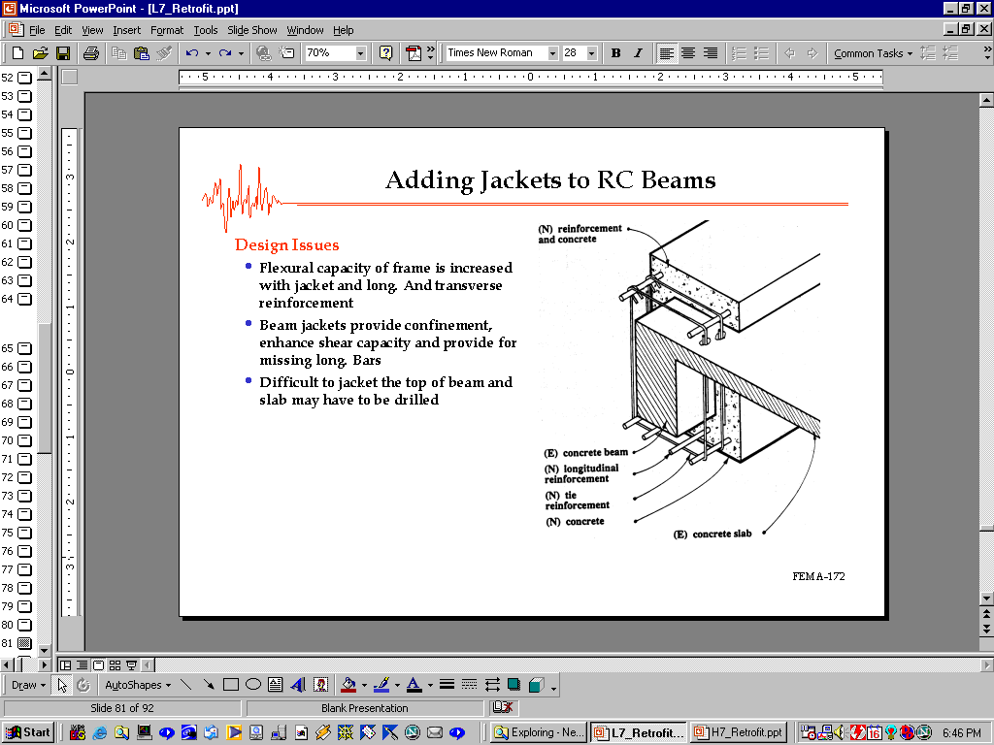
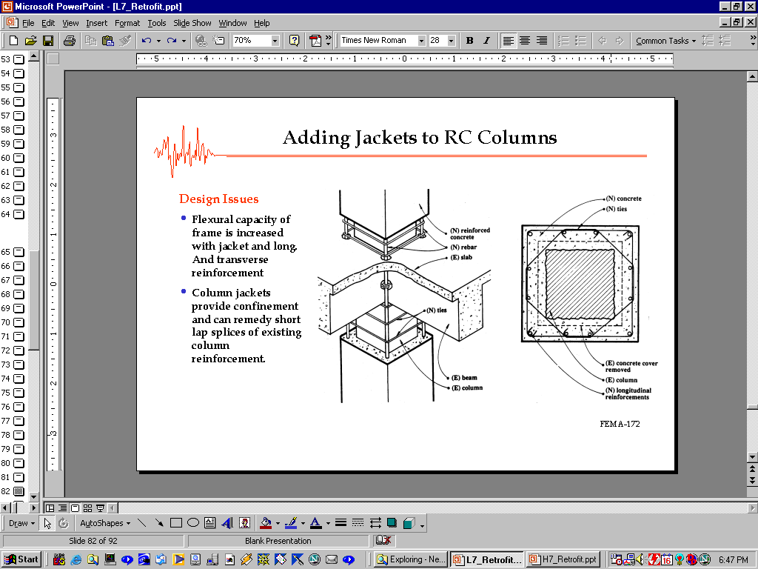
s+lqm6sf] cfj]i6g

Slide 40
vDafsf] hu a9fpg kfOn /fVb}

Slide 41
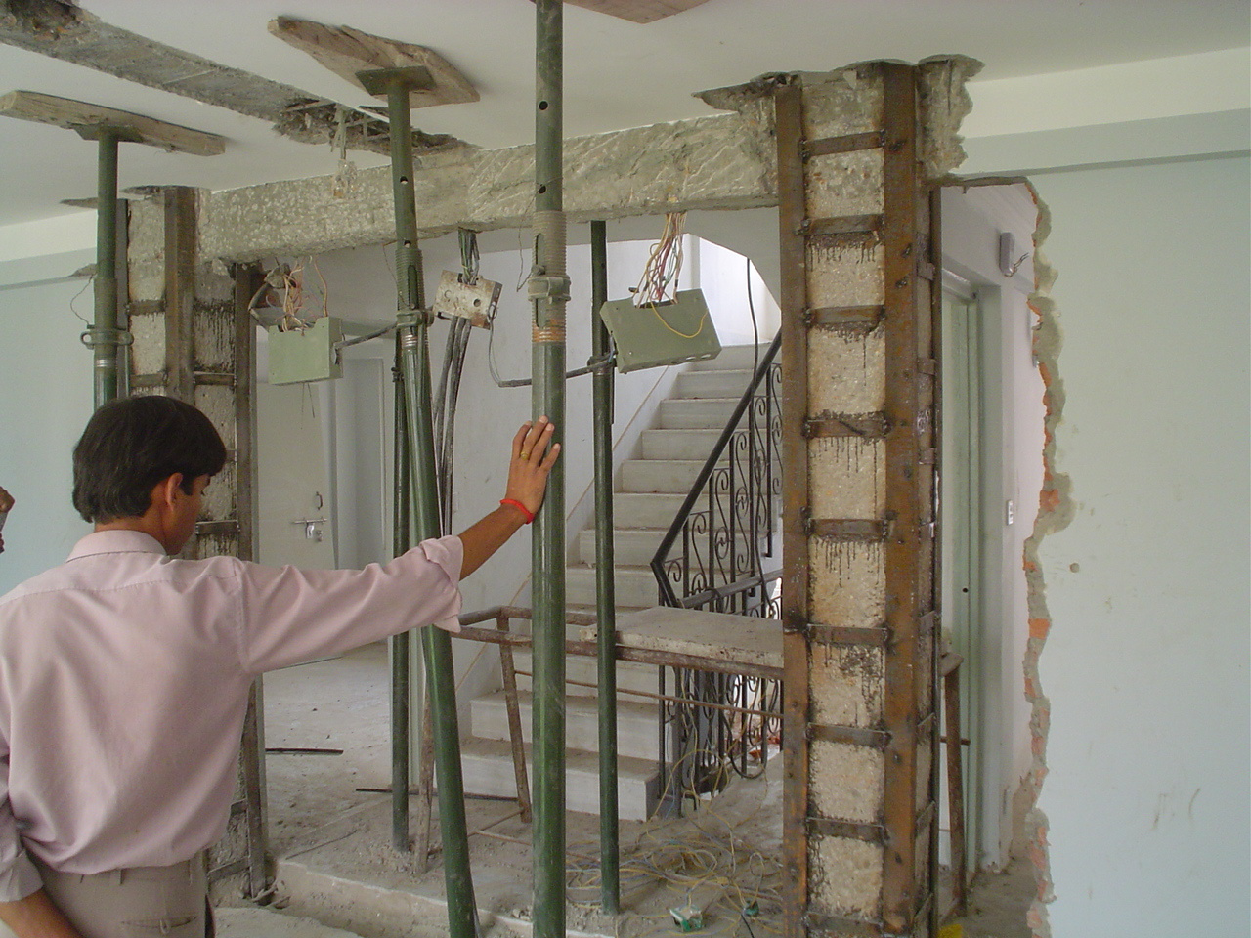
sfo{ yfngL ug'{cl3 cfjZos ;+Vofdf 6]sf] lbg' kb{5

Slide 42
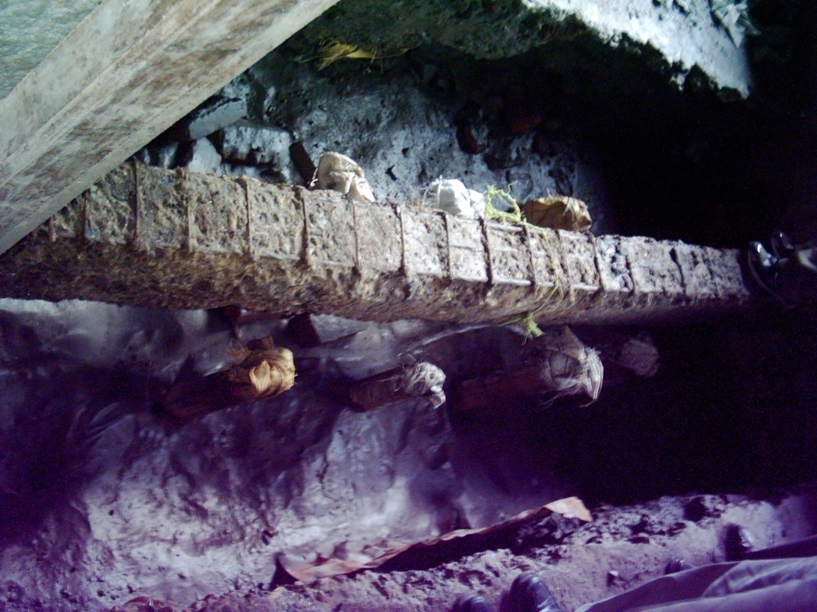
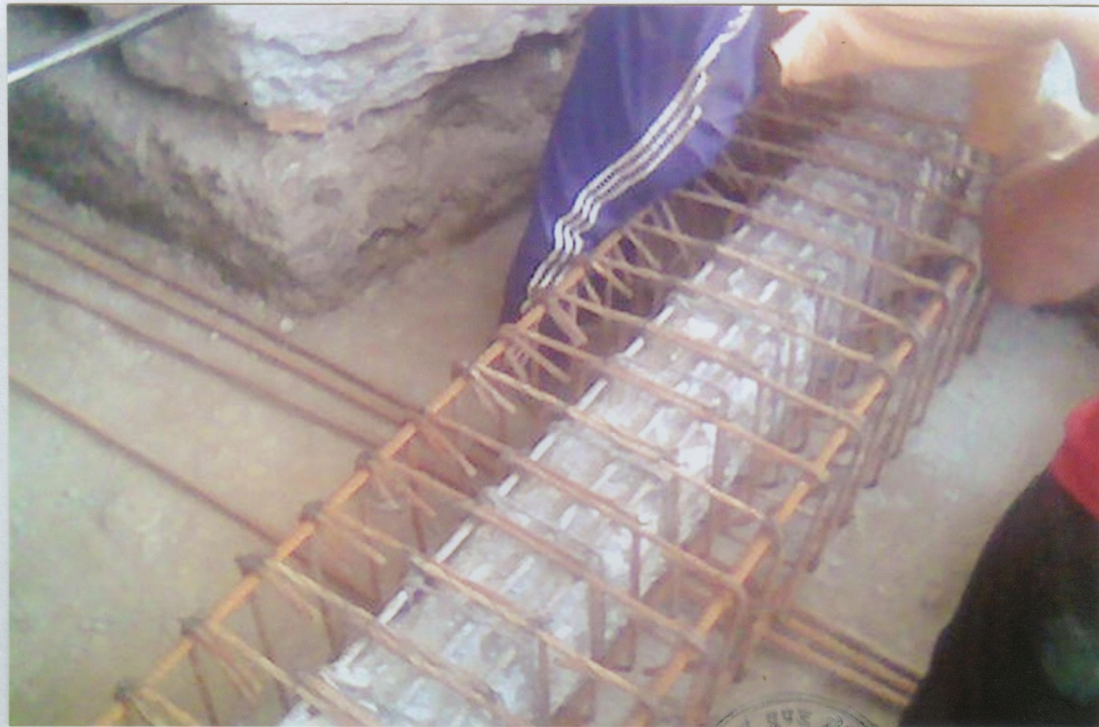
ylkg] s}+rL uf/f]sf] nflu dfOqmf] kfOlnË

Slide 43
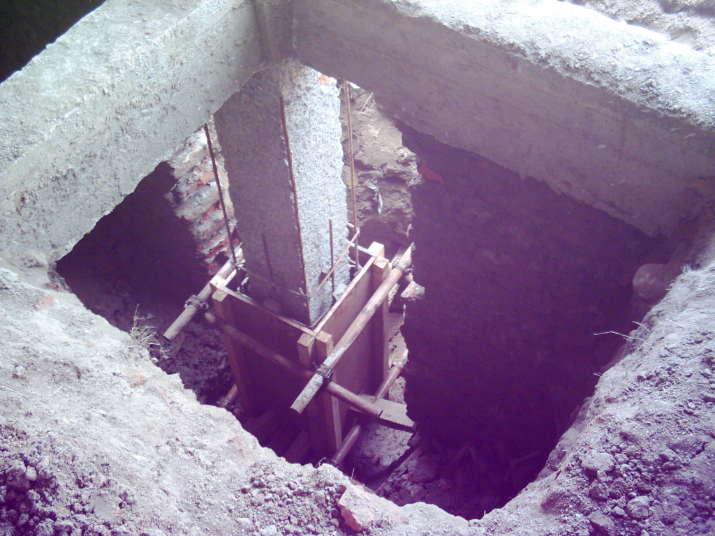
vDafdf s+lqm6sf] cfj]i6g

Slide 44
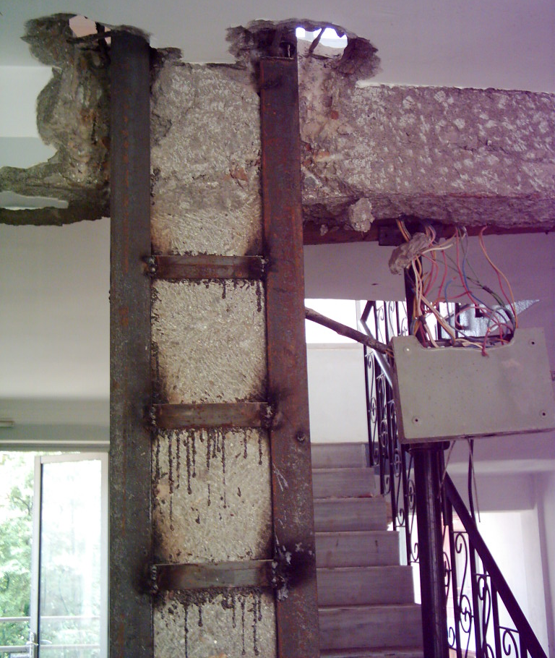
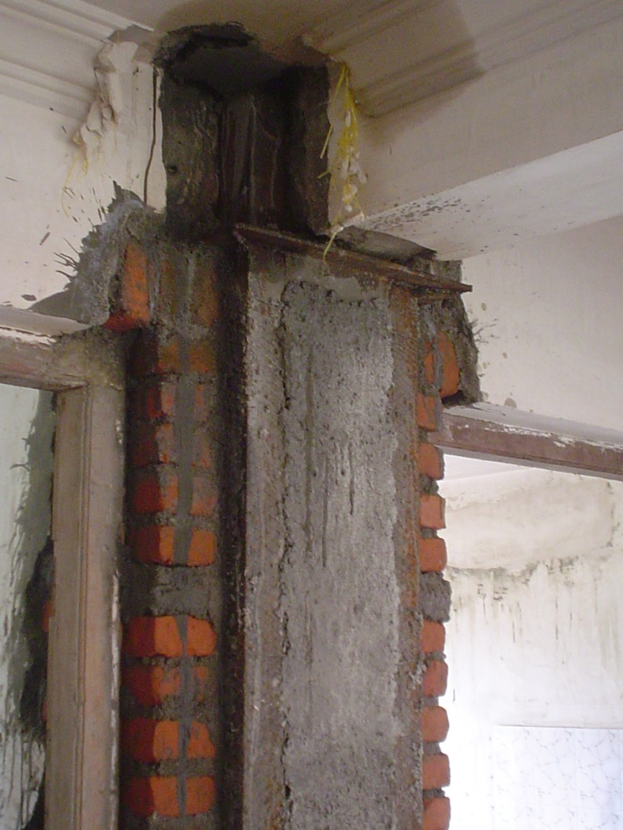
vDafdf :6Lnsf] cfj]i6g

Slide 45
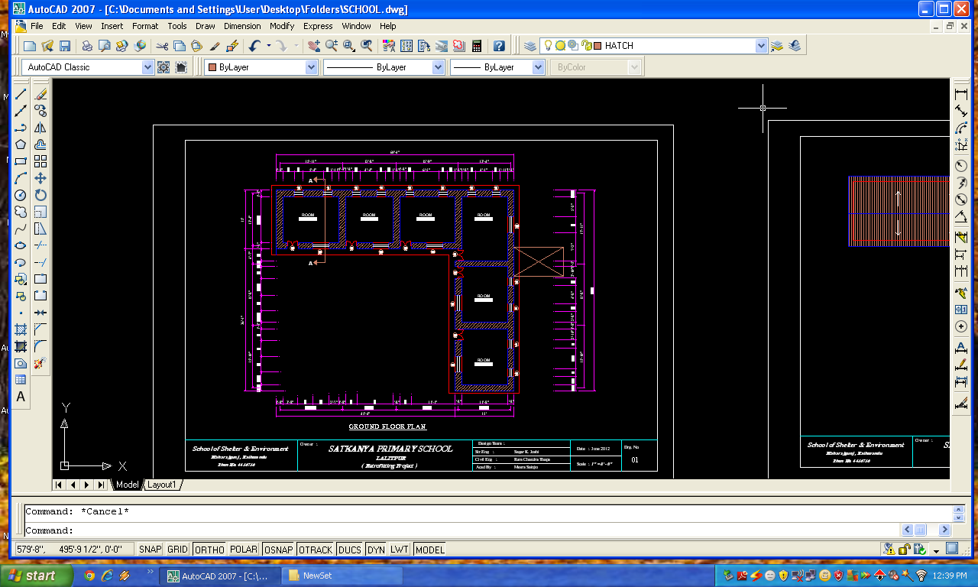
Satkanya School

Slide 46
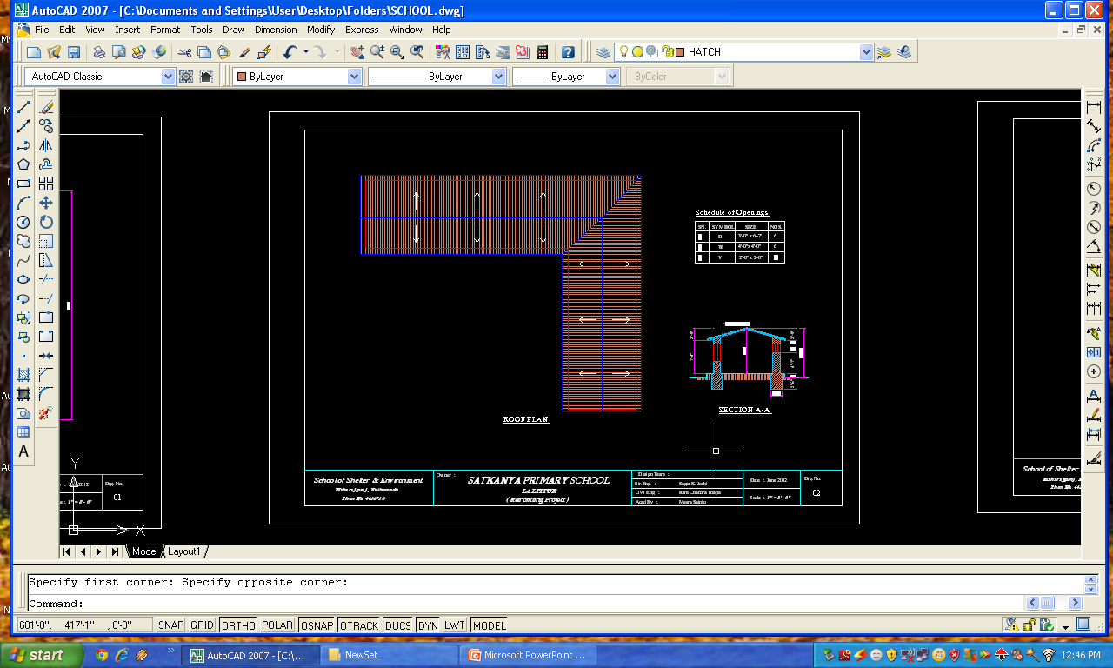
Roof Level

Slide 47
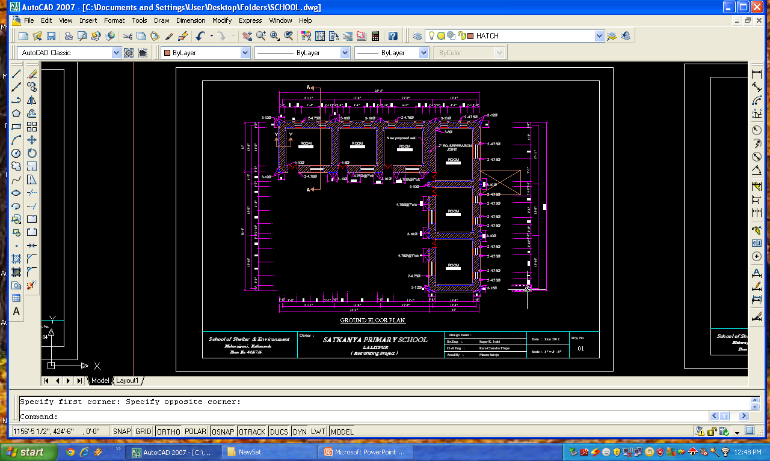
Retrofitting Design

Slide 48

Design Detail

Slide 49

Details of Foundation

Slide 50

Details

Slide 51

Elevations

Slide 52

Elevations

Slide 53
wGojfb !!!
Notes:
Objective
To repeated
Activity
Slide detail/ Discussion
Before thanking the participants, repeat following briefly:
Discussed about repair and retrofitting of masonry and RC frame buildings
It is not necessary to demolish a house just because it is damaged. Unless a building has suffered very severe damage or part destruction or has not tilted, it might not be necessary to demolish it.
Repair and retrofitting of a damaged house is a feasible option. The cost of repair and retrofitting depends upon the intensity of damage, complication associated with the structure, structural system and material etc.

