Slide 1

g]kfn ;/sf/
zx/L ljsf; dGqfno
zx/L ljsf; tyf ejg lgdf{0f ljefu
e"sDk k'glg{df0f tyf k'g:yfkgf cfof]hgf sfof{no
e"sDk k|lt/f]wfTds ejg lgdf{0f k|ljlw af/]
kfFr lbg] sflnu9 tflnd sfo{qmd
e"sDksf] sf/0f / c;/
efu ! ;q !

Slide 2
ljifo ;"rL
e"sDkhGo Ifltsf] l;+xfjnf]sg
e"sDk s] xf] <
e"sDk s;/L hfG5 <
ljutsf e"sDkn] l;sfPsf kf7x?

Slide 3
e"sDkhGo ljgfz

Slide 4
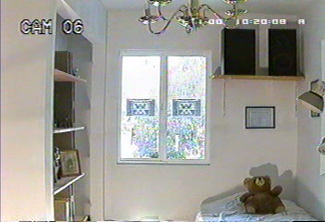
e"sDksf] ;dodf

Slide 5
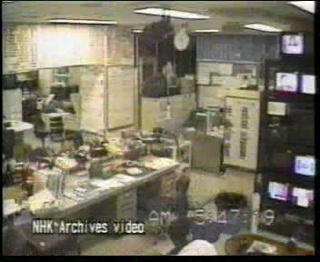
e"sDksf] ;dodf

Slide 6
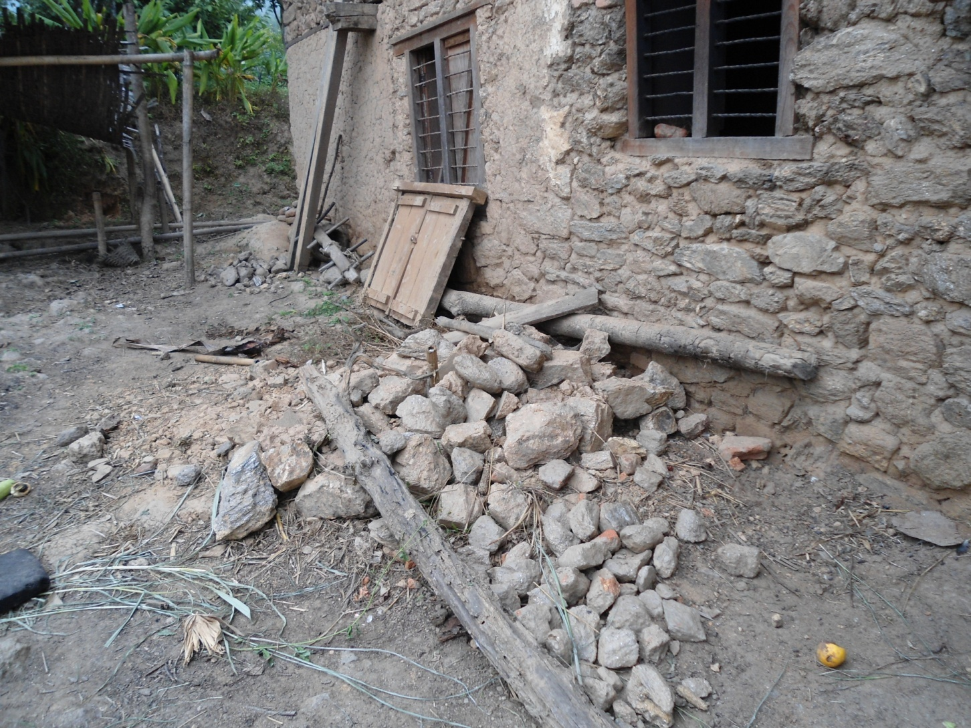
df6f]sf] hf]8fOdf lgdf{0f ePsf] uf/f]

Slide 7
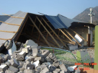
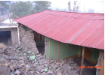
uf/f]n] ef/jxg ug]{ ejg
l;d]G6 d;nfsf] hf]8fO

Slide 8
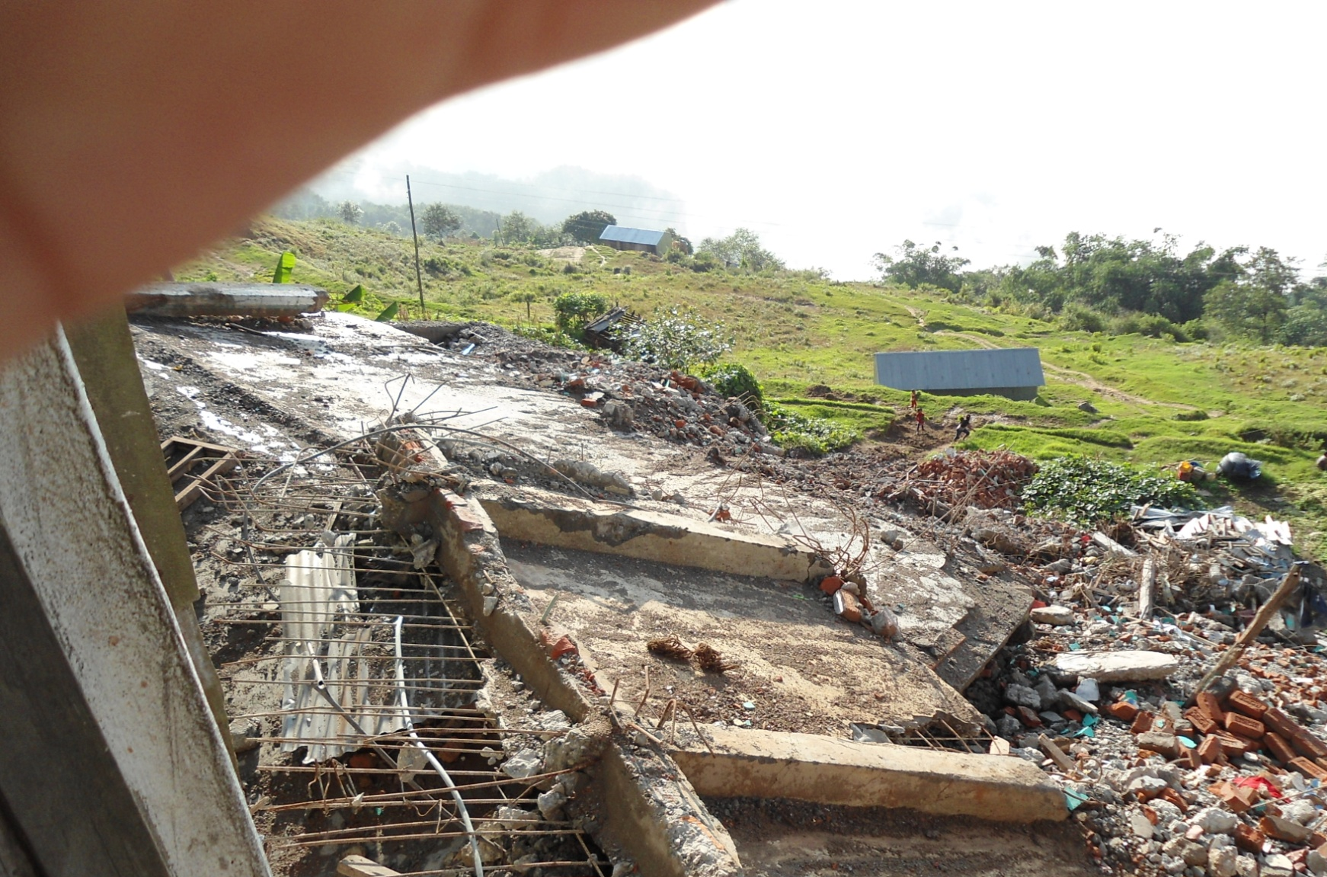
9nfg ul/Psf] ejg

Slide 9
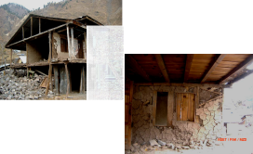
wHhL lbjf/L k|ljlw

Slide 10
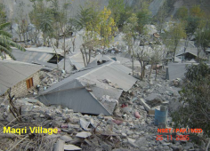
a:tLs} ljgfz

Slide 11
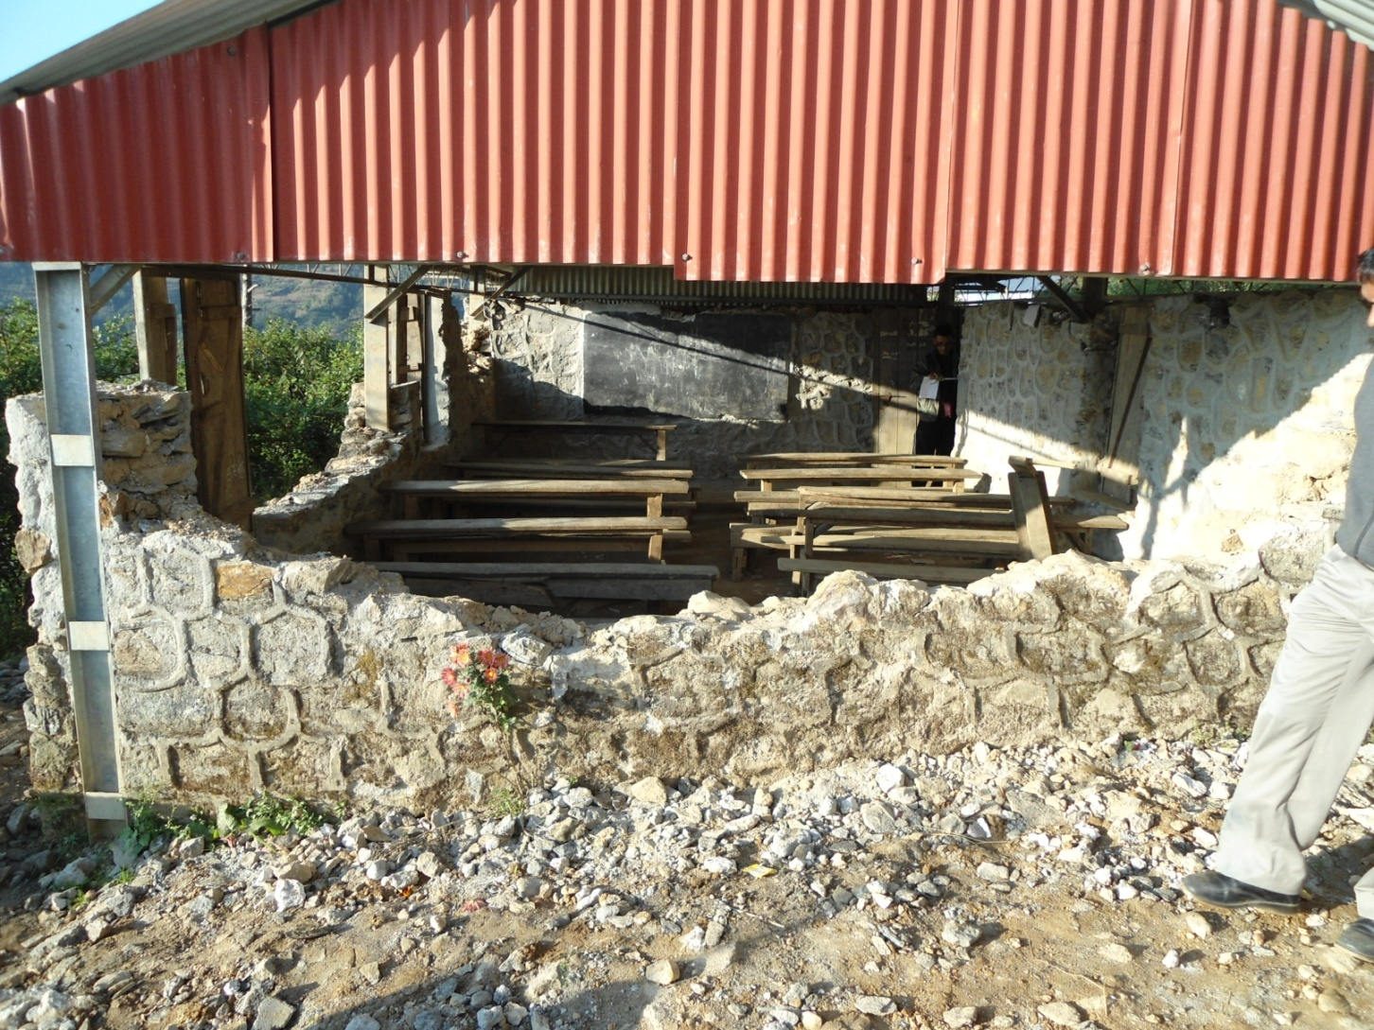
ljBfno ejg

Slide 12
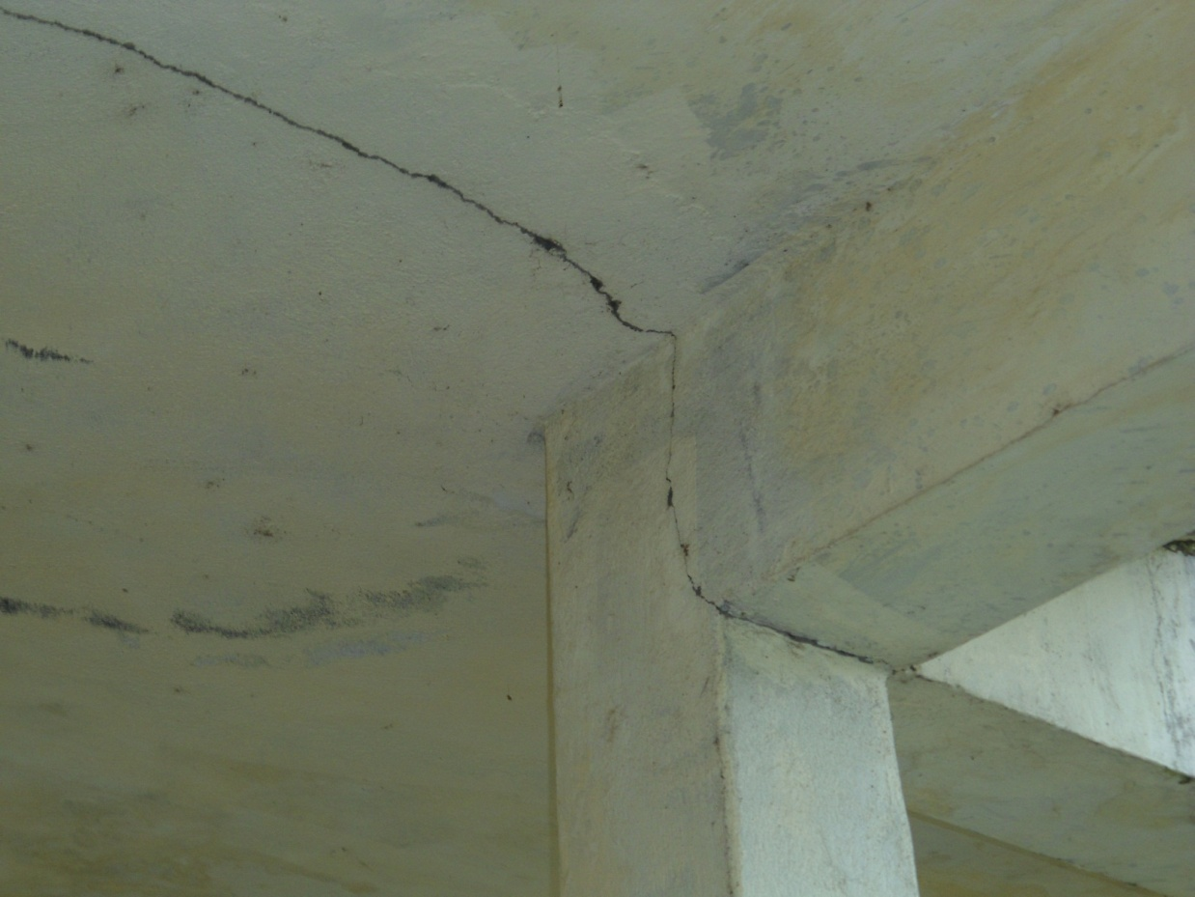
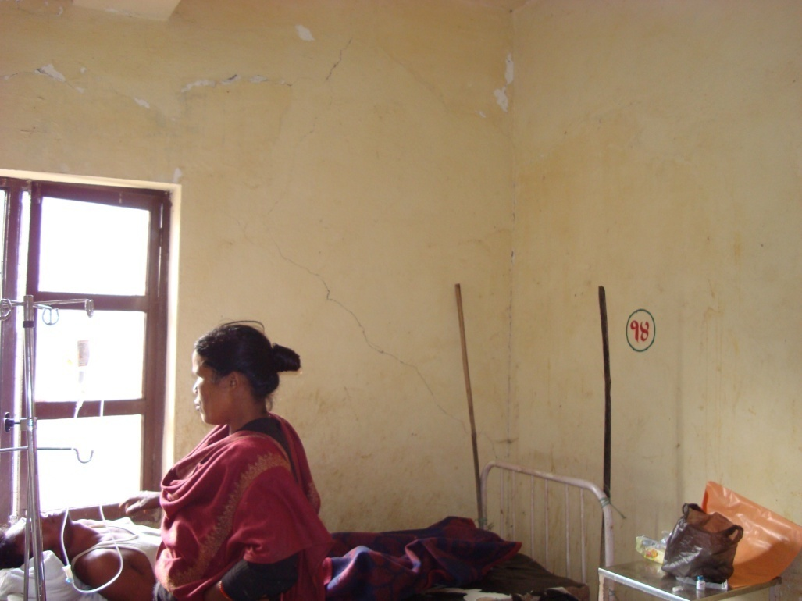
c:ktfn ejg

Slide 13
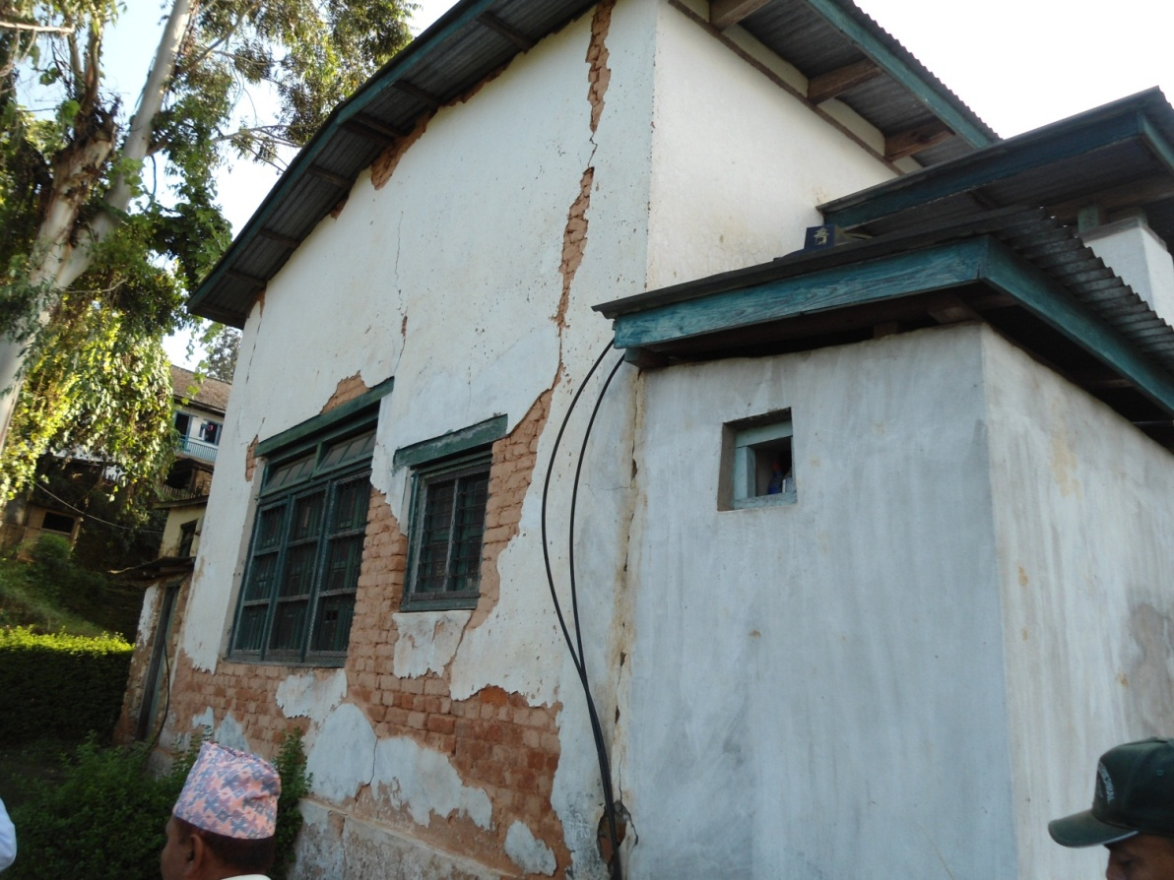
;/sf/L ejg

Slide 14
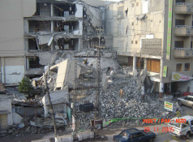
xf]6]n ejg

Slide 15
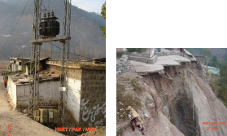
ef}lts k"jf{wf/

Slide 16
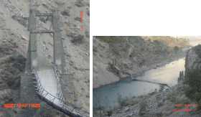
k'nx?

Slide 17
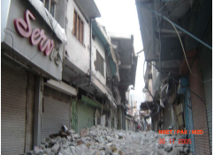
eTs]sf] ;fdu|Ln] cfjfudgdf cj/f]w

Slide 18
e"sDk s] xf] <

Slide 19
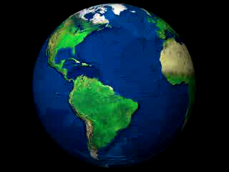
k[YjL

Slide 20
e"sDk s] xf] <
e"sDk eg]sf] k[YjLsf] cfj/0f tx jf r6\6fgsf] efu cs:dft\ k'm6]/ k[YjLsf] aflx/L ;txdf pTkGg x'g] t/Ë jf sDkg xf] .

Slide 21
e"sDk s;/L hfG5 <

Slide 22
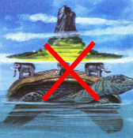
e|d

Slide 23
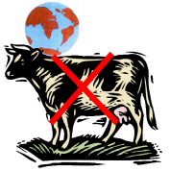
e|d

Slide 24
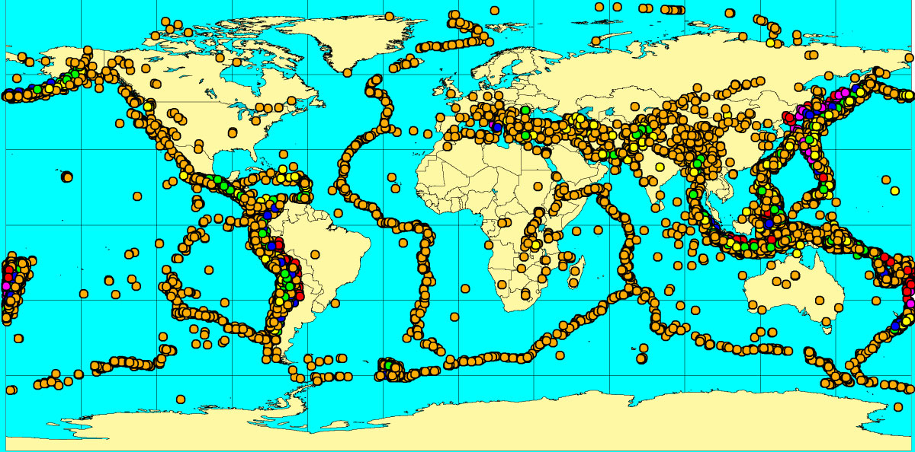
e"sDksf] sf/0f
seismic eruption

Slide 25
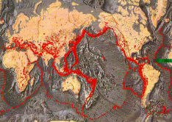
e"sDksf] sf/0f

Slide 26
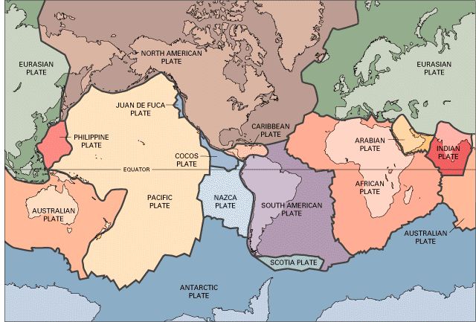
ljleGg Kn]6x?
e"sDk clwst/ oL Kn]6x?sf] l;dfgfdf s]lGb|t x'G5g\

Slide 27
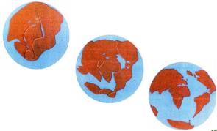
dxfb]zLo ljrng

Slide 28
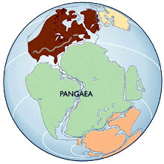
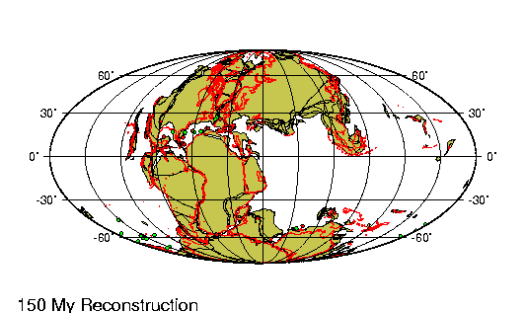
dxfb]zLo ljrng
⇦ s/f]8f}++ aif{ cufl8
Notes:
Objective:
To show how the plates are moving
Activities:
Run the animation (click on link)
Explain in brief.
Focus more on Indian part of the sub-continent
Slide Details:
There is a continuous movement of the plates since millions of years ago. This slide presents how the Pangea (the single mega continent) broke-up with time and moved in different directions creating more plates. In this animation, different stages of earth surface are shown at different time. ‘My’ in this slide refers Million years.

Slide 29
k[YjLsf] cfGtl/s agf]6
cfj/0f tx
dxfb]zLo k/t -@%–$) ls=ld=_
;fd'lb|s k/t –em08} ^ ls=ld=_
dWo k/t
dflyNnf] dWo k/t -^%) ls=ld=_
tNnf] dWo k/t -@@#% ls=ld=_
ue{
afXo ue{ -@@&) ls=ld=_
leqL ue{ -!@!^ ls=ld=_
sf]i7leqsf cÍx?n] k/tsf] cGbfhL df]6fO hgfp+5g\

Slide 30
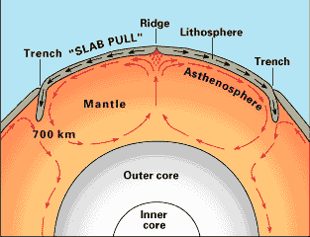
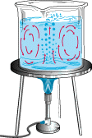
Kn]6sf] ult
dWo k/t
;+jfxg åf/f kfgL tft]sf]
Afflx/L ue{
leqL ue{

Slide 31

ck;f/0f
Kn]6x? 6fl9+b}5g\
dfUdf ;txdf k'u]sf] 5
gof+ k/t aGg] qmd cf/De ePsf] 5

Slide 32

cle;f/0f
Kn]6x? glhls+b}5g\
afXo k/t dWod k/ttkm{ kms{+b} 5

Slide 33

?kfGt/0f
Kn]6x? k/:k/af6 lrlKng] qmddf 5g\
cfj/0f k/tdf Iflt ePsf] jf gof+ ag]sf] 5}g

Slide 34
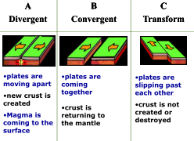
Kn]6sf] ;Ldfgf

Slide 35
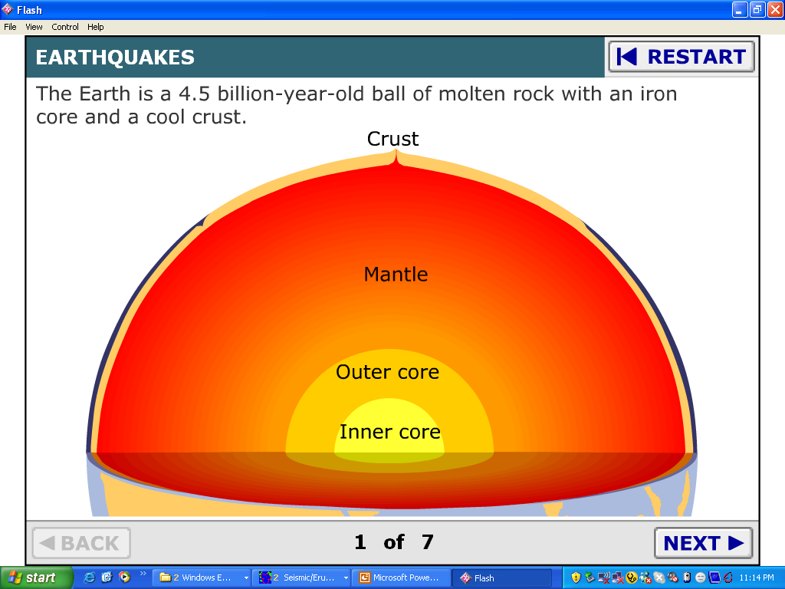
e"sDk Ps b[li6df
Notes:
Objectives:
To show how does an earthquake occur.
To make them visualization of the earthquake.
Activities:
Run the animation.
Explain the animation.
Slide details:
This slide shows the internal structure of the earth, how the convection currents are generated inside the Earth, how the convection current pushes the plates, how the plates are moved, how the earthquake is generated and how the earthquake is transmitted in the form of waves.

Slide 36
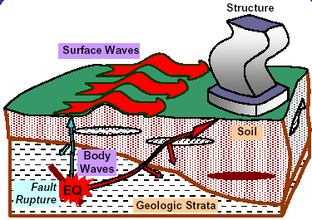
e"sDksf] c;/
;+/rgf
;tx t/Ë
hdLg
leqL t/Ë
ef}ule{s tx
e"sDk

Slide 37
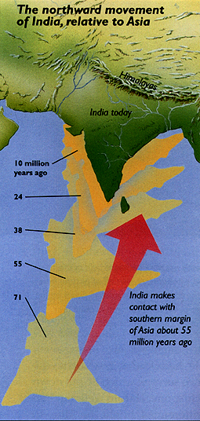
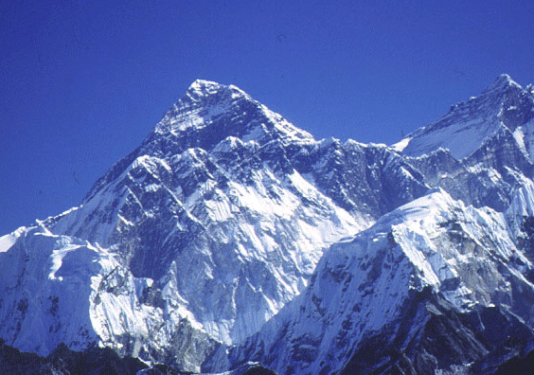
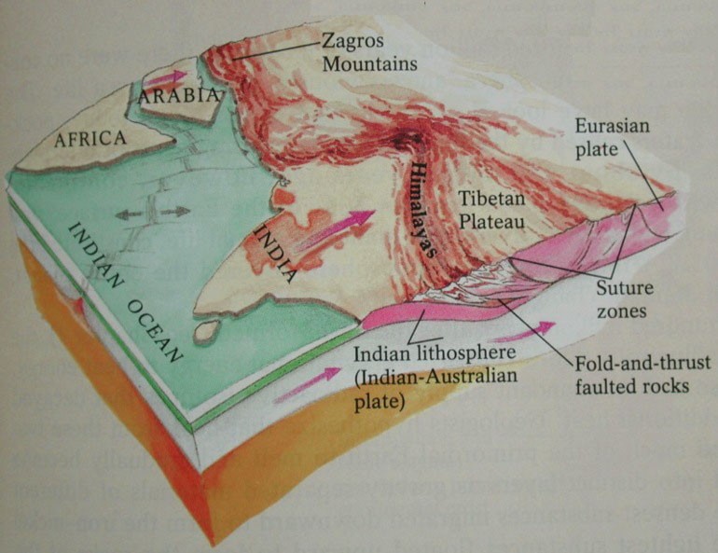
lxdfno s;/L aGof] <

Slide 38
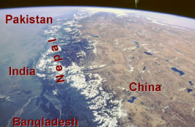
lxdfno >[ª\vnf
Kffls:tfg
ef/t
g]kfn
rLg
afËnfb]z

Slide 39
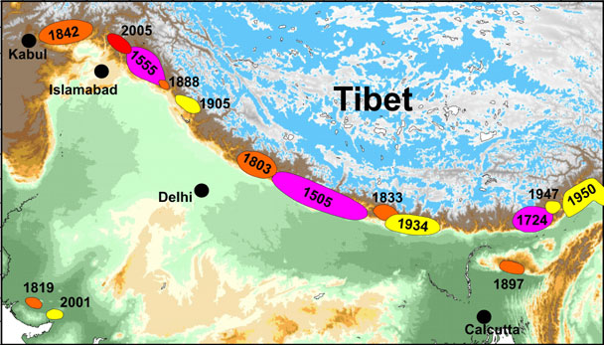
lxdfno If]qdf uPsf e"sDkx?
rLg
Kffls:tfg
g]kfn
Eff/t

Slide 40
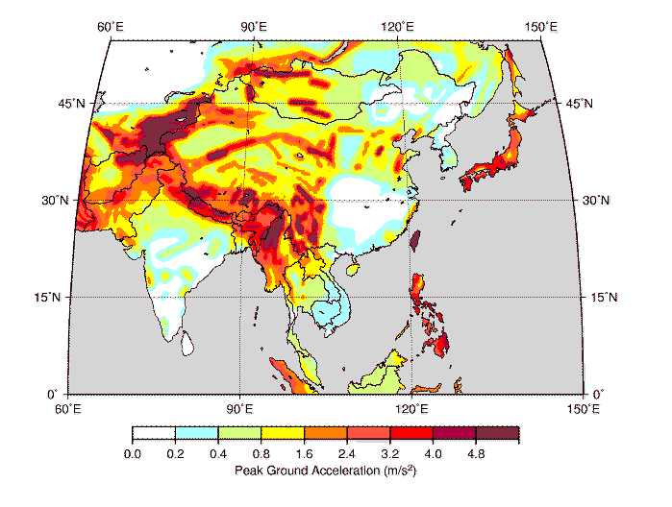
Plzofsf] e"sDkLotf

Slide 41
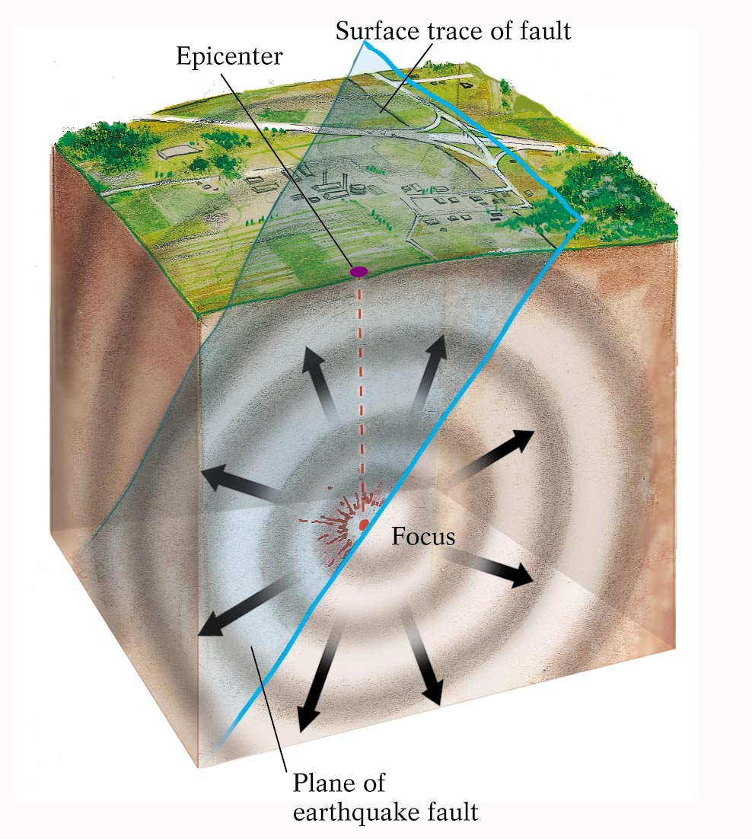
e"sDk ;Da4 zAbfjnL
Olk;]G6/
s]]Gb|ljGb'
e"sDkLo lr/fsf] ;dtn

Slide 42
e"sDk dfkg

Slide 43
e"sDk dfkg
kl/df0f
e"sDkaf6 pT;lh{t zlQm
/]S6/ :s]ndf dfkg
ltj|tf
ljleGg :yfgdf ;txsf] sDkg
kl/dflh{t df;]{nL tLj|tf (Modified Mercelli Intensity jf MMI) df dfkg

Slide 44
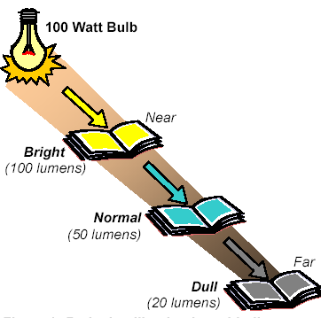
kl/df0f / ltj|tf
!)) jf6sf] lah'nL aQL
ghLs
a9L rxs
;fdfGo rxs
6f9f
sd rxs

Slide 45
;fk]lIfs ;DaGw
;fgf] tLj|tf 7"nf]
;fgf] kl/df0f 7"nf]
6f9f b"/L glhs
s8f hldgsf] cj:yf g/d
ulx/f] s]Gb|sf] ulx/fO sd
Go"g Iflt clws

Slide 46
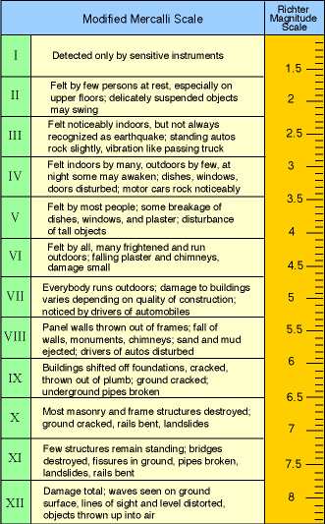
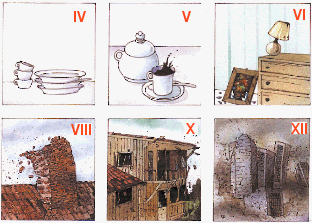
;fk]lIfs ;DaGw
e"sDkLo ltj|tf

Slide 47
e"sDksf] k"jf{g'dfg
;fdfGo / bL3{sfnLg cg'dfg
If]qLo e"sDkLotf / e"sDkLo If]qx?sf] ?k/]vfsf] cfwf/df s'g If]qdf e"sDk hfg] ;Defjgf 5 eGg] lg:sif{df k'Ug ;lsG5
lglZrt / cNksfnLg cg'dfg
ljleGg cWoog / cg';Gwfg eP klg cBflk ;Dej gePsf]

Slide 48
ljutsf e"sDkn] l;sfPsf kf7x?

Slide 49
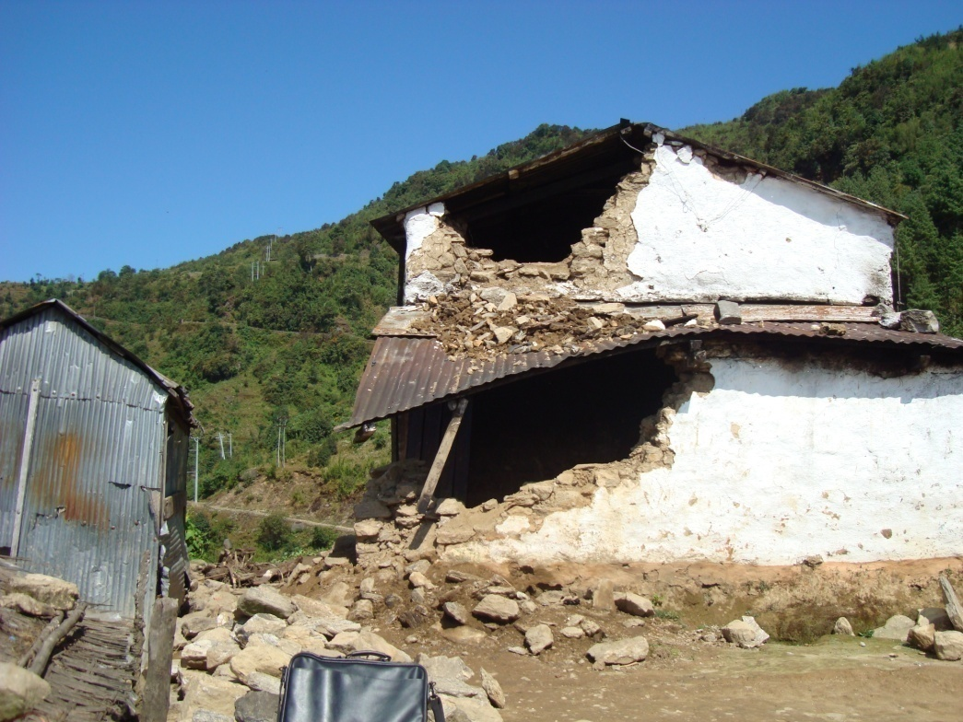
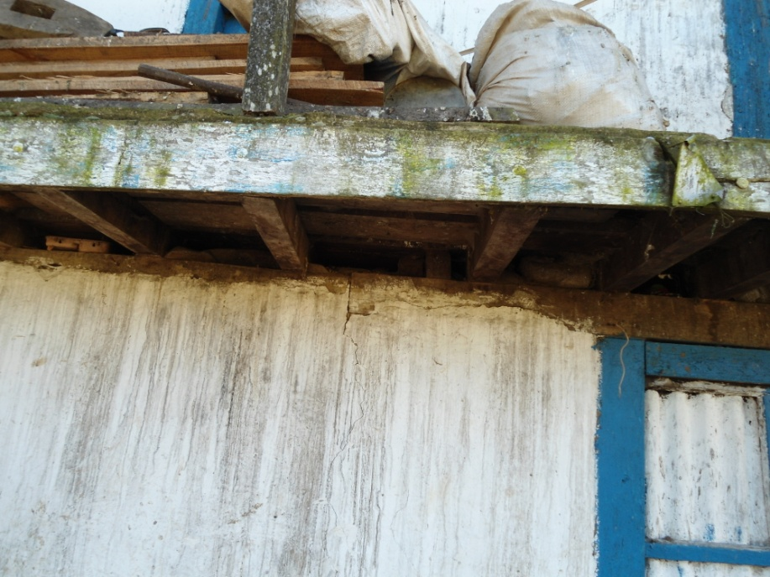
e"sDksf] c;/df lsg km/s k¥of] <
b'j} ejg df6f]sf] hf]8fOdf ag]sf x'g\

Slide 50
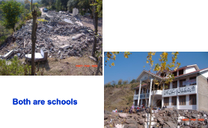
e"sDksf] c;/df lsg km/s k¥of] <
b'j} ejg :s"n ejg x'g\

Slide 51
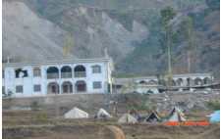
e"sDksf] c;/df lsg km/s k¥of] <
b'j} ejg dl:hb\ ejg x'g\

Slide 52
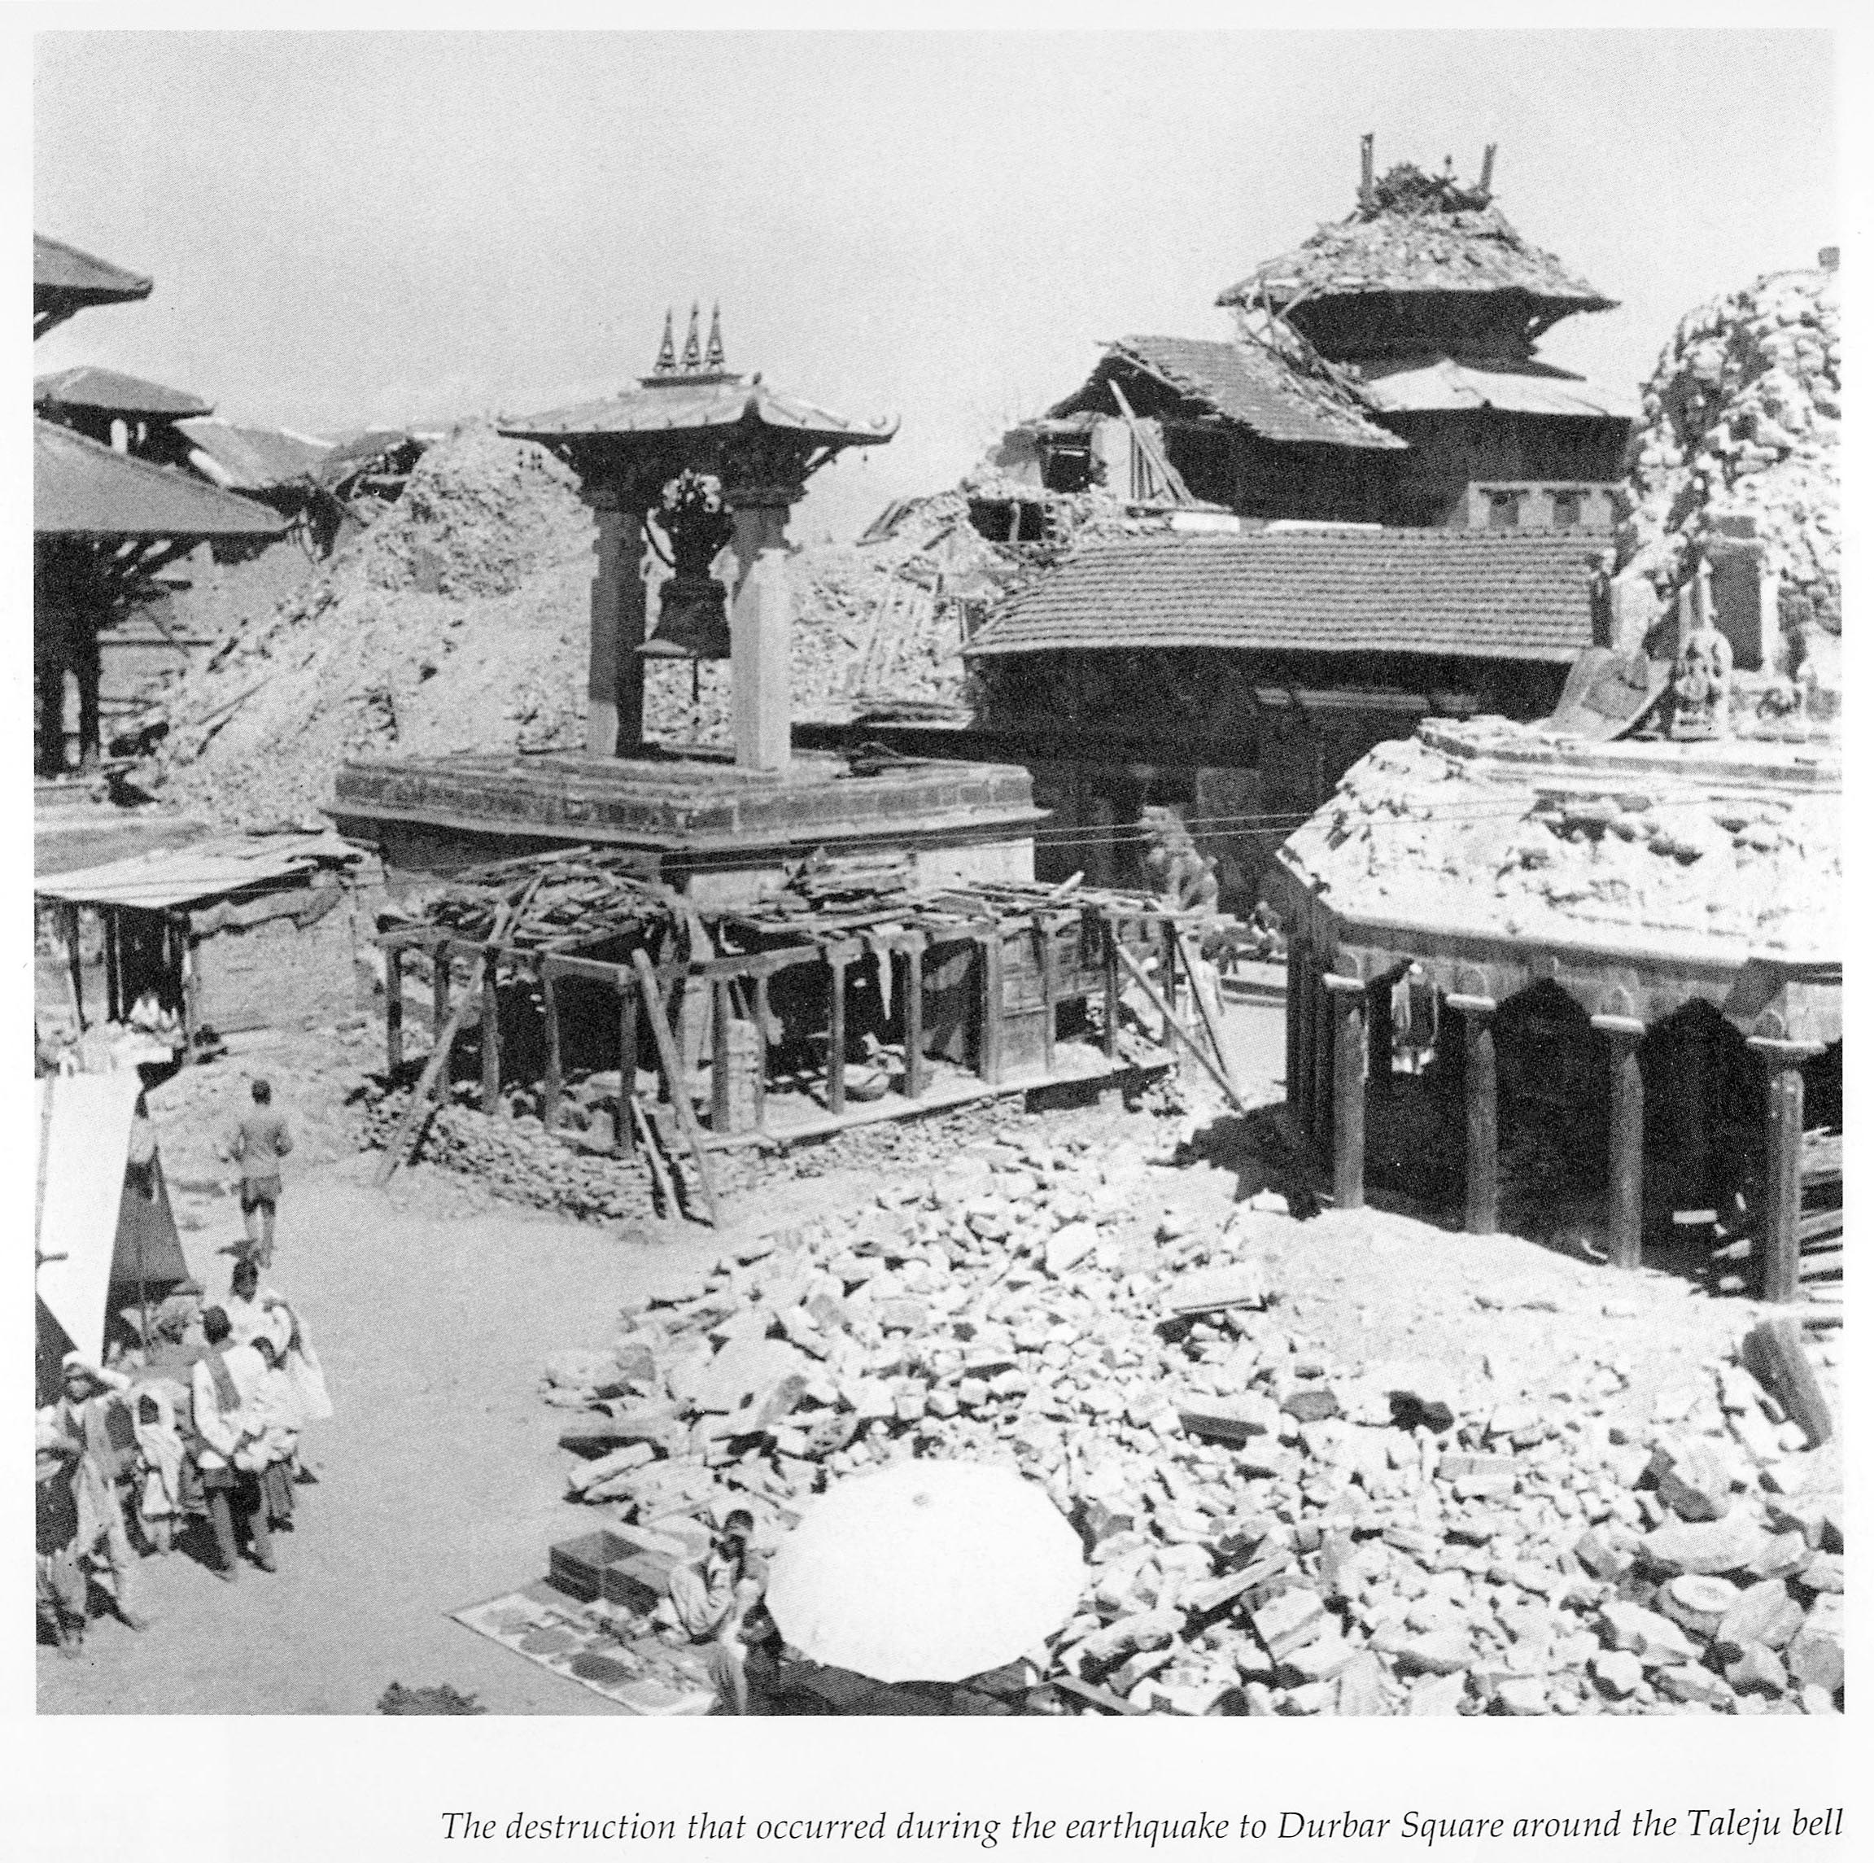
e"sDksf] c;/df lsg km/s k¥of] <

Slide 53
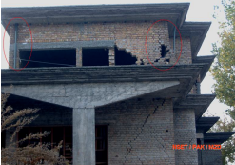
b'O{ s'gf aLr lsg of] km/s <

Slide 54
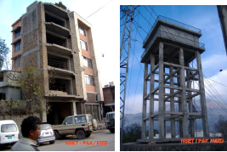
/fd|f pbfx/0f klg 5g\

Slide 55
e"sDk k|lt/f]wL ejg
sd tLj|tfsf] e"sDk ;lhn} y]Ug ;S5
dWod vfn] e"sDkdf ;fdfGo Iflt dfq x'G5
7"nf] e"sDkdf klg ejg elTsxfNb}g

Slide 56
wGojfb

