Slide 1
Cluster Coordination Performance Monitoring

Slide 2
What is the CCPM?
A self-assessment of cluster performance against the 6 core cluster functions and Accountability to Affected Populations (AAP):
  support service delivery
  inform the HC/HCT's strategic decision-making
  strategy development
  monitor and evaluate performance
  capacity building in preparedness and contingency planning.
  Advocacy
  + section on Accountability to Affected Populations
A country-led process, supported by Global Clusters and OCHA
The CCPM can be applied by both Clusters and sectors
Notes:
Support from Global Clusters and OCHA:
Facilitation support can be provided by the secretariats of the Global Clusters and OCHA-HQ.
Technical support to implement the CPM questionnaires is provided by those Clusters who has the survey tool and OCHA provides technical support to those clusters who do not have the survey tool.
In protracted crises, the CPM should be implemented on an annual basis, but clusters decide when to implement it.
If several of the core functions have been registered as weak, requiring more frequent monitoring and follow-up on improvement actions, it is recommended that the CPM is implemented on a more regular basis.
Experience shows that it is difficult to implement the CPM in a context where clusters have simultaneous commitments (e.g. the Strategic Planning Process, donor visits etc.) or the cluster architecture is in transition.

Slide 3
Where does the CCPM come from?
Transformative Agenda
          Improve coordination and accountability
Developed by the IASC Sub-Working Group (SWG) on the Cluster approach and endorsed by the IASC WG in 2012
Piloted in 2012 and implemented from 2013
Notes:
TA:
based on a review of humanitarian response to major disasters in 2010 and 2011 (Haiti and Pakistan)
55 actions agreed by the IASC Principals in December 2011 focused on leadership, coordination and accountability to affected people.
actions are aimed at simplifying processes and mechanisms, improving inter-agency communication and collaboration and building confidence in the humanitarian system as a whole.
calls for change in operational methods and for focus on results and not just process. Improving coordination and accountability are essential elements of this agenda.
IASC Sub-WG:
TA -> SWG tasked to review cluster guidance and consider ways to monitor the performance of cluster coordination at country level.
By September 2012, a coordination performance monitoring tool was developed and being tested in a few pilot countries (Pakistan, Somalia, South Sudan).
The coordination performance monitoring tools and reporting frequency were endorsed by the IASC Working Group in August 2012, and shared with the IASC Principals in December 2012.

Slide 4
Why monitor Cluster coordination performance?
Ensure efficient and effective coordination
Take stock of what functional areas work well and what areas need improvement
Raise awareness of support needed from the HC/HCT, cluster lead agencies, global Clusters or Cluster partners
Opportunity for self-reflection
Strengthening transparency and partnership within a Cluster
Show the added value and justify the costs of coordination
Notes:
Questions on accountability to affected populations:
Have mechanisms – agreed upon by cluster partners – to consult and involve affected populations in decision –making, been used by cluster partners/your organization when possible?
Have mechanisms – agreed upon by cluster partners – to receive, investigate and act upon complaints on the assistance received, been used by cluster partners/your organization when possible?
The support to affected populations is strengthened through improved coordination and increased inclusion of the issue in the decision making process.

Slide 5
The CCPM does NOT…
Monitor response (service delivery)
Evaluate individual partners or coordinators
Evaluate if/when Clusters should be deactivated, merged etc. (Review of the Cluster architecture)
Exclude usage of other tools with the same purpose

Slide 6
When to implement the CCPM?
Protracted crises: Annually, but clusters decide when to implement it
New emergencies: 3-6 months after the onset and once every year thereafter.
If several core functions have been registered as weak, then, repeat more frequently
Avoid simultaneous commitments (e.g. the Strategic Planning Process, donor visits etc.)

Slide 7
Who is involved?
Ideally all Clusters (Cluster coordinators and partners)
Global Clusters: technical and facilitation support
OCHA-FO (Field Offices) coordinate across Clusters and ensure engagement of HC/HCT
Notes:
Coordination of the CPM:
Preference is that all clusters carry out the CPM exercise at the same time.
If there is not agreement by the HC/HCT and/or clusters to carry out CPM across all clusters, individual (or small groups of clusters) are free to implement CPM on their own, with support of their Global Cluster.
If the country cluster expresses interest in implementing the CPM to the global cluster, the global cluster should (i) encourage the country cluster to speak to the other clusters and the OCHA Office to encourage multi-cluster participation and (ii) inform OCHA, which then will inform the relevant OCHA Office.
If interest is expressed to OCHA-HQ, OCHA shall (i) inform global clusters, which will follow-up with country clusters and support their decision-making and (ii) contact the Country Office, which then can advocate for a multi-cluster approach.

Slide 8
CCPM in steps
1. Planning
2.Survey
3. Analysis Action Planning
4. Monitoring
STEPS
Decision on implementation
Preliminary Report
Final Report & Action Plan
Quarterly Reports to HCT
OUTPUTS

Slide 9
Step I: Planning
HCT decision on CCPM timeframe and participation
Inter-Cluster Coordination Group discussion
Each Cluster meets to:
  Discuss the CCPM purpose, process, methodology and outputs;
  Clarify timeframe for;
    Survey start and end dates (approx. 2 weeks)
    Circulation of Preliminary Coordination Performance Report
    Cluster meeting to finalise the Coordination Performance Report (contextualise), including developing the Action Plan
  Clarify role of government counterpart
  Establish commitment to follow-up on agreed actions to improve performance
Output I: Agreement on implementation and timeframe

Slide 10
Step II: The Survey
Two online questionnaires:
  Coordination performance questionnaire, completed by the Cluster Coordinator, approx. 10 min
  Coordination performance questionnaire, completed by the Cluster partners, approx. 10 min
Important:
  Responses are anonymous – but avoid sensitive comments
  Important to fully complete the questionnaire
  Survey results only shared externally after the Cluster has contextualised it
Notes:
Important:
To share the right link with the right people – i.e. do no share the link for the cluster coordinator with cluster partners and don’t share links between clusters
Not to insert sensitive information in the comment boxes, as these automatically will be part of the Preliminary Coordination Performance Report. In principal these comments are to be taken out, but better to be safe than sorry.

Slide 11
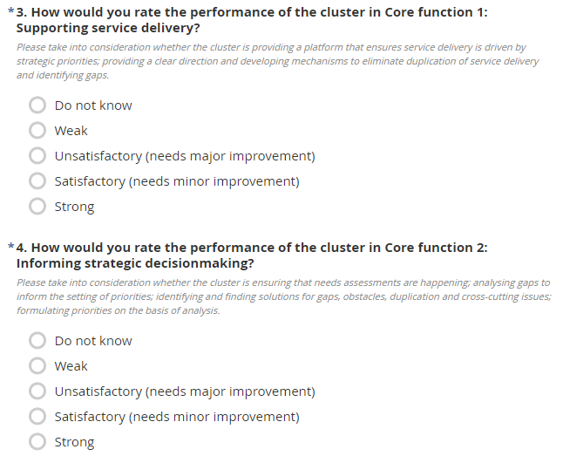
Step II: The Survey

Slide 12
Step II: The Survey
Analysis and scoring of performance status
The score for each core function is calculated based on aggregated results of partners and coordinator.
The score is classified into a 4 categories of performance status:
Score | Performance status
>75% | Green = Strong
51-75% | Yellow = Satisfactory (needs minor improvement
26-50% | Orange = Unsatisfactory (needs major improvement
≤25% | Red = Weak

Slide 13
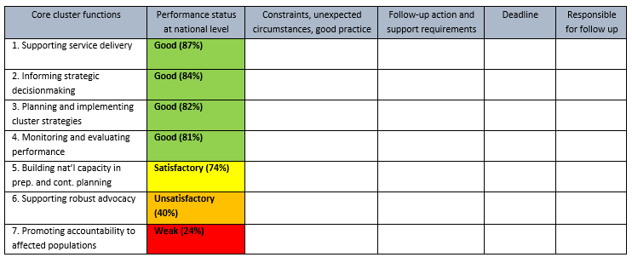
Step II: The Survey
Output II: The survey results are compiled into a report
Notes:
Background information (if asked): In the report, there is a column labeled ‘performance status’. Each core function gets a score (the median) based on the calculation of responses to the questionnaires. The score is classified into a 4-category scale of performance status:
Green = Strong (> 0.75)
Yellow = Satisfactory (0.51-0.75 )
Orange = Unsatisfactory (0.26-0.50)
Red = Weak (≤ 0.25)
→ The scoring for each question assists in identifying those function that require improvement and additional support.

Slide 14
Step III: Cluster analysis and action planning
Review/amend the Preliminary Report
Explain/contextualize findings
Identify actions for improvement (focus on weak and unsatisfactory performance), timeframe and responsible for follow-up
Pinpoint support requirements

Slide 15
Step III: Cluster analysis and action planning
Output III: Final CCPM and Action Plan
Actions for improvement, timeframe and responsible for follow-up
Awareness of support requirements (HC/HCT, Cluster Lead Agencies, Partners, OCHA, Global Clusters and national authorities)
Shared with the HC/HCT and Global Cluster and, if applicable, the national authorities

Slide 16
Step IV: Follow-up & Monitoring
Follow-up:
ICC: Review of Reports/Action Plans identify common weaknesses to be addressed systematically.
HCT: Presentation of Reports/Action Plans and discussion of support requirements
Monitoring:
Take stock of progress at monthly cluster meetings
Quarterly progress reporting to the HCT
Output IV: Quarterly reports to HCT
Notes:
It is recommended to the stock taking of the progress at the cluster meetings are recoded in the minutes from the meeting.

