Slide 1
Basic Notions Around Covid-19

Slide 2
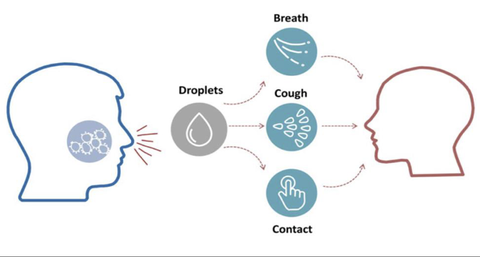

The COVID-19 disease is an infectious disease caused by severe acute respiratory syndrome
Most people recover from the disease
Many countries have been experiencing a COVID-19 outbreak, so there are enough information around how to avoid getting infected, as well as around treatments
Anyone could catch COVID-19 virus – irrespective of age, gender, sexual orientation, religious, tribal or other affiliations. Hence, it is important to prevent discrimination, stigma, anxiety

Slide 3
Prevent panic, anxiety, discrimination or stigma
Notes:
From IOM IEC toolkit

Slide 4
Prevent panic, anxiety, discrimination or stigma
Notes:
From IOM IEC toolkit

Slide 5
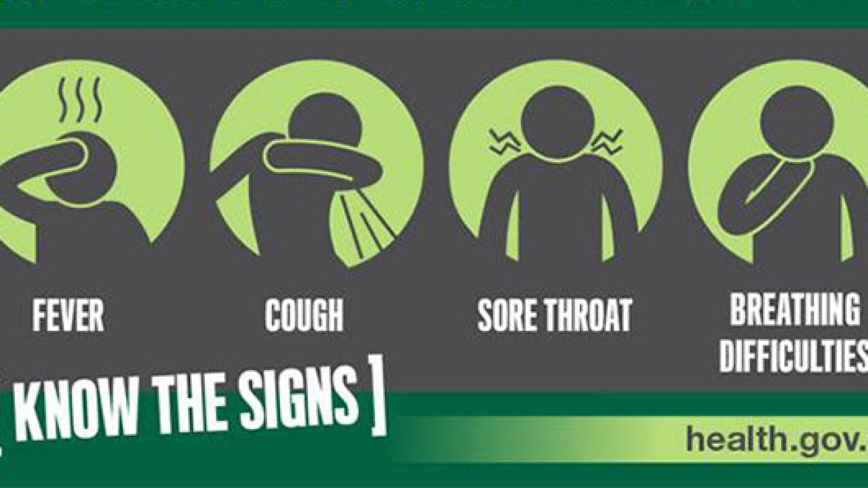


Most common symptoms
    Fever or chills
    Shortness of breath
    Dry cough
    Sore throat
Very similar to a normal flu
If you have any symptom, seek immediate advice from the nearest health care provider
If you notice anyone with these symptoms, suggest him/her to go to the nearest health care provider
Nearest clinic:
(add most appropriate phone number/address of nearest health facility)

Slide 6
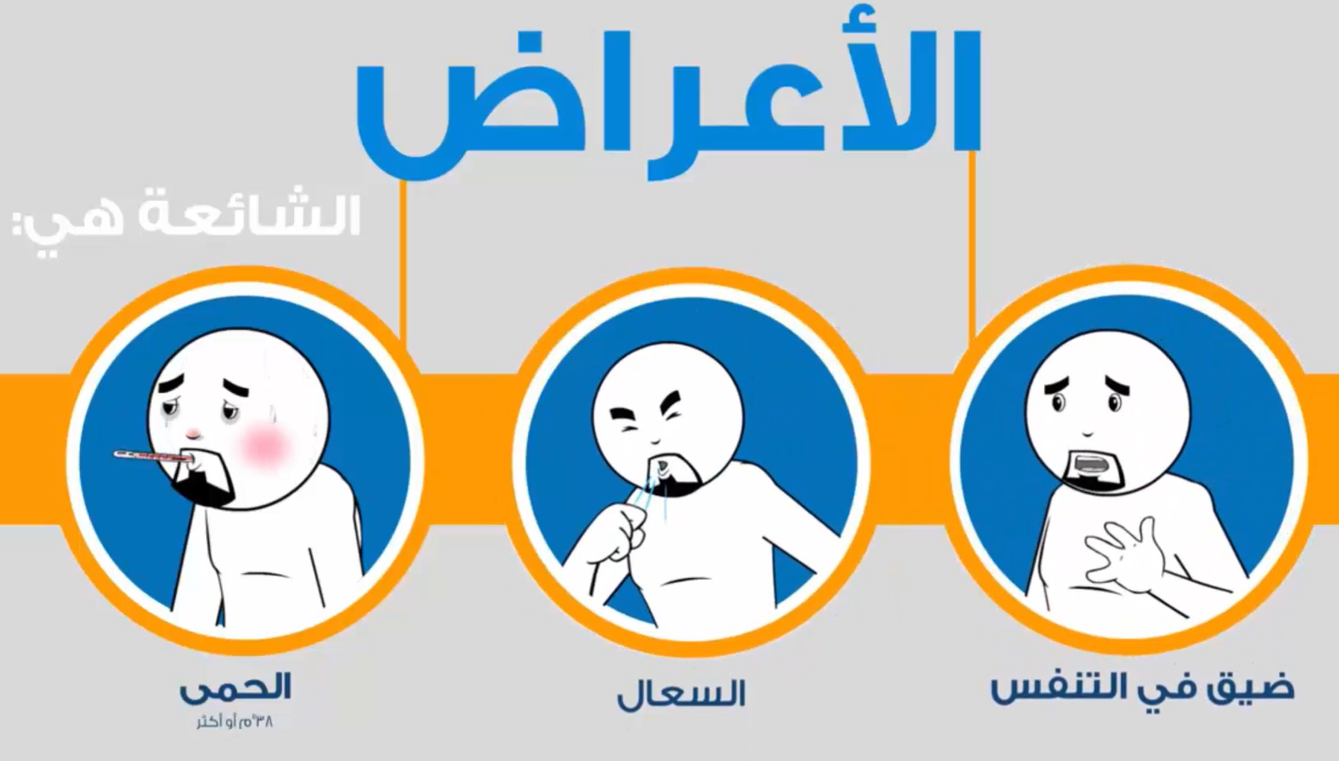
Common symptoms
Fever
38 °C or more
Dry cough
Shortness of breath

Slide 7
Healthy and Hygiene Practices
to Prevent the Contagion
(VALID FOR ALL)

Slide 8
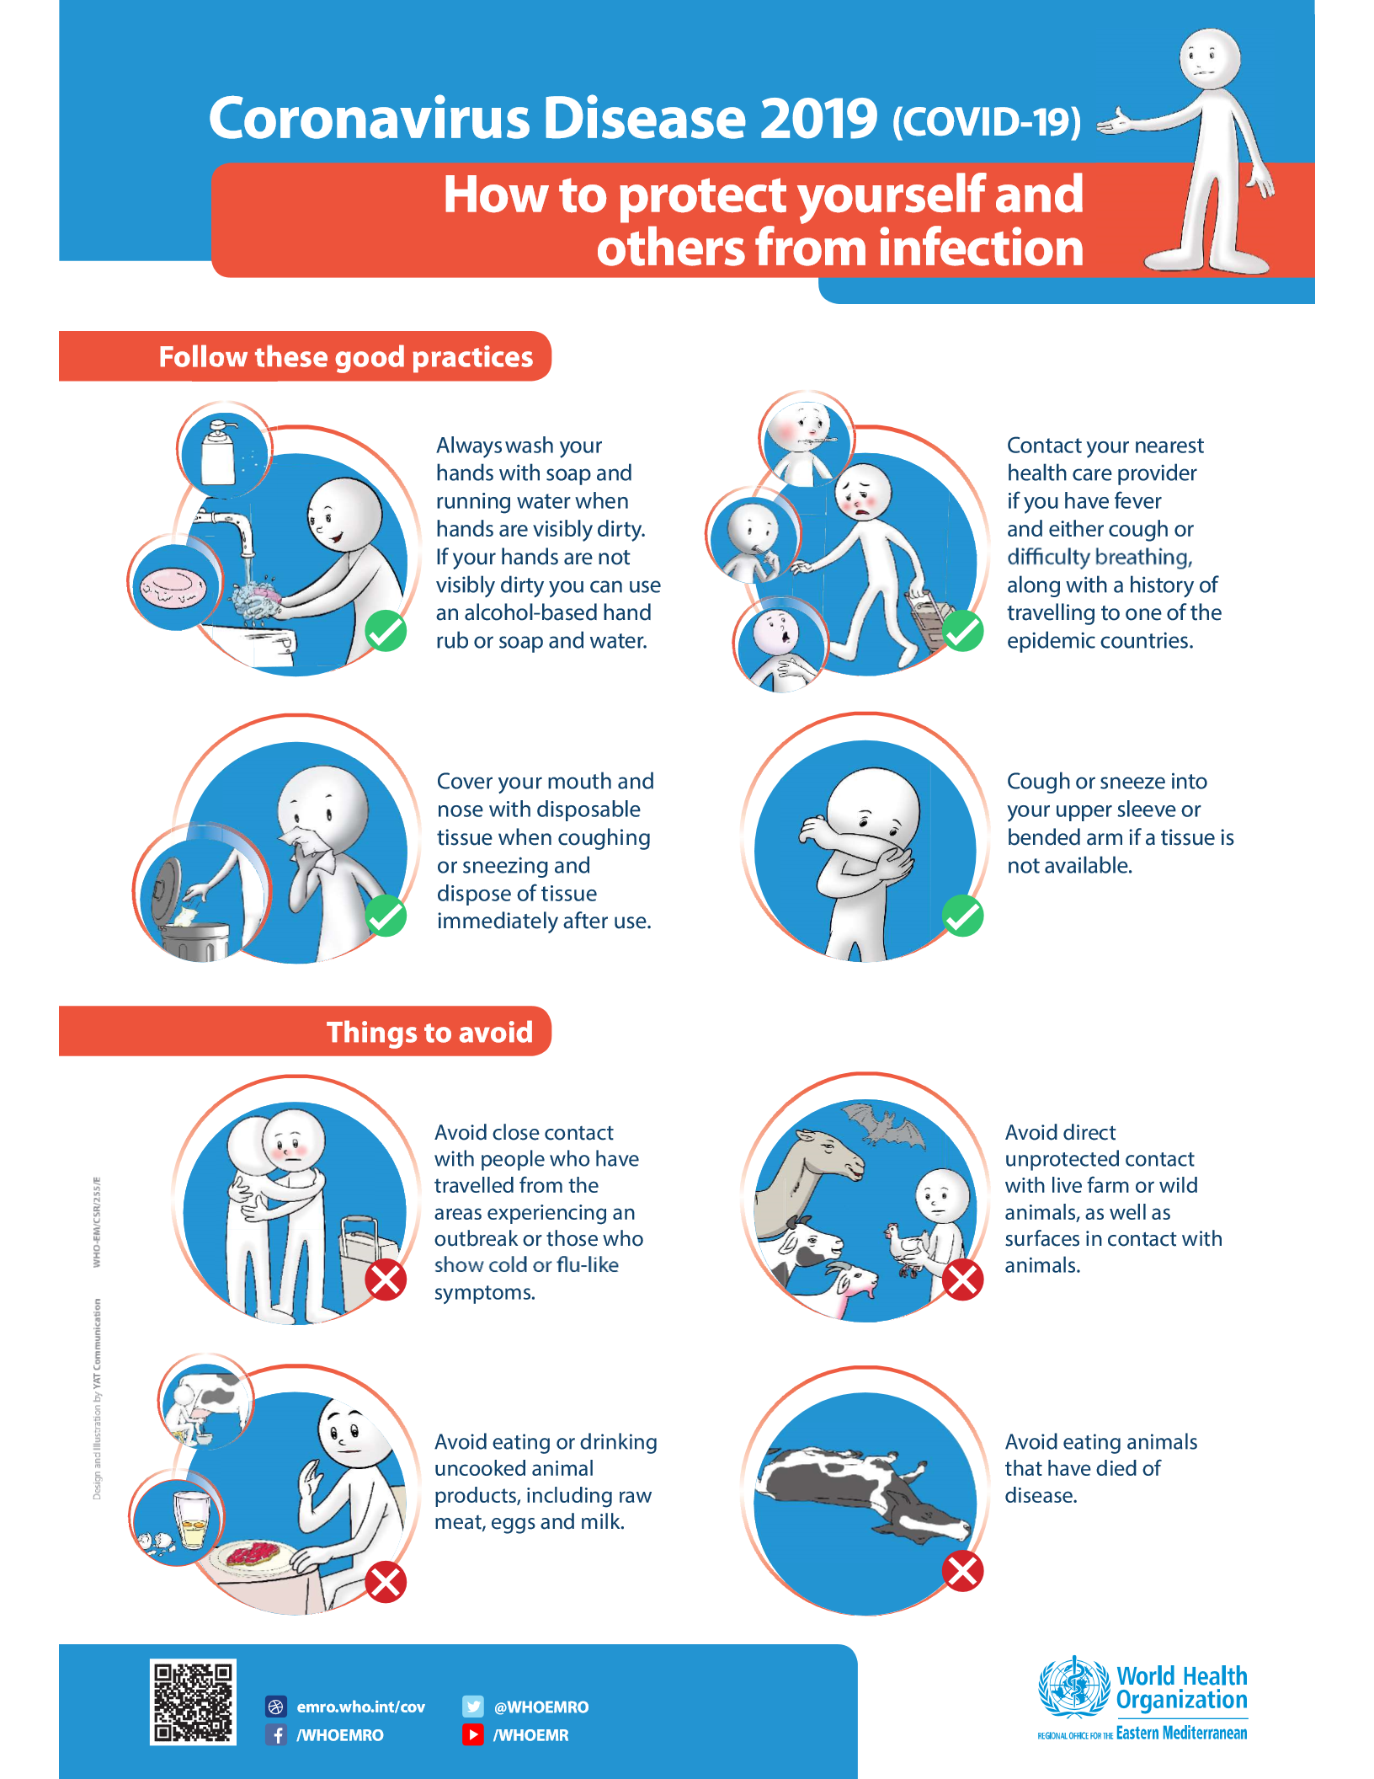

Slide 10
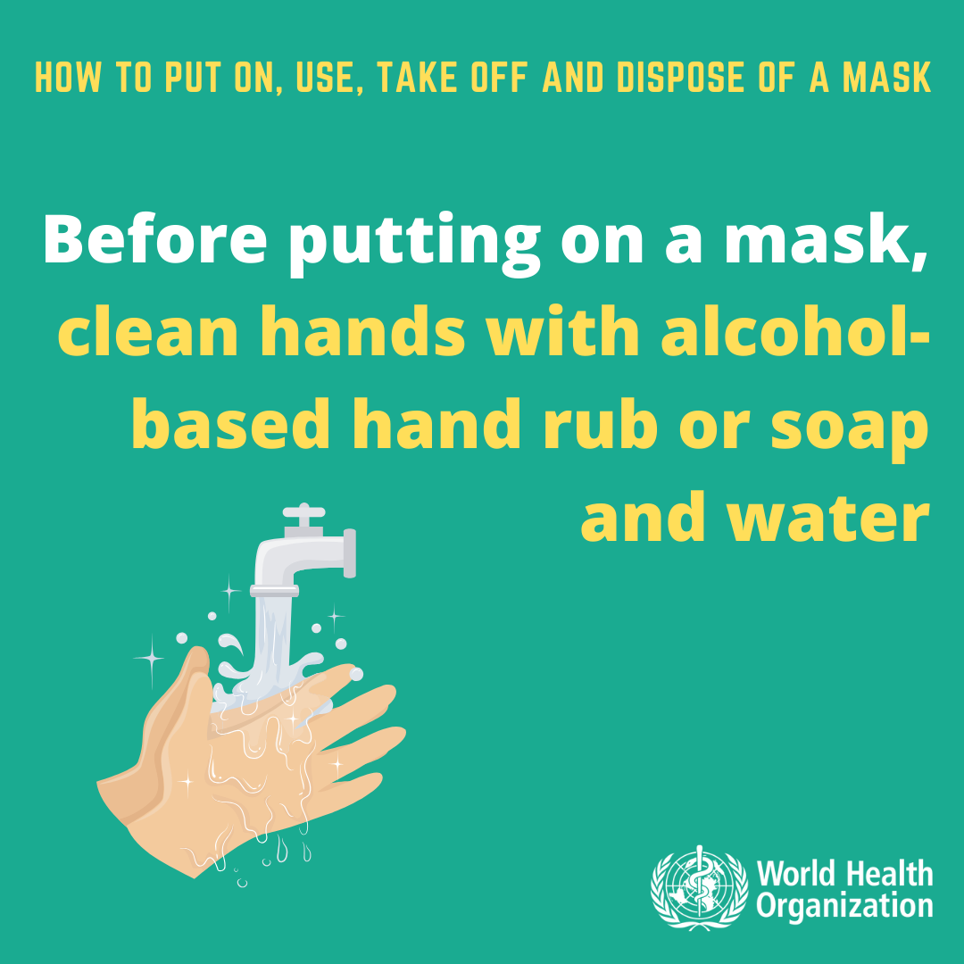
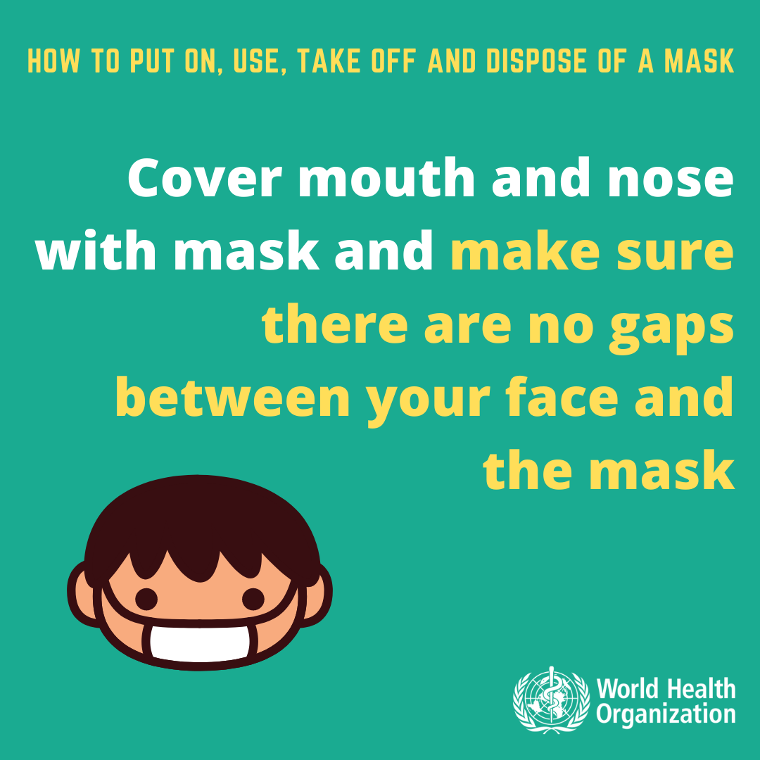
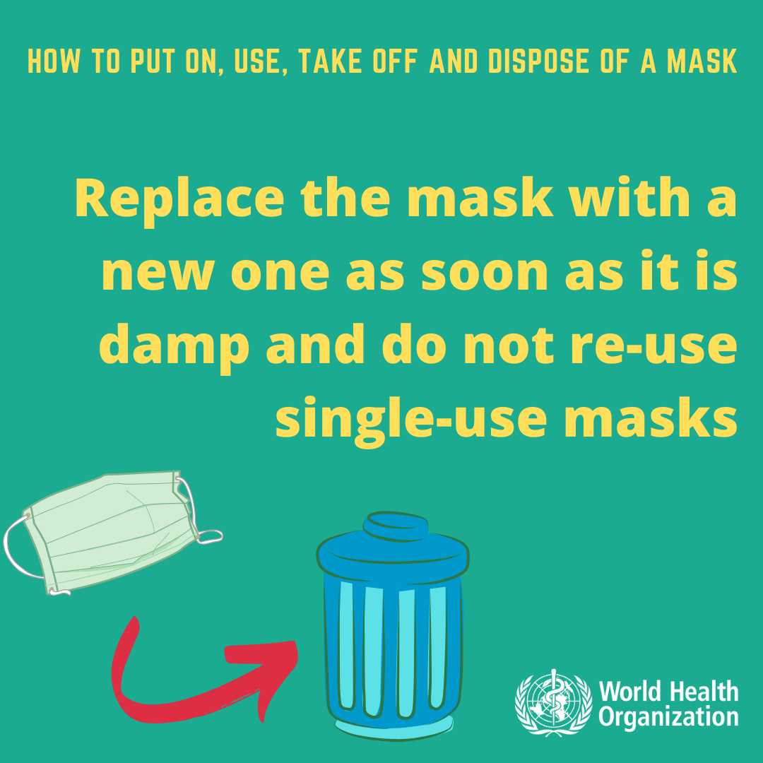
Health and Hygiene Practices to Prevent Contagion
The use of PPE only reduces the risk of contamination

Slide 11
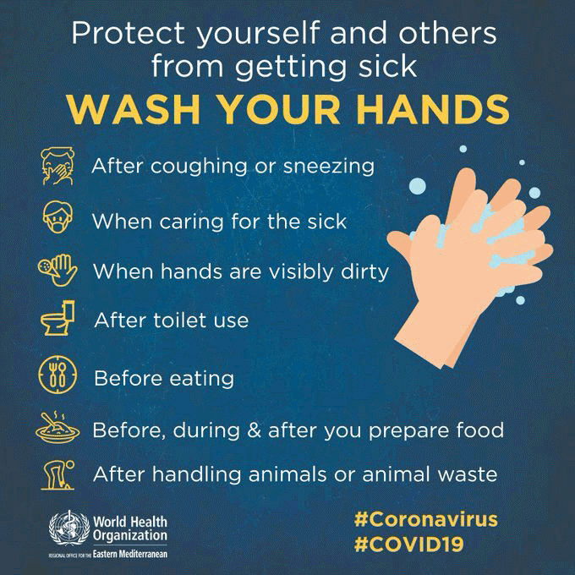

Slide 12
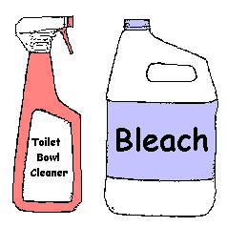

1. First Clean
2. Then Disinfect
Clean with soap and water, followed by rinsing and drying – to remove germs from surfaces. Surfaces must be cleaned prior to disinfection
Disinfect with 0.1% chlorinated water (i.e. bleach diluted into water), or 70% alcohol/ethanol-containing solution, to kill germs
Bleach

Slide 13
How to prepare 0,1% chlorine solution diluted into water
Chlorine concentrations in commercially available products (domestic bleach) vary between 4% and 6%.
To know the parts of chlorine-based product to mix into water to reach the desired concentration, the calculation is the following:
[% chlorine in liquid sodium hypochlorite ∕ % chlorine desired] − 1 =
Total parts of water for each part sodium hypochlorite.
For 0,1% chlorine-diluted solution, 49 parts of water need to be mixed for each part of sodium hypochlorite (or almost 100 each 2 parts of 5% concentrated bleach)
https://apps.who.int/iris/bitstream/handle/10665/332096/WHO-2019-nCoV-Disinfection-2020.1-eng.pdf?sequence=1&isAllowed=y (English)
https://apps.who.int/iris/bitstream/handle/10665/332096/WHO-2019-nCoV-Disinfection-2020.1-ara.pdf?sequence=12&isAllowed=y (Arabic)

Slide 14
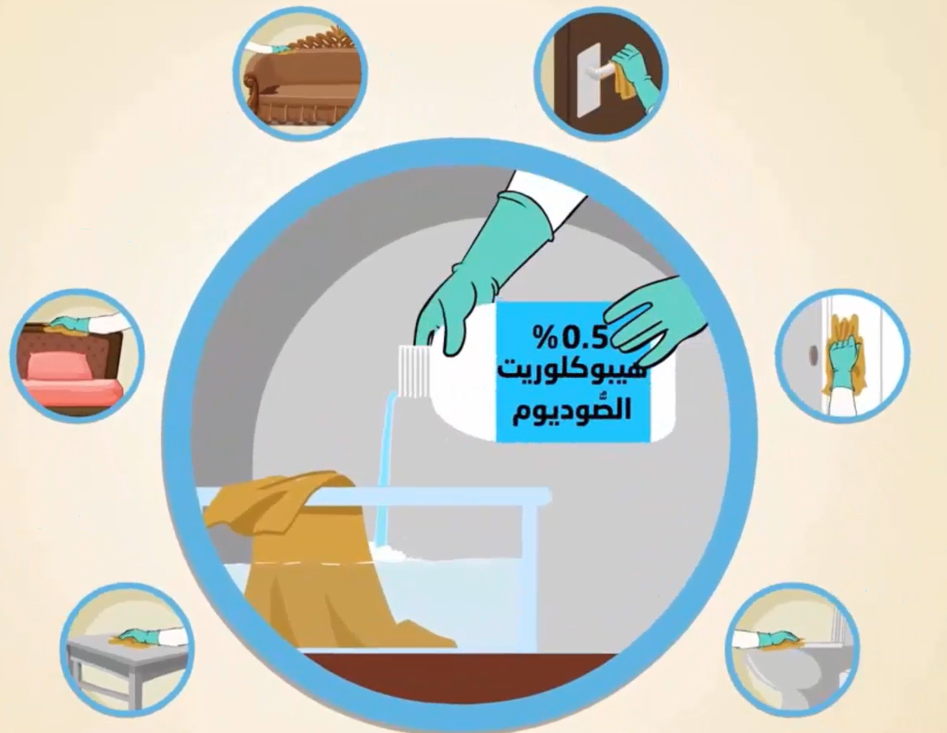
SURFACES AND OBJECTS TO DISINFECT REGULARLY
Shared tools
Door handles
Push plates
Handrails
Washrooms including tap
Toilets/sinks
Tables/chairs
Phones
Other frequently touched objects
sodium hypochlorite

Slide 15
Management and Organizational Measures
In Construction Sites

Slide 16
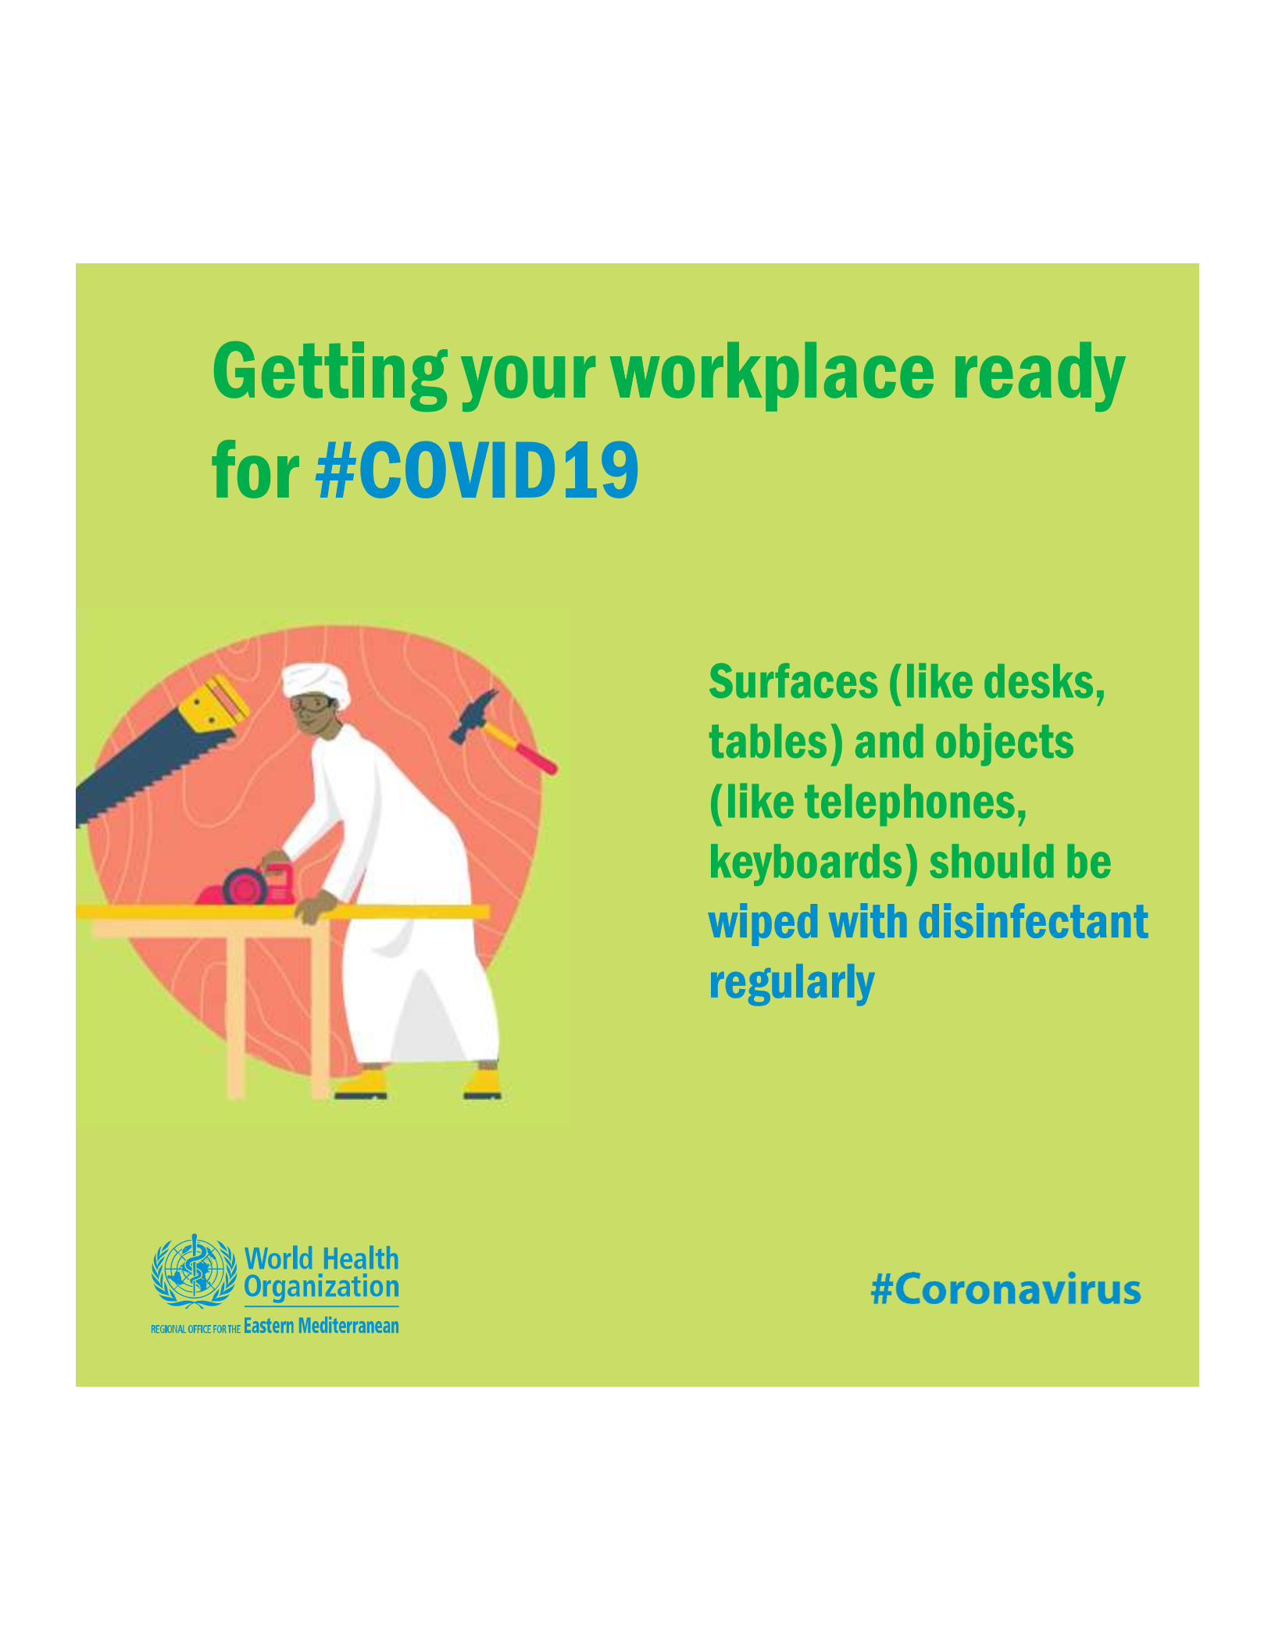


Slide 17

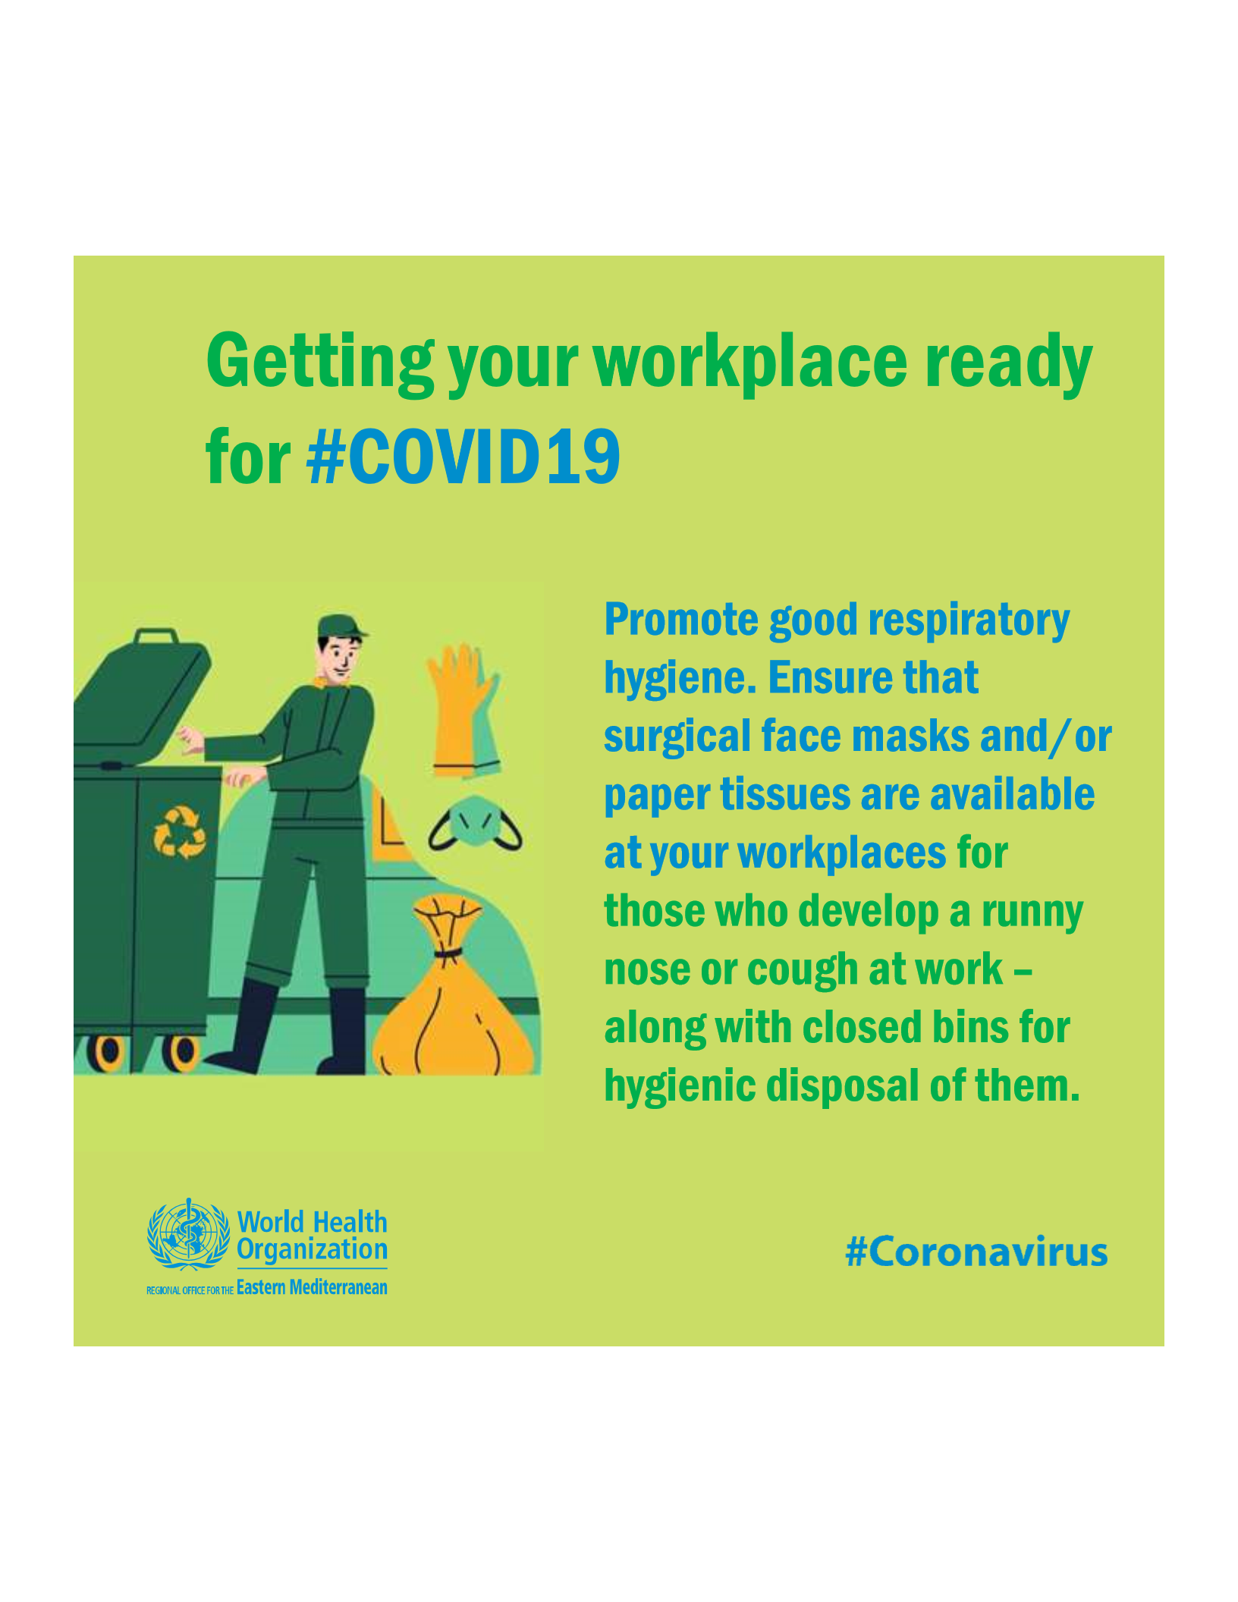

Slide 18


If you can’t keep a 1 meter distance:
Always keep at least
1 m distance
(or, a large step)
with others

Slide 19
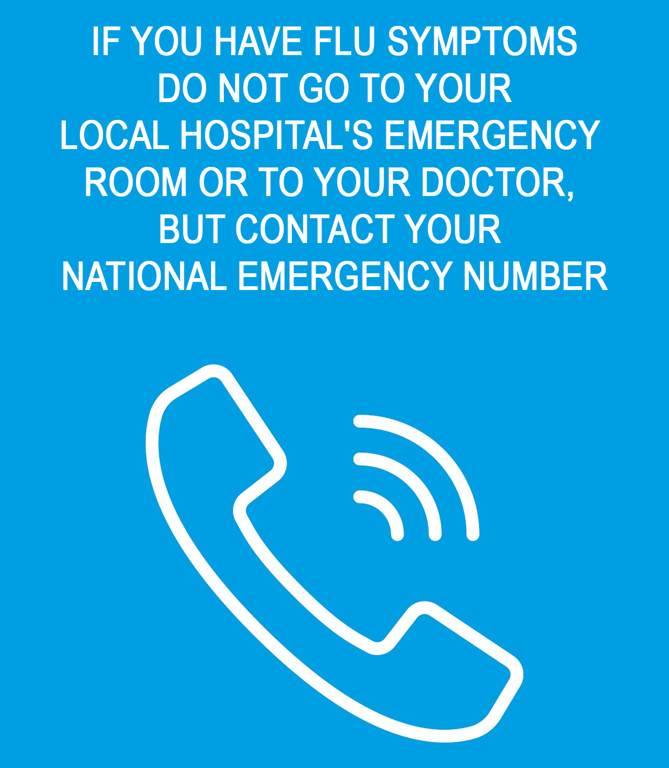
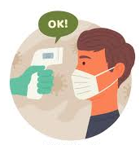
Everyone must provide to the COVID-19 Safety Manager a daily verbal self-certification that they are in the physical conditions to carry on the work
Temperature check measures may be implemented – please comply with those
122 (KRG) 123 (GOI)

Slide 20



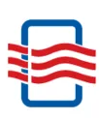

Personal and Environmental hygiene
DO NOT TOUCH ANYTHING
that is not strictly needed for your work
Keep the place
well ventilated

Slide 21
Other Organizational Measures

Slide 22


STRICT VISITING RULES ARE IN PLACE
All visitors:
Must be approved by the COVID-19 Safety Manager
Must adhere to the safety measures applied at the construction site
CANNOT enter if they have any COVID-19 symptoms, travel history OR have had contact with a positive case

Slide 23
Rules for delivery of items
Drivers MUST:
remain in or near their vehicles to supervise off-loading
If unavoidable, may offload the truck, maintaining 1 meter distance from others
wash their hands before and after unloading goods and materials

Slide 24


For any question, complaint or feedback please contact:
Shelter partner
logo
COVID-19 Safety manager
Mr./Ms. XXX
Mob.:
Shelter partner
Mr./Ms. XXX
Mob.:

