Slide 1
Basic Notions Around Covid-19

Slide 2
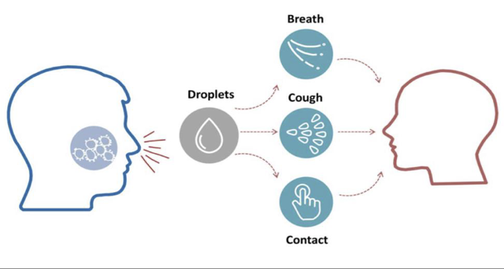

The COVID-19 disease is an infectious disease caused by severe acute respiratory syndrome
Most people recover from the disease
Many countries have been experiencing a COVID-19 outbreak, so there are enough information around how to avoid getting infected, as well as around treatments
Anyone could catch COVID-19 virus – irrespective of age, gender, sexual orientation, religious, tribal or other affiliations. Hence, it is important to prevent discrimination, stigma, anxiety

Slide 3
Prevent panic, anxiety, discrimination or stigma
Notes:
From IOM IEC toolkit

Slide 4
Prevent panic, anxiety, discrimination or stigma
Notes:
From IOM IEC toolkit

Slide 5
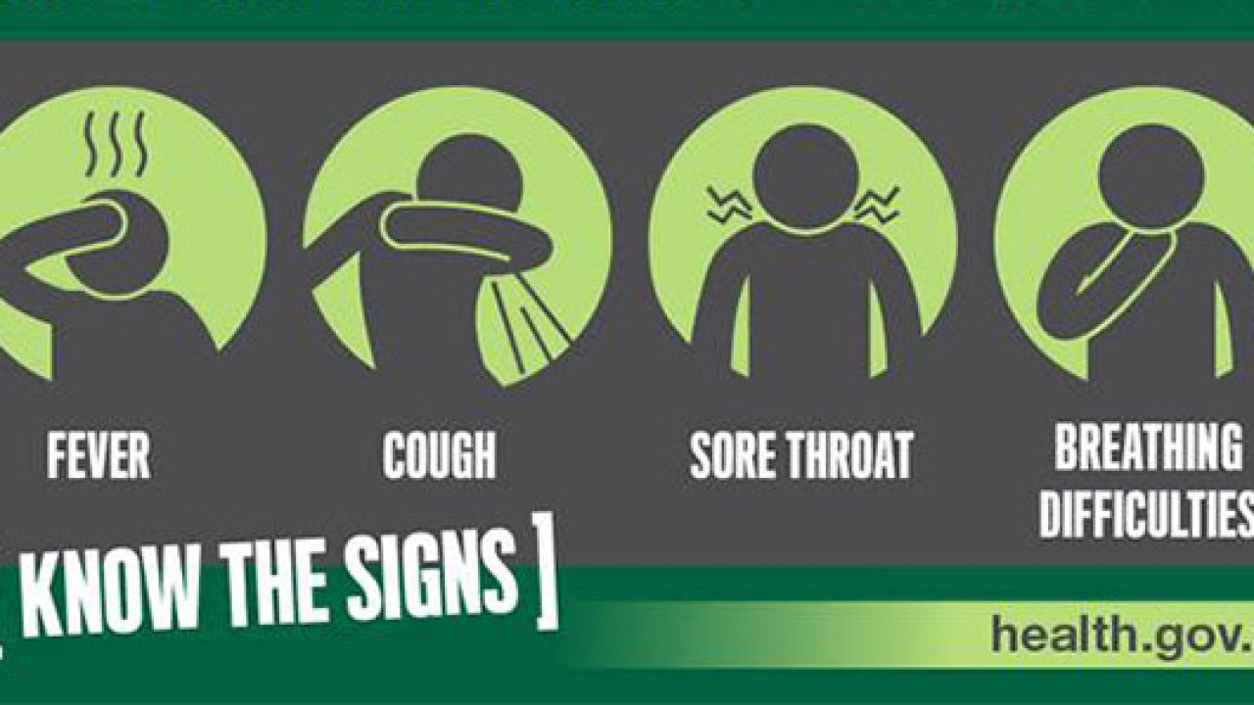


Most common symptoms
Fever or chills
Shortness of breath
Dry cough
Sore throat
Very similar to a normal flu
If you have any symptom, seek immediate advice from the nearest health care provider
If you notice anyone with these symptoms, suggest him/her to go to the nearest health care provider
Nearest clinic:
(add most appropriate phone number/address of nearest health facility)

Slide 6

Common symptoms
Fever
38 °C or more
Dry cough
Shortness of breath

Slide 7
Healthy and Hygiene Practices
to Prevent the Contagion
(VALID FOR ALL)

Slide 8
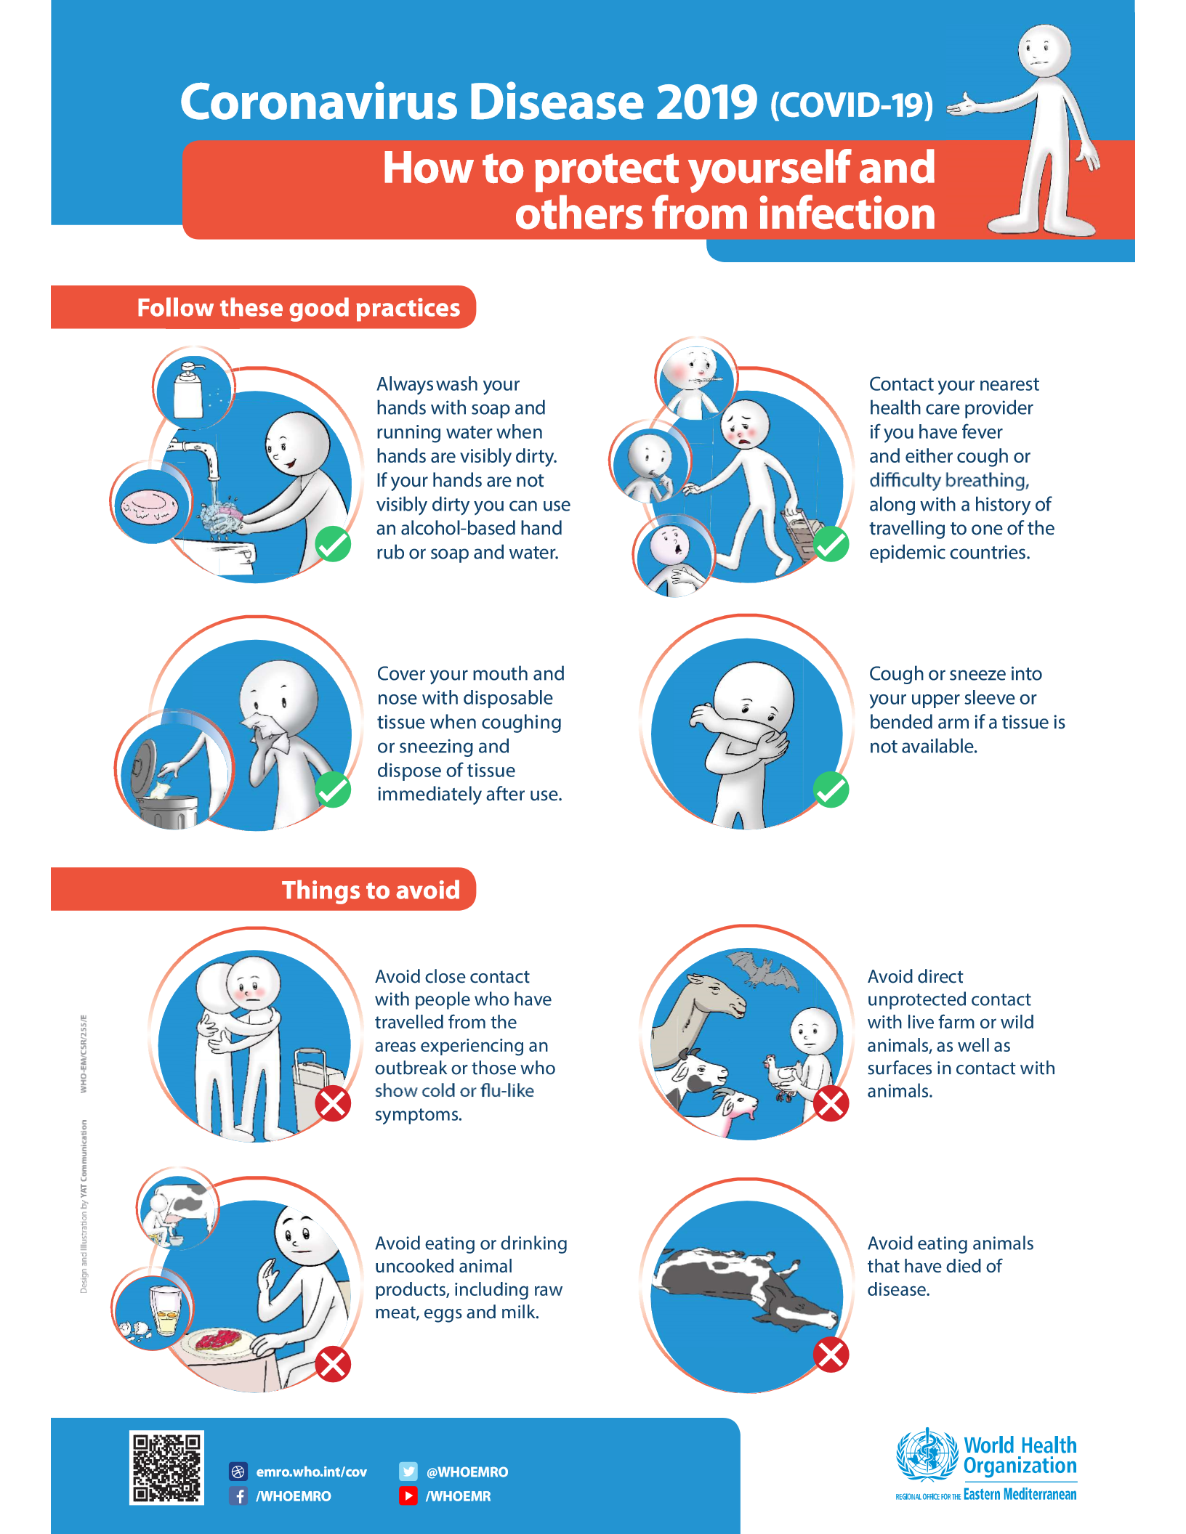

Slide 10
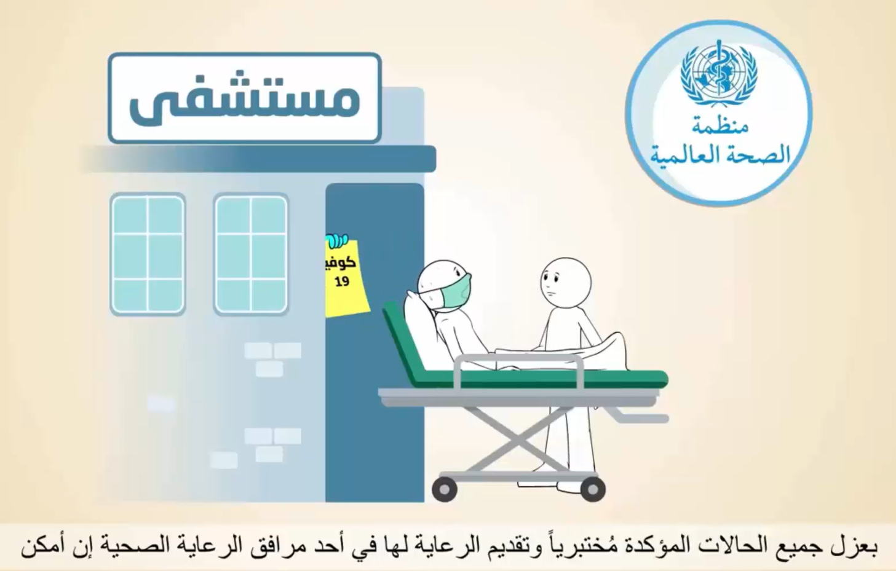
Hospital
Isolating all laboratory confirmed cases and providing care for them in a health care facility if possible

Slide 11
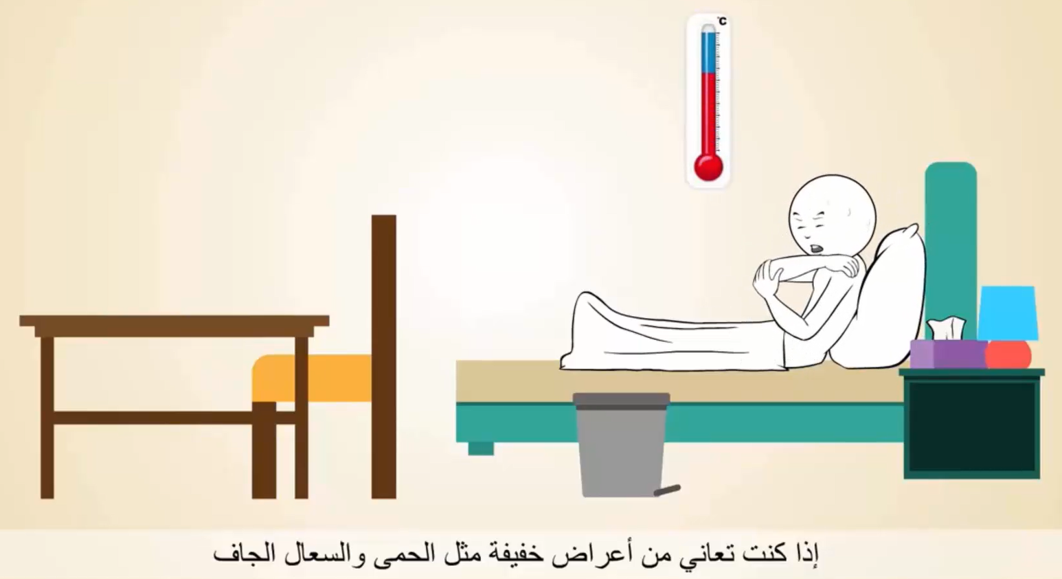
If you have mild symptoms such as fever and dry cough

Slide 12
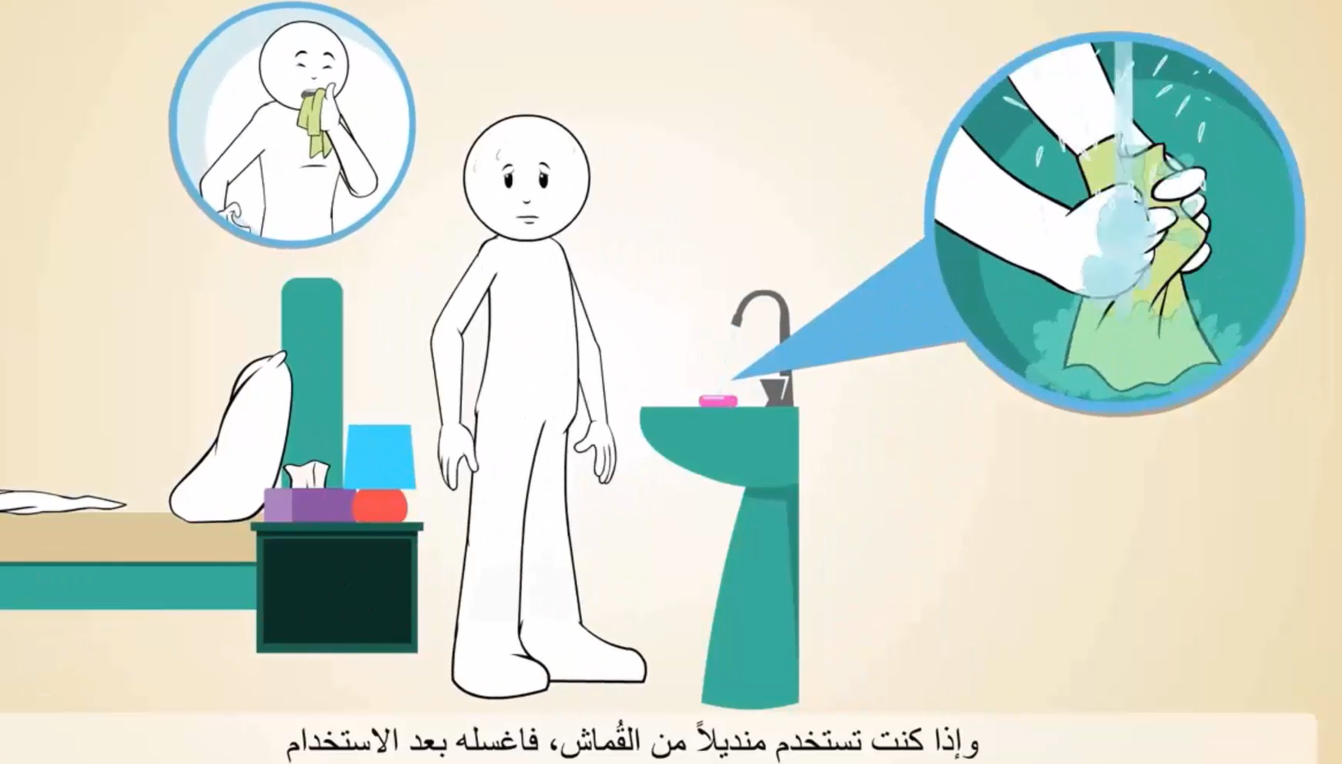
If you are using a napkin, wash it after use

Slide 13
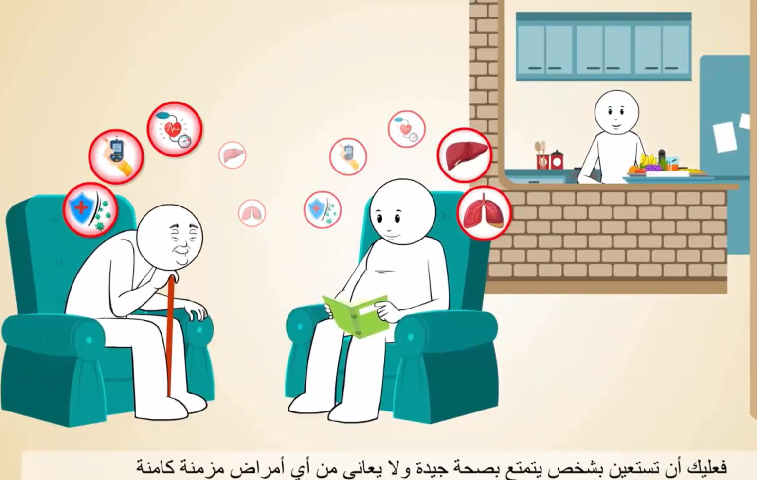
You should seek the help of someone who is in good health and does not suffer from any underlying chronic diseases

Slide 14
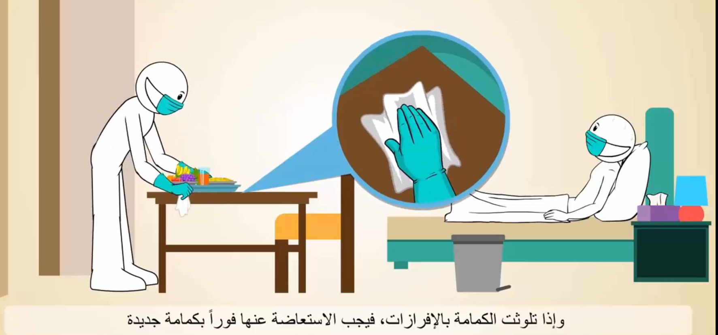
If the mask is contaminated with secretions, it must be replaced immediately by a new mask

Slide 15
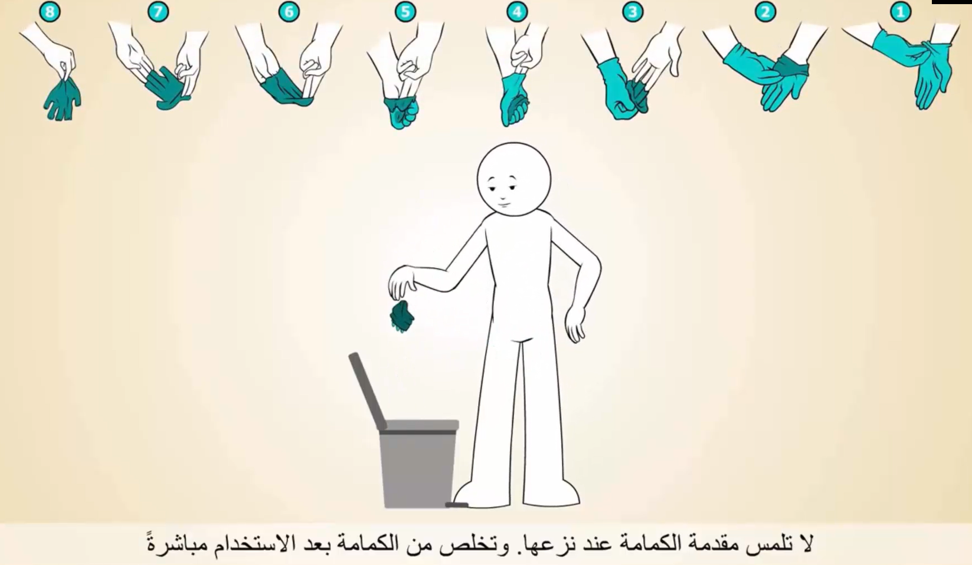
Do not touch the front of the gloves when removing them. Dispose of the gloves immediately after use

Slide 16
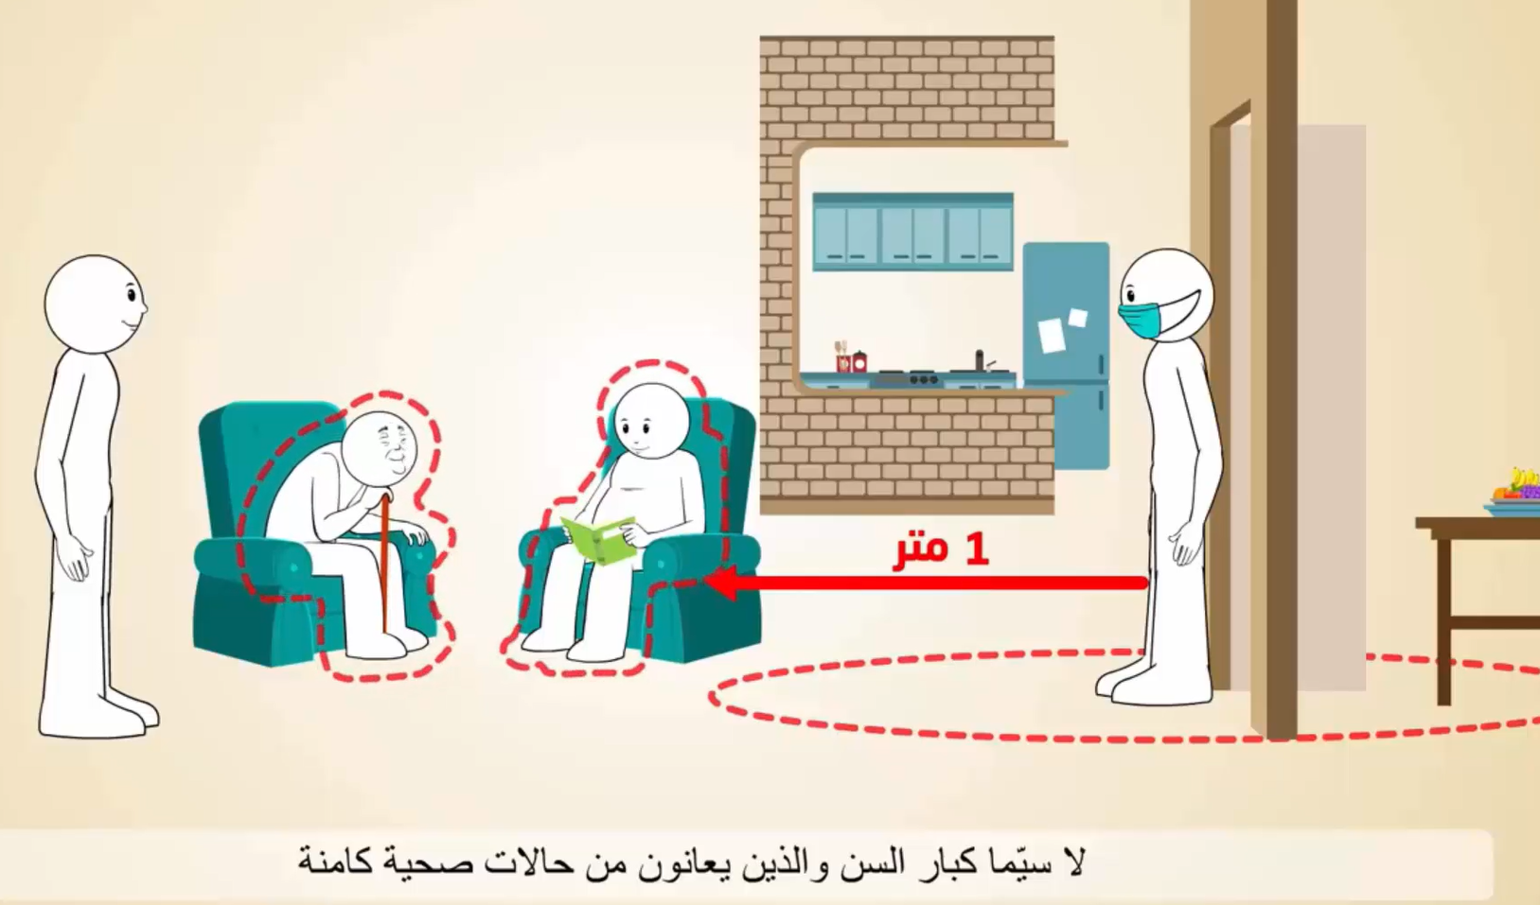
1 meter
Always leave 1-meter distance especially with elderly and those with underlying health conditions

Slide 17
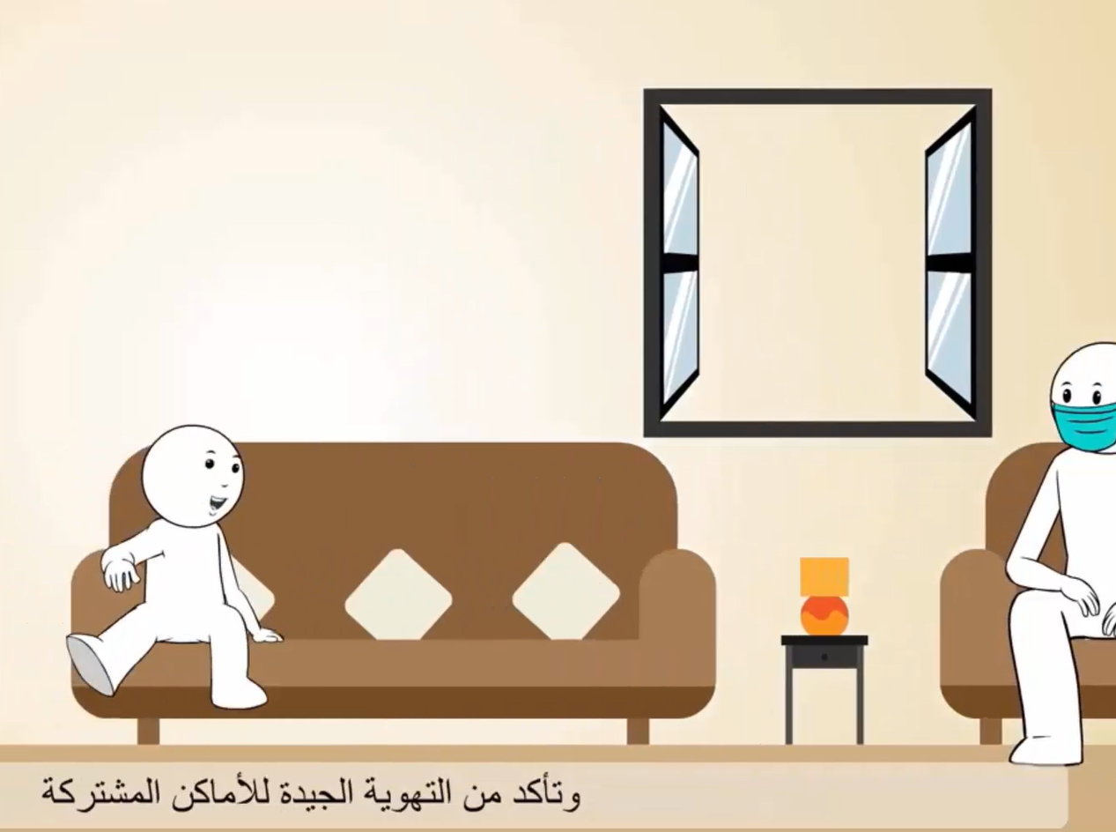
Make sure common areas are well ventilated

Slide 18
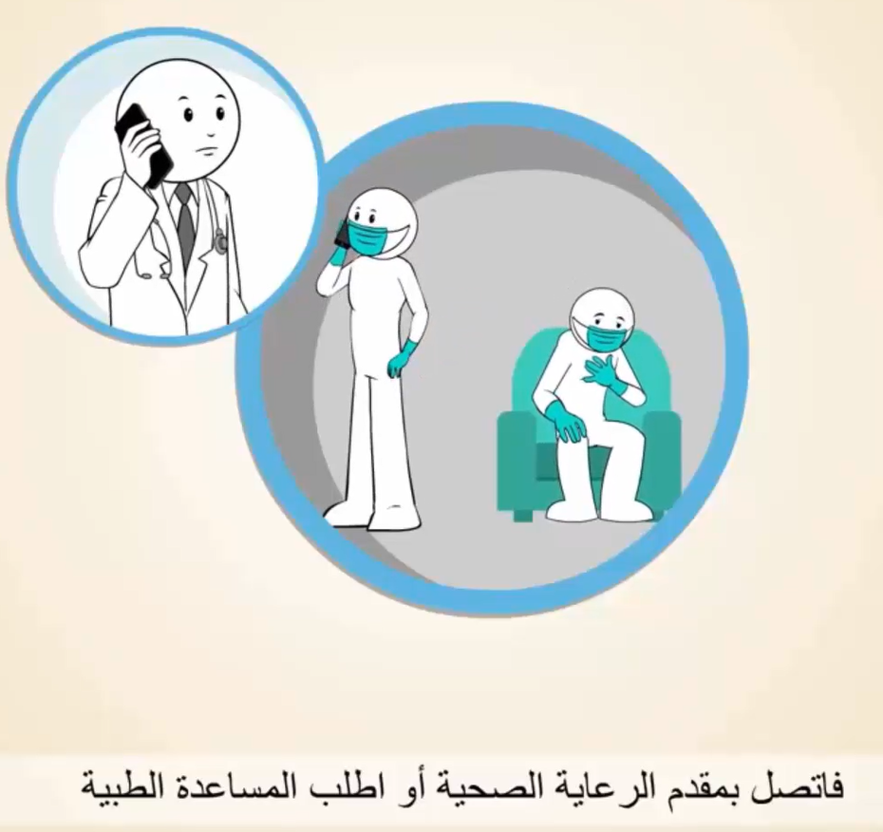
Call your health care provider or seek medical help

Slide 19

Contact us the World Health Organization and the National Health Authorities

Slide 20

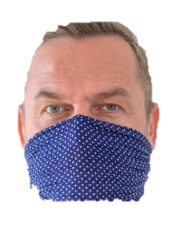
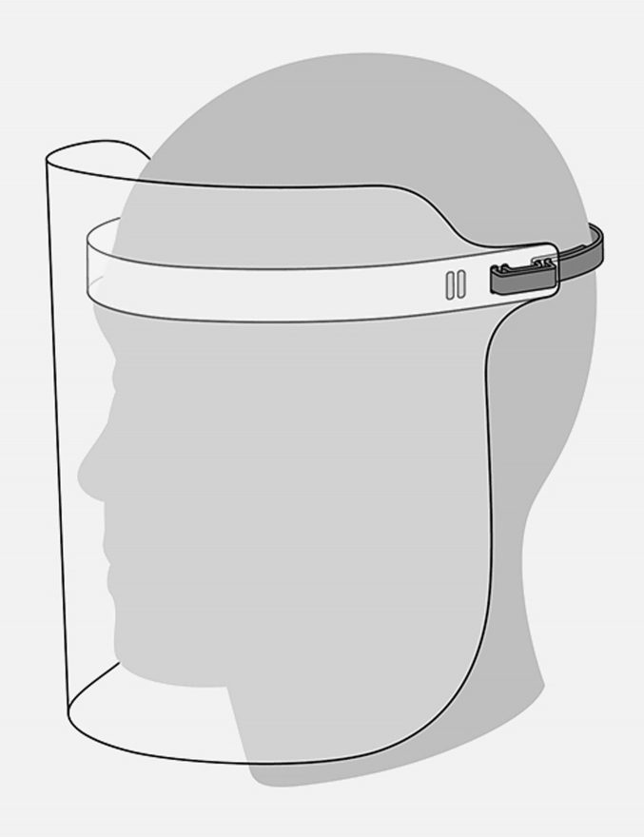
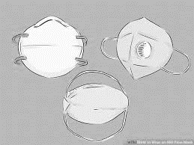
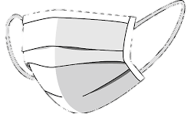
Possible face masks
4. 3-layered face cover Or
thick scarf (folded twice)
covering
mouth and nose
3. Face shield
2. Two surgical masks (one on top of the other)
1. FFP2 (N95)
Good filtration
Once removed, they need to be disposed off
Excellent filtration
Expensive
Difficult to procure
Easily available, cheap
Limited filtration
Protects the face
No filtration

Slide 21
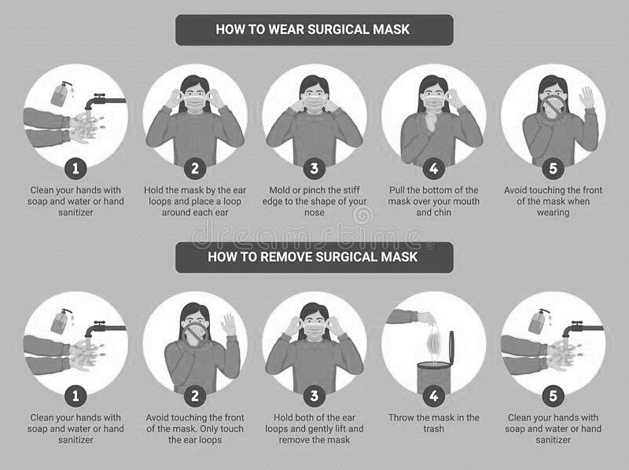
Notes:
Provide a practical demonstration

Slide 22
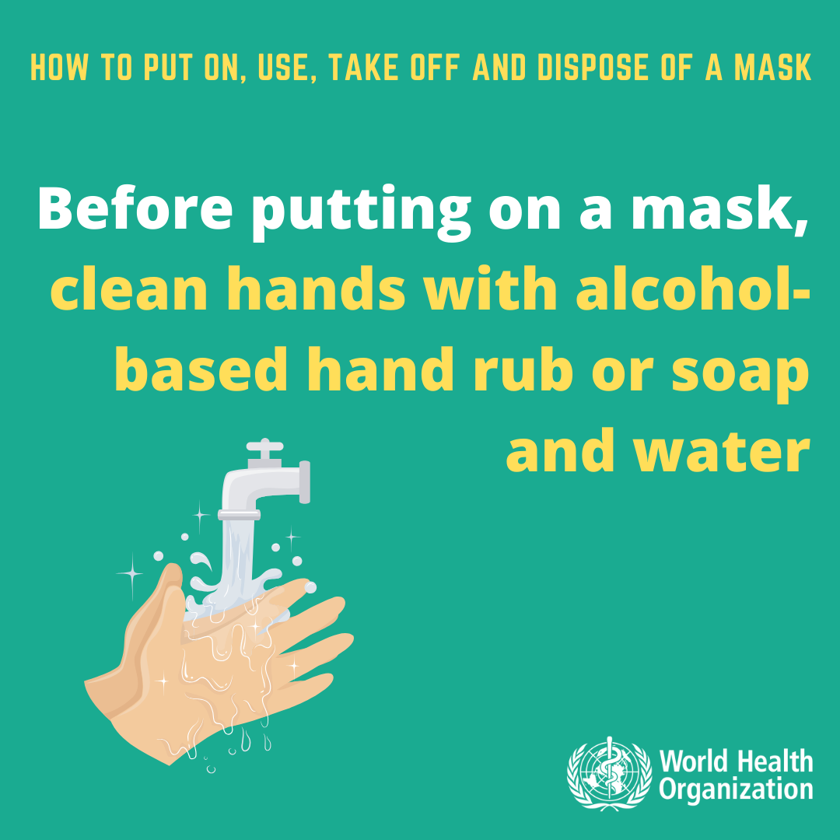
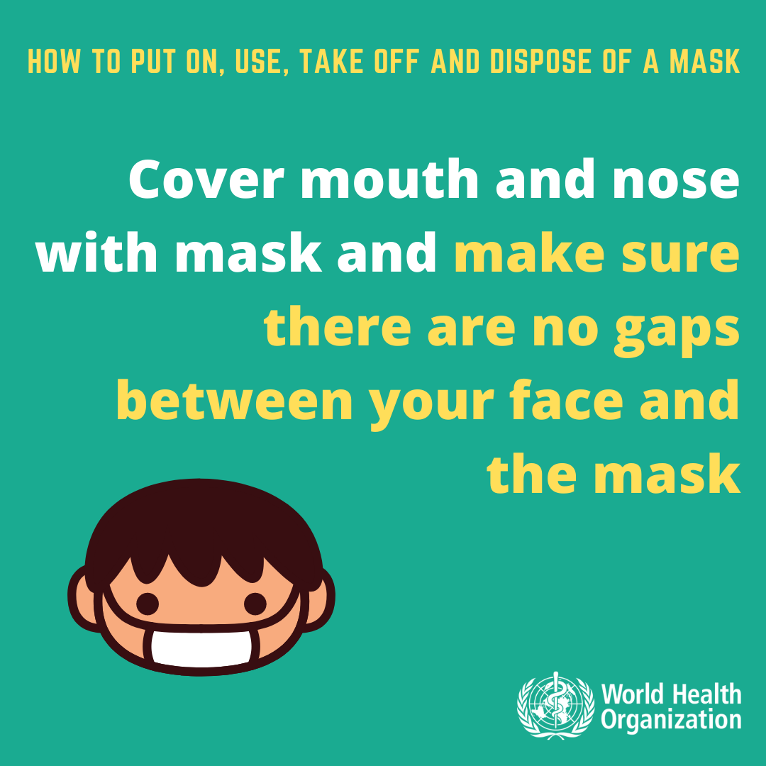
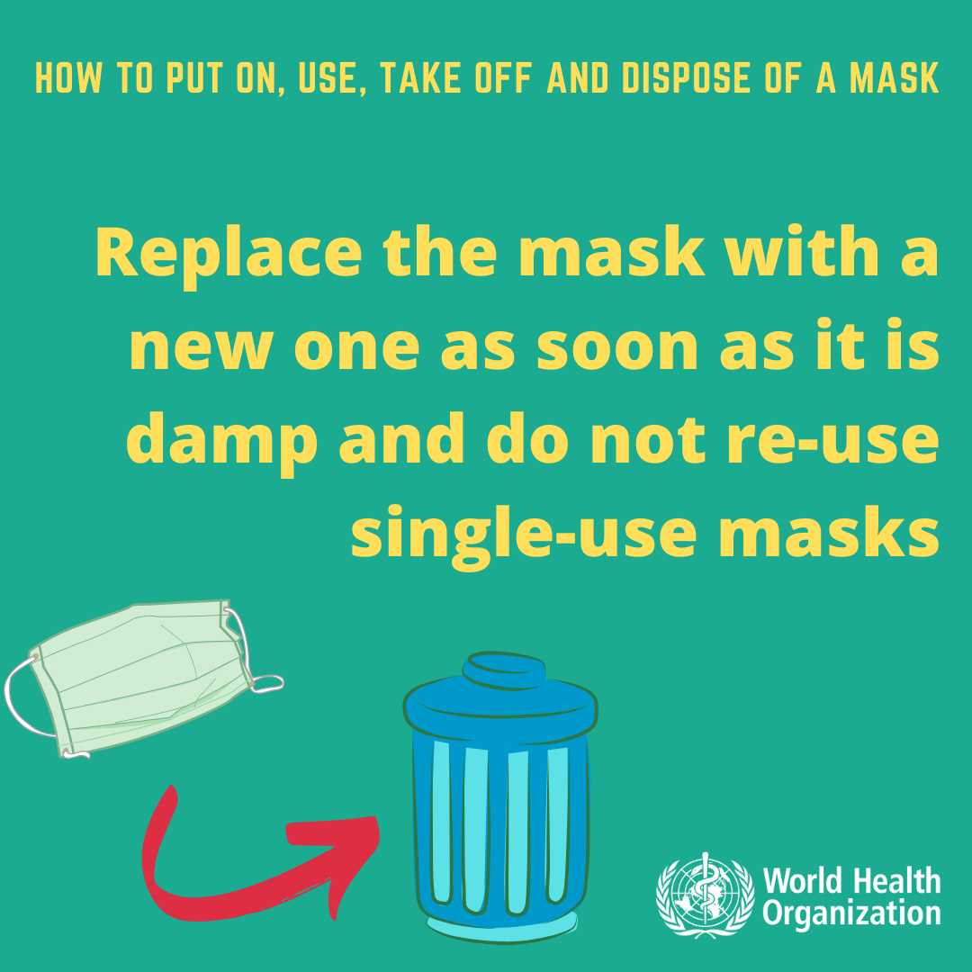
Health and Hygiene Practices to Prevent Contagion
The use of PPE only reduces the risk of contamination

Slide 23
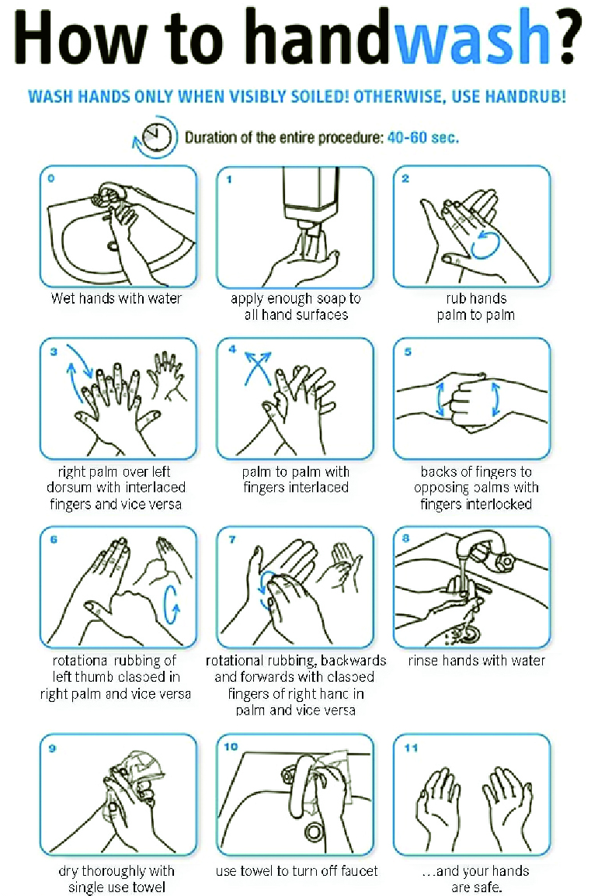

Notes:
Provide a practical demonstration

Slide 24
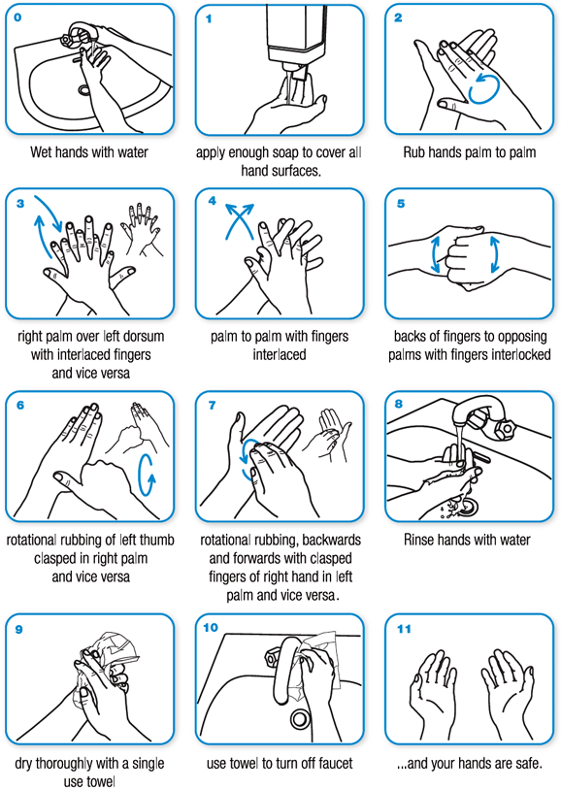
Notes:
Provide a practical demonstration – SLIDE ADDED ON JULY 13TH

Slide 25
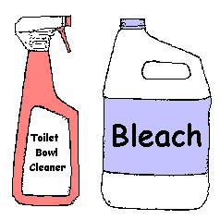

1. First Clean
2. Then Disinfect
Clean with soap and water, followed by rinsing and drying – to remove germs from surfaces. Surfaces must be cleaned prior to disinfection
Disinfect with 0.1% chlorinated water (i.e. bleach diluted into water), or 70% alcohol/ethanol-containing solution, to kill germs
Bleach
https://apps.who.int/iris/bitstream/handle/10665/332096/WHO-2019-nCoV-Disinfection-2020.1-eng.pdf?sequence=1&isAllowed=y (English)
https://apps.who.int/iris/bitstream/handle/10665/332096/WHO-2019-nCoV-Disinfection-2020.1-ara.pdf?sequence=12&isAllowed=y (Arabic)

Slide 26
How to prepare 0,1% chlorine solution diluted into water
Chlorine concentrations in commercially available products (domestic bleach) vary between 4% and 6%.
To know the parts of chlorine-based product to mix into water to reach the desired concentration, the calculation is the following:
[% chlorine in liquid sodium hypochlorite ∕ % chlorine desired] − 1 =
Total parts of water for each part sodium hypochlorite.
For 0,1% chlorine-diluted solution, 49 parts of water need to be mixed for each part of sodium hypochlorite (or almost 100 each 2 parts of 5% concentrated bleach)
https://apps.who.int/iris/bitstream/handle/10665/332096/WHO-2019-nCoV-Disinfection-2020.1-eng.pdf?sequence=1&isAllowed=y (English)
https://apps.who.int/iris/bitstream/handle/10665/332096/WHO-2019-nCoV-Disinfection-2020.1-ara.pdf?sequence=12&isAllowed=y (Arabic)

Slide 27
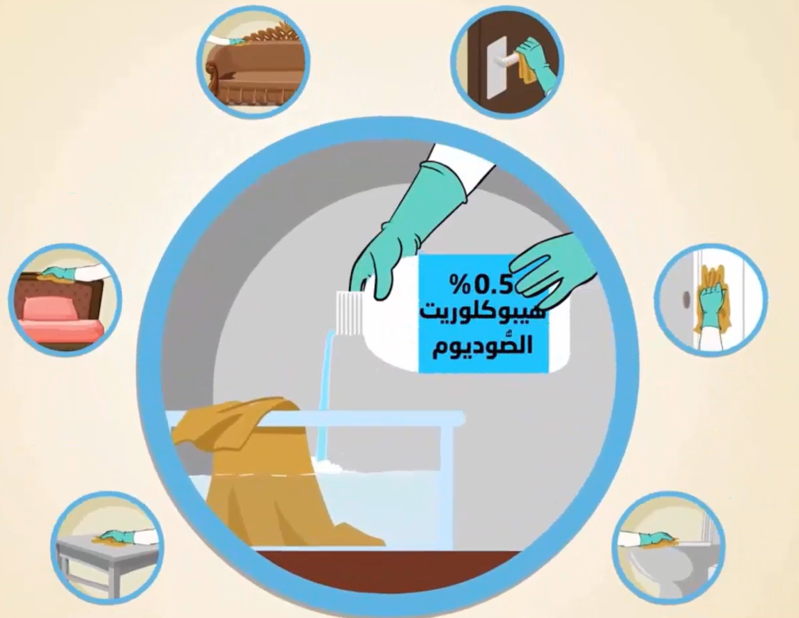
SURFACES AND OBJECTS TO DISINFECT REGULARLY
Shared tools
Door handles
Push plates
Handrails
Washrooms including tap
Toilets/sinks
Tables/chairs
Phones
Other frequently touched objects

Slide 28

Always keep at least
1 m distance
(or a large step)
with others

Slide 29


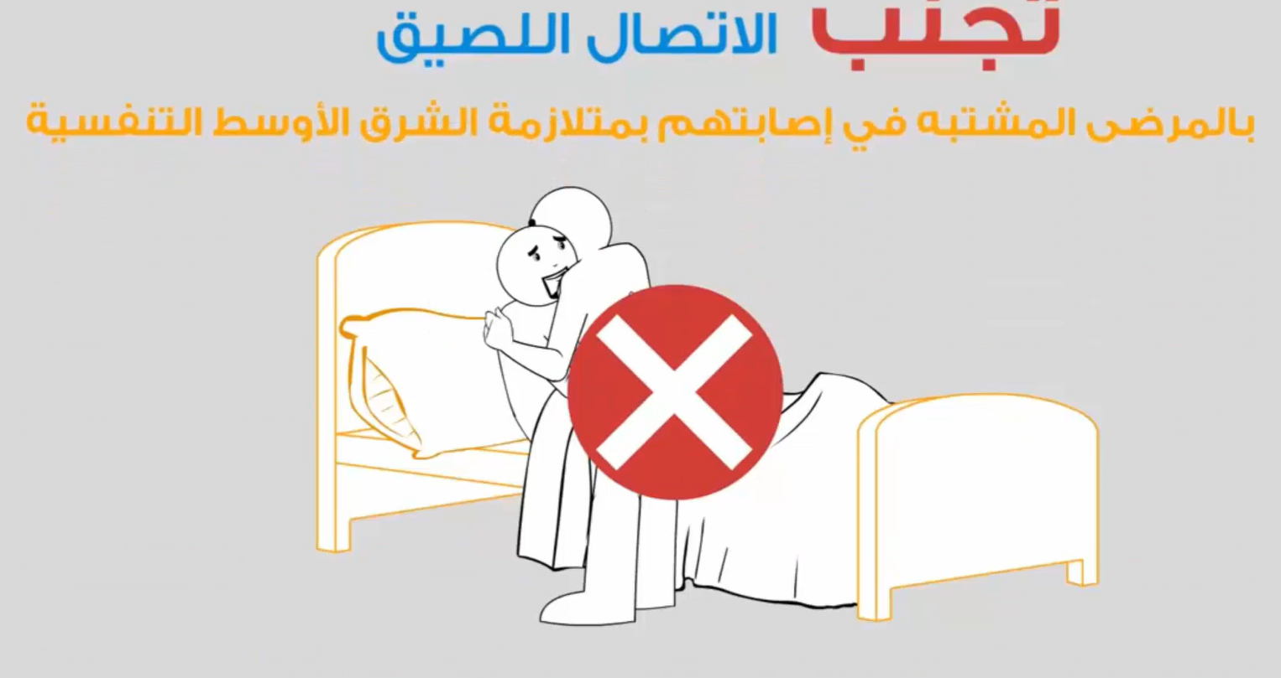
No hugging !
Words can be more powerful to prove closeness to those we care about but shall not touch!
Avoid close contact

Slide 30
Management and Organizational Measures
In Construction Sites

Slide 31

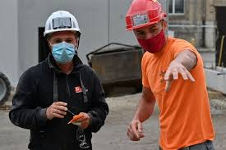
If you can’t keep a one-meter distance
The use of PPE only reduces the risk of contamination

Slide 32
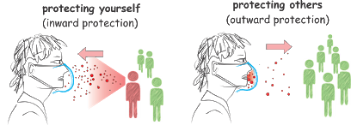
Use of PPE for the face
The use of PPE only reduces the risk of contamination

Slide 33
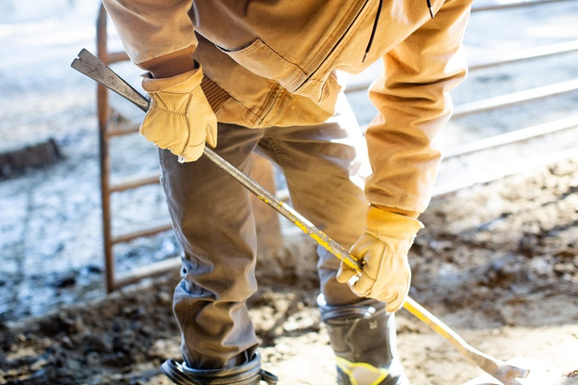

Personal Protective Equipment (PPE) for hands
Wash hands frequently
Use gloves appropriate for the nature of works
Gloves may give a false sense of safety
The use of PPE only reduces the risk of contamination

Slide 34
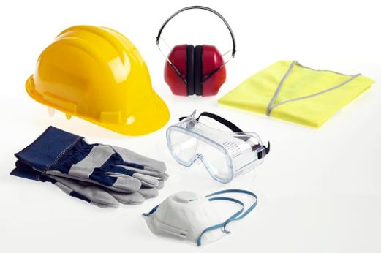
Personal Protective Equipment (PPE) for hands & for face
Use your PPEs while working
The use of PPE only reduces the risk of contamination

Slide 35


Use individual tools!
If not possible, disinfect after each use

Slide 36
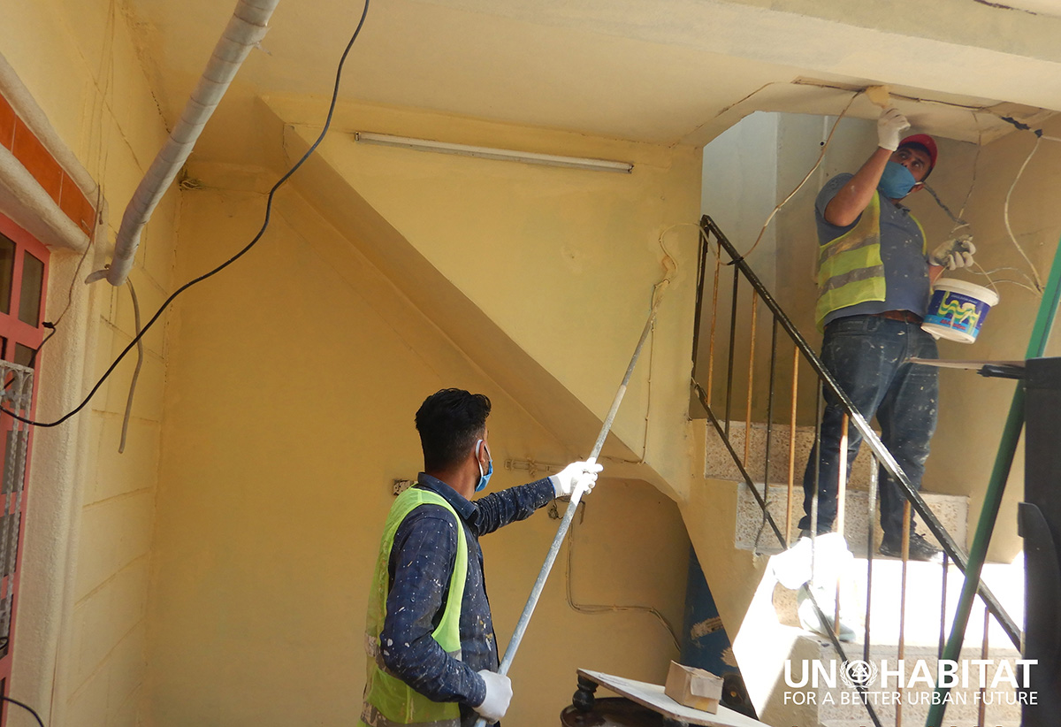
Plan all works to minimize contact between workers
Multi person activities to be limited where feasible and appropriate (e.g. lifting activities)
Increase ventilation in enclosed spaces Where more than one person is working, install a simple fan and an exhaust piping system
Not touch anything on site that is not strictly needed for the works
At the work site
Construction work has resumed on a UN-Habitat project to rehabilitate war damaged houses in Mosul in northern Iraq with protection measures against COVID-19

Slide 37
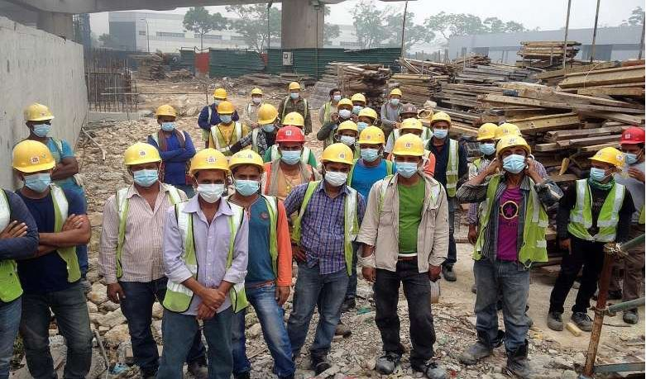
Access Control Measures - Manage working shifts and access
avoid large gatherings while accessing/exiting the worksite
avoid high staff turnover
limit the presence of (sub) contractors, suppliers, visitors and beneficiaries
Keep an attendance register/visitor book at the work site that anyone signs when entering/exiting (to facilitate contact tracing if needed)

Slide 38
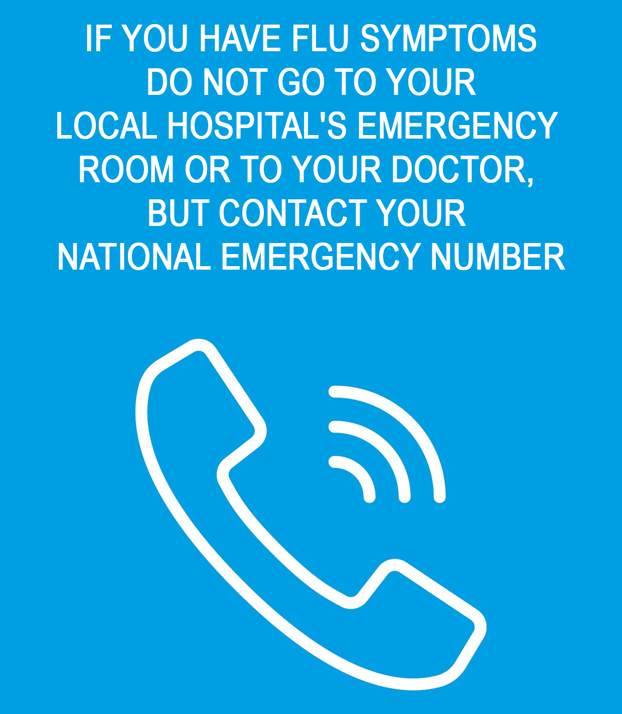

Everyone must provide to the COVID-19 Safety Manager a daily verbal self-certification that they are in the physical conditions to carry on the work
Temperature check measures may be implemented – please comply with those
122 (KRG) 123 (GOI)

Slide 39

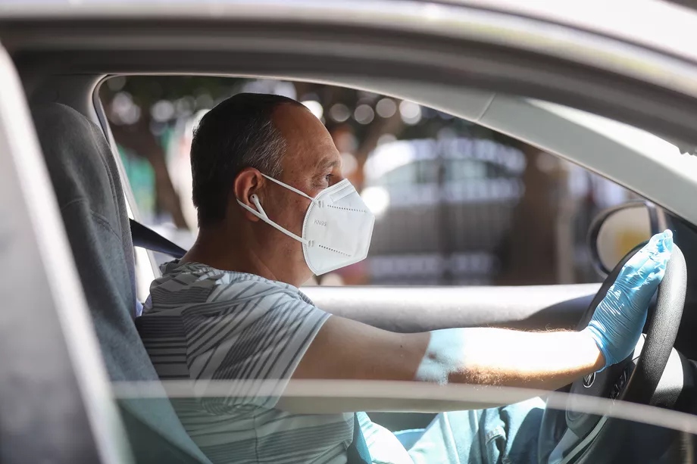
Traveling to/from the work site
Before
Share the vehicle with the same workers
Wear masks
Maximum number of people should not exceed the number of seats
Now

Slide 40



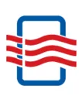

Personal and Environmental hygiene
DO NOT TOUCH ANYTHING
that is not strictly needed for your work
Keep the place
well ventilated

Slide 41
Personal and Environmental hygiene at the construction site
During breaks
Keep always physical distancing
Bringing food and water from home is recommended
No sharing of water/beverage bottle/cup
Clean up after yourself on breaks. Use water and detergent for cleaning tables and chairs, disinfect if needed
Bathroom facilities
In case there is NO toilet available for the exclusive use of the workers, after each use, each worker/user must guarantee the cleaning of all the surfaces touched with detergents and/or disinfectants
Solid waste management
Always use dustbin – do not leave any garbage on site (especially used PPE)

Slide 42
Other Organizational Measures

Slide 43


STRICT VISITING RULES ARE IN PLACE
1) Visitors must be approved by the COVID-19 Safety Manager
2) Visitors must adhere to the safety measures applied at the construction site:
3) If you have any COVID-19 symptom, OR you have had contact with a positive case, you CANNOT enter and shall seek immediate medical advise

Slide 44
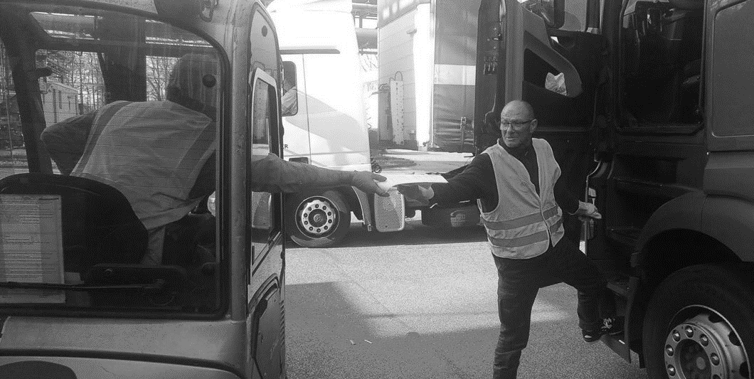
STRICT VISITING RULES ARE IN PLACE
Rules for delivery of items
Drivers should preferably remain in their vehicles, or near their vehicle to supervise offloading
If unavoidable, drivers can offload the truck while always maintaining at least 1 meter from others
Drivers must wash their hands before and after unloading goods and materials

Slide 45
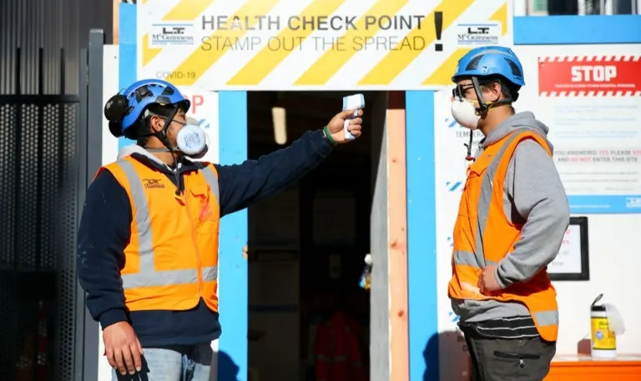
Access Control Measures
Temperature check
at site entrance:
OPTIONAL

Slide 46


COVID 19 Safety Manager
Ensures adherence to protocol through
CHECKLISTS
For any question, ask this person

Slide 47
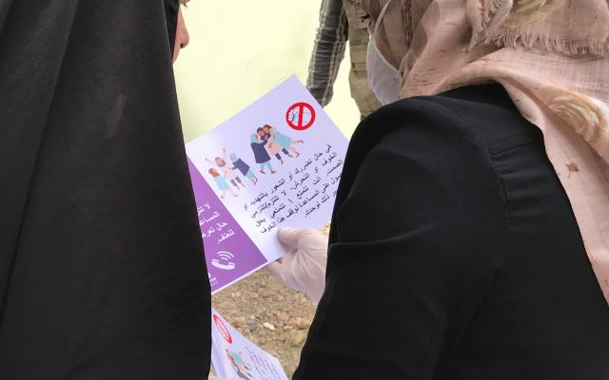

Informs beneficiaries and workers on their rights and responsibilities
Coordinates and regulates access
Notifies DoH if needed
Produces regular reports
If needed applies disciplinary measures

Slide 48

Interaction with the beneficiaries
Accountability and complaint mechanisms to be printed and shared with beneficiaries before the start of the works, including contact details of the Safety Manager, Shelter partner and IIC

