Slide 1
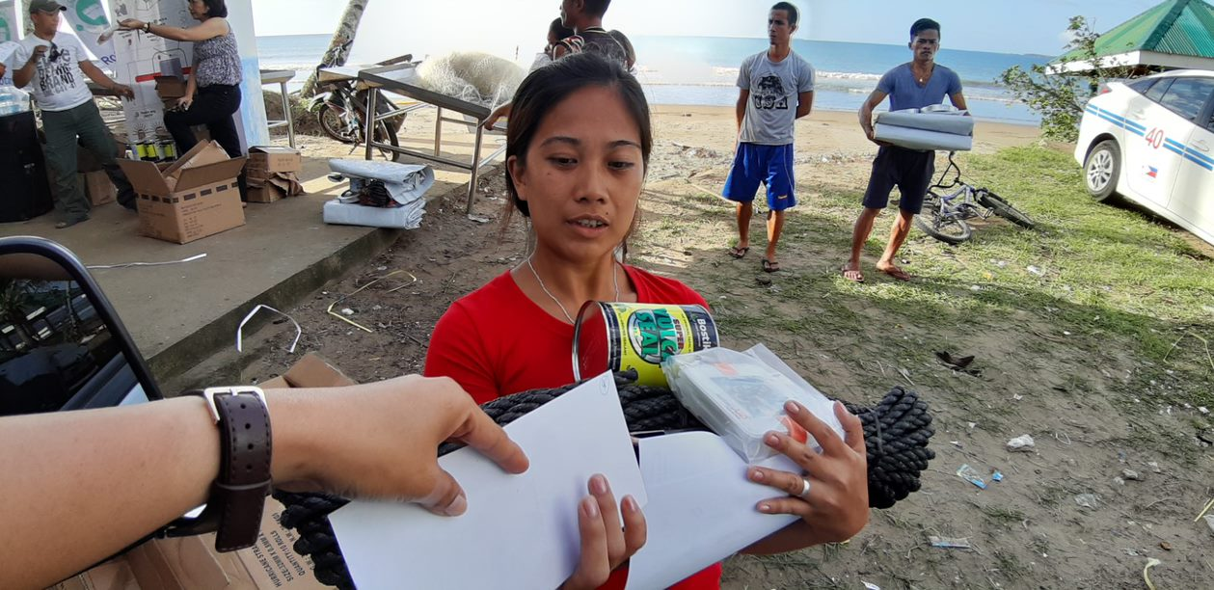


Cash and Voucher Assistance (CVA) at ShelterBox
April 2021
ShelterBox and Rotary are project partners in disaster relief. ShelterBox
is a charity independent of Rotary International and The Rotary Foundation.

Slide 2
Cash. Shelter and Emergencies!

Slide 3
ShelterBox. What we do.
Emergency focus.
Shelter focus.
Reactive and Protracted Crisis responses.
Direct implementation. Volunteers, Staff and Rotary International.
Partnering with other Organisations / Agencies. Collaboration Agreements in place.

Slide 4
ShelterBox. Some factors to programming.
United Kingdom based. Only one country office in Philippines.
No legal status/ status agreements in regions / countries of response (except for Philippines)
To date. Main focus on Goods in Kind distributions at Household level.
More focussed to Projects rather than longer term Programming.

Slide 5
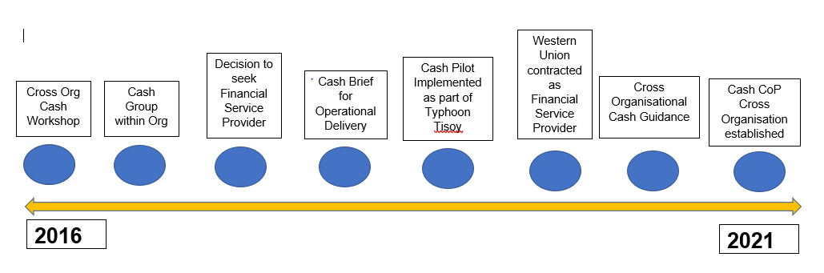
ShelterBox. Cash thinking.

Slide 6
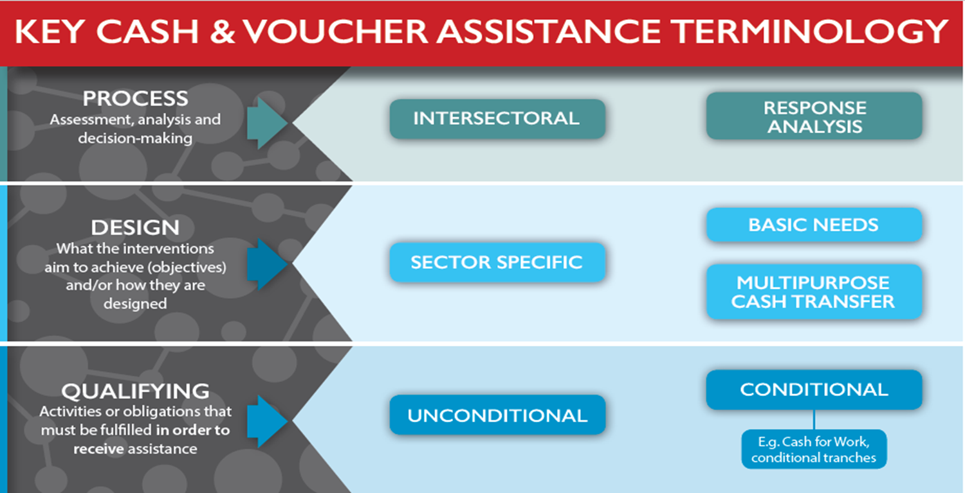
ShelterBox. Focus to what we do.
Conditionality

Slide 7


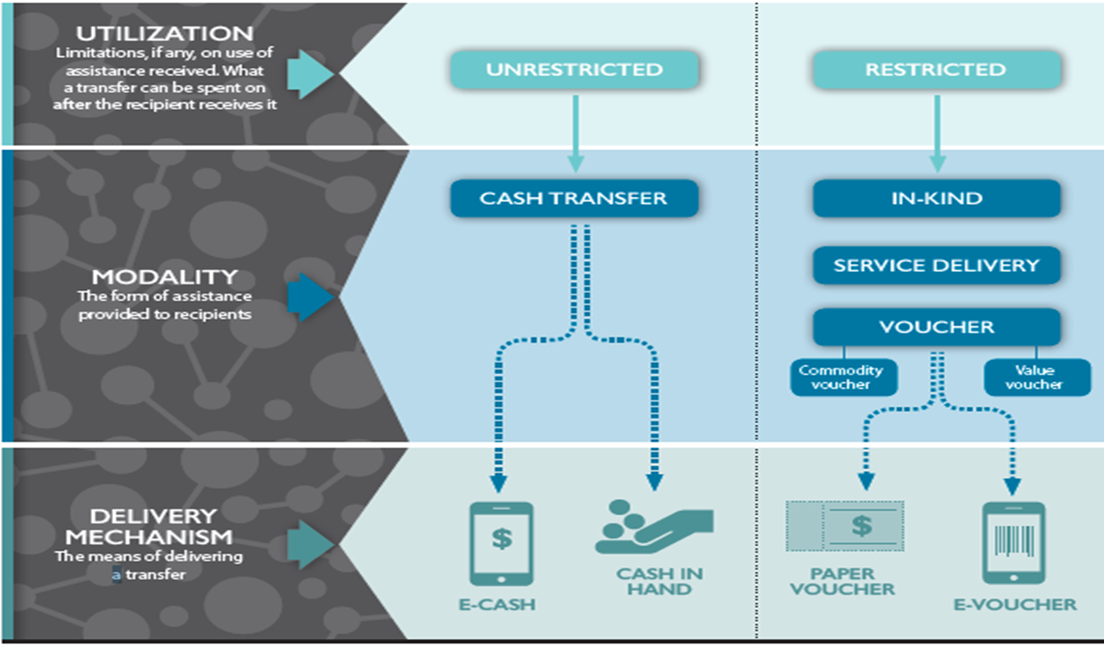
ShelterBox. Focus to what we do.

Slide 8
ShelterBox Operations – CVA Guidance
DOCUMENT FRAMEWORK
The document is set out in five sections specific to CVA within ongoing and potential projects / programmes.
Section One | Checklist for Action
Section Two | Key Terms and Definitions Complementary Cash Assistance for Shelter – Examples Cash Transfer Delivery Options
Section Three | Summary of Considerations
Section Four | Risk Considerations – CVA Focus
Section Five | Market Assessment – Complementary Cash Assistance for Shelter Focus

Slide 9
ShelterBox Operations – CVA Guidance

Slide 10
ShelterBox Operations – CVA Guidance
Transfer Options
Option 1 – Cash in Envelopes by Reactive Team / Partner.
Option 2 – Cash collection at designated cash out point / Agent.
Option 3 – Cash in Envelopes by financial institution
Option 4 – (e) Electronic Transfer

Slide 11
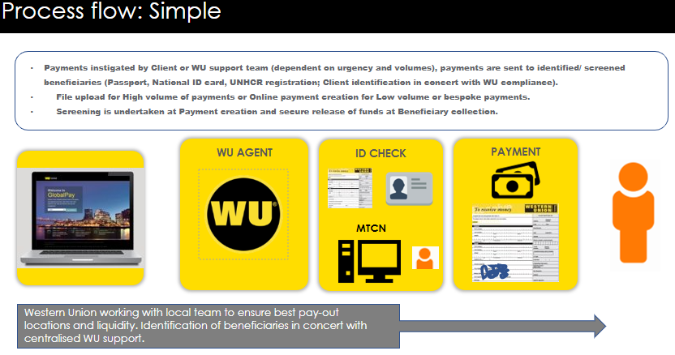
ShelterBox Operations – WU Onboard
Onboarding now completed. Account now fully open.

Slide 12
Delivering the pilot
Typhoon Tisoy, Philippines

Slide 13
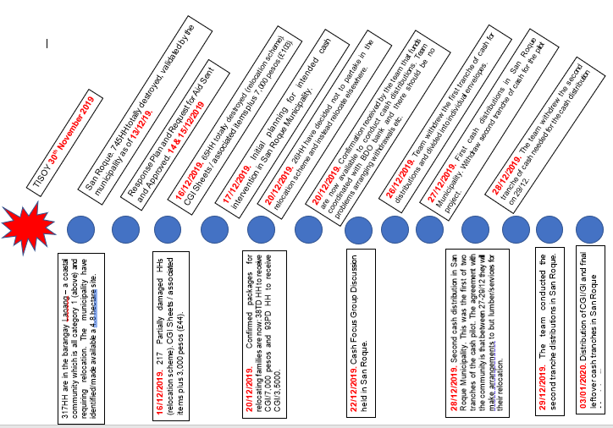
27 days from disaster to first cash disbursement

Slide 14
OVERVIEW
Complimentary cash component
Tailored packages
Transfer values agreed with Local Government
Approval to response two weeks after disaster
Goal: assist families in their shelter reconstruction process, relocating away from the danger (no-build) zone. Cash to complement the gifts in kind, filling gaps in what we provide
Cash is restricted at the outcome level: eligible purchases must be related to relocation and reconstruction. Evidence of these will trigger the release of the second tranche.
Outputs could include lumber, plywood, tools, carpentry services, transport, etc.

Slide 15
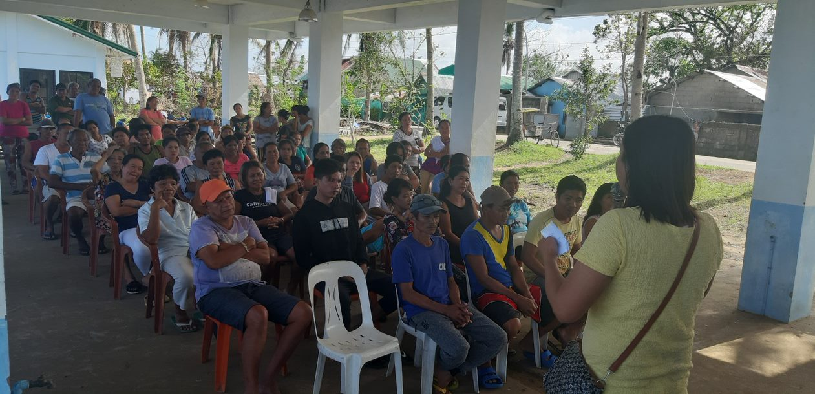
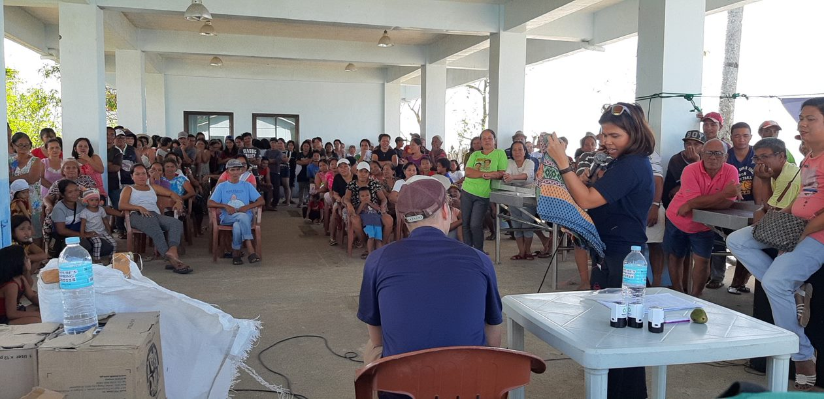
MARKET ASSESSMENTS, TRANSFER VALUES, MOBILISATION, PROMOTION & MONITORING

Slide 16
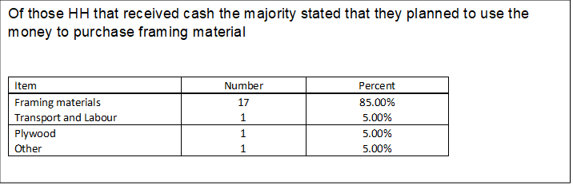
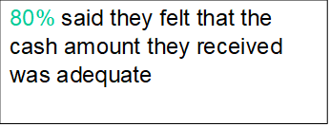
PDM RESULTS
Notes:
Reference how global MEAL framework is and needs to change.

Slide 17
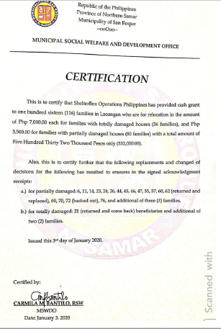
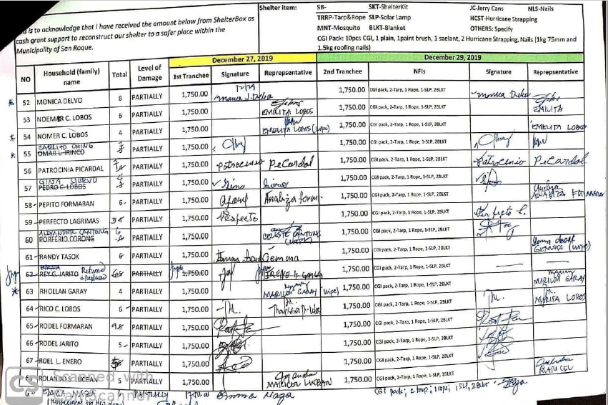
RECONCILIATION AND CONTROL

Slide 18
INNOVATION
Mobilising CVA for a shelter specific outcome within 27 days of disaster.
Proven conditional restricted (labelled) cash in emergencies set to a specific sector. Not multi purpose unrestricted assistance.
Complementary packages. In kind and cash in envelopes (two tranches).
Ability to flex case loads – families to be assisted through continual community consultation process. Through process numbers who opt in and out to relocation / assistance through ShelterBox changed.

Slide 19
Breakdown of spending behaviour

Slide 20
Cash support mechanism
In terms of the process for receipt and validation of the 2 tranches of cash, 88% of respondents stated that the system was easily accessed and did not impose any additional anxiety.
“Two tranches is a good process as it avoids temptation to spend money on other priorities as you have to show a receipt. “
Male respondent FGD 09.03.20
“Two tranches made me feel safer collecting the money.”
“2 days is just enough time between collection.”
Female respondent FGD 08.03.20

Slide 21
Cash support mechanism
PDM data shows 69% of respondents were happy with the time allocated to provide receipts. Of those that would have preferred more time, 3 to 4 days was considered more realistic.
General commentary around the distribution itself was positive.
“Distribution was systematic and felt respected. Only at the distribution did people feel they could express their feelings.
Information was clearly displayed/ delivered, and they were properly informed. It was not a hinderance to their day.
    Summary of FGD notes

Slide 22
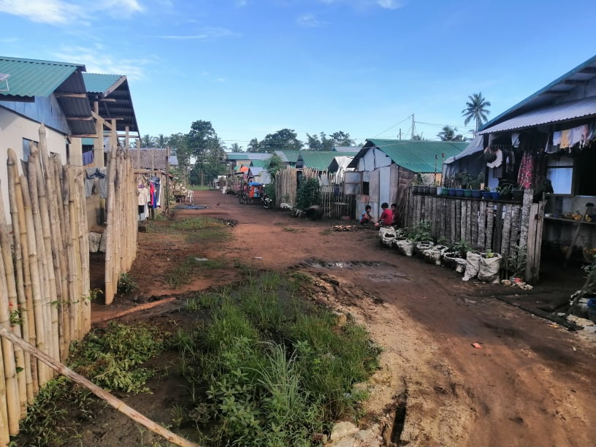
Tisoy – One Year On

Slide 23
Tisoy – One Year On

