Slide 1
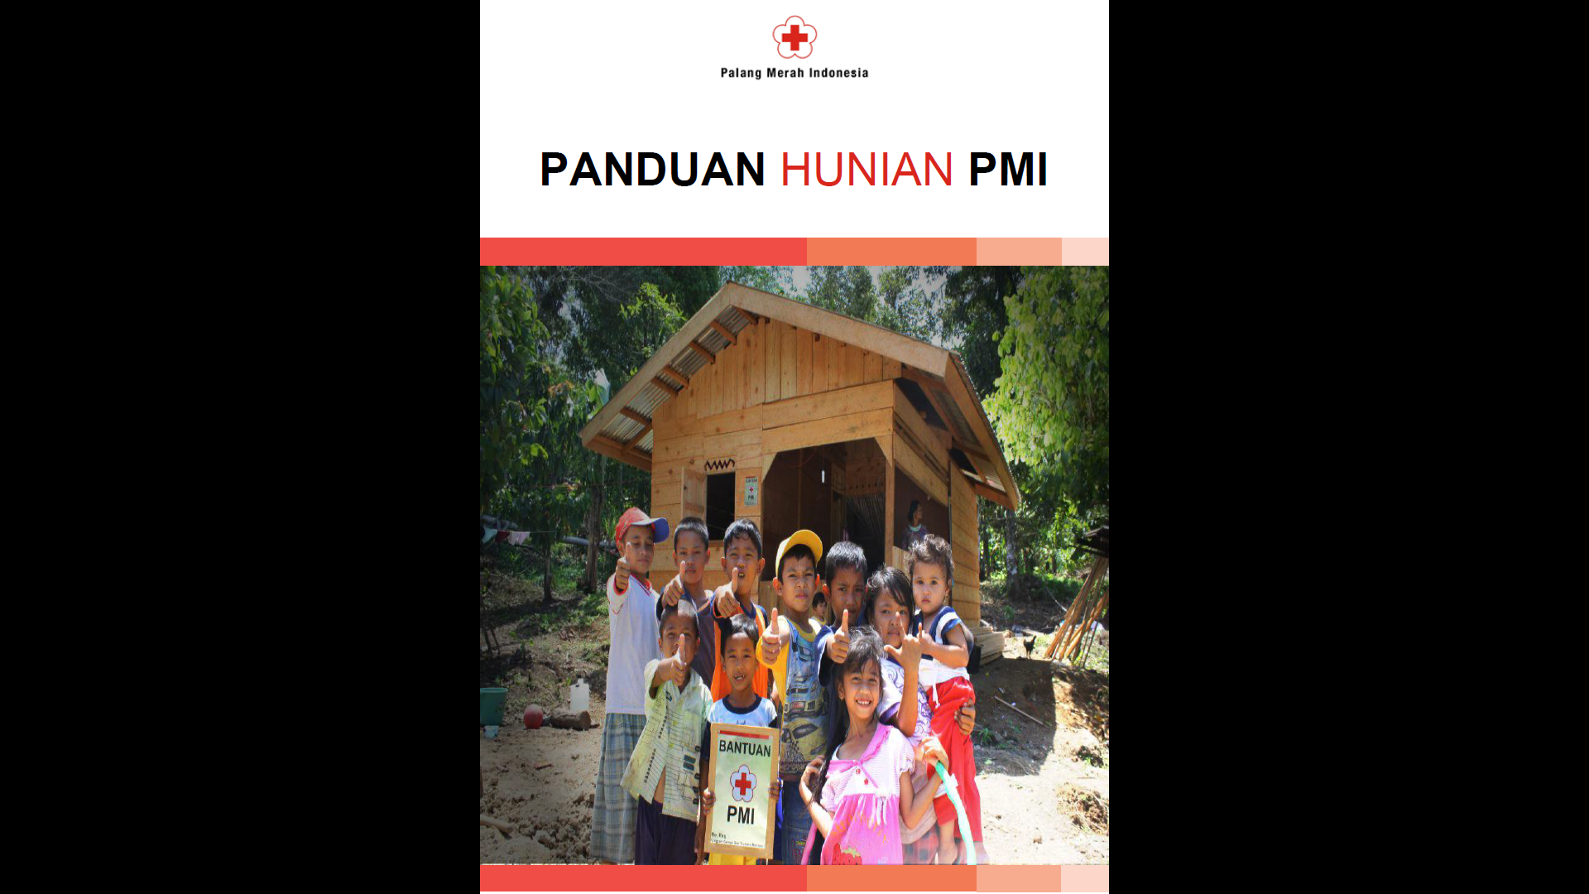

PMI Shelter Manual Review
Background
Originated as part of a Danish Red Cross/PMI Preparedness program for one province
Designed
Through interactive process with PMI
To support trainings
Completed to first draft stage
Currently being reviewed
Likely to be adopted as ASEAN competency
Need input!

Slide 2
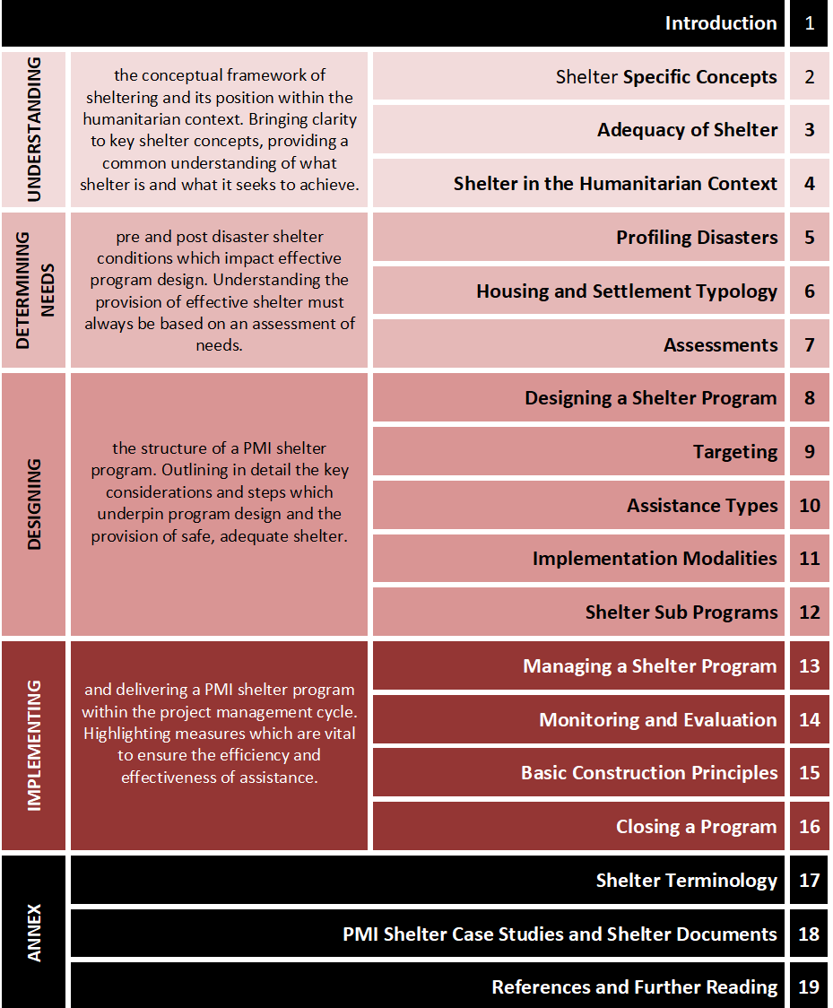
Structure
B5, binder format
Interactive training tool
5 sections
Understanding shelter issues
Determining needs
Designing solutions
Implementing programs
Annexes

Slide 3
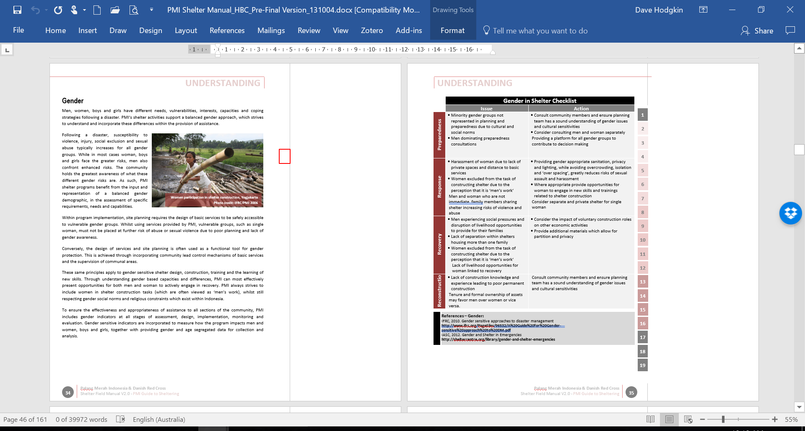
Section design
Each section contains
Summary of issue
Checklist tool
Reference
Designed to be used interactively as part of trainings

Slide 4
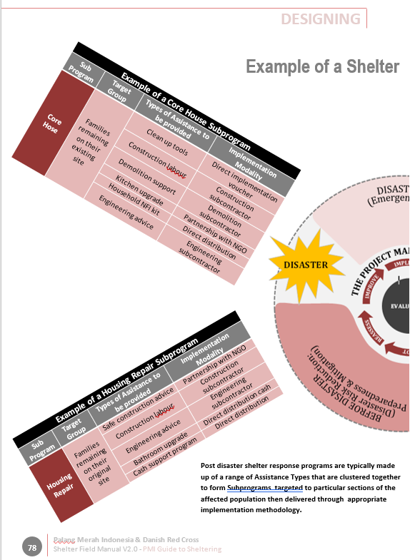
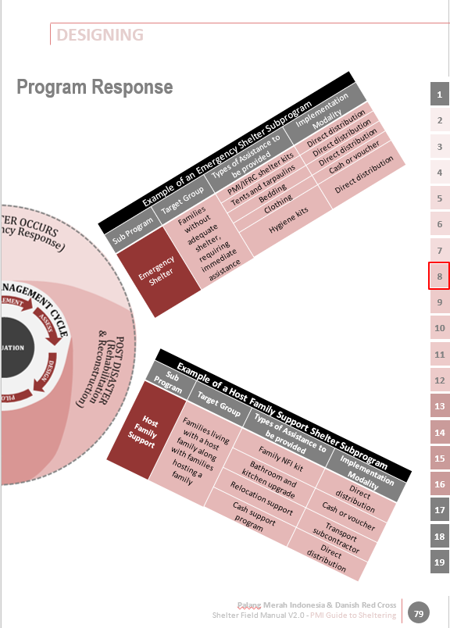
Examples
Design Section

Slide 5
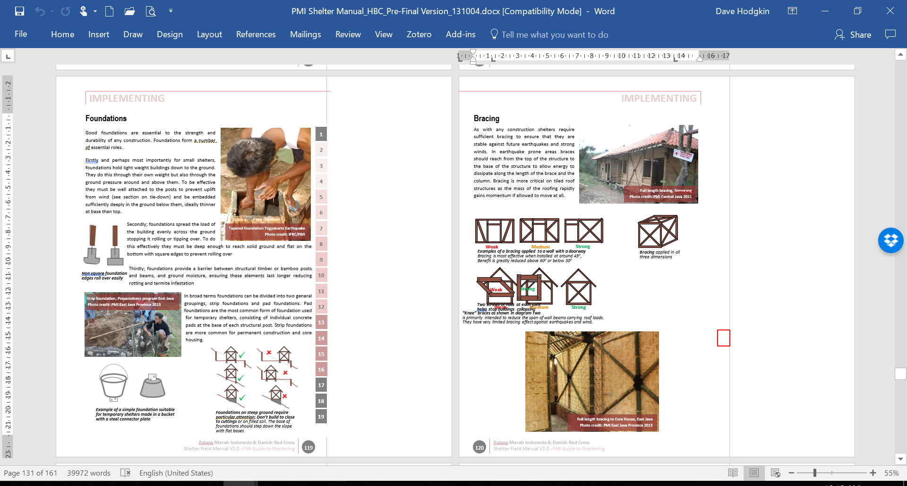
Implementation Section

Slide 6
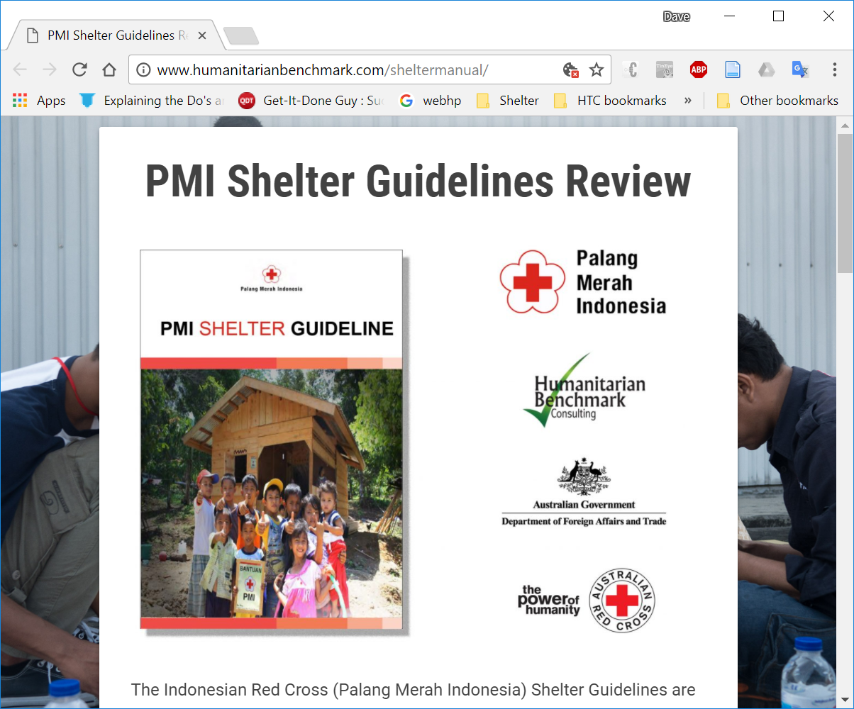
Current Status
Undergoing three stage review and update
Proof, update and finalisation of original document for use by PMI
Update for use by National Cluster
Revise for regional or broader use
PLEASE NOTE: Very much a draft!
http://www.humanitarianbenchmark.com/sheltermanual/

