Slide 1
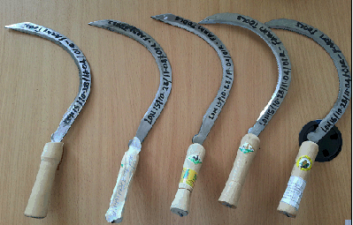
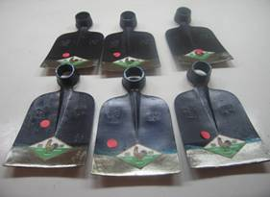
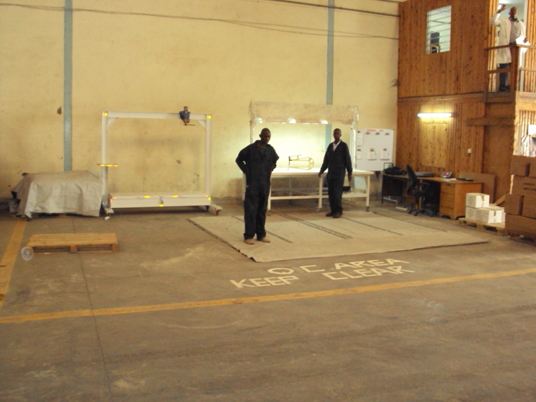
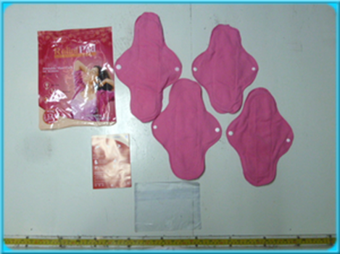
QUALITY CONTROL FOR NFI
Global Shelter Cluster Workshop Nairobi

Slide 2
Some key definitions
Quality product (& service) is the degree in which customer requirements are met.
Product minimum requirements (specification) are used to define product quality level;
Product minimum requirements have to be defined in procurement contracts;
Product minimum requirements allow Quality Control to have a reference for quality inspection

Slide 3
Some key definitions
Quality Control (QC) consists of activities of detection of the variability in the specifications of product (&service).
QC insures “we are getting what we pay for”;
QC prevents over-invoicing from suppliers;
QC includes corrective responses

Slide 4
Some key definitions
Quality Management (QM) consists not only on product quality (and goods testing) but also on the means to achieve it.
It includes establishment of
Quality policy and objectives;
Documentation management;
QC processes;
Quality, Social and Environmental manufacturer’s audit and assessment;
Improvement of procurement processes efficiency.

Slide 5
Some key definitions
Critical nonconformity:
Any discrepancy which might harm a user, or makes it impossible to use the product properly, is considered to be “critical” .
Major nonconformity:
Any discrepancy which makes the use of the product less efficient than expected, is considered to be “major”.
Minor nonconformity:
Any discrepancy which does not have an influence on the performance of the product, is considered to be “minor”.

Slide 6
Main Steps of the Procurement process
Items specifications
Manufacturer sourcing
Tender
Manufacturer's audit (or assessment for local purchase)
Manufacturers short list
Samples analysis (lab and/or internal QC)
Placing Purchase Orders
Quality Control
Manufacturer evaluation
Lessons learned

Slide 7

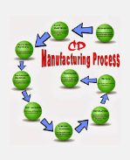

Procurement Process (local purchases and GVA F/A)
Efficient procurement process requires good cooperation between Sourcing manager, Buyers and Quality teams.
Vertical integration (working with known manufacturers ….and not traders) decreases the number of quality issues, allows a better management of corrective actions and nonconforming items found by QC.
ICRC buyers are encouraged to use EHI GVA Frame Agreement done by GVA (whole procurement process managed according to Policy and procedures).
Regarding local purchase (items not under GVA F/A) the same approach should be implemented by buyers… if not the risk of getting goods of poor quality increases..

Slide 8
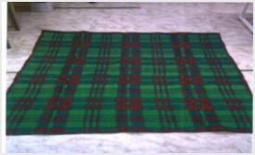
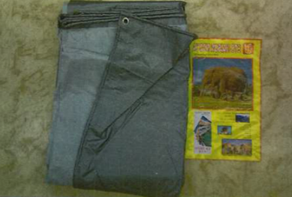
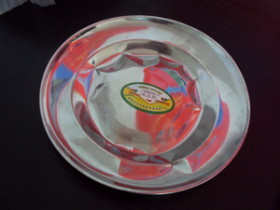
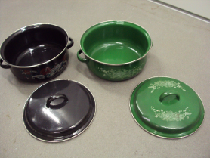
Examples of nonconforming items found by QC on EHI purchased locally through traders:
BLANKET
Unsafe combustion behaviour, flaming ingition
TARPAULINS
Tensile strength: 322 N (Specification: Minimum 500N)
UV resistance: after 250 hours UV exposure: 78% loss strength (Specification: after 1500 hours UV exposure: 20 % loss strength maximum)
KITCHEN SET
Not food grade: chromium content is too low and cadmium concentration is above the permissible limit.
Item will rust quickly because of poor protection by chromium.
Handles not suitable for the carrying and holding of frying pan (bending test fails at 1.5 kg. Specification: minimum requirements: 10 kg).

Slide 9
ROLE OF QC IN NFI PROCUREMENT PROCESS
When purchasing locally the objective of QC team in Logistics Centre is to support Buyers during the whole process (same approach as in GVA for international tenders):
Item specification development
Samples Analysis
Suppliers Assessment
Item testing at the time of receipt into the Warehouse
Corrective Action follow up

Slide 10
Main Steps of the Procurement process (local purchase)
Items specifications

Slide 11
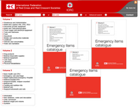


SPECIFICATIONS DEVELOPMENT
Definition of specification
Minimum requirements
NFI Specifications are based on the following
ICRC/IFRC Catalogue
ISO Guidelines
National standards regulatory body e.g. KEBS
Market analysis

Slide 12
CHARACTERISTIC OF A GOOD SPECIFICATION
Meaningful to Individuals
Based on Consultation
Attainable and Challenging
Affordable
Published
Used to measure Performance
Reviewed and Updated

Slide 13
SPECIFICATION DEVELOPMENT CHART
Use the specification in the Catalogue
YES
Does the Item Exist in the NFI Catalogue
Review the existing Guidelines and ISO documents to create a list of requirements.
Field Request
Item Name, Use/Function, Location
NO
Review and update the specifications with the prevailing circumstance and the sample evaluation
Approved RFT or RFQ with the new specifications can now be executed
Prepare draft RFT or RFQ and circulate to the concerned for review

Slide 14
IMPORTANCE OF SPECIFICATIONS
Acts as a guideline in selection of the Most competent supplier
Enables procurement officers meet the requesters needs
Informs the QC Inspection parameters during the item inspection
Ensures the Organization achieves Value for Money

Slide 15
Main Steps of the Procurement process (local purchase)
Items specifications
Manufacturer sourcing
Tender
Samples analysis (lab and/or internal QC)

Slide 16
TENDER SAMPLES ANALYSIS AND EVALUATION
Tender samples QC Analysis Gives a comparison based on quality parameters of the degree to which the different suppliers/Manufacturers are able to meet the Request For Tender(RFT) specifications

Slide 17
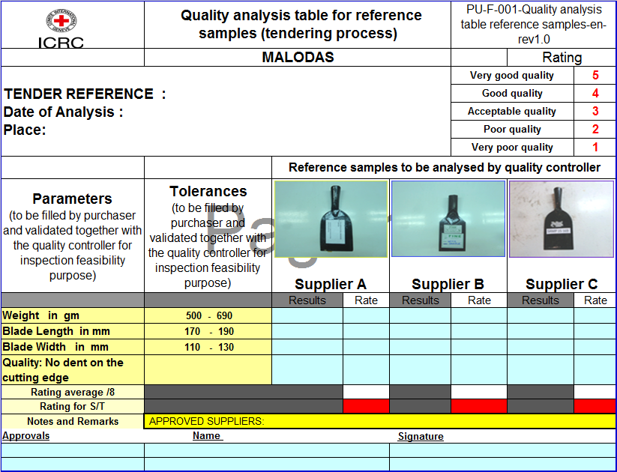
QC SAMPLE ANALYSIS TABLE

Slide 18
Main Steps of the Procurement process (local purchase)
Items specifications
Manufacturer sourcing
Tender
Manufacturer's audit (or assessment for local purchase)
Manufacturers short list
Samples analysis (lab and/or internal QC)

Slide 19
SUPPLIER ASSESSMENT/VISIT PROCEDURE
Pre Assessment/Visit Procedures
Develop the supplier assessment/Visit Checklist
Prepare the supplier Visit/ Assessment Schedule
Identify and Train the Assessment/Visit Team
Communicate to the Auditees(Supplier) and confirm the Visit dates and scope.
Assessment/Visit Procedures
Opening briefing with the auditees
Site Visit while documenting the Observations and following the supplier process flow
Wrap up meeting with the supplier

Slide 20
SUPPLIER ASSESSMENT/VISIT PROCEDURE Cont………
Post Assessment/Visit procedures
Visit/Assessment report pointing out the Observations
Supplier prepares CAPA(Corrective action and preventive plan) and submits to the Auditors
CAPA close out and conclusion of the process
Successful suppliers can be included in the list for consideration in future tenders

Slide 21
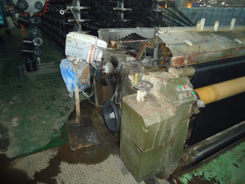
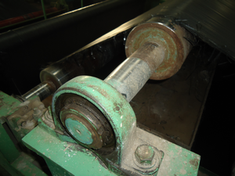
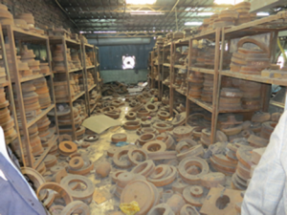
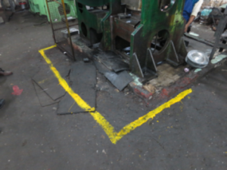
Tarpaulins manufacturer visit further to QC findings
Kitchen sets manufacturer visit further to QC findings
No more nipple on this bearing

Slide 22
Main Steps of the Procurement process (local purchase)
Items specifications
Manufacturer sourcing
Tender
Manufacturer's audit (or assessment for local purchase)
Manufacturers short list
Samples analysis (lab and/or internal QC)
Placing Purchase Orders
Quality Control

Slide 23
ITEM TESTING ON RECEIPT AT THE WAREHOUSE
Item testing on receipt at the Warehouse follows 3 steps
AQL Sampling and control
Quality Inspection
QC Inspection report follow up and Eventual case close out

Slide 24
ACCEPTABLE QUALITY LEVEL(AQL) SAMPLING
AQL is the statistical measurements of the Maximum number of defective goods considered acceptable in a particular sample size
Rejection Number : The minimum number of defects or defective units in the sample that will cause rejection of the lot represented by the sample.
AQL DEFINITION
AQL 0 means no nonconformity on the parameter inspected is accepted.
AQL 4.0 means max of 4.0% of nonconforming products accepted on the parameter inspected in average.
AQL 6.5 means max of 6.5% of nonconforming products accepted on the parameter inspected in average.

Slide 25
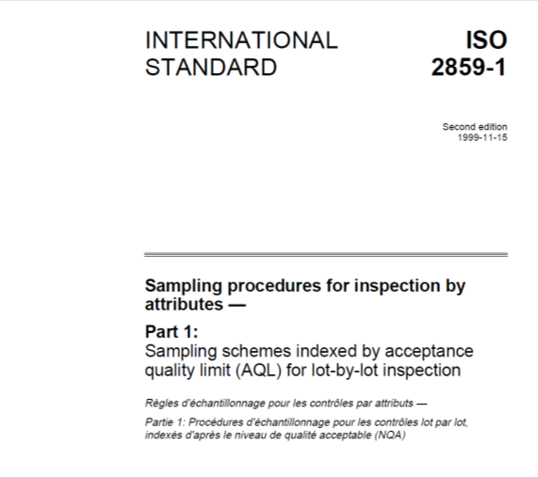
Documentation and sampling plan made according to ISO standard 2859

Slide 26
QC key points
QC implementation (4 steps): documentation, equipment, training, inspection.
QC process does not slow down the supply chain (by using appropriate inspection level).
QC is based on a physical control by internal controllers and/or laboratories (UV test…).
QC inspection reports must be of high quality (suppliers use any QC report mistake to gainsay the findings).
QC is one of the last steps of the procurement process, which is the detection of non-conformities (comparing purchasing contract requirements and goods provided by suppliers).
Notes:
26

Slide 27
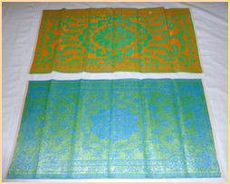
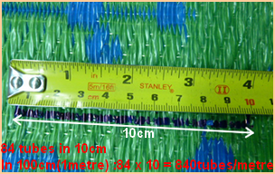
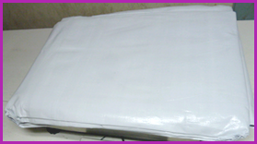
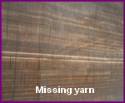
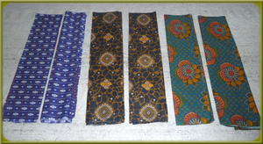

Some NFI’s and the Nonconformities Observed during QC Inspection

Slide 28
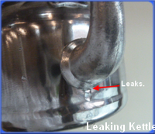
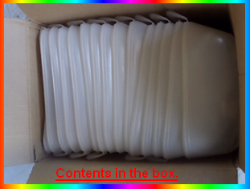
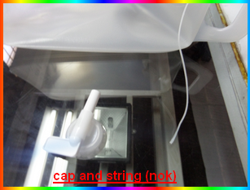
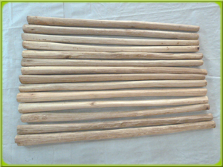
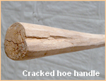
Some NFI’s and the Nonconformities Observed during QC Inspection

Slide 29
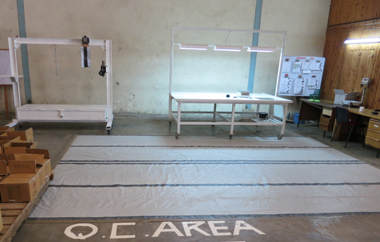
Thank you
Notes:
29

