Slide 1
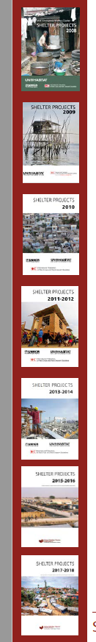
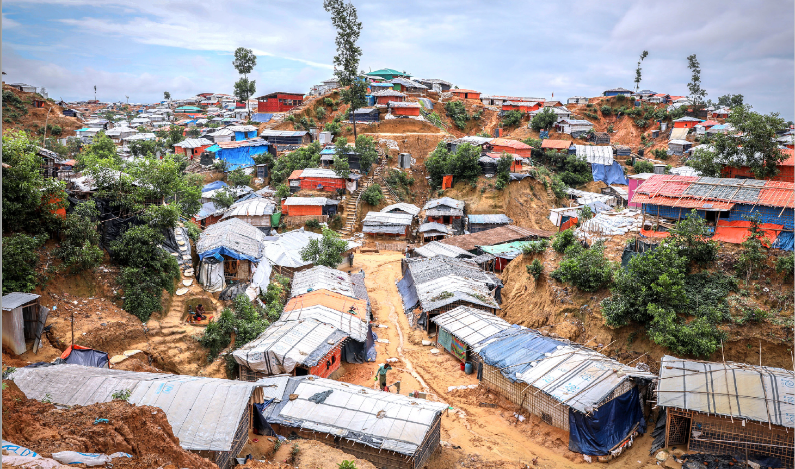

Shelter Projects
Case studies of humanitarian shelter and settlement responses
Laura Heykoop

Slide 2
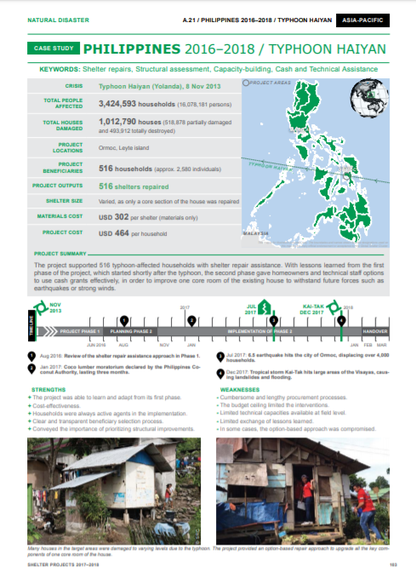
What is Shelter Projects?
Compilation of case studies, now in its 7th edition
Over 250 case studies and overviews, 80 countries
Truly collaborative effort: over 400 contributors
Overall objective: learning from past experiences
Building a body of evidence for the sector
Multiple audiences and uses (training, workshops, advocacy, informing strategy development, research)
Projects are presented anonymously
Series of thematic booklets

Slide 3
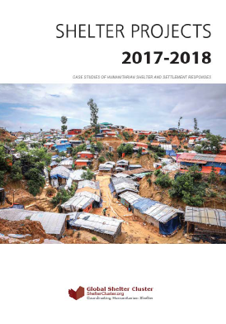
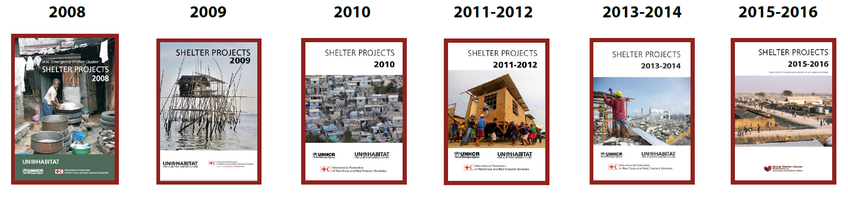
Shelter Projects Editions
2017-2018

Slide 4
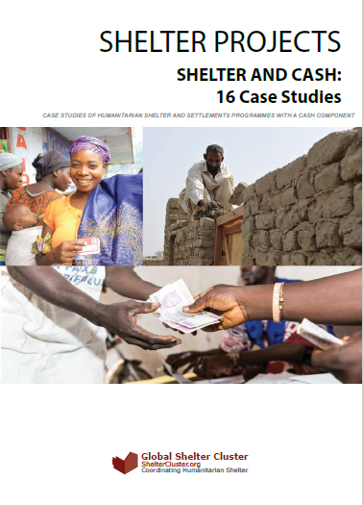
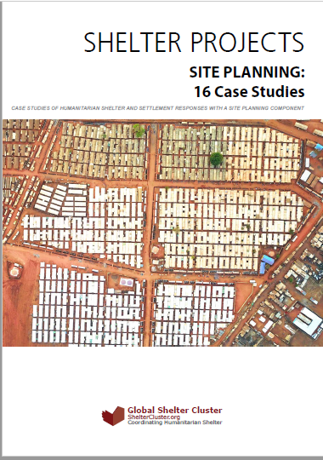
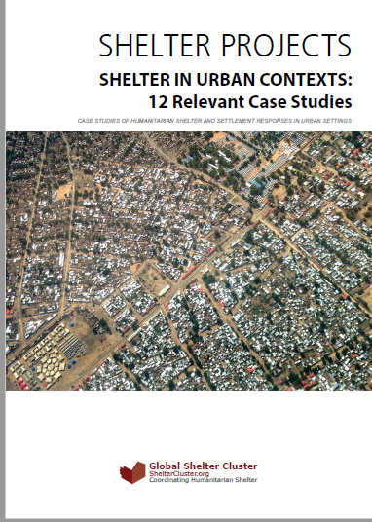
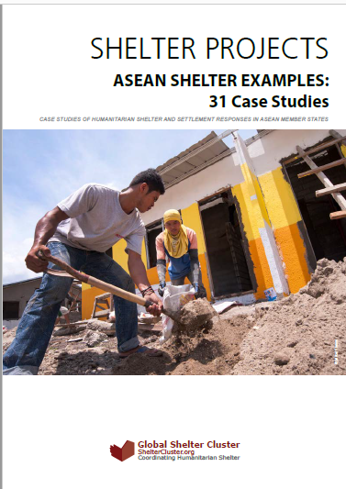
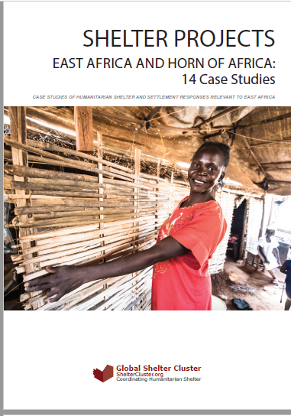
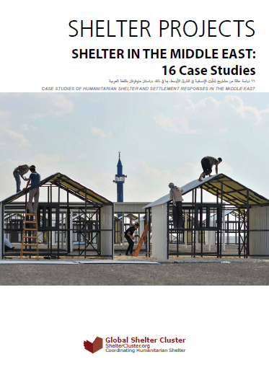
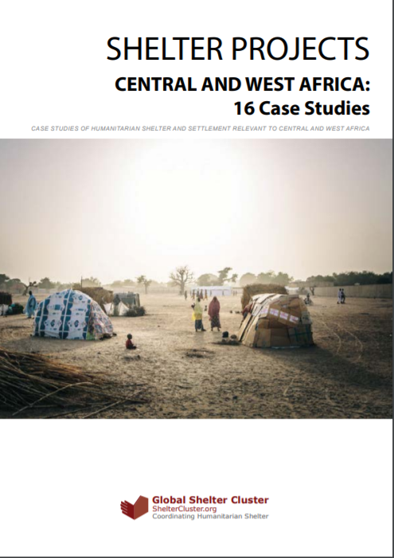
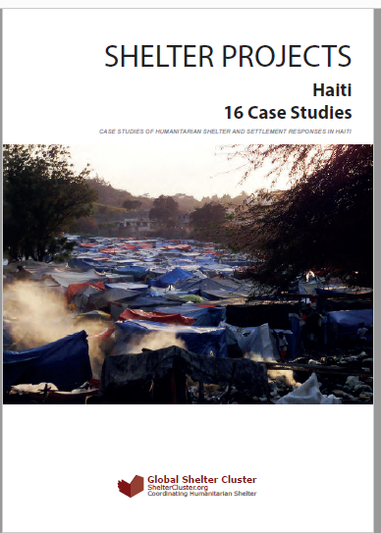
Thematic Booklets
Cash
Site Planning
Urban
ASEAN
East and Horn of Africa
Middle East
Central and West Africa
Haiti

Slide 5
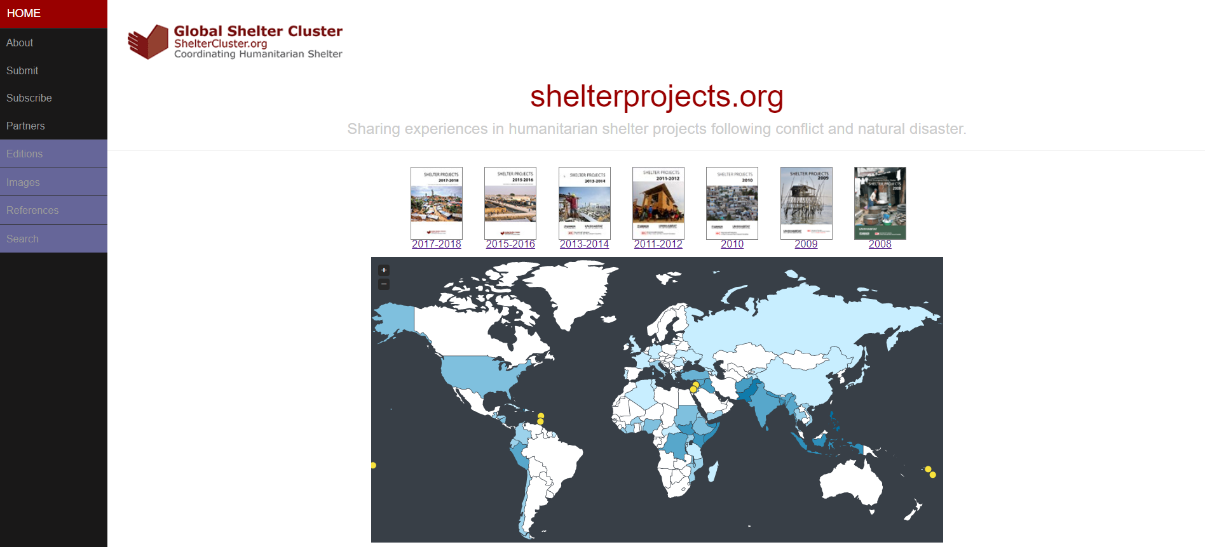
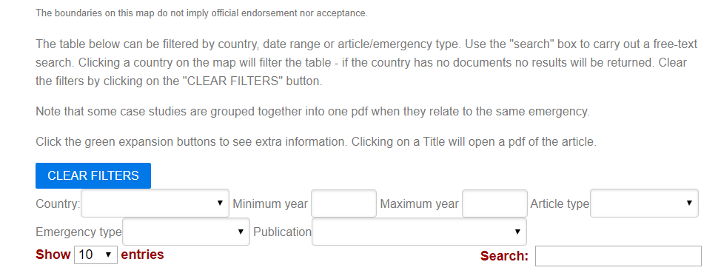
www.shelterprojects.org

Slide 6
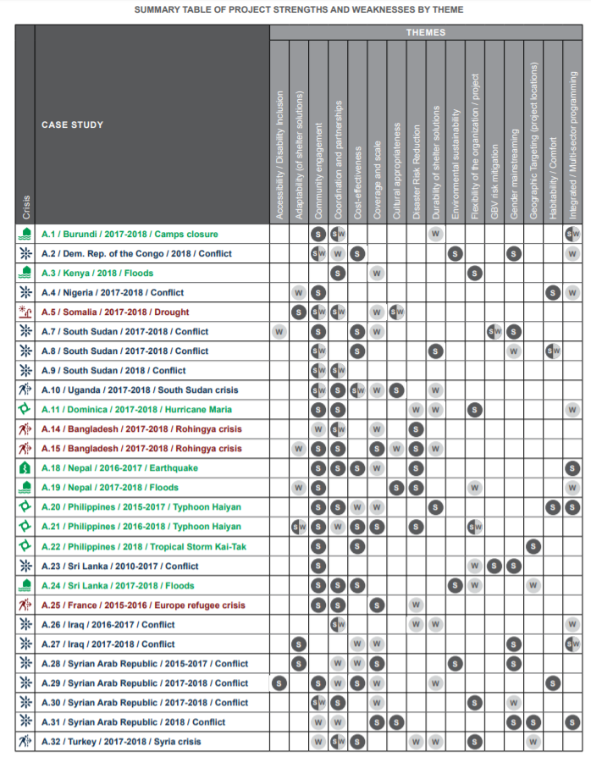


Disability inclusion

Slide 7
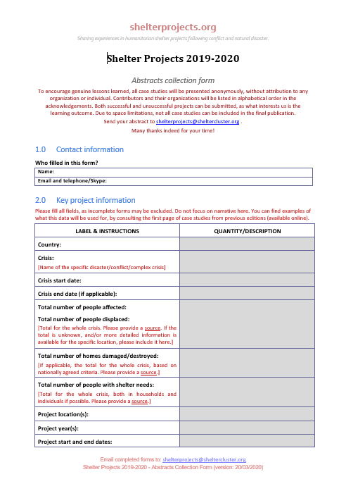
CALL FOR ABSTRACTS!
(now closed but can make exceptions)
Do you have projects that could be included as case studies in the next edition?
www.shelterprojects.org/submit.html
Get in touch:
shelterprojects@sheltercluster.org
lheykoop@iom.int

