Slide 1
Subnational Cluster Meeting
20th December
Sloviansk

Slide 2
Action Points from Last Meeting
Action Point | Who | By when
Agencies to update Specific BoQ | Agencies conducting Structural Repairs and Reconstruction Projects | Before next cluster meeting- Precision post meeting: ICRC provided
Cluster to provide specific mapping products on gap analysis for winterization | Subnational Cluster meeting | After meeting- Precision post meeting: Done
Updates on damage database | PUAMI provide specific addresses from their report and agencies to update their activities in line with the 5W | Before next cluster meeting

Slide 3
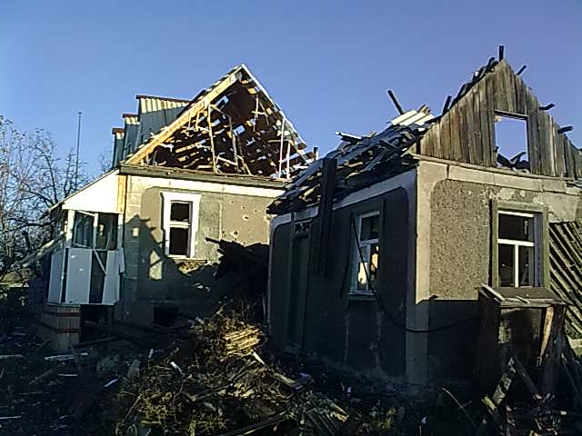
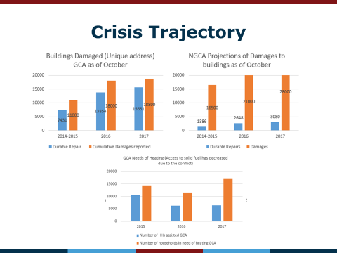
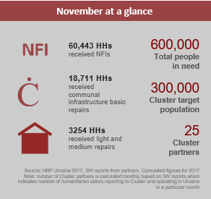
November Factsheet
Training on Damage Database for local authorities
TWIG on Structural and Reconstruction
HRP 2018 Shelter/NFI specific update
Upcoming Winterization New Year Update

Slide 4
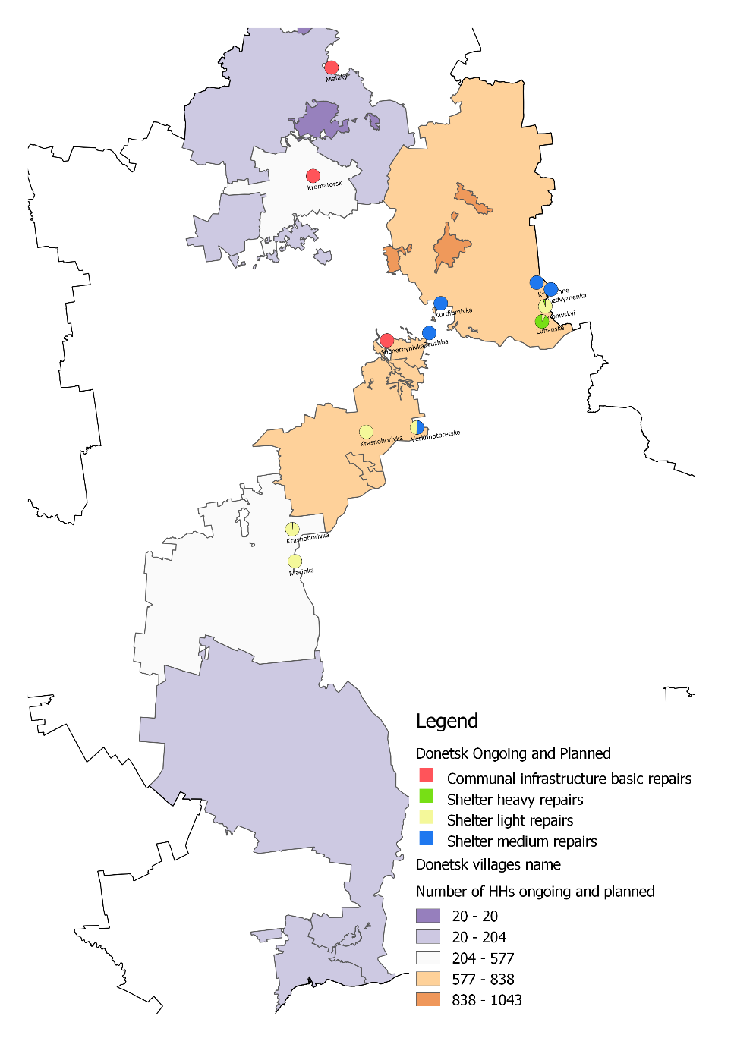

Slide 5
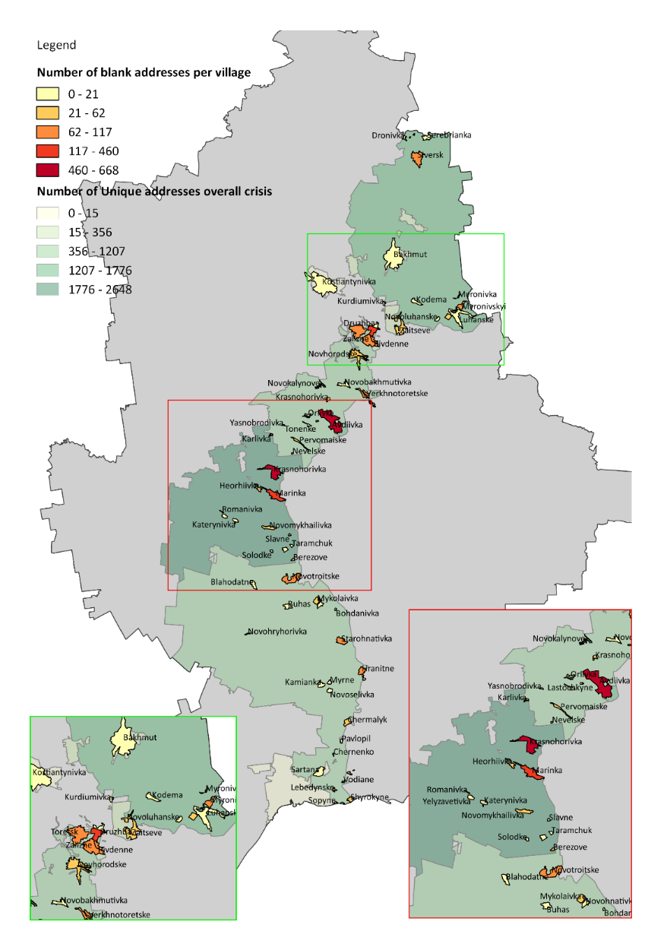
Damage Database Updates Donetsk

Slide 6
Donetsk Winterization

Slide 7
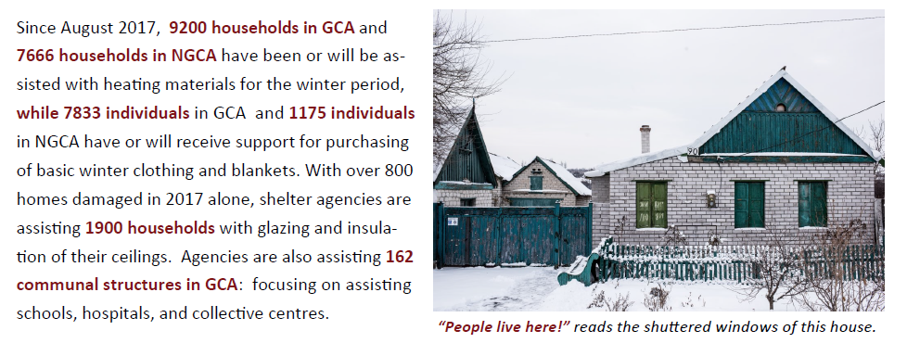
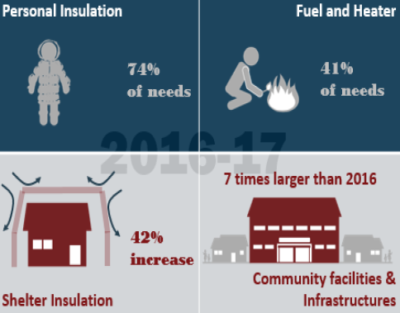

Slide 8
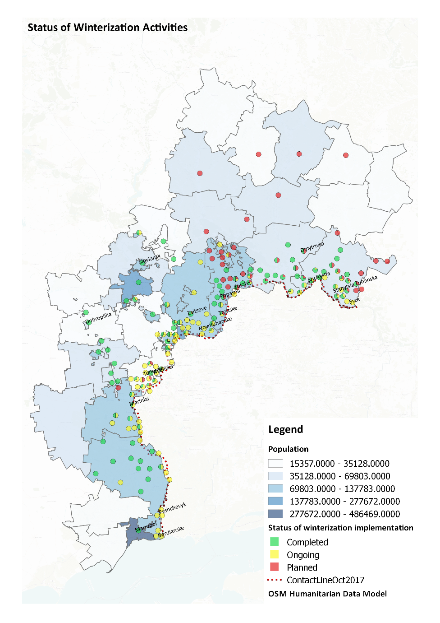

Slide 9
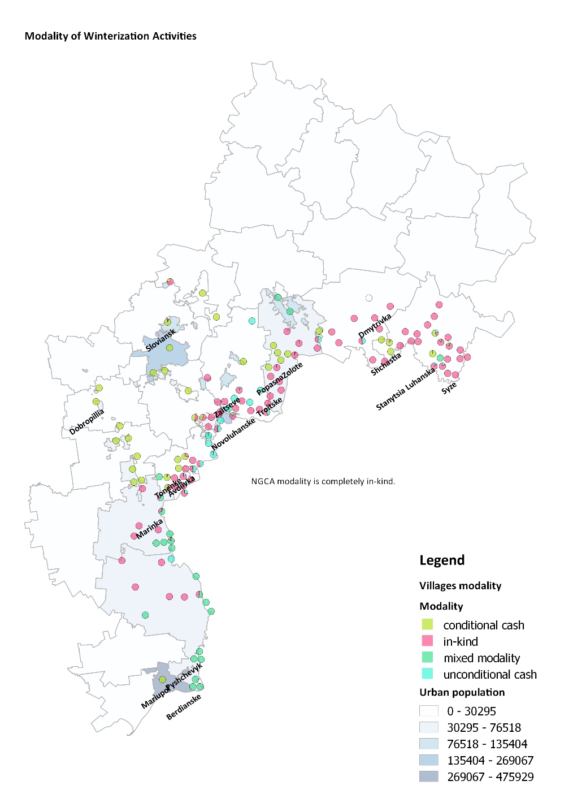

Slide 10

Global Shelter and WASH Cluster Position Paper on Cash and Markets
Common commitment to scale up use of cash transfers
More opportunities for collaboration between cash and markets community and WASH/Shelter specialists
More resources to develop required cash transfer and market sector skills
Technical support from cash and market specialists and development actors to enable WASH and Shelter actors to implement cash projects at scale
Guidance in developing M&E frameworks to examine short and long-term implication of cash transfer and market-based programming on detailed technical outcomes
Broader sectoral collaboration at global and country levels both in the sector and in cash working groups
Recognition from cash and donors that developing this expertise in WASH and Shelter specific markets requires time

