Slide 1





The Case for using Cash

Slide 2
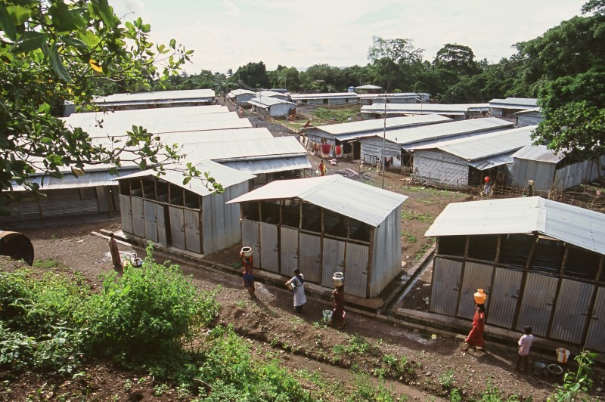
Aim
To present the case for considering using cash transfer as a modality in emergency response

Slide 3
Session components
Introductions
What is it?
Perceptions
Why use it?
Specifics of cash and shelter

Slide 4
Session components
Case studies
Challenges
Lessons learned
What needs to be done?
References

Slide 5
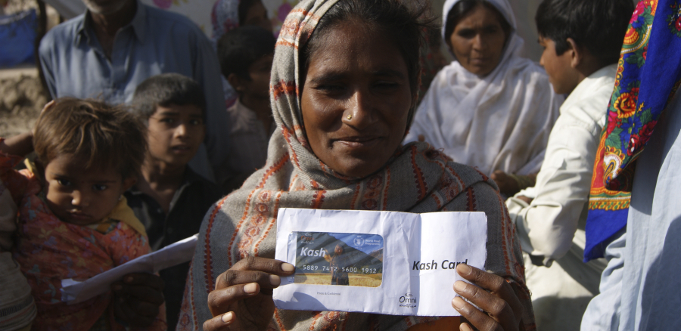
What is cash transfer?
WFP/Amjad Jamal

Slide 6
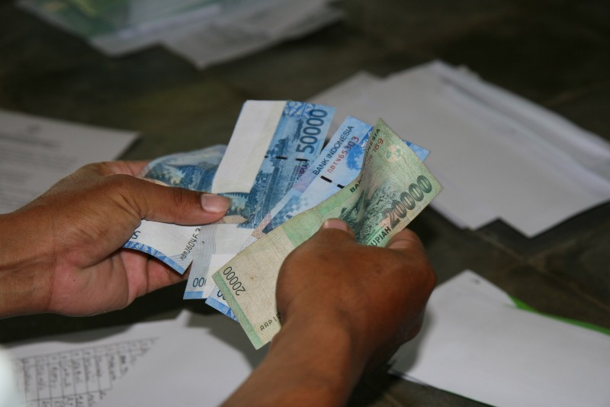
Cash transfer?
Key point!!
Cash and vouchers are a modality for addressing needs and achieving objectives
Cash transfer is not a programme in itself
“Cash interventions transfer resources to people by giving them cash or vouchers” (ODI Good Practice Review)
Notes:
There is growing experience with cash based responses and more all the time. Wide variety of contexts – all types of emergencies, many different ways of giving people money and many different actors involved
Cash grants, cash for work, conditional cash transfers, community grants, vouchers for seeds, livestock, shelter.
The experience reviewed so far suggests that cash programmes can be effective and they have been largely positively evaluated.
Often they have been seen as more cost effective, allowing people greater choice and dignity, creating greater multiplier effects in local economies
And the fears about cash have not been realised. Use has not been anti-social, people have spent the money sensibly, women have been able to have a say in how the money is used, it has been possible to deliver it safely and there have not been major problems of security or corruption. Innovations around use of remittance systems.
Some caveats – firstly most evaluations are positive – need for more rigorous research. Not often implemented on a large scale – questions about both inflationary impact and capacity (e.g Ethiopia safety nets). And times when it will not be appropriate – when markets are disrupted, inflationary effects are likely or insecurity is too high.
Often seen as an alternative but can also be complementary to in-kind approaches.
Ethiopia, Somalia, Kenya, cash playing a role in the Tsunami response, DRC, Ingushetia, Mongolia, Gujarat, Mozambique floods, Afghanistan
But still marginal and small scale compared to in-kind assistance – standardised responses – food aid, shelter, NFIs
Although of course the vast majority of in-kind distributions are in fact a mixture of cash and in-kind assistance because people sell part of what they are given.
Growing interest and experience with cash is coming from 2 directions – use in emergency relief by aid agencies and growing interest in the use of cash in social protection programmes – pensions, conditional cash transfers in Latin America – pilot programmes in southern Africa
Given this largely positive response and strong theoretical case why so much scepticism and reluctance. Cash is peculiarly threatening in all sorts of interesting ways – institutionally, organisationally and in terms of attitudes.
Certainly a potential threat to the role of food aid and the current international food aid system. But also I’ll argue an opportunity which I’ll come back to.
Also, a more fundamental threat to how we construct what we do – rather than deciding what people need – cash implies handing over power, control and responsibility to people to decide themselves.
Also interesting signs of governments seeing a shift to cash as part of an assertion of greater control – Afghan government and the more cash less kind paper, Ethiopia government and PSNP process and Tsunami affected governments.

Slide 7
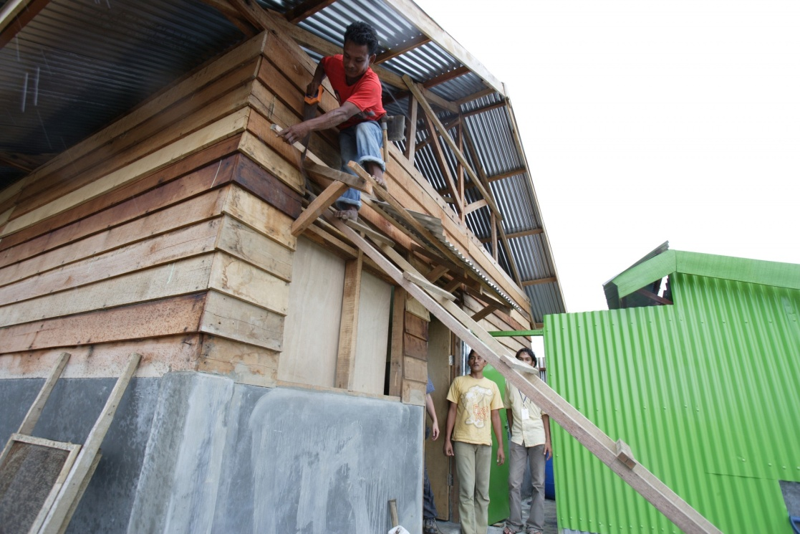
Cash and shelter - modalities
Cash grants (conditional, unconditional e.g. cash for work, staged payments)
Vouchers (cash or commodity based)

Slide 8
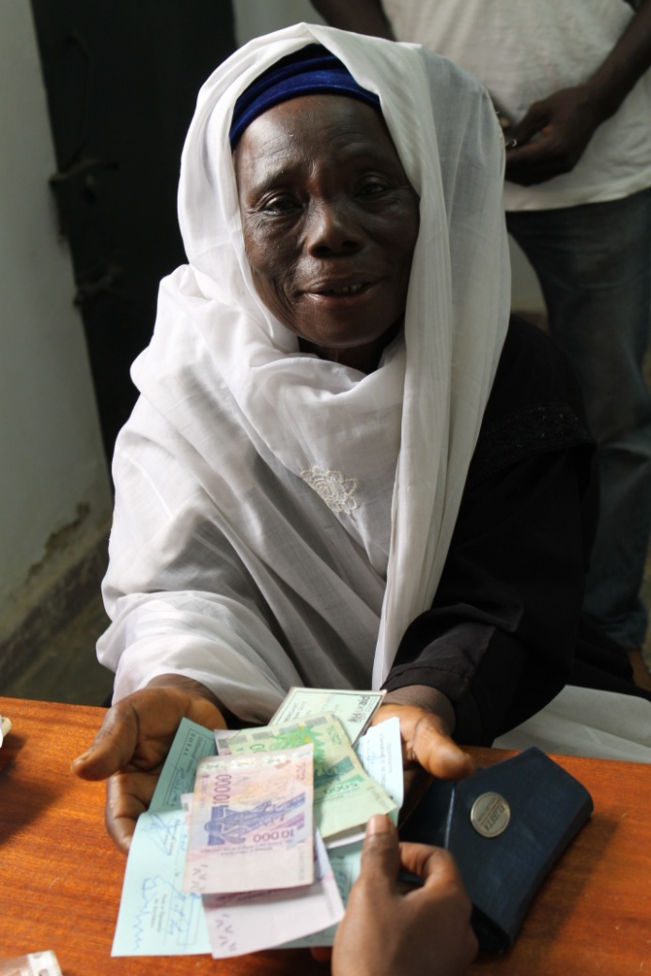
Conditionality and frequency of payments
Cash grants can be given in one payment or in installments depending on:
Project objectives
Security
Cost efficiency

Slide 9
Delivery Mechanisms
Instruments
Cash
Scratch card
Device
ATM
PDA/PC
Channels
Mobile banks
Internet
Cheque
Money Order
Paper Voucher
Mobile phone
Smart card
Shops
PoS Device
Mobile phones
Banks
Merchant/agent
SIM

Slide 10
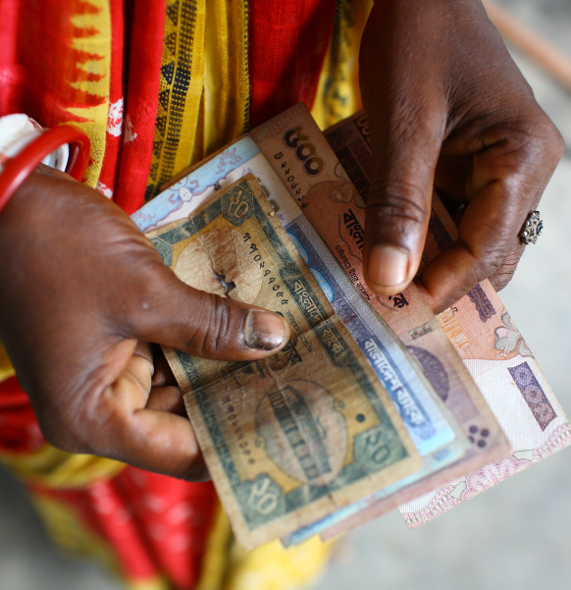
Cash transfers – key message
A new tool, rather than a new approach
Needs to be considered within a context
WFP/GMB Akash

Slide 11
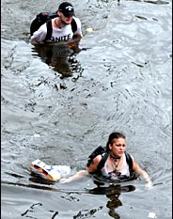
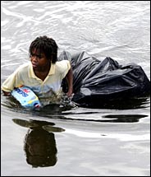
Perceptions

Slide 12
1
“Cash transfer is being considered because it is new and fashionable however it is not suitable for the shelter sector because of the high technical component needed.”

Slide 13
2
2
“It is not possible to implement cash transfer, as part of an emergency intervention, in contexts of conflict.”

Slide 14
3
3
“It is more cost effective to meet shelter needs through cash than in-kind assistance.”

Slide 15
4
4
“Cash is more likely to lead to anti-social use than in-kind assistance.”

Slide 16

Why use cash transfer?
WFPDiego fernandez

Slide 17
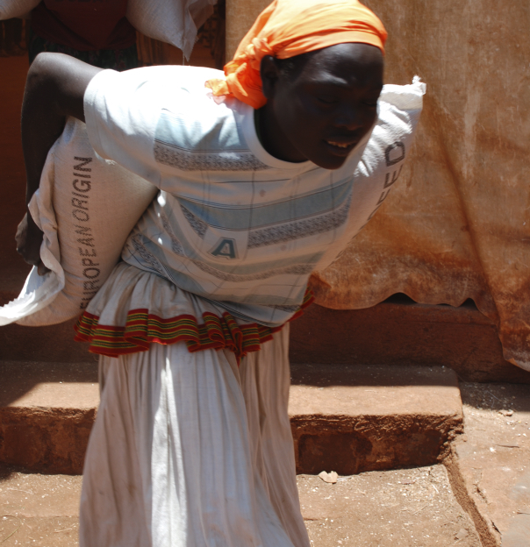
Using cash transfer can provide…
Dignity
Flexibility and choice
Cost efficient for agencies and beneficiairies
Multiplier effects and link with recovery
Support or revitalise local trade and economic recovery
WFP/Judith Schuler

Slide 18
Other examples of benefits of cash-based shelter responses
Support community solidarity through recompensing host families
Encourages people out of camps
Choice in materials or labour to build temporary shelter, rebuild or repair permanent housing
Avoid contractor-driven reconstruction
Families or individuals get a bank account, often with no administration fee

Slide 19
Prerequisites for considering cash
Analysis of:
  Local and regional market systems
  Available delivery mechanisms
  Cost-efficiency and effectiveness
  The prevailing security situation
  The beneficiaries' acceptance of cash and/or vouchers as transfer modality.
Good coordination among implementers and support from donors, governments and local authorities in deploying CTPs.

Slide 20
Prerequisites for considering cash
Political and community acceptance
Availability of well-functioning and reliable financial service providers
Institutional capacity
The presence of qualified staff who can be quickly mobilised
A reliable recipient identification system

Slide 21
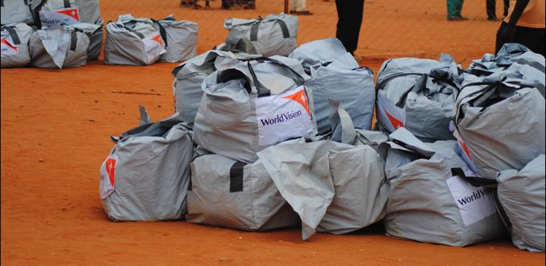
Specifics of cash and shelter

Slide 22
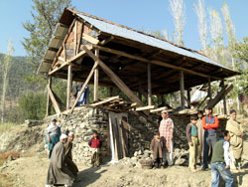
Three key issues
Scale
Quality assurance
Risk

Slide 23

Case studies

Slide 24
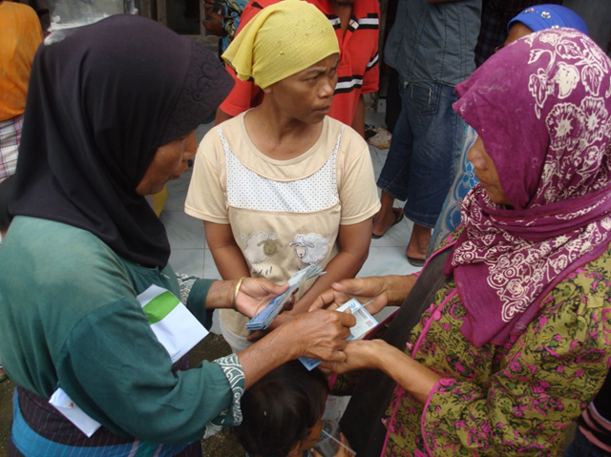
Cash for hosting families (SDC)
Aceh 2005
In Aceh, SDC distributed cash to 7,000 families hosting displaced people in Banda Aceh and Aceh Besar, giving them a one-off cash payment of IDR900,000 (around $100). Payments were made through an Indonesian bank, and were collected by beneficiaries at their local branch. The most common purchases among host families were electricity and food; guest families spent most on food.

Slide 25
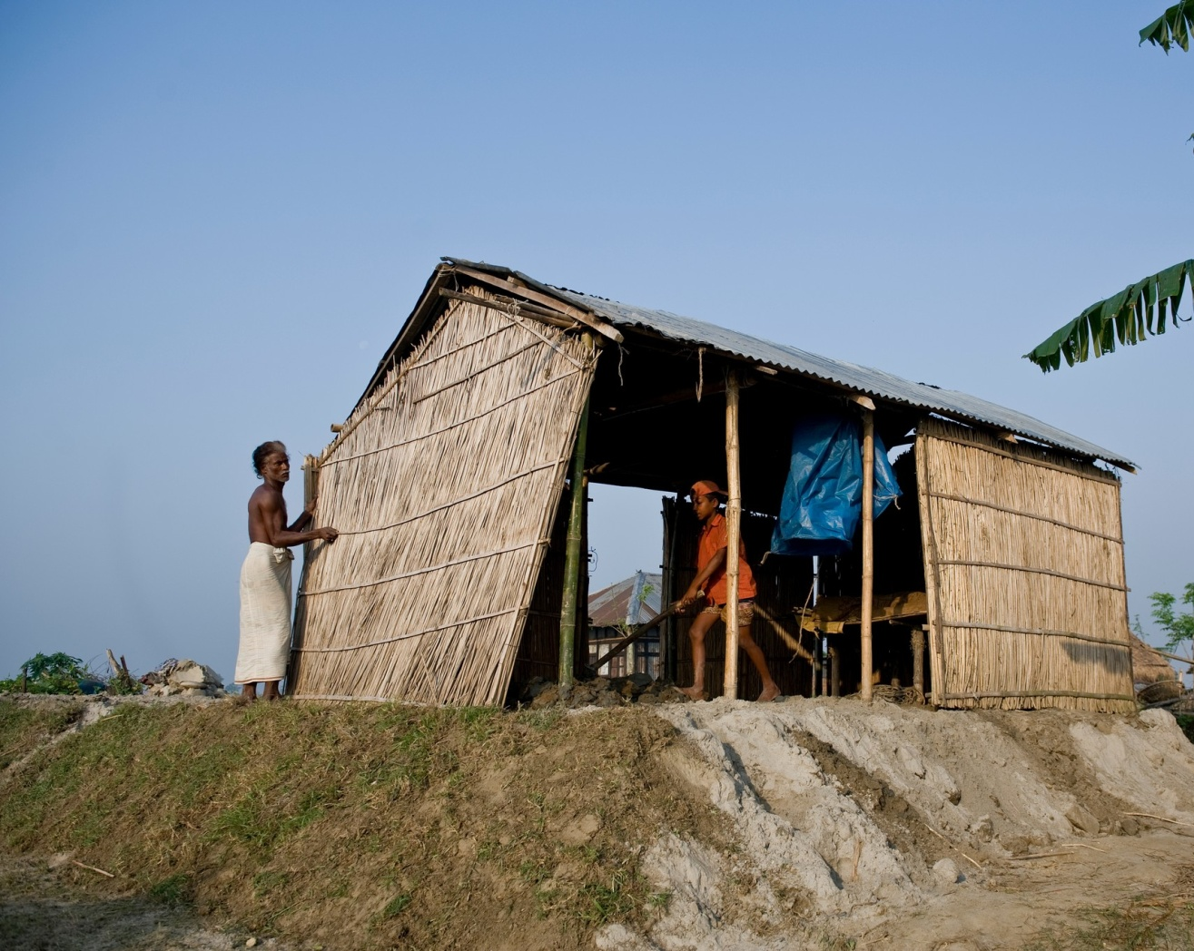
Complementary programme (IFRC)
Bangladesh 2007
In the aftermath Cyclone Sidr, IFRC provided standard, disaster resistant core shelters, along with a cash grant to buy additional materials to further increase the size of beneficiaries’ homes as well as cash grants to strengthen and repair homes.

Slide 26
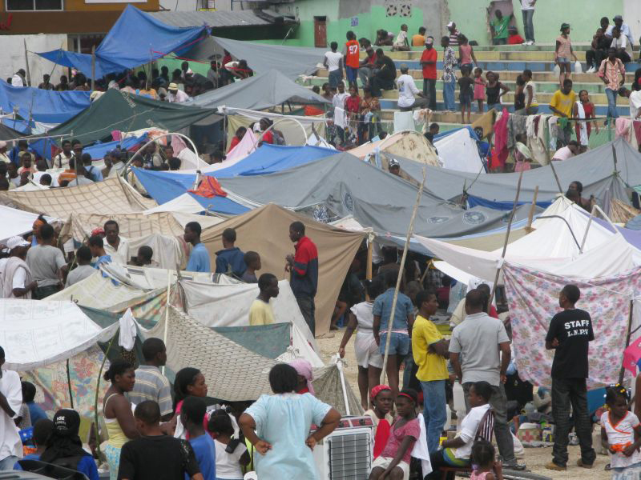
A menu of options - Haiti
Haiti, 2010
After the earthquake the IFRC set up one of the few cash programmes combining shelter and livelihoods and providing people with multiple choices with the objective of supporting households in returning to their places of origin or finding a shelter solution outside of the camp.

Slide 27
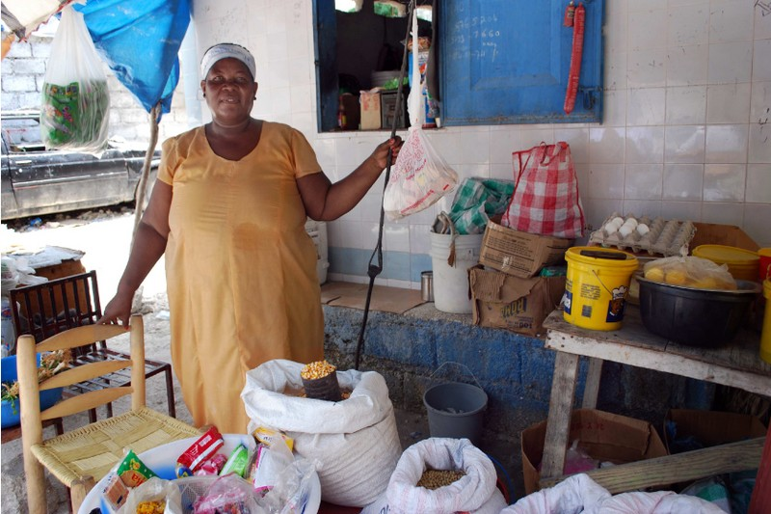
A menu of options - Haiti
Haiti, 2010
It consisted of a menu of options that people can decide from, combining a conditional grant for rents to an unconditional grant for setting up small business and restarting lives in and out of the cities.
Monitoring costs made up more than 60% of the project costs as each rental grant had to be individually monitored.

Slide 28
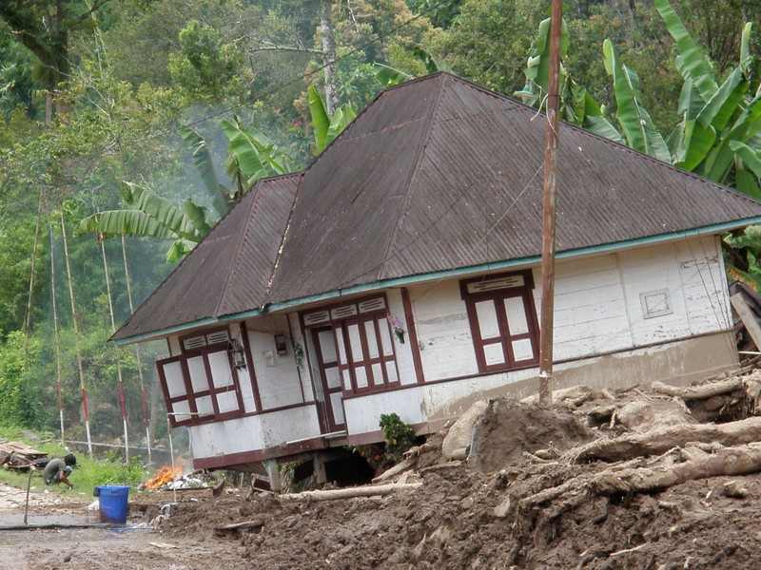
Cash grants (CARE)
Sumatra earthquake, 2010
After the earthquake CARE Indonesia provided cash grants to kick start construction, and therefore did not provide complete funds for reconstruction. The grant (US 220.00) could be spent on either labour or materials.
People could build however they wanted according to guidelines (four basic designs) provided during training and widely available posters.

Slide 29
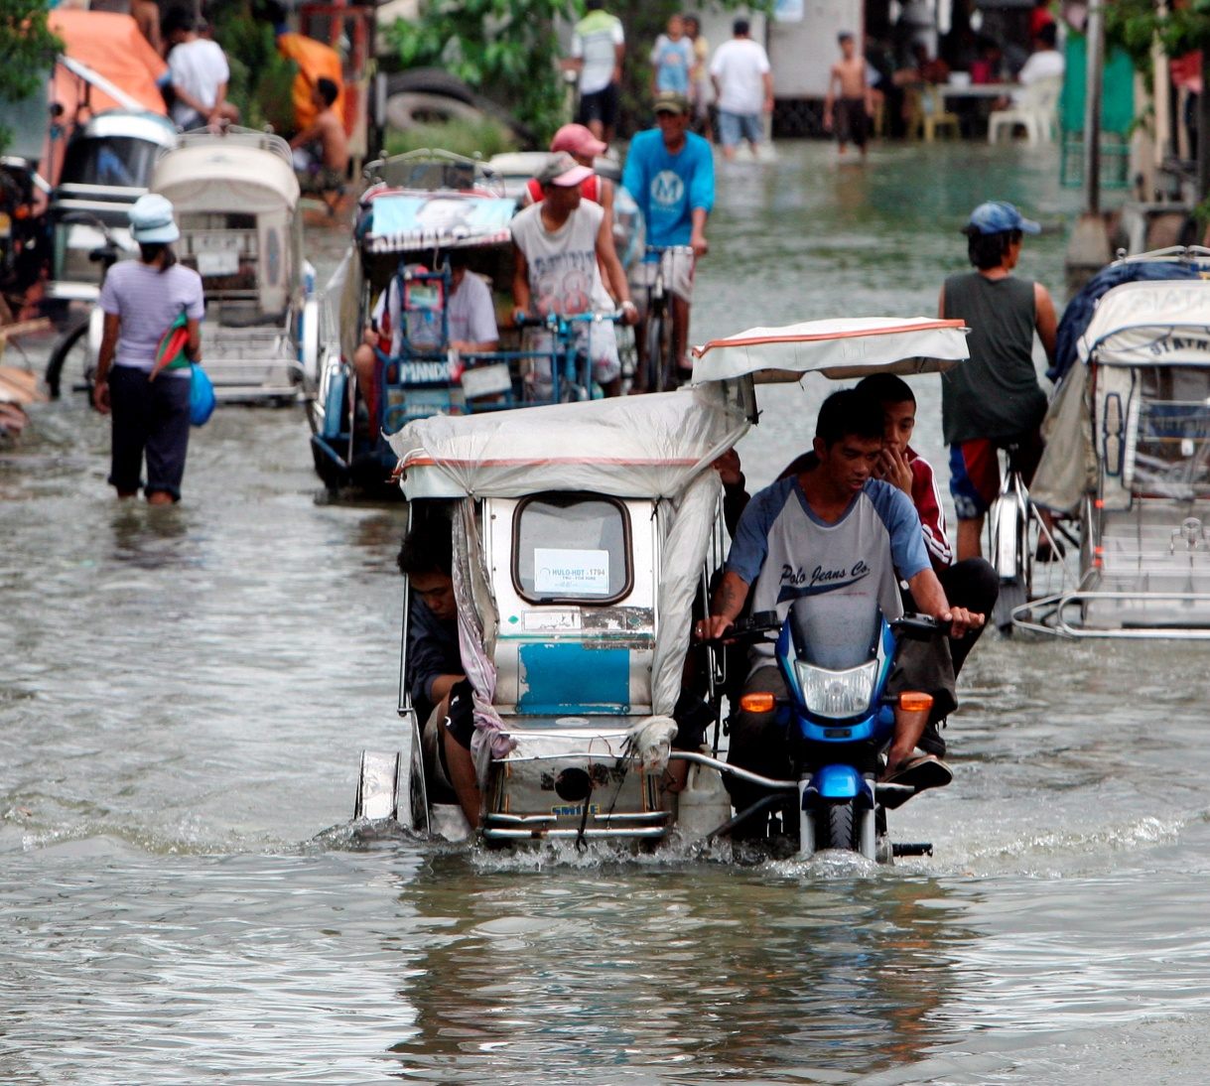
Vouchers (PRC)
Philippines, 2009 and 2010
In response to typhoons in 2009 and 2010 the Red Cross provided shelter materials for repairs and construction of shelters through a commodity based voucher system, with each household allocated the equivalent of USD $ 190.00 worth of materials. Pre-selected suppliers ensured a swift and effective implementation of early recovery activities.

Slide 30
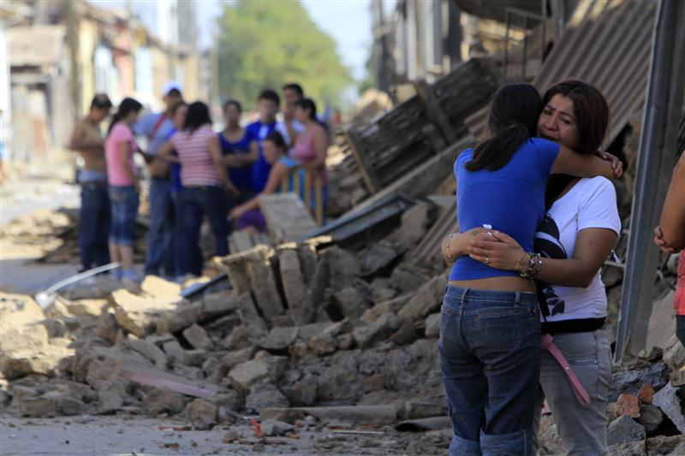
Pre-paid debit cards (CRC)
Chile 2010
In response to the 2010 earthquake, the Chilean Red Cross (CRC) launched its ‘Tarjeta RED’ debit card programme. It assisted 8,400 families rebuild, repair their homes or improve the living conditions of their transitional shelters by allowing them to purchase needed construction materials and tools.

Slide 31
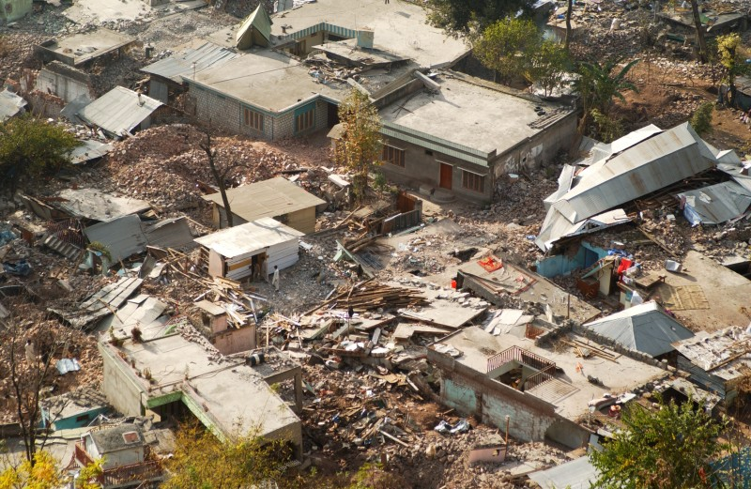
Cash for work
Pakistan, 2005
A project to build transitional shelters according to one basic design. The shelters used reclaimed materials as well as distributed materials and toolkits. Cash for work, carpenters, and technical support were also provided. The project was a combination of direct implementation by a lead organisation with its partner organisations.

Slide 32
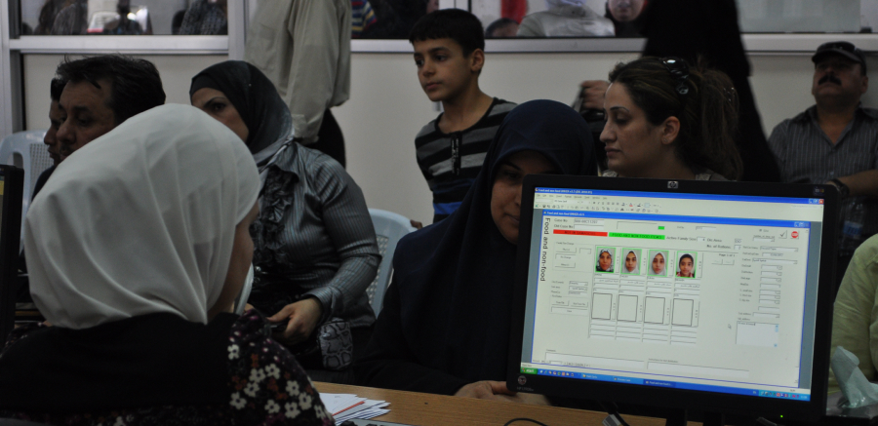
Challenges
WFP/Selly Muzamil

Slide 33
Challenges
New technologies
Staff capacity to implement
Institutionalisation
Measuring cost and impact
Coordination
Stand by agreements with private sector

Slide 34
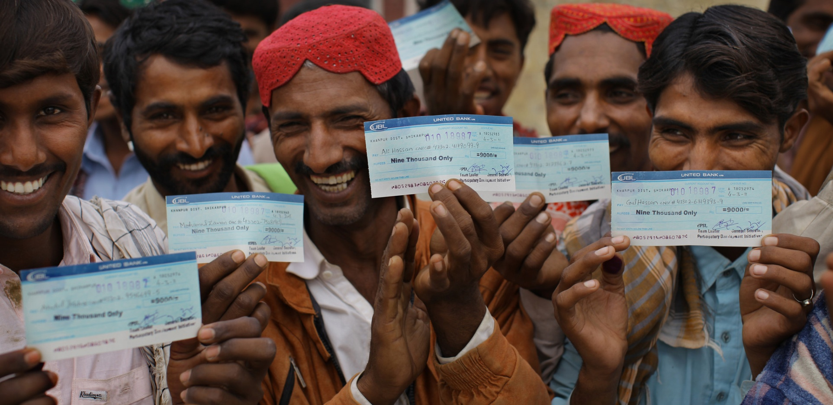
Lessons learned

Slide 35
Lessons learned
1
Appropriate technical support and sensitisation is required to complement cash grants
Traditional support roles will change (finance, ICT etc.) – these staff need training
Good preparedness and contingency planning is essential for rapid response
Establish price monitoring systems

Slide 36
Lessons learned
2
Accurate beneficiary data is essential
Sensitisation on the use of cards or other payment methods is essential
Government acceptance and coordination are essential
Cash schemes can be complicated to administer
Widely appreciated by beneficiaries

Slide 37
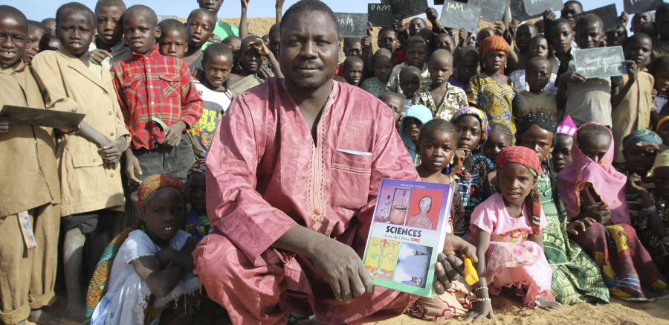
What needs to be done?
WFP/Phil Behan

Slide 38
What needs to be done?
1
Awareness raising, particularly at the field level
Buy in by senior management, govt., private sector partners, donors
Investment into preparedness e.g. stand by arrangements with financial institutions
More stringent response analysis
Adopting more complementary approach of cash and in-kind/technical assistance.

Slide 39
What needs to be done?
2
More research on multiplier effects (impacts and measurements)
Institutional SoPs
Recognition and capacity building for support staff
Formalised coordination mechanisms
Donor support and positioning

Slide 40
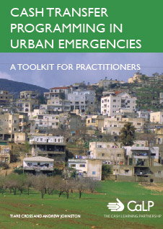
Current research

Slide 41


Cash publications
Guidelines for Cash Transfer Programming (ICRC & IFRC 2007)
Implementing Cash-Based Interventions (ACF 2007)
Cash Transfer Programming in Emergencies (Oxfam 2006)
Cash Workbook (SDC 2007)
Cash and Voucher Manual (WFP 2009)
Guidance for DFID country offices on measuring and maximising value for money in cash transfer programmes (DFID 2011)

Slide 42
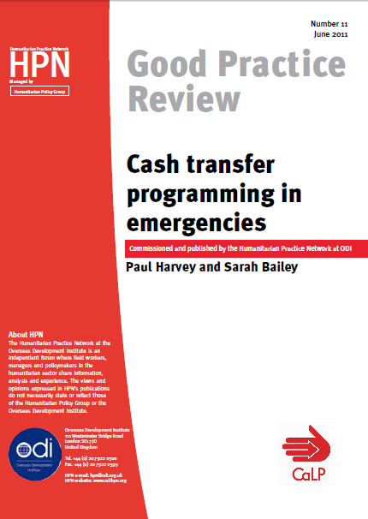
Cash publications
Cash Transfer Programming in Emergencies - Good Practice Review 11 (HPN/CaLP 2011)
The Use of Cash and Vouchers in Humanitarian Crises – (DG ECHO funding Guidelines 2009)
Cash and voucher in relief and recovery: Red Cross Red Crescent good practices (2006)

Slide 43
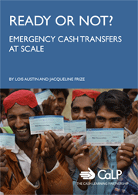
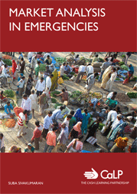
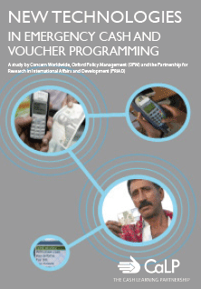
CaLP Research
www.cashlearning.org/what-we-do/research

