Slide 1

g]kfn ;/sf/
zx/L ljsf; dGqfno
zx/L ljsf; tyf ejg lgdf{0f ljefu
e"sDk k'glg{df0f tyf k'g:yfkgf cfof]hgf sfof{no
e"sDk k|lt/f]wfTds ejg lgdf{0f k|ljlw af/]
kfFr lbg] sflnu9 tflnd sfo{qmd
O{+6f jf 9'Ëfsf] uf/f]af6 aGg]
-b'O{ tNnf / a'O{+un;Ddsf_ ejgx?
cltl/Qm ;q

Slide 2
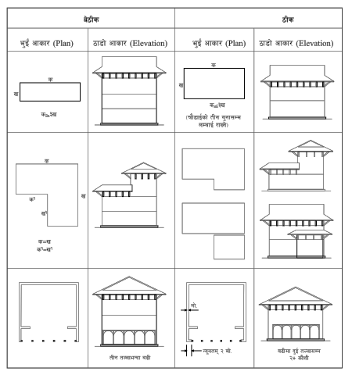
ejgsf] cfsf/ / gfk

Slide 3
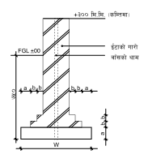
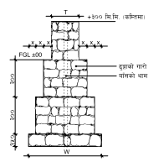
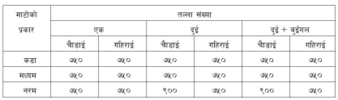
hux?

Slide 4
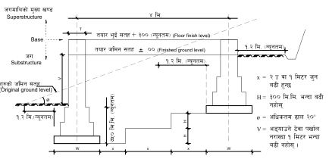
le/fnf] hldgdf hu

Slide 5
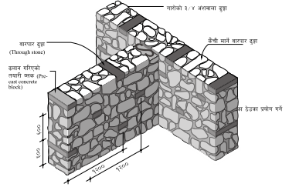
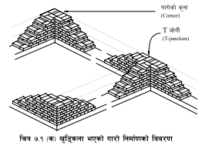
uf/f]x?

Slide 6
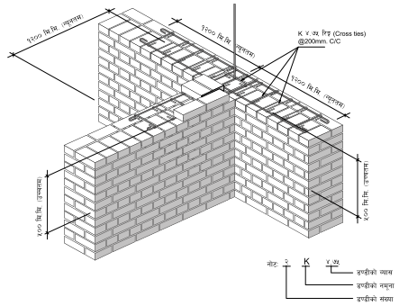
uf/f]df /flvg] k6\6L

Slide 7
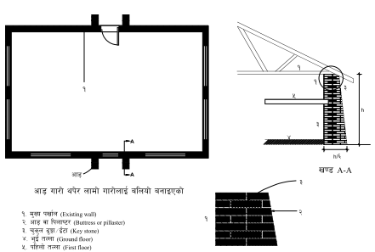
cf8 uf/f]

Slide 8
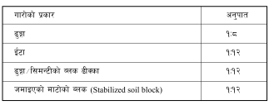
uf/f]sf] df]6fO / prfOsf] cg'kft

Slide 9
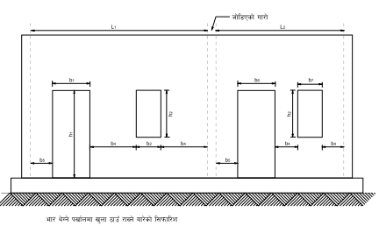

uf/f]sf] v'Nnf efu

Slide 10
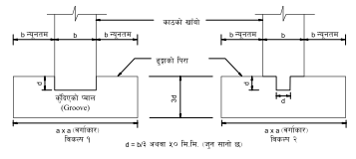
lk/fdfly vf+af] hf]8\g] tl/sf

Slide 11
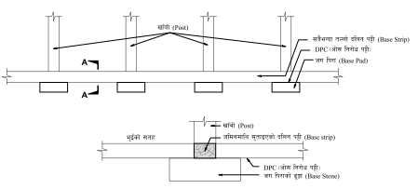
vf+af]sf] nx/

Slide 12
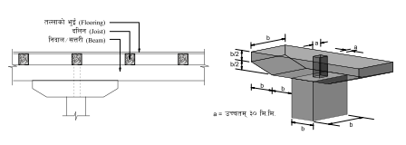
d]7 h8fg

Slide 13
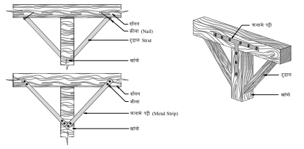
6'F8fn

Slide 14
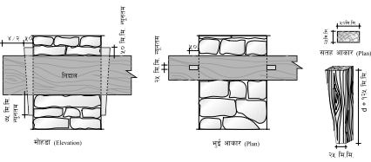
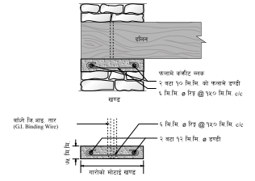
blngnfO{ r's'nn] s:g] tl/sf

Slide 15
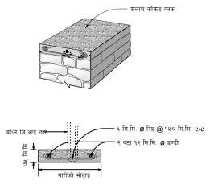
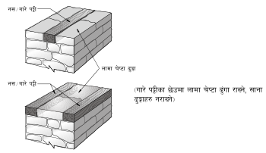
k6\6Lx?

Slide 16
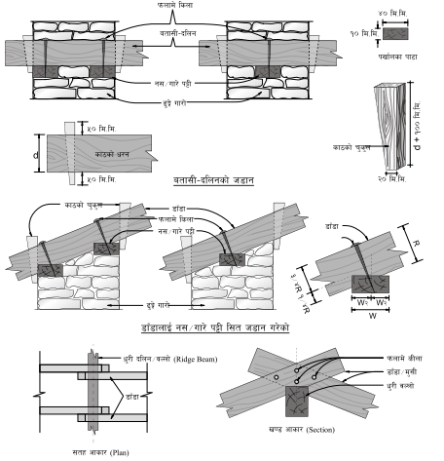
5fgf

Slide 17
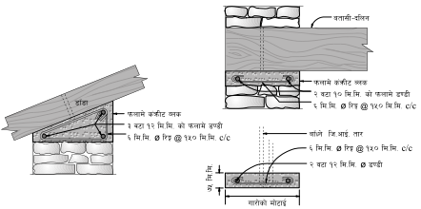
5fgf

Slide 18
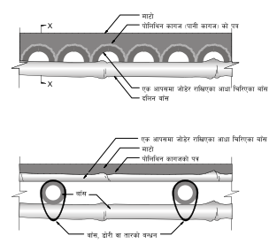
blngsf] hf]gL{

Slide 19
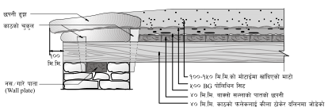
;'wfl/Psf] 5fgf

Slide 20
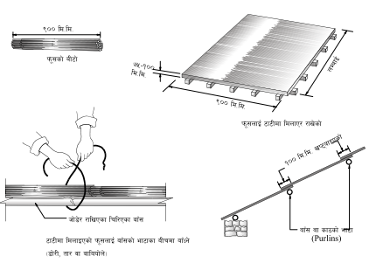
k"m;sf] 5fgf

Slide 21
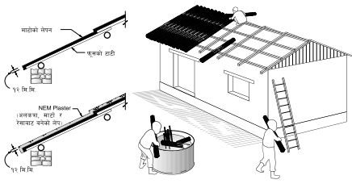
;'wfl/Psf] k"m;sf] 5fgf

Slide 22
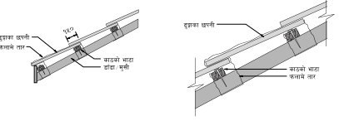
9'Ëfsf] 5kgL

Slide 23
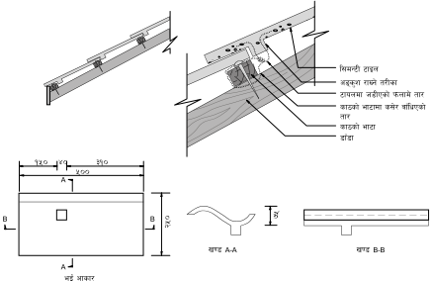
l;d]G6 6fon

Slide 24
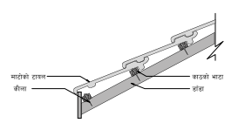
df6f]sf] 6fon

Slide 25
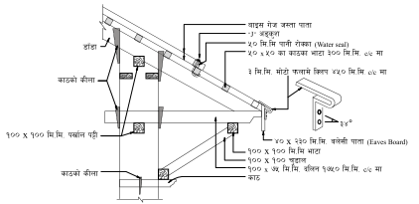
h:tf kftf

Slide 26
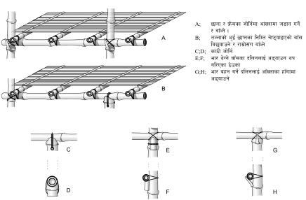
af+;sf] e'O{+

Slide 27
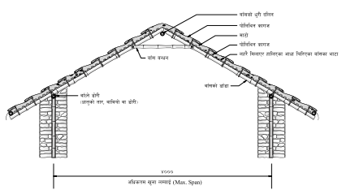
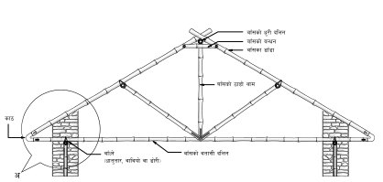
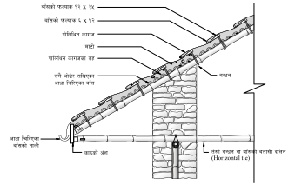
af+;sf] 5fgf

Slide 28
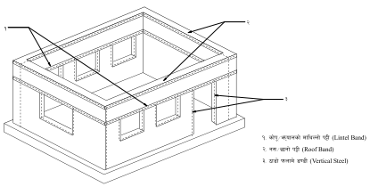
e"sDk k|lt/f]wL tTjx?

Slide 29
@)^*.^.! sf] k"jf{~rndf uPsf] e"sDksf] qmddf u|fdL0f ejgdf b]lvPsf] Ifltsf] k|j[lQ ljZn]if0f
ejgsf] s'gfdf Iflt÷lr/fx?
s}+rL k|efjsf] Iflt / sf]0fLo Iflt
v'Nnf efux?df lr/f
r'nL uf/f]df Iflt / lr/f
uf/f]sf] k/tx? 5'l6\6Psf]
6]jfljxLg nfdf] uf/f]df Iflt
5'6\6} v8f /x]sf] uf/f]df Iflt jf eTs]s]f
cg'ko'Qm ef/ky
sf]dn tNnf k|efjx?
dsf{O
k"0f{ Iflt
sDkghGo Iflt
tNnfx?sf] ljrng
c;dtnLo Iflt
w;fg jf eL/ hGo Iflt
tNnfsf] e'O{+ 5'l6\6Psf]

Slide 30
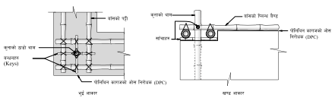
af+;sf] 7f8f] ;anLs/0f

Slide 31
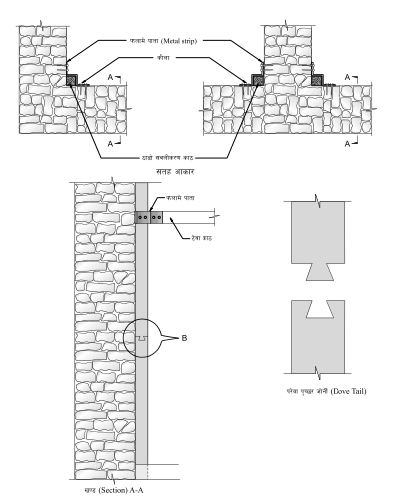
sf7sf] 7f8f] ;anLs/0f

Slide 32
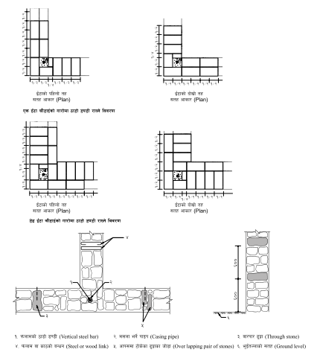
kmnfdsf] 7f8f] ;anLs/0f

Slide 33
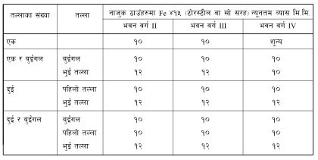
7f8f] 808L nufpg'kg]{ 7fp+x?

Slide 34
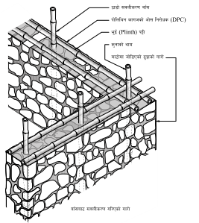
af+;sf] t];f]{ k6\6L

Slide 35
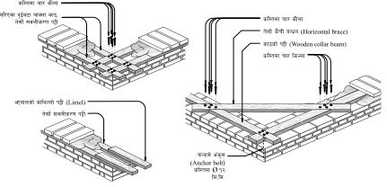
sf7sf] t];f]{ k6\6L

Slide 36
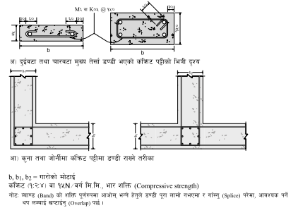
s+lqm6sf] k6\6L

Slide 37
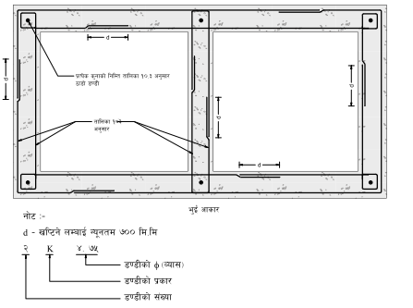
s+lqm6 k6\6Ldf /flvg] 808L

Slide 38
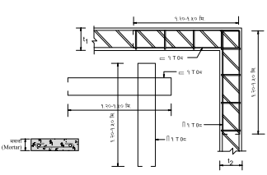
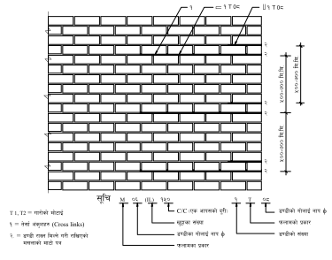
uf/f]df /flvg] 808L

Slide 39
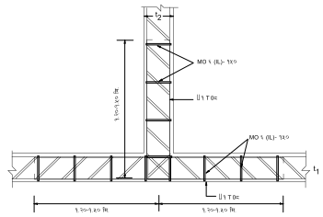
uf/f]df /flvg] 808L

Slide 40
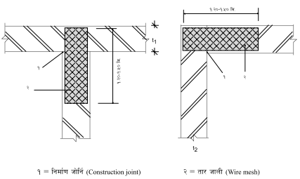
tf/hfnLsf] k|of]u

Slide 41
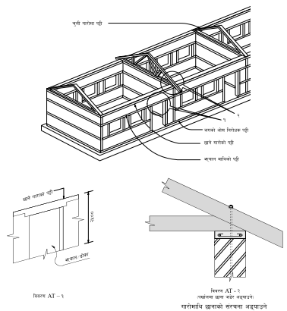
r'nL uf/f]

Slide 42
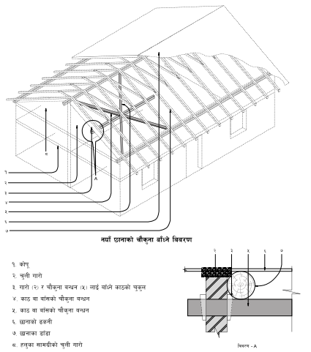
rf}s'g] aGwg

Slide 43
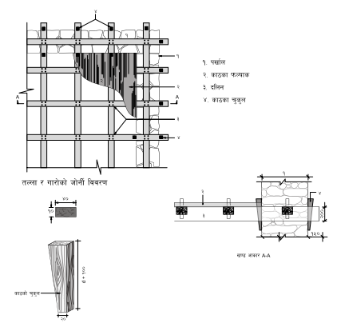
uf/f]nfO{ cf8

Slide 44
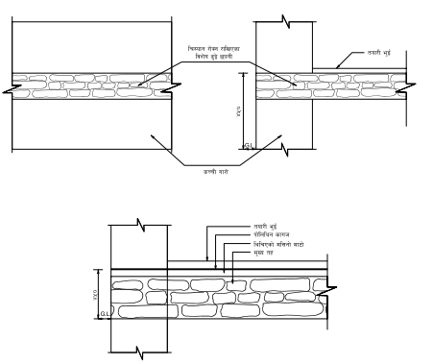


cf]; lg/f]ws k6\6L

Slide 45

kfgLsf] lgsf;

Slide 46
af+; s6fg / ;'/If0f
s6fg lgb]{lzsf
tLgjif{ eGbf slnnf] s'g} klg afF; gsf6\g], jiff{ofddf jf km"n nfUbf gsf6\g] .
bf];|f] cfFVnf eGbf tn cyjf hldgaf6 #) ;]=ld= eGbf dfly gsf6\g] .
xfFufx? / cfFVnfsf] 6'Kkf]nfO{ / s6fgsf ;a} grflx+bf kmf]x]f/x?nfO{ lemlslbg] .
kftx?nfO{ 5fkf]sf] ?kdf Tolx+ 5f]l8lbg] .
pi0f hftsf afF;sf] ‰ofªdf kfs]sf sd ;] sd 5 j6f afF;nfO{ gsfl6sg} 5f]8\g] .

Slide 47
af+;sf] arfp pkrf/
kfgLdf 8'afP/ ;'tfpg]
gofF sfl6Psf afF;nfO{ kfgLdf 8'afP/ /fVbf sL/f nfUb}gg\ .
cfjZos k/]df 9'Ëfn] lyr]/ eP klg afF;nfO{ k'/} kfgLdf 8'afpg'k5{ .
gofF sfl6Psf afF;nfO{ tLglbg b]lv tLg dlxgf;Dd / s]lx ;'s]sf afF;nfO{ yk b'O{ ;ftf kfgLdf 8'afpg'k5{ . aUbf] kfgL eP emg /fd|f] x'g]5 .
r'g kf]Tg] / cGo kq
cnsqf, r'g kf]Tg] / afn'jf 5ls{Psf] cnsqf h:tf y/L y/Lsf /f]ug kqsf] pkof]u ug]{ ;lsG5 . afF; sfl6Psf], o;sf] ;tx plKsPsf] jf sf]l/Psf :yfgx?df n]kg ug]{ .
a'?;n] emfg'{, em]fnn] k'5\g', 5ls{g' / 8'afpg'
oL ;txut pkrf/ afF; e08f/0f ug'{kbf{ jf o;df cGo /;folgs emf]n kbfy{x? af;Fdf l5/fP/ pkrf/ ug'{ cl3 ul/G5 .
cfuf] lg/f]ws pkrf/
cGo pkrf/ M :6Llkª, af}r]l/O k|s[of (Steeping, Boucherie process), tftf / rL;f :gfg 5f]Kg] k|s[of, bjfj pkrf/ cflb

Slide 48
af+;sf] e08f/0f
cUnf / prflnPsf Kn]6kmd{ dfyL afF;nfO{ t];f]{ kf/]/ tx ldnfO{ /fVg'k5{ .
wld/f gnfu'g\ egL hldgaf6 slDtdf #)) ld=ld= cUnf] Kn]6kmd{ agfpg' k5{ .
rf/} lbzfaf6 lgoldt tj/df / ;lhn}l;t x]/ljrf/ ug{;lsg] u/L afF;sf e08f/ ug'{k5{ .
ls/f nfu]sf w8Þx?nfO{ x6fpg jf pkrf/ ug'{k5{ .
^ b]lv !@ ;ftf;Dd jfo' jf el§ pkrf/ ug'{k5{ .
pkrf/df b'O{ jf tLg ;ftf nfU5, lz3|tf ul/of] eg] afF;sf aflx/L kq kmf6\g] 8/ /xG5 .
afF;df 9';L gnfuf];\ eGg] x]t'n] df6f]l;t ;Dks{ jf kfgLn] leHgaf6 afF;nfO{ hf]ufpg'k5{ .
;a} k|sf/sf kmf]x/ d}nf, sfd gnfUg] sf7 / afF;nfO{ x6fpg'k5{ .
wld/f nfu]sf] hldg / j/k/ l8=l8=l6= sf] $Ü cyjf B.H.C. sf] @Ü 3f]n h:tf sL6gfzs 5ls{g'k5{ . ls/f, wld/f nfu]sf] If]qdf tyf wld/fsf] uf]nf km'6fO{ sL6gfzs xfNg'k5{ .
hldgdf kfgL lgsf;sf] /fd|f] k|jGw ldnfpg'k5{ .

Slide 49
v/sf] 5fgfsf] lglDt clUg lg/f]ws pkrf/
5fgfnfO{ clUg / kfgL k|lt/f]wL agfpg] ;/n pkfo Knf:6/ xf] .
cfjZos ;fdu|Lx? -5fgfsf] !)) ju{ld6/nfO{ pkrf/ ug{_ M
lunf] df6f]
ux'F jf wfgsf] k/fnsf e";
*)÷!)) :t/sf] cnsqf
dl§t]n
uf]a/
bfp/f
lj6'd]g ufNg / lehfpg l/Qf] 9\jfª

Slide 50
tof/ kfg]{ t/Lsf
l:y/ df6f] d;nfsf] tof/L
Knfi6/sf lglDt cut-back lj6'd]g / n]bf]sf] tof/L
Knfi6/sf] tof/L
l:y/ ul/Psf] df6f]sf] RofkRofk] 3f]n lglDt n]bf] cnsqf tof/ kfg]{
Knfi6/ lglDt l:y/ df6f]sf] tof/L
cfuf] lg/f]ws Knf:6/ lglDt l:y/ df6f]sf] tof/L

Slide 51
nufpg] t/Lsf
5fgf ;txsf] tof/L – 5fgf–;txnfO{ ;dfg t'NofPkl5 clUglg/f]ws Knf:6/ nufpg tof/ x'G5
l:y/ df6f] Knf:6/ nufpg]
l:y/ df6f]sf 3f]n nufpg]
NEM Knf:6/ nufpg]
l:y/ df6f]sf 3f]n nufpg]
5fgfsf k|To]s s'gf / rf/}lt/ c;n clUg lg/f]ws x'g' cfjZos 5 . 5fgfsf] l;lnËnfO{ l:y/ df6f]sf] kqn] Knf:6/ ug'{k5{ .

Slide 52
wGojfb !!!

