Slide 1
FEED BACK ON TE COMPOSITION OF SHELTER KITS

Slide 2
COMPOISTION OF fy20 KITS
Shelter Item | Distribution Protocol
Plastic rope | 1 roll per family
Hoe + Handle | 1 hoe per family
Pickaxe+ Handle | 1 pickaxe per family
Shovel + Handle | 1 shovel per family
Nails | 1 kg of nails 100 mm per family
Plastic Tarpaulin Reinforced, 4x5 M | 2 plastic tarpaulins per family
Nylon bag | 1 per family

Slide 3
Kits distributed this year
Location | Planned | distributed | Balance
South West (Buea, Limbe, Tiko, West coast, Kumba 1, 2 and 3, Mbonge | 4000 | 3991 | 9
North West (Bali, Widikum, Bafut, Ndop, Kumbo) | 5000 | 3996 | 1004
Total | 9000 | 7987 | 1013

Slide 4
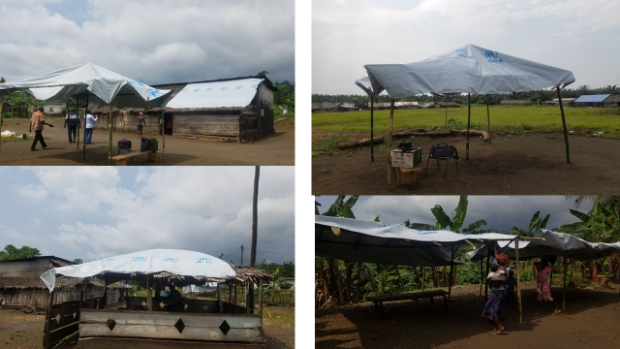

Slide 5
Items rejected by AND REASON
# | Shelter Item | Reason for rejection
1 | Plastic rope | can be used to activate explosives
2 | Hoe | Can be used to did roads to prevent the movement of the military
3 | Pickaxe+ Handle | Can be used to did roads to prevent the movement of the military
4 | Shovel + Handle | Can be used to did roads to prevent the movement of the military
5 | Nails | Can be use to make explosives

Slide 6
Feed back received from the field
They appreciate the entire content
The tarpaulins are used for shelter and some few people use it to dry their far products.
The hoes, spades and pickaxe are used for both shelter and livelihood activities.
The tarpaulins can be used without the other items as most of the people mount they their own way and most people use them to cover part of damages houses or to make house extensions.

Slide 7
conclusion
The tarpaulins that form the main part of shelter kits can be used without other rejected accessories.
Is there any possibility of providing zinc sheet (Plan once did this and it was highly appreciated. The catholic church is doing it in some communities)
CBI unrestricted/multipurpose can be used to address some shelter needs
CBI can also be used for rent purposes by IDPs in urban and semi urban settlements

Slide 8
eND
THANKS

