Slide 1
Fire Safety in Lebanon’s Refugee Settlements
Shelter/NFI lessons learned

Slide 2
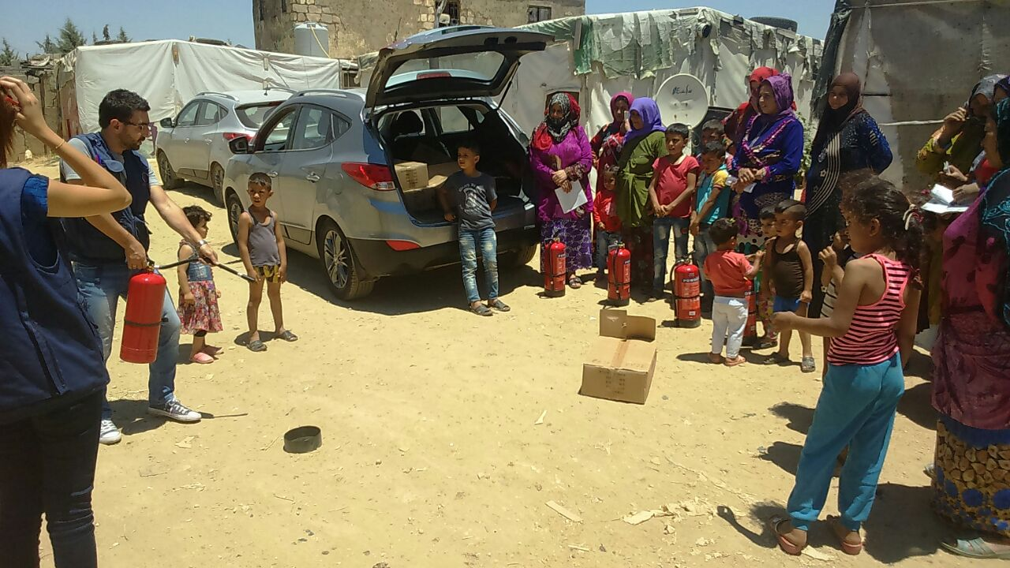
Introduction
INTRODUCTION
LEBANON CONTEXT
CHALLENGES
SOLUTIONS / LESSONS
WAY FORWARD

Slide 3
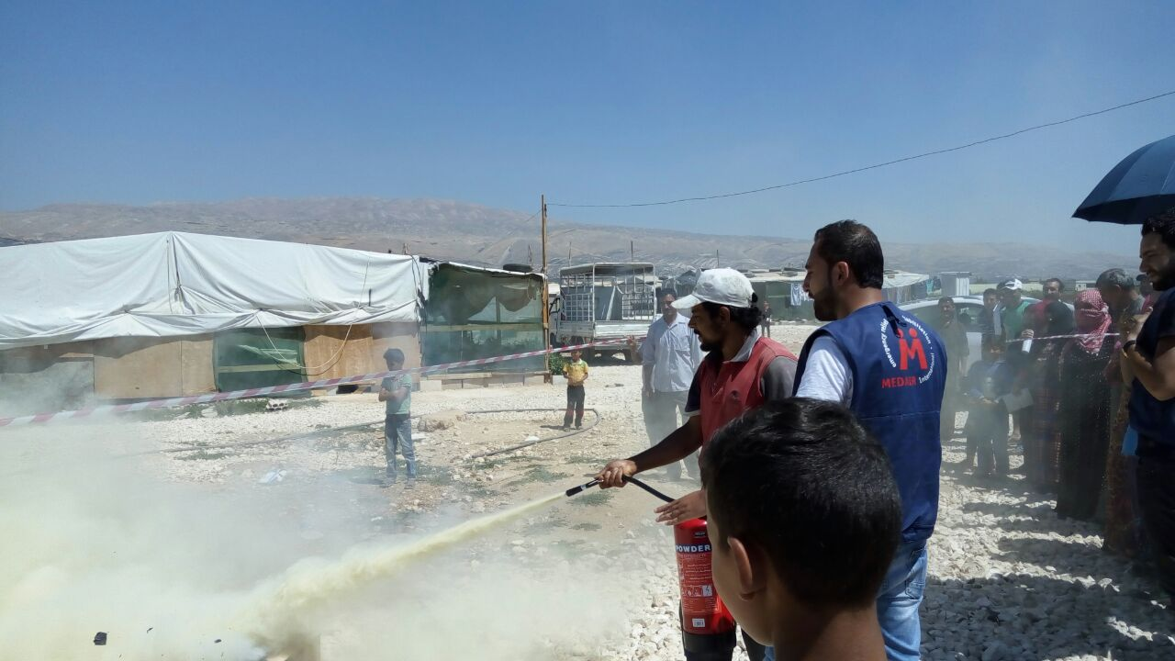
Introduction: Key elements
Why important: save lives, our NGO liability
Behavior change
Distributions + Trainings + Awareness
Coordination among partners + government
Key people/skills
NFI quality
Knowledge management
RBA / Flexibility in programming
M&E

Slide 4
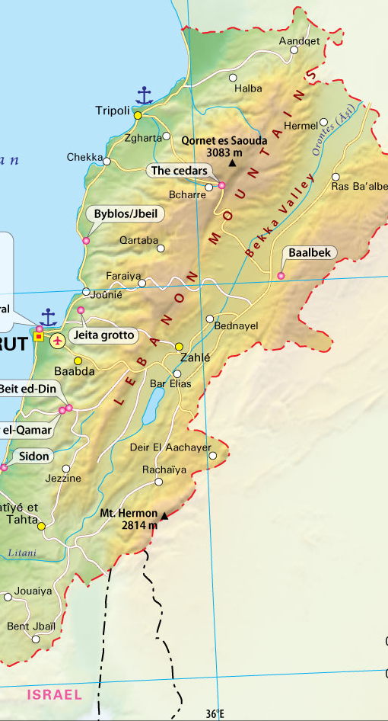
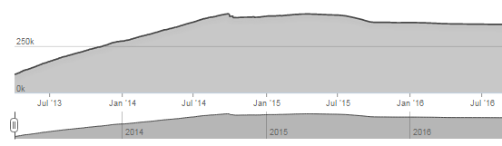
Lebanon: Snapshot
1,017,433 refugees (1/5 of Lebanon population; highest refugee population per capita)
360,773 registered in Beqaa Valley
About 200k in ITSs, 400k in SSBs/SSUs
Protracted crisis
No new registrations after 2014
SYRIA

Slide 5
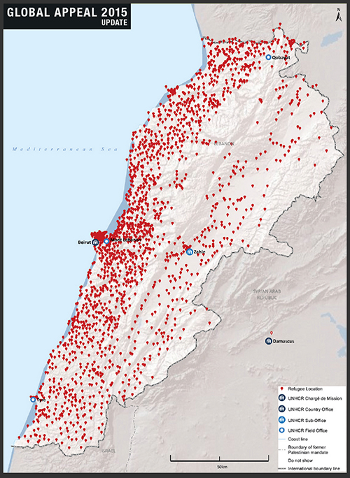
Lebanon: Humanitarian Environment
NGO AOIs
Community Management Committees (CSMCs)
Mapping
Hotline #s

Slide 6
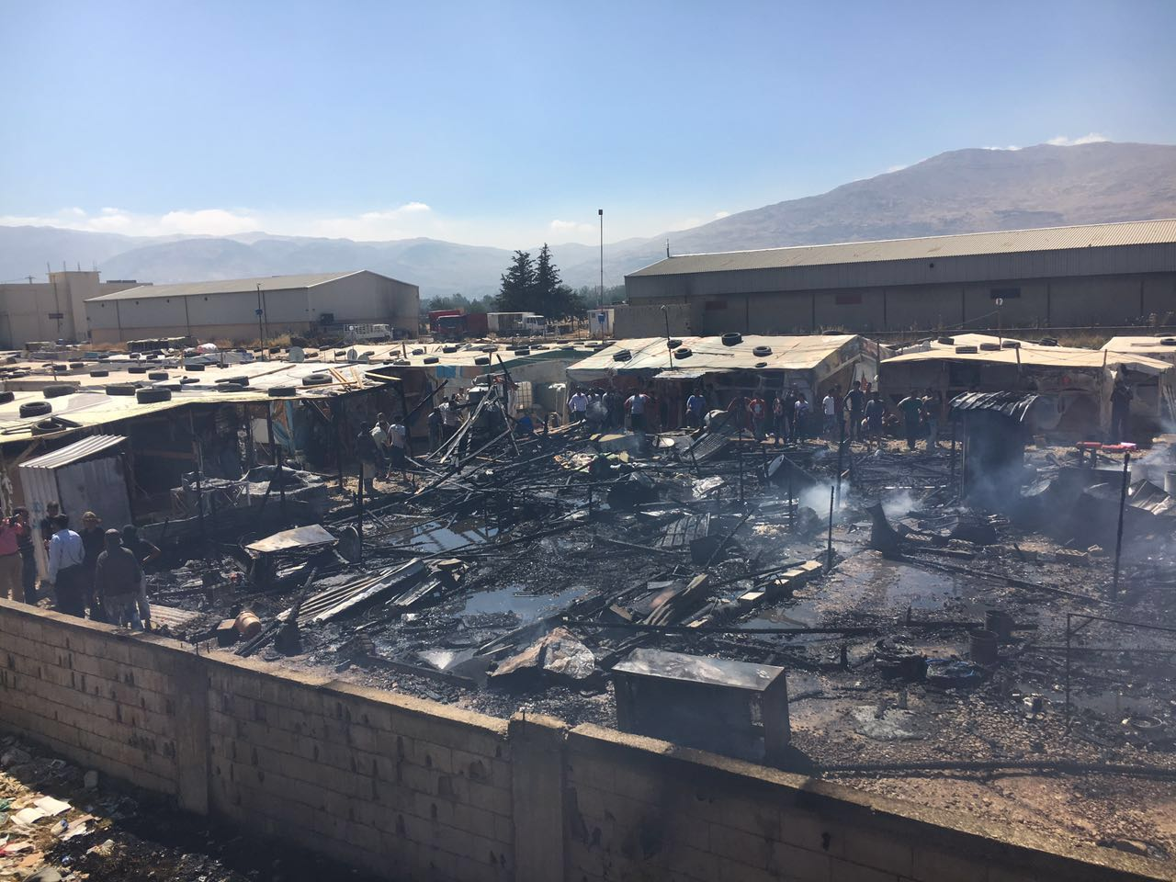
Lebanon
“The Beqaa regional fire station reported 24 IS fires in the Beqaa region in 2015. 24 IS fires had already been reported in 2016 from January to the beginning of August. The LCD recorded at total of 115 IS fires nationally in 2015. It is, of course, impossible to know the numbers of unreported fire incidents taking place’”
– Operation Florian / Save the Children

Slide 7
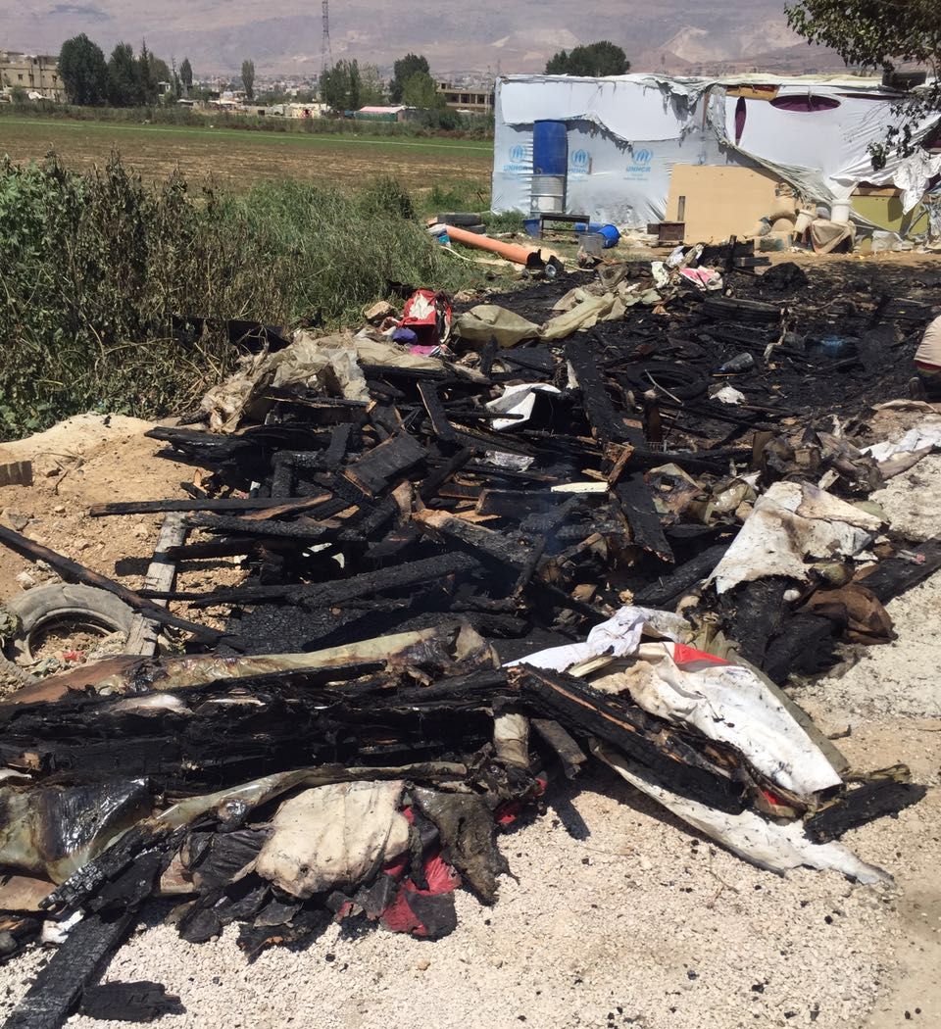
Lebanon
Video: walk through ITS (0:25-2:05)
Video: walk through SSB (0:20-1:42)
News: Fire in Settlement (0:31)

Slide 8
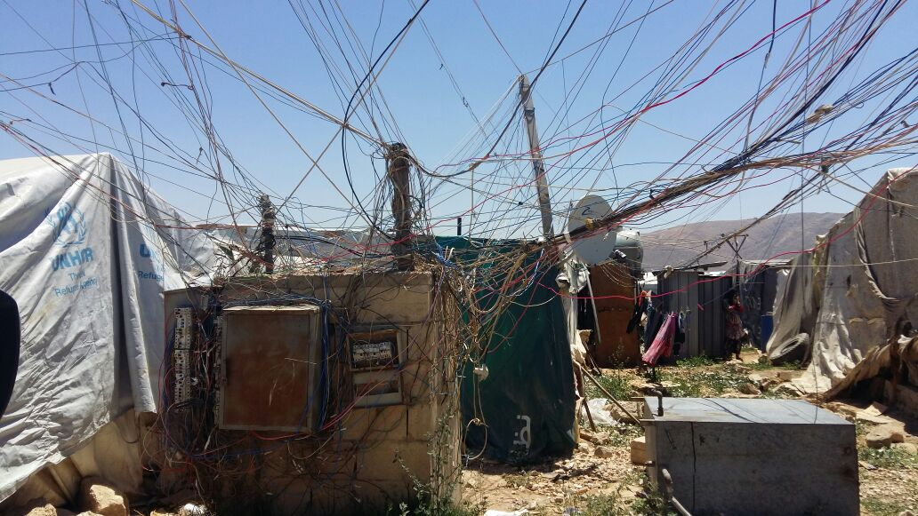
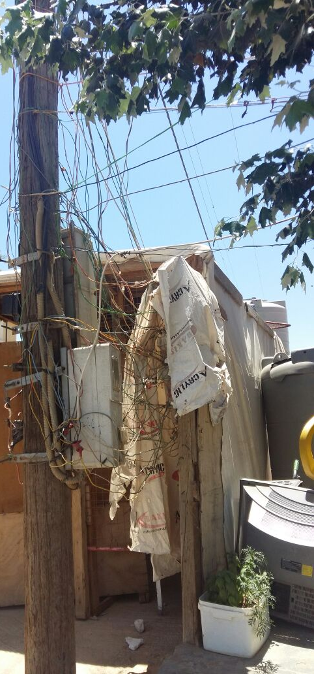
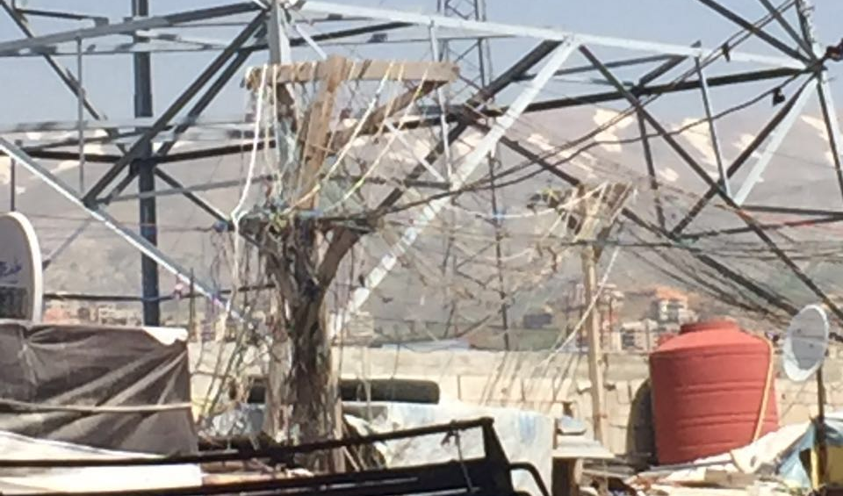
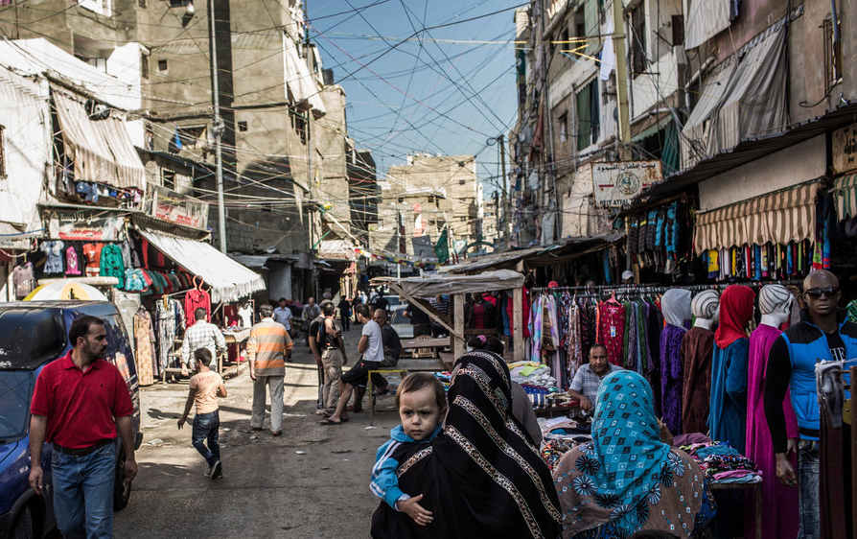
Challenges

Slide 9
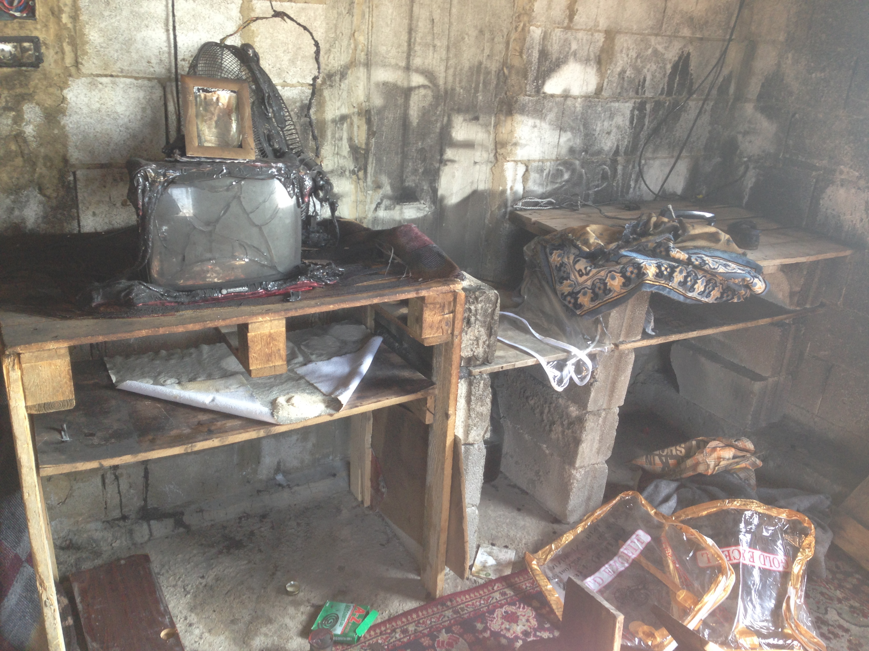
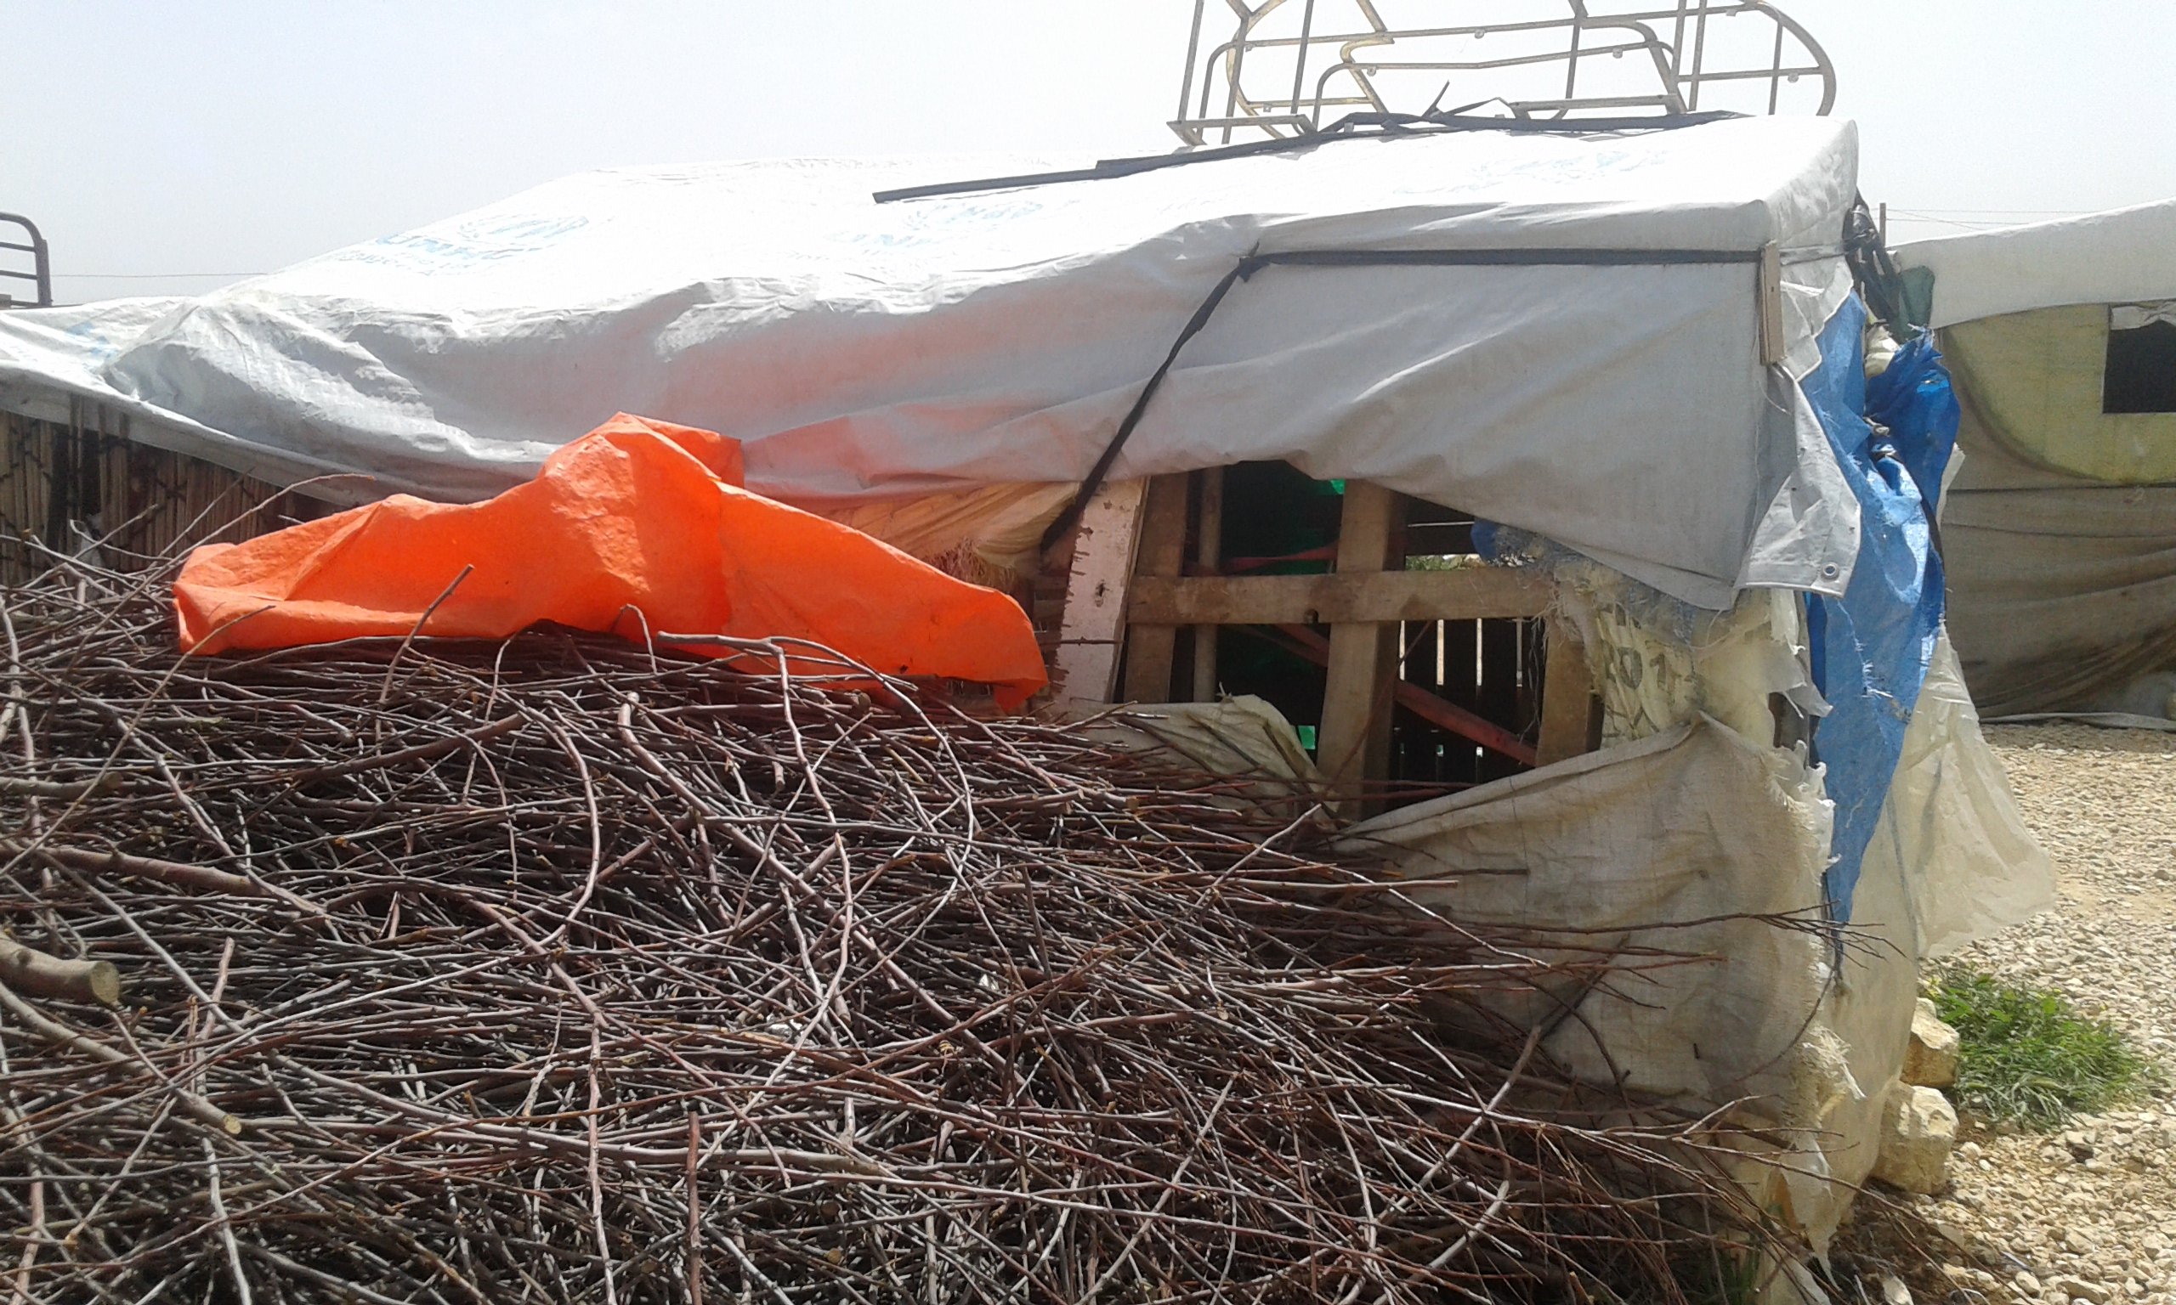
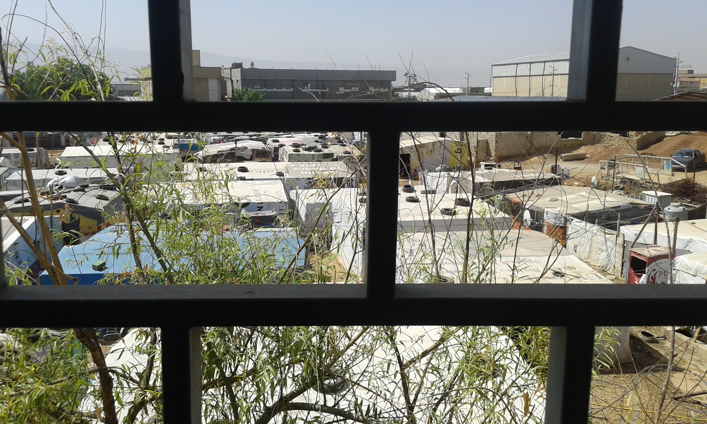
Challenges
Notes:
The way everyone lives – fire is not a priority

Slide 10
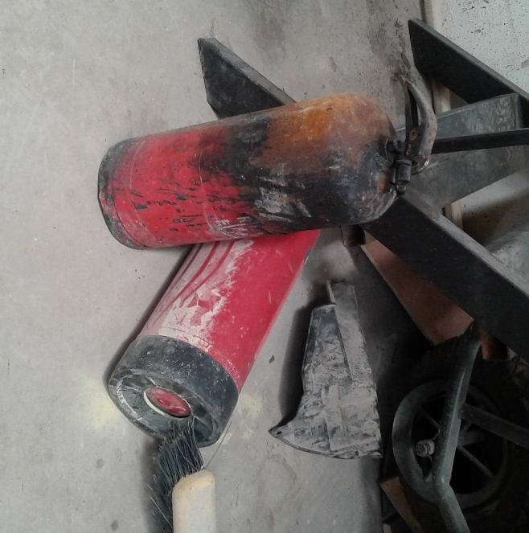
Challenges
Notes:
Misuse: throwing them on the fire

Slide 11


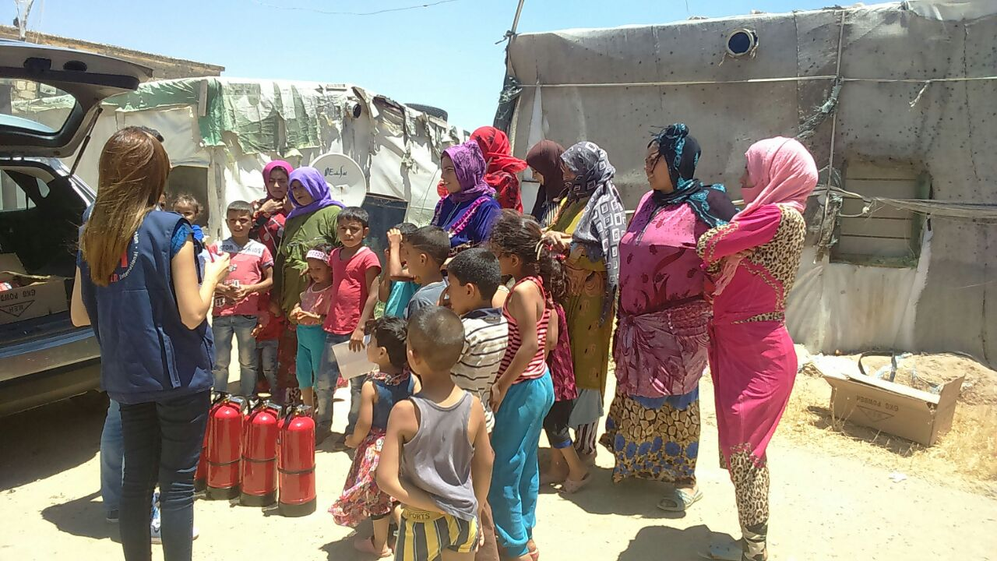





Challenges

Slide 12
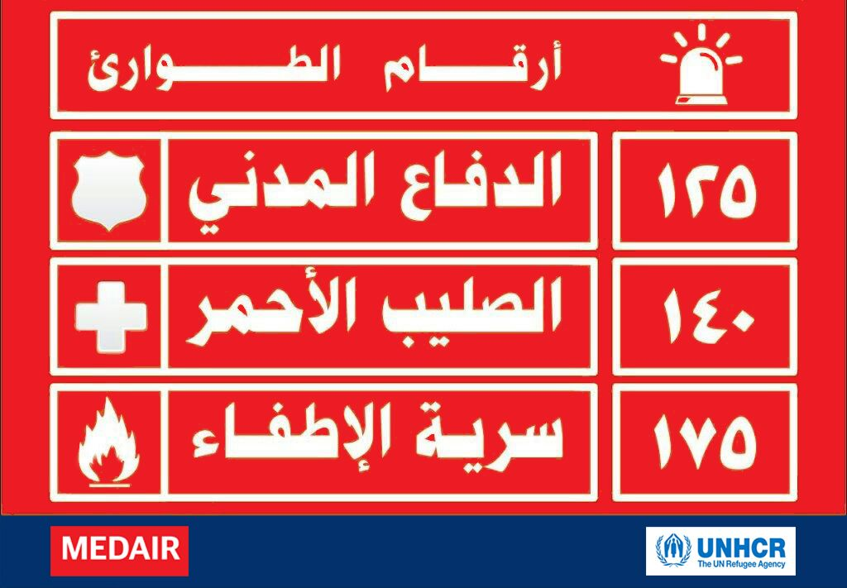
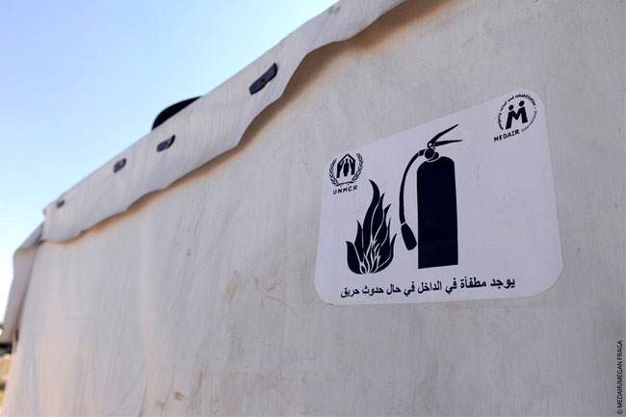
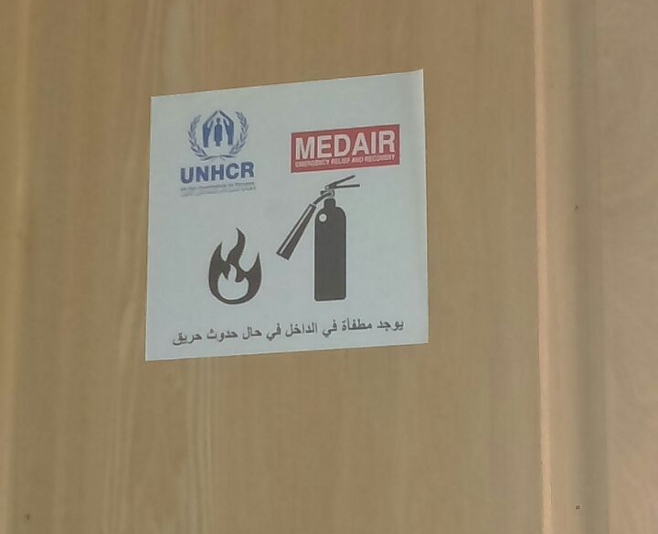
Challenges
Notes:
OTHER PROBLEMS:
local fire services are inadequately funded and equipped.
Awareness, visibility not consistent and therefore confusing
NRC, DRC, UNHCR, INTERSOS
Research needed for proper visibility or else can do more harm than good, and waste resources

Slide 13
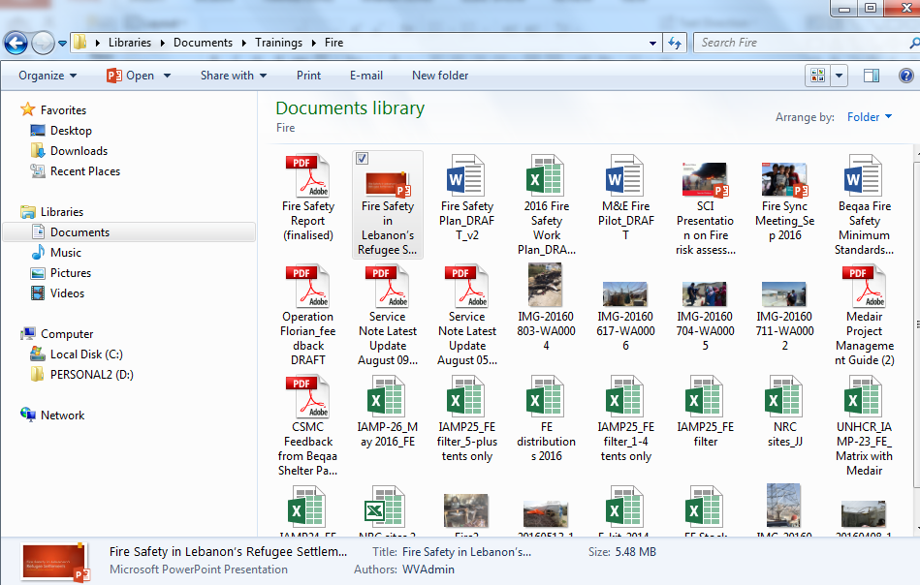
Challenges
Challenges

Slide 14
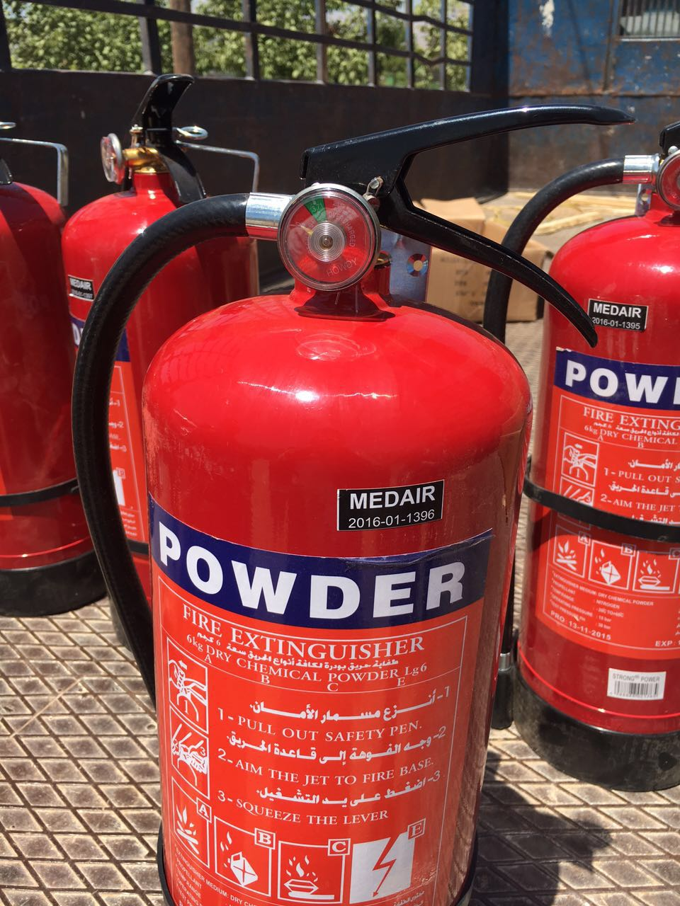
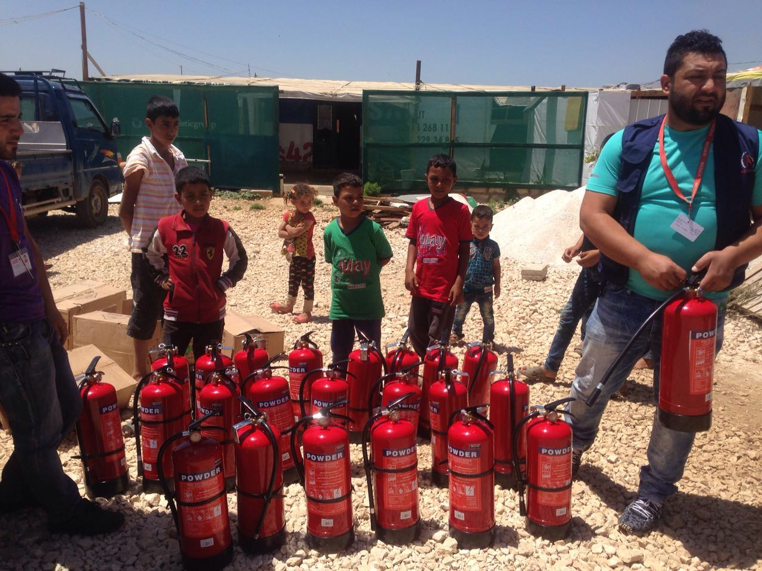
Challenges
Notes:
Powder isn’t strong enough for fires that are bigger than the size of a head basically – so ITSs emptied ALL of their Fes to put out fire (when nothing but fire works)
Kids play with the parts
Reading pressure (and then knowing what to do if the pressure drops)
Too much text (not everyone can read) / IEC Materials
Hard to track them (so we labeled them)
Labels/ tracking
F-Kit: should it only be FEs? What about fire blankets? Shovels? Sandbags?

Slide 15
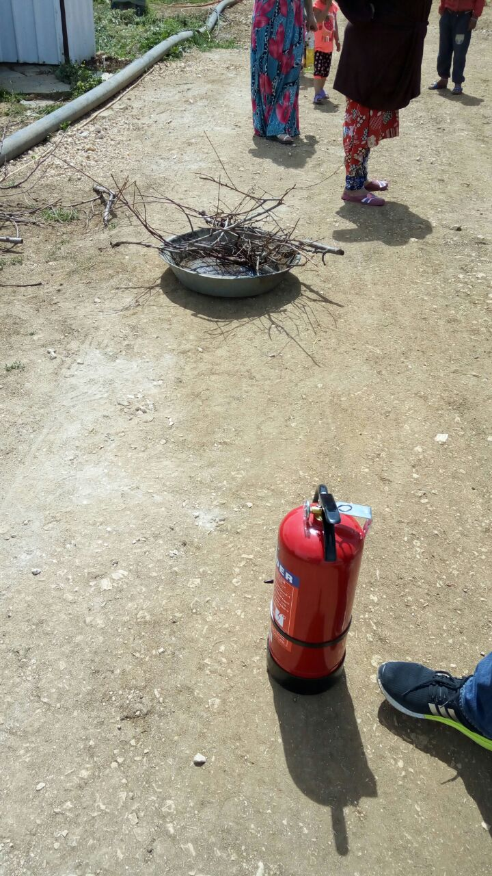
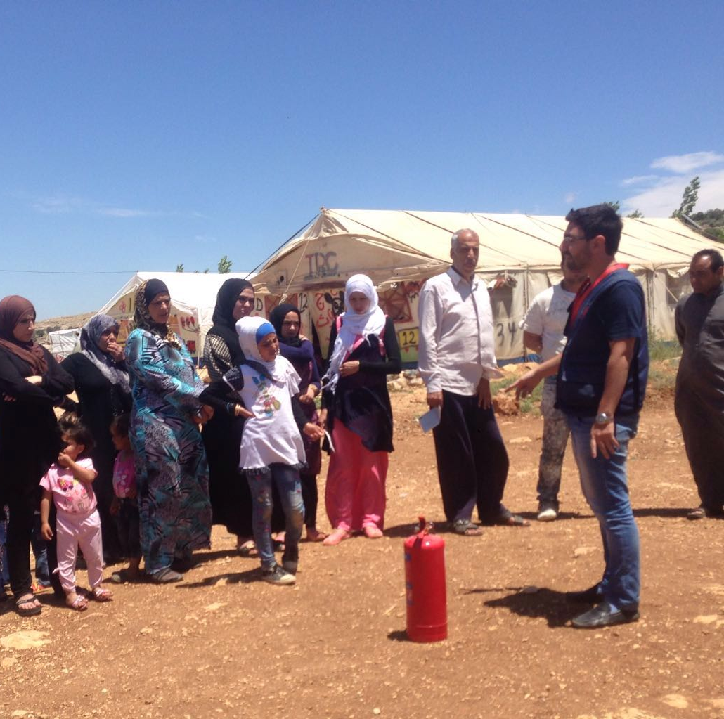
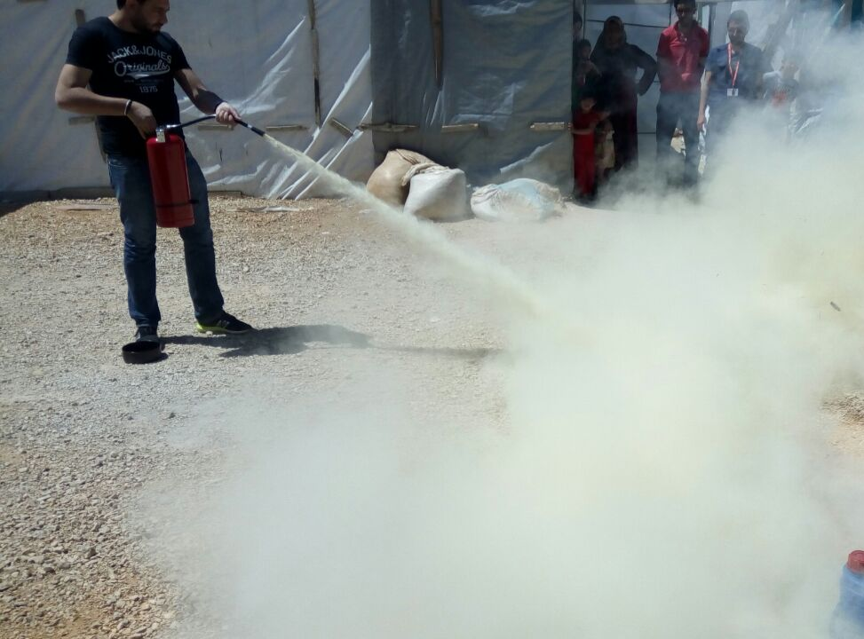
Challenges
Notes:
Who attends the training?
What risks do you point out?
What aspects should be included in the training?
Who conducts training and how are they trained?
How does intervention make strongest impact?

Slide 16
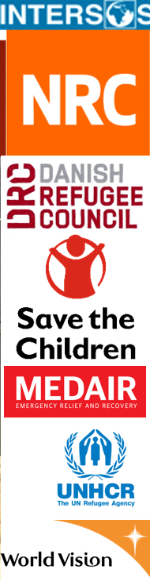
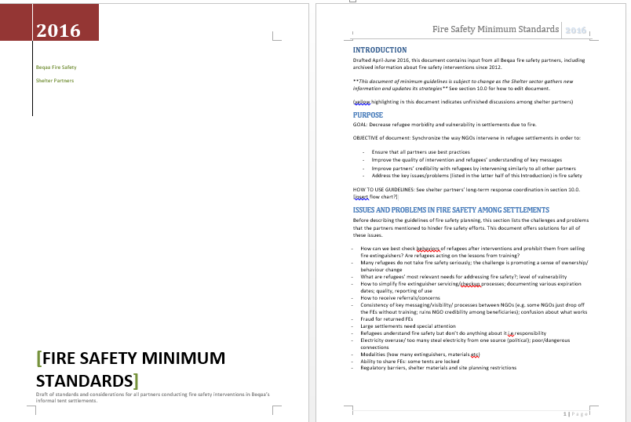
Solutions / Lessons
Notes:
Coordination Meetings
Minimum standards document – outlined key issues in 10 parts, each with a one-pager of instructions for partners to implement over time, or for new partners to adapt
Lead agency/person to lead this: knowledge management, maintain momentum, edit document, monitor progress, involve new partners, set up “behavior” among partners to meet and use doc

Slide 17
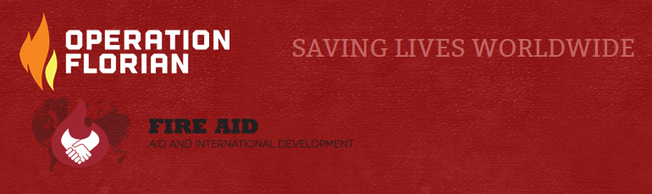
Solutions / Lessons
RBA
Support from partners
Flexibility / adaptability

Slide 18
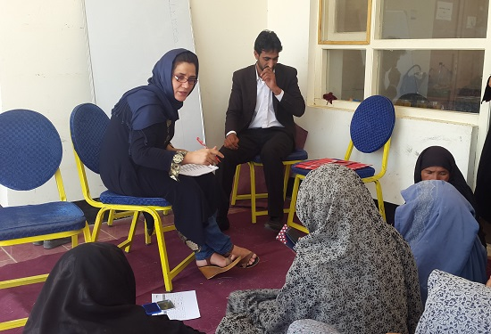
Solutions / Lessons
PEOPLE
Fire Safety Focal Points
CSMCs
Fire Officers
Fire Safety: Lead NGO

Slide 19
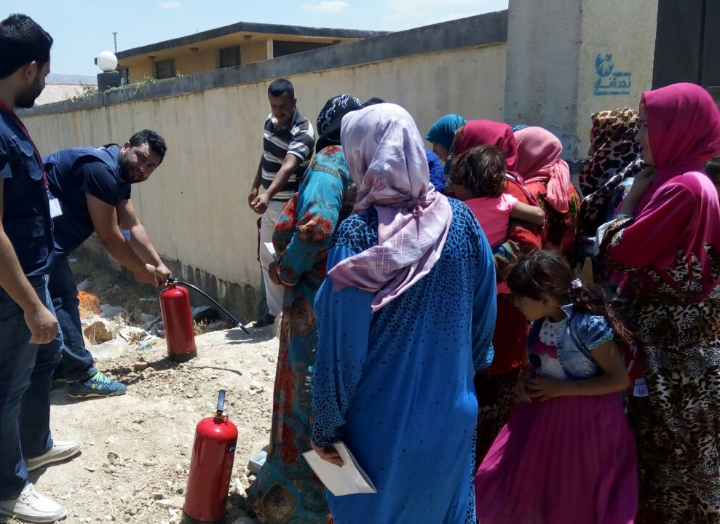
Solutions / Lessons
Successes informed the PDM questions
Sharing FEs / Fewer arguments
Partially burned tents
No death/injury
Partners involved / adopting recommendations
Hotline use
No bad press

Slide 20
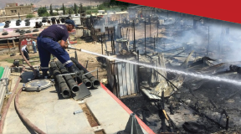
Way Forward
Work with local government services
  Civil Defense mapping
  Civil defense training
CSMC development
PDMs / data sharing

Slide 21
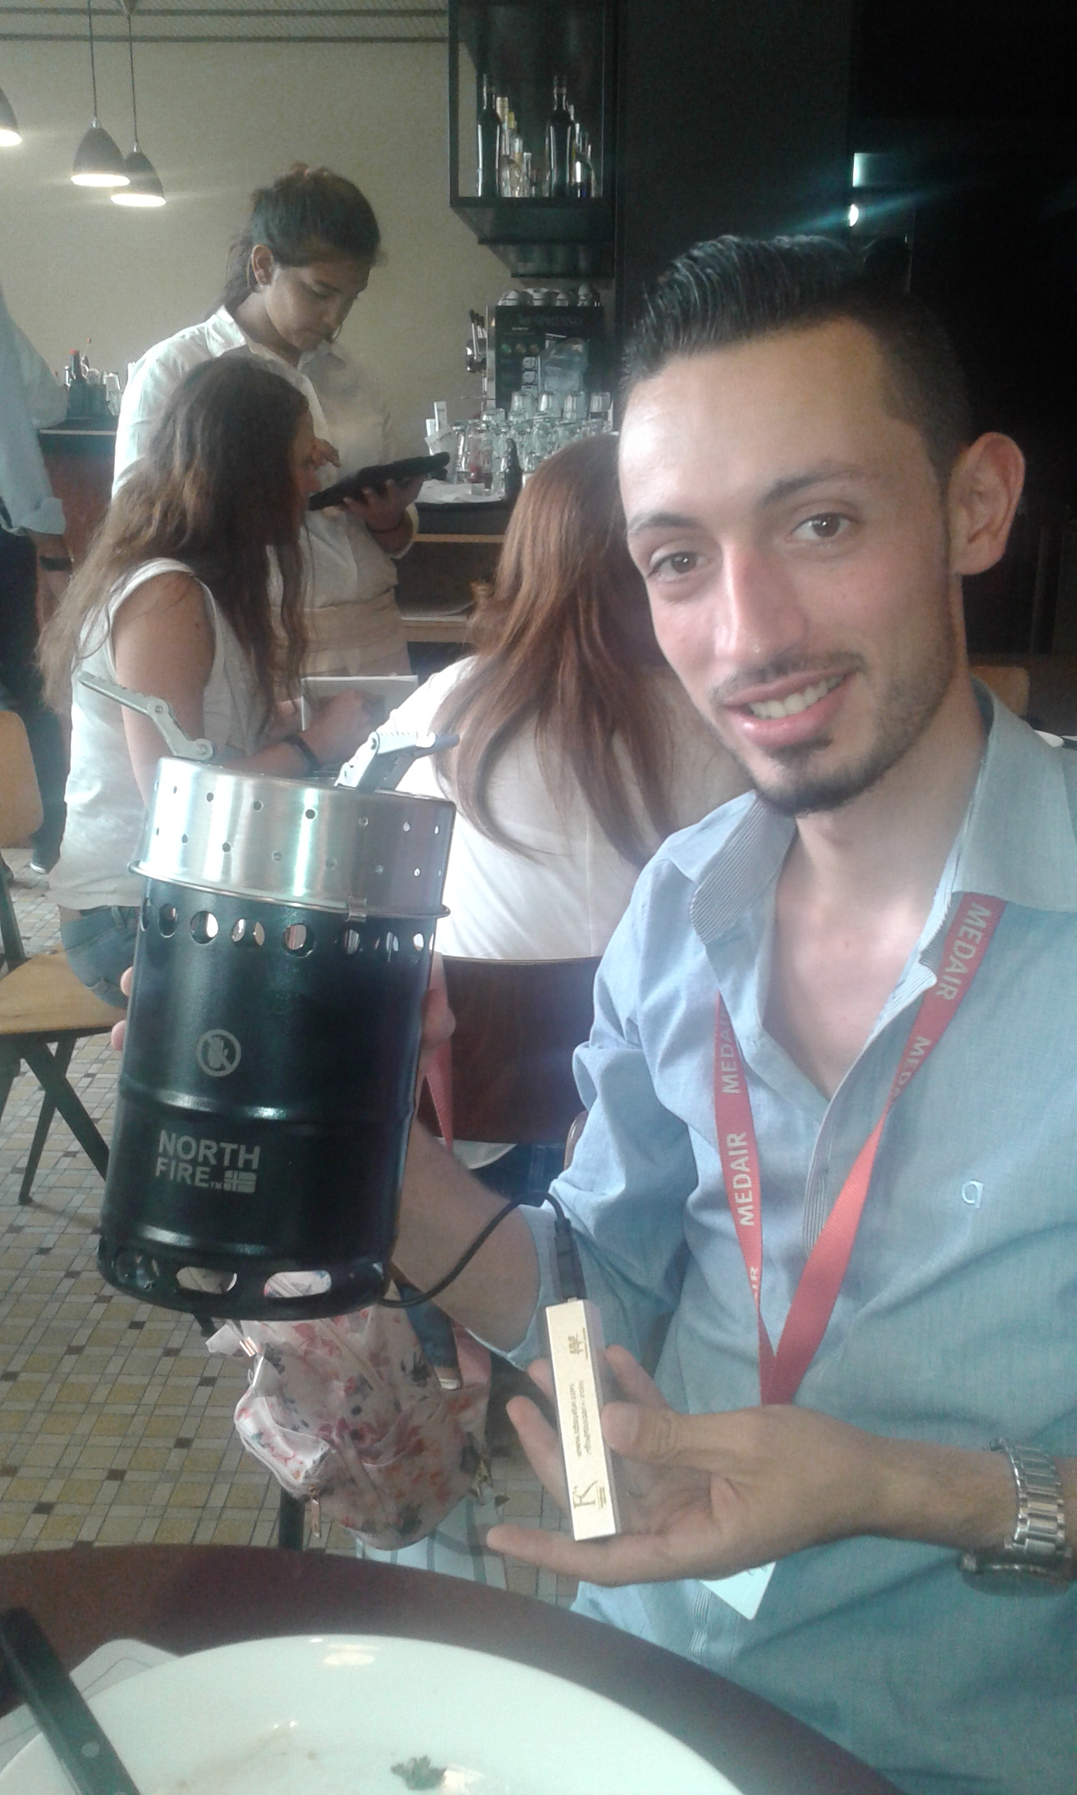
Way Forward: Coordination
Task Force / Regular meetings
Apply around country
Pilot projects
SSBs

Slide 22
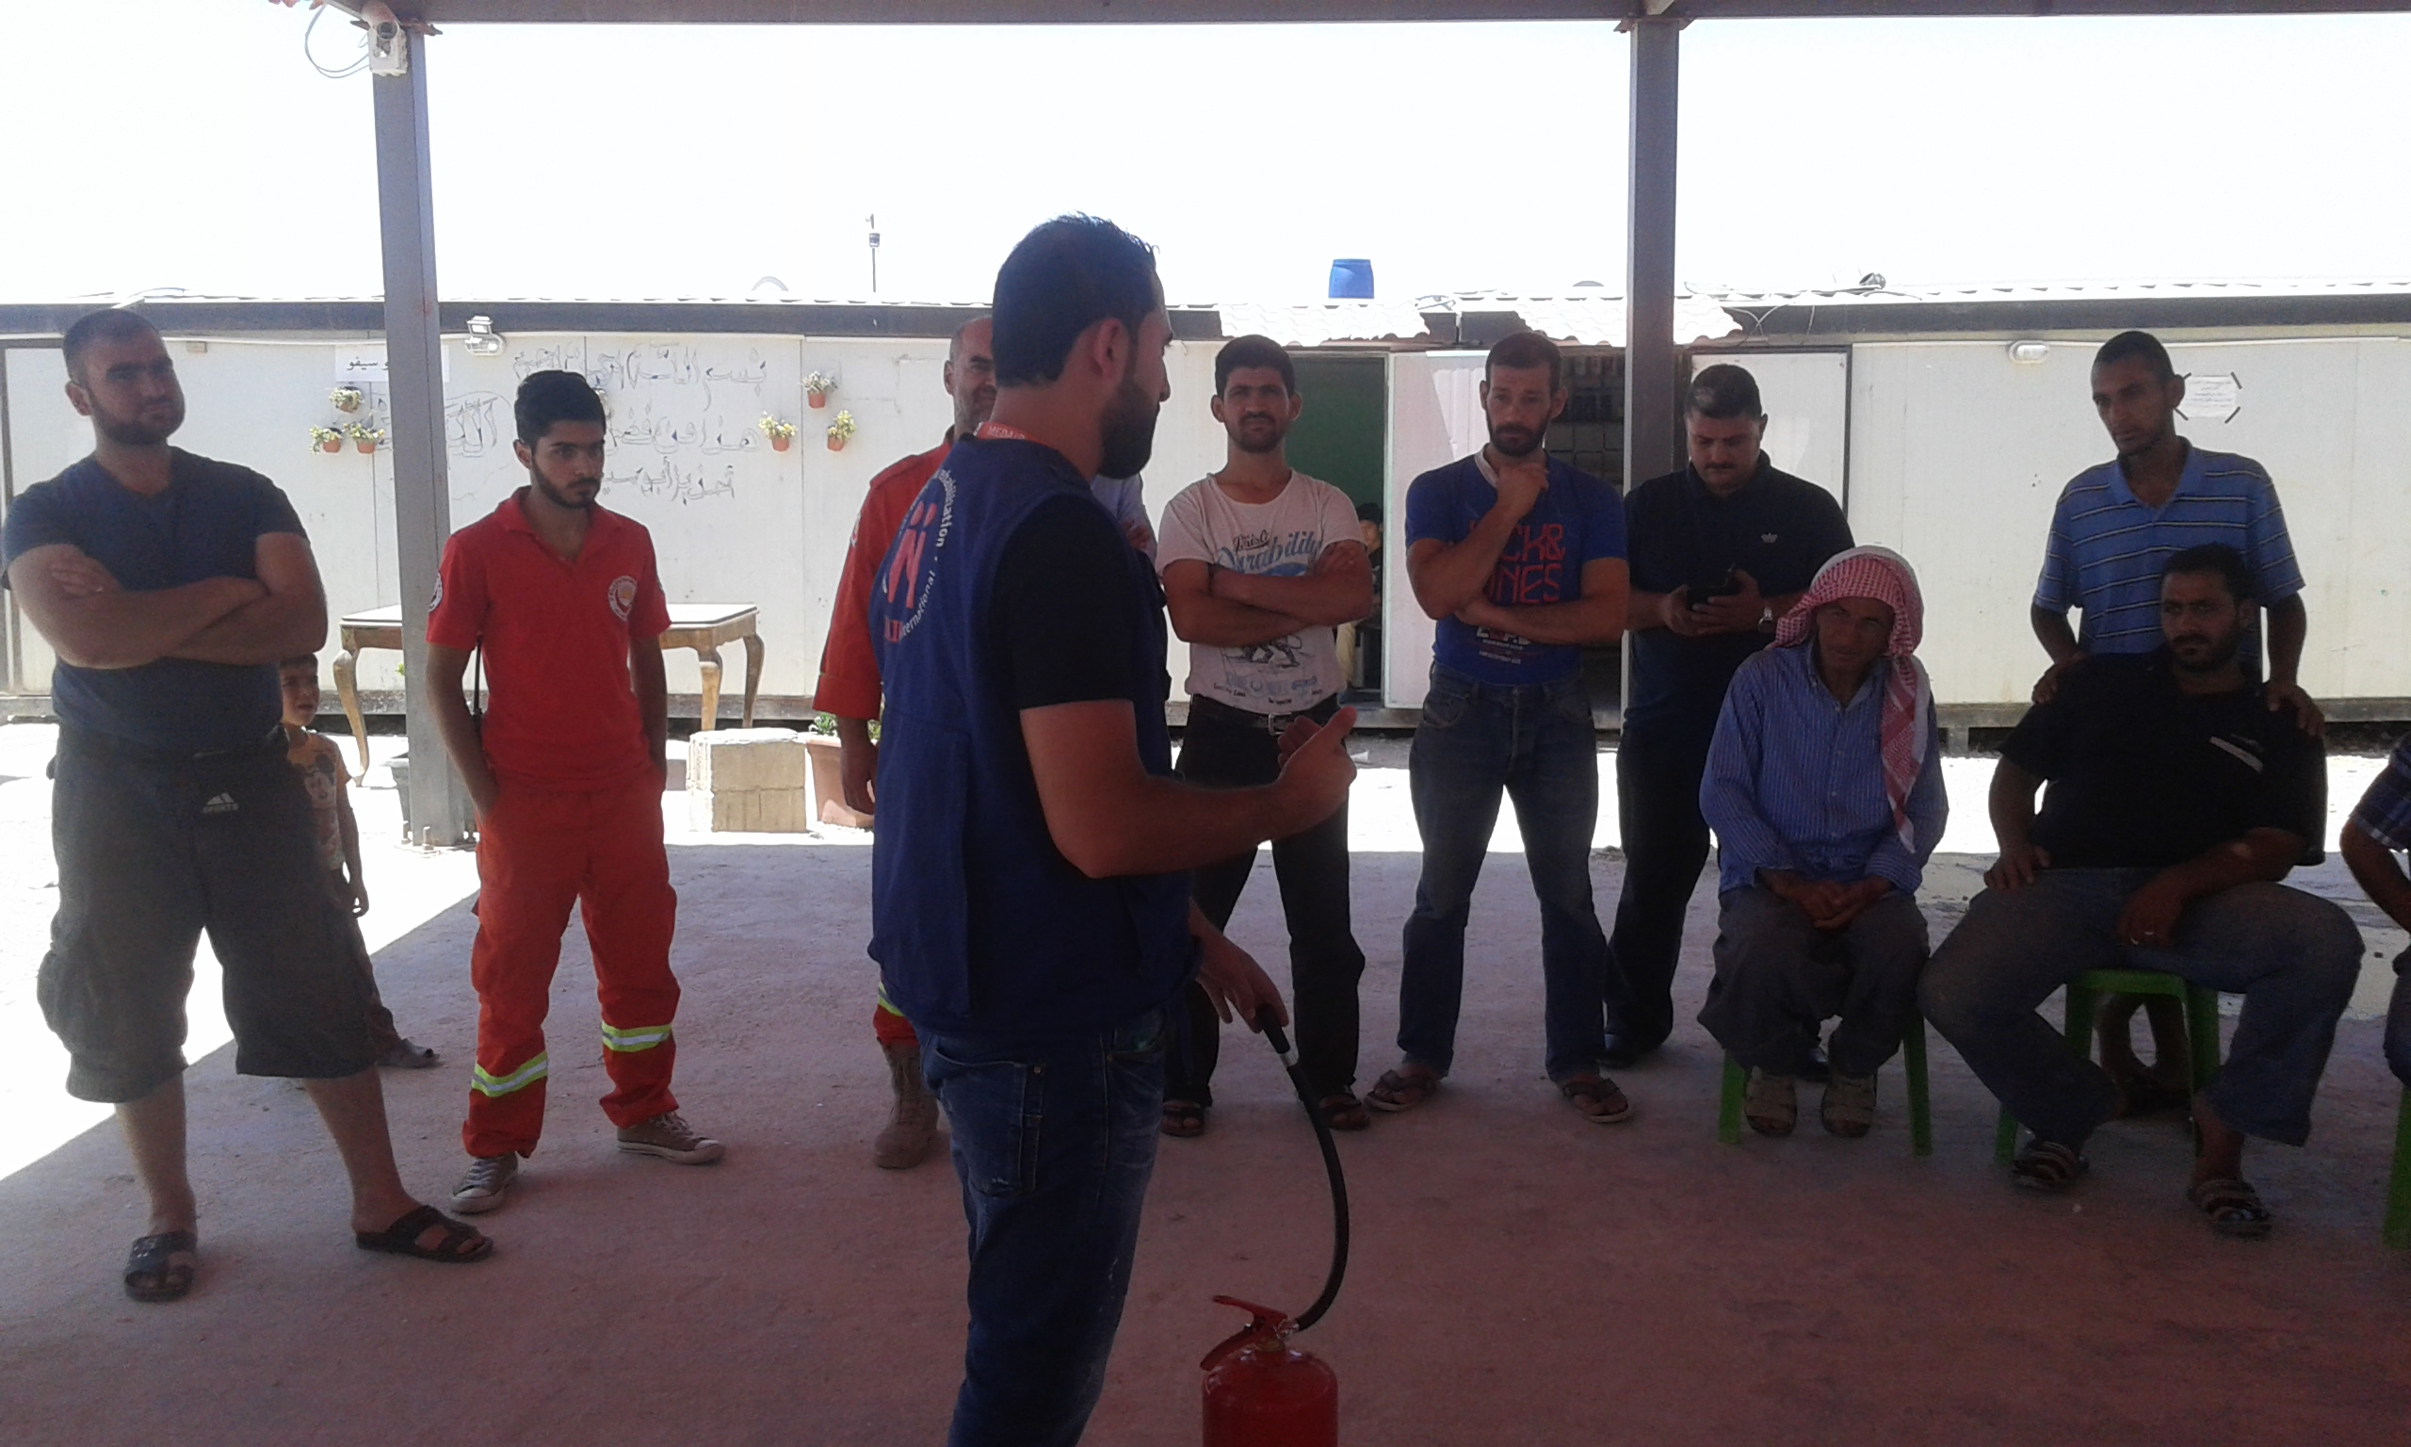
Questions?

