Slide 1

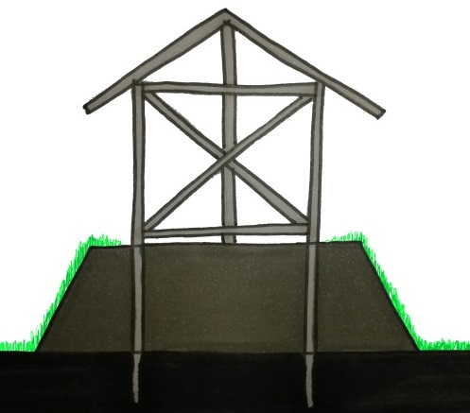
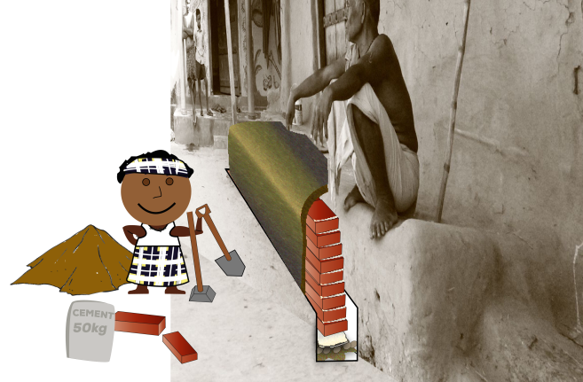

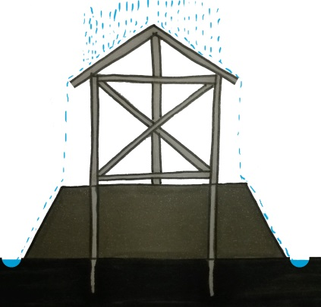
Flood: Build a Stronger Plinth
Without a strong plinth your house can be washed away in a flood
Without a strong plinth, your house can flood in an emergency
Without a strong plinth your house can erode away
WHY?
Build a brick wall around the plinth
Grow vegetation (e.g. grass) on the sides of the plinth
>1ft
Plinth height should be at least 1ft above annual flood level
RECOMMENDATIONS
or
Plinth should be well compacted: compact every 6 inch
Dig a drainage channel around the plinth to prevent erosion

Slide 2

Flood: Build a Stronger Plinth (2)
Design aspects for earthen house
Check the composition of the soil
Crush and sieve the soil through a screen. Remove debris and organic matter
Mix 5% cement by volume with earth in dry state. After thorough mixing, add water to make a past-like mixture.
Fill the jar 1/4 with soil, then top of with water.
Shake well and let it stand min. 8 hours.
Soil elements will settle into measurable bands.
The soil-cement mix can be placed by hand and compacted.
Plinth with soil-cement stabilization
Compact the finished plinth with a hand-rammer.
RECOMMENDATIONS
Curing should be done for 2-3 weeks by wetting at frequent intervals. Can be covered by jute sacks to keep wet.
Sand/gravel must be 40% tot 60% of the mix.
Add sand if needed to get to this percentage.

Slide 3
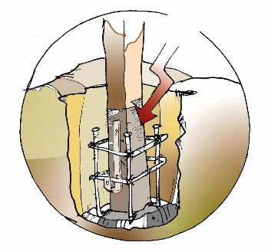
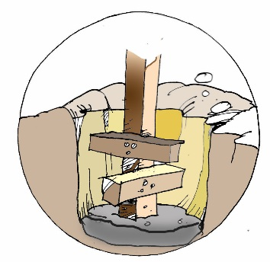
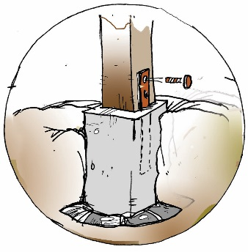
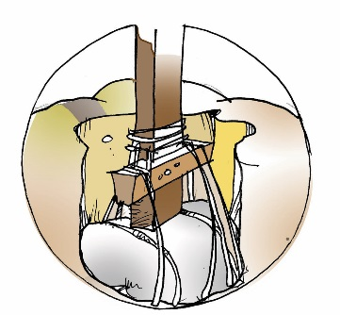
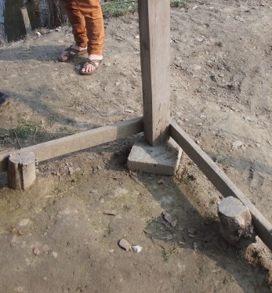


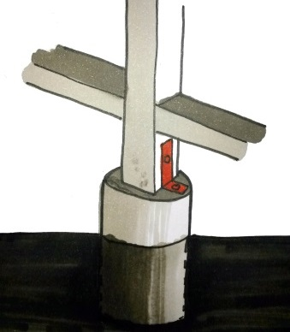
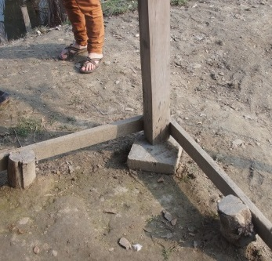


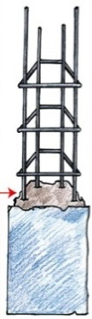
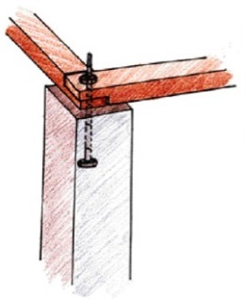
Flood: Build on Strong Foundations
Foundations are very important. They anchor your house to the ground. Ensuring foundations are suitable to your building’s location and ground conditions protect your house from flooding.
WHY?
Foundation should be dug at least 2 feet into solid ground
So below the plinth
Prevent wood and bamboo from touching the ground to avoid rotting – protect with plastic sheet or preservative (used engine oil / bitumen)
All force should go into ground, column should be attached to a foundation post.
RECOMMENDATIONS
Column not connected to foundation
Hard wood post with wooden column
Concrete post with wooden column
RCC pillar
too weak
strong
stronger
strongest

Slide 4



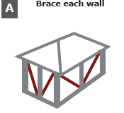
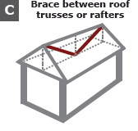
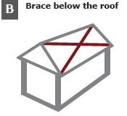
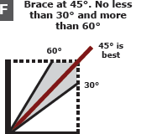

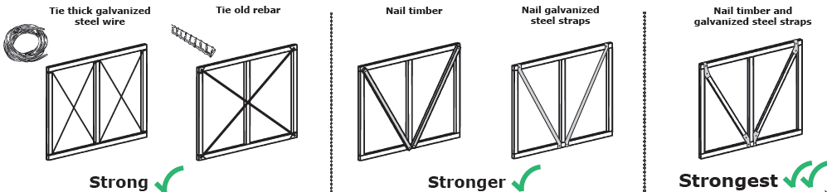
Flood: Brace your House
What type of bracing
Strong bracing stops your house being pushed over or pulled apart by the wind and flood. Bracing needs to be strong against being crushed along its length or pulled apart. Brace between the strong points of your house.
WHY?
Too weak
strong
Strongest
RECOMMENDATIONS
What materials can I use to brace my house?

Slide 5
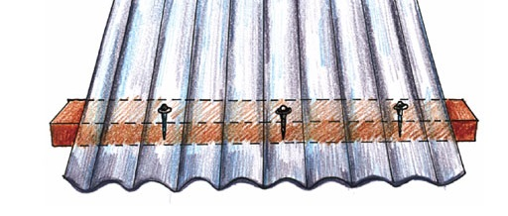
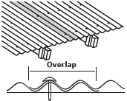
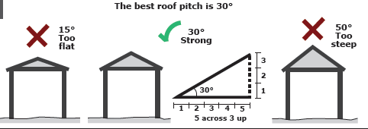
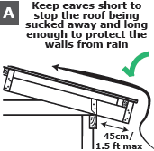
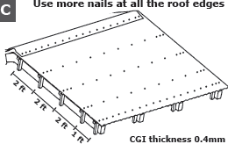
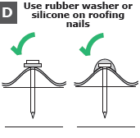
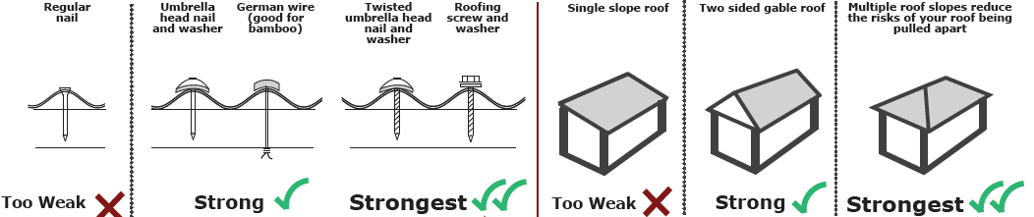
Flood/Storm: Build a strong roof
The way you design and build your roof is critical to protect you against strong winds and rain. Build your roof the right shape and pitch, and well nailed down to protect against a storm.
Overlap roof sheets at least 2 corrugations to strengthen joints
WHY?
RECOMMENDATIONS

Slide 6


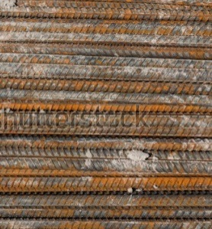
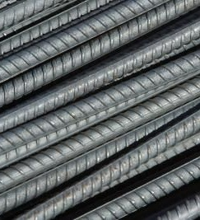
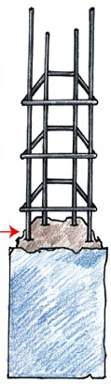




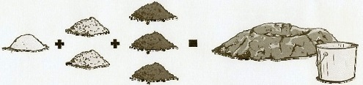



Flood: Use Good Materials for a Strong Foundation
Use a reinforced concrete pillar, reinforced with at least 4 iron bars
Bend stirrups correctly
Use clean, non-saline, water
Use unrusted iron bars
Store cement dry on palets
Use coarse gravel
RECOMMENDATIONS
Use good quality sand
Use concrete mixture 1:2:4
To mix concrete, use:
- 1 part cement
- 2 parts sand
- 4 parts coarse gravel
sea sand
river sand

Slide 7
Flood: Build a Stronger Mud House
Design options for a mud house
RECOMMENDATIONS

