Slide 1
Humanitarian Coordination Forum Date: 29 June 2017 GAROWE Shelter and NFI cluster Abdihakim Mohamed Shelter/NFI Cluster coordinator

Slide 2
Objective: Shelter/NFI cluster
Emergency assistance to newly displaced people affected by disasters (flood, fire, drought, conflict and evictions) as follows:
Distribution of a minimum NFI kit and an Emergency Shelter Kit where needed
Maintaining response capacity to distribute NFI minimum packages for 34,000 households to 204,000 people
Timely response to sudden on-set disasters through prepositioned stocks held across Somalia
Consideration of specific needs of women in programme design, and distribution of women’s dignity kits
Construction of Permanent and transitional shelter to protracted IDPs in Puntland

Slide 3
Achievements
NRC has distributed 200 NFI kits to drought effected HHs in Elbuh, Nugal region- with collaboration and funding by UNHCR
NRC has distributed 200 NFI kit to drought effected HHs in Dangoryo Nugal region- under funded by UNHCR
NRC has distributed 100 NFI kits to drought effected HHs in Haji Khayr, Nugal region- with support by UNHCR
NRC has distributed 850 NFI kit to drought effected HHs in Rako, Karkar region- under funded by UNHCR
NRC has distributed 150 NFI kits to drought effected HHs in Canbarhoose, Karkaar region-with grant by UNHCR
DRC has distributed 650 NFIs kits to drought effected HHs, in Darusalm, Margaga-2, Farhan Saaxo, Galkayou Mudug region- with funded by UNHCR
SCI has distributed 496 NFIs kits, in Gobsho village Mudug region
UNHCR and NRC have closely collaborated on initiatives to attain IDP durable solution through provision of advocacy on land and other HLP Rights.

Slide 4
Planned Activities
80 NFI in Cash to drought effected HHs in Guudcad, Karkaar region- financed by UNHCR
90 NFI in Cash to drought effected HHs in Caduura new IDP settlement, Karkaar region- with supported by UNHCR
277 NFI in Cash to drought effected HHs in Saxda, Karkar region-funded by UNHCR
73 NFI in Cash to drought effected HHs in Tibcaro new IDP settlement, Karkaar region-under UNHCR funded project
80 NFI in Cash to drought effected HHs in Daxan new IDP settlement, Karkaar region-under UNHCR funded project
600 NFI in Cash to drought effected HHs in Buran, Hayland region-under UNHCR funded project
250 NFI in Cash to drought effected HHs in Bali Busle, Hayland region-Under UNHCR funded project
150 NFI in Cash to drought effected HHs in Cawsane, Sanaag region-under funded by UNHCR
Distribution of 500 Shelter kits to drought effected HHs in Tubcaro, Caduura, Gudcad and Shaxda, Karkaar region-under UNHCR funded project
Distribution of 600 Shelter kits to drought effected HHs in Haji khayr, Elbuh, Usguray Dangorayo, Nugal region-Funded by UNHCR project
Shelter Cluster planned through coordination with government the distribution of additional 2000 NFI and 2000 shelter kits to drought effected people in Puntland-Funded by UNHCR

Slide 5
Operational Challenges/Gaps
Limited funding for much needed Shelter/NFIs
Lack or limited information sharing on needs and responses
Access in remote areas, poor infrastructure and bad road conditions in the rural area.
Different needs for protracted IDPs vs new IDPs
There is need to start re-building the resilience of these communities through early recovery programs
Unplanned eviction to relocation sites, Garowe

Slide 6
Recommendations
Urgent scale up provision of shelters kits/NFIs and tents to address the needs/gaps identified by Shelter Cluster.
Shelter Agencies together will look at increasing their emergency activities in objective 1 of the HRP 2017 to provide emergency NFI assistance to in total 204,000 persons that are displaced due to drought in Puntland. For those that have no shelter option after displacement
It is important to diversify and further de-centralize the efforts for provision of emergency non-food items to areas outside urban centers.
The following target groups should be prioritized:
Host communities outside urban centers hosting an influx of drought affected communities
Newly displaced drought affected persons and the host communities that have joined protracted IDP settlement
Host communities in urban centers hosting an influx of drought affected communities.
Construction of permanent and transitional shelter to protracted IDP and new drought effected HHs in Puntland

Slide 7
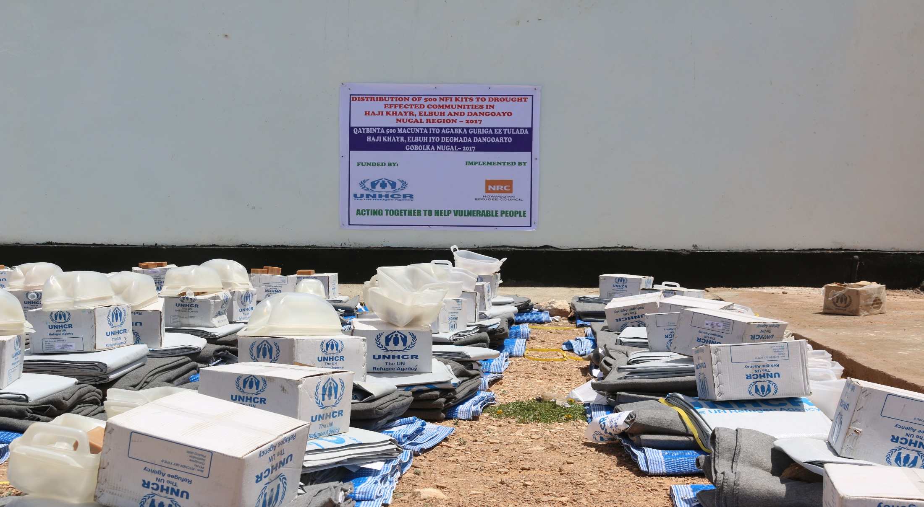
Photo

Slide 8
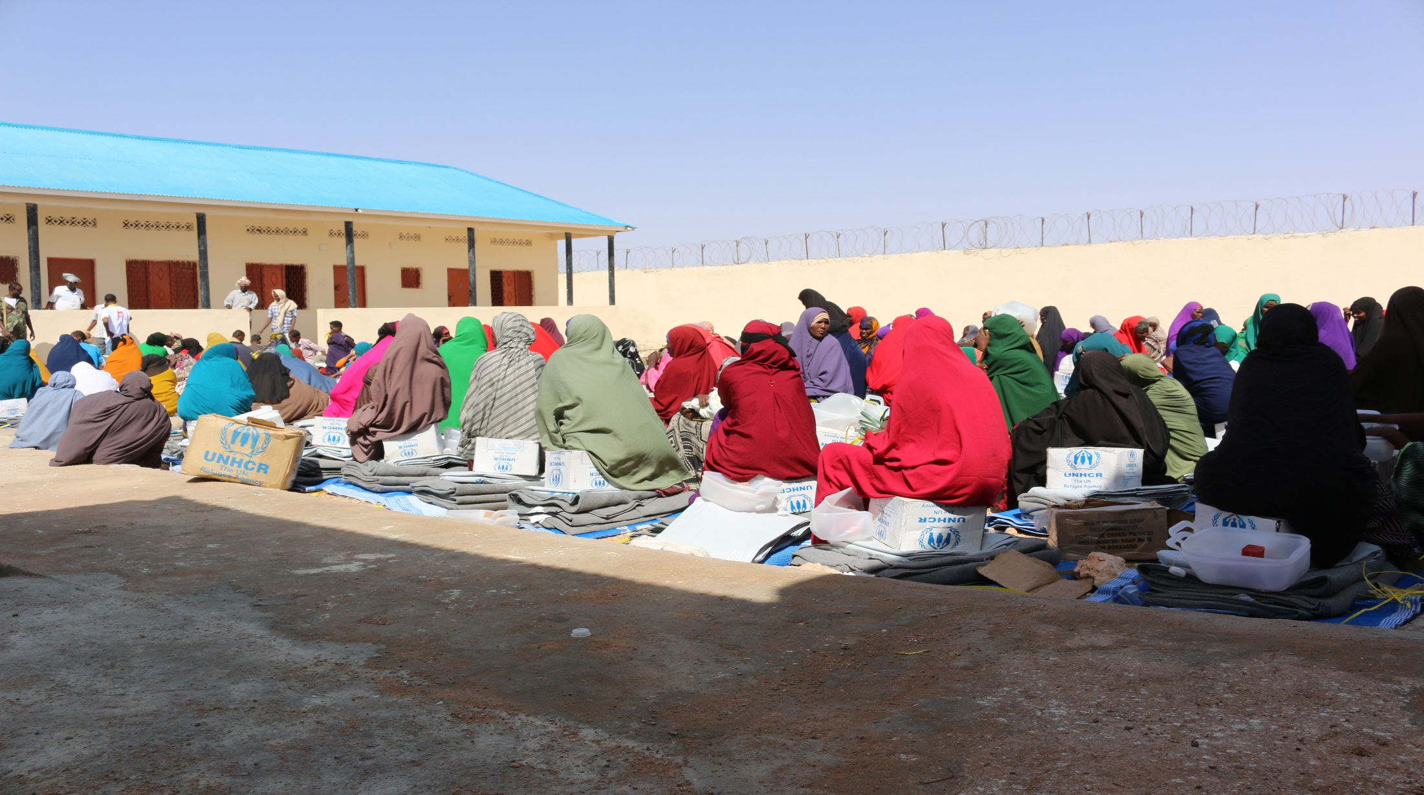
Photo

Slide 9
Thank You!
☺

