Slide 1
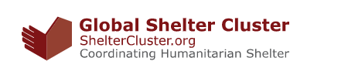


Shelter Cluster WG
Strengthening Diaspora’s Engagement in Shelter responses
First WG Meeting
December 18, 2020
Notes:
Add logos and training title – and project name

Slide 2
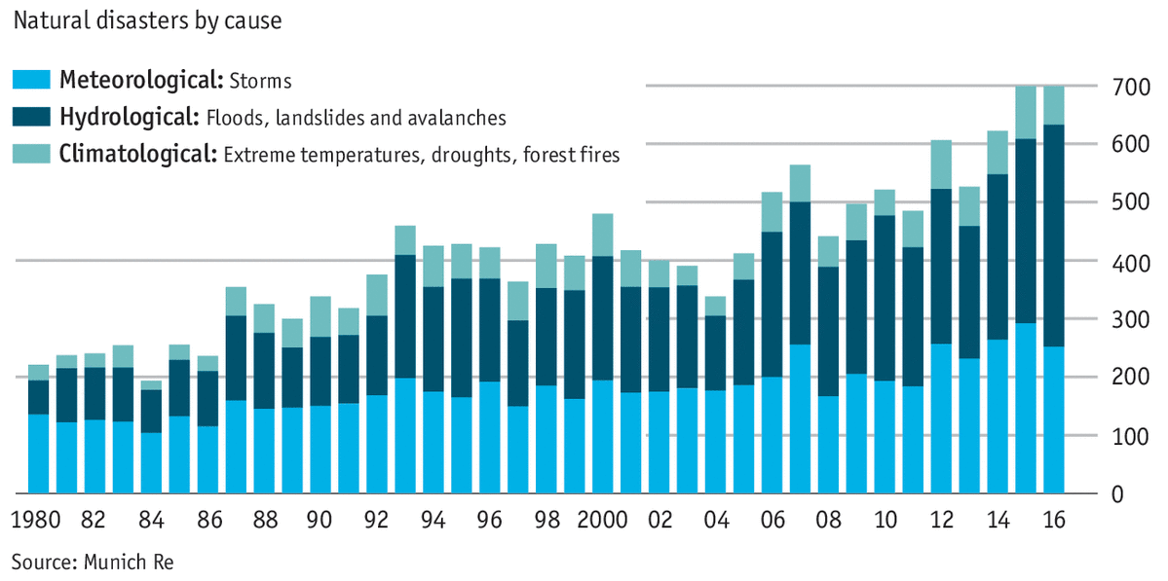
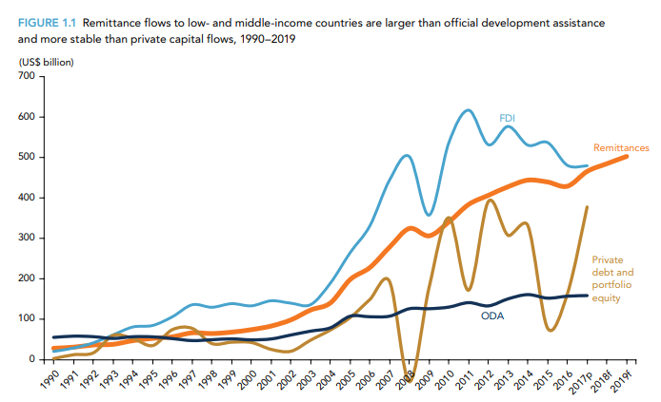
RATIONALE and BACKGROUND
RATIONALE
Unprecedented number of crises
humanitarian needs
Diasporas’ engagement
Officially recorded annual remittance flows to low- and middle-income countries reached $529 billion in 2018, an increase of 9.6 percent over the previous record high in 2017. Global remittances, which include flows to high-income countries, reached $689 billion in 2018.
Notes:
The unprecedented number and scale of humanitarian crises keep challenging national and international actors to meet the demand for assistance and services in increasingly complex situations.
. Since 1970, the number of disasters worldwide has more than quadrupled to around 400 a year. Another dataset of less serious types of weather- and climate-related events, defined as causing at least one death or a set amount of monetary damage, shows an increase, too. By this measure, compiled by Munich Re, there are six times more hydrological events now than in 1980. Last year’s total was the highest ever seen.
Shelter Sector: This is particularly true in the shelter sector where normally, only 10-20% of housing needs are met. Diasporas play often a key role in disaster response in their countries of origin, directly or through resources sent to their communities.
Migrants from developing countries send home billions of dollars in remittances every year – more than official aid and foreign direct investment. These remittances spike following natural disasters in the migrants’ home countries, with remittances having a significant impact on disaster response. Diasporas are also involved in many other aspects of disaster response, including fundraising and medical missions to their home countries.
Increasing diaspora engagement in disaster response is key to adapting to a shifting humanitarian context where humanitarian actors are looking to involve a multitude of stakeholders for a more coordinated, effective, comprehensive response. Diaspora are key actors in this field and it is time to work more closely.

Slide 3
The role of Diaspora in Humanitarian Response
Provide assistance in non-conventional humanitarian ways;
Have access to first-hand information;
Insert large amounts of cash support;
Deploy skilled volunteers to their country of origin; and
Access areas/communities that conventional actors struggle to serve.
Ability to connect and mobilize
Local knowledge
Strong network
Some challenges include:
Limited technical knowledge and resources
Issues of internal and external coordination
Limited preparedness – reactive attitude
Relations with home country institutions
Possible issues with adherence to humanitarian principles and standards
Lack of structured frameworks both in terms of internal and external coordination
Notes:
The available literature on the role that diaspora communities play in their countries of origin, particularly with regard to remittances, is vast.
Diasporas are certainly not new actors within the field of disaster response. Due to their high degree of access, local knowledge, and ability to respond and mobilize quickly in disaster situations in their countries of origin, the international community has been exploring and developing a unique relationship with diaspora members and their networks. The increased visibility and reach of diaspora engagement in humanitarian response has attracted growing attention from the international community over the last few decades, which has resulted in new research, studies, events and publications covering this issue. Although we have reached a better understanding of “why” diaspora engagement in disaster response and preparedness matters, we are now faced with the need to ensure that this engagement takes place in an inclusive, effective and systematic manner. The Diaspora Emergency Aid & Coordination (DEMAC) Project implemented by the EU’s Humanitarian Aid and Civil Protection department (ECHO) seeks to address “an understanding to enhance mutual understanding between diaspora-led and conventional actors of emergency response, and effect better coordination”. As diaspora communities become more influential in disaster response, particularly within the ability to:
Provide assistance in non-conventional humanitarian ways
In emergency settings, have access to first-hand information
Insert large amounts of cash support
Deploy skilled volunteers to their country of origin
Access areas/communities conventional actors struggle to serve
Further, the World Bank estimates that remittances up to a total of USD 436 billion are sent to their countries of origin in 2014 three times the amount of traditional development aid, it is crucial to explore the link of how diaspora community disaster response can be incorporated into the humanitarian system.
Within the scope of preparedness, disaster risk mitigation and reduction within the humanitarian field has historically been focused on internal mechanisms of support created at all levels of a society to implement policies. Yet not much research or assessment have been conducted in regard to diaspora community engagement in the preparedness again natural disasters, though a joint World Bank-UN Assessment of the Economics of Disaster Risk Reduction used evidence-based and anecdotal case studies to determine that households receiving remittances from diaspora communities are better equipped ex ante to mitigate the shocks of a natural disaster, in the form of infrastructural development or financial reserves.

Slide 4
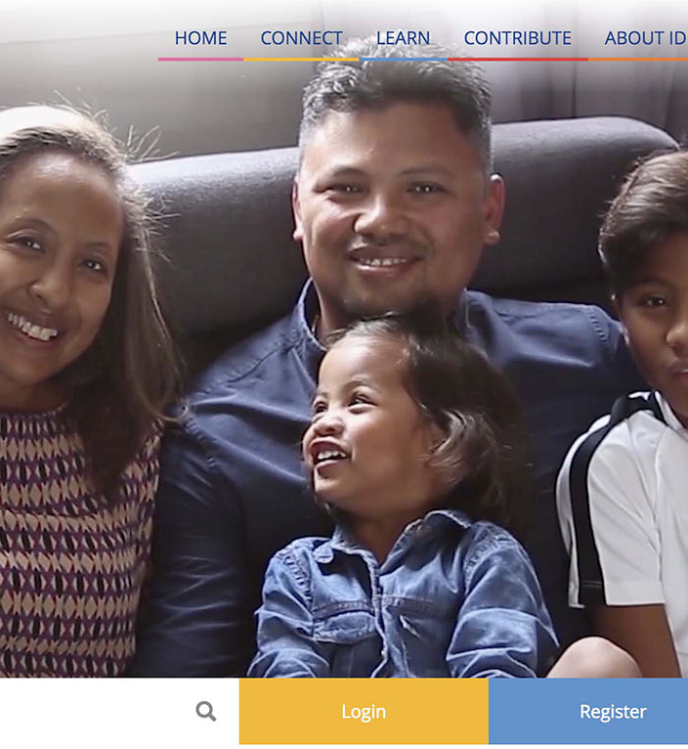
Efforts to engage diaspora in Humanitarian Response
IOM has acknowledged transnational communities’ efforts to rebuild and strengthen government and civil society institutions, focusing on post-conflict reconstruction (Afghanistan, Bosnia and Herzegovina, Iraq, Serbia, Somalia and Timor-Leste, etc).
The World Humanitarian Summit (WHS) held in Istanbul in 2016 reiterated with more vigor that Diasporas are key partners for more effective engagement – Statement of Commitments
However, despite widespread interest in diaspora’s increased role as humanitarian actors, their engagement in disaster response has yet to be systematically explored and coordinated with other actors for maximum impact – IOM DC project and DEMAC as current examples
Some internal efforts carried out by Diaspora groups and other actors as result of major natural disasters
Notes:
Efforts to engage the Diaspora in humanitarian action are grounded in this shifting humanitarian context, wherein humanitarians are looking to involve a multitude of stakeholders for a more sustainable and effective response. IOM acknowledges the need for and the value of this engagement, and the World Humanitarian Summit (WHS) held in Istanbul in May 2016 reiterated with more vigor that Diasporas are key partners for more effective engagement. However, despite widespread interest in diaspora’s increased role as humanitarian actors, their engagement in disaster response has yet to be systematically explored and coordinated with other actors for maximum impact. This project, “Engaging Diaspora for Alternative Approach to Safe Shelters in Disaster Response and Preparedness” implemented with funds from the U.S. Office for Foreign Disaster Assistance (OFDA), aims to engage diaspora groups to foster increased awareness on disaster preparedness and response, with a focus on safer shelters.

Slide 5
Experiences and efforts made by the Diaspora to engage in humanitarian response and shelter response –
The case of HRA in Haiti

Slide 6

IOM (OFDA funded) project to engage diaspora for an alternative approach to shelter response
Provide trainings of diaspora groups through online and in-person courses/workshops.
Conduct broader outreach through media campaigns
Promote the creation of diaspora response cells and other tools for a more effective and coordinated response in the shelter sector will be promoted.
Strengthen capacity building efforts on Build Back Safer and DRR for pilot affected communities.
Explore partnership to leverage remittances and the use of mobile money transfer infrastructures to disseminate DRR and Build Back Safer messaging.
Promote increased coordination with the Humanitarian system and actors (at Global and Country level)

Slide 7
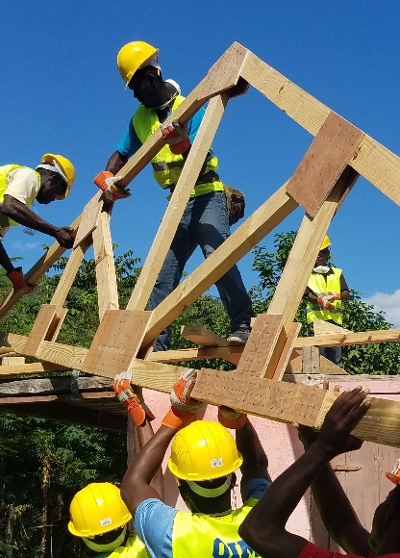
Some ways in which the diaspora could contribute to the shelter sector (survey and training results)
Provide procurement services
Provide capacity development of local actors on BBS
Work with NGOs to build housing capacity and restore the infrastructure
Provide technical expertise
Coordinate diaspora organizational efforts
Contribute architecture and engineering support
Provide temporary shelters and emergency relief to affected populations
Communicate and promote awareness campaigns for local communities
Work with local leadership
Help to direct logistics on the ground
Organize volunteers
Contribute to construction management
Fund reconstruction and support the recovery efforts
Notes:
Examples from the Bahamas

Slide 8
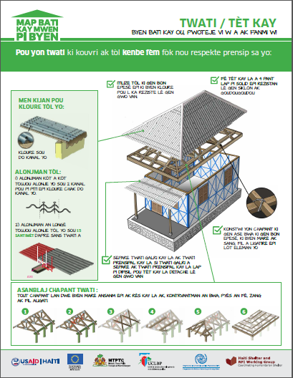
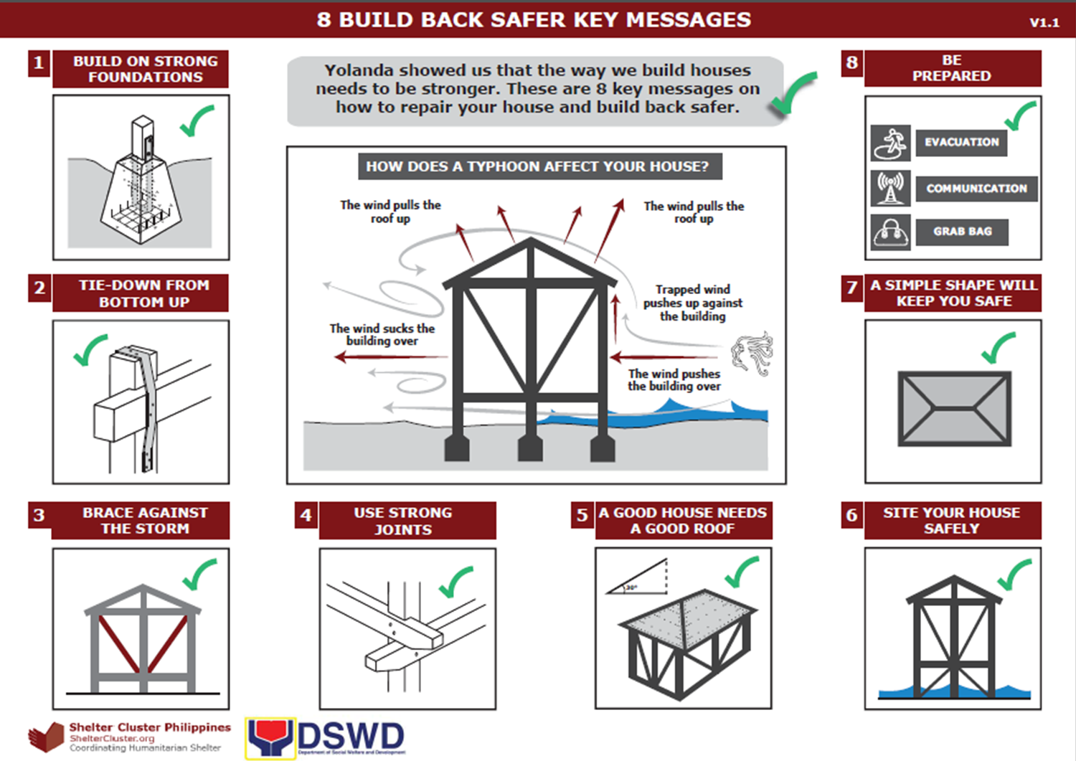

Slide 9
Scope of the WG
Develop SOPs for diaspora organizations (DOs), ensuring improved coordination, and a more effective on the ground engagement for DOs in disaster contexts.
These SOPs will seek to help clarify how these diaspora organizations can link with the shelter cluster and international shelter organizations, as well as how diaspora groups can better use their skills and capacities in response.
The focus will primarily be on natural disasters with a focus on the Diaspora groups for Haiti, Bangladesh and the Philippines.

Slide 10
Proposed timetable
Timeline | Task | Status | Actors
05 June 2019 | Submission of the project to SAG | Completed | IOM/HRA
October 2019 | Presentation of the WG to the Shelter Cluster | Completed | IOM/HRA
December 2019 | First call of the WG member: Division of roles in the SOPs drafting | Proposed date December 11th | All WGs members
January 2020 | Development of the first Draft of the SoPs – exchange between WGs members by email and bilateral calls |  | TBD
February 2020 | Second call of the WG member: Presentation of first draft and comments |  | All WGs members
March 2020 | Development of the second draft of the SOPs – exchange between WGs members by email and bilateral calls |  | TBD
April 2020 | External revision of SoPs |  | TBD
May 2020 | Third call of the WG members Endorsement of final draft |  | All WGs members
May 2020 | Dissemination of the SOPs framework to the broad Shelter Cluster |  | IOM
June 2020 | Finalization of the SoPs

Slide 11

Expected Outcomes
Recommendations for strategic diaspora engagement and integration in shelter process
Diaspora-specific SOPs for disaster response and recovery, including elements of coordination, communication, operational support, etc.
Referral tools: Guidance for diaspora actors on streamlining integration and establishing referral pathway to specialized Shelter actors
Other tools might be produced as result of the consultation process

