Slide 1
Global Shelter Cluster Satisfaction Survey
Overview of Global Shelter Cluster Survey Findings
January 2021

Slide 2
Summary
Participant profile
GSC service usage and feedback
Feedback from national shelter coordination teams
Feedback on GSC meeting outcomes and impediments to shelter response

Slide 3
Participant profile
Who participated in the survey?

Slide 4
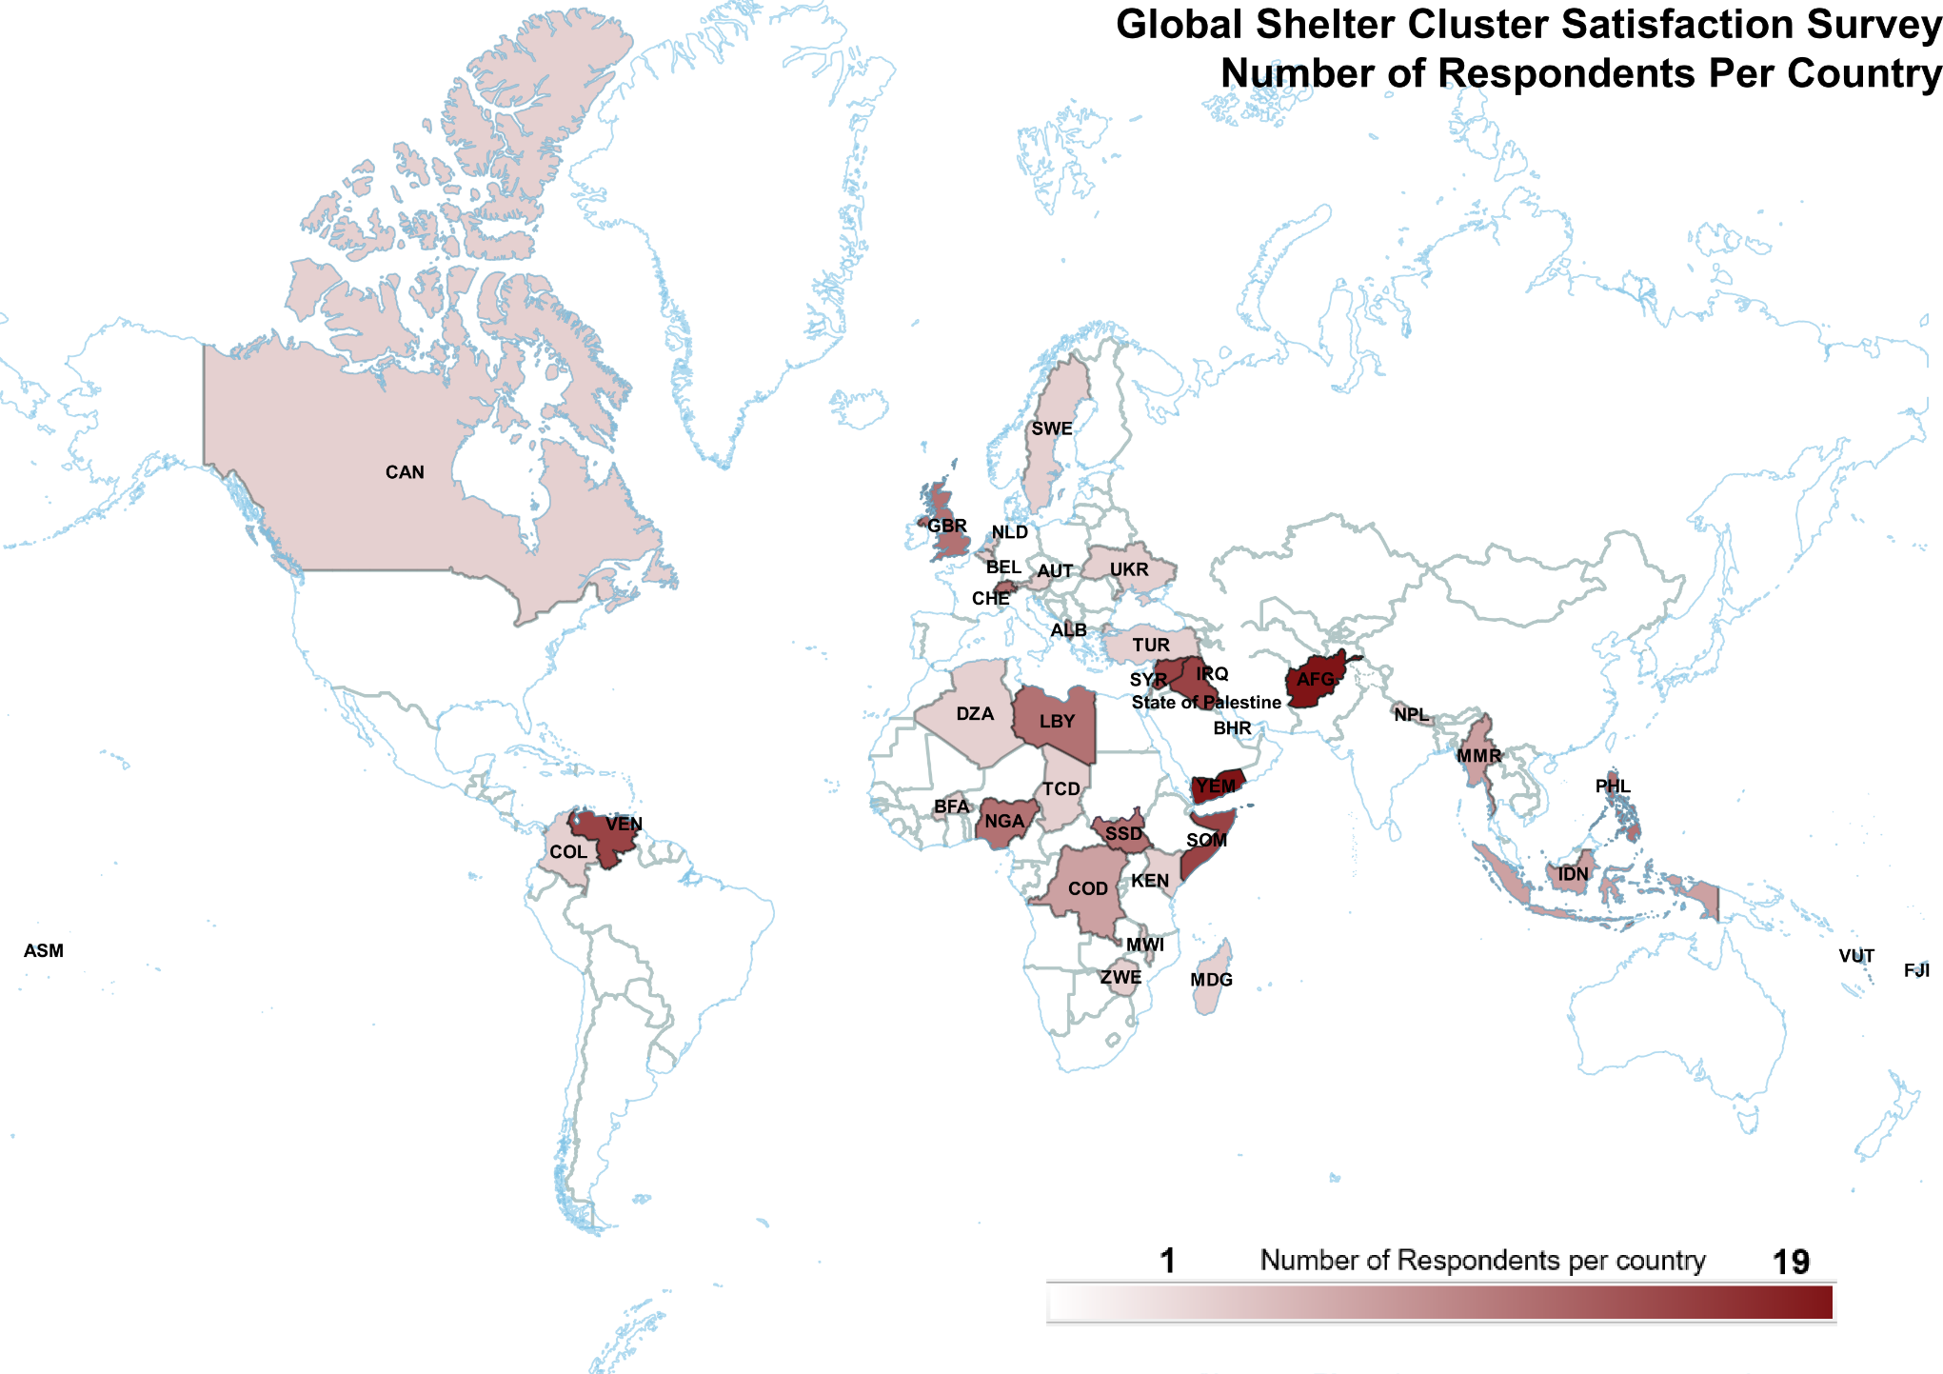
Notes:
Afghanistan, Somalia, Syria, Iraq, Somalia, and Yemen were among the countries with the highest respondents.

Slide 5
Number of respondents by region
129 responses
34%
26%
20%
12%
7%
1%
Notes:
Large proportion of respondents from the MENA region (34%) followed by Asia & Pacific (26%), and then Africa (20%). This is consistent with where there are the presence of the most clusters and partners.

Slide 6
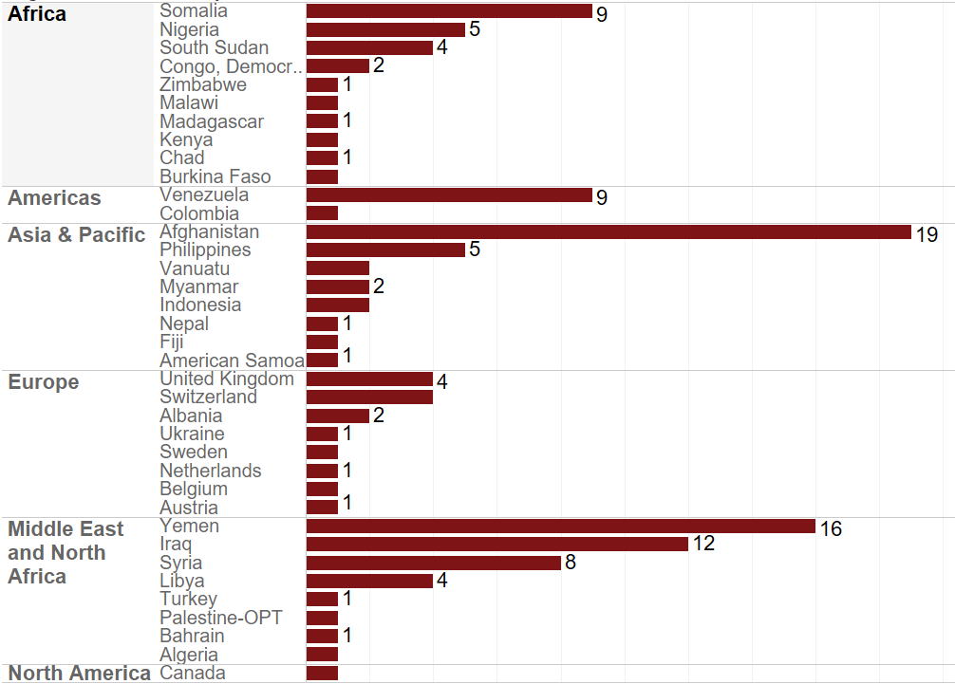
Number of respondents by country and region
Notes:
Afghanistan, Yemen, Iraq, and Venezuela provided the most responses
Within Africa, Somalia, Nigeria, and South Sudan provided the most responses

Slide 7
Number of respondents by organization type
30%
30%
23%
11%
2%
2%
1%
1%
Notes:
Slight dip in the number of national NGOs responding 24% this year compared to 32% in the previous year);
Consistent with other years, many UN agencies and INGO staff members completed the survey.

Slide 8
Org Type by Region
Notes:
The majority of National NGOs responding are based in MENA whereas last year a majority of the National NGOs were responding from the Africa region.

Slide 9
GSC service usage and feedback
What GSC services have respondents used/hosted and were they satisfied with these?

Slide 10
GSC services: number of respondents reporting using/hosting each (129 respondents)
40%
28%
26%
26%
25%
22%
19%
18%
17%
17%
15 %
14 %
14 %
11 %
10 %
7%
6%
Notes:
Respondents to the survey were asked to identify which GSC services they had used or hosted – they were able to select more than one.
Overall, approximately 33 people who completed the survey do not use the services of the GSC.
The most commonly used service was the Global Shelter Cluster website (40%) which was up significantly from last year likely reflective of the Pandemic and the virtual nature of much of the Shelter Cluster’s work in 2020, followed by Shelter Projects and the website (28%), REACH assessment and evaluation support (26%), the Humanitarian Shelter Coordination Training (26%), which because of the Pandemic could not take place in full in 2020, followed by the Global Shelter Cluster Focal Point for Coordination (25%).

Slide 11
GSC services: level of satisfaction
Coordination Indicator 1.1: % of stakeholders who are satisfied with the performance of the Shelter Cluster disaggregated by country-level and global.
Target 2020: 90%
Survey result: 94%
Notes:
The majority of respondents (94%) reported being satisfied or very satisfied with services.
Of those that reported not being satisfied, feedback was not very comprehensive or detailed, limited to the following comments:
GSC became more entrenched in Geneva, particularly with COVID and it seems caught up in discussions that are not really the discussions that are ongoing in the field. Displacement continued and GSC focused on covid discussions and not so much on how to continue to stay and deliver with growing displacement numbers.
GSC program have not reach us before at state level (Western Equatoria State) BCSO organization, therefore we recommend more training need to be done to us on all the process and tools for effective service delivery and uses of the documents of GSC
minimum standards are low. no where else in the world are people trying to be mediocre
Satisfied because GSC contains all information needed for a shelter intervention in one the countries covered by the cluster
The team is always responsive and ready to support.
They are not regarding contextual differences. E.G you cannot come and start implementing something that works for you at Yemen just because you are an expert without following the indiginiuos advice and expecting same at Nigeria
They dont advocate for getting funds and the shelter is more than important any other interventions, its a life saving and now displaced people exposed to every risk.
We have not had any contact with GSC before

Slide 12
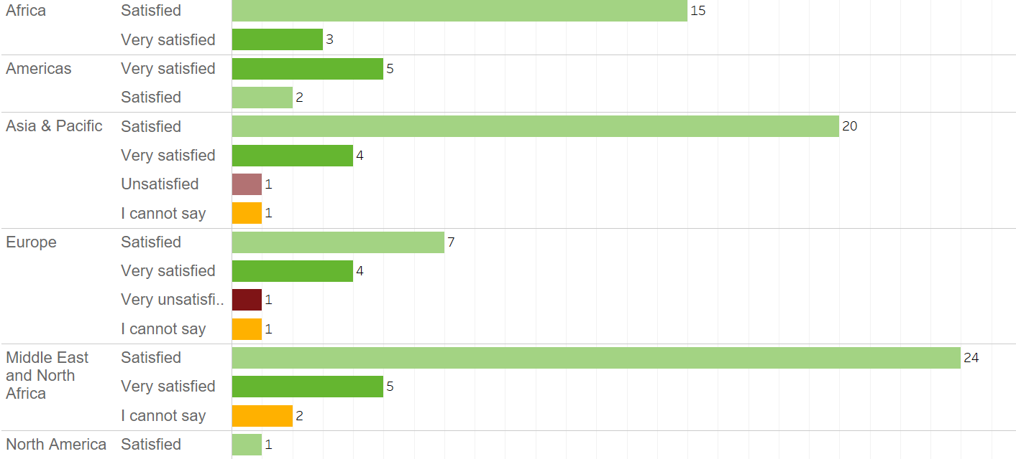
Satisfaction with GSC services by region and country levels
Notes:
The 90% target was met in the MENA region (94% satisfied or very satisfied), the Africa Region (100% satisfied or very satisfied), Asia & Pacific (92%), and the Americas (100%)
The specific countries where people were unsatisfied were Myanmar (1) and the United Kingdom (1).

Slide 13
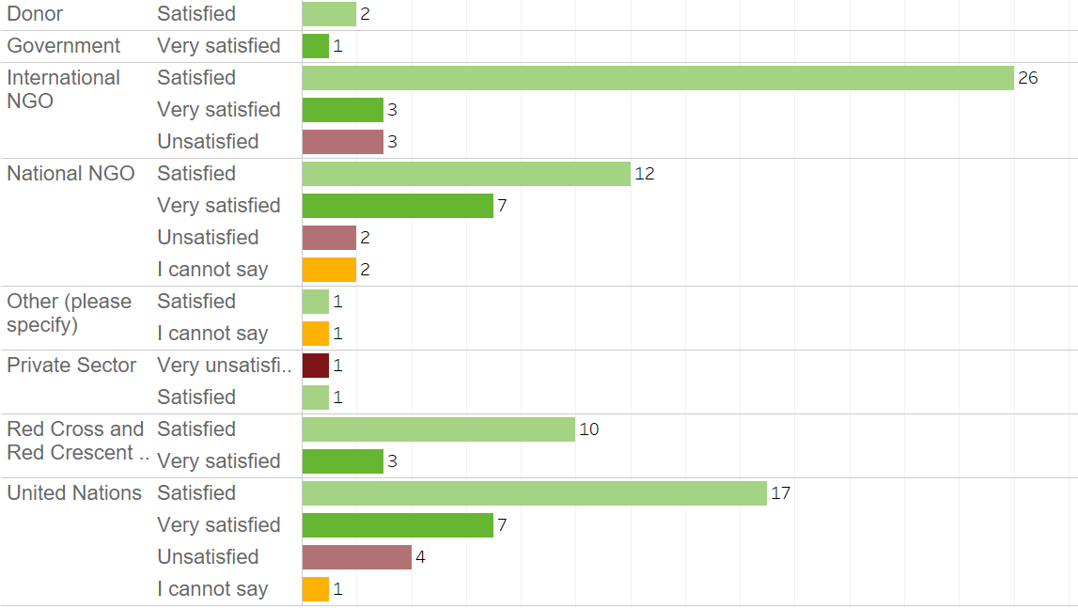
Satisfaction with GSC services by organisation type
Notes:
UN Agencies and International NGOs are generally satisfied with the performance of the GSC and its services.
There were only 2 donor and 1 government respondent.

Slide 14
Qualitative feedback on preferences to improve GSC services
Arrange training and meetings for regional cluster focal points even on provincial level.
Website could become more user friendly.
I suggest to increase the courses related to shelter and NFI , and focus on partners capacity building
Need to invest in solutions that go beyond emergency shelter and plastic sheeting.
Need for funding of coordination staff particularly nationals.
There are a lot of services, but more donor advocacy is needed to fund and implement them
Sharing the results of workshops and reports.
Comments related to in-country support and capacity building
Comments related to specific or thematic programme needs
Comments related to sharing materials and increased interactions
For my experience the GSC FPs are very supporting: more effort might be spent in roving experts for short mission to support at country level on specific topic.
There are good resources on the GSC website but mostly in English- would be useful to translate the most useful ones into French.
GSC team should be made more available to the field.
Cash for Shelter
Standards for beneficiary targeting and selection criteria should be looked into.
Create opportunities for local NGOs to implement Shelter projects.
More guidance/advocacy on changes in the HRP process.
Notes:
This is not a full list of all feedback provided, rather a selection of the most constructive.
Comments centred around 3 main themes: increased levels of in-country support and capacity building (particularly of national staff), comments related to specific programme needs (cash for shelter, assessments, private sector engagements), and sharing materials / increased interactions.

Slide 15
Feedback from national shelter coordination teams
What tools do partners/members of in-country coordination team most commonly use, and do they feel prepared to address challenges?

Slide 16
58%
17%
11%
9%
5%
Notes:
The majority of respondents are engaged in cluster coordination or shelter programming at national level (58%), followed by Subnational (17%).
Note that 7 respondents left this question blank.

Slide 17
Country Shelter Cluster services: level of satisfaction
Coordination Indicator 1.1: % of stakeholders who are satisfied with the performance of the Shelter Cluster disaggregated by country-level and global.
Target 200: 90%
Achieved: 82%
Notes:
90 respondents involved in National or Subnational Clusters ranked their satisfaction with National or Subnational Shelter Cluster Mechanisms
Respondents who marked lack of satisfaction include: Afghanistan, the Democratic Republic of Congo, Iraq, Libya, Philippines, South Sudan, Syria, the United Kingdom, Vanautu, Venezuela, and Yemen.
For respondents who remarked that they were unsatisfied or very unsatisfied, the comments provided included unedited:
cluster people are great. minimum standards suck.
Im working on improving it
It is passive and centered in burocratic tasks
Poor coordination, difficult communication, changing leadership
The National Shelter Cluster is not a good supporter of its partner specially the National NGOs
The performance of cluster is good regarding to organizing and activities, but the partners is to decrease participate due to the most aren't have fund or projects from donors, I claim to include more national NGOs in partnership with donors
the team is understaffing, actually only the coordinator is 100% dedicated. IMO at 33%, co-cordinator (INGO) at 25%. Needed staff: IMO%100, Deputy 100%, Co-Coordinator 75%, eventully area coordinators (3) 50%, Cash Expert 50%
We are unsatisfied just because we are not sharing the information.

Slide 18
Most recent Job position (90 Respondents)
34%
32%
14%
4%c
4%
3%
3%
2%
1%
Notes:
90 participants responded to this question.
A majority of the respondents were partner organizations of the Shelter Cluster at country level (34%), followed by Shelter Cluster/Sector Coordinator (32%), or other cluster/sector team member (14%).
Of the participants who responded to this question, it shows a high degree of familiarity with Shelter Cluster Coordination mechanisms at country level.

Slide 19
Tools used by shelter coordination teams (42 respondents)
86%
74%
69%
60%
48%
45%
45%
36%
31%
29%
21%
14%
7%
2%
Notes:
The 42 respondents reporting being a permanent member of the shelter coordination team (sector/cluster coordinator or other team member, and partner organizations) were asked to report on the tools that they used to address challenges.
The Shelter and NFIs indicator guide was the most popular resource used, followed by guidance on selecting NFIs for shelter.

Slide 20



Tools that are missing from the list?
Recommendations/guidelines on infrastructures (electrical plans, water systems, roads and bridges, etc.)
Inter-sectorial guidelines for joint interventions i.e. with WASH, Education, Health
The tools are okay but need more training for agencies at subnational level for effective implementation and knowledge/skill sharing
Guidance/toolkit for utilization of Cash vouchers for purchase of shelter items/kits

Slide 21
Coordination team preparedness to address challenges
Evidence-Based Response Indicator 4.1: % of shelter cluster coordination team members who feel prepared / have access to tools to address ongoing and emerging challenges
Target 2020: 70%
Survey result: 63% feel fully prepared; 35% feel somewhat prepared but need more tools, 2% do not feel prepared
Coordination team members were asked if they felt sufficiently prepared to address challenges, and whether they needed more tools.
Notes:
The respondents reporting to be a permanent member of the shelter coordination team (sector/cluster coordinator or other team member, and partner organizations) were asked to report whether they felt prepared to address ongoing and emerging challenges. This represented 57 respondents for 2020
More than half felt prepared (36 respondents), but 20 respondents felt that they would need more tools to be prepared. Of those requesting more tools to be fully prepared: 40% were in the MENA region, 25% were in the Asia and Pacific, and 20% were in Africa. The 1 respondent not feeling prepared was from Yemen.

Slide 22
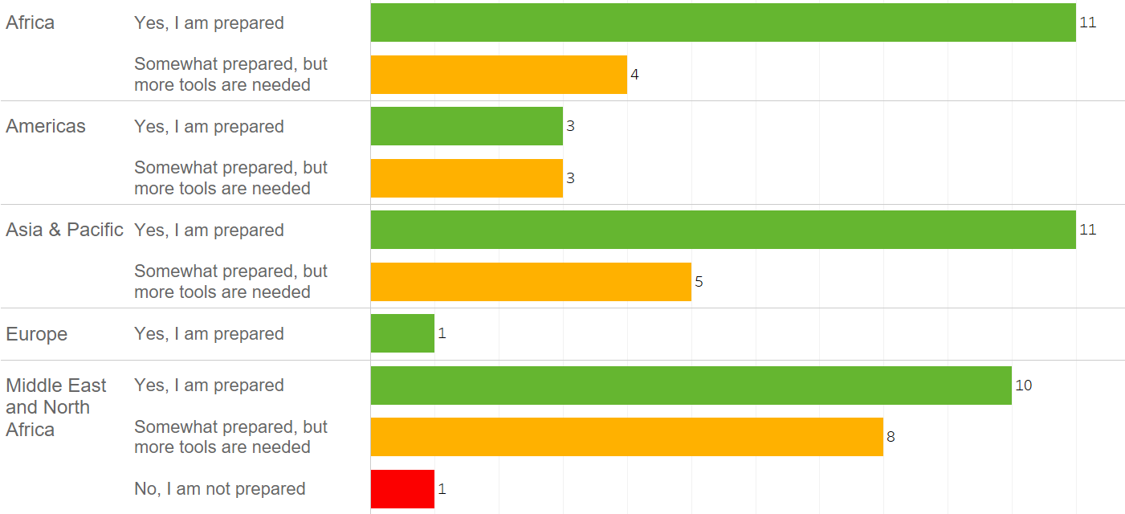
Coordination team preparedness to address challenges by region
Notes:
The respondents reporting to be a permanent member of the shelter coordination team (sector/cluster coordinator or other team member, and partner organizations) were asked to report whether they felt prepared to address ongoing and emerging challenges.
Although more than half felt prepared (33 respondents), half of respondents in MENA and 38% in Africa felt that more tools are needed.

Slide 23

Coordination team qualitative feedback on how GSC can support capacity building
The GSC can support with the minimum trainings related to information management as the Cluster coordination is sometimes facing to the lack of IMO.
Organize training related to shelter coordination at the sub-national level. Do more for funding in order to have dedicated Shelter Cluster Coordinator at sub-national level(sometimes, many of us are double hatting)
GSC should look downward create capacity building to the shelter actors at the grassroot level.
Provide induction trainings for all coordination team members joining a cluster team at country-level.
Provide online trainings especially for national staff.
Shelter repair with different categories require more harmonization to avoid harm to the beneficiaries.
Notes:
Members of coordination teams were asked what the GSC can do to invest in capacity building. This is not an exhaustive list but represents the main feedback from partners. The full list of feedback is listed below without editing for spelling or typos:
GSC can provide online training courses for ES/NFI cluster members in Afghanistan
GSC should look downward create capacity building to the shelter actors at the grassroot level
I think GSC provides a good support
induction training to Shelter Cluster team, from national to sub-national team members
information hsaring on online trainings
Meanwhile We as organization only lack funding to facilitate the activities smoothly.
Most of the GSCs' guidelines supports for our organization capacity building
online training programs to the members especially the national staff
organize online training
organize training related shelter coordination at the sub-national level. Do more for funding in order to have dedicated Shelter Cluster Coordinator at sub-national level(sometimes, many of us are double hat)
Sharing lessons learned as the result of surveys and past experiences in cluster meetings and
Shelter repair with different categories require more harmonization to avoid harm to the beneficiaries.
The GSC can support with the minimun trainings related to information management as the Cluster coordination is sometimes facing to the lack of IMO.
(blank)

Slide 24
Coordination team feedback evidence-based
Evidence-Based Response Indicator 3.3: % of shelter cluster coordinators and partners reporting that they have access and use evidence, learning and best practices
Target 2020: 90%
Survey result: 97 %
Coordination team members and partners were asked to agree with a statement: “I have sufficient access and consistently use evidence, learning and best practice in my daily work.”
Notes:
97% of the respondents (members of the coordination team or partners of a Shelter Cluster mechanism) answering this feedback (57 participants) agreed with the statement.
While the majority somewhat agree (37 respondents), 18 strongly agree, and 2 somewhat disagree.
People who disagreed, provided some explanations without editing of correcting typos:
How the best practices from other countries can be share with us?
Not enough time to dedicate to learning as I am alone in solving the daily coordinaiton and incoming issues
Reason is that new tools and polices or ways of implementing activities are develop daily, therefore, the little knowledge we as an organization have now may not be encourage and we still need more and more training in those areas and tools/documents.

Slide 25
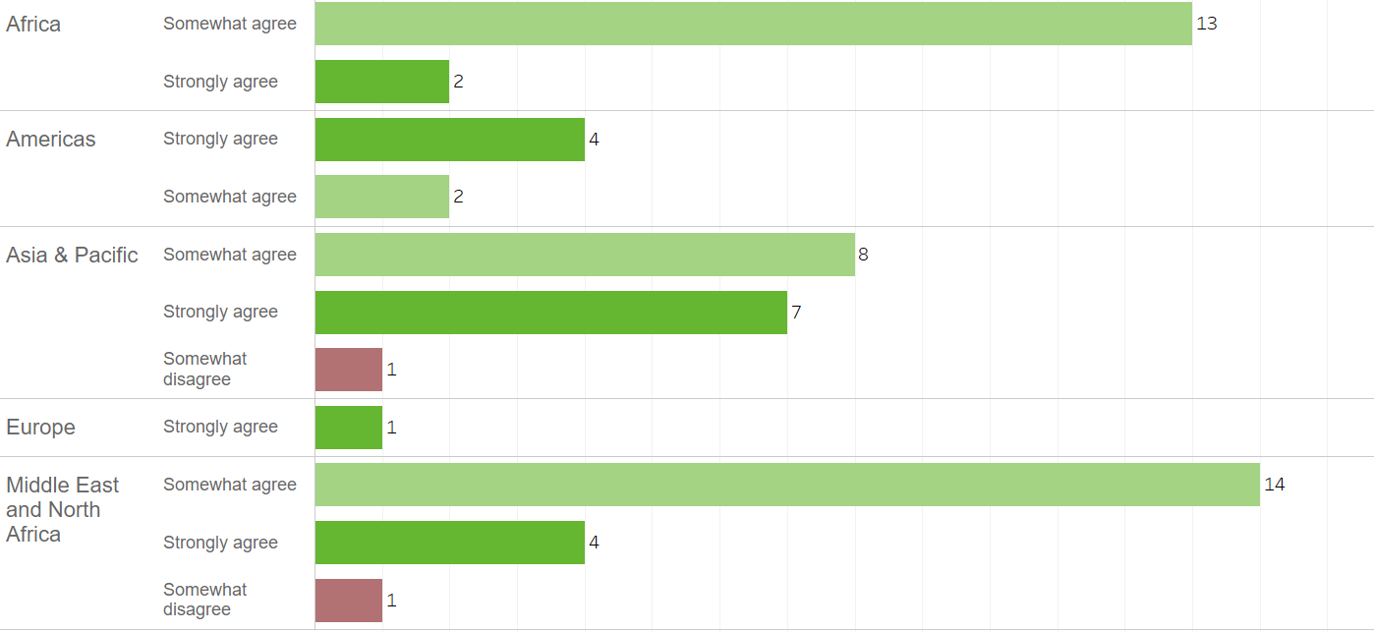
Coordination team access to evidence and learning by region: “To what extent do you agree with the following statement: I have sufficient access and consistently use evidence, learning and best practice in my daily work?”
Notes:
The respondents reporting to be a permanent member of the shelter coordination team (sector/cluster coordinator or other team member, and partner organizations) (57 respondents) were asked this question.
The majority of respondents somewhat agreed with this statement; the Asia and Pacific had the highest number of respondents who strongly agreed with the statement but also had one respondent somewhat disagree with the statement.
Feedback from country-level included the following:
Afghanistan: How the best practices from other countries can be share with us?
Libya: Not enough time to dedicate to learning as I am alone in solving the daily coordination and incoming issues.
South Sudan: Reason is that new tools and polices or ways of implementing activities are develop daily, therefore, the little knowledge we as an organization have now may not be encourage and we still need more and more training in those areas and tools/documents.

Slide 26
Coordination team feedback on response strategies
Evidence-Based Response Indicator 3.1: % of shelter cluster partners reporting that response strategies are ‘appropriate’ based upon the existing evidence
Target 2020: 68%
Survey result: 75%
Coordination team members were asked if they agree with the statement ‘The current shelter strategy of the country-level cluster is appropriate AND based upon existing evidence?’
Notes:
The respondents (57) reporting to be a permanent member of the shelter coordination team (sector/cluster coordinator or other team member, and partner organizations) were asked this question.
Most respondents (43) said that the shelter cluster strategy was appropriate based on existing evidence. 9 said the strategy was appropriate but not based on existing evidence, 4 said that it was not appropriate and not based on existing evidence, and 2 said that it was not appropriate but based on the existing evidence.

Slide 27
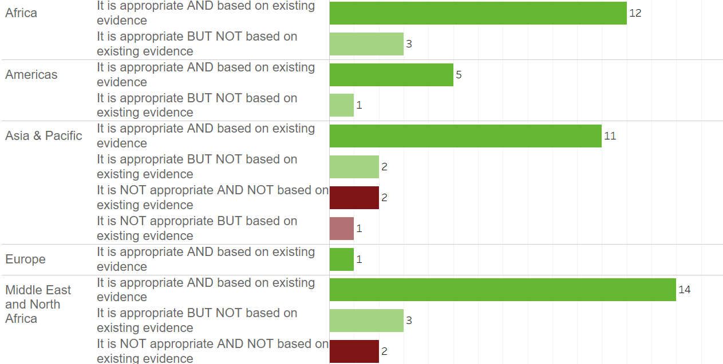
Coordination team feedback on country-level shelter cluster strategy by region
Notes:
Most of the coordination team respondents in all regions thought that the country shelter strategy is appropriate and based on existing evidence.
Some country-specific feedback:
Myanmar: A 2 year gap in dedicated coordination means we are starting again largely from scratch.
Afghanistan: As we have both cold and warm climate in the country. the one/two room shelter design for both climates should be there to better help the aid agencies and the affected population.
Democratic Republic of Congo: evidence needs updating - currently based on a 2018 evaluation
Libya: Libya has a quite complex and fluid situation, the scenarios continuionsly change thus any strategy might be inappropriate after a given time
Burkina Faso: Scarcity of shelter needs information has been a strong issue for the shelter strategy in 2020. Availability of information has improved a strategy revision is planned
Vanuatu: Strategy not clearly identified and leadership keeps changing
South Sudan: The document developed by different agencies and corrective ideas
Yemen: The focus is given to the IDPs in the camps, while the care is not given to those displaced from their homes to other homes in other areas.
Afghanistan: the strategy has responded based on need of vulnerable affected families.
Chad: The strategy was merged with CCCM strategy and now we are still reviewing it to have for each cluster its own strategy. The CCCM strategy is completed and we are working on the shelter strategy.

Slide 28
Do you have other comments, questions or concerns, or would you like to give the GSC additional feedback?
Develop guidelines on implementation of alternative shelter solutions during emergencies phase.
GSC has to have more funding opportunity for staff capacity building. Due to operations funding limitations, country level clusters can’t support staff for capacity buildings that is really needed. As mentioned earlier need to invest more and think about coordination as one of the first priorities for the operations when it comes to decision making.
I recommend to make the cluster more effective, and do a role of encourage more national NGOs to involve in implementation shelter and NFI projects, not limited only in old partners, also to recommend the qualified partners to qualify and make sub partnership with young NGOs
We need to stop working in an ad hoc way.
The sector is an excellent way to co-ordinate shelter, and it has brought many benefits to the humanitarian world. My only two comments are: 1) It is a concern that some small inexperienced actors continue to provide humanitarian shelter support outside the sector and in a damaging way - how can we stop this occurring? Some legal framework for forcing actors to confirm to minimum safety standards? b) We are a technical partner who frequently advise the shelter cluster on safer humanitarian shelter, especially in seismic areas, and on with natural materials. We have seen countless bad practice in the sector. The shelter cluster is excellent at distributing good practice, but we also need to challenge bad practice. Some additional rigour on bad practice technically would be very beneficial!

Slide 29
Registration to 2020 GSC Meeting
What do GSC 2020 Meeting Attendees want as an outcome, and what do they believe are impediments and solutions to current shelter response?
This year the meeting was held virtually and only 21 respondents participated in this portion of the survey due to the different format of an extended virtual meeting held across several months.

Slide 30


Profile of Respondents
No. replies per org.
Notes:
The majority of people who registered for the event were working in Headquarters in countries such as Australia, Switzerland, Hungary, the United States of America, the United Kingdom etc.
Similar to the Satisfaction Survey, respondents from UN agencies and International NGOs were predominant.
Respondents from UNHCR were the highest number of people responding (4), followed by IOM (3).

Slide 31
AT Which Level of Response are You working?
13 Respondents work at global level
8 work at National Level

Slide 32
What are 3 of the most influential impediments facing the shelter sector in your experience in the last 12 months?
Notes:
Insufficient funding continues to remain the top issue for country-level Shelter Clusters (11), followed by poor understanding of field realities.
Note that due to the change in format of the Global Shelter Cluster meeting, the number of respondents is remarkably lower this year.
People who replied other, stated:
Poor continuity of funding from the immediate aftermath through recovery
Shelter Design and Durability
Unforeseen consequences of the Covid-19 pandemic

Slide 33
What areas of cluster coordination have the greatest potential to reduce those impediments? (3 choices)
Notes:
Improved more predictable funding for shelter operations was the most significant improvement to reduce the challenges related with the lack of funding particularly that was identified in the previous question, this was followed by increased coordination and subnational level.
Other replies included only one: New Innovations

Slide 34

Feedback on what would be a great GSC 2020 meeting outcome
Challenge assumptions we hold and hear a new perspective.
catching up things happened since the last year meeting.
capacity to lead, to share information to the shelter cluster
To understand shelter coordinator deployment and which agencies have rosters for deployments
Clarity on emerging priorities and issues identified by Shelter Cluster and other Participants
Clear shared understanding of the Shelter Sector's limitations and necessary adaptations for the coming decades.
Networking and knowledge sharing on best practices and approaches on challenging issue like resilience shelters for seasonal flooding.
impact of C19 on shelter programs and coordination structures: resources, programming, conditions, etc.
Establishment of 2021 Inter-Agency Working Group on Fire Safety
funding perspective: what's left for humanitarian aid in 2021 and beyond?
Learn good practices on transitioning & how to reinforce humanitarian-development-peacebuilding nexus.
Notes:
This is a collection of most, but not all, of the responses to the question:
What would be a great meeting outcome for you?

Slide 35
Thank you

