Slide 1

Libya Shelter NFI Sector GSC Meeting 2020 21 October 2020
Shelter NFI Sector Libya
ShelterCluster.org
Coordinating Humanitarian Shelter

Slide 2
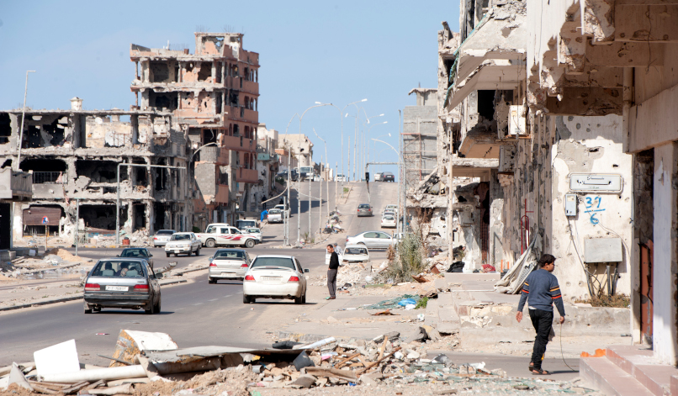
Libya Overview
9 year of conflict with political instability and active fighting driving displacement and humanitarian needs
The first half of 2020 saw an escalation of fighting in the southern parts of the country and in Tripoli
The fighting heavily affected densely populated urban areas with sustained use of artillery and airstrikes causing large scale damage to housing and community infrastructure
Poor economic situations made worse due to COVID-19 movement restrictions and closure of businesses leading to increased vulnerabilities especially within migrants and IDP populations
Change of territorial control in June 2020 resulted in reduced displacement in the west and large scale displacement towards the east. This has also triggered returns in Tripoli and the western region
In Tripoli, return is still significantly challenged by the destruction of housing and infrastructure and presence of mines and UCO’s
Situation in Sirte remains tense with both sides deploying forces in areas close to the city. the situation can further deteriorate with possible displacement towards both the east and west.
No operational space or legal framework for providing shelter solutions to migrant exists in the country, 2020 saw the closure of several migrants’ detention centres with no alternatives for shelter or solutions, Migrants remain among the most vulnerable and in need for shelter assistance
Shortages in fuel, cash and the increase of prices and rents continue to exacerbate vulnerabilities and force households to rely on negative coping mechanisms

Slide 3
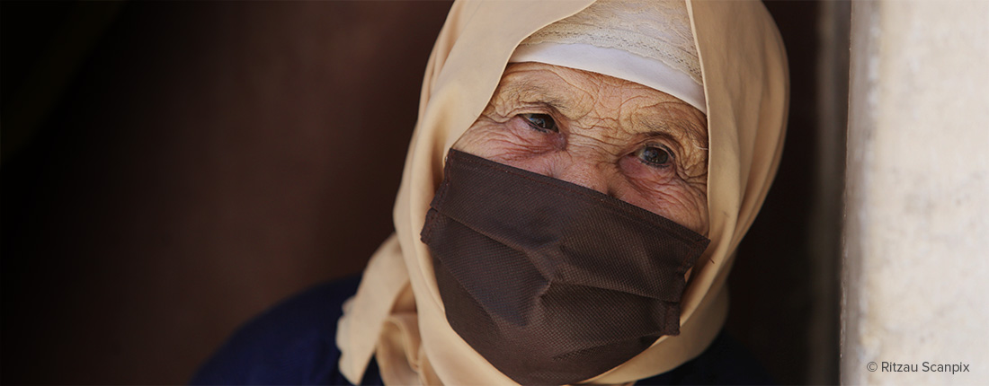
Overview COVID-19 - OCHA bulletin
Following the trend of exponential increases in number of cases of COVID-19 in Libya in recent months, the National Centre for Disease Control (NCDC) reported 35,208 confirmed cases and 559 deaths by the end of September.
Cases continued to increase in some of Libya’s largest cities, in Tripoli, Zliten, Misrata in the west, and in Benghazi and Ejdabia in the east; while the number of cases reported in the south is lower, because the near exhaustion of testing supplies and limited capacity of health facilities.
Even with under-reporting, Libya has recorded 80.19 deaths per 1 million population. The number of known deaths (559) includes only confirmed COVID-19 patients who report to health facilities. The real number of deaths (from undiagnosed infections in communities) is unknown.
While capacity for testing continued to slowly increase, with an additional 3 labs in September, only 15 labs are operational out of a total of 25 and testing remains concentrated in Tripoli and Benghazi. Furthermore, many primary health care (PHC) facilities that were functioning prior to COVID-19 have since been closed. Only 54 PHC facilities are still operational out of 92. Closures are due mainly to shortages of PPE and infection, protection and control measures, as well as delays or cuts to staff salaries.
Additionally, fuel shortages and continuous electricity and water shortages severely impacted the functioning of health facilities across the country, particularly those centers dedicated to COVID-19 testing or equipped with ventilation machines.
In a positive development, Libya signed up to be a member of COVAX, the vaccines pillar of the Access to COVID-19 Tools (ACT) Accelerator and has expressed interest in procuring the new COVID-19 rapid tests.

Slide 4
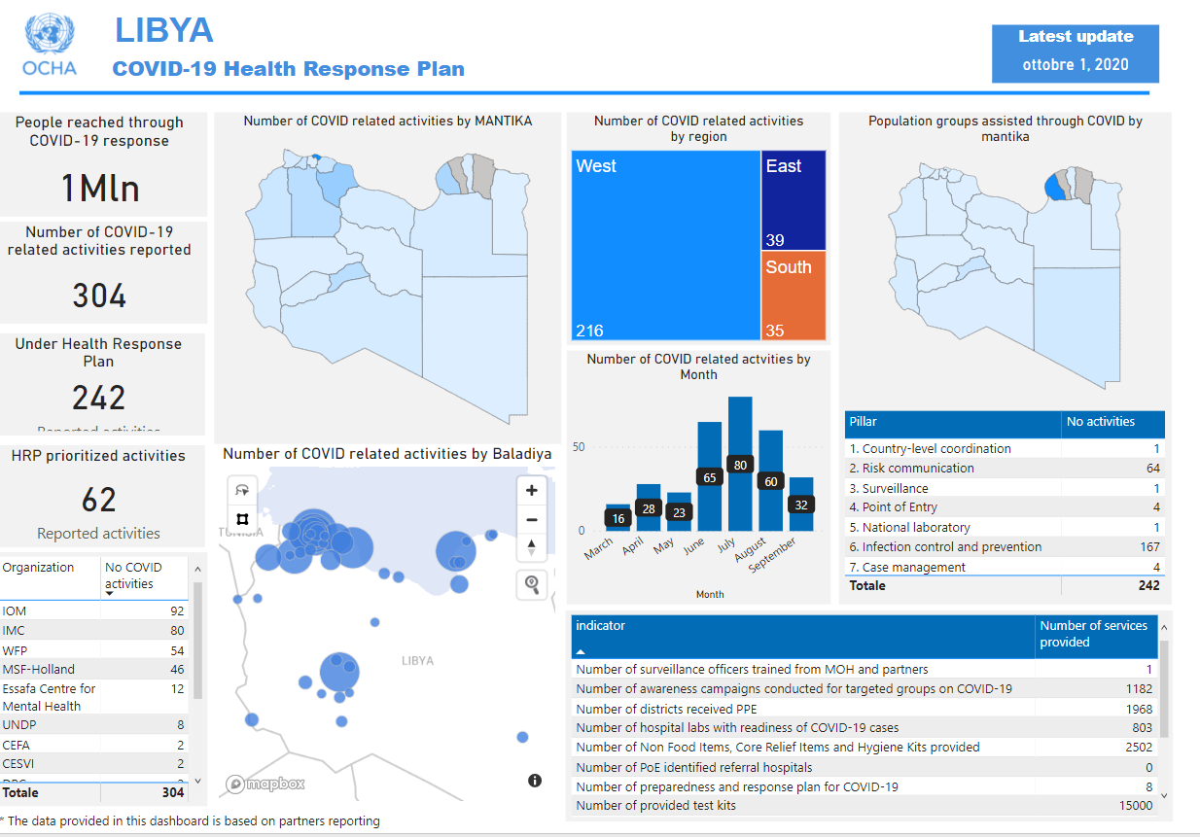
CODIV-19 response OCHA dashboard

Slide 5
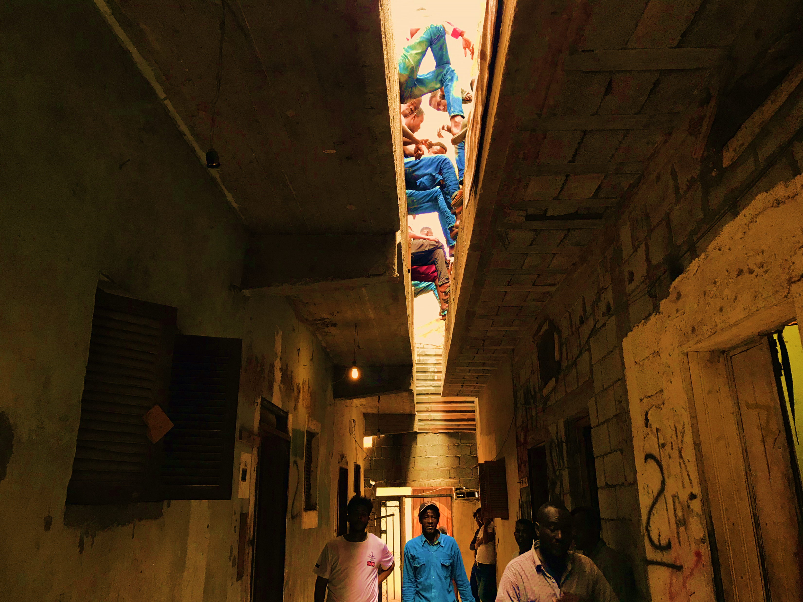
2020 HRP – SNFI strategy
2020 HRP
Shelter strategy
Achievements
Support Services

Slide 6
Overview Shelter Strategy HRP 2020
Shelter Strategy for the 2020 HRP exercise
Waves of conflict have caused population displacement and severe damage to housing and infrastructure across Libya.
As a result the need for housing continues to be stretched, especially in urban areas and around major cities, and rental prices increase.
This has exacerbated the difficulties of households in securing affordable housing and putting an increasing number of vulnerable families at risk of eviction.
IDPs, as well as the most vulnerable returnees, migrants and refugees and vulnerable non-displaced Libyans in areas affected by conflict will remain in need of shelter support to avoid movements into sub-standard shelters.
In 2020, although the authorities continued to close IDP collective centres, protracted IDPs have remained while new IDPs continue to be displaced due to conflicts, insecurity and/or inability to return to areas of origin.
The Shelter & NFI Sector's priority remained to ensure adequate, appropriate and affordable housing options for the most vulnerable people.
The SNFI assistance is focused both in responding to emergency situations, as well as providing more durable and tailored support depending on the specific needs of the population.

Slide 7
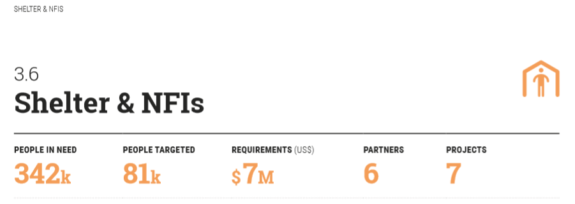
HRP 2020 – key notes
Shelter & NFIs
People in Need
342 k
People Targeted
81 k
Requirements (US)
7 M $
Partners
6
Projects
7
Two strategic objectives:
provide humanitarian life-saving and life-sustaining shelter and NFI support;
contribute to the resilience of communities and households by improving housing and related community/public infrastructure.
Prioritized interventions:
97 % planned for emergency response to populations most in need of lifesaving response and aligned to the first sectoral objective,
3% planned for repair and rehabilitation of damaged dwelling, focused on returnees and aligned to the second sectoral objective.
Response modalities:
97 % of assistance is planned to be provided in-kind, in the form of NFI and shelter material packages
3 % planned to be provided as cash-based assistance, in the form of rental subsidies.

Slide 8
2020 HRP Sectorial Objectives & targets
Objective 1: Provide humanitarian life-saving and life-sustaining shelter and NFI support
# | Indicator | Mod. | PIN | Target
1.1.1 | # of people whose core and essential NFI needs are met. | In-kind | 203 K | 48 K
1.2.1 | # of people whose seasonal and supplementary NFI needs are met* | In-kind |  | 0
1.3.1 | # of people assisted with emergency shelter materials/kits. | In-kind | 104 K | 25 K
1.4.1 | # of people assisted with rental assistance. | cash | 8 K | 2 K
1.5.1 | # of people assisted by rehabilitated collective centres. | In-kind | 15 K | 3.5 K
Objective 02: Contribute towards the resilience of communities and households by improving housing and related community/public infrastructure.
# | Indicator |  |  | Target
2.1.1 | # of people assisted by repaired/rehabilitated damaged dwelling. | In-kind | 11 K | 2.6 K
2.2.1 | # of people assisted by repaired/rehabilitated community/public infrastructure.** |  |  | 0
2.3.1 | # of people assisted by repaired/rehabilitated community/public buildings.** |  |  | 0
* Indicator # 1.2.1 has been reported under 1.1.1 till august 2020
** no projects submitted under those indicators

Slide 9
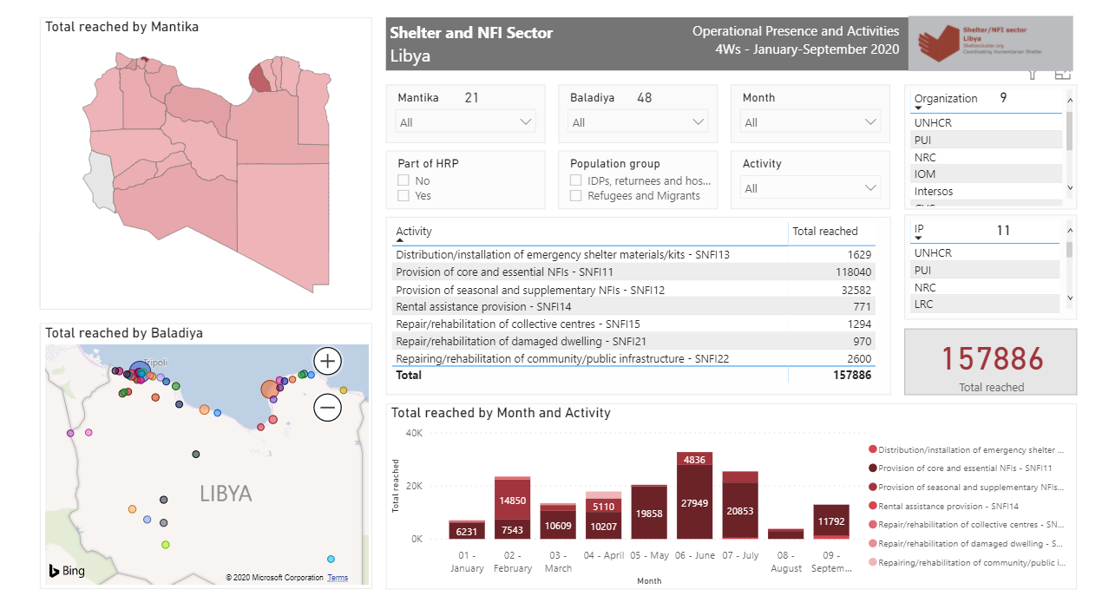
DASHBOARD Activities target and achieved against HRP and not HRP

Slide 10
What does Shelter Cluster do and how
Activities progress overview against HRP
Funds requested 7 M
People Targeted HRP
People Assisted HRP
People Assisted (HRP & not )
81 K
103.3 K (127%)
157.9 K
Funds received 5.5 M
FTS Sept.2020
Assistance vs Population groups
Mantika reached
Baladiya reached
HRP partners
SNFI Partners and IPs
58.1K
18
39
6
11
99.8K
In-Kind
99.5%
Cash
0.5%
Assistance vs Modality
157.1 K
0.77 K

Slide 11
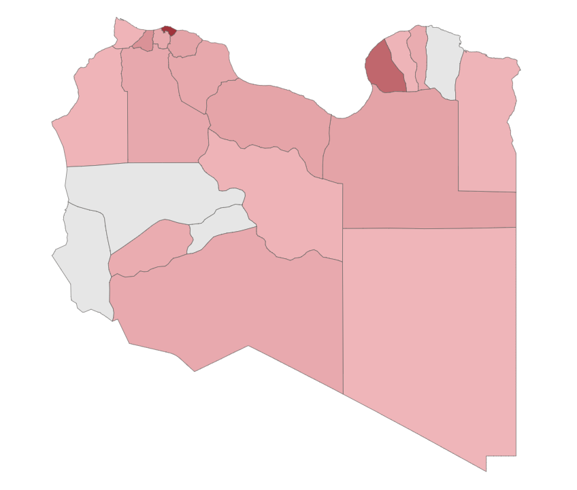
People reached by Mantika
Overall achievements against HRP targets
Al Jabal Al Akhdar | 2,866
Al Jabal Al Gharbi | 3,757
Aljfara | 3,328
Aljufra | 955
Alkufra | 425
Almargeb | 4,944
Almarj | 789
Azzawya | 9,533
Benghazi | 20,692
Ejdabia | 5,130
Misrata | 3,896
Murzuq | 3,463
Nalut | 634
Sirt | 4,880
Tobruk | 760
Tripoli | 33,898
Ubari | 2,761
Zwara | 568
Grand Total | 103,279
HRP Target – 81,000
Reached (HRP) – 103,279 (127%)
Reached (All) – 157,886
Target 81,000
HRP Achievement 103,279
Achievement (HRP and non HRP) 157,886

Slide 12
Achievements against targets per segregated indicators
# of people assisted by repair of damaged houses

Slide 13
Achievements against targets per segregated indicators
Assisted
82,804
Target
47,879
Assisted
17,440
Target
24,579
Assisted
771
Target
2,000
Gap
0
Gap
7,139
Gap
1,229
Assisted
1,294
Target
3,570
Assisted
970
Target
2,600
Gap
2,276
Gap
1,630

Slide 14
Presence of HRP partners and their IPs
Mantika | HRP partners | Implementing partners
1. Al Jabal Al Akhdar | UNHCR | LibAid
2. Al Jabal Al Gharbi | UNHCR | IMC, IRC
3. Aljfara | UNHCR | IMC, LibAid
4. Aljufra | UNHCR | LibAid
5. Alkufra | UNHCR | LibAid
6. Almargeb | CESVI
 | UNHCR | IMC, IRC, LibAid
7. Almarj | UNHCR | LibAid, PUI
8. Azzawya | UNHCR | IMC, IRC, LibAid
9. Benghazi | UNHCR | LibAid, NRC, PUI
10. Ejdabia | UNHCR | LibAid, NRC, PUI
11. Misrata | CESVI
 | UNHCR | LibAid, PUI
12. Murzuq | UNHCR | LibAid
13. Sirt | UNHCR | LibAid
14. Tobruk | UNHCR | LibAid
15. Tripoli | CESVI
 | UNHCR | CESVI, IMC, IRC, LibAid, LRC
16. Zwara | UNHCR | IMC, IRC
17. Ubari | IOM
18. Nalut | IOM
16
15
8
3
6
1
11
7
9
18
2
13
14
10
4
17
12
5

Slide 15
Sectorial Support Services: SAG and TWiG
SAG Strategic Advisory Group
Established in June 2020 upon selective process, 5 members (all UN and INGOs)
Work in progress
Consultation on Shelter strategic priorities for 2021
Guidelines on vulnerability criteria to guide the prioritization of recipients of SNFI assistance - scoring checklist
In pipeline:
Guidelines on “Do not harm” distribution of SNFI products and provision of assistance
Guidelines on Cash Based Interventions for the SNFI sector, harmonization and localization.
TWIG Technical Working Group
Established in June 2020 upon selective process, 7 members (all UN and INGOs)
Outcomes developed
Revision of the specification for NFI kits, essential and comprehensive, for individual and family (HH)
Revision of Winter kit (WK), basic and comprehensive
Sealing off kit (SOK) essential and comprehensive HH NFI
In progress:
Shelter solution for migrants, refugees and asylum seekers

Slide 16
Integrated Support Services
Integrated support activities with other Sectors
Service Mapping
SM has been created by Protection Sector recently with the aims to support in reporting the services (assistance) they provide, localizations, target groups, focal points and contacts. The Platform complements the Activity info and can improve the coordination. SNFI sector joined the initiative and is encouraging the partners to register in it.
Compliant Feedback Mechanism
Under the leadership of WFP, the Tawasul CFM activated the 1404 CFM call center services of in the Southern and Eastern part of Libya. CFM ensures accountability to the affected people by receiving calls and referring the enquiries to the relevant focal points of the humanitarian organizations or appropriate sectors.
SNFI Sector is engaged with CFM regularly providing support as referral and addressing solutions to the possible extent.

Slide 17
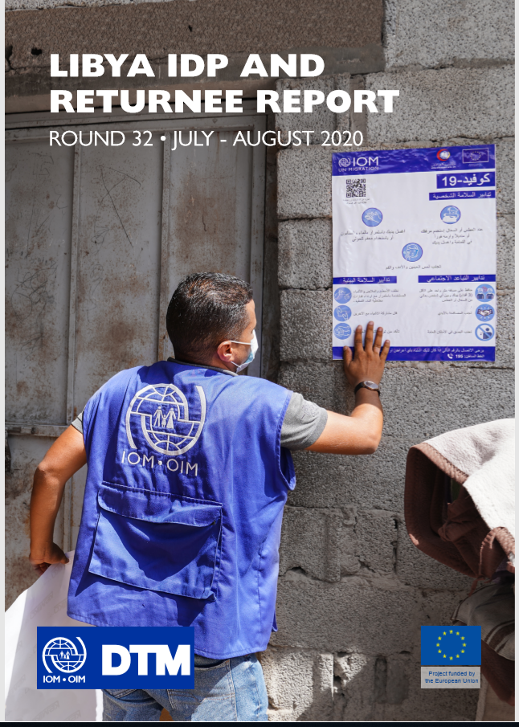
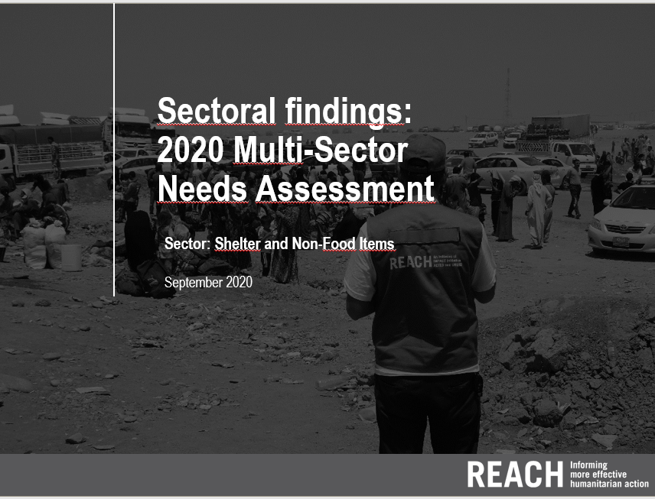
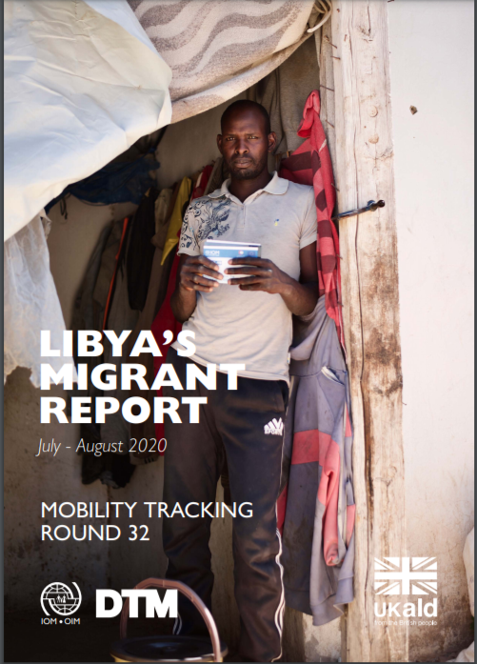
HNO –key notes MSNA -DTM

Slide 18
MSNA – NFI key needs
The NFI assistance continues to be one of the primary needs for all the groups in all the Mantikas.
The key humanitarian needs identified consistently throughout 2020:
IDPs: are accommodation (shelter), food assistance, health services and non-food items (NFIs);
Returnees: are food assistance, followed by non-food items, support in the provision of water, sanitation and hygiene (WASH) services, and health services;
Migrants, refugees and asylum seekers: health services, shelter and Non-Food Items (NFIs).
MSNA 2021 reported that there are different top five items for:
Libyans (1.generator, 2.cooking fuel, 3.blanket and heating system and computers, 4.mattress, 5.stove and water storage container)
Migrants & Refugees (1.generator, 2.mobile phone, 3 TV, 4. Kitchen items, 5.blanket and mattress).
It has to be noted how the new tendency to list communications means (phone and TV) as primary needs.

Slide 19
MSNA – Shelter Key needs
Shelter assistance remains a priority needs for Libyans and not Libyans, which is largely unmet or not properly met.
MSNA 2021 reported different percentage for the Libyans accordingly their displacement status, (62% of IDPs, 21% of Non-displaced, 47% of returnees).
Rented accommodation are the most common shelter solution in Libya.
According to MSNA and DTM
The 63% of IDPs residing in privately rented accommodation, 23% staying with host families without paying rent, 4% taking shelter in schools and other public buildings.
The 48% of those accommodation are reported to have at least one enclosure issue, only the 3% totally sub-standard.
The 83% of returnees reported to be back in their own homes in their areas of origin, which result reporting damages from light (88%) to heavy (3%).
The(74%) of migrants live in rented accommodation. The 64% pay for their own accommodation, for a minority (8%) rent is paid by the employer or by others (2%). The larger proportion of migrants live in rented accommodation in urban settings (79%) compared to rural areas. While (9%) living in collective shelter settings. (9%) are accommodated in their workplaces.
The 72% of those accommodation are reported to have at least one enclosure issue, while the 26% is reported completely sub-standards.

Slide 20
MSNA - key issues
Living in sub-standard or over-crowded housing is
A breach to the human right to an adequate standard of living
insecure and unsafe as it increases the risk of physical accidents, fires and infectious diseases, COVID
a key concern of risk of GBV and PSEA.
Inability to pay rent for lack of income is the main reason of physical eviction or threat eviction.
The lack of regular contract augments the risk of evictions for IDPs without regular legal status.
Refugees and migrants are more exposed to eviction threats as they have weaker leverages and room to negotiate with landowners

Slide 21
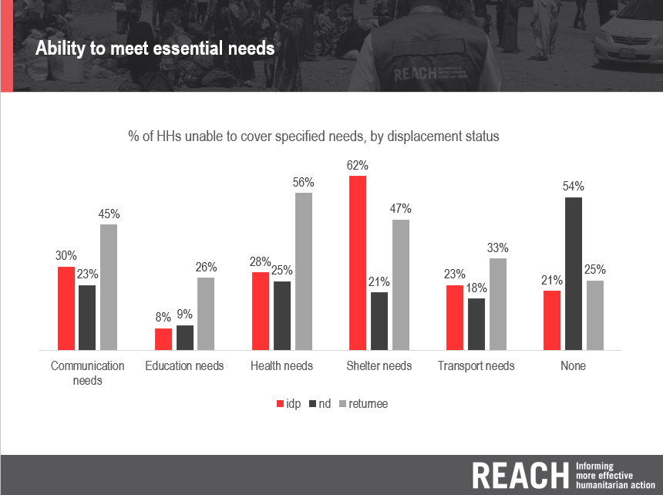
HNO –key notes MSNA Libyans

Slide 22
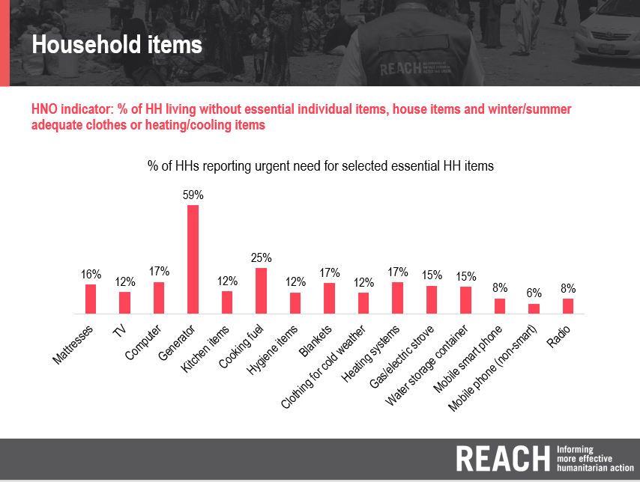
HNO –key notes MSNA Libyans

Slide 23
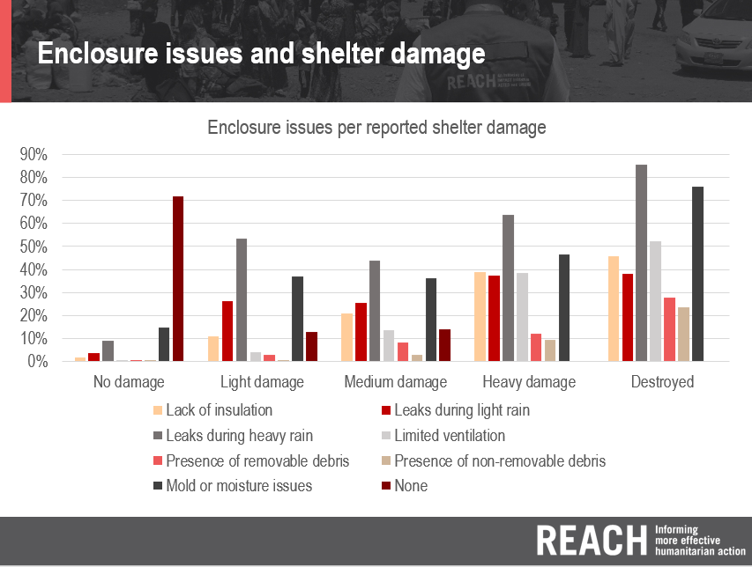
HNO –key notes MSNA Libyans

Slide 24
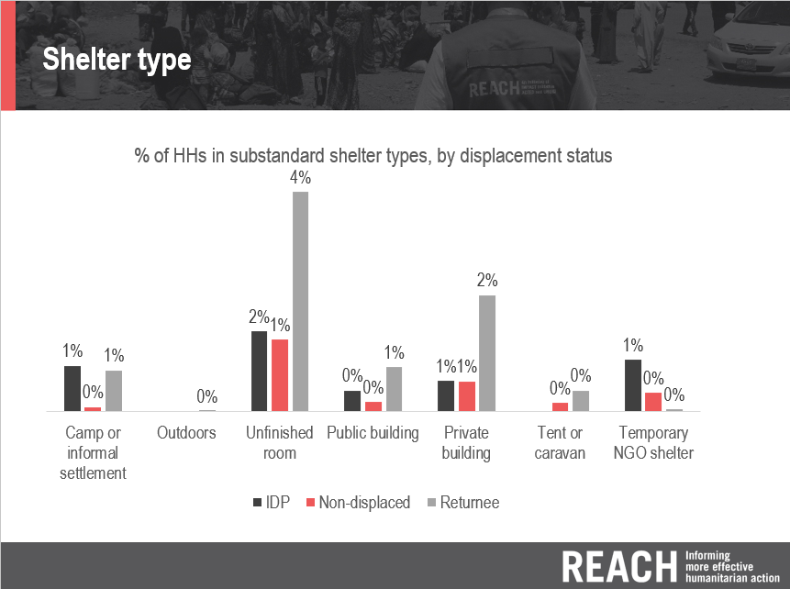
HNO –key notes MSNA Libyans

Slide 25
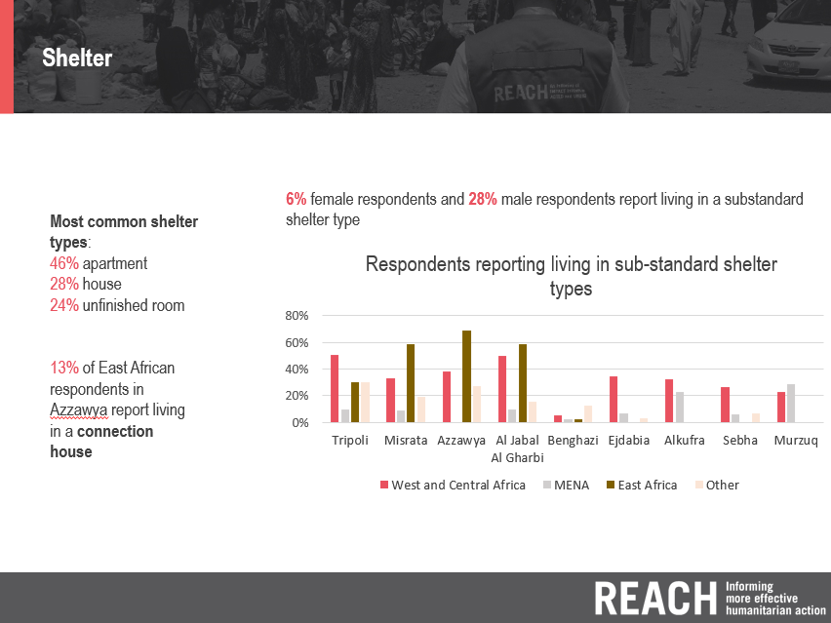
HNO –key notes MSNA Not Libyans

Slide 26
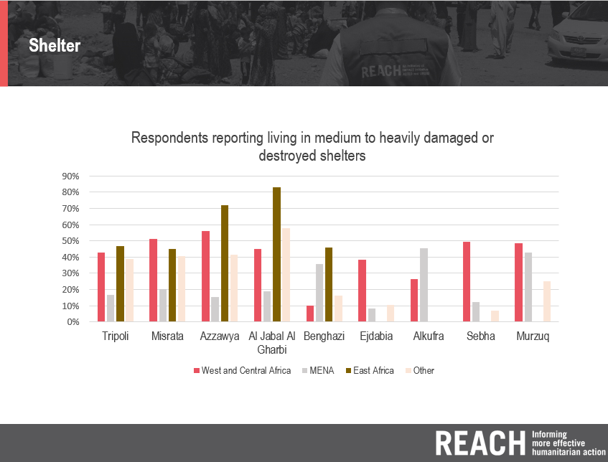
HNO –key notes MSNA Not Libyans

Slide 27
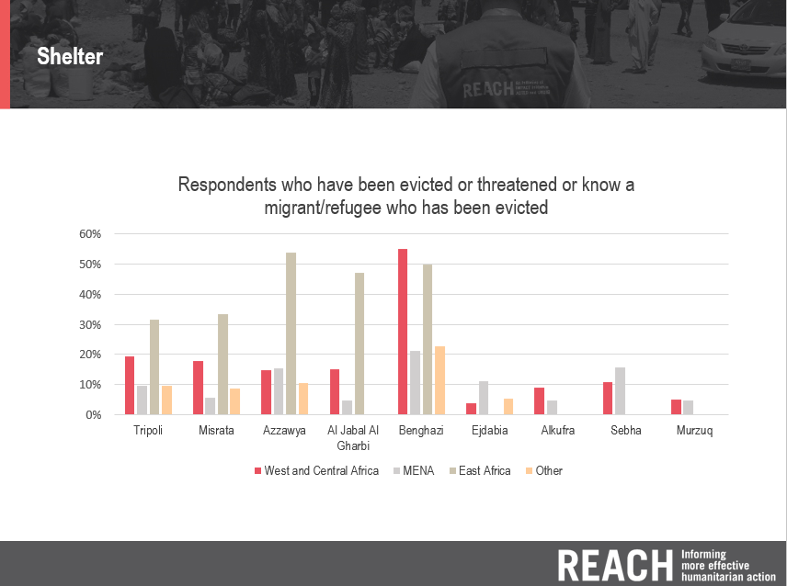
HNO –key notes MSNA Not Libyans

Slide 28
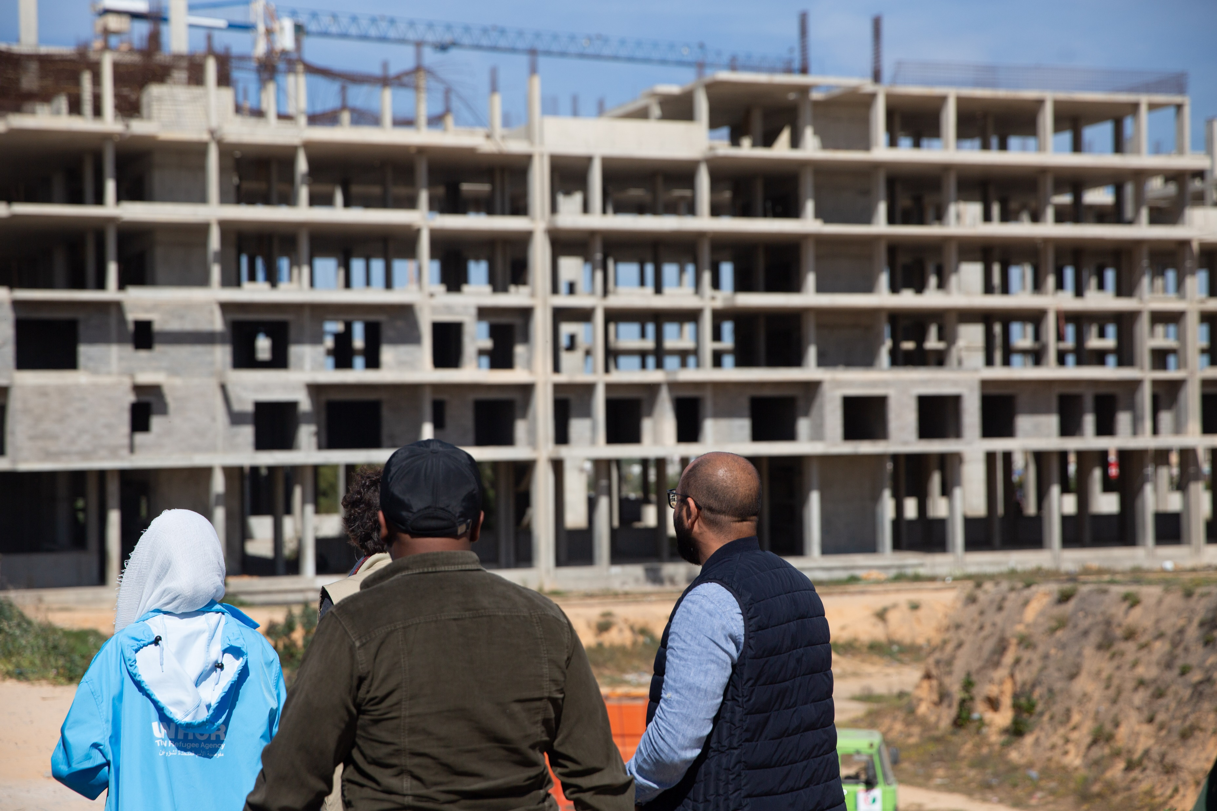
Shelter strategic priorities 2021
2021 HRP exercise
Shelter strategic priorities
PIN Severity scale
Critical problems and SOs
Challenges

Slide 29
Shelter strategic priorities 2021
In the short term the SNFI sector through its partners will :
Continue ensuring the assistance of essential core non-food items and the friendly and rapid mechanisms like the RMM and the QIP (Quick Impact Project),
Enhance and promote the standardization of the NFI kits aiming to the harmonization between partners’ assistance which may result in reduction of conflicts in the communities of assisted population,
Continue ensuring immediate shelter assistance with the provision of shelter kits and materials for emergency solutions as well rehabilitation of collective centers,
have a focus on enhancing cash initiatives in consultation with the CWG, such as rental assistance, cash for work, cash for rehabilitation, engaging the communities and exploring way to advocate to different stakeholders.
COVID response:
continue ensuring the distribution of tailored NFI integrated with Hygiene kits, soaps and jerry cans
Promote the distribution of PPE i.e. mask and gloves at the possible extent

Slide 30
Shelter strategic priorities 2021
In the medium term the tendency of shelter assistance should:
ensuring assistance for repair rehabilitation and reconstruction of damaged houses for returnees and non-displaced,
providing transitional shelters and hosting communities projects, cash for rent for IDPs, migrants and refugees.
Be more focused on durable and tailored solutions for the target groups of PoCs.
These initiatives should be largely driven projects engaging the communities to enhance the ownership and generate casual labor and income, while jointly with social mobilization framework in consultation with Protection Sector eventually. Modalities of assistance can be in kind or in cash (preferably conditioned) coupled with the technical assistance ensured by specialized partners. CBI should be largely promoted.
COVID response:
Promoting the shelter initiatives jointly with Health sector by piloting solutions for shelter unit for isolation, for quarantine, for health facilities;
Study and piloting shelter solutions for reducing the overcrowding of collective centres and IDPs settlements.

Slide 31
Shelter strategic priorities 2021
In the long term, the SNFI sector aims also:
to promote and support pilot interventions for the rehabilitation of public/community infrastructures services, like water supply, electricity and roads and repair of public buildings,
engaging the local counterparts, aligned Ministries and local Authorities,
strong advocacy to international stakeholders and donors.
COVID response:
Continuing promoting the shelter initiatives jointly with Health sector and other Sectors
Engage local authorities for structural initiatives such as rehabilitation of public health unit and infrastructures services

Slide 32
2021 PIN calculation

Slide 33
SNFI Sector PIN

Slide 34
Severity framework

Slide 35
CRITICAL PROBLEMS vs PIN –HRP 2021
HUMANTIARIAN CONDITIONS | CRITICAL PROBLEM | PiN | VULNERABLE GROUP
Critical problems related to physical and mental well-being | Conflict, including attacks and political instability limit people’s access to food and essential health services, putting the lives of children and the most vulnerable at risk and impacts their physical and mental well-being. | 880,000 people food insecure 125,000 children at risk due to interrupted vaccinations 77% of assessed people reported outbreaks of diseases. 304,000 migrants / 46,000 refugees | Children Older people People with disability Migrants and refugees Women (part. women childbearing age) IDPs People with pre-existing health conditions Rural areas
Critical problems related to physical and mental well-being | Exposure to booby traps, including IEDs, landmines and explosive remnants of war put lives of people at risk. | 345,000 people living in conflict and previous frontlines areas 6% of HH report the presence of explosive hazards 228,000 - Returnees 173,000 - IDPS 304,000 migrants / 46,000 refugees | Non-displaced living in frontline (or former frontline) areas IDPs Children Returnees Migrants and refugees
Critical problems related to living standards | Insecurity, political instability, fragmented governance and socio-economic impacts of COVID-19 impacts people’s access to basic goods and services and erodes coping capacities. | 50% HH reporting unable to cover at least one basic need 20% HH with working members’ workplace closed due to C-19 36% Libyans adopted crisis or emergency coping strategies 228,000 - Returnees 173,000 - IDPS 304,000 migrants / 46,000 refugees | Older people People with disability Women and children IDPs Migrants and refugees Libyans engaged in daily labor Female-headed households

Slide 36
SO MATRIX HRP 2021
Strategic Objective #1: Physical and Mental Wellbeing |  | Strategic Objective #2: Living Standards
SO 1: Description Prevent disease, reduce risks to physical and mental well-being, and strengthen the protection of civilians in accordance with international humanitarian law, human rights laws and other international legal frameworks. | Potential specific objectives under SO1 | SO 2: Description Facilitate safe, equitable and dignified access to critical services and livelihoods to enhance people’s resilience and ensure they meet their basic needs. | Potential specific objectives under SO2
 | Health - two indictors given COVID-19: one on access to health services and one related to disease prevalence. Mine action - one indicator on reducing mine risk. Food – one indicator related to number of people that are food insecure. Protection – one indicator on access to MHPSS services |  | Basic services (WASH, Education, housing, cash/livelihoods, protection) – access to basic services through provision of WASH, education and shelter supplies and services, as well as specialized protection (inc. GBV, CP) services. Cash/livelihoods – access to basic goods through agricultural support and multi-purpose cash Protection/CFM - Related to ensuring dignity and reducing barriers to accessing assistance Assessments – strengthening evidence-based planning Capacity building on preparedness and disaster management – related to humanitarian organizations and national authorities prepared to respond rapidly to natural disasters or man-made crises (such as escalations in conflict) through contingency planning and capacity building

Slide 37
HRP 2021 – on going
Shelter & NFIs
People in Need
376 k
People Targeted
XX k
Requirements (US)
X M $
Partners
5-6
Projects
5-6
People in Need 2021 increased of 10%
Two strategic objectives as in 2020 (consultation with partners and counterparts is in progress)
provide humanitarian life-saving and life-sustaining shelter and NFI support;
contribute to the resilience of communities and households by improving housing and related community/public infrastructure.
Prioritized interventions:
Decrease % for emergency response to populations most in need of lifesaving response and aligned to the first sectoral objective,
Increase % for repair and rehabilitation of damaged dwelling, focused on returnees and aligned to the second sectoral objective.
Response modalities:
Decrease % of assistance to be provided in-kind, in the form of NFI and shelter material packages
Increase % to be provided as cash-based assistance, not limited to rental subsidies but also other shelter assistance activities.

Slide 38
Challenges
COVID-19 pandemic has urged movement restrictions with significant implications of humanitarian access for both humanitarian actors either supplies locally and internationally procured
Political instability has caused considerable challenges to durable solutions. Continuous changes to the context hinder the efforts of humanitarian actors to provide long term solution.
Access restrictions and lengthy procedures for obtaining (Visa, travel permit, custom clearance, etc.) approvals from local authorities
Increasing needs and declining coping strategies of both the Libyan (IDPs, ND and host communities, returnees) and not Libyans (Migrants, refugees and asylum seekers)
No legal framework to provide shelter solutions to migrants, refugees and asylum seekers. This year saw the closure of several detention centers with no durable solutions in sight
Limited reporting and assessments to properly addressing shelter needs especially in areas that became accessible in 2020 or areas close to active frontlines.
Presence of mines and UXO’s in areas in southern Tripoli that were retaken by the GNA in June, which prevents access of humanitarian actors and challenges for better understanding of needs, and on the other hand makes unsafe the new trend to return in the places of origin
Low interest of donors and limited engagement in Libya operation which result in lack of funds overall and for the SNFI sector particularly
Limited dedicated resources to the Shelter & NFI sector, currently understaffing, which restricts coordination efforts and results in overwhelming with workload the few staff.
Poor engagement of Local NGOs especially for language barriers but also for limited capacities
Fuel shortages have a direct impact on Sector’s partners activities and create serious consequences in the COVID response
Housing, Land and Property issues. Eviction or threat of eviction mostly for migrants and refugees.
Lack of common prepositioned NFIs and Emergency Shelter supplies countrywide affects the ability of the Sector to provide timely response.

Slide 39
Recommendations
Promote the development of preparedness plan for COVID-19 response in term of SNFI assistance, in consultation with Health Sector, MoH and other stakeholders, engaging the partners
Escalate to OCHA and lead agency, eventually liaising directly with the local Authorities to facilitate access to the partners
Promote projects which may enhance resilience of the target populations while ensuring to meet their basic needs
Study and promote integrated projects with other sectors, for appropriate shelter solutions to migrants, refugees and asylum seekers
Engage the partners in regular reporting and assess to properly addressing shelter needs. Explore collaboration with third parties for PDM and Impact monitoring.
Develop shelter framework for returnees in consideration of the new trend, in consultation and collaboration with other sectors for integrated projects, specially Mine Action and engaging Municipalities.
Raise the visibility of the SNFI sector thought IM products. Plan a conference with the key donors and partners aiming to engage them in the HRP exercise by funding the sectors.
Increase the number of dedicated staff at national level and urge the localization at Area level with sub-coordinators which might be recruited between the partners personnel.
Identify and engage local NOGs as partners at area level and countrywide.
Promote training remotely, in presence and training on job for local partners and communities to enhance their capacities in the SNFI domain.
Promote specific training on Housing, Land and Property domain, eventually requesting the support of the GSC
Explore and promote the establishment of a prepositioned NFIs and Emergency Shelter stock and pipeline countrywide to enable timely response in emergency situations.

Slide 40
Organigramme
SNFI Coordinator
100% dedicated
UNHCR
SNFI Co-Coordinator
30% dedicated
NRC
IMO
25 % dedicated
UNHCR
UNHCR Libya
GSC
Technical Advisor 50%
Coordinator
100%
CBI expert
30%
Co-Coordinator 100%
SNFI IMO
100%
Visibility Advisor
25%
West Area Coordinator 50%
East Area Coordinator 50%
South Area Coordinator 50%
Current organigramme
Ideal organigramme

Slide 41
Thank you
Shelter NFI Sector Libya
ShelterCluster.org
Coordinating Humanitarian Shelter
Sector Coordinator
Marina Mucciarella
mucciare@unhcr.org
Sector Co-coordinator
Zaid Al - Jabari
zaid.aljabari@nrc.no
Information Management Officer
Alen Chalak
chalak@unhcr.org

