Slide 1
SHELTER CLUSTER DR CONGO
Cluster Abris RDC &
Groupe de Travail AME
19 October 2020, TEAMS

Slide 2
Agenda
Humanitarian Coordination Architecture
General Crisis Context & Response
Contextual Challenges & Opportunities
Strategic directions for 2021

Slide 3



Architecture of Shelter Cluster DR Congo
2019
2020
Shelter Cluster
Lead by
Co.Fac.
NFI Cluster
Lead
Co-Fac.
Shelter WG
Lead by
NFI WG
Lead by

Slide 4
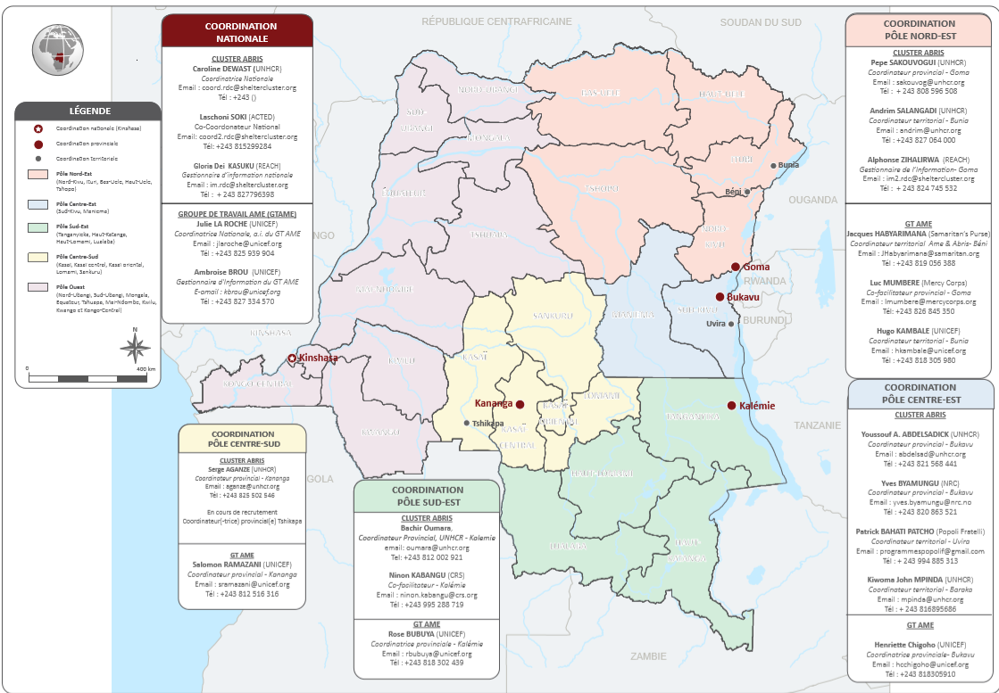
Notes:
4 hubs plus a national level team 100% dedicate
At the hub level coordinators for Shelter and for the NFI WG

Slide 5
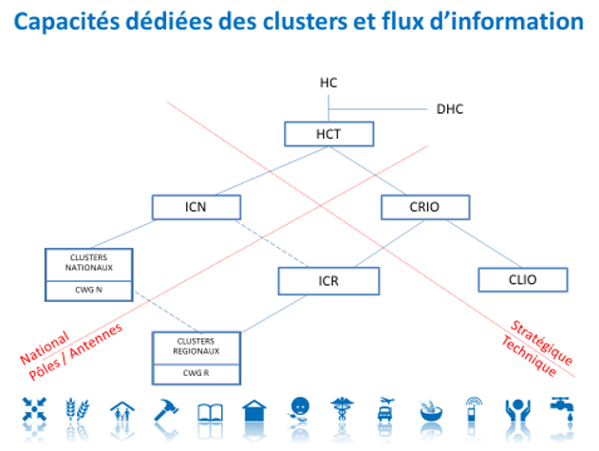
Humanitarian coordination structure
 | STRATEGIC LEVEL | CLUSTER COORDINATION |  | OPERATIONAL COORDINATION
National Level | HCT | ICN (national inter-cluster) | National Clusters | N/A
Provincial Level | CRIO | ICR (regional inter-cluster) | Regionals Clusters | CORAH
Local Level | CLIO Stratégique | CRIO Technique | Cluster Focal points | N/A

Slide 6
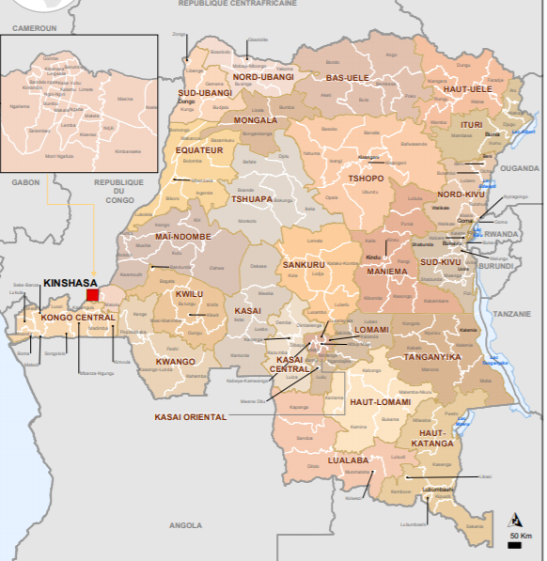
General Context Overview
Complex emergency
Conflict & disasters 5.1M IDPs & returnees
5 major crisis in the East & South
Target 2M people with shelter and 1.9M NFIs
105 Million USD – 24% funded
3rd biggest Shelter crisis
Notes:
Size of the country is like western Europe
Each crisis is like a country in itself with
Current 5 large ongoing crisis, Ituri, Pinga, Nyunzu, Hauts Plateaux, Kasai
Post COVID- revisions of numbers in june

Slide 7
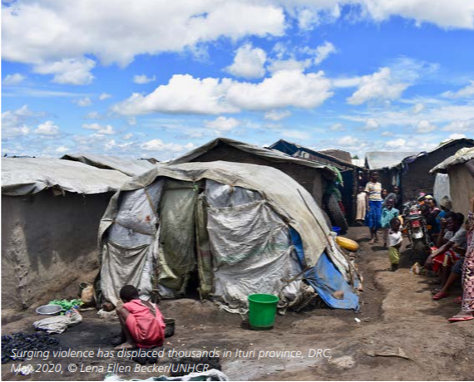
Ituri Crisis
Conflict related displacement since 2017
1.6M IDPs and 213,000 in camps
Destruction of infrastructure, villages burnt down
Some seeking refuge in neighboring countries
Notes:
Massacres , interethnic related conflicts
Burned houses an villages
Destruction of infrastucure
Populatin in spontaneous sites and hosting families
Some seeking refugees in neighboring Uganda and SS

Slide 8
Shelter & NFI Response

Slide 9
NFIs response
Operational response in the DRC
  In majority: rapid response involving flexible funding mainly for geographical zone of intervention / need to improve flexibility for intervention modality
  Rapid response: around 15 actors in the East
  3 interventions’ modalities

Slide 10
NFIs response
Operational modalities used in the DRC
  In-kind in places where no other modality can be used / supply difficulty / faster distribution with already constituted kits
  Cash and Voucher/fair where market place and products available / improvement of dignity and population empowerment / based on MEB taking into consideration real items needs
  Fair: aggregation of traders close to population in needs / taking into consideration ppl choices

Slide 11
NFIs response
Operational coordination – Example of Pinga
  Strengthen NFIs response efficiency and rapidity
  Take into account multi-purpose cash
  Ensure do no harm principle respect
  Reinforce humanitarian response efficiency through the involvement of food sec cluster and actors
  Ensure sensitive conflict NFIs response

Slide 12
Shelter Response
5 Shelter response scenarios
IDPs in Host families
Returnees
Host community
IDPs in Collective centres
IDPs in Sites (formal and informal)

Slide 13
Types of Shelter Packages
SHELTER RESPONSE TYPE | DETAILS | $/ HH
Individual shelter options
Emergency shelter | Emergency shelter Kit including tarp | 122
Rental support | Rental support for 6 months | 240
Shelter upgrade for hosting/hosted families | Construction of latrines, extension, separation or upgrade | 150
Shelter construction using local construction practices | Construction using local construction practices | 350
Housing land and property documentation | Recover land/tenure documentation | 30
Collective shelter options
Upgrades of collective centers | Latrines, upgrades, internal separations, etc. | 143
Construction of collectif centres | Construction of collective shelters | 122

Slide 14
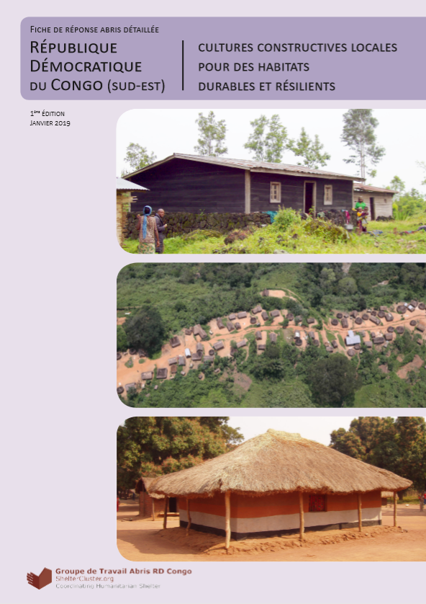
Shelter tools & modalities
Cash
In- kind
Local construction
Seasonal construction calendar
Catalogue
HLP & security of tenure

Slide 15
Challenges & opportunities

Slide 16
NFI response challenges
Restricted humanitarian access due to insecurity
Difficult logistic / physical access
Flexibility on intervention modality
Flexibility on geographical intervention zone with humanitarian funds
Difficulties for supply
Difficulties to improve the response rapidity

Slide 17
NFIs response opportunities
Synergies with other sectors
  With Food sec Cluster to improve the multisectoral response to a crisis
  With Logistics Cluster to facilitate NFIs kits transportation and storage
  With WASH cluster for kits composition determination (NFIs kits / Wash kits)
  With GBV AoR for menstrual hygiene kits
  With RR WG for strategic orientations on rapid response and NFIs

Slide 18
Shelter Response Challenges
  Scale of the needs and type of displacement, pendular, cyclical, long-lasting
  Lack of available and flexible funding for emergency responses but also to build durable solutions
  Lack of contingency plan and socks
  Access to certain areas, increase insecurity
  Environmental degradation as a result of shelter response
  Pressure around the use of certain construction materials (CGIs) without market consideration

Slide 19
Shelter Response Opportunities
  Joint advocacy Shelter & NFI for funding, flexibility
  Developing joint contingency plan
  Opportunity to build strong synergies with the NFI WG, sharing a common strategic vision (contingency plan, protection mainstreaming, inclusion, PWD, etc)
  Synergies with other sectors, specifically WASH and Protection with HLP WG
  Growing membership of the shelter cluster and growing interest in shelter, especially with COVID

Slide 20
Strategic directions 2021

Slide 21
Strategic Direction 2021
Harmonising Shelter & NFI strategic approach
Advocating for funding & more flexible funding
Development of an NFIs strategy & action plan for 2021
Revision of NFI kits composition
Extend operational coordination to all Eastern hubs
Reinforce synergies with other clusters
Design a protection mainstreaming plan
Harmonize the consideration of gender, protection and disability into all interventions & activities
Reinforcing environmental awareness and support to partners on environmental response challenges

Slide 22
THANK YOU

