Slide 1

Somalia Shelter Cluster
12 October 2020

Slide 2
Context
Active armed conflict
Political fragility
Extreme poverty (69%)
Recurrent drought and flooding
Continuous displacement
Clan conflict

Slide 3
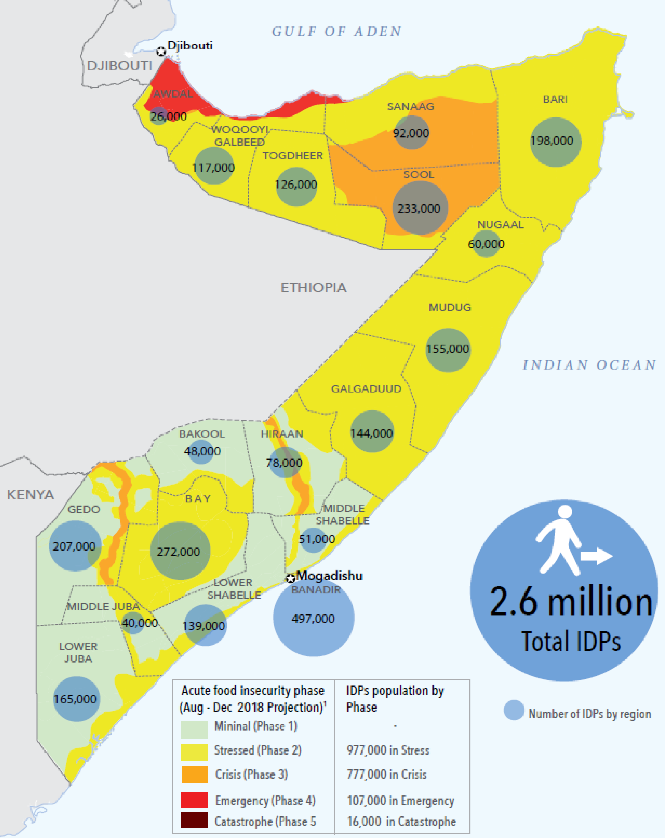

KEY FIGURES
Population: 12.3 M
Displacement/yr: 800K ind.
Eviction/yr: 200K ind.
PiN (Inter-cluster): 5.9 M
PiN (Shelter): 3.1 M
IDPs: 2.6 million
Funding (Shelter): 24%
Funding (HRP overall): 58%

Slide 4
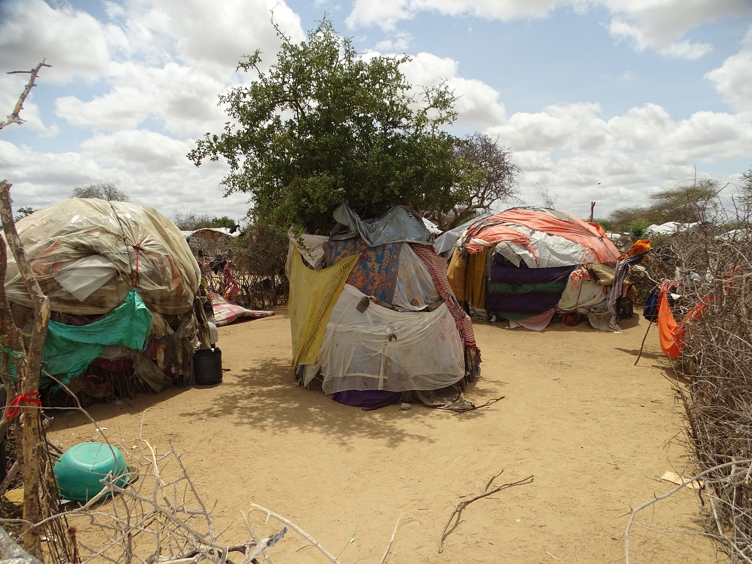
KEY ISSUES
Protracted displacement.
Regular displacement (83K/month, 0.7% of total pop/month).
Lack of security of tenure.
No/very limited shelter and NFI contingency stocks.
Insecurity and limited access in some areas.
Limited funding.

Slide 5
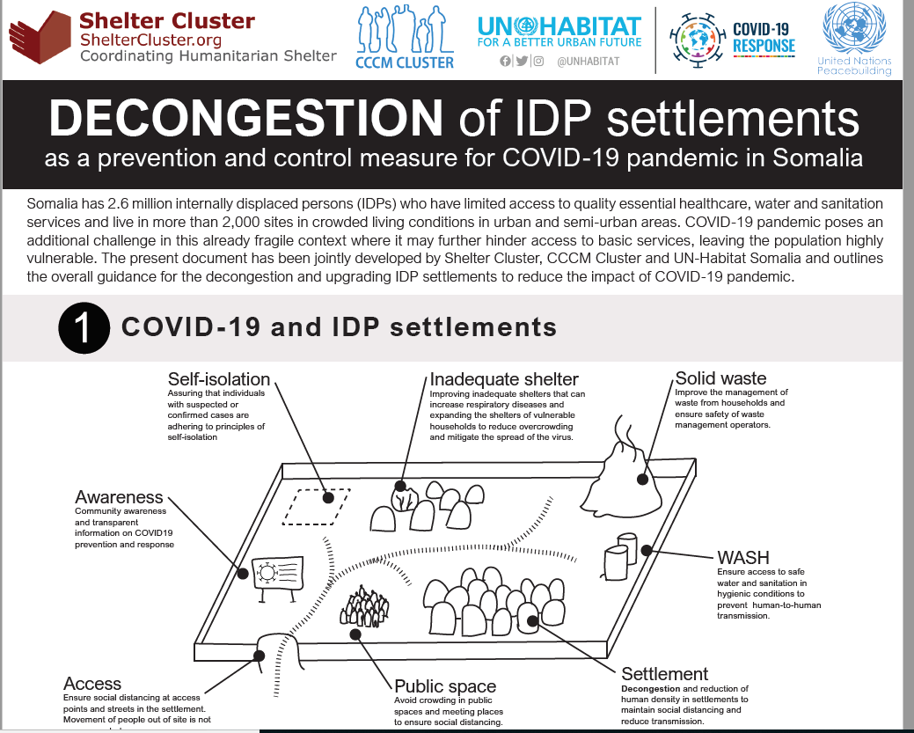
Documents
Cluster strategy (2020-21)
NFI kit guidelines
Shelter kit guidelines
Decongestion guidance
JMM factsheet
PDM forms
Common assessment framework (draft)
Shelter typologies (under development)

Slide 6
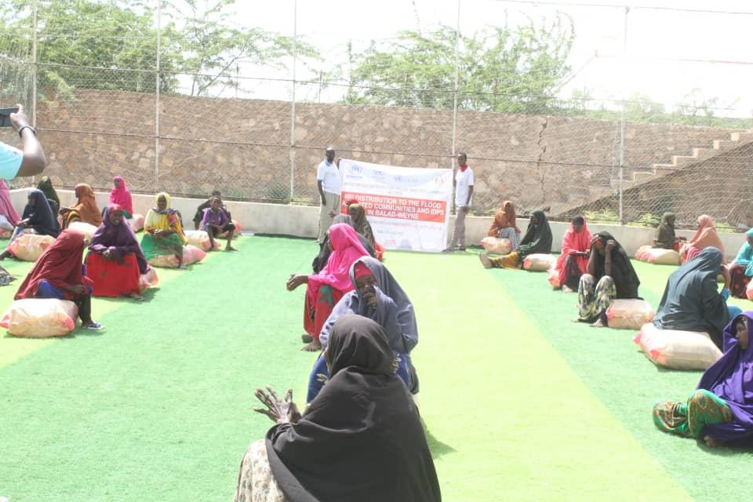
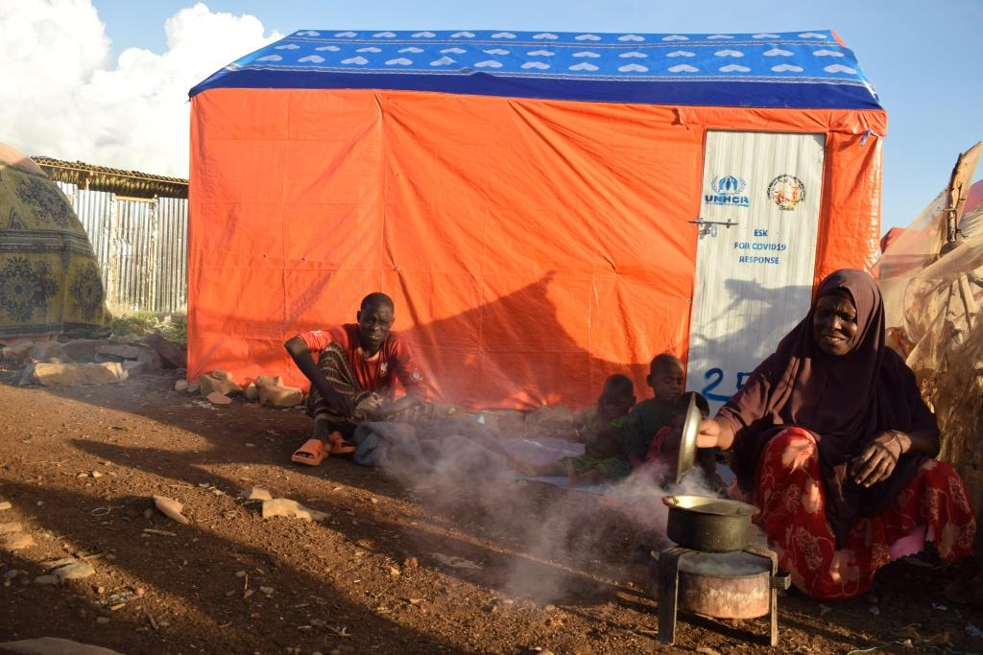
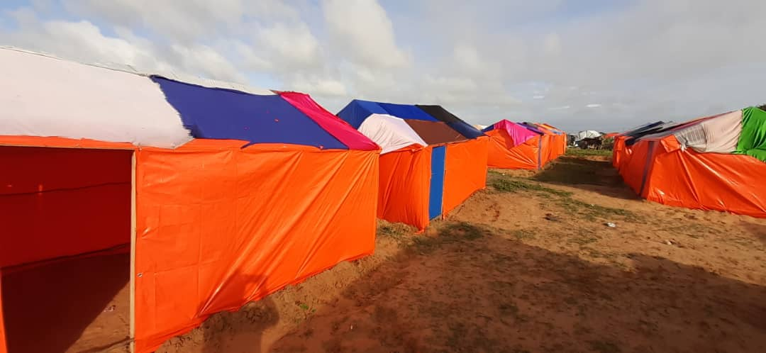
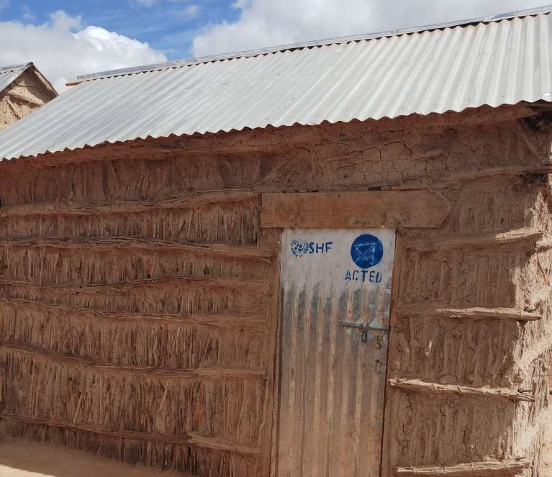
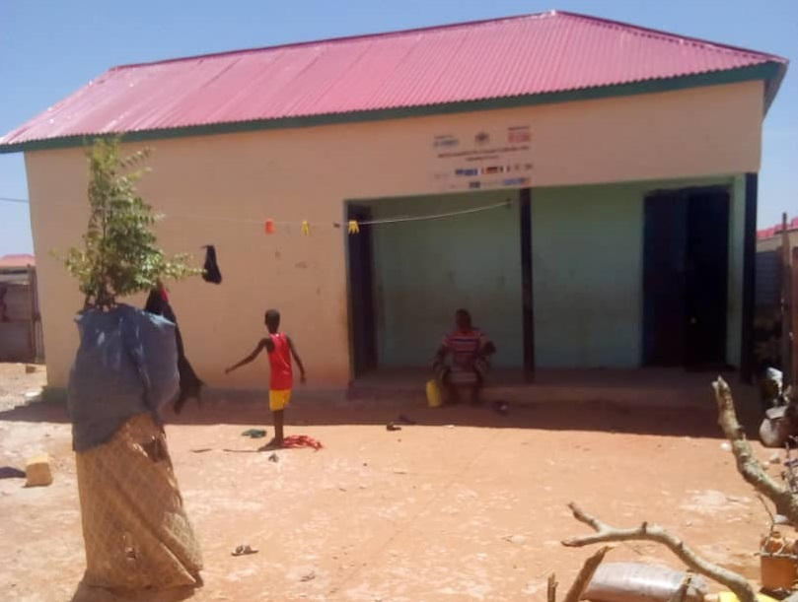
Response
NFI kit
Shelter kit
Decongestion
Transitional shelter
Permanent shelter

Slide 7
THANK YOU

