Slide 1
VENEZUELA
SHELTER, ENERGY AND NFI CLUSTER
GSC Annual Meeting – Country update
5 October 2020
Coordinator: Adriana Durán
Information Management Officer: Luis Alcaraz
Assistant: Emigdio Filardi

Slide 2
Content
Venezuela situation
  Context
  Estimated population with shelter, energy and NFI needs
Cluster strategy
Cluster response
Gaps and challenges

Slide 3
Venezuela situation

Slide 4

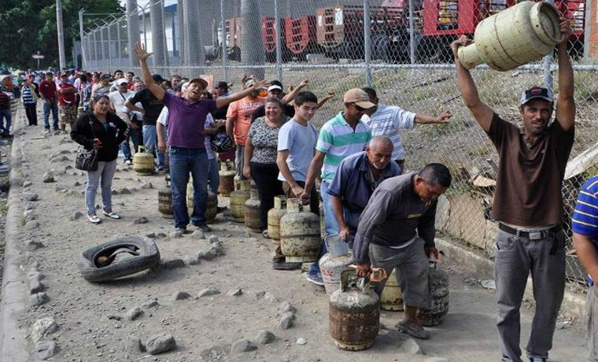
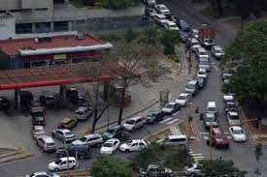
Context (I)
Venezuela is affected by a severe deterioration of basic services, high levels of insecurity and hyperinflation, including limited access to:
  Electricity
  Gas bottles
  Fuel
  Food and livelihoods
Basic services access and economic conditions have generated a migration in search of better conditions of life.
Migrants move towards the Colombian-Venezuelan border to work in Colombia for a day and then return to Venezuela to sleep or migrate to a third country.
Reportedly, Internally Displaced Persons (IDPs) also move to large urban areas where the access to basic services and livelihoods is not heavily affected.
Limited access to electricity
https://www.elpais.com.uy/mundo/saqueos-protestas-cortes-luz-venezuela.html Photo: Reuters
Limited access to gas bottles
https://www.caraotadigital.net/hoy/93-de-la-poblacion-venezolana-depende-las-bombonas-de-gas
Fuel access restrictions
https://www.el-carabobeno.com/preven-que-escasez-de-gasolina-en-venezuela-se-agravara-en-proximas-semanas/

Slide 5
Context (II)
Human mobility has increased the pressure in terms of accessing the already limited basic services, which also extends to the shelter arrangements:
  Limited economic capacity of most people on the move, not being able to access decent housing (e.g. a hotel)
  Fostering overcrowded homes or in substandard conditions
  Shelters built with materials far below the standard
Since the last quarter of 2019, an influx of Venezuelan returnees led to a corresponding escalation in humanitarian needs.
Returns from displacement to their areas of origin (AoO) also present a new complex humanitarian challenge amid the COVID-19 pandemic.
Temporary shelter arrangements, including the Government-led Puntos de Atención Social Integral (PASI) are being established mainly in border locations to support the influx of individuals and families.

Slide 6

Estimated population with shelter, energy and NFI needs (GHRP- 2020)
Population: 32 million (2020 estimation based on 2011 census)
Capital: Caracas
Area: 916,445 km²
*PEOPLE IN NEED: 7.0M (GHO 2020)
*TARGETED: 4.5M (1.1M for Shelter, Energy, NFI)
*COVID-19 Requirements: $87.9M
Health: $50.4M
Non-health: $37.5M
*Total financial requirements: $762.5M
COVID-19: 87.9M
Non-COVID-19 (HRP): $674.6M
Total cases: 75,913 (2 October 2020)
-----------------------------------------------------
*Source : GLOBAL HUMANITARIAN RESPONSE PLAN COVID-19 UNITED NATIONS COORDINATED APPEAL APRIL – DECEMBER 2020

Slide 7
Estimated population with shelter, energy and NFI needs (HPC 2020)
% of HHs living in sub-standard and overcrowded shelters
EHM (INE), S2 2018
% HHs with sub-standard bathroom facilities
VAM (WFP), 2019
% HHs reporting use of unsafe alternative sources of gas for cooking
VAM (WFP), 2019
% of HHs without gas or electric kitchen
EHM (INE), S2 2018
% HHs reporting daily electricity cuts
VAM (WFP), 2019
People in
Need (PiN)
1.38 M

Slide 8

Estimated population with shelter, energy and NFI needs (HPC 2020)
24 partners
State
Severity
# projects
3
3
5
6
7
3
Bolívar | 4 | 7
Miranda | 3 | 7
Zulia | 4 | 6
Distrito Capital | 3 | 5
Anzoátegui | 3 | 4
Merida | 1 | 4
Táchira | 4 | 4
Apure | 4 | 3
Carabobo | 3 | 3
Falcón | 3 | 3
Nueva Esparta | 2 | 3
Sucre | 4 | 3
Amazonas | 4 | 2
Delta Amacuro | 4 | 2
Guárico | 3 | 2
Lara | 2 | 2
Vargas | 2 | 2
Yaracuy | 2 | 2
Monagas | 3 | 1
Portuguesa | 2 | 1
Aragua | 1 | 0
Barinas | 2 | 0
Cojedes | 2 | 0
Trujillo | 2 | 0
2
3
2
4
1
1
2
2
4
4
3
7
Distrito Capital
1 - mínimo
2 - estrés
3 - severo
2
4 - crítico
5 - catastrófico
# de proyectos con alcance en este estado

Slide 9
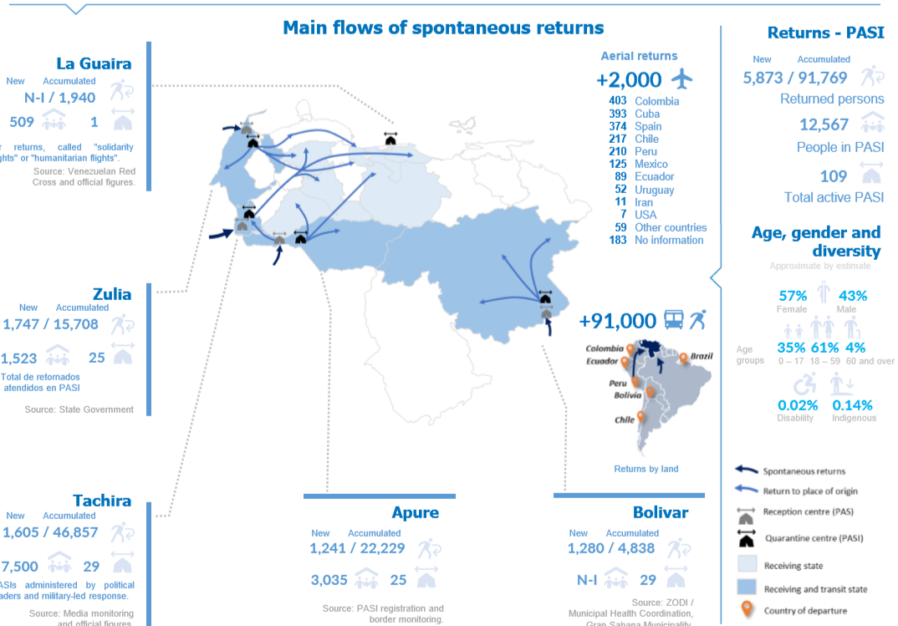
Spontaneous returns
-----------------------------------------------------
*Source : ACNUR, Spontaneous Returns March 15 April 30, 2020

Slide 10
CLUSTER STRATEGY

Slide 11
Where to focus?
Shelter strategy is focus on three main areas:
Targeting returnee population staying at the PASIs and IDPs staying in other temporary shelter arrangements, in border areas or transit states
Shelter repairs (e.g. improving shelter conditions)
Supporting the network of temporary shelter arrangements
NFI distributions (e.g. sleeping mats)
Key small electric repairs
Community-level interventions
Supporting communities with limited access to basis services with a better access to electricity or energy for cooking
Sustainable and clean access to energy
Focus on preventing displacement
Shelters repairs
Supporting sub-standard shelters in border areas
Targeting individuals and families living in overcrowded conditions and/or inadequate shelters in host communities
NFI distributions
Including areas of high returns

Slide 12
Indicators for HPC 2021
Indicator name [Corresponding question(s)] |  | Measured HNO/HRP 2020 | HNO/HRP 2021
1 | % of HHs reporting living in sub-standard or damaged shelter [MSNA 9.1] / in vulnerable shelters, by type of shelter [VAM 13.4; 13.5; 13.6] | Partially, INE S2 2018 | To be included
2 | % of HHs living in over-crowded conditions [MSNA 3.x] | Partially, INE S2 2018 | To be included
3 | # of individuals that can be covered with current shelter units for quarantine or isolation (COVID-19 indicator) | No | To be included
4 | # of individuals that can be covered with current buildings / structures for quarantine or isolation (COVID/19 indicator) | No | To be included
5 | # of vulnerable individuals in need of NFI kits in isolation, quarantine or health facilities (COVID-19 indicator) | No | To be included
6 | % of HHs reporting access to a secure energy source for cooking, by type of source [VAM 12.9] | Yes | To be included
7 | % of HHs reporting lack of or limited access to electricity from the public grid [MSNA 9.2] | Partially, VAM 2019 data | To be included
8 | % of HHs reporting a secondary source to produce electricity is available [VAM 12.10, 12.11] | Yes, VAM 2019 data | No
9 | % of HHs reporting that their needs for basic and domestic items are met [VAM 13.10] | Partially, INE 2018 S2 | To be included
10 | % of HHs reporting difficulties to access basic NFIs, including equipment and furniture, by type of NFI [partners, KIIs] | No | TBD
^{[1]} RHUs, tents, rub halls, rehabilitated or constructed household level units.
^{[2]} Can be either for suspected cases or vulnerable cases, and for quarantine purposes (temporary exclusion to enter a camp, settlement or border facilities).
^{[3]} VAM 2019 results found that most of households do not have a secondary source to produce energy.

Slide 13
cluster RESPONSE

Slide 14
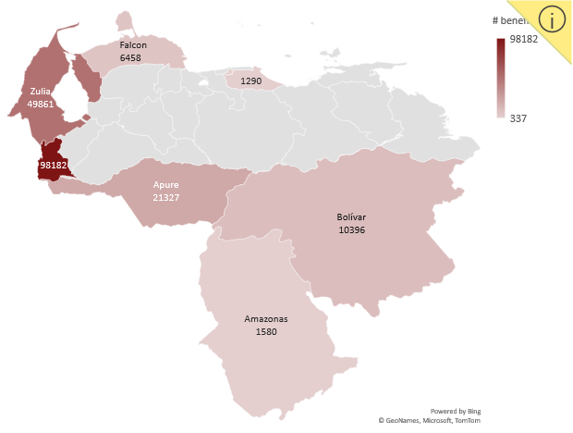
a) Humanitarian Response Plan / COVID-19 activity monitoring (5Ws) (I)
Through 2020 (January to August), over 196K individuals benefited from a better access to safe and dignified shelter, energy and/or basic NFIs.
Figure 1. Number of beneficiaries, disaggregated by state (adm level = 1).

Slide 15





a) Humanitarian Response Plan / COVID-19 activity monitoring (5Ws) (I)
COVID-19 response
8
Health facilities reached in border municipalities
10
State-led institutions and municipalities reached
COVID-19 response
71
Refugee Housing Units (RHUs) installed for isolation/quarantine purposes
+57
Temporary shelter arrangements and PASIs (Government-led) reached

Slide 16


a) Humanitarian Response Plan / COVID-19 activity monitoring (5Ws) (II)
2
UN agencies
4
Local NGOs / national Red Cross movement societies
3
International NGOs
Figure 2. Number of individuals reached January through August 2020, disaggregated by partner organisation.
More international NGOs reporting to the monthly 5Ws in 2020.
Humanitarian access and COVID-19 response.
Figure 3. Number of partners reporting to monthly 5Ws since January 2020 (as a minimum, the organisation has sent one 5W report).

Slide 17
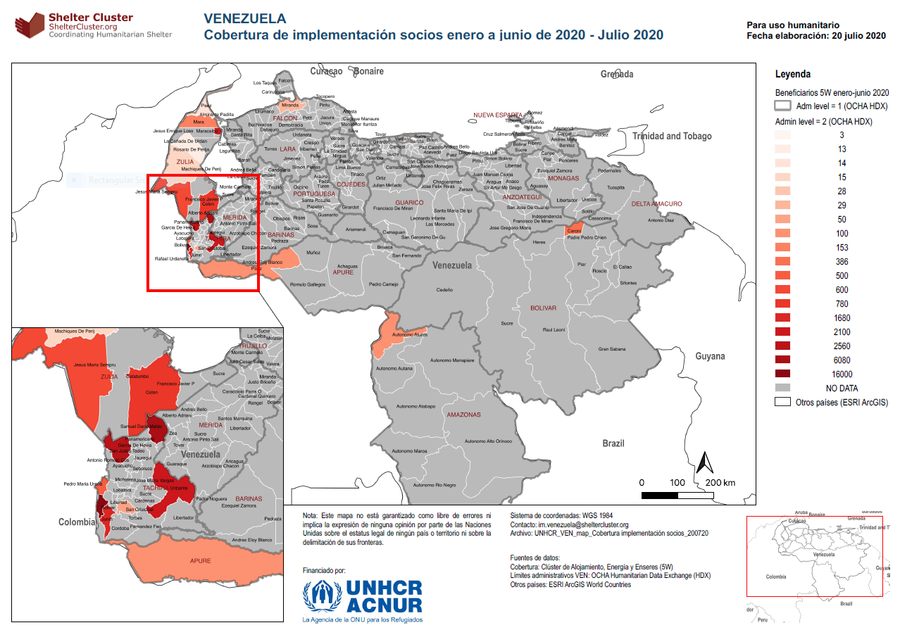
a) Humanitarian Response Plan / COVID-19 activity monitoring (5Ws) (III)
Switzerland fits here! (41K sq m2)

Slide 18
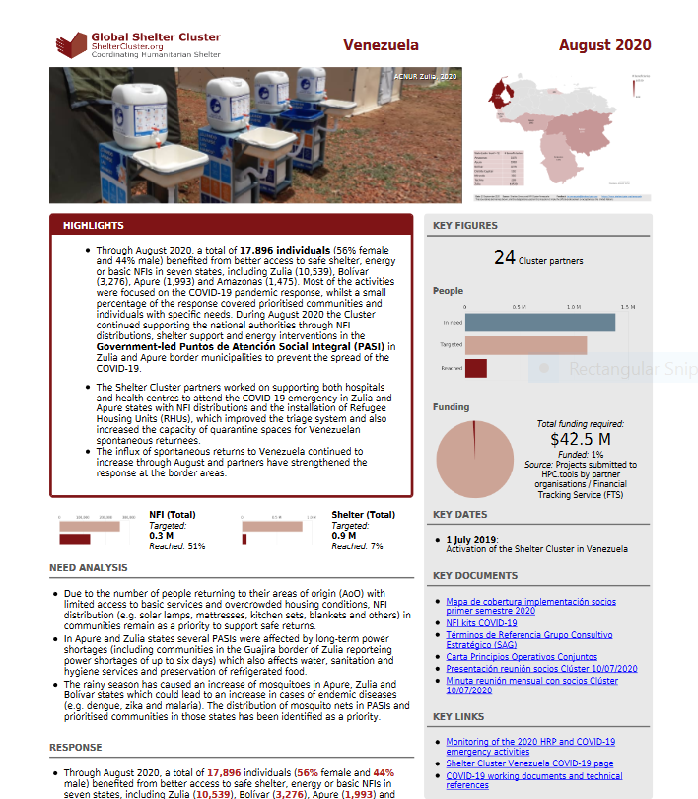
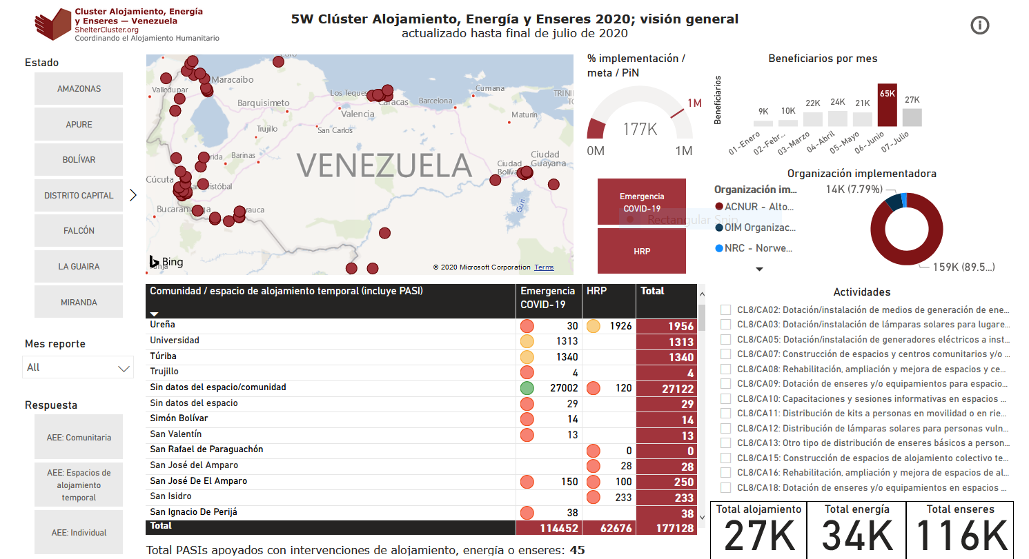
b) Information management products (I)
Response monitoring dashboard (5W):
https://bit.ly/ClusterAlojamiento_Venezuela_5W
Monthly factsheet:
https://www.sheltercluster.org/venezuela/factsheets/2020-08

Slide 19
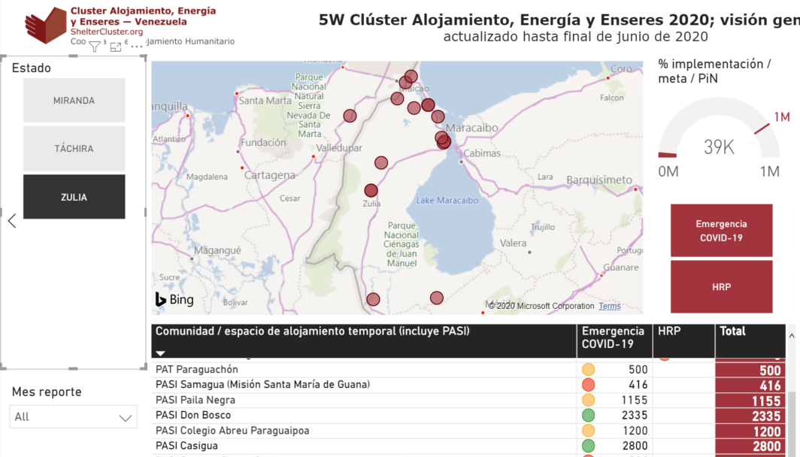
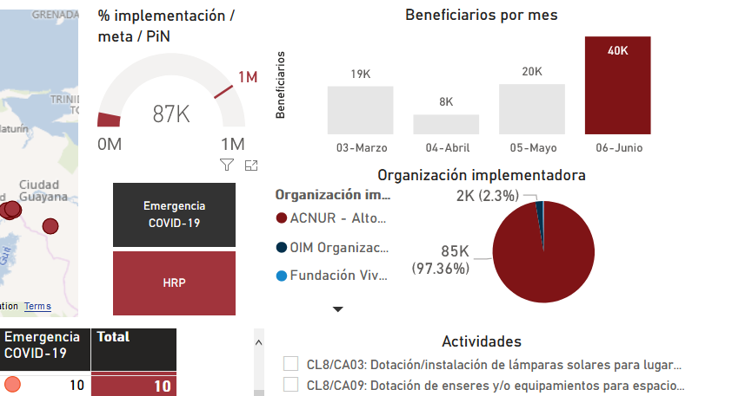
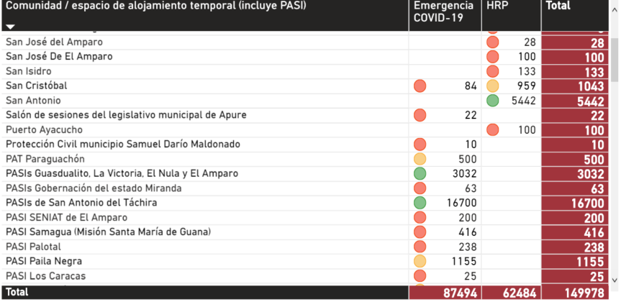
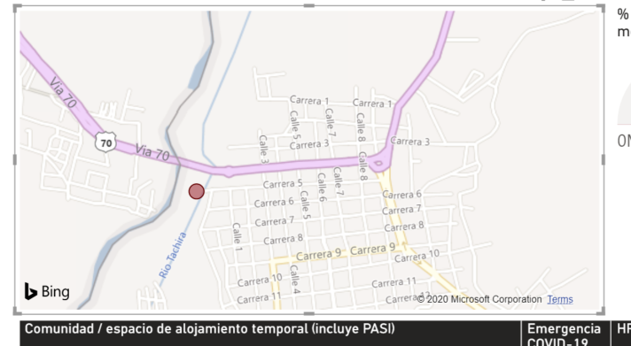
a) Information management products (II)
Figure 4. Selecting locations. Note you can do multiple selections using “Ctrl”.
Figure 5. Dashboard allows disaggregation COVID-19 and HRP.
Figure 6. Table shows adm level = 4.
Figure 7. Implementation sites (GPS coordinates).

Slide 20
GAPS AND CHALLENGES

Slide 21
Gaps and challenges (I)
Most of partners have not received funds through the Response Plan yet, which significantly limits the implementation of field activities.
Limited resources for both international and local partners, which limits response capacity. No response in Sucre and Delta Amacuro; very limited in Bolívar and Amazonas.
Movement restrictions that were put in place due to the spread of the pandemic have severely impacted the operations of partner organisations.
Lack of fuel in country continue affecting the implementation of activities of partner organisations countrywide. Fuel shortage have also led to a considerable increase in the price of transportation services.
Challenges to collect primary data. (not updated data, last information provided from authority sources is available only since 2011).

Slide 22
Gaps and challenges (II)
Additional support for returnees is required to ensure access to health care and basic goods and services.
PCR testing to be scaled up and the results to be processed time reduced to facilitate quicker returns to areas of origin and ensure the capacity of the PASI.
Still the healthcare system needs to scale-up preparedness to be able to respond to the evolution of the outbreak.

Slide 23
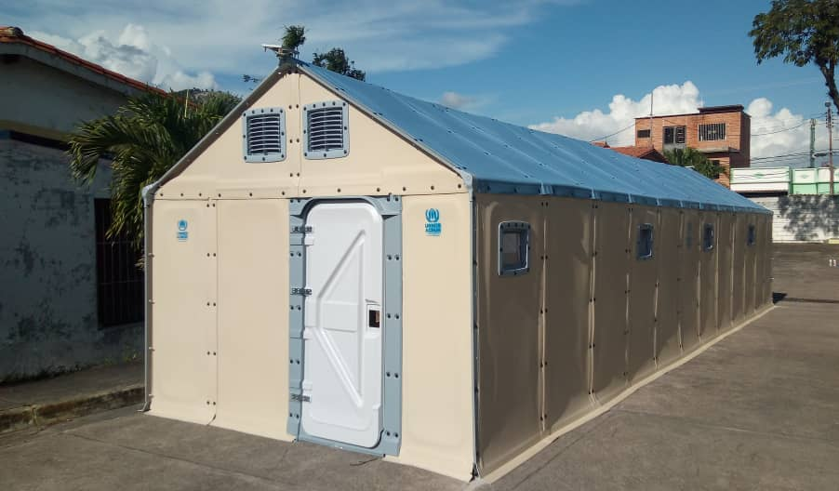
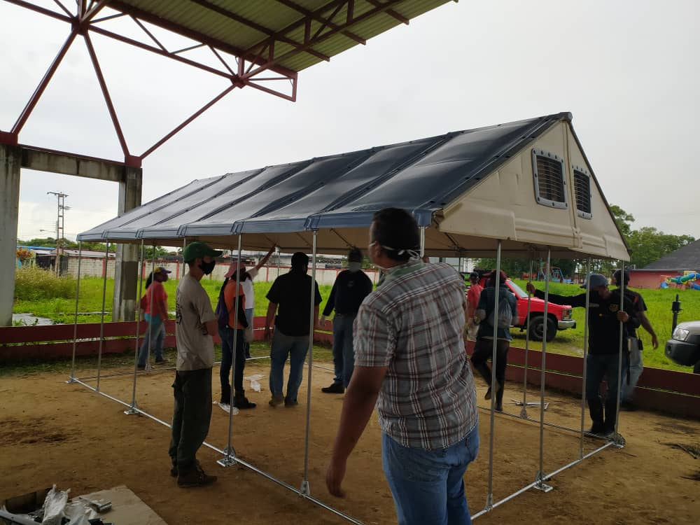
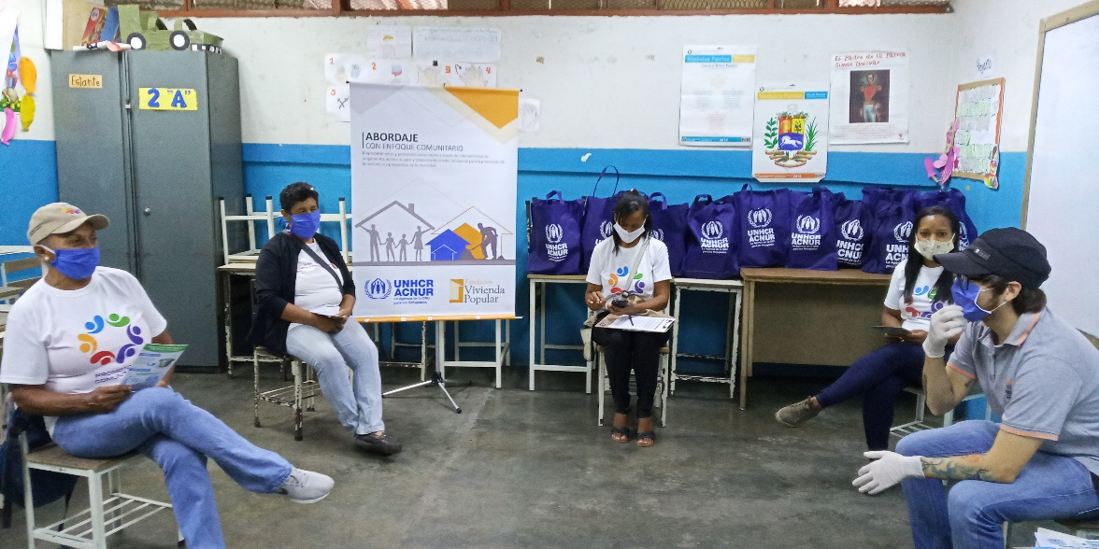
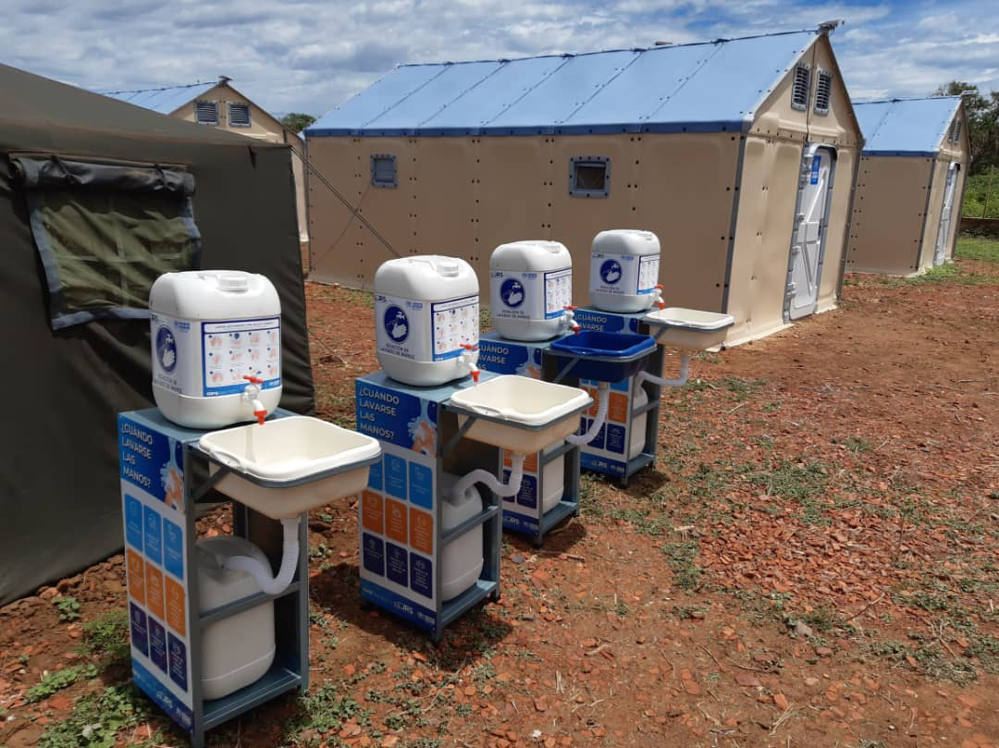
Shelter response

Slide 24
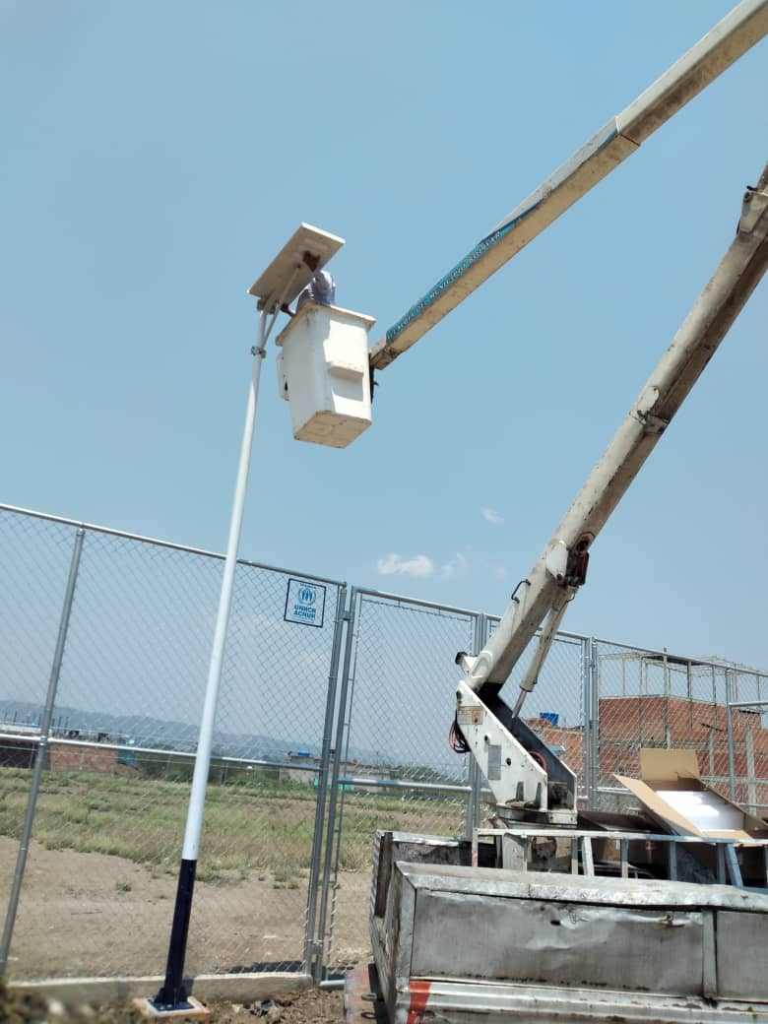
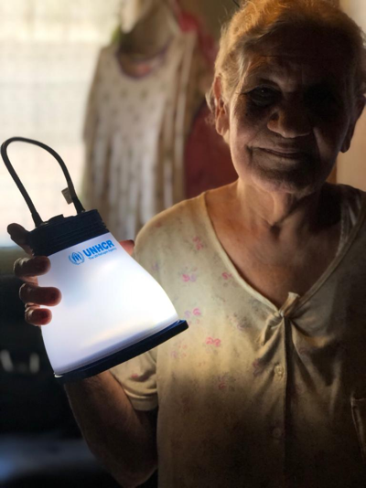
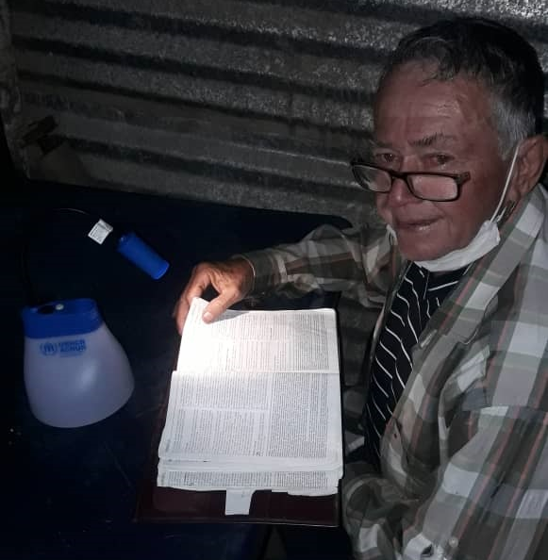
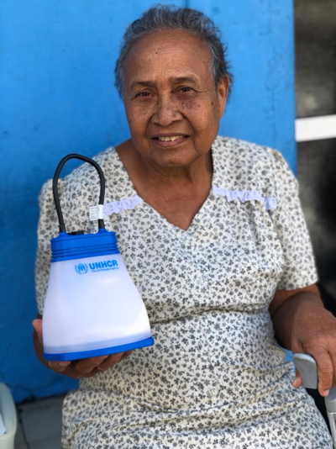
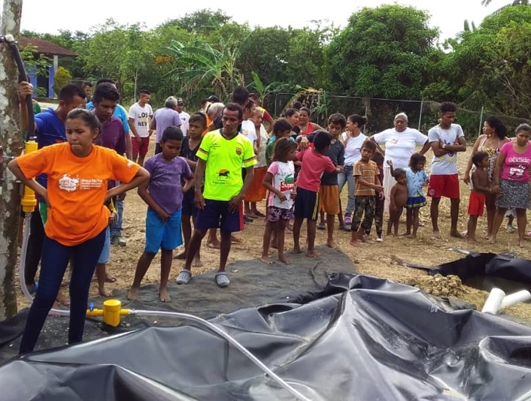
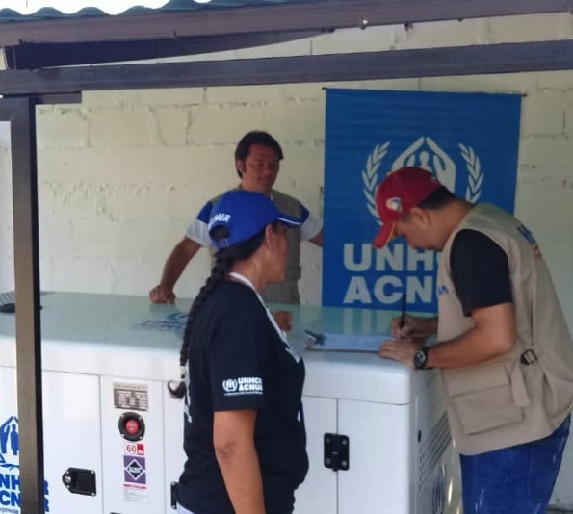
Energy response

Slide 25
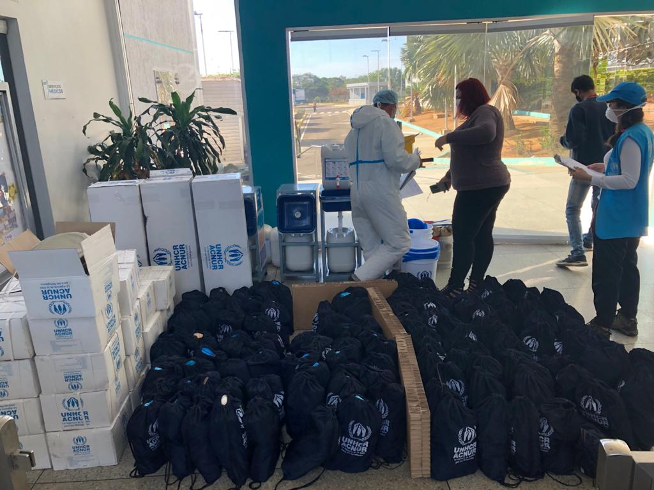
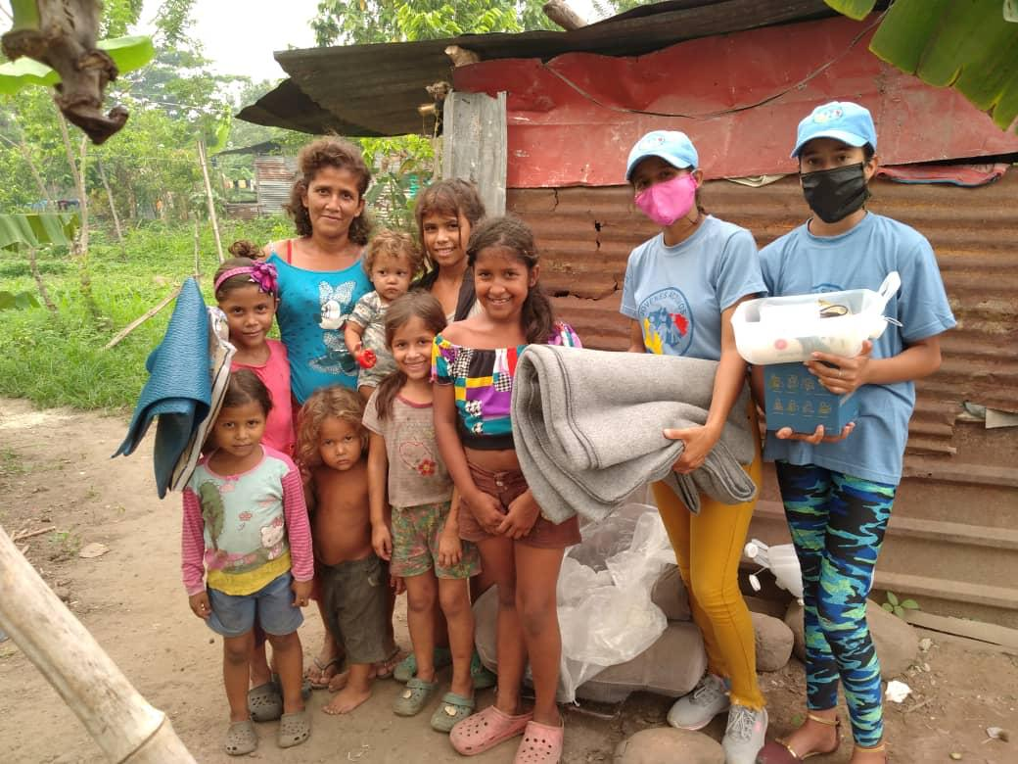
NFI response

