Slide 1


GSC – ECHO project
Greening the shelter response

Slide 2
GSC-ECHO Project: Key data
Start date and duration: 1 April 2021 for 24 months
Total cost: 930,571 EUR
Contribution from ECHO: 650,000 EUR (70%)
Co-funding by UNHCR, IFRC, partners
Funding will be received by UNHCR on behalf of the Global Shelter Cluster.
Methodology similar to the one used in 3 past ECHO grants

Slide 3
Logic of the project
Result 1: Shelter responses become more environmentally sustainable at country and global level
Activity 1.1: Shelter partners green their response
Activity 1.2: Environmental research and advocacy available to make country-level shelter responses greener and climate smart.
Activity 1.3: Country-level shelter clusters effectively design and implement greener and climate-smart shelter responses
Result: Shelter responses become more environmentally sustainable at country and global level
Activity 1: Shelter partners green their response
Activity 2: Environmental research and advocacy available to make country-level shelter responses greener and climate smart
Activity 3: Country-level shelter clusters effectively design and implement greener and climate-smart shelter responses
Global
Country

Slide 4





Activity 1: Shelter partners green their response
Green specifications of the most purchased emergency shelter and NFIs: greener without a reduction in their performance.
Recycling and repurposing options of some of the main global shelter solutions (plastic sheeting, blankets, tents, shelter kits, Refugee Housing Units, and others) captured and shared.
Sustainable energy options, including solar, will be better understood and made available to global shelter partners in order to include them better in their responses.
Methodology to measure the CO2 equivalent & plastic footprint of shelter responses.
Link with the Global Logs Cluster and other clusters.

Slide 5
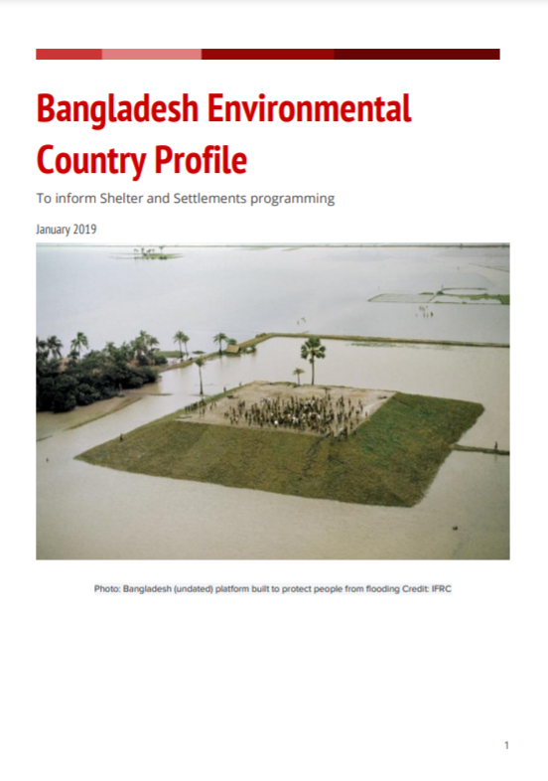
Activity 2: Environmental research and advocacy
Provide the global knowledge needed to help design greener and climate-smart country-level shelter responses.
Environmental profiles:
Overview of the main threats to the environment, key environmental focal points, an analysis of the different shelter options most-commonly used in country, environmental impact calculators, total life-cycle amount of CO2 produced by these interventions.
- Advocacy tools

Slide 6



Activity 3: Green country clusters shelter responses
Strengthen country-level clusters to use the materials developed in activities 1 and 2
Well-designed market interventions to empower affected population and reduce the environmental impact. Cash champions initiative: capacity and methodology to implement well-designed cash and shelter responses.
Appropriate local solutions and materials: CraTerre, local institutions, mason schools. Local building practices will be mapped and analysed for key responses.
Support countries to identify options for reducing, reusing, repurposing and recycling or other end-of-life alternatives, for local shelter solutions.
Collaborate with institutions with environmental expertise such as BRE to support countries with methods for calculating CO2 emissions of local shelter solutions.
Pilot innovative more environmentally sustainable shelter solutions or approaches.
Link with Logistics Cluster, and others at country level
Notes:
BRE, the world’s leading building science centre: www.bregroup.com

Slide 7
ECHO project way forward
Communication of grant approval and activities eligible for funding
SAG agrees on the criteria to select partners
Call for expressions of interest to be partners
SAG selects partners based on agreed criteria
UNHCR transfers funds to the partners
Partners implement, fulfill ECHO requirements and report
UNHCR monitors implementation, consolidates reporting, and maintains relation with ECHO
1
2
3
4
5
6
7

Slide 8
Thank you!

