Slide 1


GSC – ECHO project
Greening the shelter response

Slide 2
Overview of the webinar
14.00 – 14.10 Welcome - Why this project
14.10 – 14.20 GSC ECHO project overview
14.20 – 14.30 Activities for partners
14.30 – 14.40 Process for EoIs
14.40 – 15.00 Questions and Answers

Slide 3
Overview of the webinar
14.00 – 14.10 Welcome - Why this project
14.10 – 14.20 GSC ECHO project overview
14.20 – 14.30 Activities for partners
14.30 – 14.40 Process for EoIs
14.40 – 15.00 Questions and Answers

Slide 4
GSC and Greening the Response
Why?
- Global Priorities
- Environmental & Climate Imperatives: Global GG emissions 40% from built environment
- Interagency priorities (IASC, agency, system-wide)
- Shelter Cluster: Integrated Shelter and Settlement Issues (inc NFI, E&E) including issues related to energy consumption at household level
- Response to partner and strategy priorities

Slide 5
Overview of the webinar
14.00 – 14.10 Welcome - Why this project
14.10 – 14.20 GSC ECHO project overview
14.20 – 14.30 Activities for partners
14.30 – 14.40 Process for EoIs
14.40 – 15.00 Questions and Answers

Slide 6
GSC-ECHO Project: Key data
Start date and duration: 1 July 2021 for 24 months
Total cost: 930,571 EUR
Contribution from ECHO: 650,000 EUR (70%)
Co-funding by UNHCR, IFRC, partners
Funding will be received by UNHCR on behalf of the Global Shelter Cluster.
Methodology similar to the one used in 3 past ECHO grants and the USAID BHA grant.

Slide 7
Logic of the project
Result 1: Shelter responses become more environmentally sustainable at country and global level
Activity 1.1: Shelter partners green their response
Activity 1.2: Environmental research and advocacy available to make country-level shelter responses greener and climate smart.
Activity 1.3: Country-level shelter clusters effectively design and implement greener and climate-smart shelter responses
Result: Shelter responses become more environmentally sustainable at country and global level
Activity 1: Shelter partners green their response
Activity 2: Environmental research and advocacy available to make country-level shelter responses greener and climate smart
Activity 3: Country-level shelter clusters effectively design and implement greener and climate-smart shelter responses
Global
Country

Slide 8





Activity 1: Shelter partners green their response
Green specifications of the most purchased emergency shelter and NFIs: greener without a reduction in their performance.
Recycling and repurposing options of some of the main global shelter solutions (plastic sheeting, blankets, tents, shelter kits, Refugee Housing Units, and others) captured and shared.
Sustainable energy options, including solar, will be better understood and made available to global shelter partners in order to include them better in their responses.
Methodology to measure the CO2 equivalent & plastic footprint of shelter responses.
Link with the Global Logs Cluster and other clusters.

Slide 9
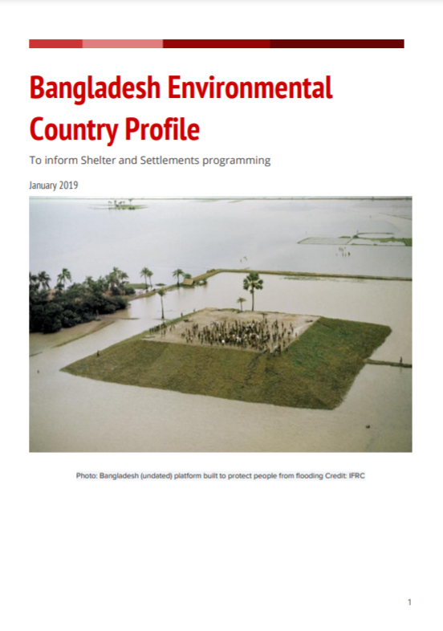
Activity 2: Environmental research and advocacy
Provide the global knowledge needed to help design greener and climate-smart country-level shelter responses.
Environmental profiles:
  Overview of the main threats to the environment, key environmental focal points, an analysis of the different shelter options most-commonly used in country, environmental impact calculators, total life-cycle amount of CO2 produced by these interventions.
- Advocacy tools

Slide 10



Activity 3: Green country clusters shelter responses
Strengthen country-level clusters to use the materials developed in activities 1 and 2
Well-designed market interventions to empower affected population and reduce the environmental impact. Cash champions initiative: capacity and methodology to implement well-designed cash and shelter responses.
Appropriate local solutions and materials: CraTerre, local institutions, mason schools. Local building practices will be mapped and analysed for key responses.
Support countries to identify options for reducing, reusing, repurposing and recycling or other end-of-life alternatives, for local shelter solutions.
Collaborate with institutions with environmental expertise such as BRE to support countries with methods for calculating CO2 emissions of local shelter solutions.
Pilot innovative more environmentally sustainable shelter solutions or approaches.
Link with Logistics Cluster, and others at country level
Notes:
BRE, the world’s leading building science centre: www.bregroup.com

Slide 11
Indicators
Specific objective:
Indicator 1: Reduction in the yearly CO2 equivalent footprint of shelter and non-food items. Baseline: 0, this is a new indicator. Target value: 63,000 tons
Indicator 2: Reduction in the amount of virgin plastic distributed per year in shelter and non-food items. Baseline: 0, new indicator. Target value: 7,000 tons
Indicator 3: % of country clusters in response mode which have used the tools and found them useful to support to green the shelter response. Baseline: 0% new indicator. Target value: 60%
Result 1:
Indicator 1.1: Number of commitments to using the new greener specifications developed. Baseline: 0, new indicator. Target value: 10
Indicator 1.2: Number of countries that have a recent environmental profile. Baseline: 1. Target value: 10
Indicator 1.3: Number of local shelter response modalities for which options for reducing, reusing and recycling have been developed. Baseline: 0. Target value: 5

Slide 12
Overview of the webinar
14.00 – 14.10 Welcome - Why this project
14.10 – 14.20 GSC ECHO project overview
14.20 – 14.30 Activities for partners
14.30 – 14.40 Process for EoIs
14.40 – 15.00 Questions and Answers

Slide 13
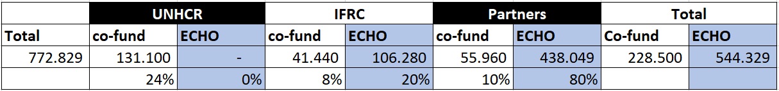
Budget: direct costs
Activities to partners:
GFP for Environment
Support to ECoP
Energy options description
Environmental profiles
Localization initiatives
Cash Champions
Local Building Practices Profiles

Slide 14
Budget for activities to partners
Activity | Budget (EUR) | Comments
1. GFP for Environment + travel | 105,960 8,440 | Co-funding of 45,960 needed. Must be deployable to both conflict and natural disasters. Encouraged to apply even if co-funding not confirmed.
2. Support to ECoP | 33,300
3. Energy options description | 20,589
4. Global Focal Point for Advocacy | 70,000
5. Development of 5 environmental profiles | 29,540 | Focus on conflict as IFRC is also receiving funds for this.
6. Increased Advocacy | 33,760
7. Localization initiatives | 13,760
8. Cash Champions | 33,760
9. Local Building Practices Profiles | 27,980 | Co-funding of 10,000 needed. Balance between conflict and natural disasters
10. Pilot of environmentally appropriate shelter solutions or approaches (in conflict) | 60,960 | Focus on conflict as IFRC is also receiving funds for this.
Total | 438,049
Notes:
Final amounts could be higher as UNHCR will contribute co-funding for some of these activities
Co-funding is welcome for all activities but a requirement when indicated

Slide 15
Budget for activities to IFRC
Activity | Budget (EUR) | Comments
1. GFP for Technical Coordination | 61,740
2. Development of 5 environmental profiles | 29,540
3. Pilots of environmental shelter solutions | 15,000
Total | 106,280
IFRC will provide contribute the following co-funding (EUR):
GFP for Technical Coordination: 10,000
Support to the ECoP: 15,000
Website development: 8,440
GSC meeting and workshops: 8,000
Total: 41,440

Slide 16
Budget for activities to UNHCR
Activity | Budget (EUR) | Comments
Hosting of the grant manager (indirect cost) | 66,000
Total | 66,000
UNHCR will provide contribute the following co-funding (EUR):
GFP for Coordination: 87,660
Support to the ECoP: 15,000
Localization activities: 20,000
Website development: 8,440
Total: 131,100

Slide 17
ECHO project way forward
Communication of grant approval and activities eligible for funding
SAG agrees on the criteria to select partners
Call for expressions of interest to be partners
SAG selects partners based on agreed criteria
UNHCR transfers funds to the partners
Partners implement, fulfill ECHO requirements and report
UNHCR monitors implementation, consolidates reporting, and maintains relation with ECHO
1
2
3
4
5
6
7

Slide 18
Overview of the webinar
14.00 – 14.10 Welcome - Why this project
14.10 – 14.20 GSC ECHO project overview
14.20 – 14.30 Activities for partners
14.30 – 14.40 Process for EoIs
14.40 – 15.00 Questions and Answers

Slide 19
Partners selection process
Step | Description | Date
1 | Launch of call for Expressions of Interest | 28 June 2021
2 | A webinar with interested agencies to explain the process | 6 July
3 | Deadline for submission of queries from partners (to be answered in 2 days) | 8 July 2021
4 | Deadline for submission of Expressions of Interest | 1 August 2021
5 | Communication of results to successful and unsuccessful applicants | 1 September 2021
6 | Partners which are not registered in the UNHCR partner portal can do this in preparation for signing the Partnership Agreement (PA) | 1 August – 1 September 2021
7 | Finalization and signature of PA with successful Project Partners | 24 Sept 2021
8 | Start of Eligibility of Project expenses | 1 July 2021
9 | End of Eligibility of Project expenses | 30 June 2023

Slide 20
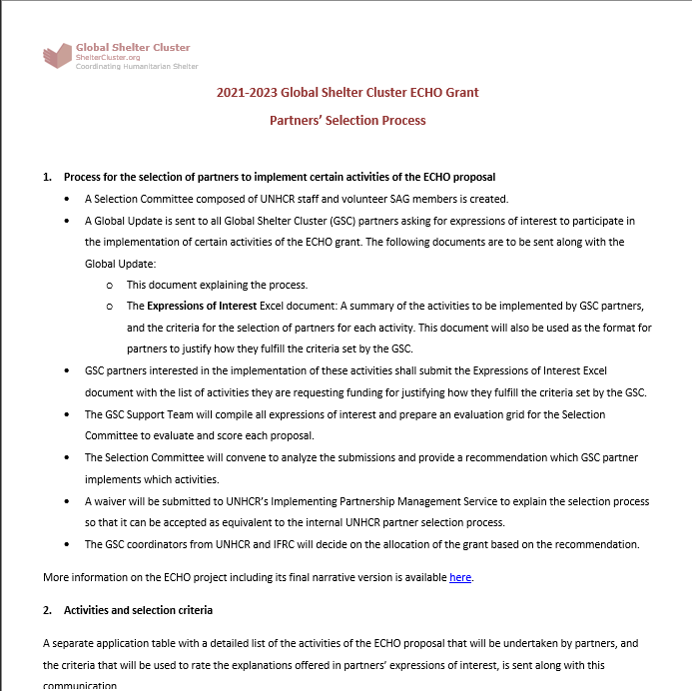
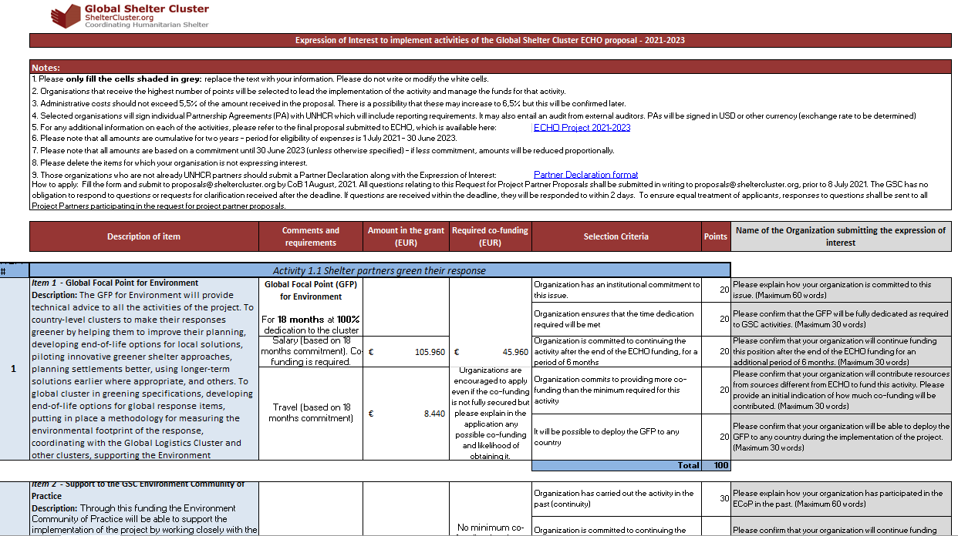
Key documents
Partners’ Selection Process
Expressions of Interest

Slide 21
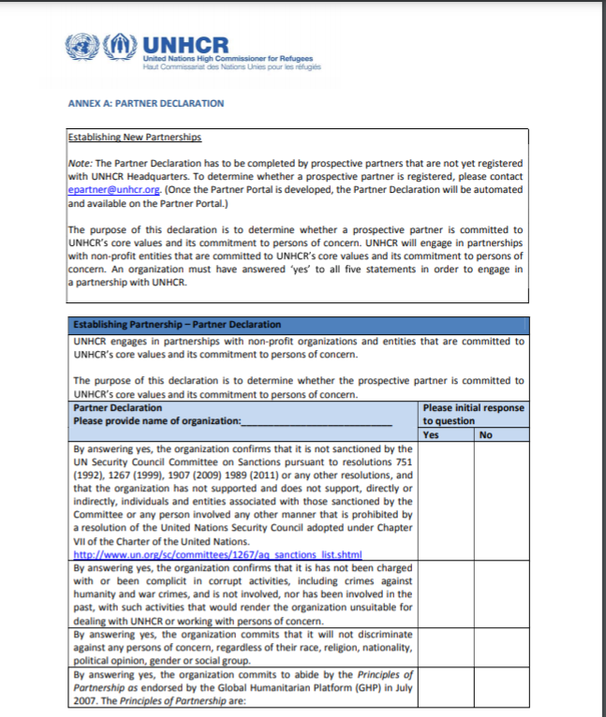
Key documents
For those who have never been a UNHCR partner:
Partner declaration

Slide 22
Criteria to select partners
Global FP for Environment
Cash Champions
Organization has an institutional commitment to this issue. | 20
Organization ensures that the time dedication required will be met | 20
Organization is committed to continuing the activity after the end of the ECHO funding, for a period of 6 months | 20
Organization commits to providing more co-funding than the minimum required for this activity | 20
It will be possible to deploy the GFP to any country | 20
Total | 100
Organization has carried out similar activity in the past (experience) | 20
Organization has the technical capacity and expertise required | 30
Organization commits to providing co-funding for this activity | 30
Organization can undertake this activity in any country | 20
Total | 100

Slide 23
Overview of the webinar
14.00 – 14.10 Welcome - Why this project
14.10 – 14.20 GSC ECHO project overview
14.20 – 14.30 Activities for partners
14.30 – 14.40 Process for EoIs
14.40 – 15.00 Questions and Answers

Slide 24
Thank you!
Q&A

