Slide 1
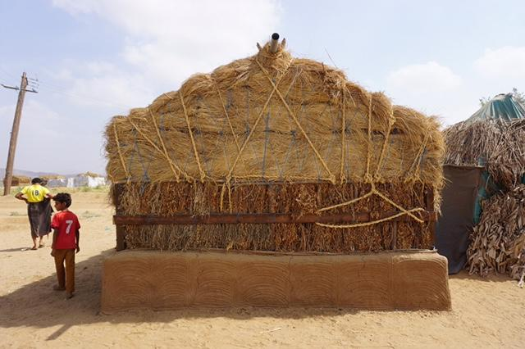

GSC online meeting 2021
Opening Session
GSC online meeting 2021
Photo: Naseem Mardas, Hajjah Governorate, Yemen 2018

Slide 2
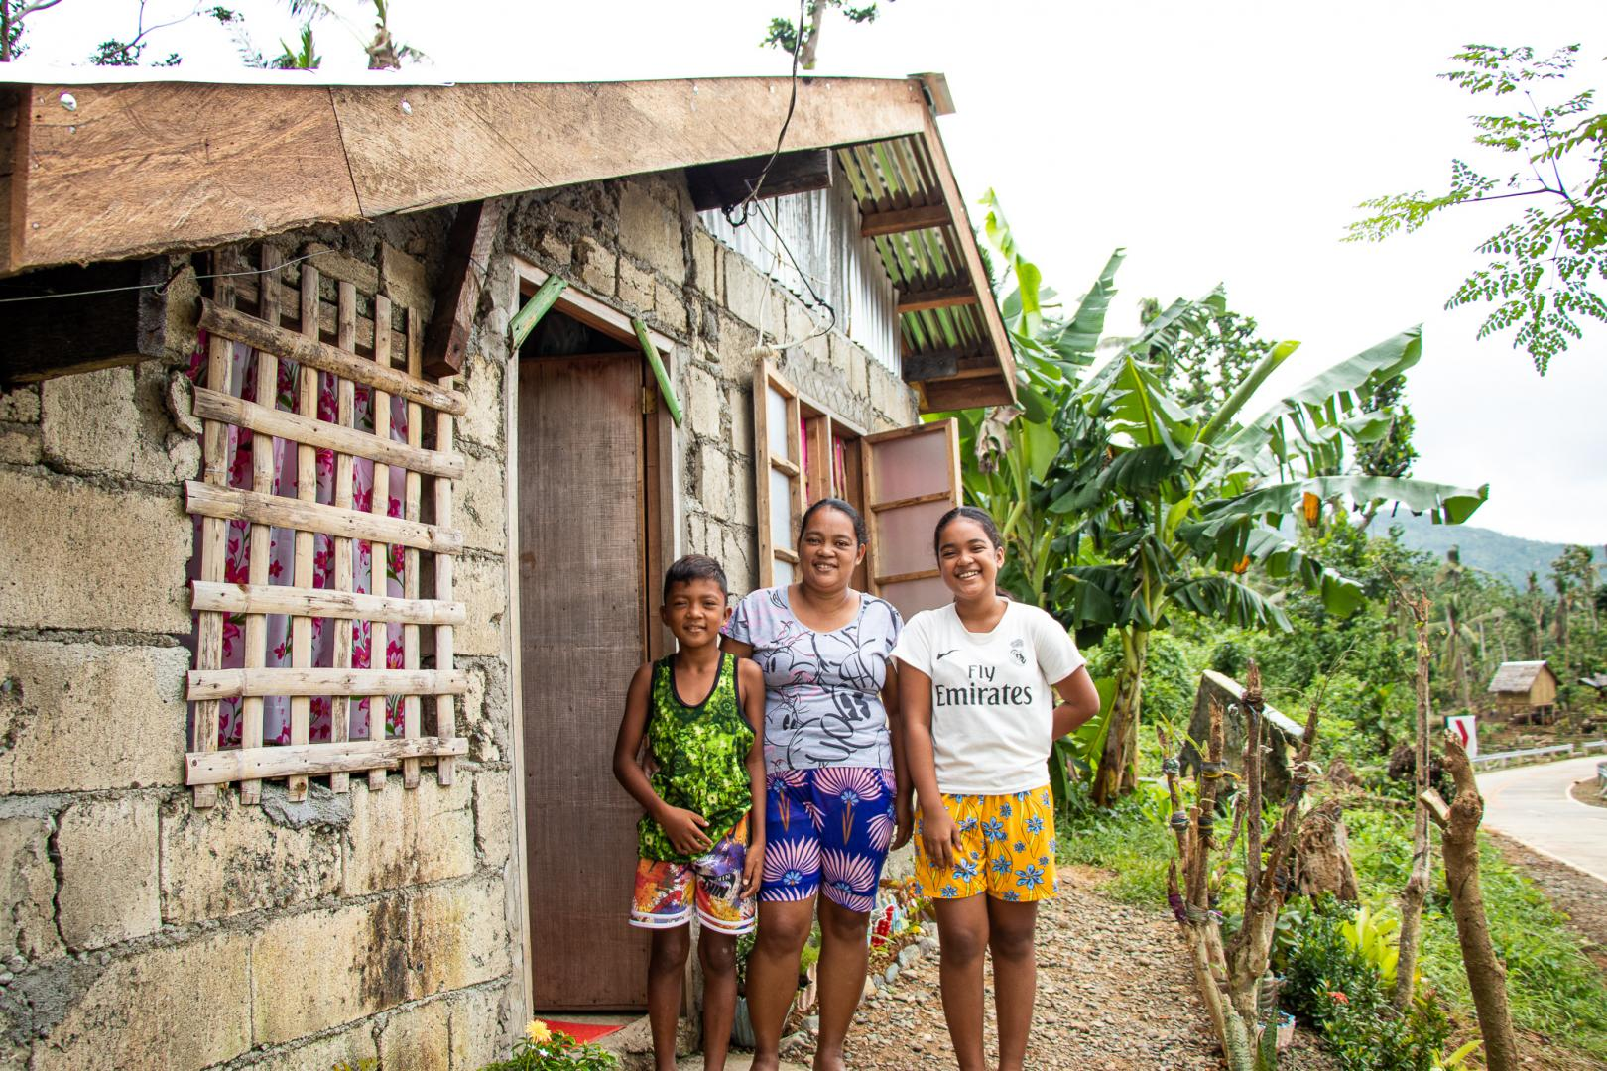
WELCOME
by
Ela Serdaroglu,
GSC co-lead IFRC
Housing repair in Barangay Yocti, San Andres, Philippines, by CRS, November 2020,
Photo: Jomari Guillermo.
Copyright: CRS Mozambique

Slide 3
Overview of the session
Welcome
Achievements in 2020 and plans for 2021+
Feedback on achievements and plan
Overview of the GSC online meeting 2021
Closing Remarks

Slide 4
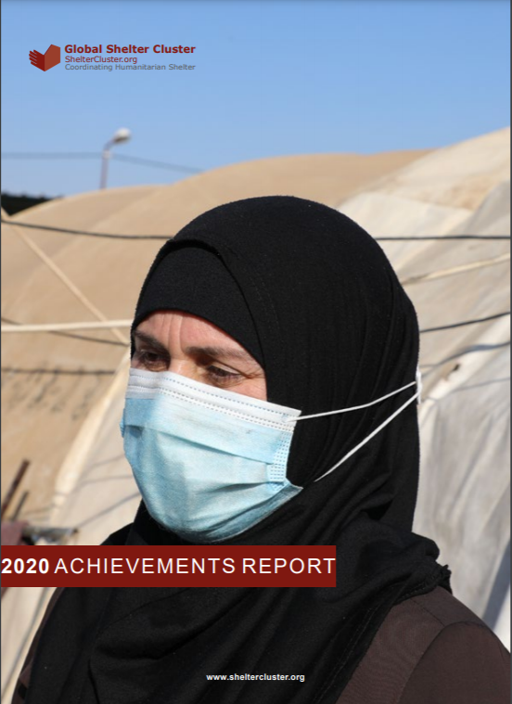
GSC 2020 Achievements Report Highlights

Slide 5

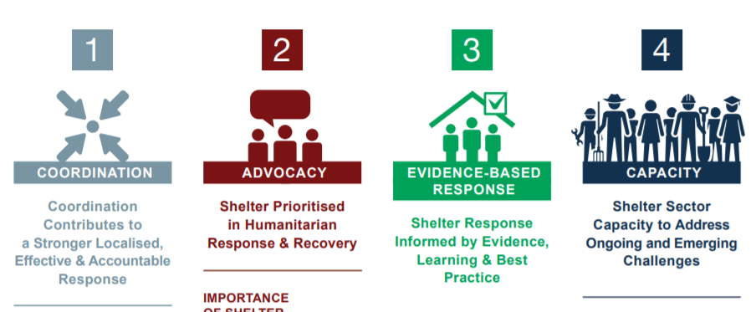
Progress against Global Shelter Cluster Strategy

Slide 6










Global Shelter Cluster Achievements in 2020
Active Clusters
30
Field Mission Support Days
244
Cluster Partners
804
Remote Cluster Support Days
727
People Supported with Shelter
6.4 Million
Annual Shelter Event/Participants
53 Events / 400 Participants
People Supported with NFI
10.4 Million
Guidance Developed
Coordination Toolkit – 2020 Update
Information Management and Assessment Toolkit
Rental Market Guidance
Covid-19 Resource Library…
Funding Received
$646.2 Million
Link to Global Shelter Cluster Operations Dashboard

Slide 7
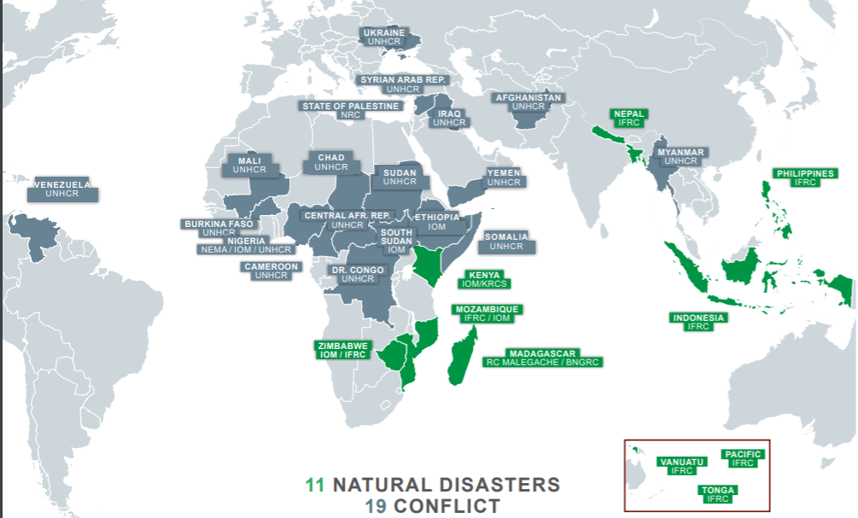
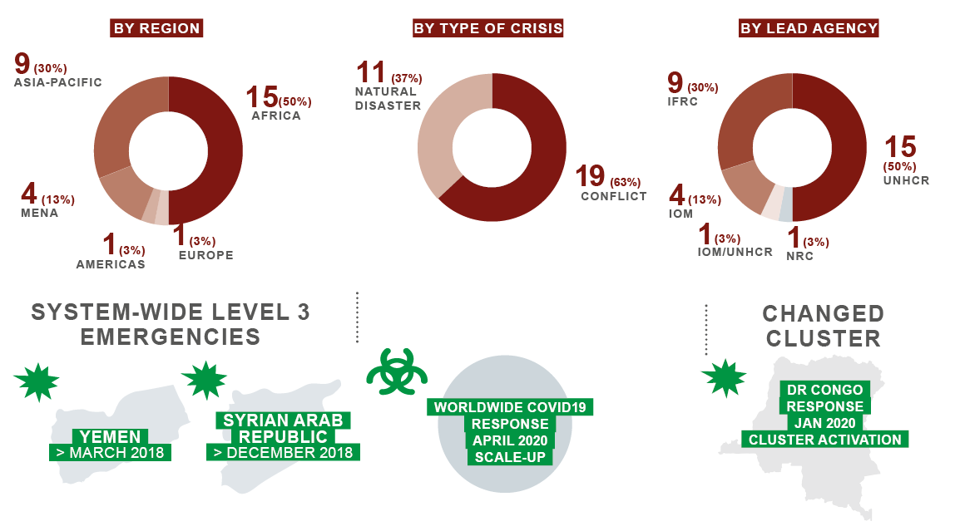
Country-level Shelter Clusters
30 Active Clusters
Breakdown of Clusters

Slide 8
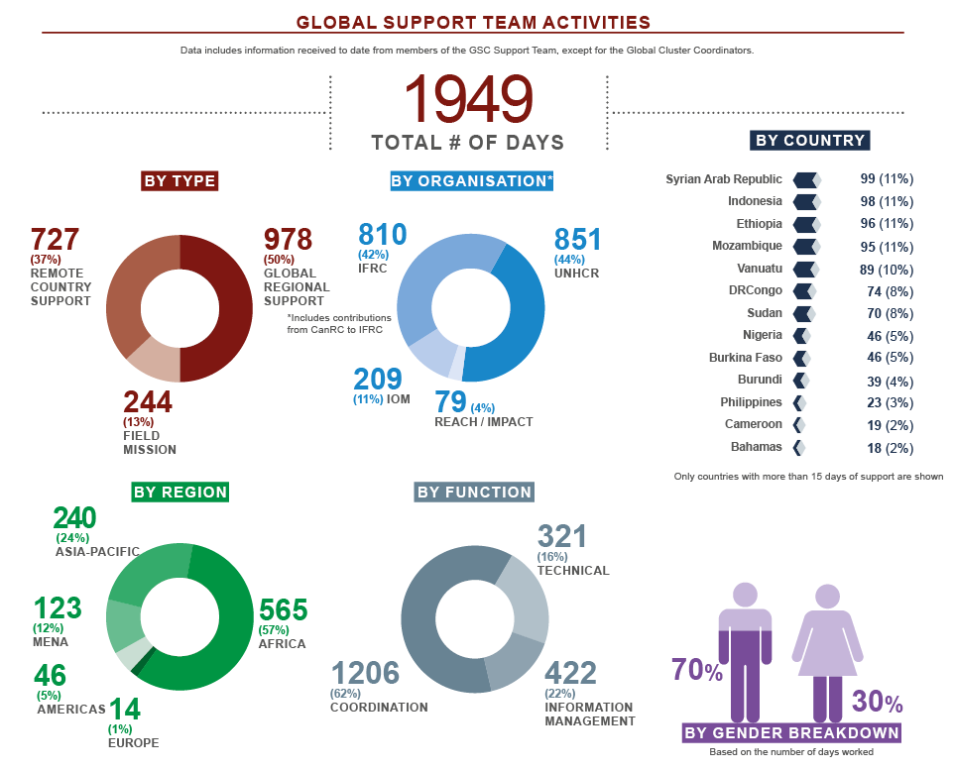
Global Shelter Cluster Team

Slide 9
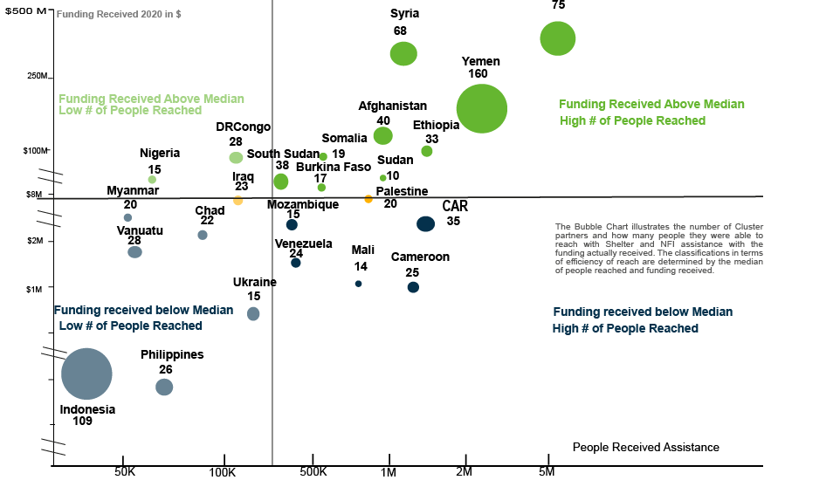
Partners and Donors
Gaziantep Hub

Slide 10
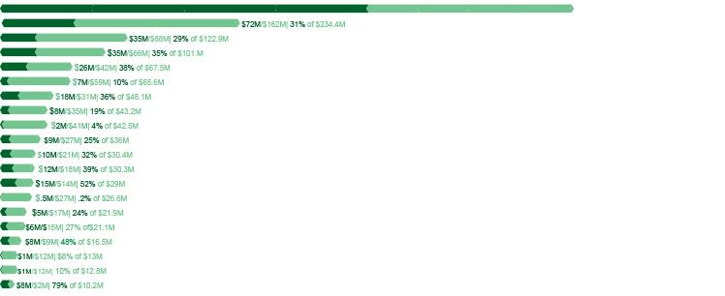
Funding Received/Gap
Syrian Arab Republic
Yemen
Afghanistan
Ethiopia
DRCongo
Nigeria
Somalia
Iraq
Venezuela
South Sudan
Mozambique
Burkina Faso
Sudan
Ukraine
Chad
Myanmar
Rep. Centafrique
Mali
Cameroon
State of Palestine
$367M/203M 64% of $569.9M
$646.2M
Funding Received
$1.6B
Funding Required
31%
Average Funding Level
59%
Funding Gap

Slide 11
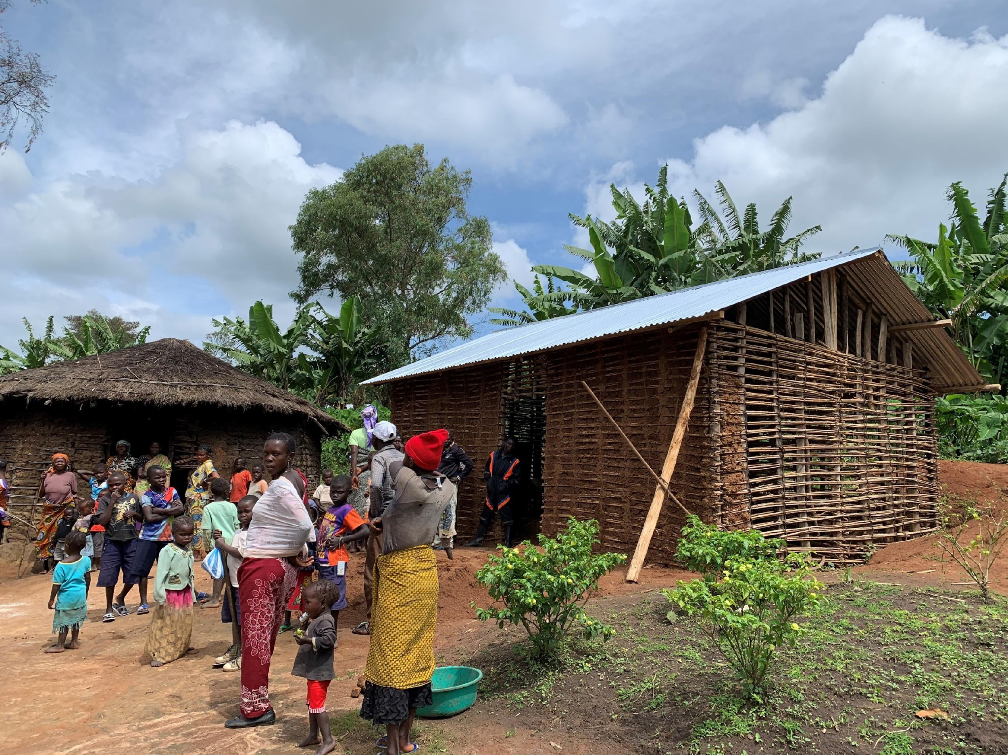
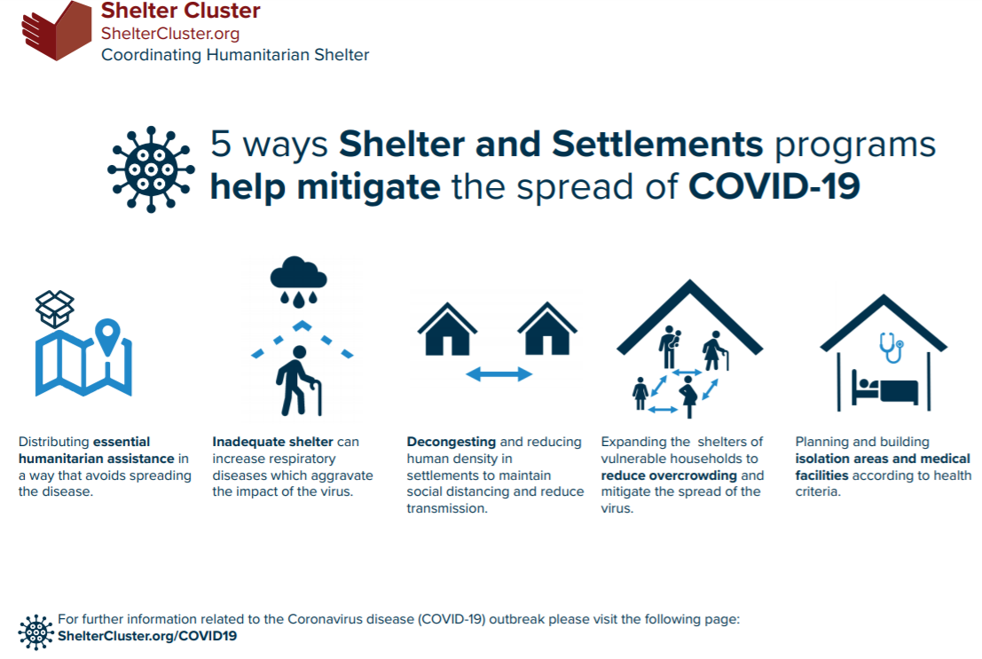
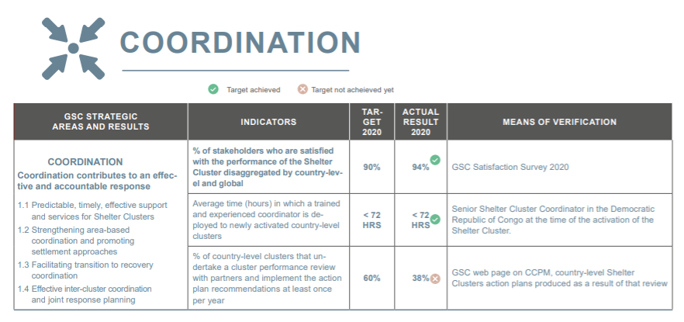


Pillar 1 Progress: Coordination
Working Groups and Communities of Practice
Global Support Team Remote Support and Missions
Global Scale Up to COVID19

Slide 12
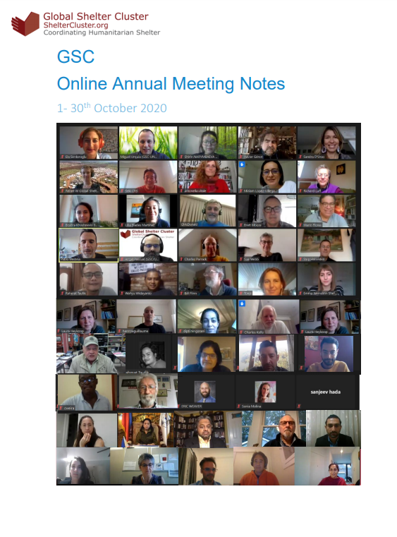
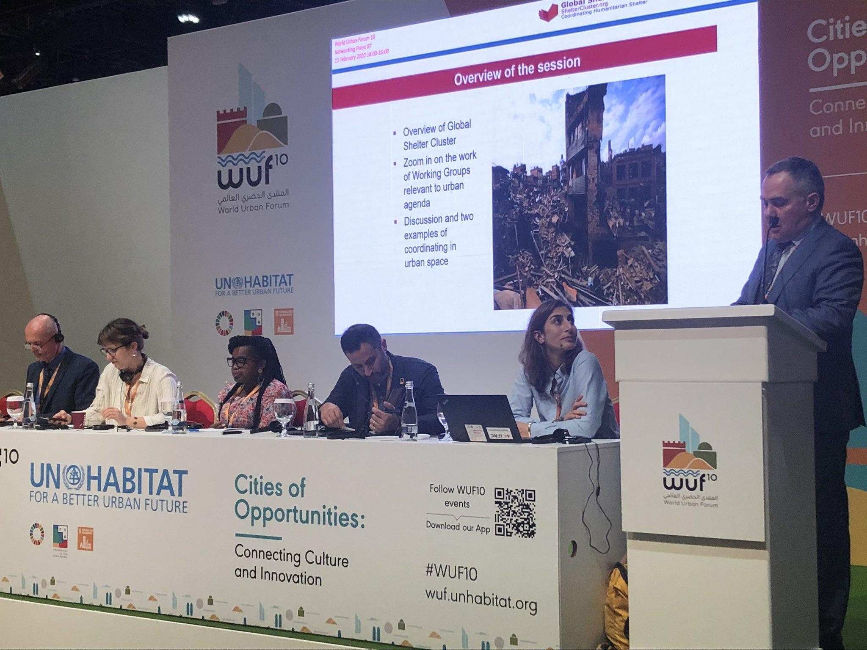
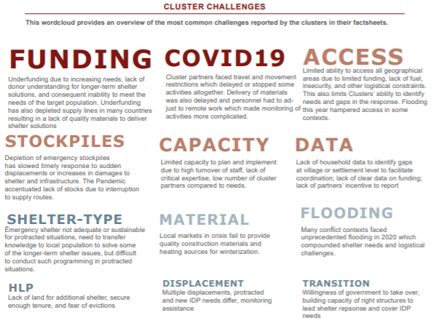
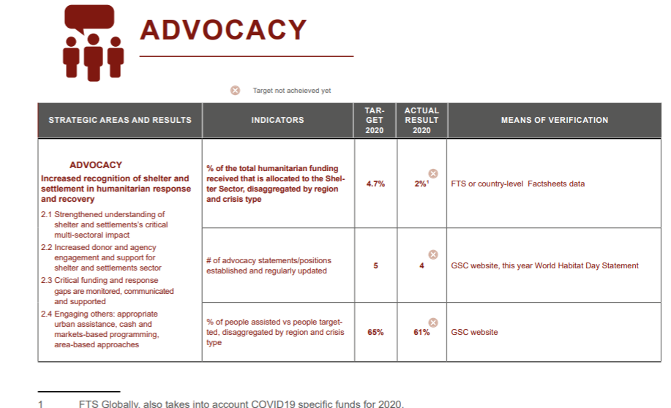
Pillar 2: Advocacy
Global Updates
Twitter
World Habitat Day
World Urban Forum
Country-advocacy products - factsheets

Slide 13
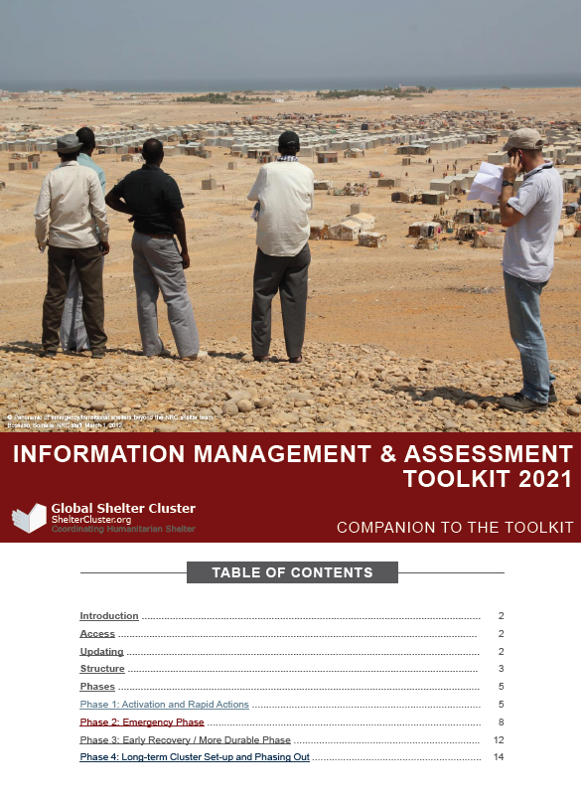
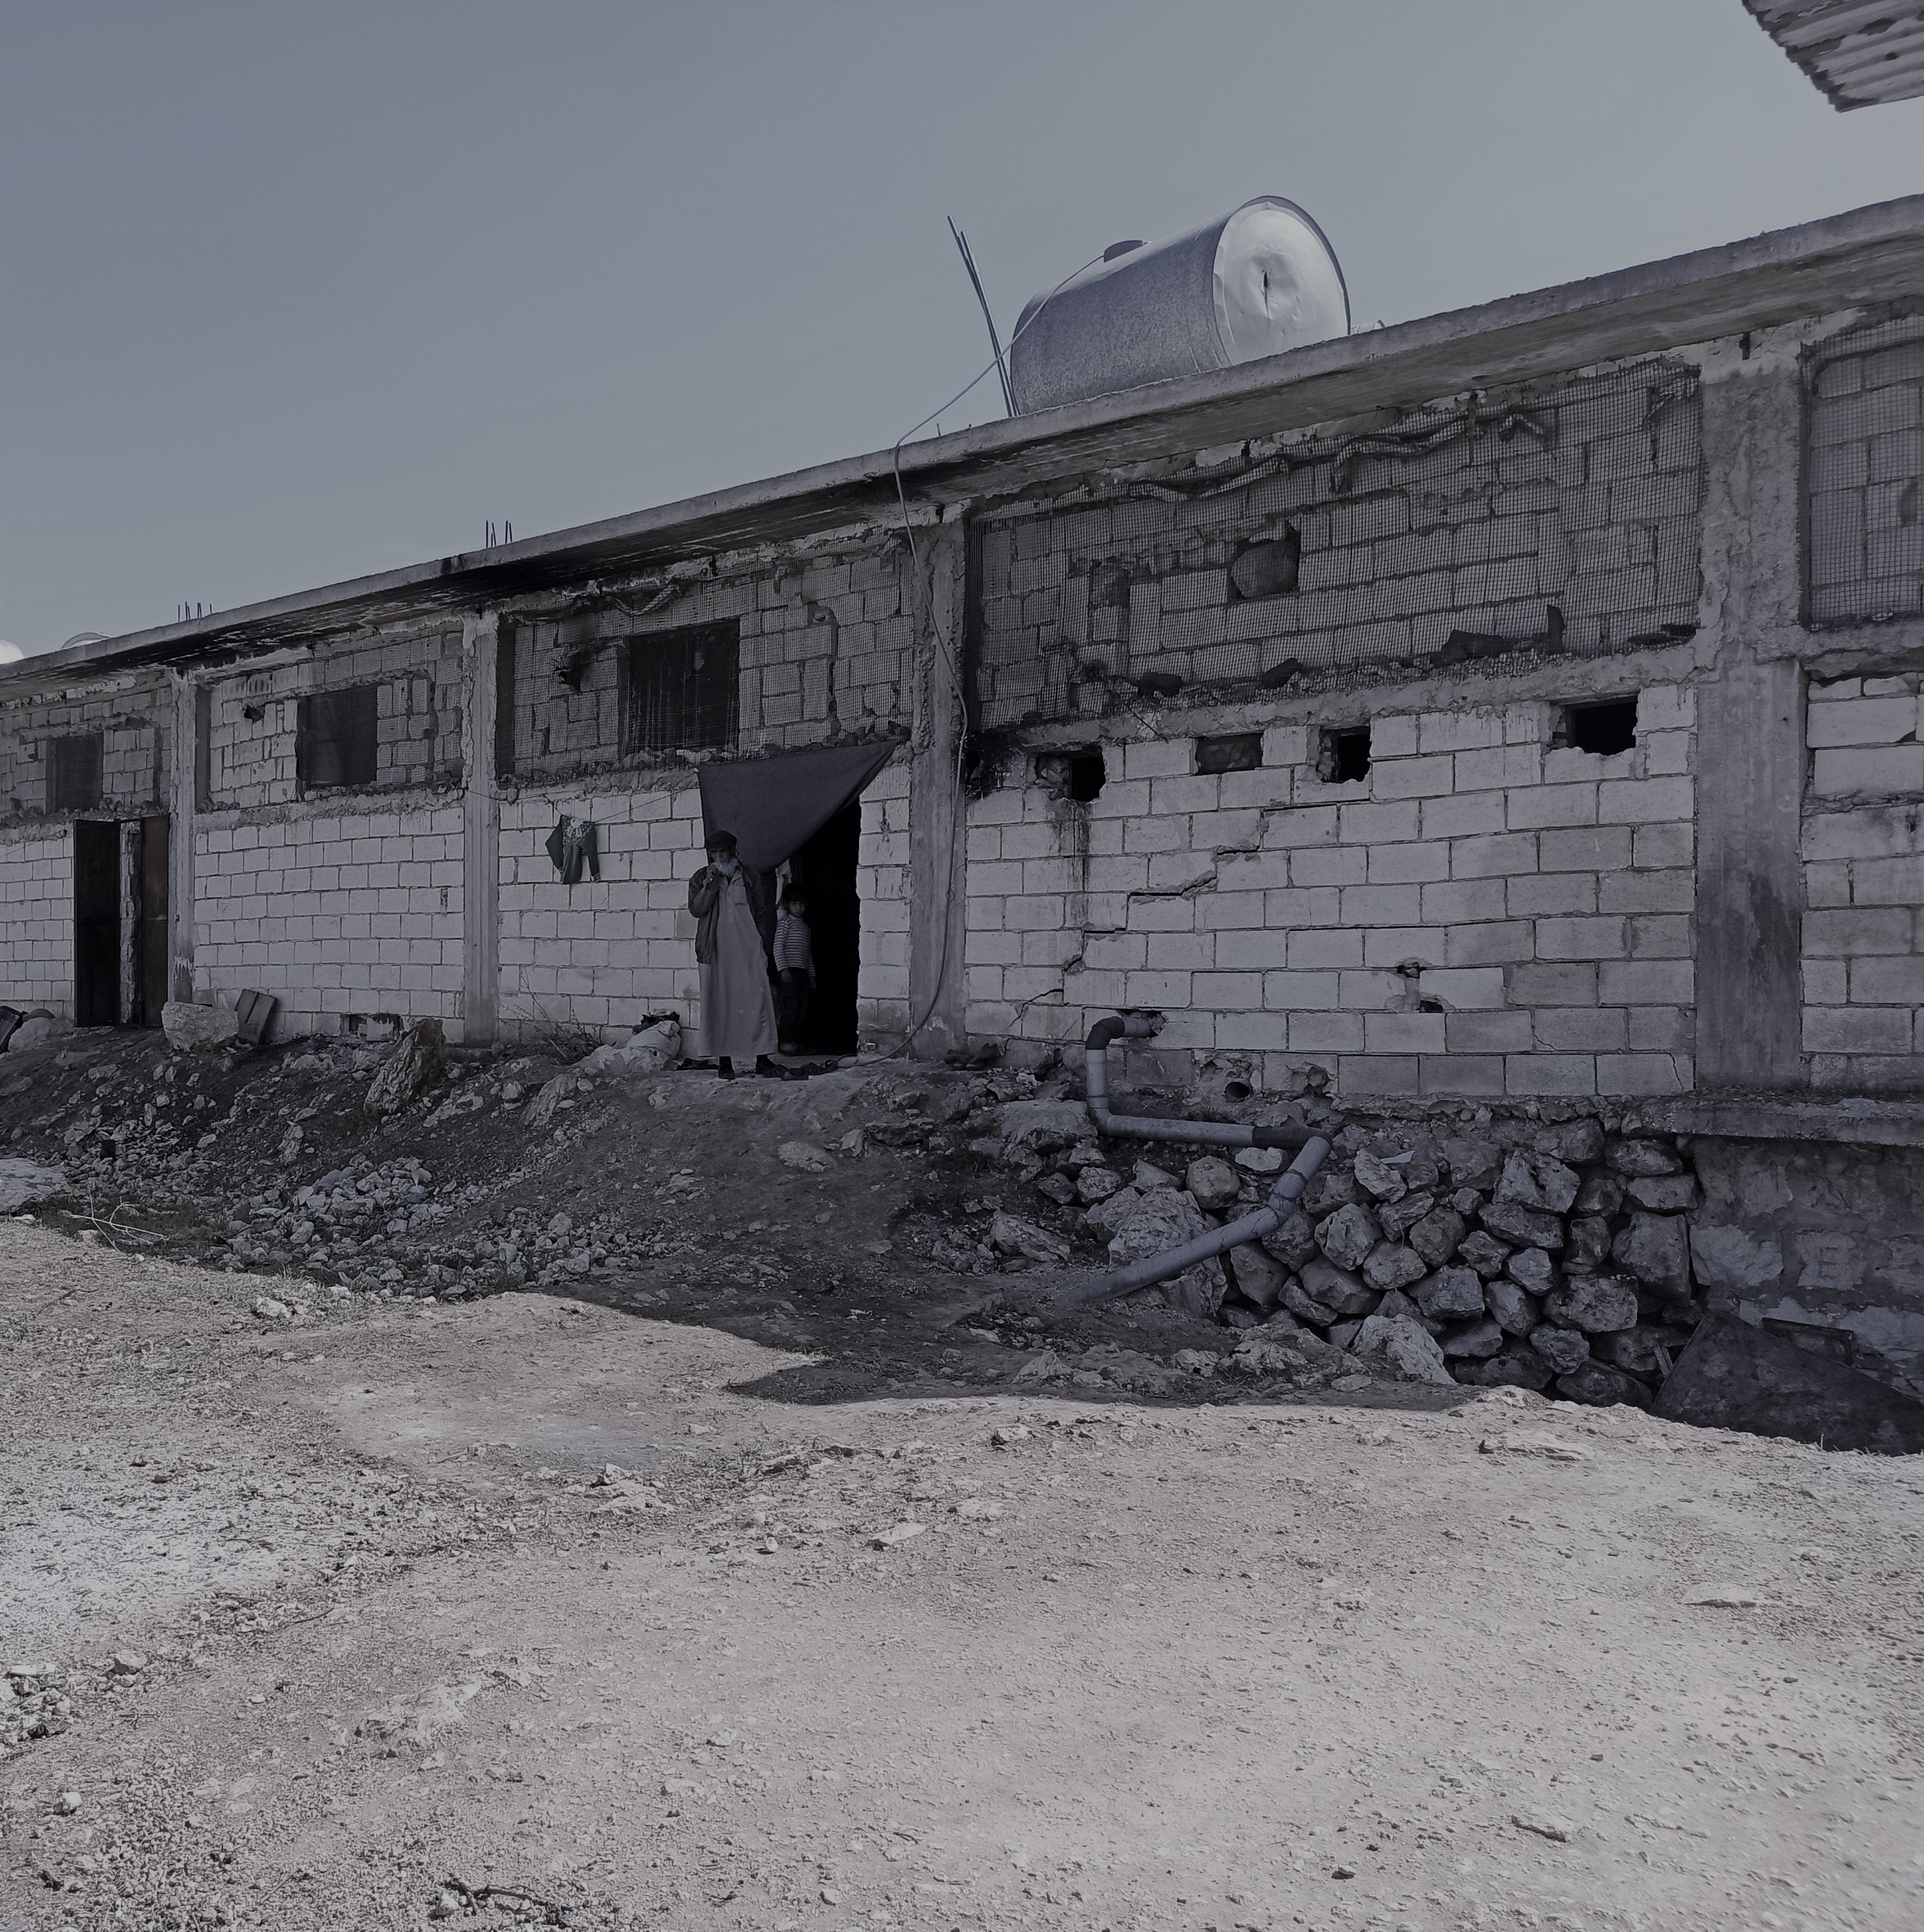
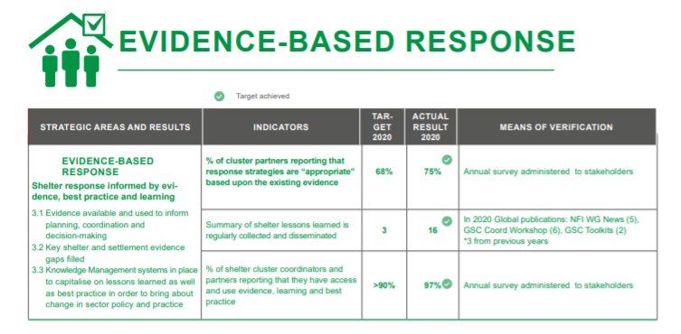
Pillar 3: Evidence-based Approach
Assessment Support: Cross Border Operations in Syria and Sudan Shelter Clusters
GSC website updates
Revision to Coordination Toolkit-April 2020
Development of first Information Management and Assessment Toolkit

Slide 14
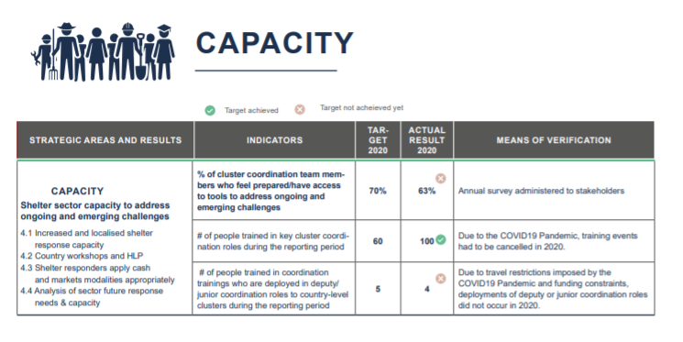
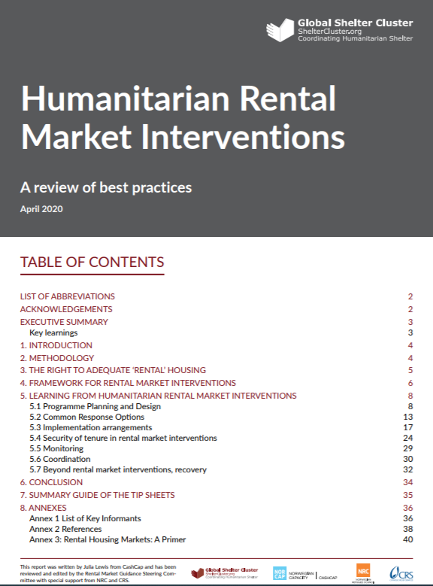
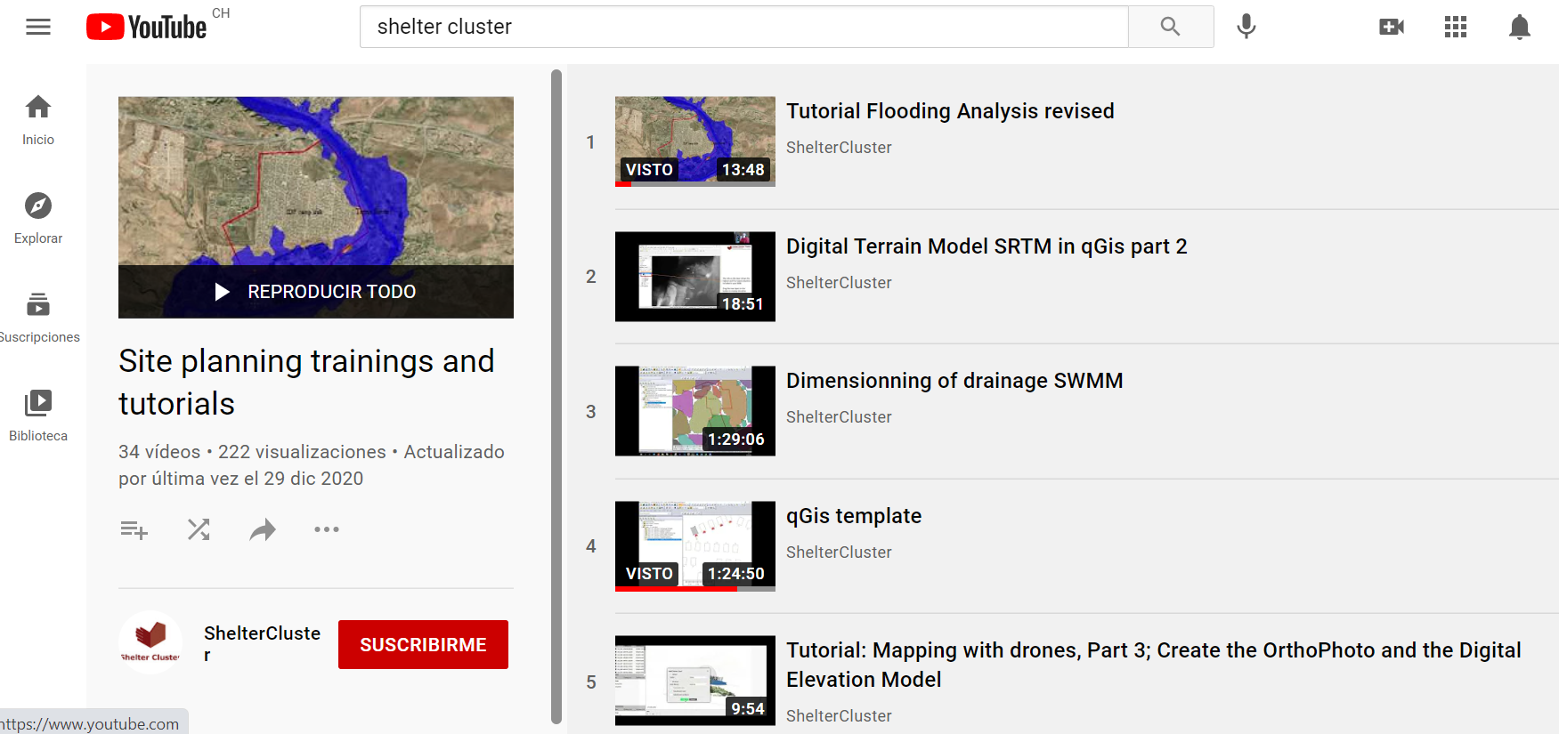
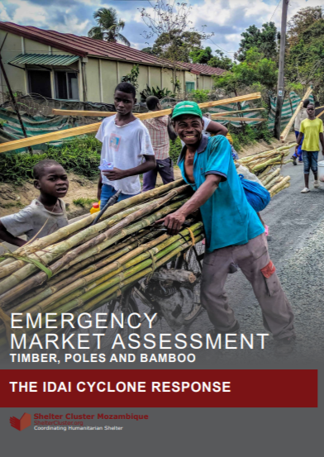
Pillar 4: Capacity
Humanitarian Shelter Training
Agency Initiatives
GSC Rental Guidance Tipsheets, Report and Library of Resources
HLP country profiles: key messages on COVID19
Country Initiatives
Cross Border Syria Operations Settlement Planning Training
Indonesia Training Series
CRS support to market assessment in Mozambique

Slide 15
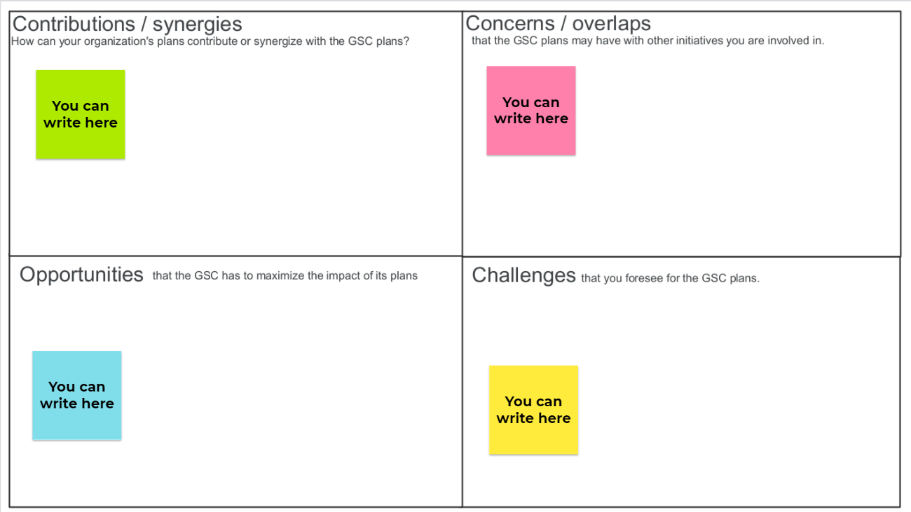
Jamboard
Share your thoughts on the plans through this jamboard:
https://jamboard.google.com/d/13RHwoCn_xjksMF6bY3bn1a006lXsBBaYtdh8c6DqAhc/edit?usp=sharing

Slide 16
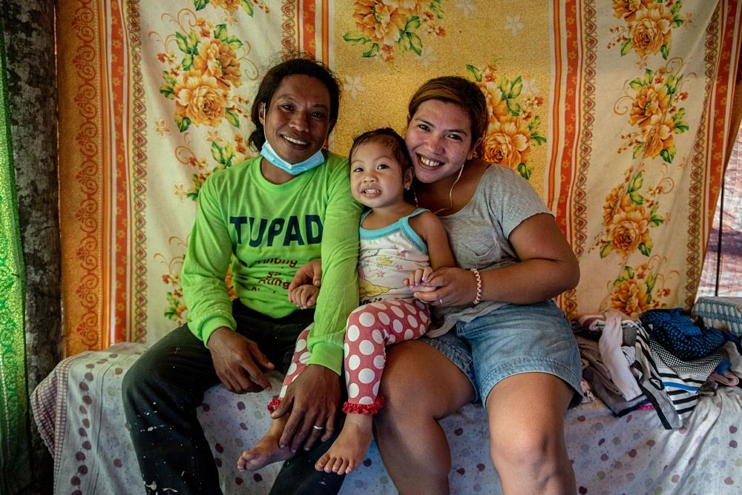
BHA Grant
Enhancing the Capacity and Quality of the Humanitarian Shelter and Settlements Response
Program goal: Strengthened shelter and settlements responses that more effectively meet the emergency and transitional humanitarian shelter and settlements needs of the people affected by humanitarian crises.
Result 1: Improved humanitarian shelter and settlements planning and implementation processes, leading to increased emergency and transitional coordination and response capacity.
Result 2: Enhanced humanitarian shelter and settlements practice, through an integrated system of analysis and learning, informing widely shared policy and guidance.
Photo: Philippines Red Cross /IFRC, Bolo, Albay, Philippines, 2021

Slide 17

BHA Grant
R1.A1: Surge capacity for preparedness and response.
R1.A2: Localization, capacity building, preparedness and outreach.
R2.A1: Analyze, learn and improve responses.
R2.A2: Advocacy, policy, and guidance.
R2.A3: Increased access to information and knowledge
Photo: Fiji Red Cross Society

Slide 18
BHA Grant
Overall budget of the BHA grant (October 2020 - September 2022):
- Partners direct cost: USD 586 111 (35%)
- UNHCR direct cost: USD 560,000 (34%)
- IFRC direct cost: 505,209 (30%)
- Grant Management: USD 131,400
- Total direct cost: USD 1,782,720
- Indirect Cost: USD 217,004
- Total Budget: USD 1,999,724

Slide 19
Process
Call for Request for Proposals launched 10th February 2021
Two webinars conducted 11-12th February 2021 with 89 participants
83 submissions from 23 agencies received
A Selection Committee to review and select the proposals formed:
IFRC, GSC SAG, UNHCR
13 agencies selected for a total amount of 1,019,678 CHF

Slide 20
Surge capacity for preparedness and response
Item # | Activity description | Activity title | Amount available in USAID grant (USD)
Result 1: Improved shelter and settlements planning and implementation processes leading to increased emergency and transitional coordination and response
1-2 | Activity 1.1. Surge capacity for preparedness and response: Global Focal Point for HLP (2 Positions) | Global Focal Point (GFP) for HLP (Position 1) For 18 months (April 2021 - September 2022) Salary and travel costs | 65,000 * 2
3-4 | Activity 1.1. Surge capacity for preparedness and response: 1 Senior Roving Cluster Coordinator (seconded to UNHCR - 2 Positions) | Senior Roving Cluster Coordinator For 18 months (April 2021 - September 2022) Salary | 90,000 * 2
5-6 | Activity 1.1. Surge capacity for preparedness and response: 1 Roving Information Management Officer (seconded to UNHCR - 2 Positions) | Roving Information Management Officer For 18 months (April 2021 - September 2022) Salary | 90,000 * 2

Slide 21
Localization, capacity building, preparedness and outreach
Item # | Activity description | Activity title | Amount available in USAID grant (USD)
Result 1: Improved shelter and settlements planning and implementation processes leading to increased emergency and transitional coordination and response
7 | Activity 1.2. Localization, capacity building, preparedness and outreach: Capacity building, preparedness and outreach - The maximum amount available from this grant per initiative is USD 10,000 | Capacity building, preparedness and outreach: training on shelter coordination in Bangladesh; social media awareness campaigns; directory of local vendors (Americas); contingency planning in Nepal’s districts; shelter response modalities and cash for shelter training in NW Syria | 40,000
8 | Activity 1.2. Localization, capacity building, preparedness and outreach: Localization related initiatives - The maximum amount available from this grant per initiative is USD 15,000 | Localization initiatives: translation of Settlements approach guidance note (Sp & Fr) and Good Shelter Programming tools and courses (Ar, Sp & Fr); Capacity and Training Needs Assessment for Americas Shelter Cluster; 2 Shelter Response Profiles | 60,000
9 | Activity 1.2. Localization, capacity building, preparedness and outreach: Development and updating of online trainings | Development and updating of online trainings: update and translate More than Just a Roof; settlements approach online training; contextualized analysis of Local Building Cultures | 40,000

Slide 22
Analyze, learn and improve responses
Item # | Activity description | Activity title | Amount available in USAID grant (USD)
Result 2: Enhanced humanitarian shelter and settlements practice, through an integrated system of analysis and learning, informing widely shared policy and guidance
10 | Activity 2.1. Analyze, learn and improve responses: Global Focal Point for Research and Advocacy | Global Focal Point for Research For 18 months (April 2021 - September 2022) Salary and travel costs | 100,000
11 | Activity 2.1. Analyze, learn and improve responses: Global Focal Point for Research and Advocacy | Global Focal Point for Advocacy For 18 months (April 2021 - September 2022) Salary and travel costs | 100,000
12 | Activity 2.1. Analyze, learn and improve responses: Country level assessment, monitoring and evaluation activities​ | Country level assessment, monitoring and evaluation ​ | 110,000 ​
14 | Activity 2.1. Analyze, learn and improve responses: Regional and country level shelter practice and lessons learnt workshops/fora - Applying organizations may not request more than USD 10,000 per event​ | Regional and country level shelter practice and lessons learnt workshops/fora ​ | 40,000 ​
15 | Activity 2.1. Analyze, learn and improve responses: Shelter Projects​ | Shelter Projects​ | 40,000 ​
16 | Activity 2.2. Advocacy, Policy and Guidance: Activities of the GSC WG, CoPs, SAG and DCG​ | Activities of the GSC WGs, CoPs, SAG and DCG​: Disability inclusion; Environment CoP; Shelter & Health; Vulnerability Classification; Urban Settlements; Construction Standards; Promoting Safer Building; Diaspora | 120,000 ​

Slide 23
Selection Criteria
For HR related activities:
For other activities:
Criteria | Points
Organization has carried out the activity in the past (continuity) | 20
Organization has provided co-funding for the activity in the past | 10
Organization ensures that the time dedication required will be met | 20
Organization is committed to continuing the activity after the end of the BHA funding, for a period of 6 months | 20
Organization commits to providing co-funding for this activity | 10
It will be possible to deploy the GFP to any country | 10
Design and relevance of the proposal | 10
Criteria | Points
Organization has carried out similar activity in the past (experience) | 20
Organization has technical capacity and expertise required | 20
Organization commits to providing co-funding for this activity [removed for the activity on Localization Initiatives] | 20
Organization can undertake this activity in any country [only for activities that require maximum geo coverage] | 30
Design and relevance of the proposal | 10

Slide 24
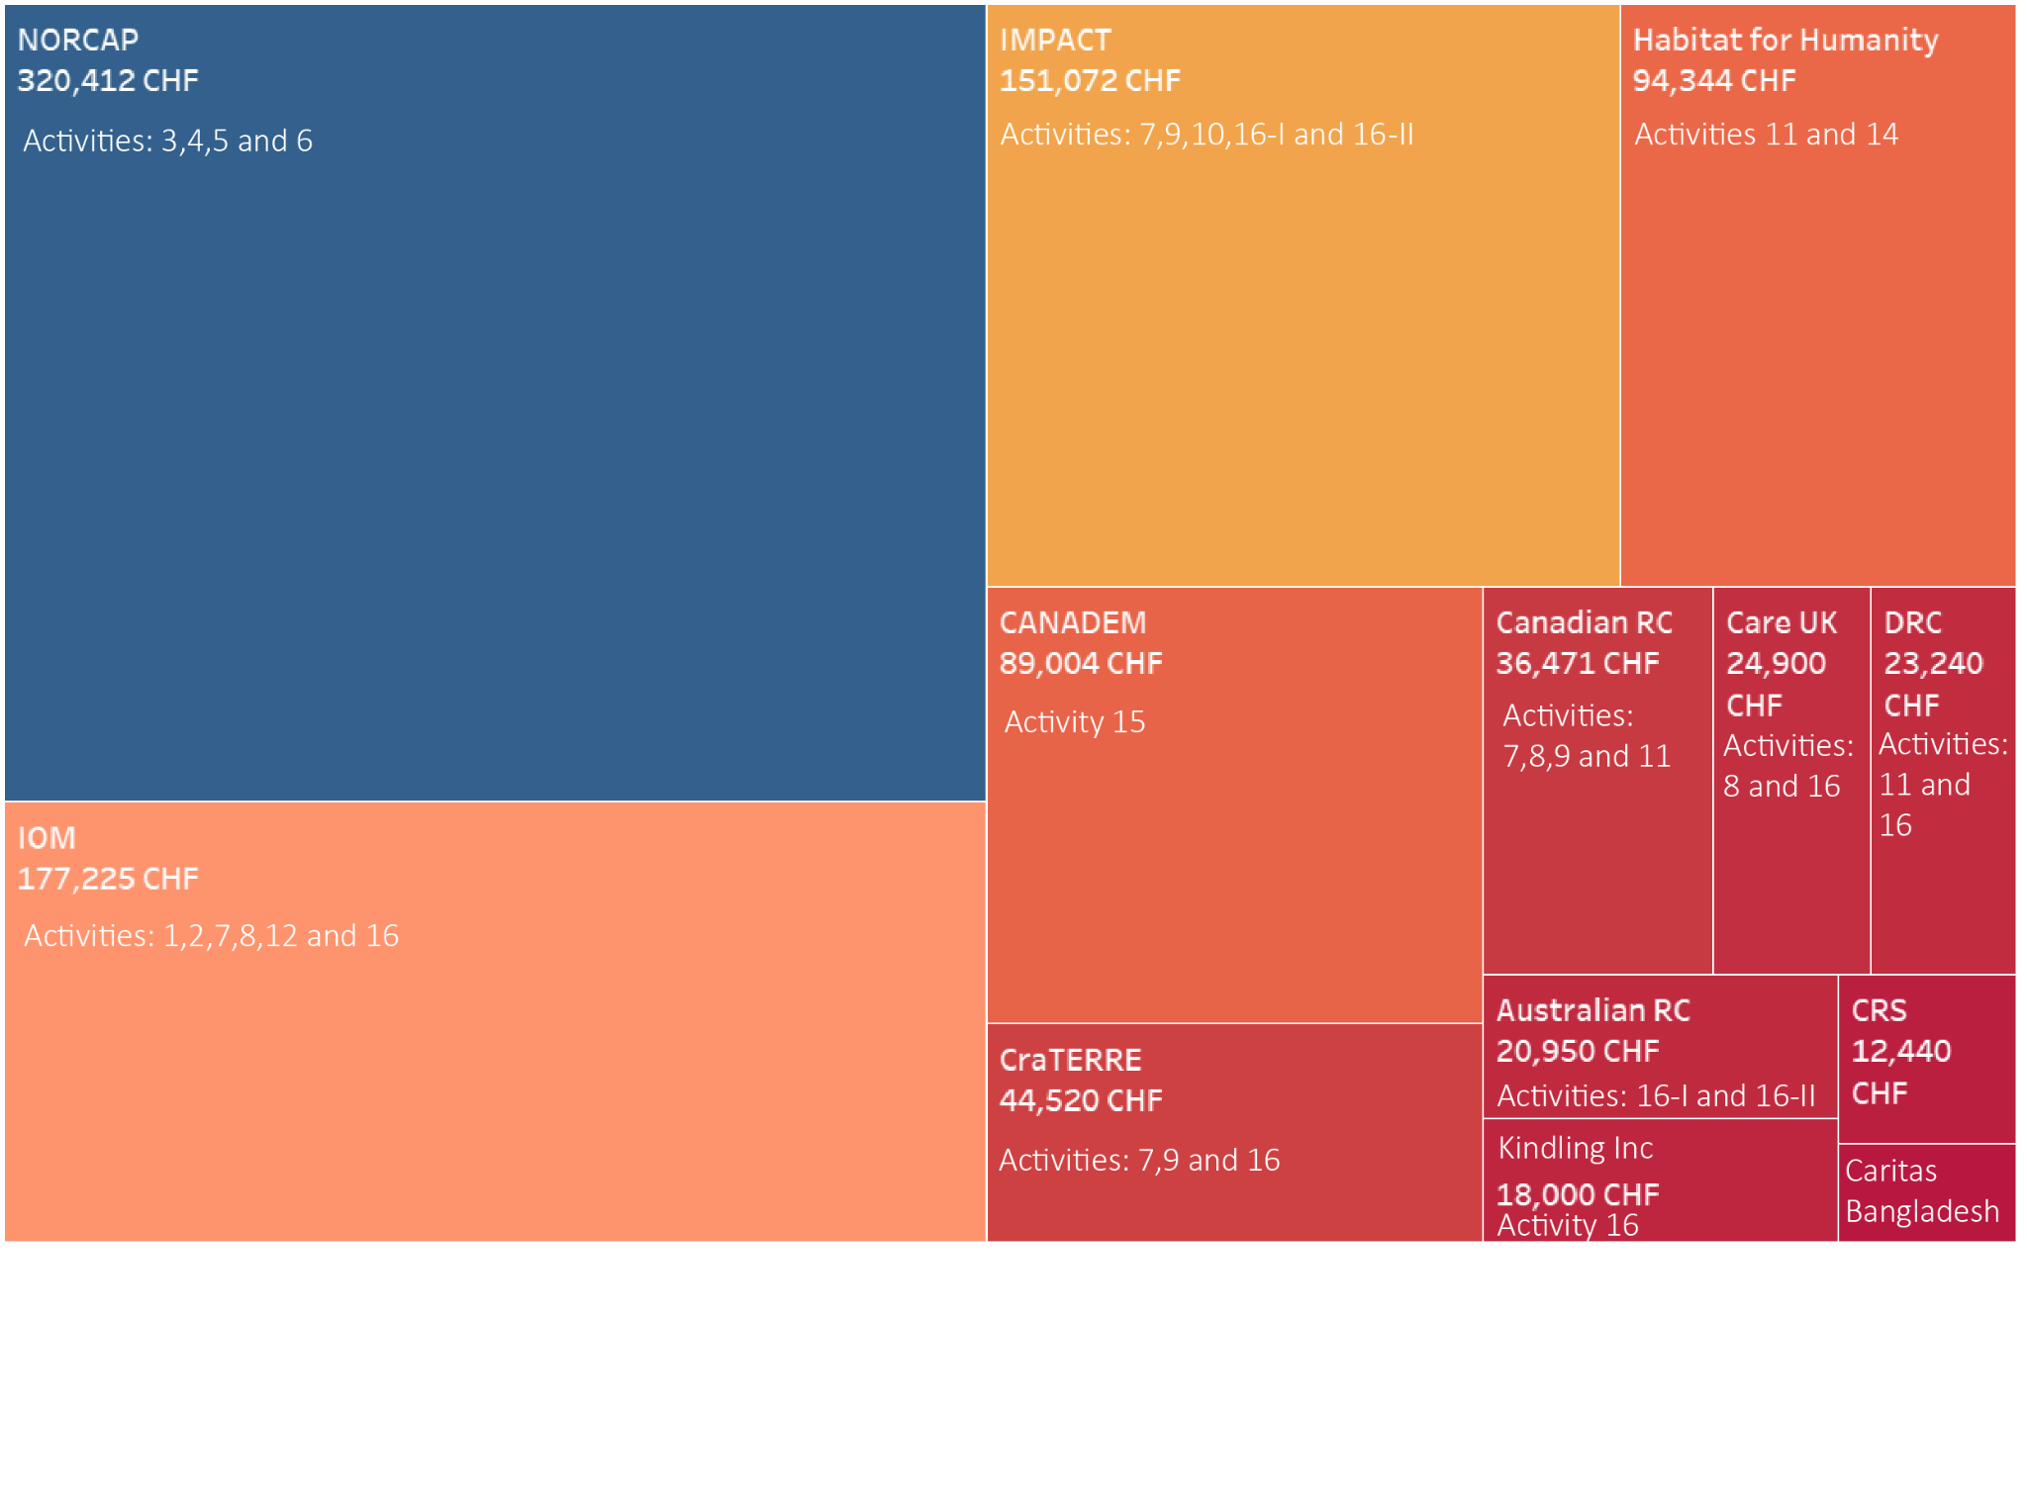

Slide 25
Progress Update
Agencies | Progress
CANADEM | Contract approved
Canadian RC | Approval in progress
NORCAP | Approval in progress
Australian RC | Contract shared with the agency
Care UK | Contract shared with the agency
Habitat for Humanity | Contract shared with the agency
IMPACT | Contract shared with the agency
Kindling | Contract shared with the agency
Caritas Bangladesh | Financial & Risk Assessment complete
CRAterre | Financial & Risk Assessment complete
DRC | Financial & Risk Assessment complete
CRS | Financial & Risk Assessment pending
IOM | Contract under Legal review

Slide 26


GSC – ECHO project
Greening the shelter response

Slide 27
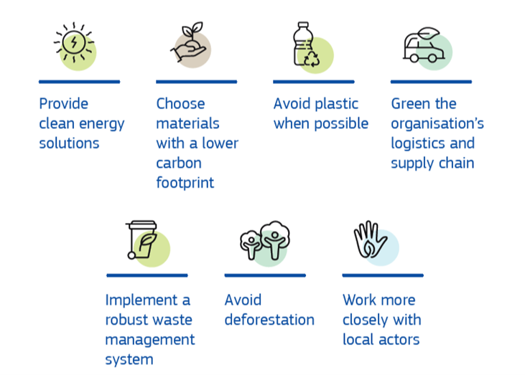
DG ECHO’s approach to reducing the environmental footprint of humanitarian aid

Slide 28
DG ECHO’s approach to reducing the environmental footprint of humanitarian aid

Slide 29
GSC-ECHO Project: Key data
Start date and duration: 1 April 2021 for 24 months
Total cost: 930,571 EUR
Contribution from ECHO: 650,000 EUR (70%)
Co-funding by UNHCR, IFRC, partners
Funding will be received by UNHCR on behalf of the Global Shelter Cluster.
Methodology similar to the one used in 3 past ECHO grants

Slide 30
Logic of the project
Result 1: Shelter responses become more environmentally sustainable at country and global level
Activity 1.1: Shelter partners green their response
Activity 1.2: Environmental research and advocacy available to make country-level shelter responses greener and climate smart.
Activity 1.3: Country-level shelter clusters effectively design and implement greener and climate-smart shelter responses
Result: Shelter responses become more environmentally sustainable at country and global level
Activity 1: Shelter partners green their response
Global
Activity 2: Environmental research and advocacy available to make country-level shelter responses greener and climate smart
Activity 3: Country-level shelter clusters effectively design and implement greener and climate-smart shelter responses
Country

Slide 31





Activity 1: Shelter partners green their response
Green specifications of the most purchased emergency shelter and NFIs: greener without a reduction in their performance.
Recycling and repurposing options of some of the main global shelter solutions (plastic sheeting, blankets, tents, shelter kits, Refugee Housing Units, and others) captured and shared.
Sustainable energy options, including solar, will be better understood and made available to global shelter partners in order to include them better in their responses.
Methodology to measure the CO2 equivalent & plastic footprint of shelter responses.
Link with the Global Logs Cluster and other clusters.

Slide 32
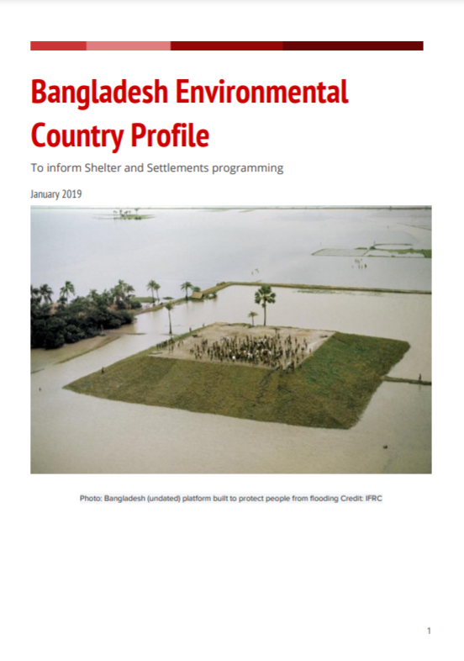
Activity 2: Environmental research and advocacy
Provide the global knowledge needed to help design greener and climate-smart country-level shelter responses.
Environmental profiles:
Overview of the main threats to the environment, key environmental focal points, an analysis of the different shelter options most-commonly used in country, environmental impact calculators, total life-cycle amount of CO2 produced by these interventions.
- Advocacy tools

Slide 33



Activity 3: Green country clusters shelter responses
Strengthen country-level clusters to use the materials developed in activities 1 and 2
Well-designed market interventions to empower affected population and reduce the environmental impact. Cash champions initiative: capacity and methodology to implement well-designed cash and shelter responses.
Appropriate local solutions and materials: CraTerre, local institutions, mason schools. Local building practices will be mapped and analysed for key responses.
Support countries to identify options for reducing, reusing, repurposing and recycling or other end-of-life alternatives, for local shelter solutions.
Collaborate with institutions with environmental expertise such as BRE to support countries with methods for calculating CO2 emissions of local shelter solutions.
Pilot innovative more environmentally sustainable shelter solutions or approaches.
Link with Logistics Cluster, and others at country level
Notes:
BRE, the world’s leading building science centre: www.bregroup.com

Slide 34
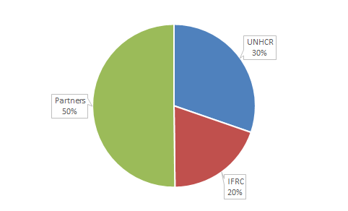
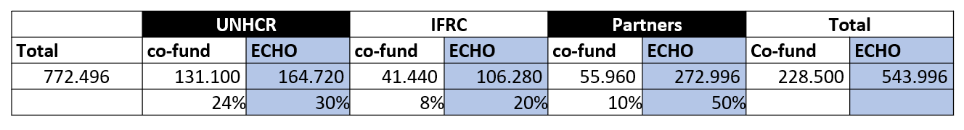
Budget: direct costs
Activities to partners:
GFP for Environment
Support to ECoP
Energy options description
Environmental profiles
Localization initiatives
Cash Champions
Local Building Practices Profiles

Slide 35
Your Feedback

Slide 36
Jamboard
Share your thoughts on the plans through this jamboard:
https://jamboard.google.com/d/13RHwoCn_xjksMF6bY3bn1a006lXsBBaYtdh8c6DqAhc/edit?usp=sharing

Slide 37
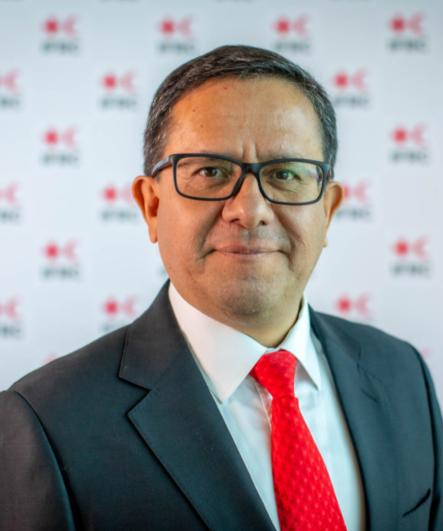
By:
Closing Remarks
Xavier Castellanos
Under-Secretary General
National Society Development and Operations Coordination
IFRC

Slide 38
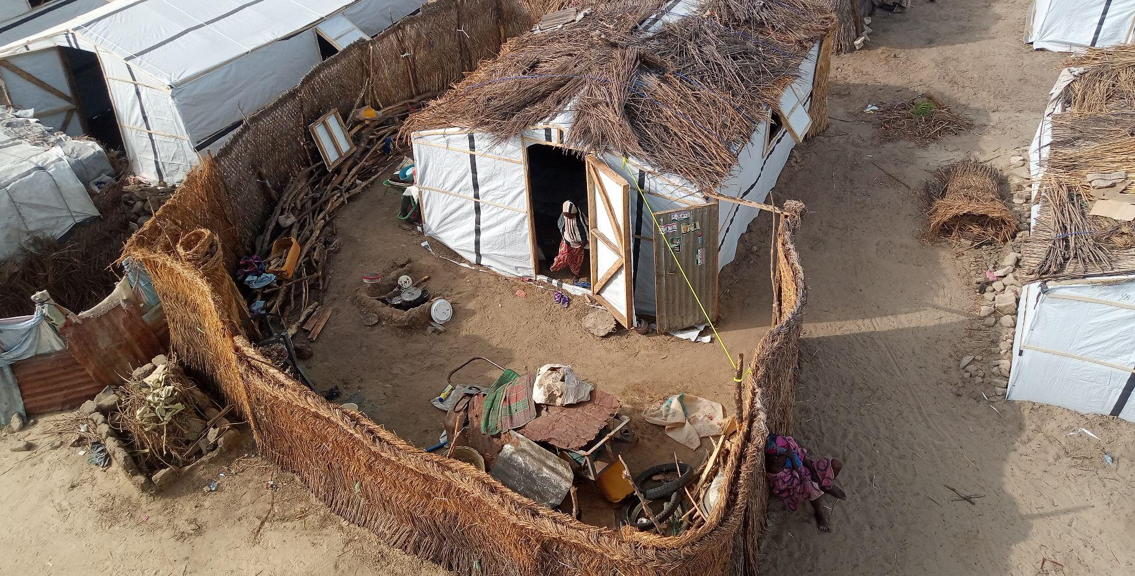
CLOSING
by
Brett Moore,
GSC co-lead UNHCR
Recently constructed shelter being upgraded by the occupants to include space for cooking and storage of items, and privacy.
Photo: Ezekiel Ava’Abem Aguh

Slide 39
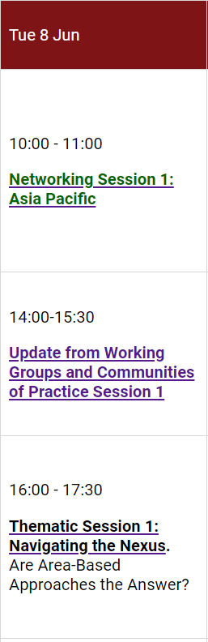

Thank you!
GSC online meeting 2021
Next meetings:
With the financial support of:
Photo: Naseem Mardas, Hajjah Governorate, Yemen 2018

