Slide 1
Global Shelter Cluster
NFI WG Meeting
14 April 2021

Slide 2
Today’s Agenda
Review of Action Points from the Last Meeting and Results of the Work Plan Survey and ways forward
  Action Points
  Survey Results
  Would a Community of Practice Forum be more appropriate
Classifying NFI Items and groups of Items (Content of NFI packages and platforms to facilitate this process)
  Emergency Supply Pre-Positioning Strategy: Classification of NFIs into functional groups- Florent Change
  Solvoz Platform: Claire Barnhoorn
Sustainable Packaging Initiative for NFI packages –Mandy George
New Global Shelter Cluster project on Greening the Response- Miguel Urquia
AOB

Slide 3
Action Points from Last Meeting
Action Point | By Whom | By When
Partners can subscribe to the GSC NFI WG for updates on the activities of the Working Group | Partners by clicking subscribe on the NFI WG Page | No deadline but to get all updates, don’t forget to subscribe!
Take feedback on 2021 priorities and solidify their prioritization in a Survey | NFI WG Chairs | January 29
Partners to reply to Survey on Priorities for WG plan | Partners | February 10
Partners wanting support on energy issues or to share practices to reach out to Aimme Jenks from GPA/UNITAR | Partners | Ongoing
Review the energy indicators shared by IOM by putting your name and organization in a comment section or reaching out to Project Lead Adam Ostaszewski | Partners | As soon as you are able
UNHCR and FCDO to exchange about details on testing on fire retardant plastic sheeting. | UNHCR and FCDO
UNHCR to share with NFI WG ToR for PM for Innovation Norway Project to be circulated to NFI WG members | UNHCR | NFI WG will then publish it on website and circulate to relevant networks
Partners and Country-level Shelter Cluster teams to consider sharing NFI specifications with GSC Environmental Community of Practice | Partners and Shelter Cluster teams | Ongoing basis
Global Shelter Cluster paper on Energy linkages with Shelter and Settlement Programming: Partners to contact NFI WG Chairs about participating in the finalisation of this paper | Partners and NFI WG chairs | ASAP

Slide 4
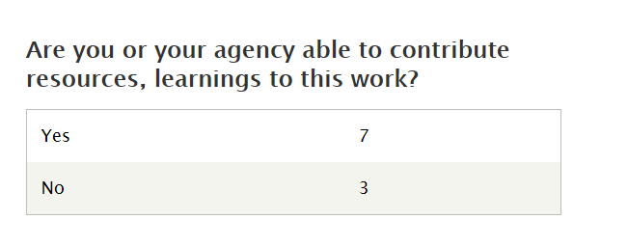
GSC 2021 Plan Survey
6% Participation Rate
Active Members
(10 people)

