Slide 1

Yemen Country Updates Date: Monday 19 Oct 14h00 - 15h00

Slide 2
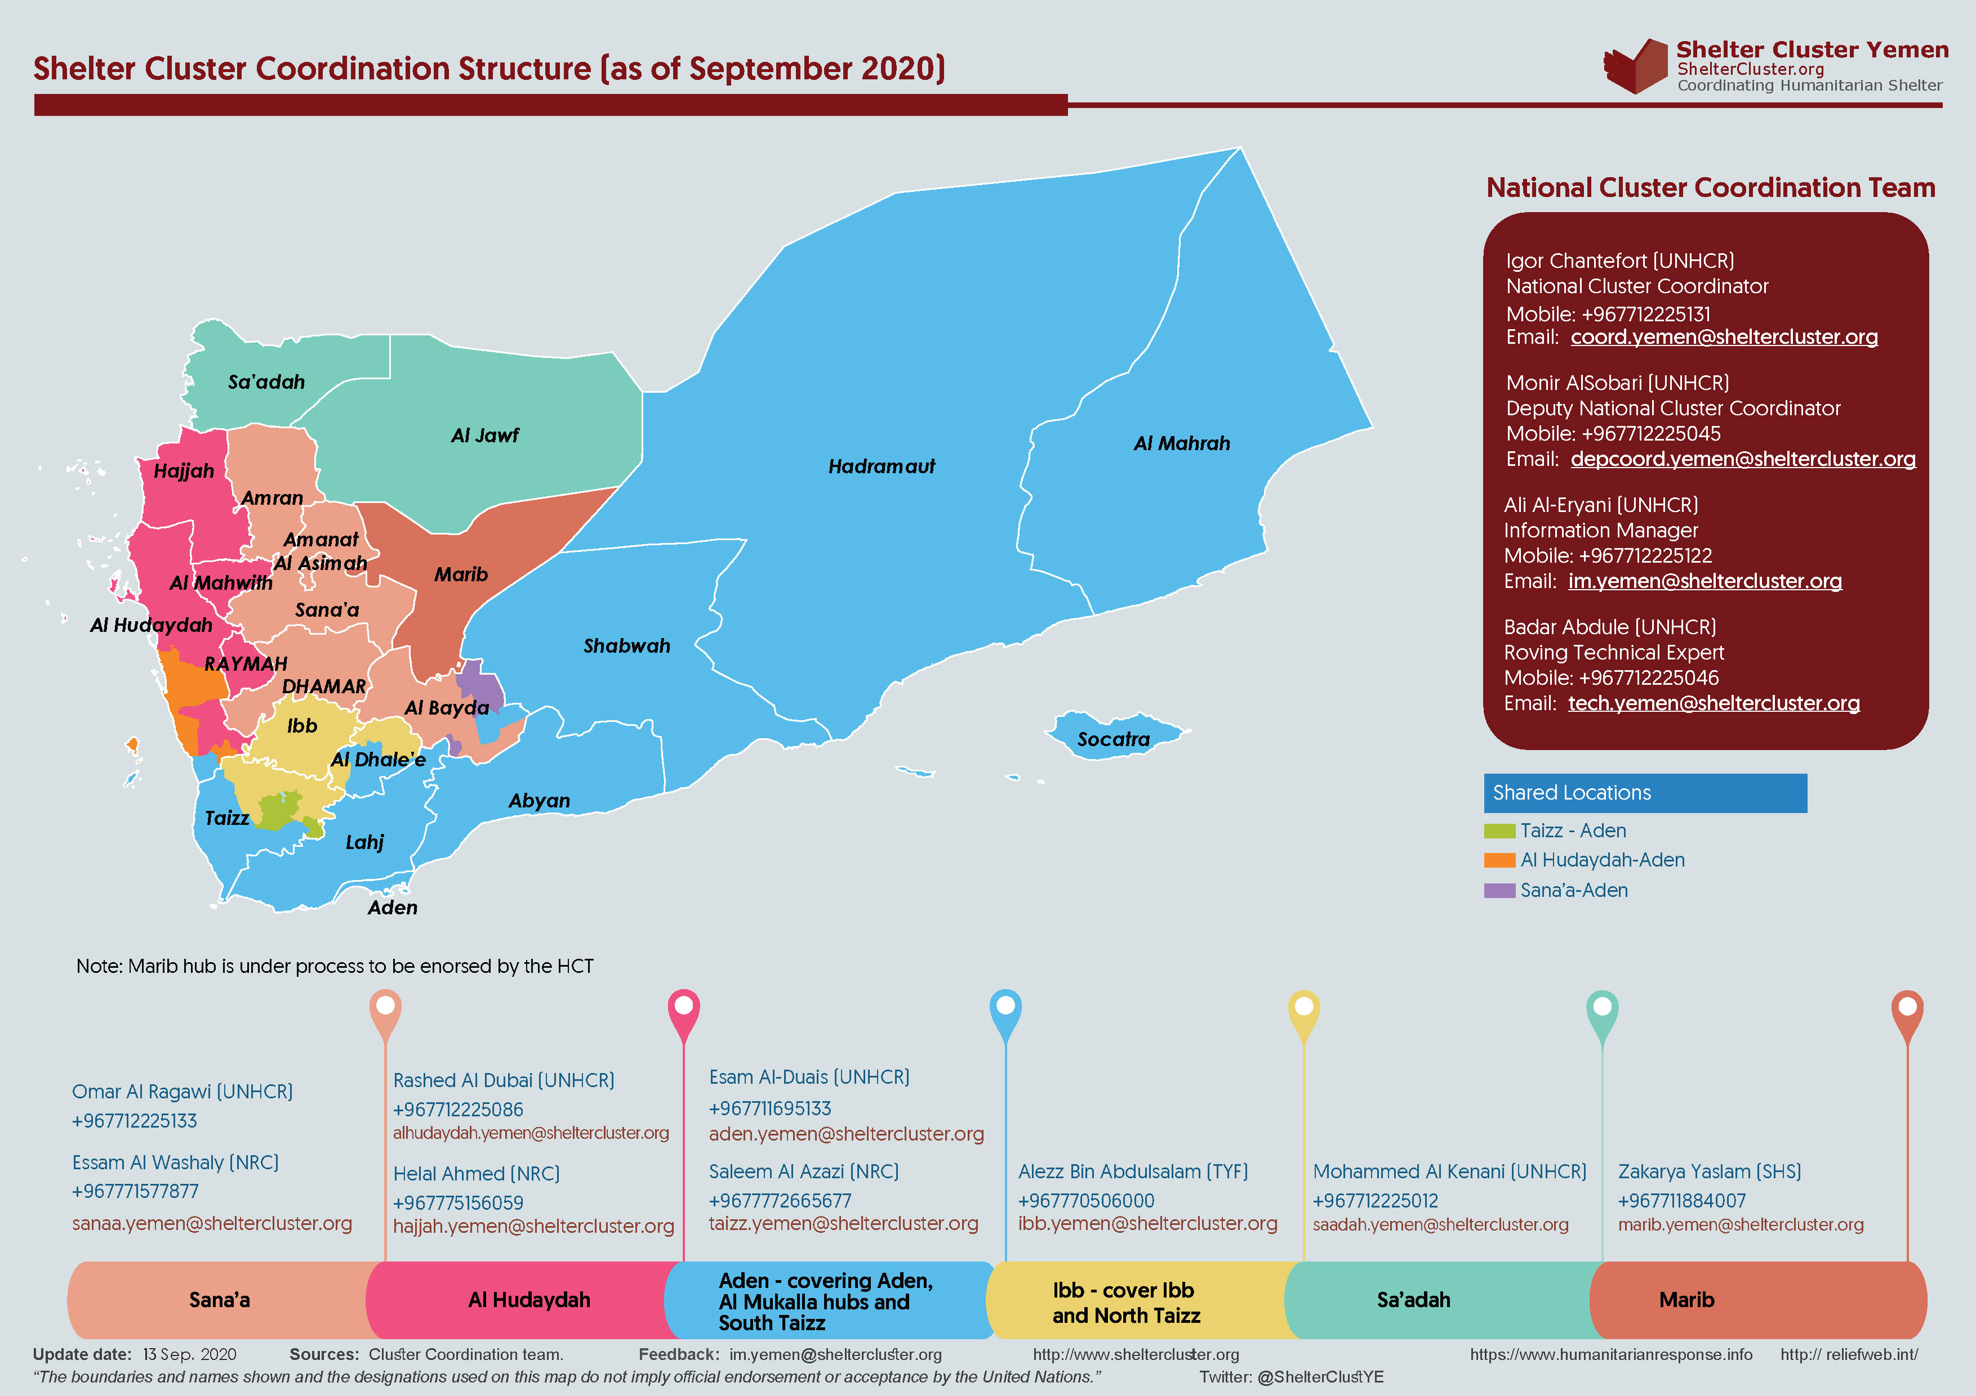
Background: Shelter Cluster

Slide 3
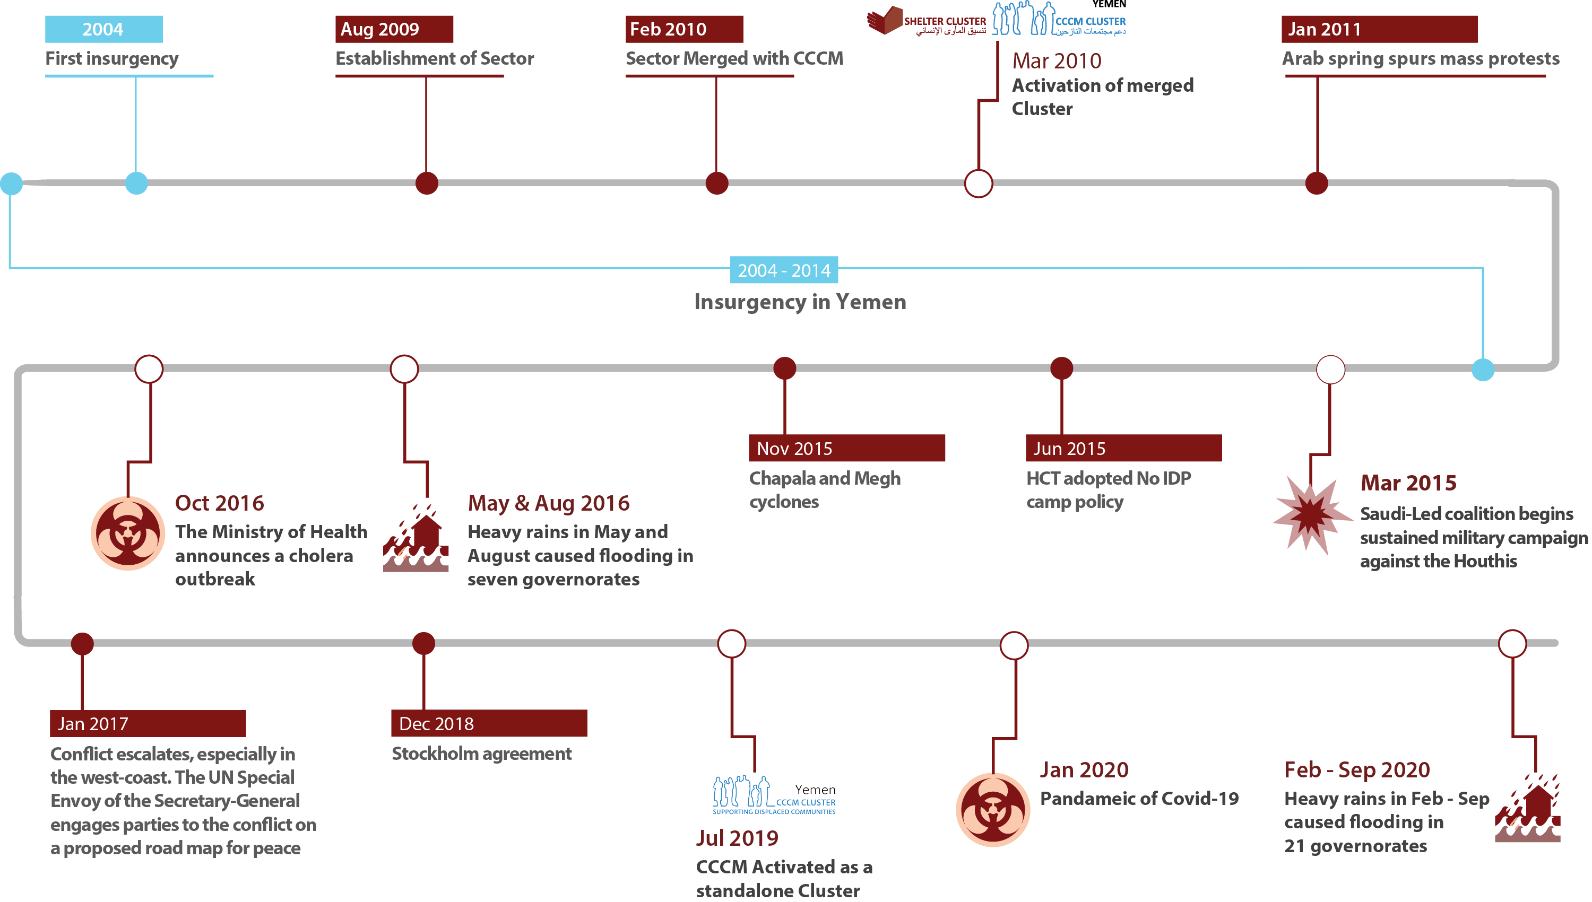
Background: Context

Slide 4
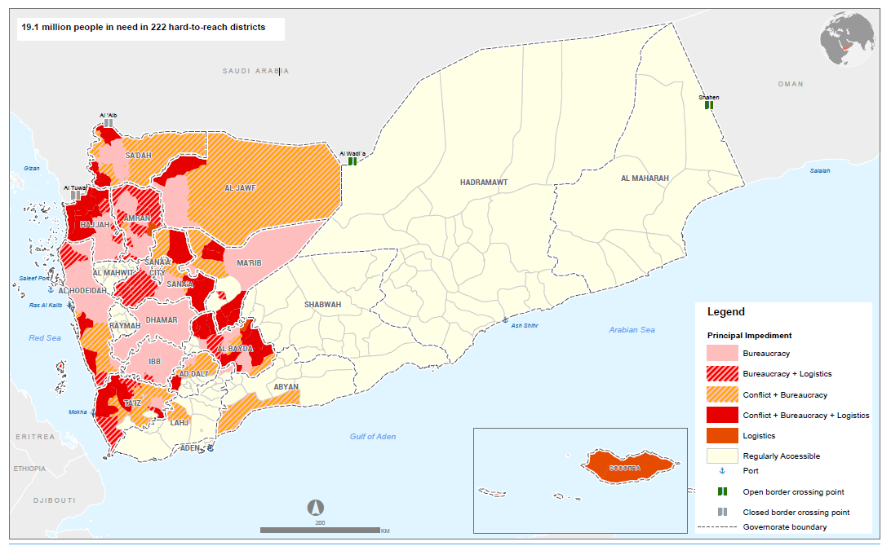
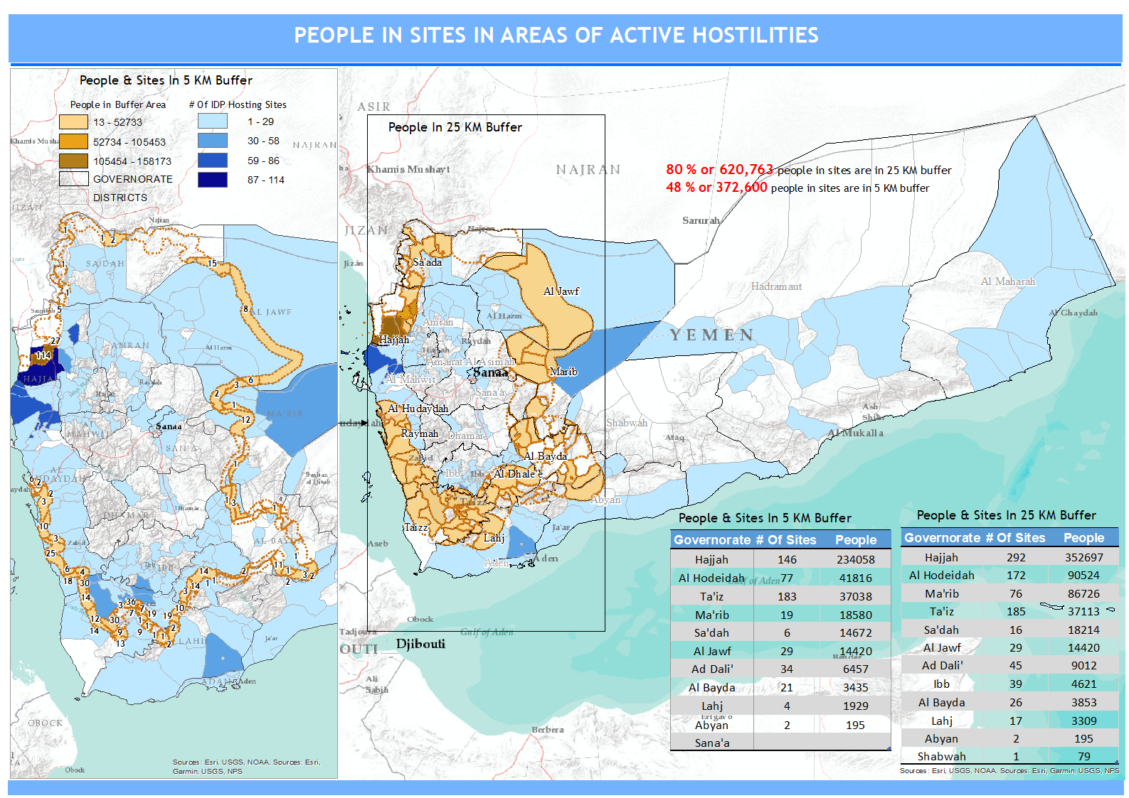
Background: Context
Geographical constraints
Hard-to-reach districts
People & Sites in 5 KM Buffer

Slide 5
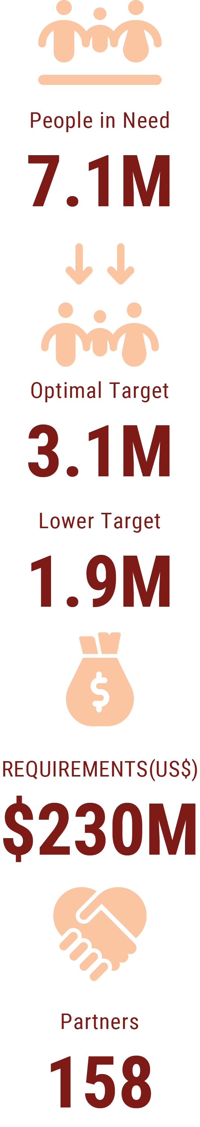
Background: Context
HRP 2020 – Technical extension of 2019
Sequencing approach using 1st line, 2nd line and full fledge
Parallel set up RCT contingency stock & RRM introduced and supported by the HC
#72hoursresponse
7.27M
167
Funded
15%
Assisted up to Sep
1.3M

Slide 6
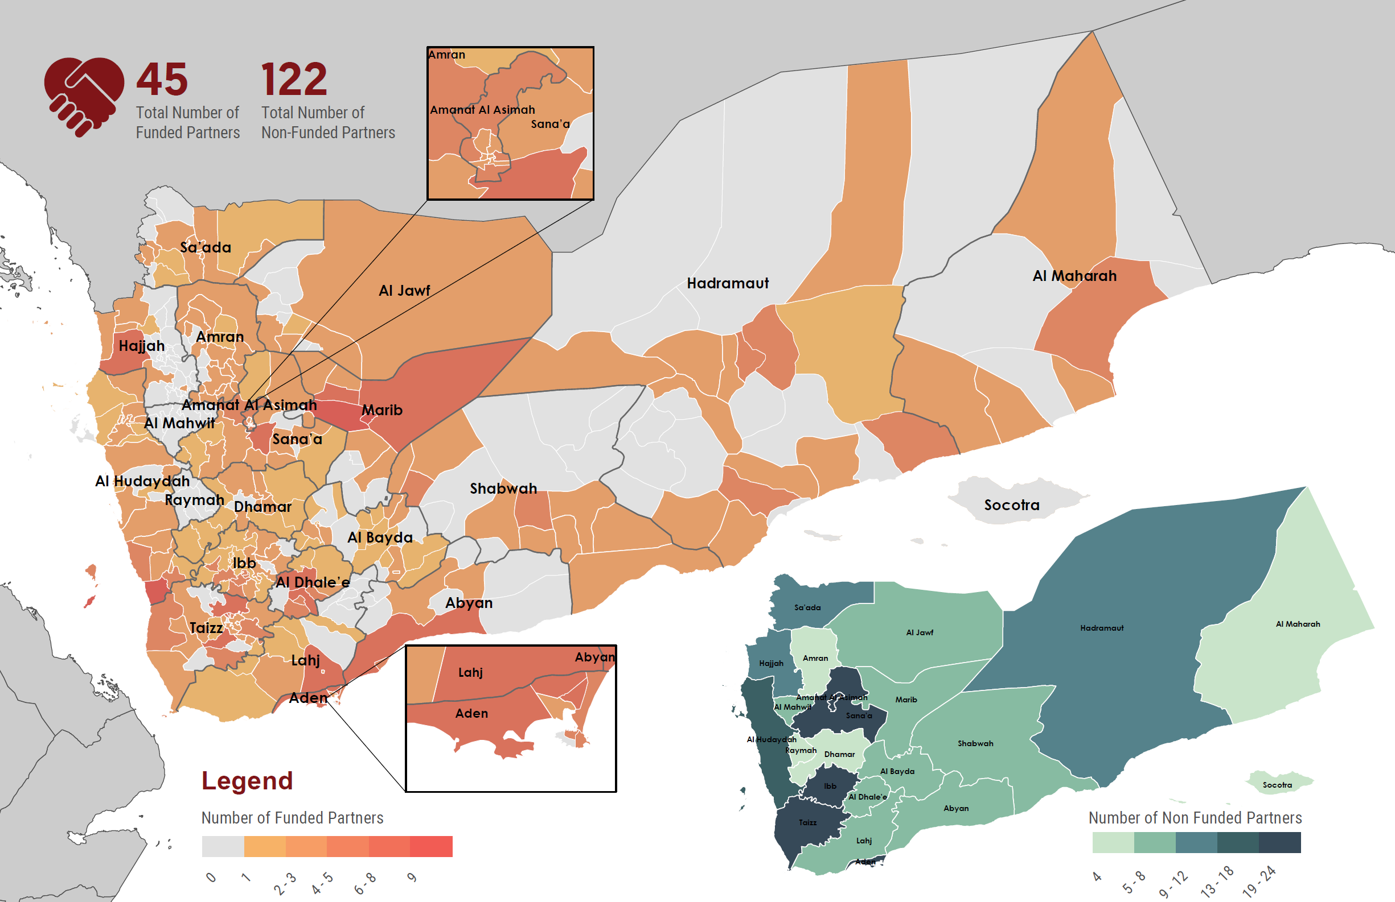
Background: Context
Biggest network of humanitarian partners in the country
1% International
5% National
26% Provincial
68% Local

Slide 7
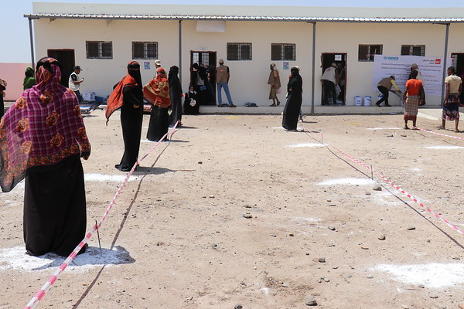
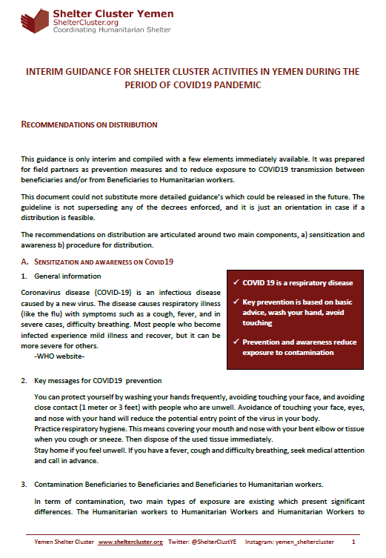
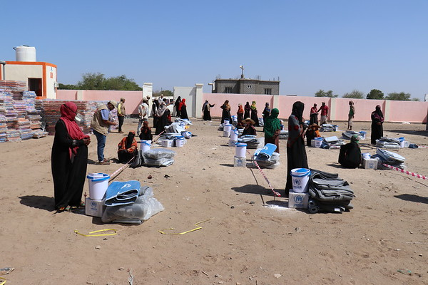
Intervention during COVID19 time
Initial involvement in quarantine sites – political issues
One simple guideline
Very good endorsement by field partners

Slide 8
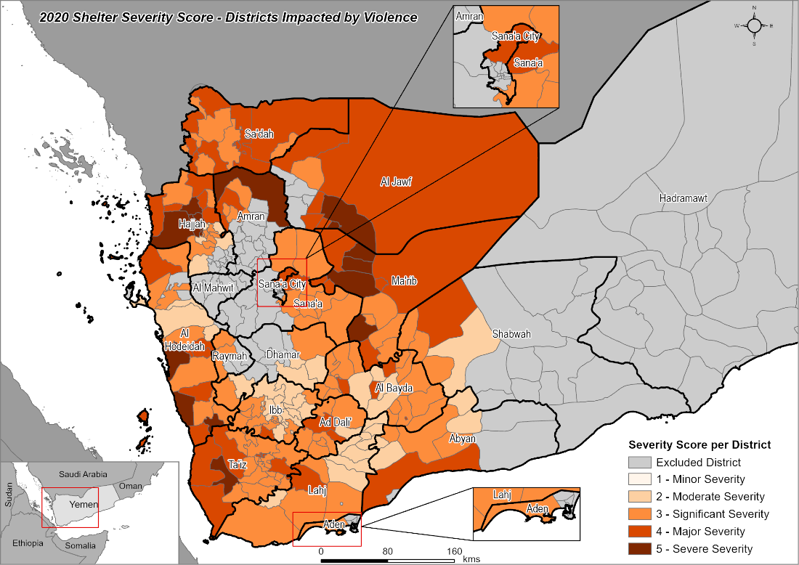
Shelter Severity - Districts impacted by violence
First lens of analysis aggregate needs related to the armed crisis.
Newly displaced & affected host communities
Recurrent needs for multi-year displaced population
Two (2) critical hot spots:
Al Hudaydah 500 k & Marib 1 millions ind.

Slide 9
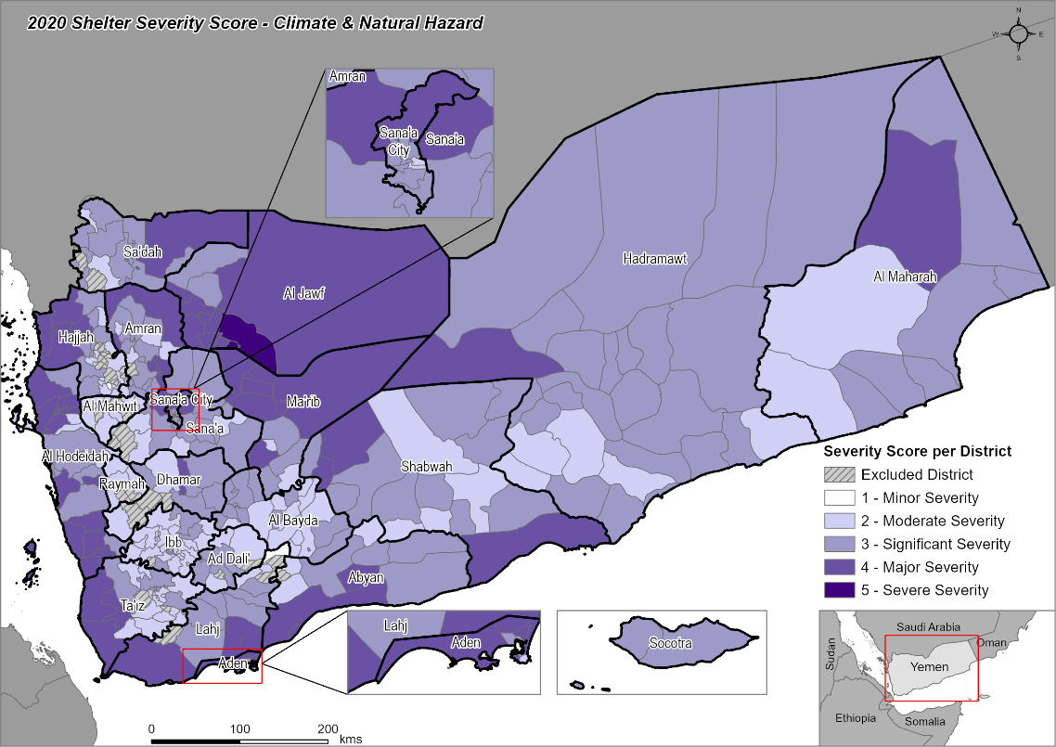
Shelter Severity - Climate & natural disasters
Second lens focus on regular seasonal & natural factors.
Winterization
Summarization

Slide 10
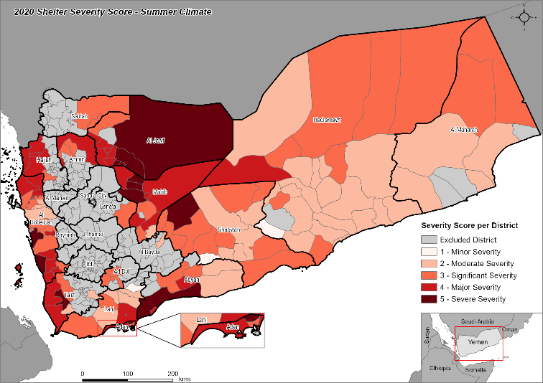
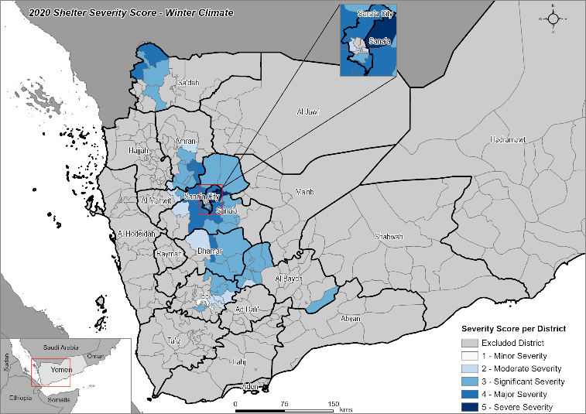
Shelter Severity - Climate & natural disasters
Summarization
Temperature above 50 degrees
Winterization
Altitude over 1,900 meters
Temperature below 10 degrees for moderate and 0 for acute needs

Slide 11
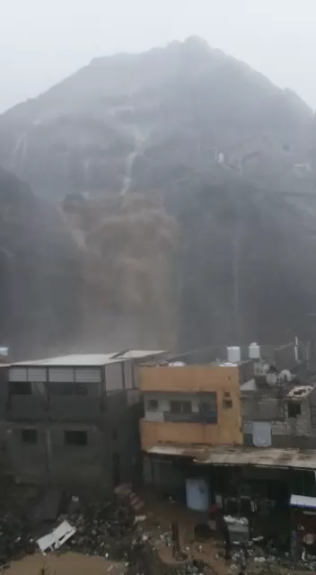
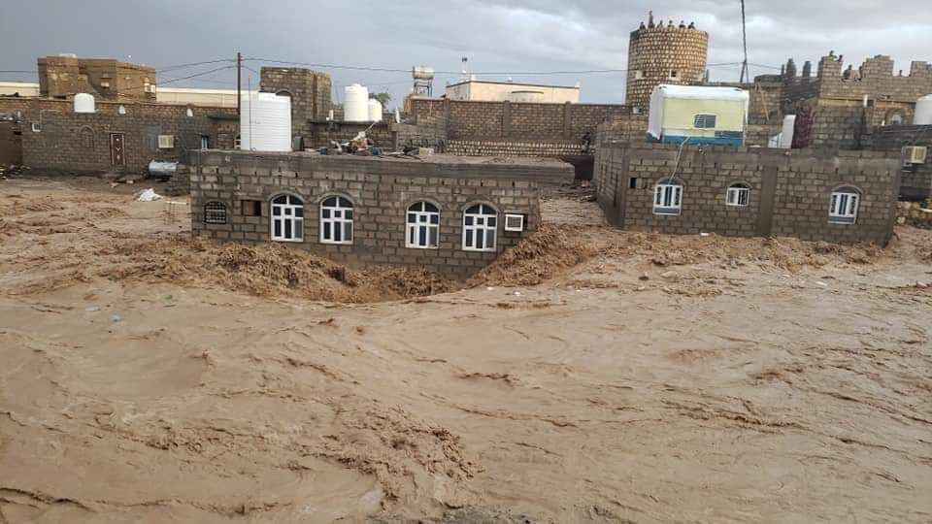
Shelter Severity – exceptional flood in 2020
62k HHs affected
143 districts
313 episode
Due to climate change, the impact of the flood season is rising.
Most of the contingency stocks dried up by July.

Slide 12
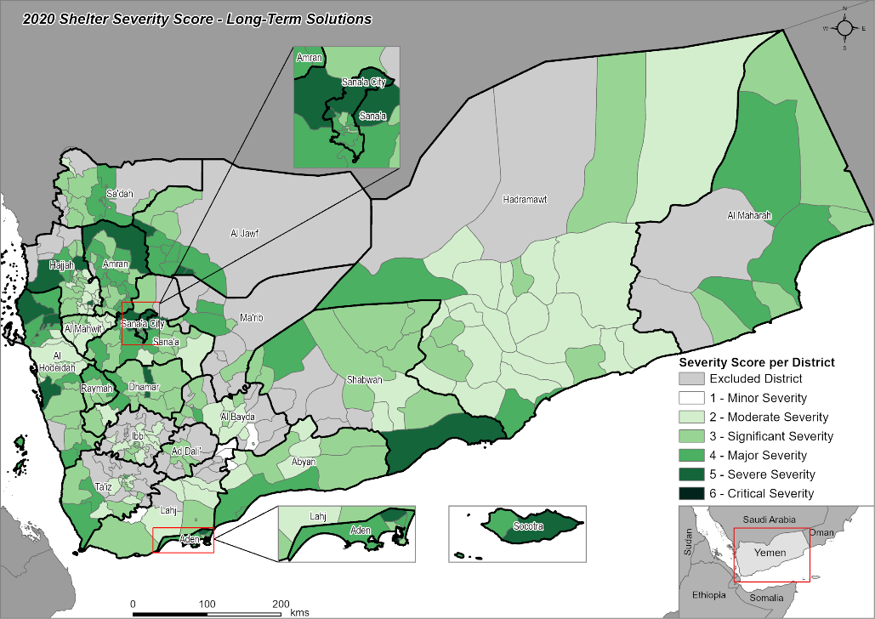
Shelter Severity - Long-term solutions
To break the cycle of constant emergency
Prioritize long-term solutions
Criticality of HLP

Slide 13
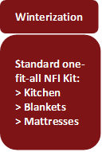
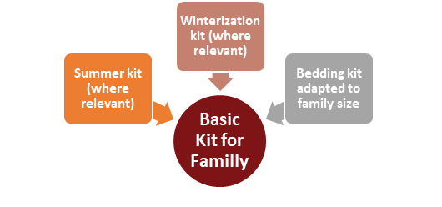
TWIGs Updates
2 TWiGs: 1 NFI & 1 Shelter
24 of partners
18 meetings conducted on bi-weekly basis
Shifting from one fit all NFI kit composition to flexible approach
Complete revision of Shelter solutions specifications
Sandbagging solutions for flood mitigation
A one-fit-all model
Basic kit with options according to situation

Slide 14

Strategic Common Pipeline – a way forward
Regular distribution related to the conflict
Newly displaced, forecast based on conflict dynamic
Renewal of materials for the shelters of old caseload
Clarity of procurement
Cost efficiency
Quality
Seasonal Distribution(s)
Flood response
Winterization
Summarization
Contingency stock
Static stock
Example of high thermal blankets
From the global stockpile USD $8.85
Large national procurement $13
Small national procurement $14.5
Bulk purchase local market $16.5 (Bulk may not be available in the local market)
Purchase per unit: $18.5
Type | Type of functions | Comments
UN & International Organization | Cluster Lead Agency Custodian of the common pipeline Large oversea procurement Large national procurement (if necessary) Central warehousing Upstream Logistic (preferred) Downstream Logistic (last resort) | 1 agency in charge at the national level
International NGO | Sub-National Coordination Large and medium local procurement Central & provincial warehousing Contingency stock warehousing Downstream Logistic (preferred) | 1 agency in charge per large area of intervention (north, south, east)
National NGO | Local warehousing Standardized assessment Local Dispatching /Distribution Monitoring &Reporting | Multiple agencies
Community-Based Organization | Standardized assessment (under supervision) Distribution only | Multiple agencies
Definition of roles

Slide 15
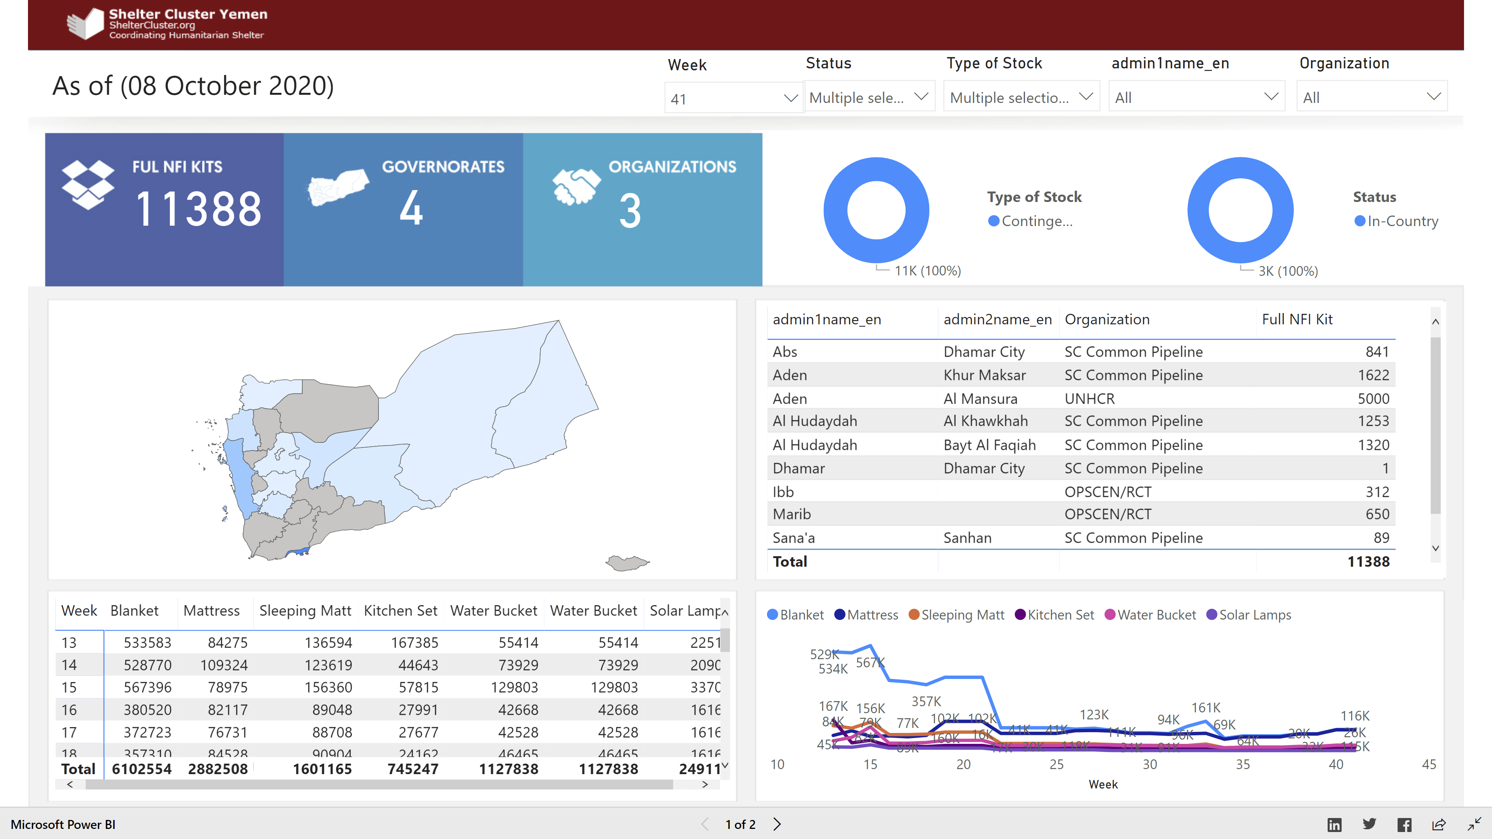
IM Products – evolution in 2020
IM Products:
Cluster Response Dashboard
Stock monitoring
Flood tracking matrix
Fund mapping
Access survey
Shift to sub-districts.
New system introduced in 2020:
stock-pile monitoring
Flood tracking

Slide 16
IM Innovation
Automatic machine learning to tag reports with key words and extract data.
Output:
a) Read and tag more than 50 reports
b) Build a glossary of key words organized per thematic
c) Generate automatic map to show each thematic

Slide 17
Challenges
Extremely low funding coupled by alarmingly low stock levels of Shelter and Non-Food Items
Increasing needs due to escalation and movements of conflict contact lines in addition to unusual rainfall and flooding
Fuel shortages
Housing Land and Property Issues
Delays by authorities in signing sub-agreements and movement clearances

