Slide 1
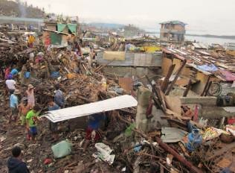
Area-Based Urban recovery program
CRS Philippines Typhoon HaiyanTacloban
Shelter and Settlement
Tulio Mateo tulio.mateo@crs.org

Slide 2
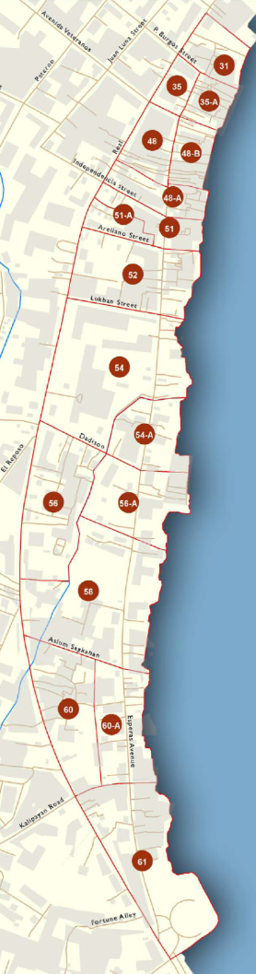
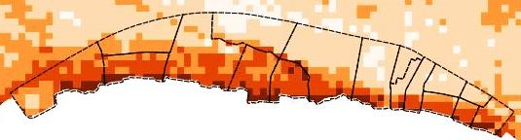
Area based selection
Storm Surge Map (JICA)
Ranging from 2 to 4m height

Slide 3
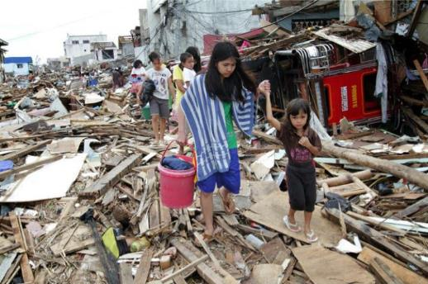
The Challenges in an Urban area
3,000 Beneficiaries w/different needs, in urban area
Ill - defined City planning “No Dwell Zone”, with over half of beneficiary inhabitants.
Limited space for sheltering affected populations
Informal settlements; security of tenure and access to electricity, sewage and water.
Lost documents,
Lost livelihood & relationships

Slide 4
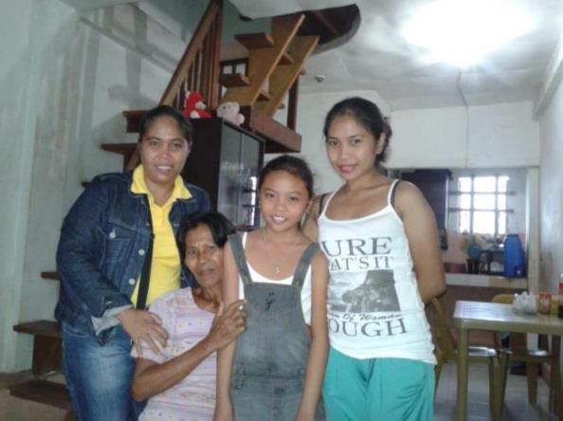
The Opportunities in an Urban area
Most people willing to repair or move out of hazardous area.
People willing to host affected ones.
Good relationships with Government at City and Barangay levels.
Cash transfer systems available in town.

Slide 5
Our Accomplishments
Creating a Menu of Options, with adaptable solutions
Designed through FGDs and KII w/stakeholders
Notes:
Graph is only for Sagkahan

Slide 6
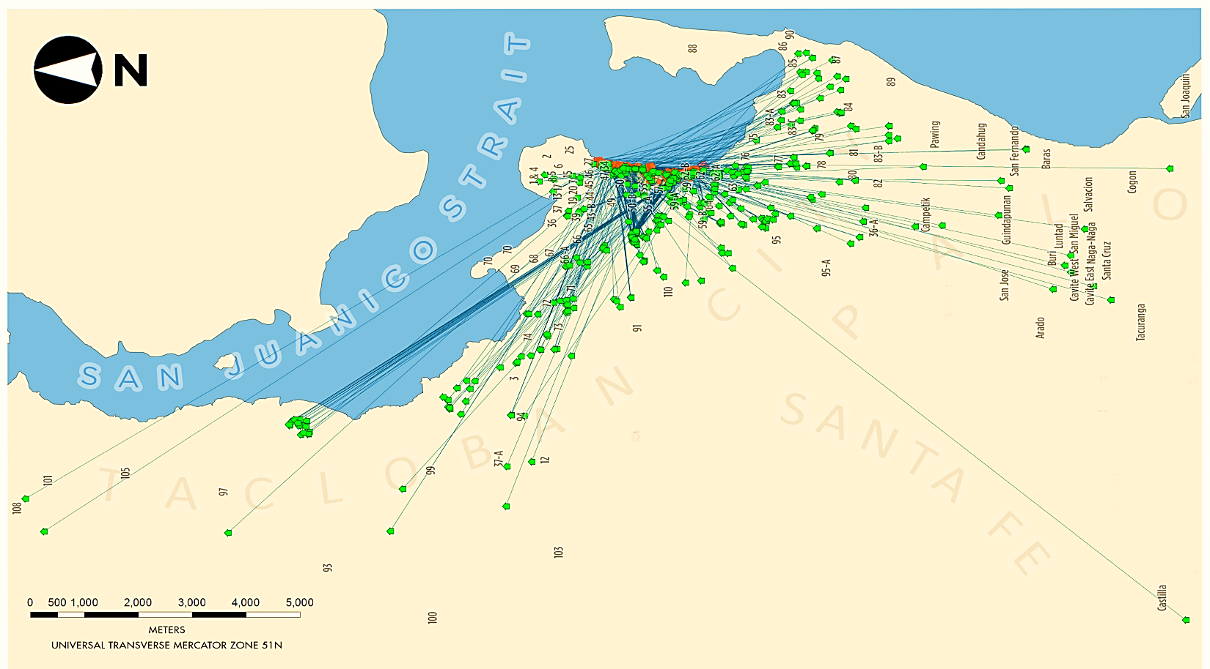
We pursue more success finding updated solutions
RELOCATED BENEFICIARIES, by Aug. 10

Slide 7
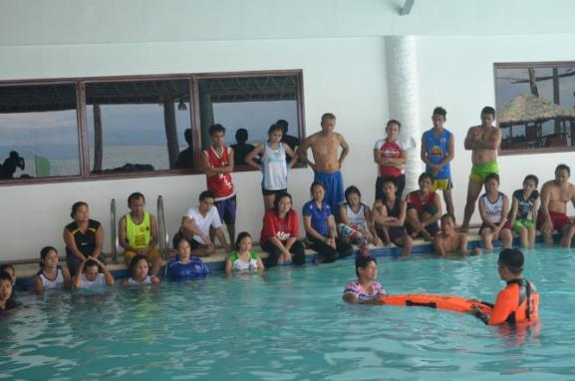
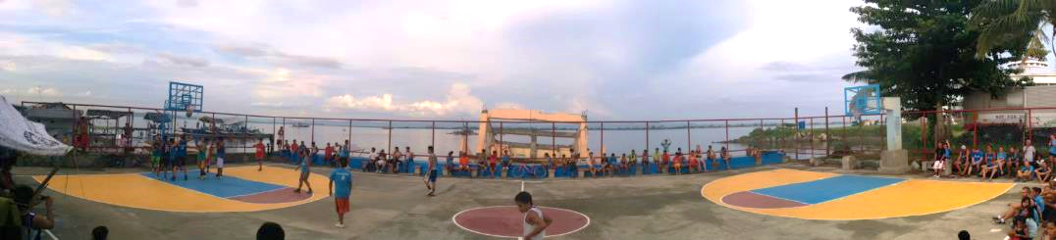
Holistic approach
Build Back Safer
Hygiene promotion
WASH facilities O&M
Child protection & gender
Land, housing and property rights
Community-based DRR
Contingency planning
Typhoon drills
Community infrastructures

Slide 8
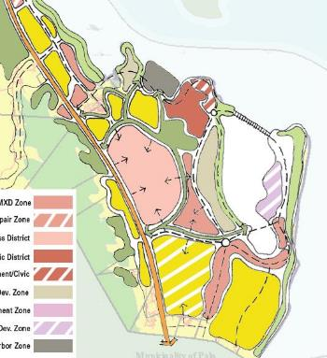
Coordinating with the city administration
Cities master plan
Tidal embankment (w/JICA support)

Slide 9
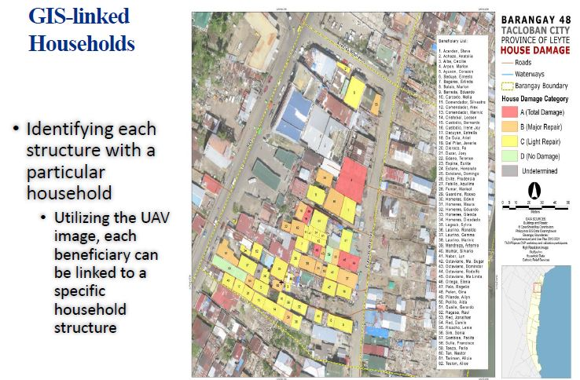

Slide 10
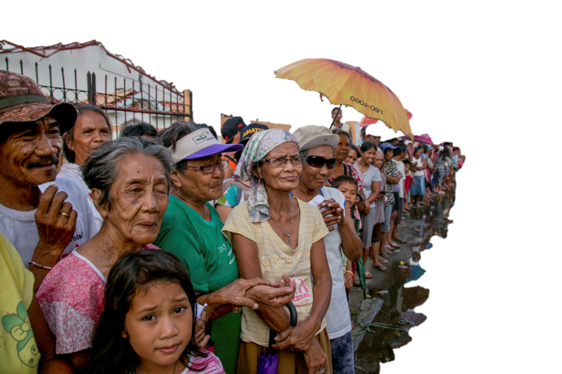
Learning from practice
Community conflicts
Lack of clarity in government resettlement schemes
Holistic approach
Putting choice into the Households
Supporting governance structures
Conflicting gov’t projects

