Slide 1

“Adding Clarity on Area-Based Approaches by Learning from Practice”
Urban and Settlement Approaches WG
27 February 2019
Urban Settlements Working Group

Slide 2
Topic | Speaker
Area Based Approaches case study analysis: Overview of key findings | USWG co-chairs Victoria Maynard, Consultant
2. Area Based Approaches in practice: Midnimo project - Somalia | Sam Grundy, Programme Advisor, Transition and Recovery Division IOM
3. Development of USWG area / settlement approach guidance: Overall strategy Options for content framing Consultation process - how to engage | USWG co-chairs
4. Updates from CCCM cluster Work-in-progress update on CCCM case study collection and CCCM mobile paper | Annika Grafweg, CCCM Area-Based Approach Working Group Representative, IOM
5. Updates from WG members:
Neighbourhood Approach consultations (Haiti, DC, Geneva) | Laura Jones, Technical Advisor, Humanitarian Assistance and Resilience, PCI Harriette Purchas, Senior Urban Advisor, RedR
Any other updates?
6. 2019 Work plan | USWG co-chairs
7. AOB/ wrap up

Slide 3
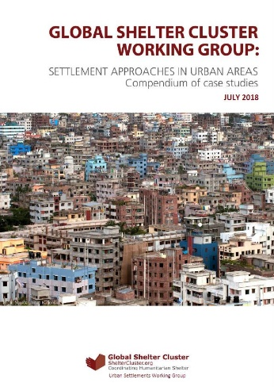
USWG Case Study Compendium: Analysis & Executive Summary
Consultants:
Victoria Maynard & Elizabeth Parker
Urban Settlements Working Group

Slide 4
USWG Case Study Compendium: Analysis & Executive Summary
Broad coverage across the case study compendium :
Humanitarian crises and developmental challenges
Numerous sectors: Protection, WASH, Shelter, Health, Early Recovery, livelihoods, infrastructure and psychosocial support
Varied geographic regions: Africa, Latin America and the Caribbean, Asia and the Middle East
Types of emergencies / development challenges:
Rapid onset natural disasters, complex emergencies and/or refugee contexts
Rapid urbanisation and sub-standard living conditions
Scale: Different types/scales of city and administrative scales: from city level, through to district, ward and neighbourhood.
Length: Implementation ranges in length from a few months to several years
Partnerships: Individual agencies, multiple agencies, and clusters
July
September
March

Slide 5
USWG Case Study Compendium: Analysis & Executive Summary
Common attributes of area-based approaches from existing literature:
are people-centred
include the active participation of all stakeholders relevant to the context
are based on multi-sectoral, multi-agency assessments
are used selectively and focus on areas with a high concentration of needs
are linked to wider city or regional plans and policies
address immediate needs while focusing on longer-term outcomes and impacts
allow sufficient time to build relationships
adopt iterative, flexible and adaptive approaches to programme design, management, funding and coordination
build on existing systems
monitor and evaluate multi-agency contribution
July
September
March

Slide 6
USWG Case Study Compendium: Analysis & Executive Summary
Definition
Area-based approaches provide multi-sectoral support which considers the whole population living in a specific geographic area with high levels of need
USAID (2011) DFID & NRC (2014), Parker & Maynard (2015), IRC (2015), IDMC (2015), Sanderson & Sitko (2017), ReDSS (2018).
July
September
March

Slide 7
USWG Case Study Compendium: Analysis & Executive Summary
Reasons for adopting area-based approaches
If well designed and implemented area-based approaches can:
create a ‘platform’: diversity of actors/ different capacities/ collective response
complement existing (governance) systems
reduce tensions and inequalities; improve social cohesion
effectively focus resources: multi-sector and multi-stakeholder approach
July
September
March

Slide 8
USWG Case Study Compendium: Different scales and stages of area-based approach
July
September

Slide 9
USWG Case Study Compendium: Analysis & Executive Summary
Type and scale of area-based coordination models
All the programmes included coordination throughout all the stages. Different coordination mechanisms included:
Urban Working group: led by local government/the Mayor and key humanitarian agencies (Bangui and Kampala)
Tri- sector / cluster task forces: Aleppo (Shelter, WASH and Early Recovery); Mogadishu (Shelter, WASH, Health)
One agency-led coordination: via existing humanitarian Clusters- (Port-au-Prince and Mosul, including Community Resource Centres)
July
September
March

Slide 10
USWG Case Study Compendium: What can we learn from the case studies?
Multi-sector, multi-agency assessment, planning, coordination and implementation led to:
Shared prioritisation and planning
Better communication between partners
Faster response to evolving needs
More efficient implementation
Links between humanitarian and Development interventions
Participatory tools and approaches:
Community-based assessments
Mapping/ action planning/settlement planning/coordination
Implementation and monitoring helped to: build trust
Generate ownership; strengthen community cohesion
Efficiently identify needs
Manage expectations
Work with communities to solve complex problems - Port-au-Prince)
High levels of engagement with all relevant stakeholders:
Develop consensus/shared response plans
Impartiality and respect
no key influencers were left behind
improved capacity of local actors
relationships between communities and government
September
March

Slide 11
USWG Case Study Compendium: Analysis & Executive Summary
Challenges
Targeting: tensions with residents in surrounding areas - Bangui
Stakeholder engagement: Mapping, complexity and understanding of stakeholders - Mogadishu and Mosul
Linking between scales: incorporating smaller-scale projects into city development plans or city-government plans into community-based planning – Tacloban
Many others
Enabling contexts
sufficient funding as well as donor support - multi-sectoral working group, assessment and response plan - Bangui Port-au-Prince
existing multi-sectoral coordination - Mogadishu
communities were less transient and more cohesive - Kampala
local government was supportive – Tacloban
Scaling up
The case studies included examples of scaling-up area-based approaches through:
pilot projects in specific areas - Colombia and Guatemala
starting multi-sectoral coordination with just 2-3 core sectors – Mogadishu
July
September
March

Slide 12
USWG Case Study Compendium: Analysis & Executive Summary
How can area-based approaches be improved?
Focus on the quality of the characteristics:
multi-sectoral, multi-agency assessments and focus on areas with high levels of complex, inter-related and multi-sectoral need.
people-centred and include meaningful engagement
active participation of all stakeholders
linked to wider city or regional plans and policies
work with, and build on existing systems: address short-term needs - focusing on longer-term outcomes and impacts
sufficient funding / staff with adequate experience and expertise / allow sufficient time
iterative, flexible and adaptive approaches
multi-agency contribution
July
September
March

Slide 13
Area Based Approaches in practice
Midnimo Project,
Somalia
Sam Grundy,
Programme Advisor, Transition and Recovery Division
IOM
Urban Settlements Working Group

Slide 14
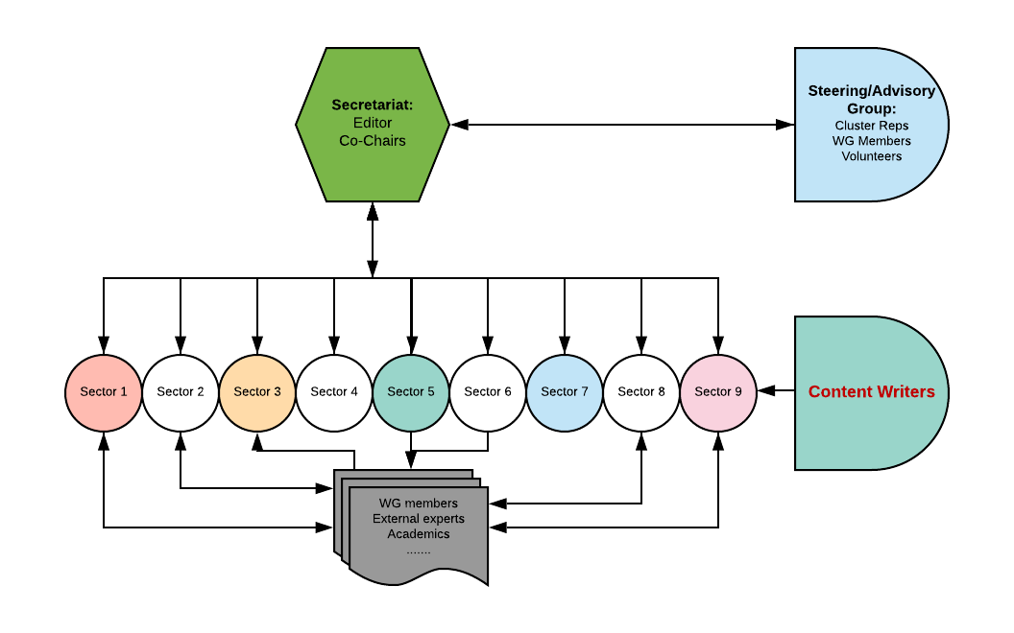
USWG: Settlement Approach Guidance: 2019 - 2020
Overall strategy
Initial content framing
Consultation process - how to engage
March

Slide 15
USWG Settlement Approach Guidance: CONTENT sheet (initial ideas for your inputs)
1. Introduction (5 pages)
Why an Area based approach?
About this guideline (urban focused),
Definition, Characteristics, Principles, Strength and opportunities for Adopting area-based approach,
Links to development and exit strategy
2. Deciding when and where ABA is appropriate (4 pages)
Pros cons, type of crisis, Enabling contexts, Immediate need vs long- term outcomes, alternative approaches
3. Learning from practice Link to compendium.

Slide 16
USWG Settlement Approach Guidance: CONTENT
4. Four defining Components of Area Based Approach
How to define a specific geographic area with high needs? (5-10 pages)
Defining and selecting a specific geographical area, scale; The level of high concentration of needs that warrant ABA
How to work with Multiple stakeholders? (5-10 pages)
How to manage a settlement building on existing local governance;
Who are the (Multi) stakeholders (constituencies)
What are their common perspective and how to find complementarities.
How to deliver Multi- sectorial? (5-10 pages)
What are the Multi sectorial needs of a population and how to collaborate and coordinate to deliver in a cohesive way.
Health, Education, Housing, Employment (livelihoods), Social safety nets, Water and sanitation, Other
Linking with wider city or regional plans and policies
How to be Inclusive of whole population? (5-10 pages)
Engaging the whole population, active participation of stakeholders
The legal status of individuals;
People facing unique protection risks and groups at particular risk of discrimination and social exclusion
Long term residence

Slide 17
USWG Settlement Approaches Guidance: CONTENT
5. Operationalising Area based approaches
5.1 Preparedness, partnerships, collaborations (5 pages)
5.2 Area Based Assessment (5 pages)
Displacement Tracking Matrix; Area Based Assessments.
5.3 Area Based Response Planning (5 pages)
Response planning and multi-sectoral prioritisation
Ongoing monitoring
5.3 Scale and models; (5-10 pages)
City level working group
Municipal working groups
Tri-sector task force
One agency (neighbourhood/ settlement approach)
6. Appropriate Funding models (4 pages)
7. Outcomes and impact (4 pages)
8. Efficiency, effectiveness and sustainability (4 pages)

Slide 18
Area Based Approach Scales
Coordination and Implementation options according to administrative levels/scales
City level working group / coordination
(Local authority, project based coordination, technical working groups, associations)
Municipal working group / coordination
(Tri-sector task force / coordination)
One agency coordinating and implementing in specific area
(Neighborhood committees, community councils, community resource centers)
City/town
Multiple agencies
sharing responsibility of each phase
July
District/borough
September
March
One agency
Sequentially working through each stage
Ward
Neighbourhood

Slide 19
Updates from & engagement with other clusters
CCCM Cluster
Annika Grafweg, IOM

Slide 20
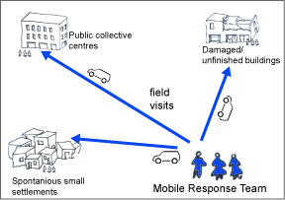
CCCM work-in-progress update- CCCM area-based working group
CCCM Mobile approach paper:
“Management and coordination of collective settings”
3 parts: - Mobile paper
- Case studies of CCCM Mobile Approaches
- Collected Tools developed
Webinar: coming Month- date to be confirmed

Slide 21
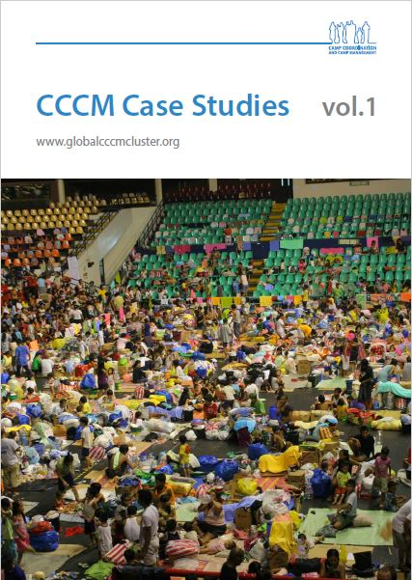
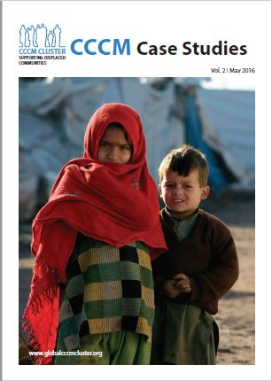
CCCM work-in-progress update
CCCM case study publication - Vol.3 :
Chapters:
Introduction chapter: CCCM modalities
Camp Management case studies
Camp closure/return/reintegration
Mobile approaches
Area-based Approach – CRC
Site Management Support
Women’s participation
Preparedness
Preliminary
Case studies: agrafweg@iom.int

Slide 22
Updates from WG members
Neighbourhood Approach consultations
Haiti, DC, Geneva
Laura Jones,
Technical Advisor, Humanitarian Assistance and Resilience, PCI
Harriette Purchas,
Senior Urban Advisor, RedR

Slide 23

Urban Humanitarian Workshop Series:
Programming with the Neighbourhood Approach 13 March, Washington DC
Implementation: lessons from the Neighbourhood Approach 19 March, Port-au-Prince
Neighbourhood Approach: a practical tool for Coordination 30 April, Geneva
For more information email andrew.mahon@redr.org.uk

Slide 24

USWG 2019 Work Plan: Opportunities for Engagement
Case Study Compendium
Development of Case Study Compendium
Supporting with dissemination
Drafting Settlement Approach guidance
Steering Group, chapter authors, peer reviewers
Consultation series (3 x regional; 3 x country)
Walking the talk: Further operationalising the approach
More information coming soon!
Infographics & advocacy materials
Support to develop infographics (you or your comms team?)
GSC training module (urban / area based approaches)
Later in 2019 – building off guidance (pending funding)

Slide 25
AOB & wrap-up
AOB?
Upcoming meeting: April 2019

