Slide 1






Global Shelter Cluster Meeting 2021
7 – 17 June 2021, Online
Coordination at Country Level–
Ready for the Future?
Wednesday 16 June
14:00 to 15:30 CEST
Register to the GSC Meeting 2021 at www.sheltercluster.org/meeting2021
PANELISTS
MODERATORS
Marina Skuric P.
Chief of SAPS
OCHA
Thomas Bamforth
Cluster Coordinator NWS
UNHCR
Gareth Lewis
Shelter & WASH Specialist
NRC
Sahdia Khan
Homes & Communities Coordinator, CRS
Amelia Rule
Emergency Shelter Advisor
CARE International UK

Slide 2
Session Agenda
Welcome and Introductions
Introduction to Q&A platform – Easy Retro
Panel Discussion – Initial remarks from panelists
Plenary Q&A
Conclusions and final remarks

Slide 3




Panelists
Marina Skuric,
Chief of SAPS,
OCHA
Thomas Bamforth,
Cluster Coordinator NWS
UNHCR
Gareth Lewis,
Shelter & WASH Specialist
NRC (Syria Response Office)

Slide 4



MENTIMETER SURVEY
Scan here to access the menti on your phone
Questions
Who do you work for? (Authorities, UN, World Bank, NGOs, Other)
What is your main field of work? (Humanitarian or Development)
What kind of setting are you working in? (Natural Disaster or Conflict)
How do you relate to Country Level Clusters?
In just one word, define a positive aspect of Country Level Coordination!
In just one word, state the key challenge to country level cluster coordination
What is you recommendation to improve country level shelter cluster coordination?
Join Menti via internet browser through the link provided in the Teams chat or through mobile phone by scanning the QR Code above or go to www.menti.com and use code 8396854

Slide 5

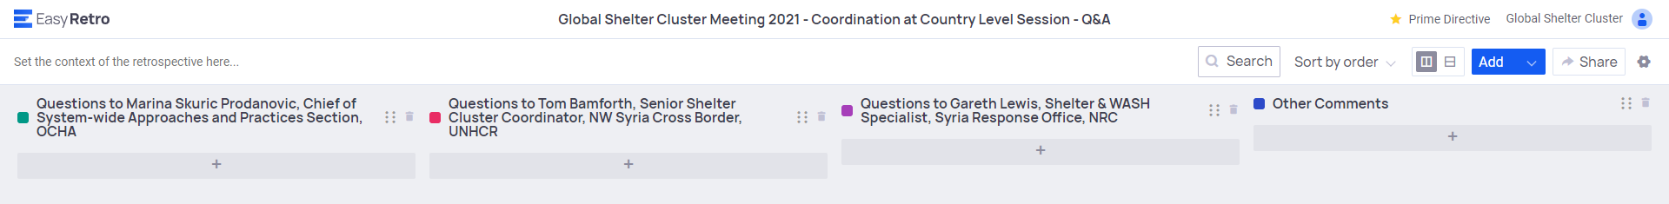
Intro to Q&A EasyRetro
EasyRetro – How to Use It
Open the link provided in the chat
Add your question to the selected panelist
Vote on other participants questions

Slide 6


PANELISTS DISCUSSION
Thematic Session 4
Coordination at Country Level – Ready for the Future?
Global Shelter Cluster Meeting 2021

Slide 7
Global Shelter Cluster
Coordination at the country level: Ready for the future?
Marina Skuric-Prodanovic; Chief, System-wide Approaches and Practices Section, OCHA
16 June 2021

Slide 8
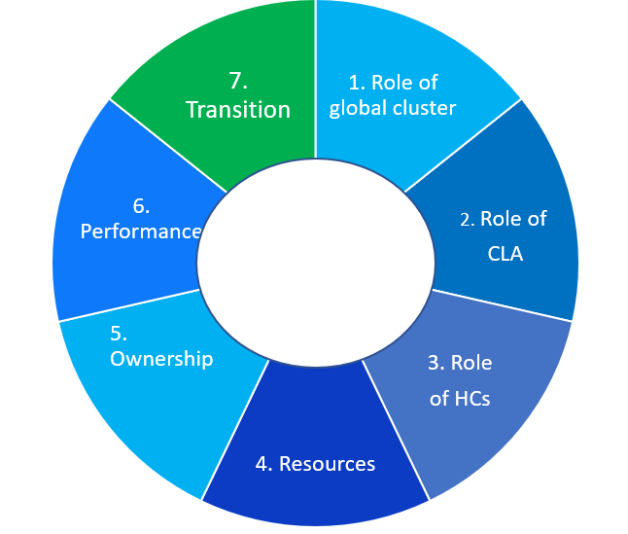
1. Coordination at country level – current challenges
1. Delivering where and when it matters the most - our report card
2. Are clusters being empowered to reach their potential?
Key factors

Slide 9
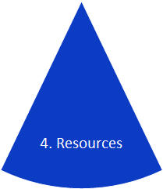
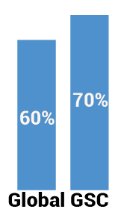
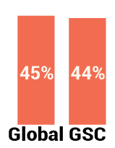
1. Coordination at country level – current challenges
Resourcing
Fully dedicated capacity
Coordinator
IMO

Slide 10
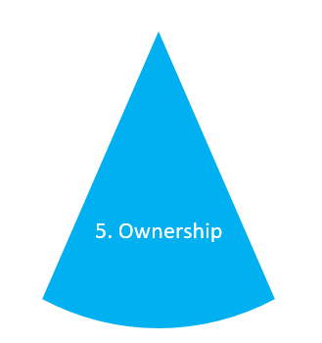
1. Coordination at country level – current challenges
Ownership
Participation in ICCG
Representing the collective
Linkages between HCTs and ICCGs
Notes:
-CLAs do not always represent clusters at the HCT
- Reason for limited engagement by CCs in certain ICCGs is due to not always clear objectives of meetings, plethora of meetings, continuous request for information, heavy HNO and HRP process.
Need to discuss operational issues and problems faced by clusters instead of focusing on details/filling templates.

Slide 11
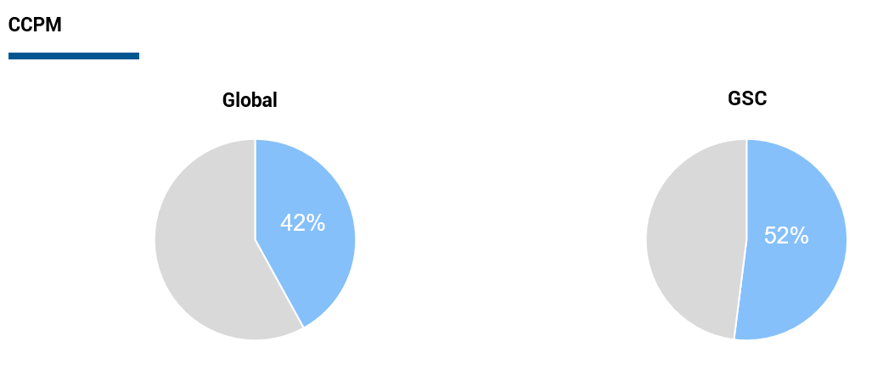
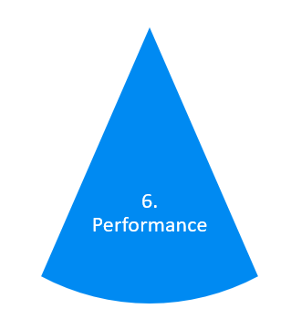
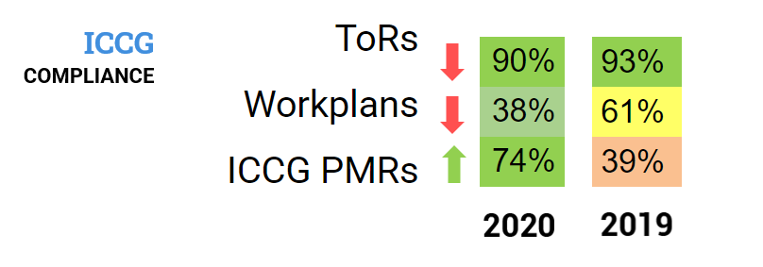
Coordination at country level – current challenges
Performance
Coordination reviews*

Slide 12
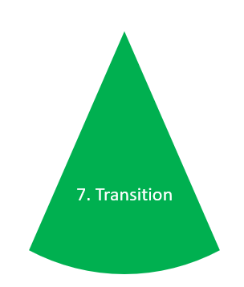
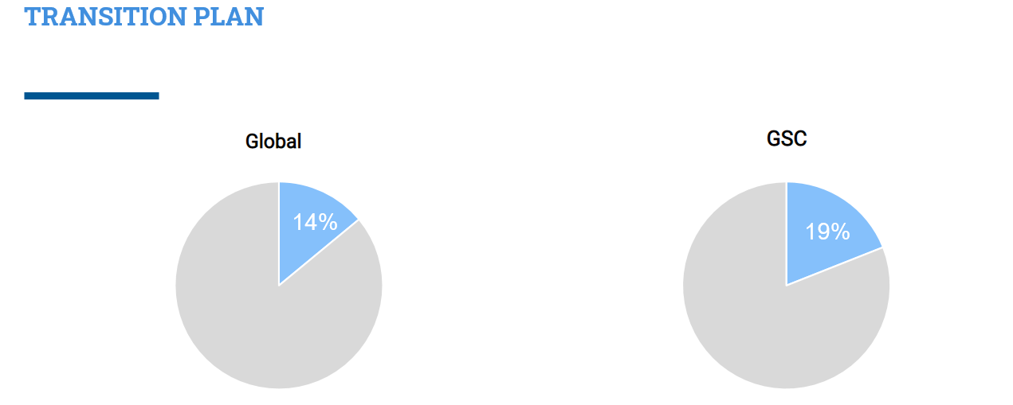
1. Coordination at country level – current challenges
Transition and localisation

Slide 13
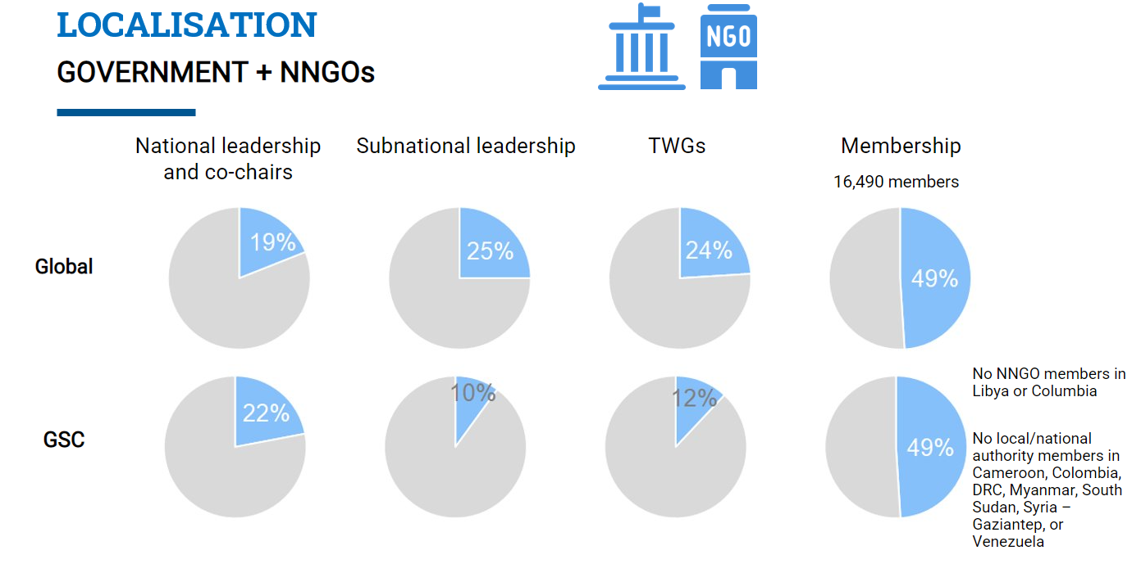
1. Coordination at country level – current challenges
Transition and localisation

Slide 14
Coordination
1. Has the system become too heavy? Should they adapt to remain fit for purpose?
Data-driven and evidence based process. Is the process at the expense of operational response?
Remarks on heaviness comes from all sides. What is the solution?
Participate in HPC processes at global and country level. Revamped HPC SG provides a new opportunity for engagement.
2. Do clusters continue to be seen as necessary or are their days numbered?
Cluster approach is more than 15 years old. Time for a spruce-up? GCCG flagged the need for a review back in 2017.
Adaptations have occurred - by country, by different type of cluster, different approaches, working with local communities, AAP.
No viable alternative - clusters continue to be the main reference when it comes to coordination - clarity, predictability, accountability.
Other coordination approaches – area-based, urban - can complement cluster coordination; not an either/or.
3. What can clusters do better to address the criticism of being siloed and self-serving?
Joint needs assessments, multi-purpose cash lead us away from siloeing.
Participate actively in inter cluster coordination, with other clusters – different combinations and ownership / responsibility
Strengthening efforts between global and country-based efforts
Performance assessments (Cluster Coordination Performance Monitoring and ICCG performance monitoring) => to identify trends & needs and find solutions for better functioning.
Architecture reviews
Financing – (in) equity in funding access – CLA vs. non-CLA; international vs. local actors; differences between sectors; variations in costing for different activities vis-a-vis populations reached => further importance of joint, intersectoral approaches.

Slide 15
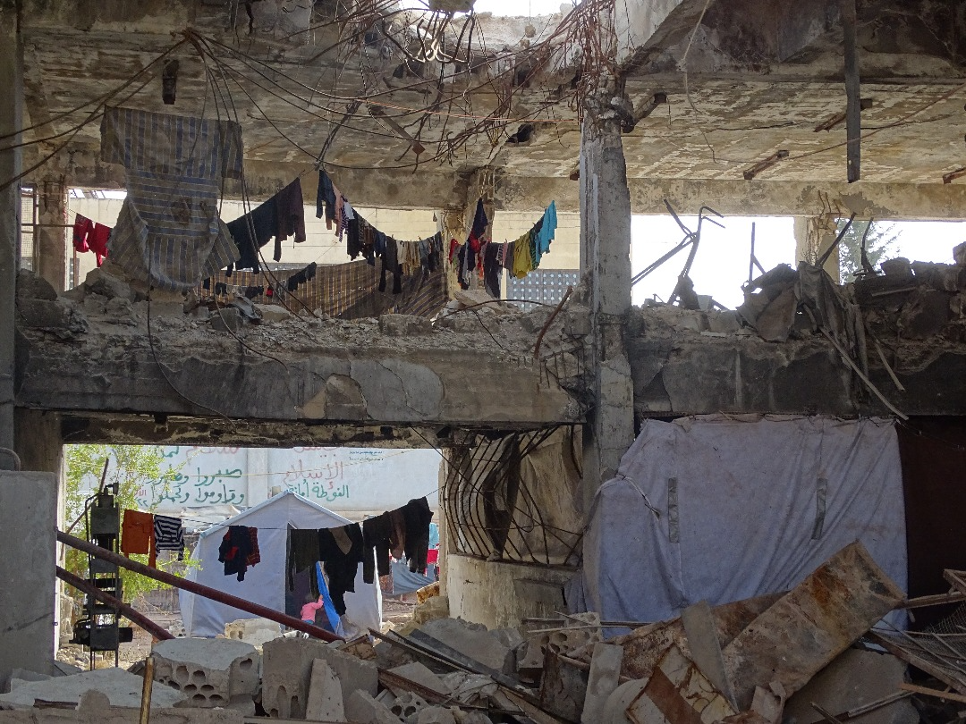
Shelter Coordination at Country Level

Slide 16
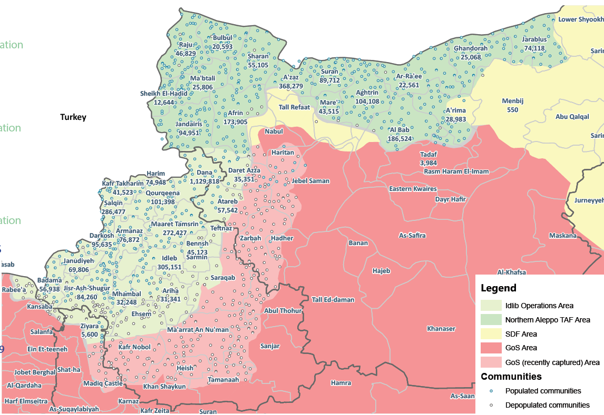
Key Shelter Figures in NW Syria
1.6M in IDP Sites
Shelter PiN: 2.2M
NFI PiN: 1.65M

Slide 17
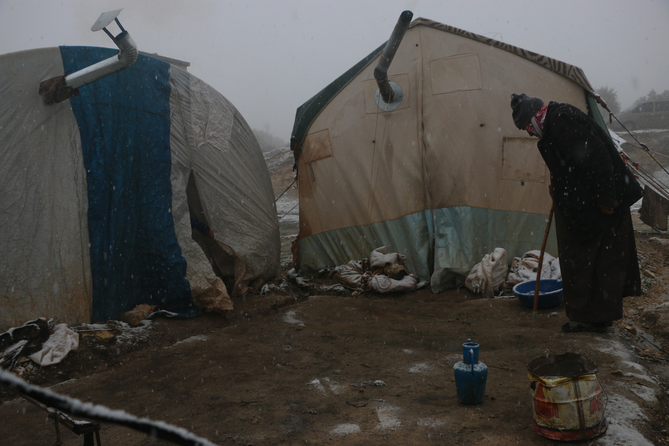
Shelter Challenges: Winter

Slide 18
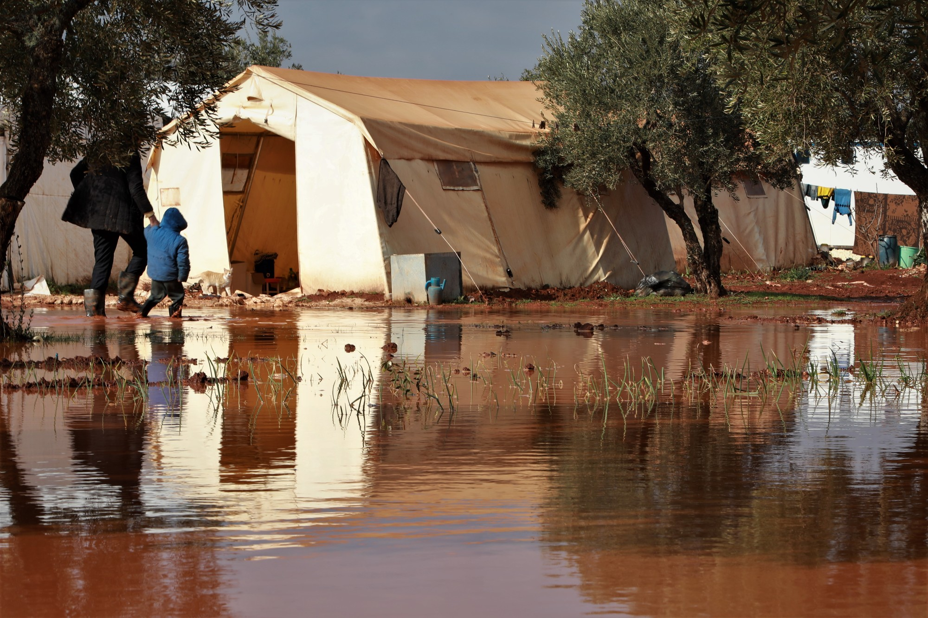
Shelter Challenges:
Flooding

Slide 19
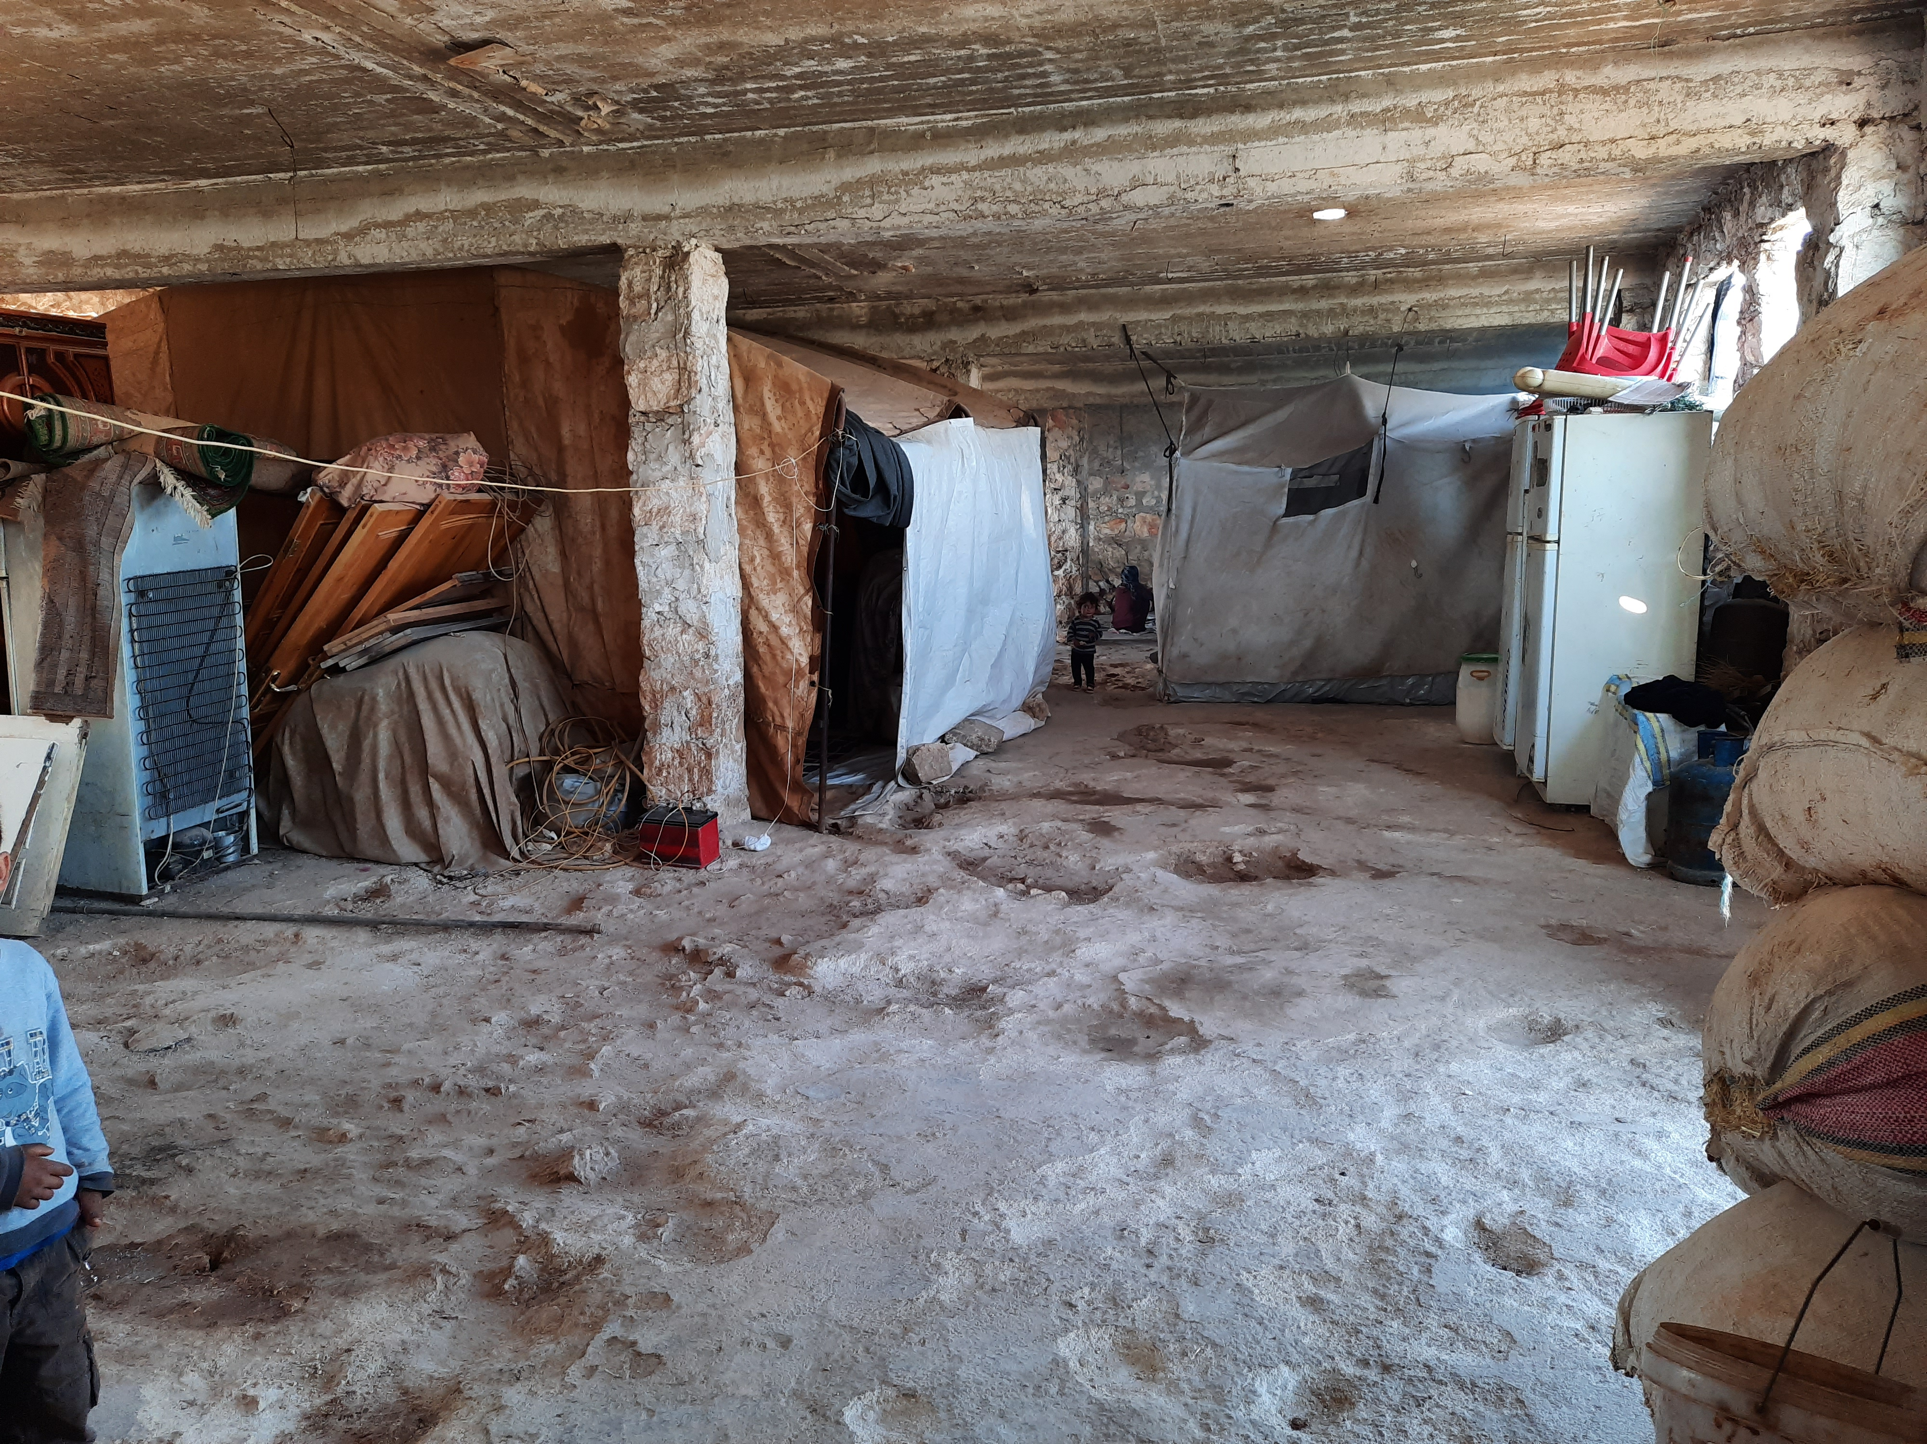
Shelter Challenges:
Unfinished buildings

Slide 20
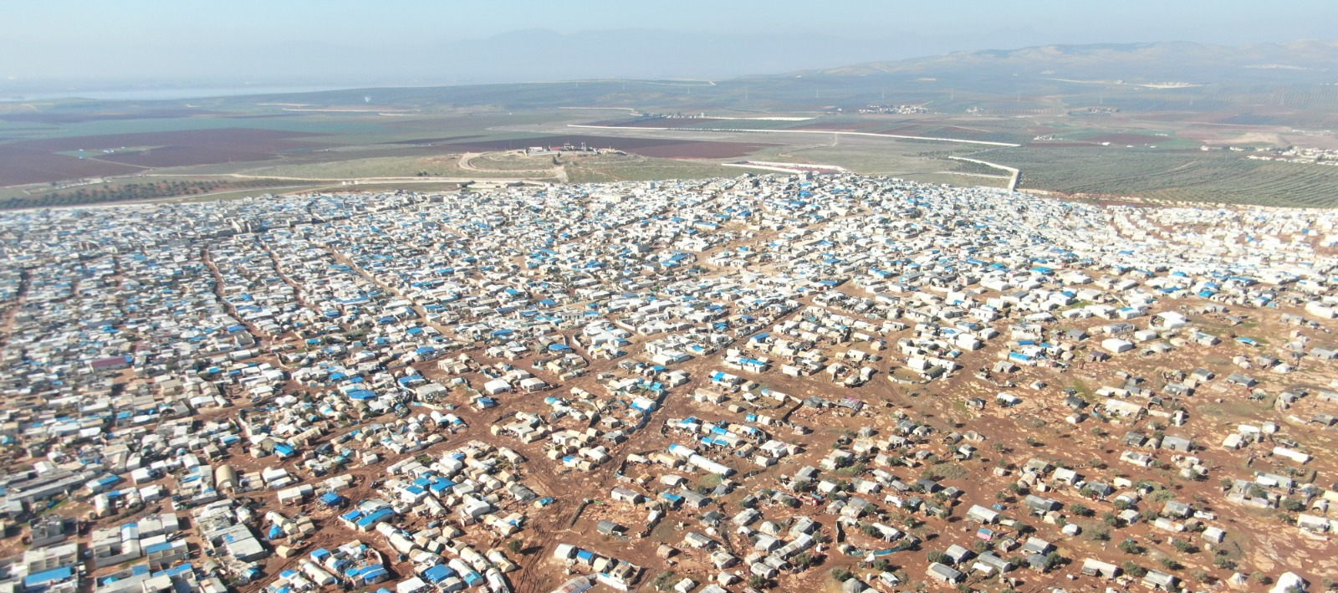
Shelter Challenges: IDP Sites

Slide 21
Dignified Shelter: Emergency Shelter Options

Slide 22
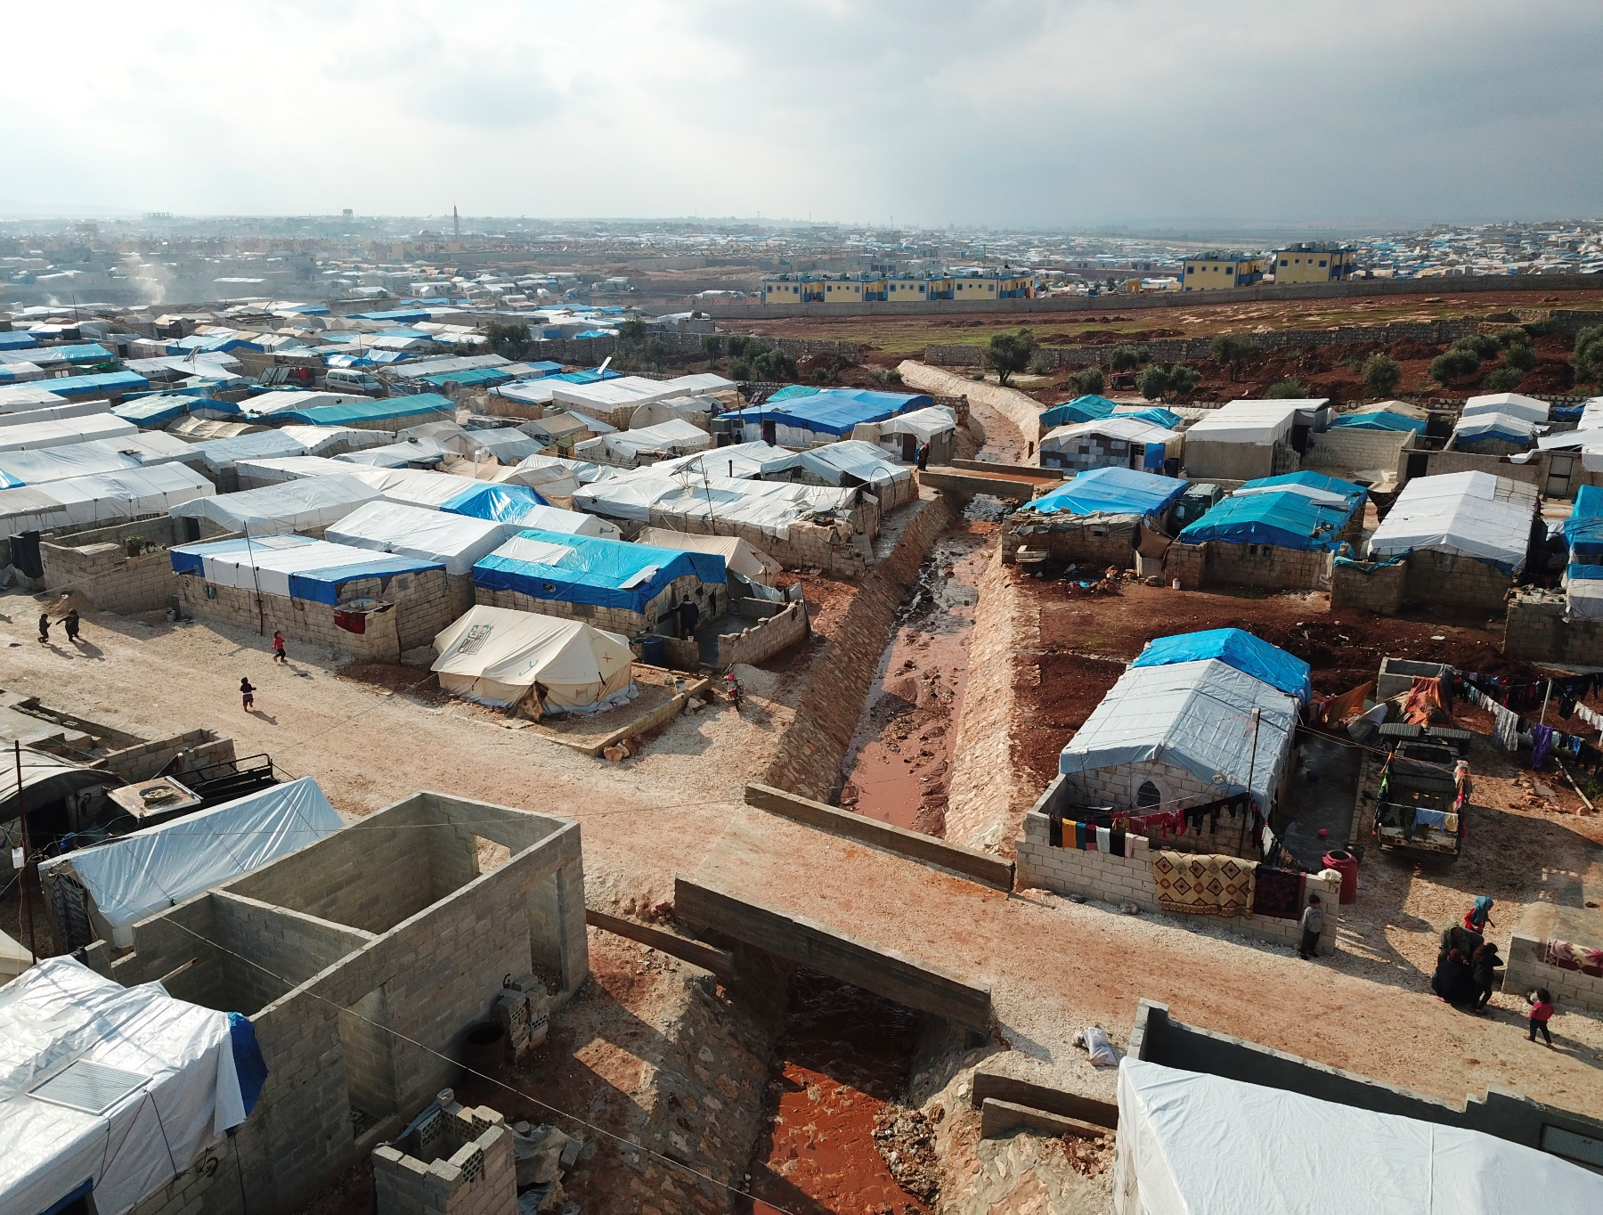
Dignified Shelter: Site Improvements

Slide 23
Dignified Shelter: Winterization Support

Slide 24
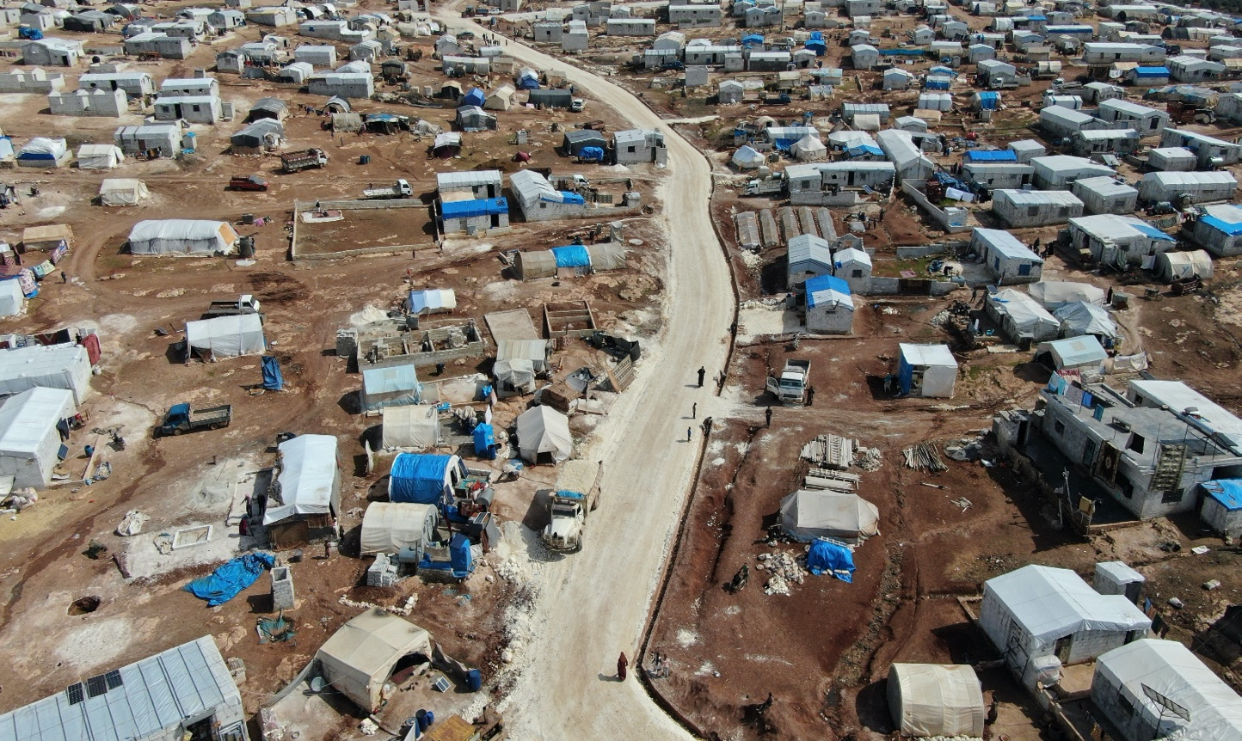
Dignified Shelter: Locally Procured Solutions

Slide 25
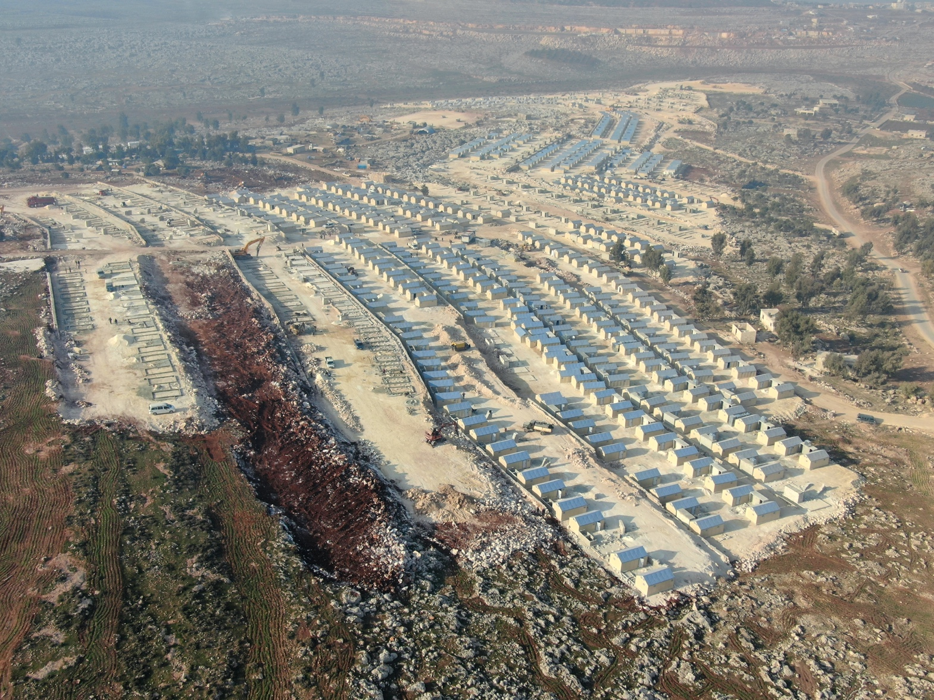
Dignified Shelter: Site Planning/RHUs

Slide 26
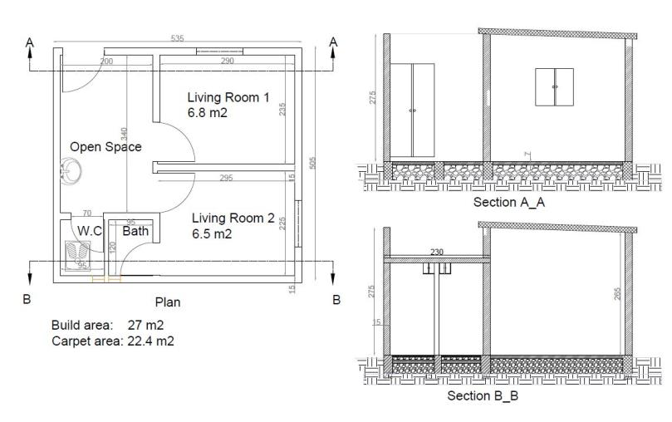
Dignified Shelter: Designed Responses

Slide 27
Reminder - Q&A EasyRetro
EasyRetro – How to Use It
Open the link provided in the chat
Add your question to the selected panelist
Vote on other participants questions

Slide 28


Q&A SESSION

Slide 29


Conclusions & Final Remarks
Final Remarks

Slide 30
THANK YOU FOR YOUR PARTICIPATION!
NEXT SESSIONS TODAY:
Open Space (16:00 CEST) - Panel Discussion on Fire Safety in Humanitarian S&S
Open Space (17:00 CEST) - Increasing Communities’ Knowledge and Access to Safer Shelter Practices through Diaspora Engagement
SESSIONS ON THURSDAY 17 JUNE
Open Space (11:00 CEST) – Shelter Projects discussion on potential research into longer term and wider impacts of projects
CLOSING SESSION (14:00 CEST)

