Slide 1

Working group on Inclusion of Persons with Disabilities

Slide 2
Working group on Inclusion of Persons with Disabilities
Introductions
Please share with us:
your name
your organisation (if relevant) and background
if you have used ‘All Under One Roof’ or other inclusive guidance in your work.

Slide 3




Working group on Inclusion of Persons with Disabilities
Introductions

Slide 4



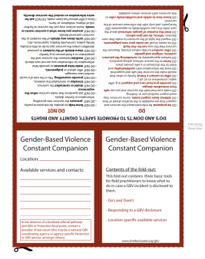
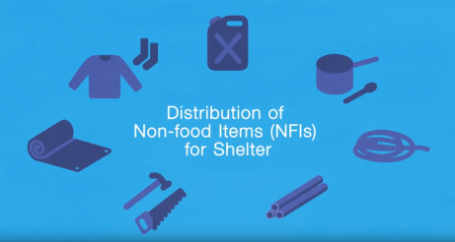
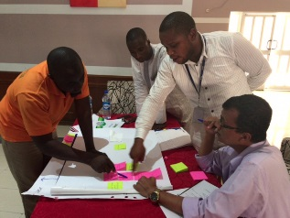
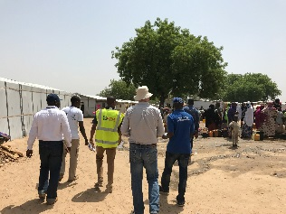
Health, security, privacy and dignity
Previous experience with GBV Working Group:
  Focusing on how to improve programming in various areas of shelter and settlement responses – NFI/Cash distributions, site planning/ improvements, shelter design and construction = how to distribute, inclusion of all aspects of community, close discussions with specific groups (women, people with disabilities and/or disabled persons organizations).
Production of guidelines and rollout of workshops
  Ensuring guidelines are of value to field staff and ability to provide ongoing support.

Slide 5
Working group on Inclusion of Persons with Disabilities
Deliverables
• Test and review the efficacy of AUOR and other inclusive guidance in practice.
• Collect data, other related tools and case studies on good/ not so good practice.
• Revise AUOR and other good shelter programming guidance for use as GSC tools.
• Disseminate GSC tools and Standards for use by cluster members, disabled people’s organisations and relevant actors.
• Develop awareness training package and standalone training module.
• Develop ToR for an inclusive shelter expert to support emergency operations.
• Identify potential funding sources for the dissemination of the revised manual, good shelter programming tools, standards and the roll out of awareness trainings.

Slide 6
Working group on Inclusion of Persons with Disabilities
Timeline:
The Working Group will be activated for a period of 3 years.
July 2018 | Activation of WG and first meeting
Aug 2018 | Confirmation of action plan and defined process for collecting evidence
Jul 2018 – Apr 2020 | Consultation / Review of All Under One Roof and other inclusive guidance in various contexts as part of operations/ response activities
Jul 2019 – Apr 2020 | Ongoing collation of data, relevant case studies and other evidence
Mar – Jun 2020 | Revision of All Under One Roof as GSC tool and development of GSC standards. Revision of other inclusive GSC guidance.
Mar – Sep 2020 | Development of dissemination strategy, update awareness training, TOR for roving support and pilot plan
October 2020 | Final endorsement of standards and ToR by GSC
May 2021 | End of project – possible establishment of Community of Practice

Slide 7
Working group on Inclusion of Persons with Disabilities
Immediate priorities:
Defining process for collecting evidence (please share comments).
Sharing case studies/ resources (will share OneDrive link).
Looking for opportunities of testing/ piloting All Under One Roof and other guidance.

Slide 8

IASC - Guidelines for Inclusion of Persons with Disabilities
in Humanitarian Action
IASC guidelines on disability inclusion are currently being developed to strengthen accountability to persons with disabilities in situations of risk and humanitarian emergencies.
Includes Shelter and Settlements chapter. Seeking input on:
Suggestions for case studies where organisations of persons with disabilities and shelter agencies collaborate (channel through WG)
Thoughts on access to shelter and settlement assistance for persons with disabilities - what are the main challenges and gaps - what type of guidance is needed? (To complement AUOR or other existing guidance).
Contacts:
Vidar Glette vidargl@gmail.com
Valerie Sherrer lerie@bluewin.ch
Ulrike Last u.last@hi.org

Slide 9
Working group on Inclusion of Persons with Disabilities
Contact:
lemarshall@redcross.org.au
michael.waugh@nrc.no
mmojtahedi@icrc.org
iskrine@iom.int

