Slide 1
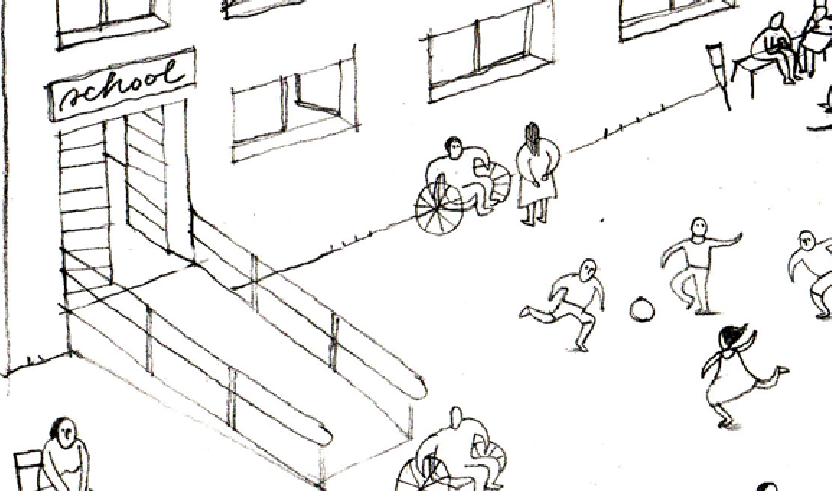

Inclusion of Persons with Disabilities in Shelter and Settlements Programming
Global Shelter Cluster
ShelterCluster.org
Coordinating Humanitarian Shelter
September 2020 Working Group Call
Notes:
Introductions of group

Slide 2

Agenda
Update on planned field consultancy in CXB
Overview of the Elrha Gap Analysis on the Inclusion of people with Disability and Older People in Humanitarian Response
Accessible IECS – update on the PSB working group protocol and the IEC materials compendium process
Shelter Projects + learning from a case study
Takeaways from the Shelter & Health learning day
AoB and Q&A
Notes:
Brief overview of agenda
Ask for any other business to put at end

Slide 3
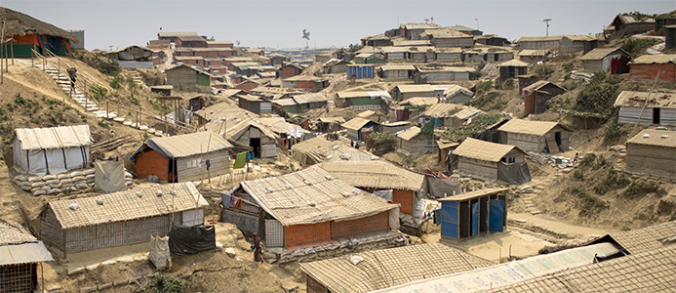
Inclusion of Persons with Disabilities in Shelter and Settlements Programming
Field Consultancy: Cox’s Bazar
Update Agenda
Inception phase completed but on hold due to COVID-19
Consultants: Caroline Dewast, Shirin Kiani, David Dalgado
Revised timeframe of visit (dependent on COVID-19 further disruption) – February 2021 for 3 weeks
Current initiatives which may impact – REACH work.
Methodology
Global Shelter Cluster
ShelterCluster.org
Coordinating Humanitarian Shelter
Notes:
Brief overview of agenda
Ask for any other business to put at end

Slide 4
Methodology Outline:
1. Identification of key questions
2. Context analysis & Literature review
3. Identification of stakeholders
4. Disability Inclusion Assessment with practitioners
5. Risk mapping; and enablers and barriers mapping exploration through people with disabilities lived experience
6. Validation discussions /workshop
7. Participatory workshop with practitioners

Slide 5
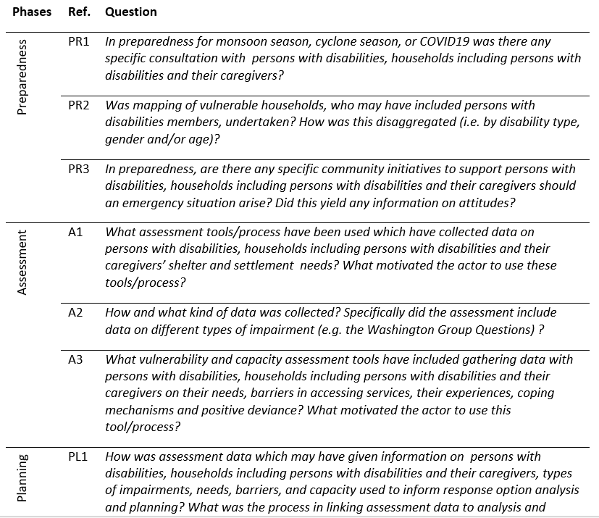
Extract of list of questions
(Circa. 30 question, organised around the Programme Cycle).

Slide 6
Stakeholder Mapping
In relation to this assignment to investigate disability inclusion in shelter and settlement programming the following are important stakeholders:
Shelter/NFI Sector Coordination Team*
Shelter/NFI Sector agencies – particularly the Shelter TWiG attending Shelter Staff*
Site Management & Site Development Coordination Team*
Site Management & Site Development agencies*
Site Maintenance and Engineering Project (SMEP) representative*
Age and Disability Working Group lead and key agencies*
Protection Working Group*
PSEA Network – under the ISCG
Gender Hub* – under the ISCG
Gender in Humanitarian Action (GIHA) – under UN Women
WaSH Sector Coordination Team*
Health Sector Coordination Team
Communications with Communities working group*
IOM and UNHCR staff who are included in the above groups but play a particular crucial role because of their division of Area of Responsibility in the camps.*
Red Cross Red Crescent (IFRC*, BDRCS) – who may be included in the above groups but may not be as involved in the Inter-Agency coordination activities and structures.
Cyclone Preparedness Programme (CPP) staff in Cox’s Bazaar who may be involved in the mega-camp CPP initiatives.
UNICEF* – particularly with respect to Child Protection
Persons with disabilities*
Persons with disabilities caregivers and family*
Disabled Peoples’ Organisations, DPOs
Disability-specific humanitarian agencies*
Community leaders* & religious leaders*
Refugee Relief and Repatriation Commission (RRRC) and Camp-in-Charge staff*
Bangladesh Government Armed Forces involved in camp coordination
Needs and Population Monitoring (NPM)*, UNHCR Registration staff* and REACH*
Donors (such as DFID, ECHO and others)*
* Essential, whereas those without an asterisk are only where time allows
Fufils a similar function to IOMs Displacement Tracking Matrix in other countries/contexts.

Slide 7
Consultations with persons with disabilities
Leaders & vocal persons with disabilities with any type of impairment
Adults with visual and physical & mobility impairments
Adults with hearing impairments and their caregivers (where appropriate) – may be solely through KIIs given that FGDs may be difficult, especially if different communication methods are required.
Adults with mental health impairments and their caregivers (where appropriate) – it is recognised that it can be hard to identify and interview these adults and it is thought likely KIIs will be needed here and connections (with consent) made through agencies providing psycho-social support/mental health support will be required.
Adults with intellectual impairments – it is thought likely KIIs will be required here.
Children with visual impairments and their caregivers– could potentially be undertaken with KIIs with caregiver and potentially children.
Note FGDs will be split by gender and age where appropriate. Recognised intersectionality disability, age, class/caste, etc.

Slide 8
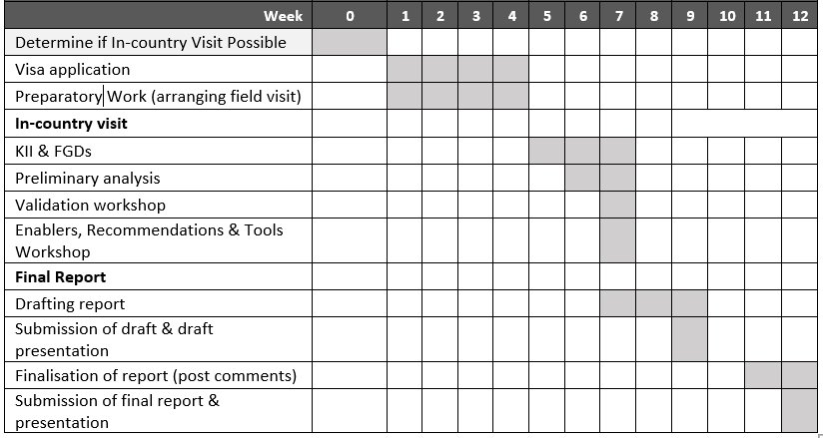

Slide 9

AoB and sharing
Key Messages on applying IASC Guidelines on Disability in the COVID-19 Response
Provides an overview of the factors that may put persons with disabilities at heightened risk in the COVID-19 pandemic and response in humanitarian settings
Open call for case studies for Forced Migration review related to Mental Health and Psychosocial Support
Abstracts due 19 October 2020
Global Shelter Cluster meetings coming up in October (online)
For more information and to contribute contact:
disability.inclusion@sheltercluster.org

